Slide 1



Lloyds Bank-Mobile banking
Students:
2113314, 2113444, 2113144, 2113593, 2113479
Digital Skills and Research Methods (BMSW4003_LON)
University of Wales Trinity St David
Lecturer: Asim Satti

Slide 2
History of Lloyds Bank One of the oldest banks in the UK; One of the Big Four Banks
1765 Taylors and Lloyds was founded in 1765 in Birmingham by button maker John Taylor and iron producer and dealer Sampson Lloyd
1852 the Federation ended because John Taylor died and his sons did not have any interest to join the business. The company name changed to LLOYDS AND COMPANY
1865 the firm needed to increase capital and from a private bank, changed to a Joint Stock Company -LLOYDS BANKING COMPANY LIMITED.
1870 Lloyds bank let the married women keep their saving in the bank.
Notes:
1765 Lloyds Bank was founded in 1765 in Birmingham City. It started with John Taylor and Samson Lloyds joining together. John was a button maker and Samson an Iron producer. Also, Taylor and Lloyds were in Birmingham the first Bank that had been operated for 99 years in the city.
1852 In 1852 the Federation ended because John Taylor died, and his sons did not have any interest to join the business. LLOYDS AND COMPANY, the company name changed to.
1865 In 1865 the firm needed to increase capital and from a private bank changed to a Joint Stock Company. The name was changed again to LLOYDS BANKING COMPANY LIMITED. Also in this year, the Bank had 148 shareholders and they invested in many funds.
The company grew and the next 50 years took over around 50 competitors.
1870 Lloyds bank let the married women keep their saving in the bank. The value of the amount is £200 what is today about £9000. Before this, all the female assets become the husband property after marriage.

Slide 3
History of Lloyds Bank
1884 Lloyds inherit the Black Horse logo from BARNETTS, HOARE and CO
1914 Female workers start working in the bank for the first time due to First World War
1928 The Bank started to mechanise the accounting sector.
1949 Lloyds let the married women work in the Bank
A
Notes:
1884 was a very important year because Lloyds inherit the black horse. The black horse logo belonged to a different company called BARNETTS, HOARE and CO. This was a goldsmith business that Lloyds took over.
1914 During the First World War first time in history start to work female workers in the bank because the men were fighting in the front. 6 women started and by and of the War they were over 2000.
1928 The Bank started to mechanise the accounting sector. It was quicker and needed much fewer employees to do the accounting work. The employees were Female because their wages were calculated less than the Men’s salary.
1949 Lloyds let the married women work in the Bank, it was also the first time when they can work even before marriage, but not just temporally, they also offered a permanent contract.

Slide 4
History of Lloyds Bank
1972 Brentwood Essex Lloyds Bank installed the first real-time ATM in the UK
In 1995, Lloyds Bank plc merged with TSB Group plc, forming Lloyds TSB Group plc
2009 The LLOYDS BANKING GROUP was established
2013 9th of September 2013 LLOYDS TSB separated and become an independent bank. In Britain, 630 branches were renamed TSB Bank.
Notes:
1972 Brentwood Essex Lloyds Bank installed the first real-time ATM in the UK.
2009 The LLOYDS BANKING GROUP was established. Middle of the financial crisis LLOYDS TSB bought HBOS PLC, and the new firm become the UK biggest retail Bank.
2013 9th of September 2013 LLOYDS TSB separated and become an independent bank. In Britain, 630 branches were renamed TSB Bank.
Since 2013 banks stayed how we know them today.

Slide 5
Challenges before the introduction of Modern Technology for Banking sector
Modern technology has made the banking sector easy and comfortable that helps for the development of the banking sector. Modern technology has made the tasks of banking sector more efficient and effective. Before the introduction of modern technology banking sector had faced several challenges that made the banking tough for both the bankers and the users (Pokharel, 2018). The challenges had made the banking tough that is why people didn’t want to transact with the banking system. The challenges of banking sector before the introduction of modern technology are-
Security Issues
Rising Expectations
Customer Retention

Slide 6
Challenges before the introduction of Modern Technology for Banking sector
Traditional banking or the banking system before the modern technology faced the security issues performing the activities of the banking sector. There was a little security at that age of banking. There was no end-to-end encryption system for the banks that is why the data of the customers were leaked that harms the safety of the customers (Osborne, 2014). Traditional banking systems had not proper authentication systems that had made several problems for the banks. The security issues were the most challenging issues for the traditional banking system that has solved by the modern technologies.

Slide 7
Challenges before the introduction of Modern Technology for Banking sector
The expectations of the customers of banking systems were raised day by day and the customers need a secure banking system that will protect their money as well as make the information secure also. The modern technology has provided almost all the expectations of the customers that helps to satisfy the customers (Dr.S and Dr.C, 2020). Before the introduction with the modern technology, the banking sector won’t able to provide all the expectations of the customers. The modern technology has fulfilled the desired and expectations of the customers for transacting in a better and secure environment. Also, the expectations of the customers are also increasing day by day that is also fulfilled by the modern technologies.

Slide 8
Challenges before the introduction of Modern Technology for Banking sector
Customer retention is the retaining of the customers or simply switch the organization for better services. Before the introduction of modern technology in the banking sector, the customers generally switched their accounts to other banks for the security purposes. The customers of banking sector generally want personalized and meaningful experiences by simple and intuitive interfaces that can be provided by the modern technologies (Alhawari, 2014). Before the introduction with the modern technology, there were a lot of customer retention that was a big challenge for the banks to keep their customers loyal to the bank.

Slide 9

What is Modern Technology?
The progress of old technology with new additions and adjustments is known as modern technology (Jin, 2020).

Slide 10

Modern Technology of Lloyds Bank
Lloyds bank use various modern technology to provide their banking service to their clients.

Slide 11
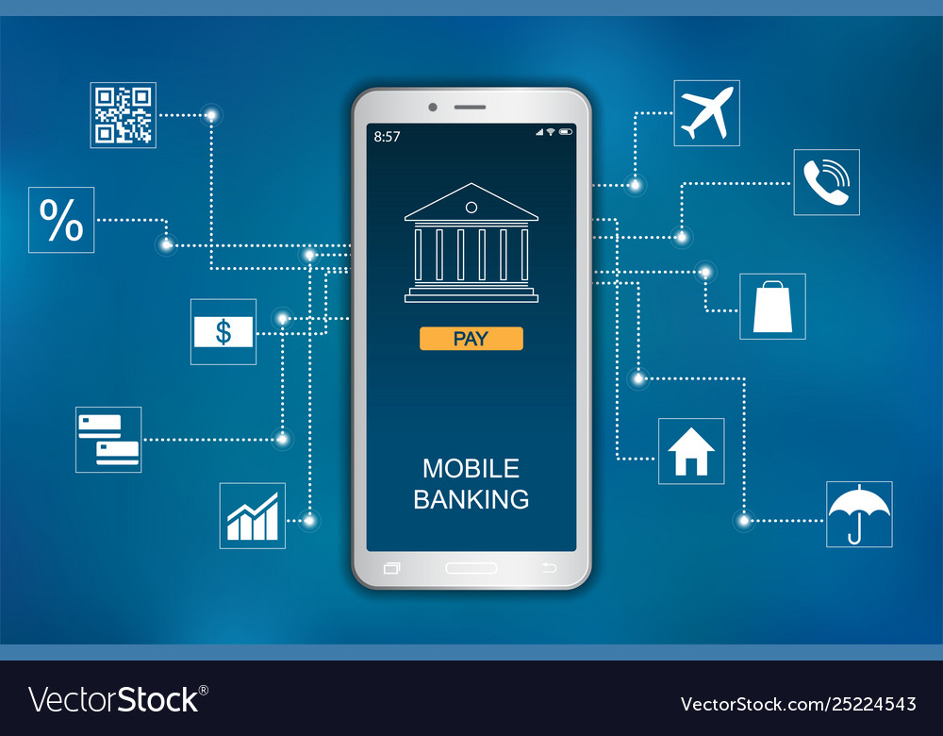
Mobile Banking of Lloyds Bank
Lloyds Banking Groups in providing mobile banking services for the betterment of the organization and the satisfaction of their clients (Mathieson, 2018).

Slide 12
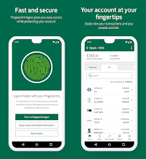
Mobile Banking Apps of Lloyds Bank
Lloyds Banking Group has been launched an app to provide services to their clients and betterment the bank.

Slide 13
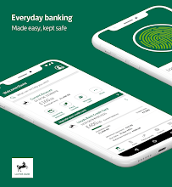
How does this app work
The mobile banking app of Lloyds Bank group is working by registering or creating banking profiles by client's mobile device with internet connection.

Slide 14

Mobile banking
Artificial intelligence's use in mobile apps is becoming more proactive, tailored, and advanced.
Lloyds Bank, for example, has integrated a financial application.
The client's transaction has been made easier thanks to the use of portable baking.
People may now use the app to send money or make other transactions from anywhere at any time.

Slide 15

Artificial intelligence minimizing operating costs
Artificial intelligence eliminates these error-prone human cycles.
AI, computerization tools, AI companions, and handwriting recognition, for example, can smooth out some aspects of human situations.
These tools can directly acquire, organize, and enter customer information from their agreements and structures.

Slide 16
Artificial intelligence improves customer support
Artificial Intelligence's influence on banking, particularly in customer service, has helped Lloyds shape their consumers' impressions of them.
Customer loyalty has a direct impact on the image and income of every firm, and the financial industry is no different.
AI awareness is a cutting-edge breakthrough that has been at the forefront of mechanical change all over the world (Alzaidi, 2018).
Banks like Lloyd can now service their customers 24 hours a day, seven days a week, regardless of their time zone or location, thanks to voice assistants and AI chatbots.

Slide 17

Artificial intelligence Transaction Data Enrichment
Lloyds uses artificial intelligence (AI) and human reasoning to turn a jumbled string of characters addressing exchanges and dealers into understandable language that displays each vendor's name and notes their location and city.
It reduces both client support calls and extortion research expenses since customers can see exactly what they bought and where they got it (Banking, 2021).
Fewer calls imply less research into misrepresentation, which lowers expenses.
Planning, deconstructing techniques of managing money, credit score, and the ability to forecast future purchasing and spending troubles are all aided by AI.

Slide 21
References
Lloyds Bank, 2021. Who We Are. [Online]
Available at: https://www.lloydsbank.com/banking-with-us/who-we-are.html [Accessed 28 11 2021].
Lloyds Banking Group, 2021. The history of Lloyds Bank. [Online]
Available at: https://www.lloydsbankinggroup.com/who-we-are/our-heritage/lloyds-bank.html [Accessed 25 11 2021].
Lloyds TSB, 2021 Best Bank Award [Online]
Available at: http://www.financemarkets.co.uk/2007/07/16/lloyds-tsb-%E2%80%93-best-bank-award/ [Accessed 29 11 2021].

Slide 22
Chavali, K. and Kumar, A., 2018. Adoption of Mobile Banking app of Lloyds Bank Group. Banks and Bank Systems, 13(1), pp.72-79.
Dona, I. and Mohan, U., 2020. Evaluation of Service Dimensions of Traditional Banking and Digital Banking: The Case Study of Lloyds Bank, United Kingdom. The International Journal of Business & Management, 8(12).
esk, M., 2017. Mobile Banking App. Bankmagazin, 62(10), pp.51-51.
Jin, Y., 2020. Educational Administration Management System and Modern Education Management on the Perspective of Modern Information Technology. Information Technology Journal, 13(2), pp.340-346.

Slide 23
Malali, A.B. and Gopalakrishnan, S., 2020. Application of Artificial Intelligence and Its Powered Technologies in the Indian Banking and Financial Industry: An Overview. IOSR Journal Of Humanities And Social Science, 25(4), pp.55-60.
Ukpong, E.G., Udoh, I.I. and Essien, I.T., 2019. Artificial intelligence: opportunities, issues and applications in banking, accounting, and auditing in Nigeria. Asian Journal of Economics, Business and Accounting, pp.1-6.
Singh, K., 2020. Banks banking on ai. International Journal of Advanced Research in Management and Social Sciences, 9(9), pp.1-11. Available at: https://garph.co.uk/IJARMSS/Sep2020/G-2835.pdf
Banking, 2021. Impact of Artificial Intelligence in Banking Sector - AI in Banking. [online] Intone Networks. Available at: https://intone.com/impact-of-artificial-intelligence-in-banking-sector/ [Accessed 19 November 2021].

