Slide 1

Basil’s Bakery : Analysis & Strategic
Student name: Dwight Evans
Student Id: 2528521
Module code : LCLM 4004
Lecturer’s name: Dr. Deji Olagboye
Module Name: Problem Solving Decision-making
Component 1: Basil’s Bakery

Slide 2
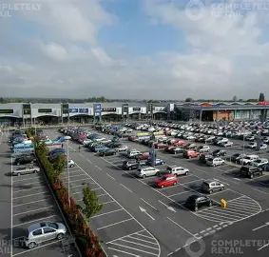
Presentation Content
Introduction to Basil’s Bakery
Business Issues Affecting sales
PESTELS Anaylsis
Fishbone Diagram
Fishbone diagram Evaluation
Conclusion
Reference

Slide 3
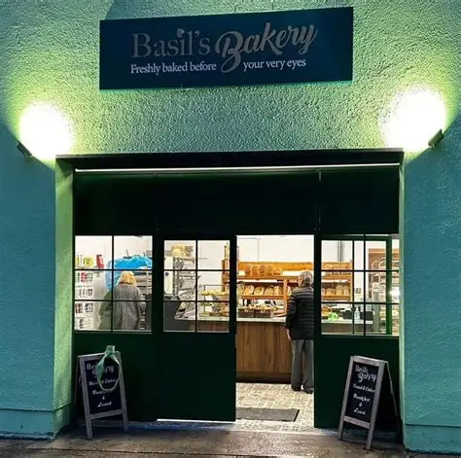
Background Information on Basil’s Bakery
Basil's Bakery, an independent artisan bakery located in a Coventry UK retail park, is an unincorporated small bakery that has grown substantially since its inception due in large part to the high quality of its products, as well as the convenient location of the bakery for local workers and shoppers. The expectations for sales after COVID-19 were that they would return to the same levels as 2019 sales; however, sales have stabilised to be approximately 25% lower than 2019 sales. British Business Bank (2025)
In this presentation the reasons causing the stagnation of sales will be evaluated; additionally, the challenges facing Basil's Bakery will be analysed via the PESTEL and Fishbone analysis models. Sales at Basil's Bakery increased over the years from 2015 to 2019 due to the increase in customer demand and consistently good product quality. The COVID-19 pandemic had a significant negative impact on customer behaviour and on retail in general. Gov.uk (2025)

Slide 4
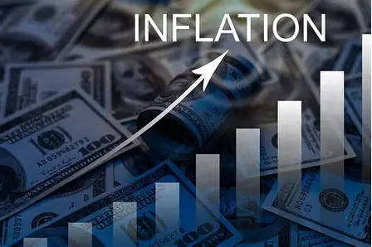

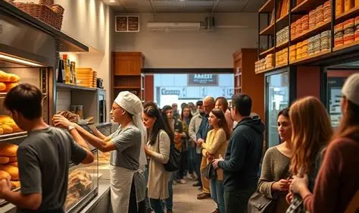
Nature and Scope of the Issues
Scope of the problem
Sales stagnant at 25% below 2019 levels
Threat to long term business sustainability
Risks of reduced profitability and closure Statista (2025).
External issues
Reduced football in retail park
Shop closures reducing customer traffic
Increase in remote working
Economic pressures reducing spending BBC News (2025).
Internal Issues
No delivery service
Poor pre order system
High operational costs
Dependence on expensive organic ingredients BBC News (2025).

Slide 5
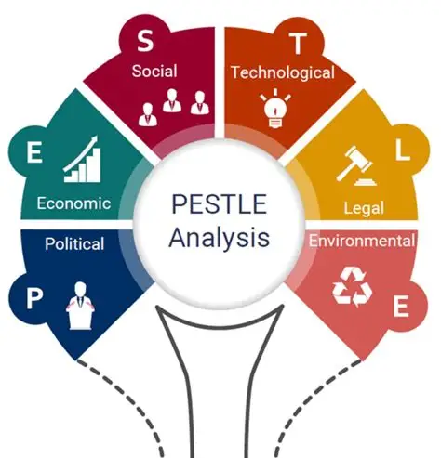
PESTLE Analysis
PESTEL analysis is a strategic framework used to explore macro factors that impact business success.
It stands for Political, Economic, Social, Technological, Environmental and Legal factors.
Businesses use PESTEL to identify opportunities and threats in the external environment.
It supports strategic planning and decision-making.
Benefits and Limitations of PESTEL :
Benefits
Provides a structured approach to analysing the external business environment.
Helps businesses identify opportunities and potential threats.
Supports strategic decision-making and future planning.
Encourages organisations to consider wider market influences
Limitations
Focuses only on external factors and ignores internal business issues.
External conditions can change quickly, making analysis outdated.
Does not measure the importance of each factor.* Results can be subjective depending on the person conducting the analysis (Institute of Leadership & Management, 2013

Slide 6
Application of PESTLE Framework to Basil’s Bakery Case Study
POLITICAL | Regulations from the government including food safety standards, rates of taxation on a business and employment legislation all contribute to increasing the operation costs and the overall responsibilities of running a bakery, and COVID 19.
ECONOMIC | High rates of inflation, an increases in invoices with higher utility bills and the rising price of ingredients has all adversely affected profit margins of the bakery. People are also spending less due to the cost of living.
SOCIAL | Consumer behaviour changed after COVID 19. People work from home, reducing daily customer numbers in the retail park. Customers also expect faster and more convenient services.
TECHNOLOGY | Due to the absence of online ordering/telephone ordering and no delivery services at Basil bakery, competitors who have embraced the digital space are at an advantage.
ENVIRONMENTAL | The use of organic ingredients in baked goods at the bakery incurs an added expense; moreover, the organic ingredients used are subject to crop failure and supply chain disruptions. Also, people are becoming even more environmentally friendly.
LEGAL | The bakery must comply with laws governing food safety ,health and employee relations in order to steer clear of legal penalties and maintain the trust of customers.
Mind Tools (2025)

Slide 7
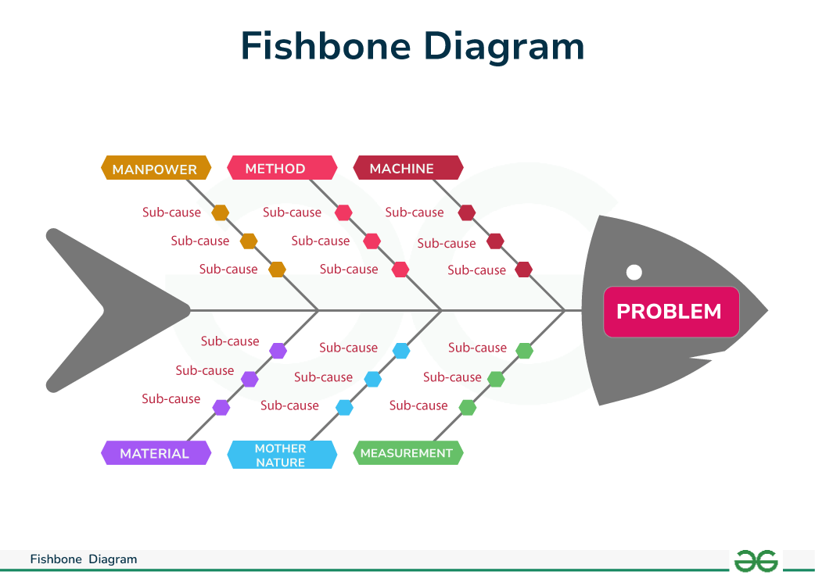
Fishbone Diagram
A Fishbone Diagram is also known as the Ishikawa Diagram that helps to find a cause for a specific business problem - this example being an issue with sales stagnation.
It helps businesses investigate why a problem is occurring rather than focusing only on the symptoms.
Causes are grouped into categories, making it easier to analyse complex issues.
It is commonly used in quality management and business improvement processes
Benefits and Limitations of Fishbone Analysis:
Benefits
Helps identify the root causes of a problem.
Encourages structured and logical thinking.
Organises causes into clear categories.
Supports decision-making and problem-solving.
Limitations
Does not identify which cause has the greatest impact.
Can become subjective if based on opinions rather than evidence.
May oversimplify complex business problems.
Requires further analysis to confirm the actual causes Lucidchart (2025).

Slide 8
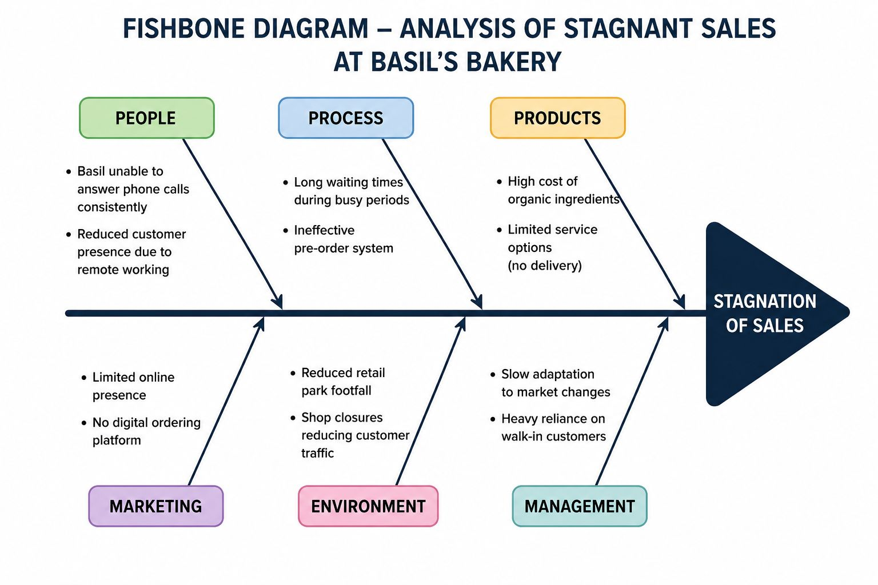
Fishbone diagram Evaluation of Basil’s
According to the Fishbone Diagram, sales performance is declining due in large part to operational inefficiencies and lack of innovation.
Despite offering quality products, Basil's Bakery was unable to sufficiently change how they did business based on the changing behaviours of consumers and/or the market Lucidchart (2025).

Slide 9

Summary of Findings
In conclusion, Basils Bakery as many problems that contributes to it remaining below the 25% previous profit margins.
Their ability to sell products and there over all sales.
Customer demand has decreased because fewer people are visiting the store.
87% population take lunch at home (BBC News, 2025).
Not having a wide variety of produce and services to offer.
Not providing home delivery or online services to customers.
Not having enough staffs nor the flexibility change with modern technology .
Difficulty to source organic produce with the unstable prices.

Slide 10
References
BBC News (2025)UK inflation and rising business costs. Available at: https://www.bbc.co.uk/news/business [Accessed: 23 May 2026].
British Business Bank (2025)Small business challenges after COVID-19. Available at: https://www.british-business-bank.co.uk [Accessed: 23 May 2026].
Gov.uk (2025)Business rates and workplace regulations. Available at: https://www.gov.uk [Accessed: 23 May 2026].
Indeed Editorial Team (2024)What is PESTEL Analysis? Available at: https://www.indeed.com/career-advice [Accessed: 23 May 2026].
Lucidchart (2025)Fishbone Diagram Tutorial. Available at: https://www.lucidchart.com/pages [Accessed: 23 May 2026].
MindTools (2025)PEST Analysis. Available at: https://www.mindtools.com [Accessed: 23 May 2026].
Signomatic.co.uk. (2025). Poster printing - Design a custom poster - Signomatic. [online] Available at: https://www.signomatic.co.uk/posters?msclkid=a12235e6685a169e1cc65ff7a751b472&utm_source=bing&utm_medium=cpc&utm_term=posters&utm_content=posters&utm_campaign=skyltmax-uk-search-generic-bing [Accessed 23 May 2026].
Statista (2025)Impact of remote working on UK businesses. Available at: https://www.statista.com [Accessed: 23 May 2026].
Super series solving problems and making decision 5th edition E-book/ 5th edition, Routledge, 2013,total pages 132 section A: introduction ( page 1-11)

Slide 11
THANK YOU

