Slide 1

Effective Teamworking and Communication
Flight Foods Ltd
Presentation
Fabiana Plesca
Module: LCLM4003

Slide 2
Introduction to Flight Foods Ltd
Key communication challenges
Application of Schramm’s Model
Recommendations
Conclusion and References
Today’s Presentation
1
2
3
4
5

Slide 3
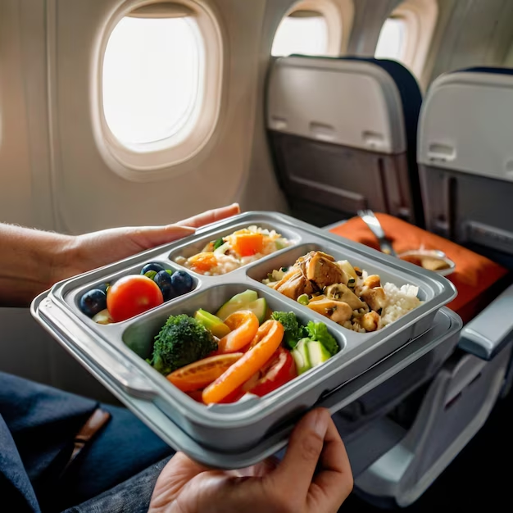
Company Background
Flight Foods Ltd is a medium-sized enterprise manufacturing and supplying ready-made meals for airlines.
In recent years, the company has faced a decline in market share due to many customer complaints about undercooked food, cross-contamination, and poor packaging.
Some other operational issues and communication challenges within the facility.

Slide 4
Cultural and language barrier
Communication
Noise
Lack of training
Product
Cultural and language barriers among a diverse workforce- staff don’t understand English, also varied perceptions of hygiene and authority.
Poor communication between staff and manager (only the manager communicates using signs and verbal orders).
Important in a business for everyone to be able to understand verbal and non-verbal meanings (Kalogiannidis,2020).
Outdated equipment is making excessive noise, which makes communication difficult.
Lack of structured hygiene and training, also the manager fails to demonstrate proper hygiene (wearing an unclean uniform).
There is a decline in product quality and hygiene, which is affecting the business.
Key Problems Identified

Slide 5

Manager’s perspective
The floor manager, Gary, shared that he struggles to train employees who have limited English skills.
Communication is mainly by gestures or partial translations.
Hygiene standards are not followed correctly, and staff fail to understand the importance of cleanliness and safety procedures.

Slide 6
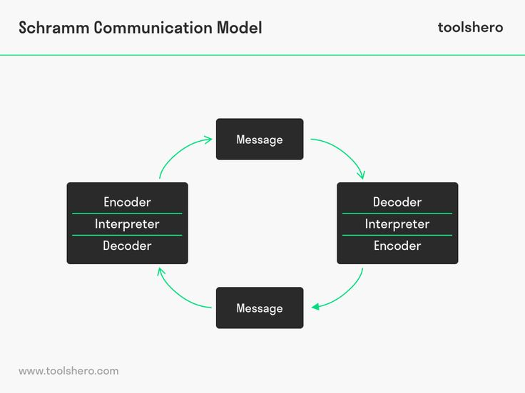
Schramm’s Interactive Communication Model
The Schramm Model (1954) views communication as a shared process where both sender and receiver exchange experiences and meanings, emphasising common understanding and feedback.
Effective communication occurs when participants share similar backgrounds and experiences. (Kapur,2020).

Slide 7
Element | Application to Flight Foods Ltd
Sender | Gary, the floor manager, communicates hygiene and safety rules.
Encoder | Gary uses English, gestures, and signs to communicate.
Decoder | Staff interprets instructions through limited English and cultural filters.
Receiver | Factory staff and varied linguistic and cultural backgrounds.
Message | Food hygiene protocols, cleanliness standards, and safety procedures.
Feedback | Staff provide minimal or unclear feedback, often misunderstood.
Noise | Loud machinery, language, barriers and cultural differences.
Field of Experience | Limited share experience among staff and manager.
Outcome | Miscommunication leads to hygiene issues and customer complaints.

Slide 8
Recommendations for Improvement
The company should introduce short courses for language training. This would help reduce communication barriers (Adanlawo, Reddy, and Rugbeer,2021).
Assign bilingual team leaders for translation support, it is a crucial skill to understand verbal and non-verbal meanings (Kalogiannidis,2020).
Replace outdated, noisy machinery.
In a business organisation, when implementing structured feedback meetings between staff and management, the manager must empower and train team members to enhance their performance (Chan, 2024).
Establish clear hygiene policies and uniform standards.

Slide 9
Conclusion
Considering the points discussed above, this presentation has analysed and explained the key communication barriers at Flight Food Ltd, supported by theories such as Schramm’s Communication model.
Flight Food Ltd is experiencing issues due to communication breakdowns and inadequate safety practices.
These challenges stem from language barriers, cultural differences, and ineffective communication methods. I have examined these factors to develop recommendations aimed at reducing these key barriers.

Slide 10
Thank You

Slide 11
References
Adanlawo, E.F., Reddy, M.M. and Rugbeer, H., 2021. Intercultural business communication: The implications of language barriers. Psychology and Education Journal, 58(5), pp.6281-6290.
Chan, A.C.K., 2024. Doing Mentoring and Managing in Giving Corrective Feedback: A Study of Managerial Discourse in Business Meetings. Business Communication Research and Practice, 7(2), pp.85-95.
Kapur, R., 2020. The models of communication. University of Delhi, pp.1-10.
Kalogiannidis, S., 2020. Impact of effective business communication on employee performance. European Journal of Business and Management Research, 5(6).

