Slide 1
Response Policing Part 3

Slide 2
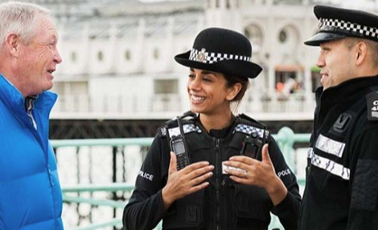
Revisit the following sessions:
Response & practical policing, major and critical incidents.
Digital Policing.
Decision making & Discretion.

Slide 3
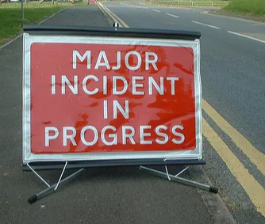
Major Incidents
Major incidents are likely to require a response from several emergency services. Each will conduct their own primary role during the incident.
Police are required to oversee the coordination of the emergency response phase of the incident.
The police response should be visible and will ensure that other agencies can carry out their own duties effectively.
Examples of this at major incidents will include the managing of traffic and the management of cordons.
The first responder must assess the nature of the incident and communicate all findings to the control room.
Notes:
The definition of what is a critical and what is a major incident have been covered during your initial training. Examples include terrorist incidents, such as the London bombings 7/7 2005/ Manchester Arena Bombing 2017. These were declared major incidents.
" A major incident is a situation in which special arrangements have to be implemented by an organisation to deal with it, above normal routine activity"
The police are also responsible for:
• coordinating evacuation; • assisting with and warning the public; • protecting property; • collating and disseminating casualty information by obtaining information from all those directly involved in an incident, and comparing information from those reporting families or friends missing to identify those involved. This is done through a ‘Casualty Bureau’; • identifying the deceased on behalf of the coroner; • establishing the facts and pursuing or assisting in the prosecution of offenders where offences have been committed
MLA (Modern Language Assoc.)
Clive Harfield. Blackstone’s Police Operational Handbook: Practice and Procedure. Vol. Second edition, OUP Oxford, 2014.
Officers must ensure their own personal safety at the scene, when carrying out a dynamic risk assessment. You must be aware of any threat/risk to self or others.

Slide 4
Critical Incidents
Any incident has the potential to become a critical incident.
Examples include: The Victoria Climbie Inquiry and The Brixton Disorders April 1981.
Early recognition of a critical incident is essential.
Forces need to take proactive steps to prevent critical incidents developing.
Critical incident management is vital for the restoration of public confidence.
Notes:
Definition : Blackstones
"Any incident where the effectiveness of the police response is likely to have a significant impact on the confidence of the victim, their family and/or community" The concept of critical incident was developed following the murder of Stephen Lawrence and the Macphereson Inquiry (1999)
A first responder at the scene of a critical incident is responsible for carrying out the initial duties of the police. Early recognition of a critical incident is vital to ensure an appropriate response. Critical incidents are managed through a three-rank command structure in which the hierarchical layers are labelled Gold, Silver, and Bronze. This structure allows the response to the incident to be scaled up or down according to the changing circumstances. The Gold Command is undertaken by the role of an Assistant Chief Constable and is responsible for overall strategic leadership and direction of the incident. The Silver Commander is normally a rank of Superintendent, while the rank of Bronze Commander is undertaken by the Duty Inspector.
Lessons learnt from critical incidents: the importance of effective joint interrogability has been highlighted thought the analysis of critical incidents such as the Victoria Climbie case. Effective communication between partner agencies is necessary to ensure that information is not overlooked during investigations.
MLA (Modern Language Assoc.)
Clive Harfield. Blackstone’s Police Operational Handbook: Practice and Procedure. Vol. Second edition, OUP Oxford, 2014.
Consider the three phases of critical incident management:
1 Preparing for critical incidents
This requires chief officers to consider current management structures ensuring, where possible, that:
staff are trained effectively
resources are available
the overall quality of the police response reflects a competent and accountable standard of incident management.
2 Managing critical incidents
This considers how to identify critical incidents early on. It includes processes to ensure incidents are notified to the most appropriate person, and that they are managed effectively.
3 Restoring public confidence
This considers incidents that have had a significant impact on public confidence but were not identified when the incident was live, and how confidence may be rebuilt through community engagement, resolution or a public inquiry.

Slide 5
Debriefing
The debriefing process is an essential part of all policing operations. Designed to identify good policing practice and highlight areas for improvement.
Debriefing should be well structured and documented for the purposes of disclosure rules.
All parties should ensure that all documentation has been completed before the start of the debrief. This will include notes and pocket notebooks.
All decisions made during critical incidents should be documented. In order to review policing practice effectively.
Notes:
Debriefing should be fully recorded for the purposes of disclosure ( Criminal Procedure and investigations Act 1996 (CPIA) ).
Allegations of collusion will be avoided if notes are completed prior to the debrief and to help prevent issues regarding integrity.
Officers should be emotionally aware and recognise if they may have been effected by an incident. Seeking relevant support if needed.

Slide 6

Joint Service Interoperability Principles (JESIP)
JESIP is designed to ensure that initial multi-agency response to all incidents is more organized, structured and practiced
Consistent review of working practices focuses on continual improvement of partnership working and service delivery.
Research has highlighted several past failures in relation to multi agency work including, lack of training and ineffective communication.
Notes:
The findings from a number of reviews of major national emergencies and disasters made clear that the emergency services carry out their individual roles efficiently and professionally.
Improvement was needed - JESIP was established to address these issues:
Challenges with initial command, control and coordination activities on arrival at scene
A requirement for common joint operational and command procedures
Role of others, especially specialist resources and the reasons for their deployment, not well understood between services
Challenges in the identification of those in charge at the scene leading to delays in planning response activity
Misunderstandings when sharing incident information and differing risk thresholds not understood
JESIP commissioned the Cabinet Office Emergency Planning College to research the persistent lessons identified relating to interoperability so we could gain an understanding of the issues. The outcome of this research was the Pollock Report

Slide 7
Bibliography
Phillips, M., 2017. Frontline first. Commercial Motor, 227(5744), pp.36–37. (JESIP)
Harfield, C., 2013. Blackstone's police operational handbook : practice and procedure Second.
Bryant, Bryant, Robin & Bryant, Sarah, 2019. Blackstone's handbook for policing students Fourteenth.,
Garrett, P.M., 2004. Talking Child Protection: The Police and Social Workers ‘Working Together.’ Journal of Social Work, 4(1), pp.77–97.
Critical Incident Management. 2020. Available at: https://www.app.college.police.uk/app-content/critical-incident-management/types-of-critical-incident/#three-phases-of-critical-incident-management
JESIP. 2020. JESIP - Working together, Saving Lives. Available at: https://jesip.org.uk/home.
Pollock, K., 2013. Review of Persistent Lessons Identified Relating to Interoperability from Emergencies and Major Incidents since 1986. Emergency Planning College Occasional Papers New Series Number 6, pp.1-97

