Slide 1

working with children in a social care setting 7-11 years old
Created by tashan wilkin 2024779

Slide 2






Introduction

Slide 3
This is my presentation on working with children in a health and social care setting my chosen age group is 7-11 year old and I chose to use the soical learning therory learning from our social surroundings

Slide 4




working with children

Slide 5
Activity 1
Activity one puzzles and board games I have choosen these activitys using the social learning theory and looking at cognitive development these activitys promote family time can help build communication skillls can help children with speacial needs this activity will teach kids how to follow instructions but will help teach them how to learn to fail

Slide 6
Activity 2
Activity two I have choosen music and dance its good for stimulation and helps the children develop large motor skills improved balance and hand and eye corordination rhythm .
Small motor skills such as finger play playing musical instruments music and movement enables children to learn new words concepts through singing songs to learn the alphabet.

Slide 7
Evaluation
Albert bandura The social learning theory states that social behaviour is learnt by observing then copying the behaviour of others for example if you told a group of 5 children to eat all there food before they get to play with there toys and the first 2 finished there meals and was able to play with toys but the children that had not finished there meals cannot play with there toys social learning theory suggest by the observation of the children they willl copy this behaviour and in turn should finish there meals and get to play with there toys.

Slide 8
5 princples of social learning
Observation
Attention
Retention
Re-production
Motivation
These are the 5 key steps in order for learning to take place

Slide 9
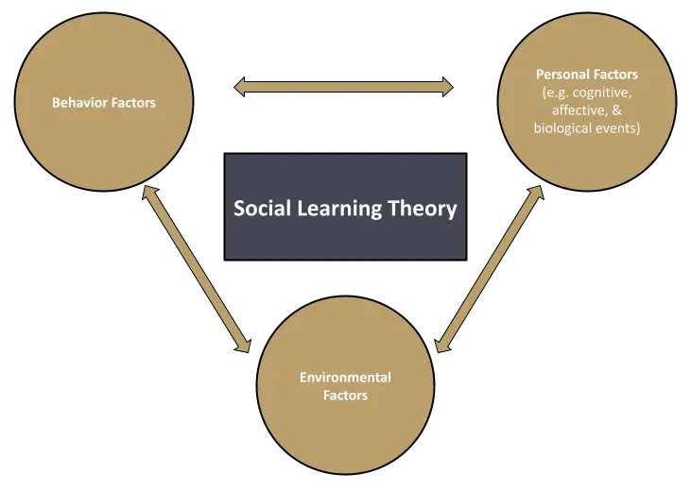
Albert bandura
Social learning theory

Slide 10





Safe guarding

Slide 11
The duty of safeguarding goes beyond and overrides any responsibility of primary health care
7 main safe guarding concerns
Bullying
Radicalsation
Sexual
Grooming
Forced marriage
Indication of self harm
Allegations against staff

Slide 12
3 legislations relating to safeguarding

Slide 13
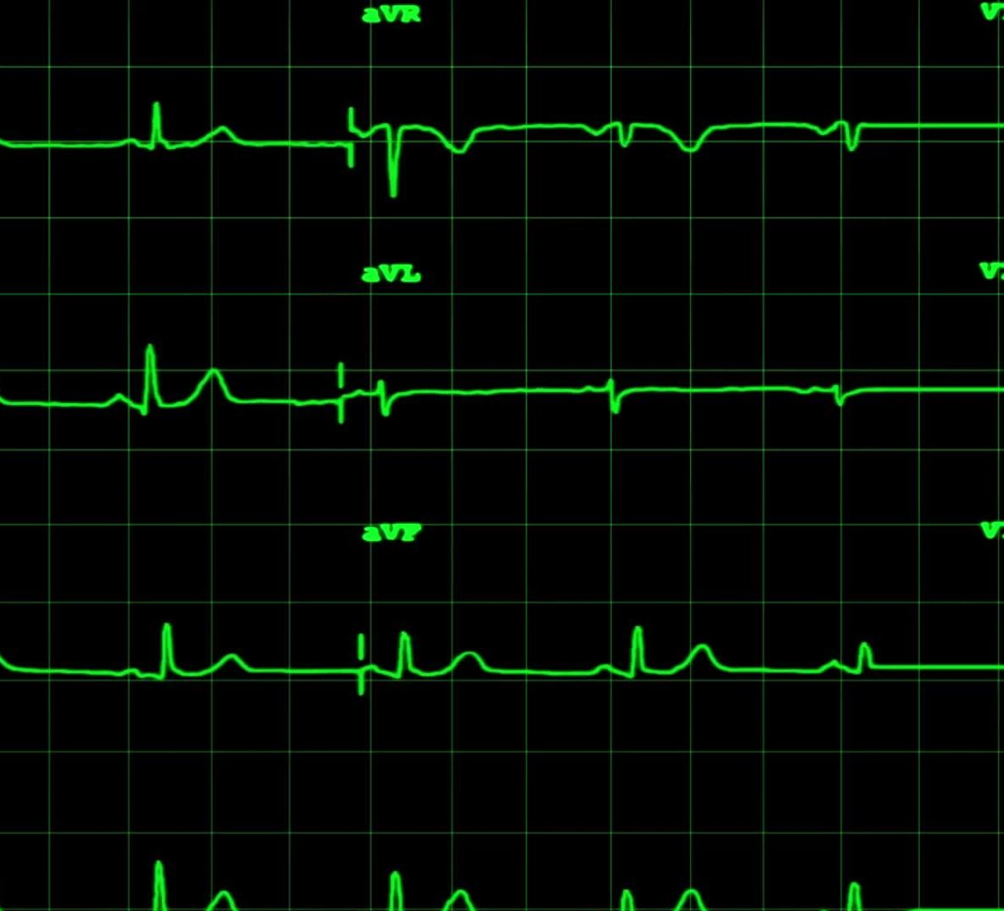
Safe guarding vunruble groups act 2006.
Health and social care act act 2012.
Mental capacity act 2005.

Slide 14
2 main laws of child protection
2010
The equality act 2010.
2014
The children and families act 2014

Slide 15
Section 17
Section 17 of the safeguarding act places a general duty on all local authorites to safe guard and promote the safeguarding act

Slide 16

Conclusion

Slide 17
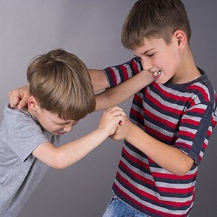
Looking at albert bandura social learning theory my conclusion is children can show aggressive or non aggressive behaviour's because they observate then imitate such behaviours.
somebody acting aggressive observed by a child the child will imitate and also act aggressive and over time you will see the child reinforce these behaviour's complex behaviour's patterns can be learned through imitation without renforcment

Slide 18
How to become a residential support worker
A collage course an apprentaship or working towards the role, level 2 cert or level 3 diploma in youth work practise
Or a level2 gcse in health and social care level 2 certificaye or level 3 diploma in health and social care
Level 2 certificate or level 3 diploma for the children and young peoples work force
Level 3 diploma for residential health care

Slide 19
Refrences list
https://www.google.com/url?sa=i&url=https%3A%2F%2Fpositivepsychology.com%2Fsocial-learning-theory-bandura%2F&psig=AOvVaw0TVvjt2sOyBtYZ7tvQf3W8&ust=1676400624801000&source=images&cd=vfe&ved=0CAsQjRxqFwoTCJjfwo-Vk_0CFQAAAAAdAAAAABAE
https://www.google.com/url?sa=i&url=https%3A%2F%2Fwww.empoweringparents.com%2Farticle%2Fhitting-biting-and-kicking-how-to-stop-aggressive-behavior-in-young-children%2F&psig=AOvVaw28ZzPyM-k61VRo3KOx834f&ust=1676403486692000&source=images&cd=vfe&ved=0CAwQjRxqFwoTCLCGyPWfk_0CFQAAAAAdAAAAABAD
Grusec, J.E., 1994. Social learning theory and developmental psychology: The legacies of Robert R. Sears and Albert Bandura.
Bandura, A. and Hall, P., 2018. Albert bandura and social learning theory. Learning theories for early years practice, pp.63-65.
Bandura, A. and Walters, R.H., 1977. Social learning theory (Vol. 1). Prentice Hall: Englewood cliffs.
Bandura, A., 1969. Social-learning theory of identificatory processes. Handbook of socialization theory and research, 213, p.262.
Rumjaun, A. and Narod, F., 2020. Social Learning Theory—Albert Bandura. Science education in theory and practice: An introductory guide to learning theory, pp.85-99.
Lyons, S.D. and Berge, Z.L., 2012. Social learning theory. UMBC Faculty Collection.
Woodward, W.R., 1982. The" discovery" of social behaviorism and social learning theory, 1870–1980. American Psychologist, 37(4), p.396.
Akers, R.L., 2017. Rational choice, deterrence, and social learning theory in criminology: The path not taken. In Crime Opportunity Theories (pp. 299-322). Routledge.

Slide 20
Thank you for taking part in my presentation

