Slide 1
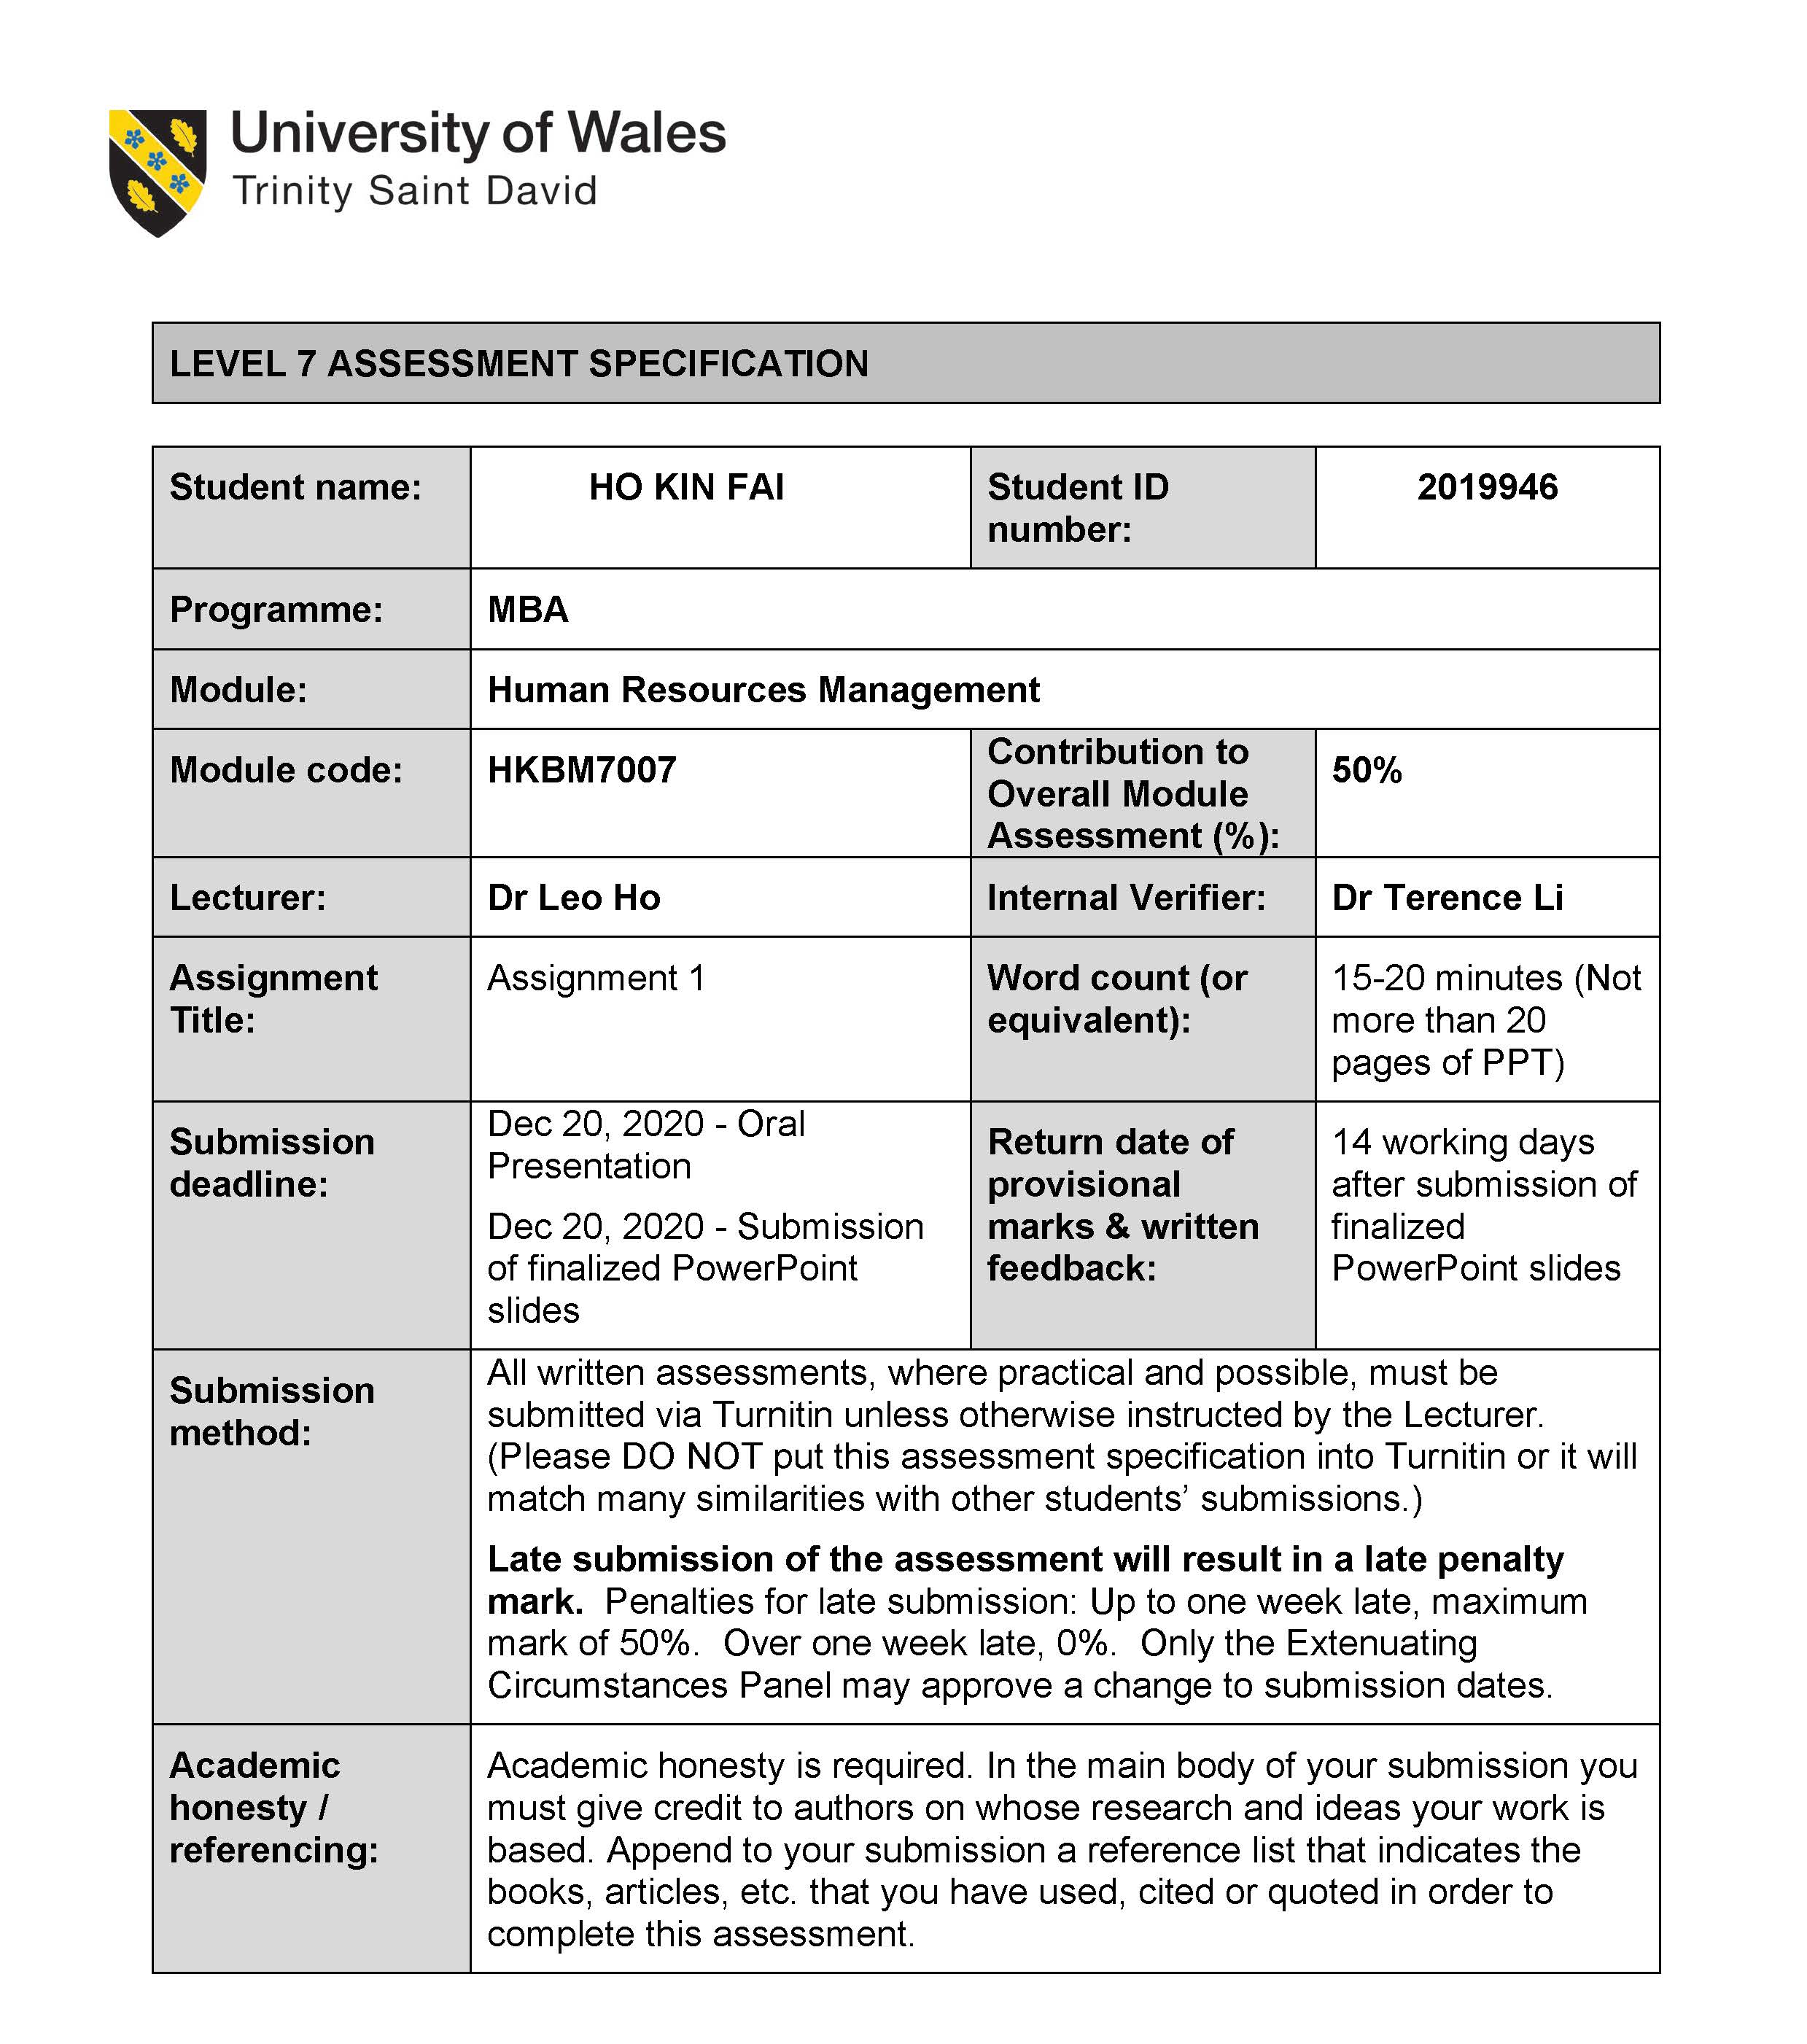

Slide 2

Adopt IoT on HRM
Performance management

Slide 3
Employee behaviour and working environment can be reflecting employee productivity, such as attendance rate, employee activity, physical condition and working environment factors. We suggest applying IoT technology to recording employee attendance, monitoring their physical fitness and working environment to improve employee performance. In this presentation, I will act as an IT consultant to propose our HR Dept. to adopt IoT technology.
introduction

Slide 4
Flow
Introduction
How IoT adopts & embraces on HR functions
Key Challenges & Recommendations
Conclusion
Reference
Q&A

Slide 5
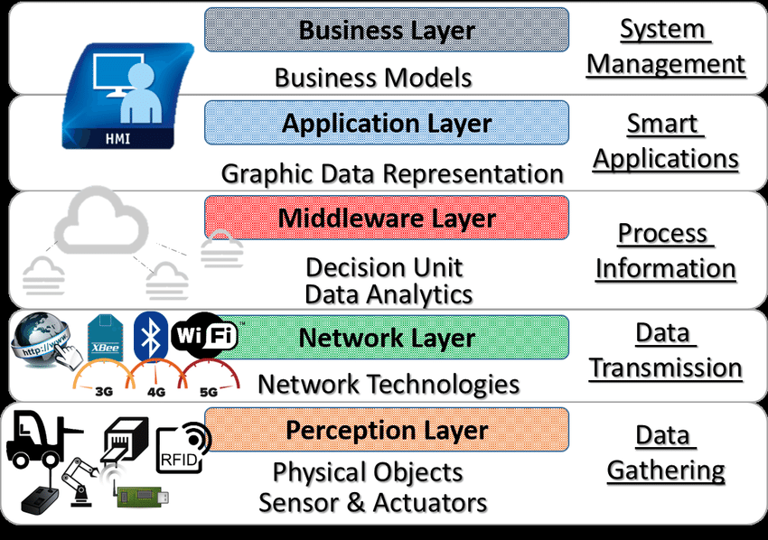
What is IoT?
Kevin Ashton presented the first concept at Procter & Gamble (P&G) in 1999 by connecting a physical object with RFID and embedded technology connect to the internet.
Physical objects—“things”— embedded with sensors, software, or other technologies to connect and exchange data between devices and systems within the internet infrastructure.
RFID Staff Card
Smart Watch
Temperature Sensors
Humidity Sensors
Water Mag/Bottle
Coffee Machine
Smart Workstation
Vehicle
Fig. 1. Five Layer IoT Architecture
Notes:
The first concept presented by Kevin Ashton at Procter & Gamble (P&G) in 1999, by connected a physical object with RFID and embedded technology to the internet.

Slide 6
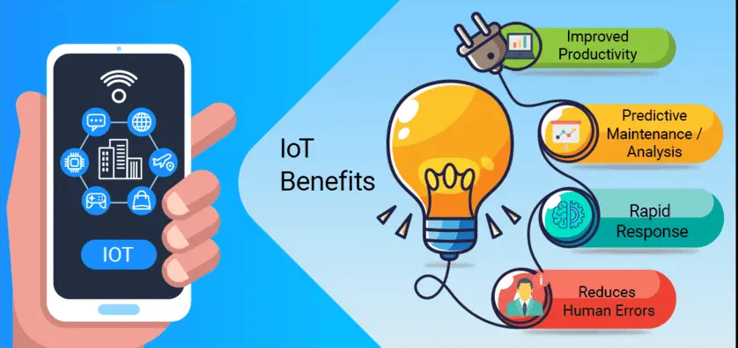
Why adapt IoT technology?
Productivity improvement
Predictive analysis
Rapid response
Automation and Control
Fig. 2. IoT Benefits.
Notes:
Automation and Control – Without human intervention, all machines connected with wireless in the IoT infrastructure, the “Things” stay connected and controlled by the central system to reduce human errors due to mundane or repetitive tasks.
Productivity improvement - IoT allows monitor and control by sensors or smart devices and link up to specific system, it helps tracking or detecting humanity activities, thus increase productivity and efficiency.
Rapid response – the data is collected in real-time and even remotely. All activities are being monitored by system which can base on the situation to provide response rapidly.
Predictive analysis: After collected a large amount of data, IoT technologies make it possible to examine recurring patterns and contribute to predictive analysis, which can be used mainly in maintenance. This precise information will be used to improve existing processes and services(Srija, 2020)

Slide 7
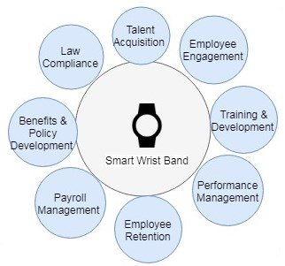
How IoT adopts & embraces on:
HR departments can adopt IoT to create more delightful and efficient workplace by looking at productivity, communication, tracking employee location, monitoring office environment to improve:
Performance management
Health and well-being
Fig. 3 IoT on HR Functions

Slide 8
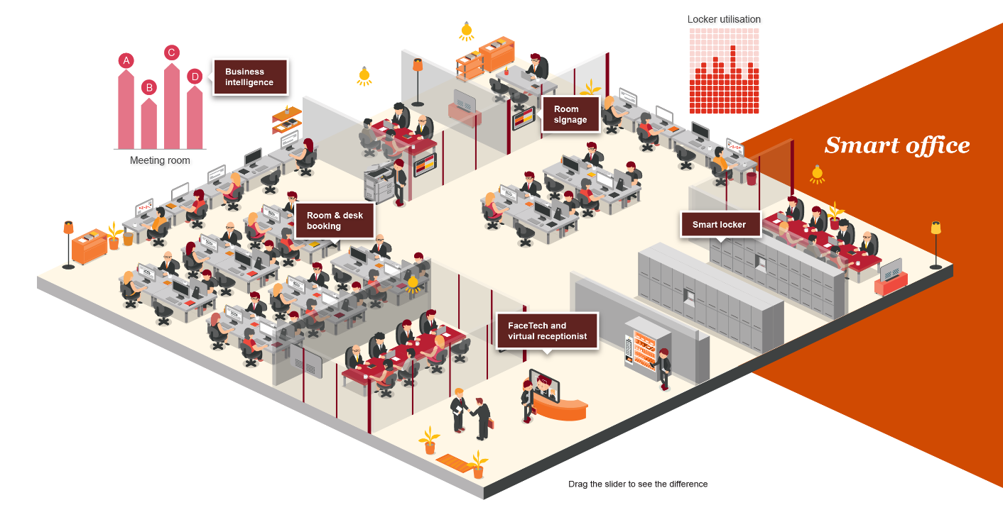
Office Lighting Senor
Humidity & Temperature monitoring
Office occupation Monitoring
Personnel access control
Work Station Activity Monitoring
Office asset control
Smart Entrance
Image source: https://smartoffice.pwchk.com/en/index.html

Slide 9
Case Study
IoT can provide different ways for HR to make performance management more diversity and efficiency. Those can be:
Attendant and Identification – using smartwatches, smartphones or ID badges/card with RFID for recording attendance ,working time and secure access to a restricted area.
Location tracker – Employees carry a staff card embed RFID chip to record and track their movement, even track and monitor employee’s work overseas by taking smartwatch and cell phone assorted with GPS.
Activity monitoring – Install monitoring software tracks employee activate on applications, websites, emails, and network connection.
Communication - Employees, line managers and HR carrying IoT mobile devices can connect with each other without boundary.
Real time alert and notification - notify the employee when any emergency incident occurs in real-time.

Slide 10
Case Study cont’d (Health and well-being)
To encourage employees to maintain physically and mentally healthy, Employee wellness can be monitored by wearing activity sensors (by carry smartwatch to collect their steps and heartbeats in real-time to measuring each employee’s movement and health status).
For detect ECO system by install sensors in workplace to monitor:
  Humidity
  Lighting
  Air pressure
  Temperature
  Volatile organic compounds.
HR Dept can use the collected data to analyse staff turnover, discomfort, medical costs, and sick leave reflected by the office environment.

Slide 11
SWOT Analysis
STRENGTHS | WEAKNESSES
Process Automation Auto tracking employee attendance and activity Environment friendly (easy to implement) Resource allocation (monitored by system) Reducing human intervention Monitoring workplace Ecosystem Easy counting employee payroll | Information Security Data Privacy Massive investments (on hardware/software) No road map( means no ending) Too many categories IoT solutions
OPPORTUNITIES | THREATS
Innovation (Smart Office) Develop a healthcare workplace Reduce costing on energy (power, lighting) Communication without regional restriction Ubiquitous computing | Lack of employee involvement (pre--digital age employee) Data leakage by human error Attacked by hacker via hardware/software vulnerability Employee privacy conflicts

Slide 12
What challenge on apply IoT?
Challenge
Trust and Ethics
Costing
Information Security
Data Privacy

Slide 13
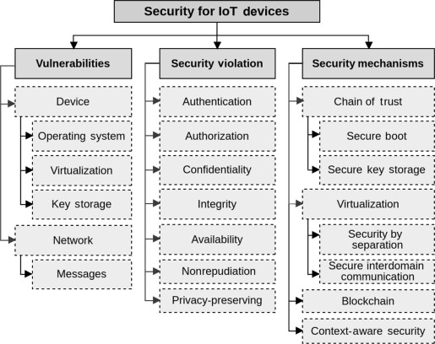
Information Security
IoT involved many devices and systems. The data is transferred over the network automatically. If the device or system has vulnerabilities, it will breach the security such as data leakage, hacker attack, or ransomware attack.
Recommendation:
Follow the IoT security frameworks
  GSM Association,
  the IoT Security Foundation,
  the Industrial Internet Consortium and others
Popular approaches to prevent the security breach
  Embed cryptography on software and hardware encryption
  Multi authentication process
  Encrypt the Data
Fig.3. Different sector of Security for IoT devices

Slide 14
Data Privacy
By tracking and monitoring will generate massive data by collecting human behavior and interaction.
People analytics - is a data-driven approach to manage and monitor employee performance by using trackers; it will collect a lot of private data.
Recommendation:
Follow a guideline for who will handle the data in HRM activity for the Data collection.
PCPD, Privacy Guidelines: Monitoring and Personal Data Privacy at Work(2004).
the General Data Protection Regulation (GDPR) data privacy laws across the European Union).
Restricted/limited the monitoring area (Dinning hall, Toilet, Hostel).
Fig.4. Key Concerns for Deploying Mobile Technology
Notes:
Using IoT can be associated with a Huge amount of data generated and manipulated that may relate to human behaviour and interaction (Antoniou and Andreou, 2019). And in people analytics is a data-driven approach to manage and monitor employee performance. Then we need to consider a breach of privacy.
Data privacy requires access control to govern access to the data by considering information on data provenance and metadata concerning the data acquisition context, such as location and time. (Elisa, 2016), HR dept must keep in mind what data/information can be collected and be compliant with the local laws.
Recommendation:
Follow a guideline to data users who handle the personal data in performance HRM activity for Data collection(CLIC, 2020)
PCPD HK ( Code of Practice on Human Resource Management(2010), Privacy Guidelines: Monitoring and Personal Data Privacy at Work(2004)
the General Data Protection Regulation (GDPR) data privacy laws across the European Union) (Margaret R. 2018)
Restricted/limited the tracker monitoring area (Dinning hall, Toilet, Hostel)

Slide 15
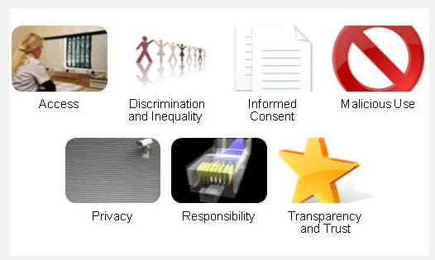
Trust and Ethics
Ethics issues will be affected by performance monitoring. The practitioner should be considerate in Deontological and Teleological perspectives.
In research, people feel that monitoring their activity is dehumanising. It invades employee privacy, makes them stressful, and decreasing morale. It will reduce the work-life quality and affect their human rights, psychological and pressure.
Recommendation:
Set clear ethical commitment to increase users’ confidence in adopting innovation.
Be aware of the importance of informed consent, the possibility of malicious use, privacy, liability issues, and transparency and trust involving the use of personal data.
Fig. 5. Ethical issues in IoT-Based Tracking

Slide 16
Costing
Massive (unpredictable) investment required
Implement IoT will involve different unique digital infrastructures. Since many factors will affect the costs, it could be challenging to predict the final investment cost. These include Hardware, Software, API integration, maintenance, and training.
Recommendation:
We recommend splitting the implementation by phase / by department and review the process by experience taskforce, invite them to estimate costs for the next development process.
Using LPWAN(Low-Power Wide-Area Network) technology to reduce the costs of the Internet component.
Using software cost estimation model COCOMO and Case Points to estimate the cost.
Fig. 6. Roadblocks to Adopting New HR Technology

Slide 17
Conclusion
In this digital era, technology is undeniably crucial for HR practitioners. It helps in recruitment, creates a more effective and efficient communication way, manages and enhances employee’s performance.
Internet of things (IoT) is no doubt can improve HR Dept. to measure employee performance by monitoring their activities and management of employee wellness. IoT would definitely generate an unprecedented relationship between employer and employee.
For example, the sensor is used to "track employees" or "improve performance", there is only a fine line between them. Therefore, companies must also communicate well with employees and be precise to obtain benefits.
By tapping into mobile and social tools, it can increase HR accessibility and facilitate connection. It has the potential to lighten their workload in some areas and engage employees in a new way.

Slide 18
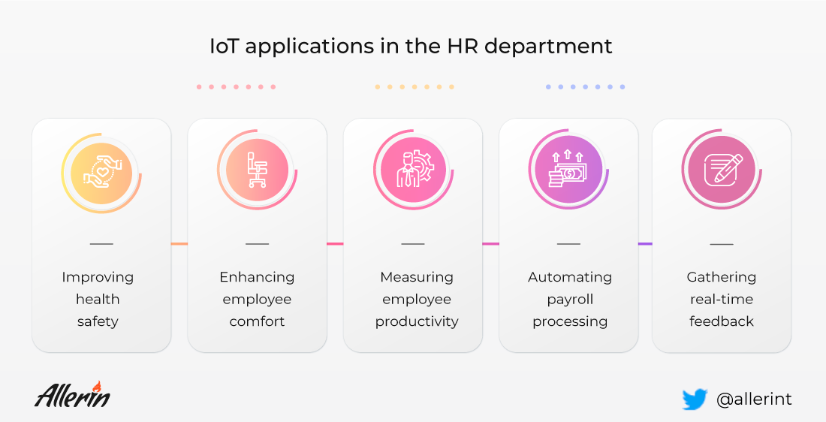
Image source: https://www.allerin.com/wp-blog/wp-content/uploads/2020/04/What-IoT-is-doing-in-human-resources.png

Slide 19
FAQ

Slide 20
Reference
Antoniou, J., & Andreou, A. (2019) Case Study : The Internet of Things and Ethics. ORBIT Journal, 2(2). [online] Available at: <https://www.project-sherpa.eu/the-internet-of-things-and-ethics/> [Accessed 26 November 2020].
Arup, B. and Karan D. (2018) Internet of Things (IoT) as the Future Smart Solution to HRM-How would wearable IoT bring organisational efﬁciency? Introduction: Rise of HR Technology.
Alder, G. S. (1998) Ethical Issues in Electronic Performance Monitoring: A Consideration of Deontological and Teleological Perspectives, Springer Business Ethics, 7 (17), pp. 729 – 743.
CLIC. (2020) Community Legal Information Centre. Privacy in Recruitment, human resources management and at work. [online] Available at: <https://www.clic.org.hk/en/topics/personalDataPrivacy/in_recruit_hr_and_work/> [Accessed 28 November 2020].
Dash, D. et al. (2019) Internet of Things (IoT): The New Paradigm of HRM and Skill Development in the Fourth Industrial Revolution (Industry 4.0). IUP Journal of Information Technology, 15(4), pp. 7-30.
Elisa B. (2016) Data Privacy for IoT Systems. 2016 IEEE International Conference on Big Data (Big Data)
Empxtrack. (2020) How Internet Of Things (Iot) Will Impact In Human Resources?. [online] Available at: <https://empxtrack.com/blog/how-internet-of-things-will-impact-human-resources/> [Accessed 11 November 2020].
Gaur, B. & Shukla, V. and Verma, A. (2019) Strengthening People Analytics through Wearable IOT Device for Real-Time Data Collection. 555-560. 10.1109/ICACTM.2019.8776776.
Hong Kong Institute of Human Resource Management. (2018) HR SERVICE PRODVIDERS DIRECTORY 2018 page 5-9. [online] Available at: https://www.hkihrm.org/HKIHRM_HRSP_2018.pdf /> [Accessed 24 November 2020].
Ivan, V. et al. (2019) J. A cost estimation approach for IoT projects. Journal of Physics: Conference Series

Slide 21
Reference
Josh B., Joe M. and Kelly M. (2016) Will IoT technology bring us the quantified employee? .The Internet of Things in human resources.
kontakt.io. Hannah A. (2018) Employee Attendance Tracking Gets IoT Treatment [online] Available at: https://kontakt.io/2018/06/22/employee-attendance-tracking-gets-iot-treatment /> [Accessed 24 November 2020].
Margaret R. (2018) What Is Iot Security (Internet Of Things Security)? IoT Agenda. 2020. [online] Available at: <https://internetofthingsagenda.techtarget.com/definition/IoT-security-Internet-of-Things-security> [Accessed 16 November 2020].
Mohanty, S. and Mishra, P. (2020) Framework for understanding Internet of Things in human resource management., Revista ESPACIOS Vol. 41 (Issue 12) Year 2020. Page 3
Mohamed, A. and Geir M.K. (2015) Cyber Security and the Internet of Things: Vulnerabilities, Threats, Intruders and Attacks. Journal of Cyber Security and Mobility Vol: 4 Issue: 1
Mohl, D. (2006) Balancing Employer Monitoring and Employee Privacy. Workspan, pp.68-70.
Moratelli, C.R. et al. (2020) Chapter 9 - Privacy and security of Internet of Things devices. In: H. DAS, N. DEY and V. EMILIA BALAS, eds, Real-Time Data Analytics for Large Scale Sensor Data. Academic Press, pp. 183-214.
Naveen J. (2020) What IoT is doing in human resources. [online] Available at: <https://www.allerin.com/blog/what-iot-is-doing-in-human-resources /> [Accessed 26 November 2020].
Spaceti. (2017) How IoT-equipped offices foster better employee wellbeing. [online] Available at: <https://iottechnews.com/news/2017/nov/17/how-iot-equipped-offices-foster-better-employee-wellbeing/> /> [Accessed 28 November 2020].
Srija. (2020) IoT Trends. [online] Available at: <https://360digitmg.com/iot-trends#iot-advantages-and-disadvantages/> [Accessed 24 November 2020].

