Slide 1
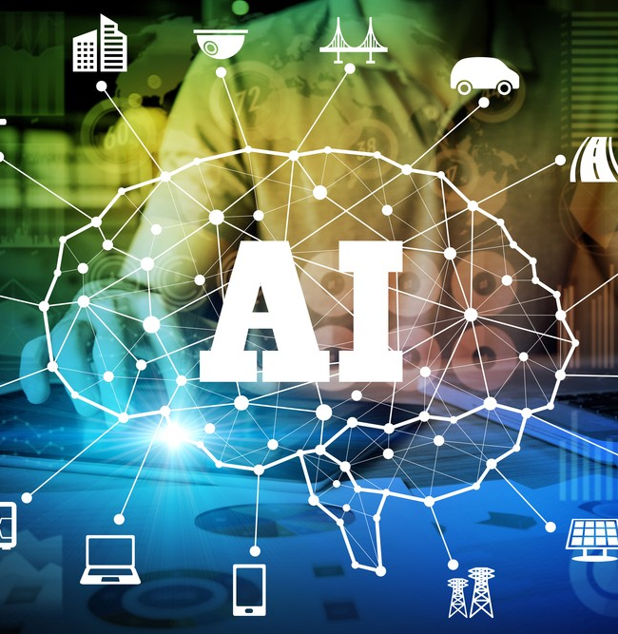
“Artificial Intelligence (AI) in Tourism and Hospitality: Renovating the Experiences of Customer and Rearrangement of the Operations"
PRESENTED TO: Dr: Ernest balutie wavei & Ben Chong
PRESENTED BY: Ahmed Reza helal
STUDENT ID: 2021309701
COURSE MODULE: Contemporary themes in the hotel industry BMIH6001

Slide 2
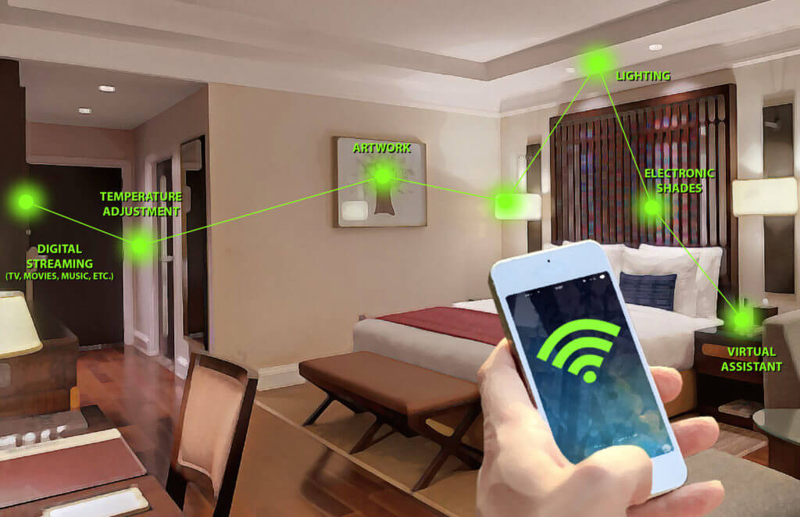
Introduction
Artificial intelligence is being embraced by travel and hotels to enhance efficiency and even the quality of services offered to customers. This is a reason why AI can be used in businesses to offer appropriate content and services and by using predictive analysis.. Also, AI in data analytics enables organizations to have better and improved knowledge of the clients’ preferable choices, hence improving marketing (Glion, 2023).
Enhancing Customer Experience
AI enhances customer satisfaction by providing reliable and convenient services to the customers easily. Self-sufficient artificial intelligence, including live chat with guests or using virtual hosts and hostesses, translates into the generation of answers and shorter response time and, therefore, high quality (Ferhataj, 2024). Many services, such as the check-in kiosks, face recognition technology, and robotic services, all ensure that guests do not have to spend too much time in queues while at the same time improving security measures (Schwarz,2025).

Slide 3
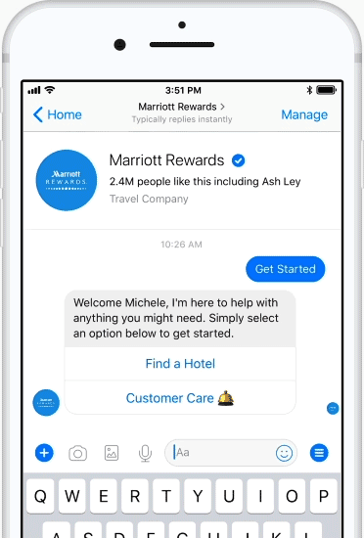
LITERATURE RIVIEW
The Role of The AI in Customer Services:
a. Chatbots Driven by AI (Utilise The Marriott International Hotel as an Example):
Created by Marriott International, AI chatbots are a means to simulate human behavior and reach out to customers (guests) for instant responses to their questions. A combination of human staff and these chatbots supports booking processes and handles room service while addressing standard guest inquiries to decrease staff operational stress and accelerate the service delivery (Revfine, 2023).
The Role of The AI in Customer Services
The Role of Artificial Intelligence in Digital Marketing
AI in Operations

Slide 4
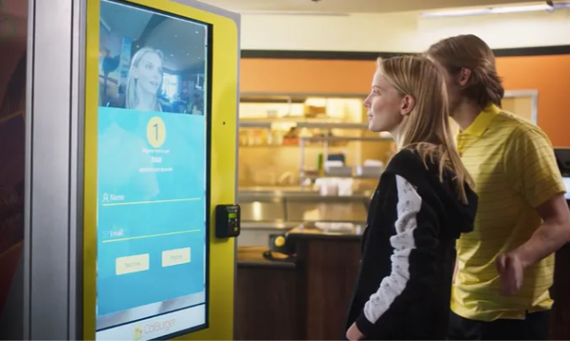
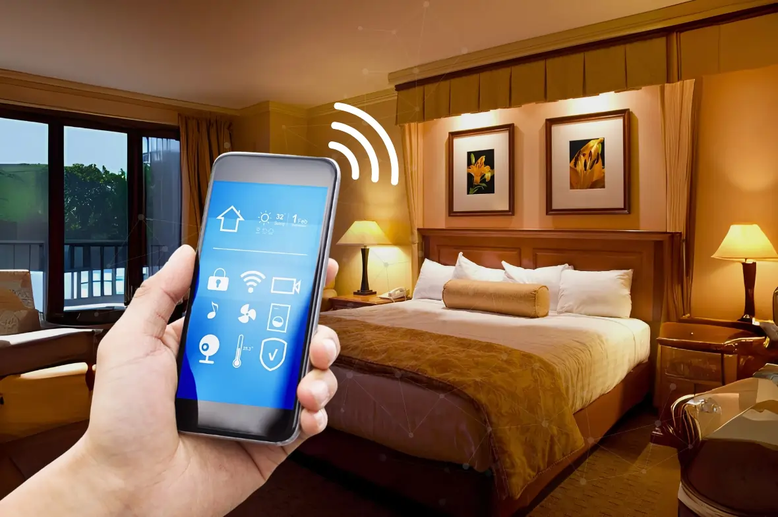
b. Facial Recognition Check-in (Hilton & Alibaba FlyZoo Hotel):
Facial recognition is being adopted in the checking-in process in some hotels such as Hilton and the FlyZoo Hotel which is owned by Alibaba. At the FlyZoo Hotel, facial recognition control is linked with other parts of the hotel where the guest is subjected to an automated lifestyle during his or her stay (Berman, 2023).
c. Virtual Assistants and Controls of Smart Room
People who use Amazon Alexa for Hospitality can operate room settings, request accommodation services and obtain information about local attractions by speaking directly to the system. The use of innovative technologies in a smart room will allow the control of light, temperature and entertainment according to the guest’s choice to ensure a comfortable atmosphere (Ndhlovu et al, 2024) .

Slide 5
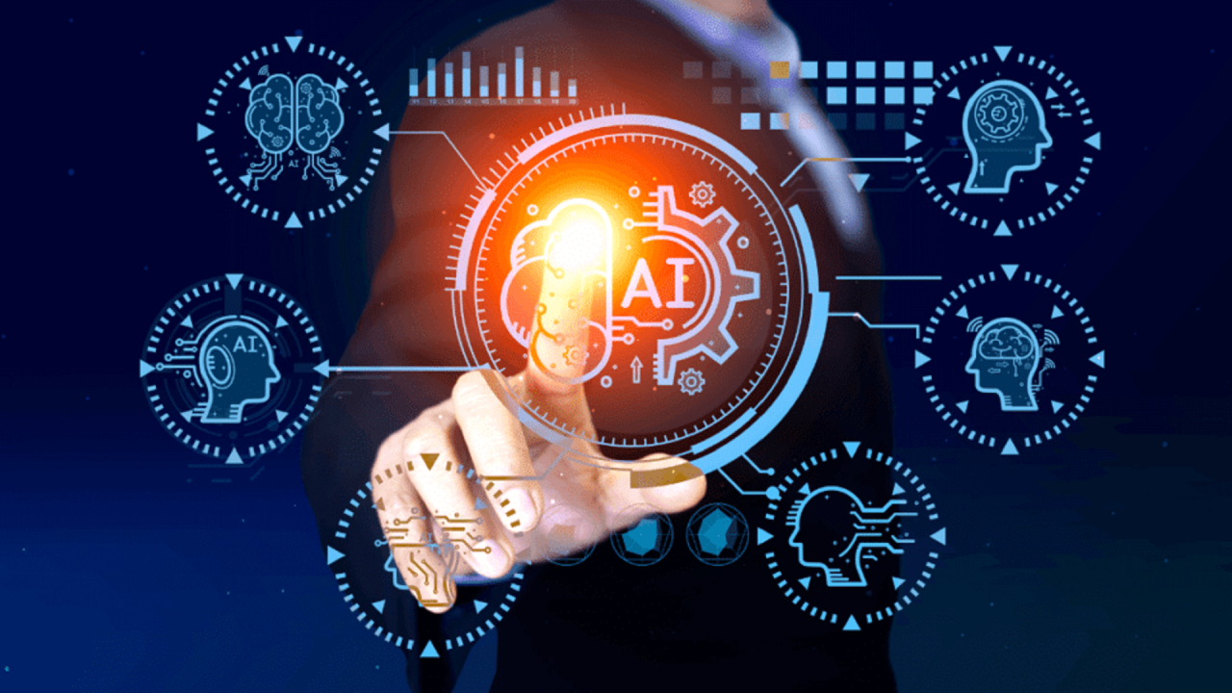
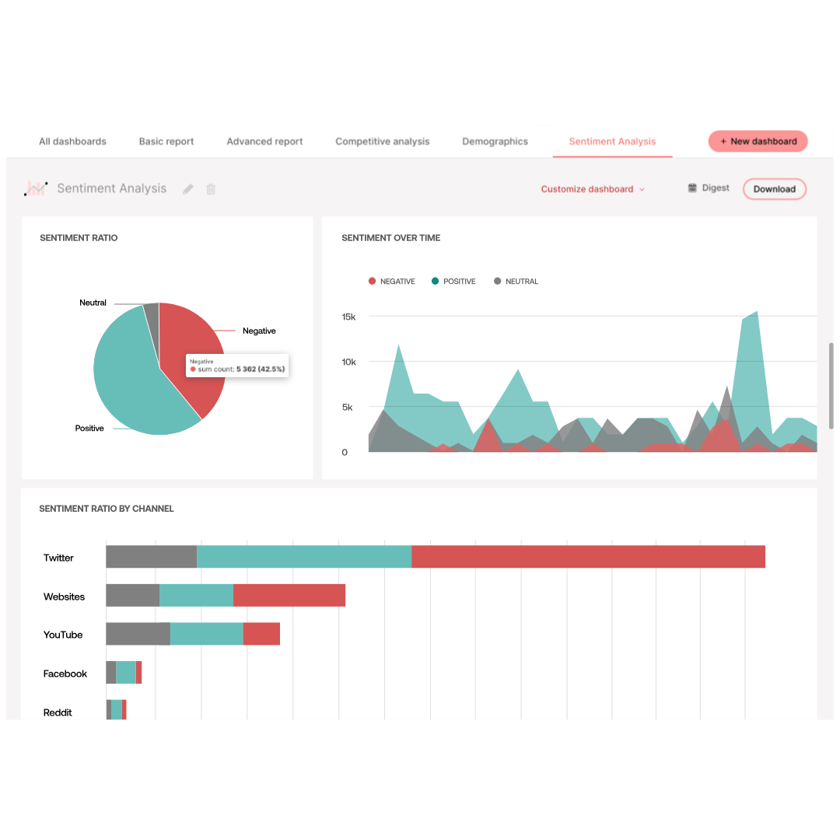
2. The Role of Artificial Intelligence in Digital Marketing:
a. Personalization through AI-Driven Analytics (Booking.com, IHG Hotels):
The executives of Booking.com and IHG Hotels have incorporated AI in making tailored suggestions to guests, special offers, and well-targeted emails to the right customers to enhance their interaction with them. According to the research, the use of artificial intelligence increases conversion and consumption rates as well as repeat bookings, which is a crucial factor in contemporary hotel marketing (Gunduzyeli, 2024).
b. The Feedback of the Customer through Sentiment Analysis Tools:
AI technology lets hospitality firms track customer feedback from different sources without delay through their analysis of online feedback and survey results. A study indicates that companies using AI technology in the evaluation of sentiments stand a higher chance of retaining their customers and therefore enjoying the loyalty that automates with that particular brand (Huang and Rust, 2021) .

Slide 6
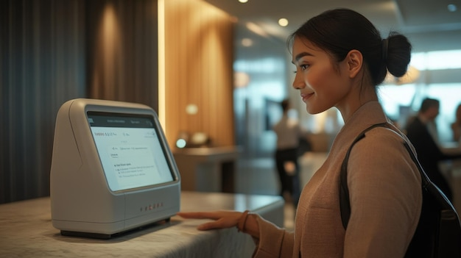
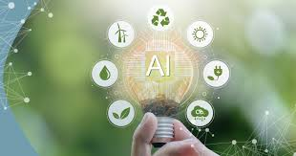
3. AI in Operations
a. Automation Driven by AI of Check-in/Check-out:
Self-service kiosks and mobile check-in help in entering the aircraft freely and comfortably; at the same time, facial recognition helps in safe entry. The survey shows that hotels should install AI check-in kiosks since they benefit the hotel through improved customer satisfaction and operational effectiveness (Ivanov and Webster, 2019).
b. AI for Sustainability
AI is therefore essential for sustainability, especially when lighting, heating and cooling are controlled in line with occupancy. Smart waste management programs ensure that efficient use of resources is established by studying the habits of consumption. According to literature, applying artificial intelligence sustains efforts for operations at a lower cost while striving to achieve environmental objectives (Vinod, 2020).

Slide 7
Theme Impact Analysis (PEST):
Political: To protect people’s rights and meet the demand for transparency, the government sets strict norms, for example GDPR and CCPA (Tavani, 2020).
Economic: AI decreases expenses, in particular, staffing costs while increasing income by offering automation of some services, analytics, and flexible pricing systems (Morosan, 2020).
Social: AI alters customers’ expectations by creating better and more relevant experiences for them at the same time as it reshapes roles and job descriptions for workers (Murphy et al, 2019).
Technological: AI and NLP are discovering the locus of its application in customer relations, better process, upgrade in automation and overall smoother functioning in the hospitality industry (Tavani, 2020).
The Industry Response and their Critical Reflection
Integration of the AI on the Large Chain of the Hotel:
Starwood, Marriot, Intercontinental and Hilton hotels use artificial intelligence to increase productivity to check-in advice guests and notice them regarding their experiences through wise room and side serving bots (IHG Hotels, 2022).

Slide 8
AI's Benefits for the Hospitality Sector
The Benefits of Artificial Intelligence in Hospitality Sector
a. Practicality: it eliminates repetitive work, boosts the number of bookings, and improves their quality.
b. Increased Revenues: AI-based revenue management helps in strategizing and customizing the prices to yield the highest possible returns.
c. Convenience: AI offers unique suggestions for the guest, which provides a better experience and intelligent control of the rooms.
Limitations and Challenges
Implementation concern: Expense songs of implementing and maintaining AI systems may affect only hotel chains.
Automation: With the help of advanced technology, employment becomes automated and eradicating certain traditional position needs to develop new talent.
Challenges of Implementing AI: Ethical issues such as the data privacy, and limitations caused by the categorization errors based on AI bias and regulatory issues.

Slide 9
Conclusion
AI is making a big impact in the hospitality industries by automating a number of services and making clients’ preferences as personal as possible. The study finds that it is very useful for the industry because of these aspects related to operation and the guests that help to maximize results for every business. However, there should always be a balance between the interaction with the AI solution and a guest to have an efficient hotel. Organizational integrity of the use of AI is thus vital, especially in the protection of data and how the staff embrace the changes being brought about by the shift to AI in hospitality.
Recommendation:
Human-AI Integration: Making sure that AI can support human services to provide a unique experience to the guest.
Data Privacy Compliance: Enhancing Security and Ensuring Full Compliance to Regulations like GDPR to Safeguard the Information of the Guests.
Employee Training: Improving the ability of the company’s workers in regards to utilizing the AI skills for integration.

Slide 10
References:
Berman, D. (2023). Revolutionizing the Hospitality Industry with Artificial Intelligence. Available at: https://www.forbes.com/councils/forbesbusinesscouncil/2023/09/11/revolutionizing-the-hospitality-industry-with-artificial-intelligence/. Accessed: (19 Feb 2025).
EHL, I. (2024). What is the hospitality industry? Available at: https://hospitalityinsights.ehl.edu/hospitality-industry. Accessed: (25 Jan 2025).
Ferhataj, A. (2024). Ai-Driven Personalization in Tourism: Analysing Sustainable Travel Preferences With Machine Learning. Available at: https://www.researchgate.net/publication/387348197_Ai-Driven_Personalization_In_Tourism_Analyzing_Sustainable_Travel_Preferences_With_Machine_Learning. Accessed: (19 Feb 2025).
Gunduzyeli, B. (2024). Artificial Intelligence in Digital Marketing within the Framework of Sustainable Management. MDPI, pp: 230-276.
Glion, (2023). What is tourism and hospitality? Available at: https://www.glion.edu/magazine/what-tourism-hospitality/. Accessed: (19 Feb 2025).
Huang, M.-H., Rust, R. T. (2021). A strategic framework for artificial intelligence in marketing. Journal of the Academy of Marketing Science. Pp: 30–50.
Ivanov, S. Webster, C. (2019). Robots, artificial intelligence, and service automation in travel, tourism, and hospitality. Emerald Publishing.
IHG Hotels (2022). AI-Driven Personalization in Hospitality. IHG Hotels & Resorts.
Morosan, C. (2020). "Artificial intelligence and hotel revenue management: How AI is reshaping the industry." Journal of Hospitality and Tourism Technology, 11(4), 389-403.
Murphy, J., Gretzel, U., Pesonen, J. (2019). "Marketing AI applications in hospitality and tourism." Journal of Information Technology & Tourism, 21(4), pp: 375-395.
Ndhlovu, E., Makuyana, T, Thwala, k. (2024). Tourism and Hospitality for Sustainable Development: Volume Three: Implications for Customers and Employees of Tourism Businesses. Springer nature.
Revfine, C. (2023). How can voice control benefit the hospitality industry? Available at: https://www.revfine.com/voice-control-hospitality-industry/. Accessed: (19 Feb 2025).
Schwarz, L. (2025). AI and hospitality: Advantages and & use cases. Available at: https://www.netsuite.com/portal/resource/articles/business-strategy/ai-hospitality.shtml. Accessed: (19 Feb 2025).
Stryker, C. (2023). What is AI? Available at: https://www.ibm.com/think/topics/artificial-intelligence. Accessed: (19 Feb 2025).
Tavani, H. (2020). Ethics and Technology: Controversies, Questions, and Strategies for Ethical Computing. Wiley.
Vinod, B. (2020). Artificial Intelligence and Emerging Technologies in Hospitality. Journal of Revenue and Pricing Management. pp: 279-313.

