Slide 1
Title: Working with children in social care
Name: Mariyum Munsha
Student Number: 2127038
Module: Psychology in Health and Social Care
Module Code: LCHS4006_BIRM
Lecturer Name: Joanne Davies

Slide 2

introduction
In this presentation I will be presenting two suggested creche activities for children up to the age group of 0-2 years, who live with their mothers in refuge centres. The activities will hopefully help the development of the children and keep them occupied while their mothers are in their 1 to 1 weekly support sessions.
I will be linking this to psychological theory of child development

Slide 3
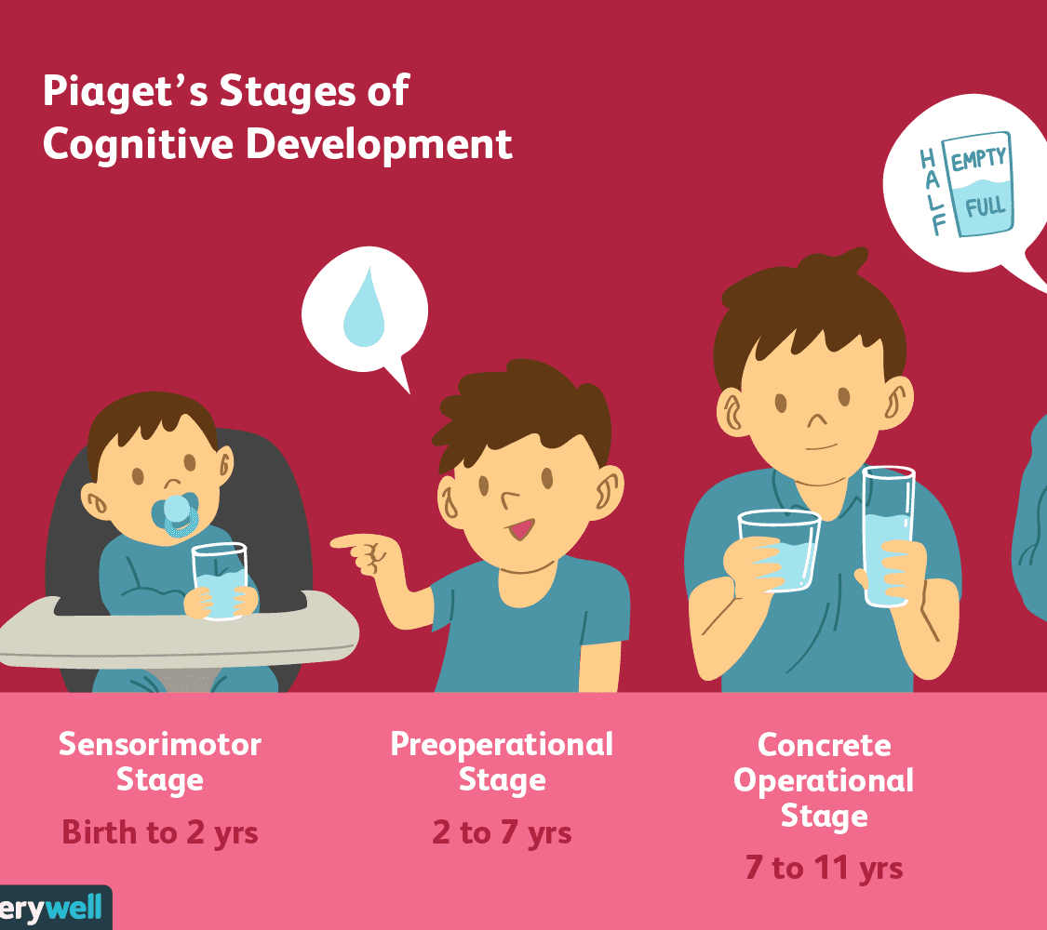
The theory I am going to explore in this presentation is Piaget's theory of development
Piaget's theory of cognitive development consists of four stages-
· Sensorimotor- 0-2 years
· Pre-operational- 2-7 years
(Preconceptual 2-4 and Intuitive Thinking 4-7)
· Concrete operational- 7-11 years
· Formal operational- 11 years onwards
(Mcleod, 2022)
Piaget believed that children build their own knowledge based on their experience, children's intelligence develops in stages that is linked to their age's. As children mature in age so does the cognitive structure in the brain and hence the intelligence.

Slide 4
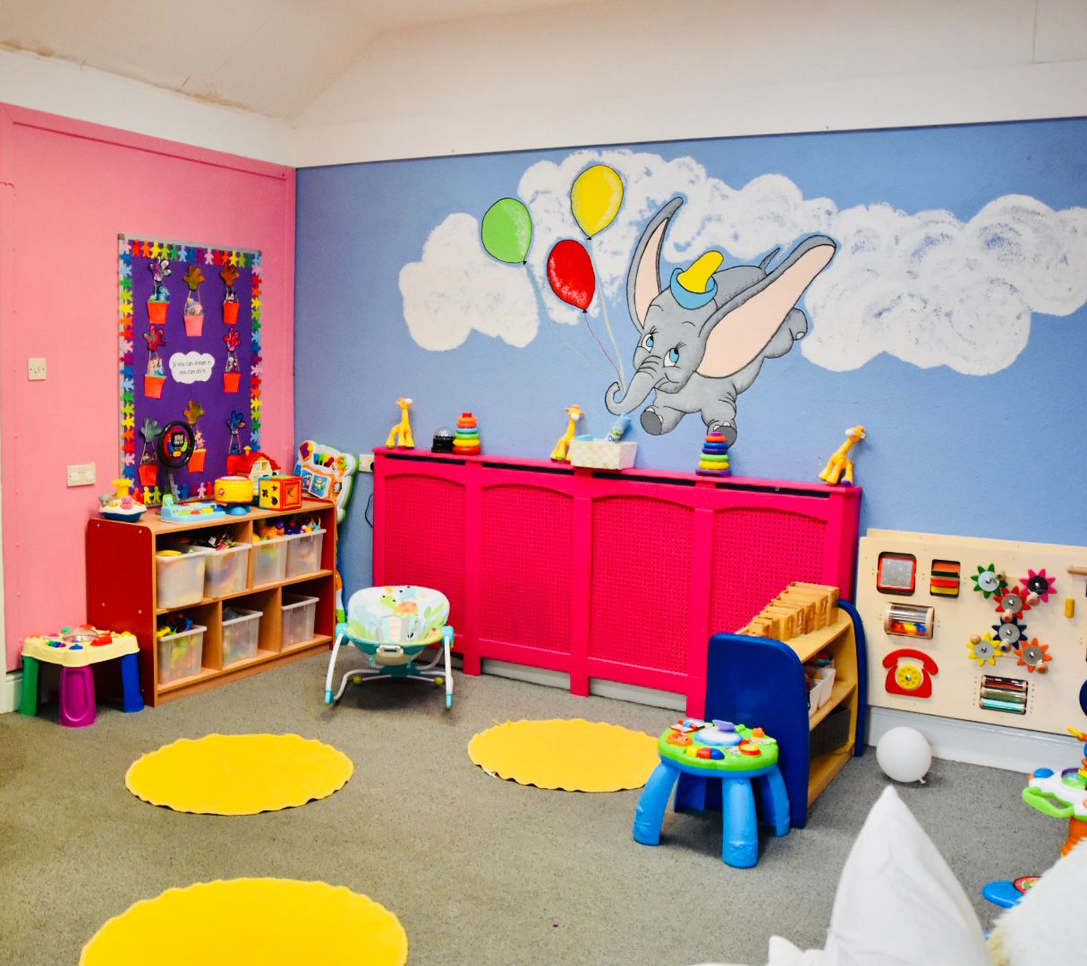
Development Activities in children 0-2
Piaget theory of cognitive development the sensorimotor stage is the first stage of a child's life, it begins at birth and last till 2years of age. Learning in this age happens through experience, and children learn about the world by using their senses to interact. They touch things, lick them, bang things and put them into their mouths. Learning at this stage in life happens through experience (Healthline, 2019)

Slide 5
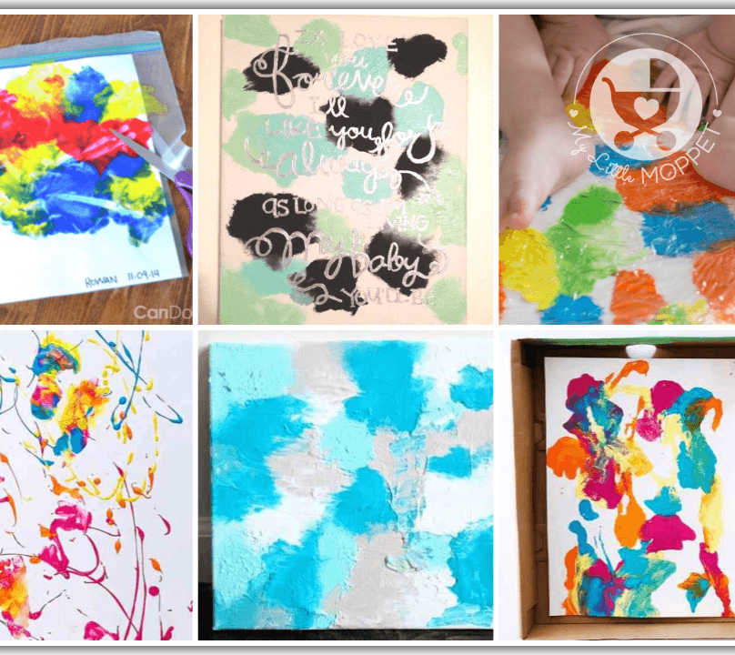
Activity 1
Sensorimotor activity 0-2 Piaget theory
Painting
Painting is a fun, messy and a colourful sensory activity which children enjoy very much. Very young children can create really effective art using simple techniques such as these:

Slide 6

Activity 2
Sensorimotor activity 0-2 Piaget theory
Stacking Blocks
As well as kids will love playing with their block's day after day from early childhood well into their toddler years
There are plenty of toddlers stacking block games that can make this activity interesting, fun, and fresh every time you and your child sit down to it.
When children Interacting with stacking building blocks or nesting cups is a sign that your child has developed good sensory development.

Slide 7
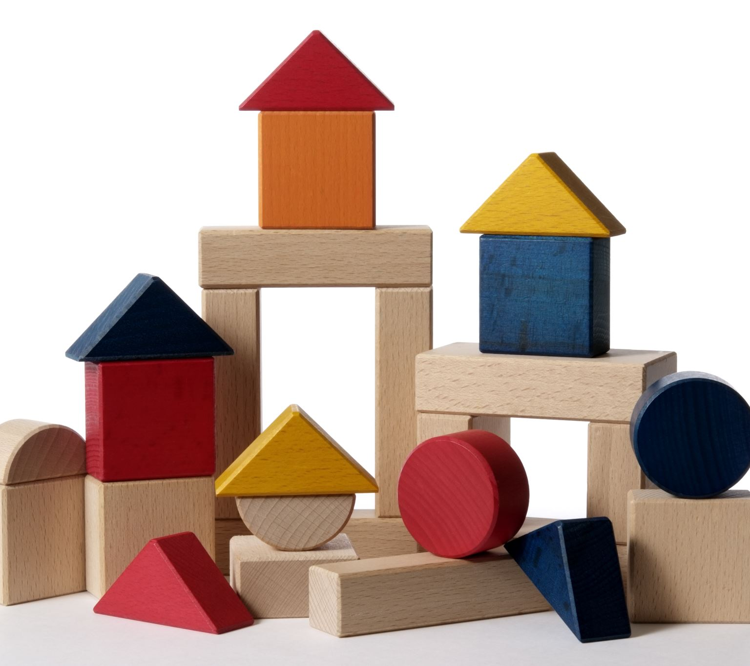
How does Piaget's theory relate to this.
Piaget's theory of cognitive development suggests that children move through four different stages of development.
Piaget considered the concrete stage a major turning point in the child's cognitive development, it marks the beginning of logical or operational thought.
This means the child can work things out internally in their head, rather than physically.
According to Piaget, children are born with a very basic mental structure on which all subsequent learning and knowledge are based.

Slide 8

Conclusion
In this presentation I have used Piaget's cognitive theory and looked at the sensorimotor stage to explain how children need to build or develop a mental model of their surroundings. And looked at how children are very creative and imaginative and that they like to play. Piaget also believed that children should be allowed to make mistakes and that they shouldn't be punished for making them and this was considered.

Slide 9
Reference List
Healthline (2019)What is the Sensorimotor Stage? Available at: https://www.healthline.com/health/baby/sensorimotor-stage#:~:text=The%20sensorimotor%20stage%20is%20the,to%20interact%20with%20their%20surroundings. (Accessed: 14 February 2023).
First Discoverers (2022)21 Early Years Painting Activities and Ideas Available at: https://www.firstdiscoverers.co.uk/early-years-painting-activities-ideas/ (Accessed: 14 February 2023)
Adam & Mila (2022) The Building Blocks of Stacking Skills Available at: https://www.adam-mila.com/milestones/fine-motor-skills/stacking/ (Accessed:14 February 2023)
Simple Psychology (2018) Piaget's Stages of Cognitive Development Available at: https://www.simplypsychology.org/piaget.html#:~:text=To%20Piaget%2C%20cognitive%20development%20was,they%20discover%20in%20their%20environment. (Accessed: 14 February 2023

