Slide 1

Recap – Last week
Public Order and Assaults

Slide 2
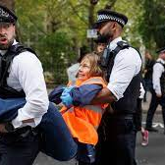
Learning Outcomes : Public Order Act 1986
S1 - Riot
S2 - Violent Disorder
S3 - Affray
S4 - Intentional fear of provocation of violence
S4a - Intentional Harassment, Alarm or Distress
S5 - Disorderly Conduct
Common Law Offence - Breach of the Peace

Slide 3

The Scale of Assaults
.
Homicide: Murder, Manslaughter.
.
G.B.H with intent - Section 18 OAP Act 1861.
.
G.B.H - Section 20 OAP Act 1861.
.
A.B.H - Section 47 OAP 1861.
.
Common Assault - Section 39 CJA 1988.

Slide 4
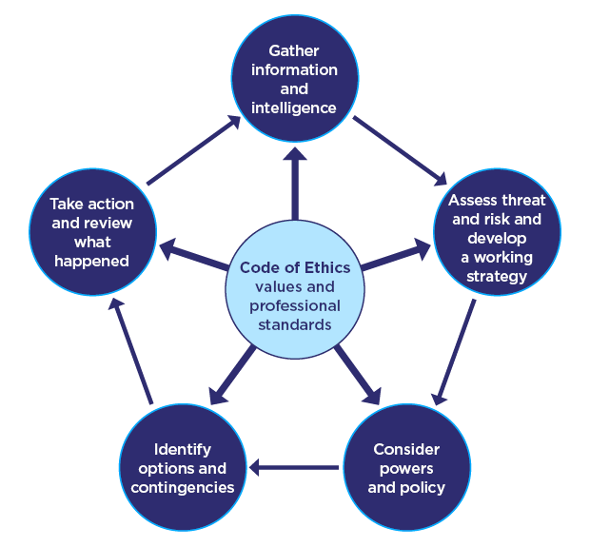
What else do you need to consider?

Slide 5


Domestic Abuse

Slide 6

Today’s objectives……
Define
Domestic Abuse
Explain
Police Officers’ first response actions in relation to Golden Hour enquiries
Summarise
The impact of Domestic Abuse on victims
State
The behaviours displayed by victims of domestic Abuse
Summarise
The measures used by police to safeguard victim of Domestic Abuse
Describe
Domestic Violence Protection Notices (DVPNs), Domestic Violence Protection Orders(DVPOs), Domestic Abuse Protection Notices (DAPNs) and Domestic Abuse Protection Orders (DAPOs)

Slide 7

Three key areas to look at…
Domestic Abuse
Controlling and Coercive
Stalking and Harassment

Slide 8
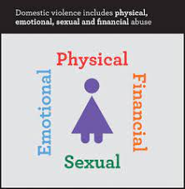

What is domestic abuse?

Slide 9
Overview of Domestic Abuse Act 2021
29th April 2021, Domestic Abuse Act 2021 became law
Aim is to ensure that DA is properly understood & that it is unacceptable & will be challenged
New legal definition of DA
Children as victims of DA
Extension of coercive control offence
Domestic Abuse Protection Orders (DAPOs)
Domestic Violence Disclosure Scheme (Clare’s Law) now on a statutory footing
Domestic Abuse Commissioner
Notes:
The new Act supports the view that DA can take many forms. The legal definition now incorporates a range of abuses beyond physical violence including emotional, coercive and controlling behaviour and economic abuse. The abuse can be behaviour consisting of a single incident or course of conduct.
Victim and perpetrator must be personally connected. The definition ensures that different types of relationships are captured including ex-partners and family members. The definition is gender neutral to ensure that all victims and all types of DA are sufficiently captured. The definition does not extend to paid and unpaid carers, unless they are personally connected.
It will also provide further protection to the millions of people who experience DA, as well as strengthen measures to tackle perpetrators
DA is for over 16years, if abusive behaviour were directed to under 16 years old, it would be dealt with as child abuse rather than DA. However, for the first time a child who sees or hears, or experiences the effects of DA and is related to the person being abused or the perp, is also to be regarded as a victim of DA in their own right. This will help ensure that services address the needs of children affected by DA. (this will be one of the functions of the DA Commissioner to encourage good practice and the provision of protection in relation to the ID of children affected by DA)

Slide 10
Definition of ‘Domestic Abuse’
Behaviour of person A towards another person B is domestic abuse if -
A & B are each aged 16 or over & are personally connected to each other, & the behavior is abusive
Behaviour is ‘abusive’ if it consists of any of the following – physical or sexual abuse, violent or threatening behavior; controlling or coercive behavior; economic abuse, psychological, emotional or other abuse;
And it does not matter whether the behavior consists of a single incident or a course of conduct
Notes:
Definition of “personally connected”
(1)For the purposes of this Act, two people are “personally connected” to each other if any of the following applies—
(a)they are, or have been, married to each other;
(b)they are, or have been, civil partners of each other;
(c)they have agreed to marry one another (whether or not the agreement has been terminated);
(d)they have entered into a civil partnership agreement (whether or not the agreement has been terminated);
(e)they are, or have been, in an intimate personal relationship with each other;
(f)they each have, or there has been a time when they each have had, a parental relationship in relation to the same child (see subsection (2));
(g)they are relatives.
(2)For the purposes of subsection (1)(f) a person has a parental relationship in relation to a child if—
(a)the person is a parent of the child, or
(b)the person has parental responsibility for the child.
(3)In this section—
“child” means a person under the age of 18 years;
“civil partnership agreement” has the meaning given by section 73 of the Civil Partnership Act 2004;
“parental responsibility” has the same meaning as in the Children Act 1989 (see section 3 of that Act);
“relative” has the meaning given by section 63(1) of the Family Law Act 1996. (4)Economic abuse” means any behaviour that has a substantial adverse effect on B’s ability to—
(a)acquire, use or maintain money or other property, or
(b)obtain goods or services.
(5)For the purposes of this Act A’s behaviour may be behaviour “towards” B despite the fact that it consists of conduct directed at another person (for example, B’s child).
3Children as victims of domestic abuse
(1)This section applies where behaviour of a person (“A”) towards another person (“B”) is domestic abuse.
(2)Any reference in this Act to a victim of domestic abuse includes a reference to a child who—
(a)sees or hears, or experiences the effects of, the abuse, and
(b)is related to A or B.
(3)A child is related to a person for the purposes of subsection (2) if—
(a)the person is a parent of, or has parental responsibility for, the child, or
(b)the child and the person are relatives.
(4)In this section—
“child” means a person under the age of 18 years;
“parental responsibility” has the same meaning as in the Children Act 1989 (see section 3 of that Act);
“relative” has the meaning given by section 63(1) of the Family Law Act 1996.
Controlling behaviour is: a range of acts designed to make a person subordinate and/or dependent by isolating them from sources of support, exploiting their resources and capacities for personal gain, depriving them of the means needed for independence, resistance and escape and regulating their everyday behaviour.
Coercive behaviour is: an act or pattern of acts of assault, threats, humiliation and intimidation or other abuse that is used to harm, punish, or frighten their victim

Slide 11
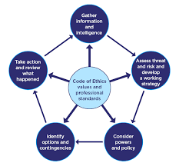
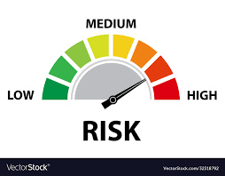

Slide 12

High Risk Victim
There are identifiable indicators of risk of serious harm.
The potential event could happen at any time and the impact would be serious.
Serious Risk of Harm
"A risk which is life threatening and or traumatic and from which recovery, whether physical or psychological can be expected to be difficult or impossible".

Slide 13

Medium Risk Victim
There are identifiable indicators of risk of serious harm.
The offender has the potential to cause serious harm but is unlikely to do so unless there is a change in circumstances, for example, failure to take medication, loss of accommodation, relationship breakdown, drugs or alcohol abuse.

Slide 14

Standard Risk Victim
Current evidence does not indicate likelihood of causing serious harm

Slide 15

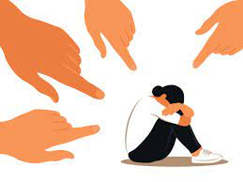
Repeat Victim
A repeat victim is someone who has reported two or more domestic abuse incidents to the police within a rolling 12-month period, accepting that this could an incident and/or a crime.

Slide 16
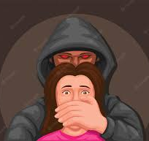
Repeat Perpetrator
A repeat perpetrator is someone who has been reported to the police as having committed or threatened domestic abuse against the same victim more than once in the last rolling 12- month period. This includes current or former intimate partners and family members.

Slide 17
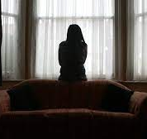
Serial Perpetrator
A serial perpetrator is someone who has been reported to the police as having committed or threatened domestic abuse against two or more victims. This includes current or former intimate partners and family members.

Slide 18

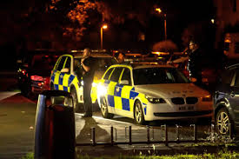
What do you need to know prior to attending an incident of Domestic Abuse as a PC?

Slide 19
Think!
Location of caller?
Location of incident?
Injuries?
Weapons?
Children?
Offender?
Previous incidents?
Warning signals?
……and??

Slide 20
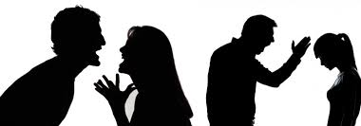
Preserve Life
Risk
Safeguarding
Officer Safety
Medical Assistance
Police Protection
Powers of entry
Decision Making

Slide 21
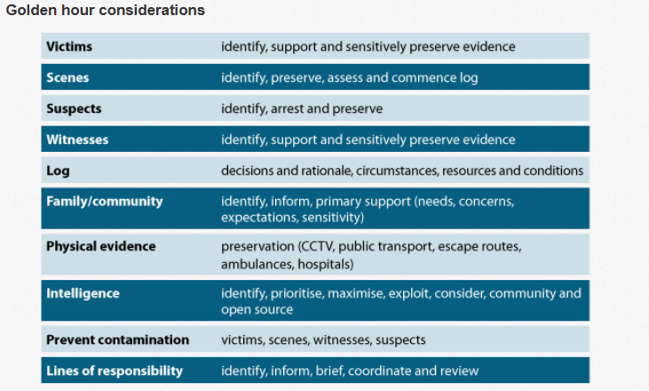
College of Policing (2022)
Notes:
GOLDEN HOUR:
Testimony of victims and witnesses can be obtained while the offence is still fresh in their mind.
Physical evidence secured and not disposed of or lost to the investigation.
Suspects located earlier, maximising opportunities to recover property and forensic evidence.
CCTV footage and other data can be collected before it is deleted.
Scenes are identified and secured before they become contaminated.
Interview of suspect, CPS advice and Charge/Remand completed sooner.
(Reducing time, money and safe guarding victim/witnesses)
Corroborative evidence obtained (Injuries, demeanour, first accounts etc.)
Improve levels of response & investigation to deliver an excellent service to the public (FORCE PRIORITY)
House to house.
Separate / Positive Action

Slide 22
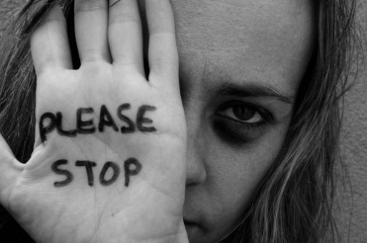
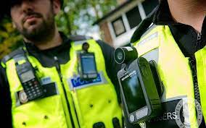
Victims
Medical Assistance
Risk Assessed/ Managed
Body Worn Video
Physical Evidence
First Account
Safeguarding
Type of Witness
Injuries
Risk

Slide 23
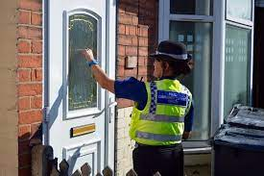
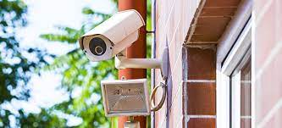
Witnesses
First Disclosure
Social Media
House to House
Witnesses
Types of Witness

Slide 24

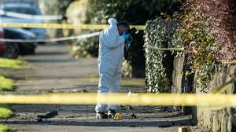

Crime Scene
Crime Scenes
Identification
Preservation
Common Approach Path
Log Books/ Cordons
Cross Contamination
Staff
Recording

Slide 25

Identifying Suspects
Are there any suspects identified at this early stage?
What do I need to do to preserve material relating to them?
(e.g medical exam)
Where are they now?
Searches
Intelligence checks – are there premises or vehicles I need to search?
Do I have enough grounds for arrest and is it necessary for me to do so now?

Slide 26

What do you consider to be the differences between ‘Domestic Abuse’ and ‘Stranger Violence?’
Notes:
GOLDEN HOUR:
Testimony of victims and witnesses can be obtained while the offence is still fresh in their mind.
Physical evidence secured and not disposed of or lost to the investigation.
Suspects located earlier, maximising opportunities to recover property and forensic evidence.
CCTV footage and other data can be collected before it is deleted.
Scenes are identified and secured before they become contaminated.
Interview of suspect, CPS advice and Charge/Remand completed sooner.
(Reducing time, money and safe guarding victim/witnesses)
Corroborative evidence obtained (Injuries, demeanour, first accounts etc.)
Improve levels of response & investigation to deliver an excellent service to the public (FORCE PRIORITY)
House to house.

Slide 27

Domestic Abuse vs Stranger Abuse
Victim and abuser known to each other
Domestic abuse behind closed doors
Lack of evidence
Domestic abuse gives the offender access to the victim
Might not report abuse
Blame themself
Children maybe abused
Breach of trust
Stranger violence treated more seriously
Stranger violence usually a one off
Stranger violence gives the victim a place of safety - home

Slide 28
Relationship Violence
Situational Couple Violence
Situation based
No underlying dynamic of control & domination
Perp by both men & women but men’s violence often more frequent & severe
Many see the violence they receive not requiring police involvement
Can be frequent or infrequent
Partners do not live in fear of each other
CBB/Intimate Terrorism
A pattern of coercive control
Induces fear
Continues after separation
Typically perpetrated by men
Linked to homicides
Escalates over time
Produces a negative impact on victims ability to act independently & in own interest
Violent Resistance
Victim might fight in self –defence (physically or verbally)
Might act in revenge/retaliation
Might fight in self preservation (i.e when victim kills their abuser)
Victim does not seek power & control
Typically perpetrated by women responding to CCB
How can you use this information when you are policing DA incidents?

Slide 29

Discuss: Barriers to reporting DA?

Slide 30

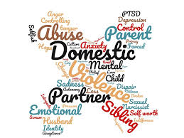
Barriers to Reporting
One off
Public humiliation
Not believed
Loss of children
Wrong outcome
What happens when the Police leave?
Can’t accept it’s Domestic Violence
The victim’s own fault
Not a police matter
Fear, criticism, ostracised, blamed by family
Notes:
Barriers present for all victims especially for the following:
Substance Misuse, disabled, male (1-4female)/1-6 Male), mental health, learning disability, young, old, professional, sex workers, Gay (LGBT), black and ethnic minorities.

Slide 31
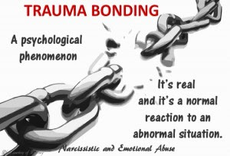
People like other animals are conditioned to form bonds as a survival mechanism
Repeat Victims – Trauma Bonds?
Notes:
That’s why the young of species are so cute –they need help to survive, they need to bond quickly to survive.
Survival overrides logical thought in the brain.
Could this be a reason that Domestic abuse victims do not report incidents and go back to the perpetrators of the abuse?
The next slide looks at Stockholm's syndrome as one possible explanation for this
(Zoe Lodrick ,Psychotherapist, taken from her website www.zoelodrick.co.uk )

Slide 32
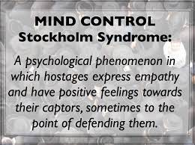
Stockholm Syndrome (Van der Kolk 1996)
.
Positive feelings towards the victimiser
.
Negative feelings towards potential rescuer
.
Develops after 4 days of captivity
Traumatised people lead traumatic and traumatising lives (Van der Kolk and McFarlane 1996)

Slide 33

DASH Model
Domestic Abuse, Stalking, Harassment
(including Honour-Based Abuse)
Risk identification, Assessment and Management

Slide 34
The DASH model seeks to……
Help front line practitioners & specialist staff identify high risk DA, stalking & harassment & HBV
Help staff to identify dangerous & serial perpetrators
Decide which cases should be referred to MARAC, & what other support might be required. A completed form becomes an active record
A common tool for agencies that are part of MARAC process & provides a shared understanding of risk in relation to DASH & HBA
Enable agencies to make defensible decisions based on the evidence from extensive research of cases, including domestic homicides & ‘near misses’ which underpins most models of RA

Slide 35

PPN: Public Protection Notification

Slide 36
Risk Levels of DA
STANDARD
Current evidence does not indicate likelihood of causing serious harm
MEDIUM
There are identifiable indicators of risk of serious harm. Offender has potential to cause serious harm but unlikely unless there is a change of circumstances
HIGH
There are identifiable indicators of risk of serious harm, which could happen at anytime.

Slide 37

A PPN form must be submitted in every Domestic Abuse and Stalking and Harassment incident
The PPN is used to update partner agencies and share information they may be aware of in order for them to provide further assistance to the victims and other vulnerable persons

Slide 38

PPN
The PPN lists 29 questions which are used to identify, assess & manage risk in relation to DA
All 29 questions must be asked for every DASH incident
All decisions & actions must be reviewed, recorded & updated
The risk identification process remains dynamic & must be kept under review

Slide 39
PPN Referral Pathway Example…
PPN completed by Officer
Officers tasks DAU box according to RA made on PPN
PPU Risk Assessor
Social Services
IDVA
Education
Health
3rd Sector Agencies

Slide 40

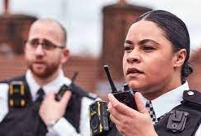
There are 18 Specific
HIGH RISK questions
However, there is the need to use professional judgement
- a person who engages in an activity with competence and skill and being able to make an informed decision based on a balanced viewpoint.
Notes:
Such situations may include:
• There are extreme levels of fear.
• Cultural barriers to disclosure such as in cases of ‘honour based violence’ and female genital mutilation.
• Extreme levels of control and/or isolation.
• Obsessive stalking behaviour.
• Where the perpetrator is abusing more than one partner.
• Fear of loss of financial support, or losing children, house etc.
• Remind the delegates that if they are not so experienced – and therefore not so confident with their professional judgement, they should speak to a supervisor or someone more experienced in this area - a specialist/domestic abuse officer, for example.
• Using the sum total of your knowledge, experience and skill, you have concerns about this person’s risks and the risk of serious harm is high. A question the delegates should ask themselves here would be “What do I feel that I cannot walk away from?”

Slide 41
There may be occasions where the victim may be at higher risk than the risk tool suggests…
Such situations may include:
• There are extreme levels of fear.
• Cultural barriers to disclosure such as in cases of ‘honour-based violence’ and female genital mutilation.
• Extreme levels of control and/or isolation.
• Obsessive stalking behaviour.
• Where the perpetrator is abusing more than one partner.
• Fear of loss of financial support, or losing children, house etc.
Notes:
• Remind the delegates that if they are not so experienced – and therefore not so confident with their professional judgement, they should speak to a supervisor or someone more experienced in this area - a specialist/domestic abuse officer, for example.
• Using the sum total of your knowledge, experience and skill, you have concerns about this person’s risks and the risk of serious harm is high. A question the delegates should ask themselves here would be “What do I feel that I cannot walk away from?”

Slide 42
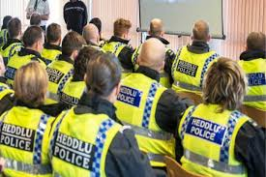
Important!
Using the sum total of knowledge, experience and skill, you have concerns about this person’s risks and the risk of serious harm is high.
A question the delegates should ask themselves here would be “What do I feel that I cannot walk away from?”

Slide 43


DASH Exercise

Slide 44
Domestic Incident Activity
You receive a call from the PSC to attend as a G1, an ongoing violent domestic. A next-door neighbour has rung in stating that they can hear shouting and screaming and sounds of a disturbance. On arrival, you gain entry to the address to find the victim in the living room with blood coming from their nose and mouth, with a black eye starting to form on their left eye. The living room is in disarray with furniture turned over and ornaments smashed. There is no-one else in the room but children can be heard crying upstairs.
In relation to the building blocks of investigation and golden hour principles, please discuss and note what actions you would take in relation to the following….

Slide 45

S75A Serious Crime Act 2015 – Strangulation or Suffocation
75A(1) A person (‘A’) commits an offence if-
(a) A intentionally strangles another person (‘B’), or
(b) A does any other act to B that –
(i) affects B’s ability to breath, &
(ii) constitutes battery of B
75A (2) It is a defence to an offence under this section for A to show that B consented to the strangulation or other act
75A(3) But subsection (2 ) does not apply if-
(a) B suffers serious harm as a result of the strangulation or other act, &
(b) A either –
(i) intended to cause B serios harm, or
(ii) was reckless as to whether B would suffer serious harm
Notes:
****A new piece of legislation has come into force concerning non-fatal strangulation, meaning abusers will now face up to five years behind bars.
The offence, created as part of landmark domestic abuse legislation, applies to perpetrators who strangle or intentionally affect their victim’s ability to breathe in an attempt to control or intimidate them. The Domestic Abuse Act 2021 amends the Serious Crime Act 2015, introducing 2 new sections — section 75A and 75B— which will create a new and specific criminal offence of non-fatal strangulation and suffocation.
It came into force on Tuesday (June 7) in England and Wales and will also apply to British nationals who are overseas.
The move follows concerns that abusers were avoiding punishment as non-fatal strangulation does not always leave visible signs of injury.
Signs to look out for include bloodshot eyes, or bleeding in the ear or jaw pain or a swollen tongue instead of marks around the neck.

Slide 46
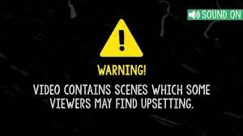

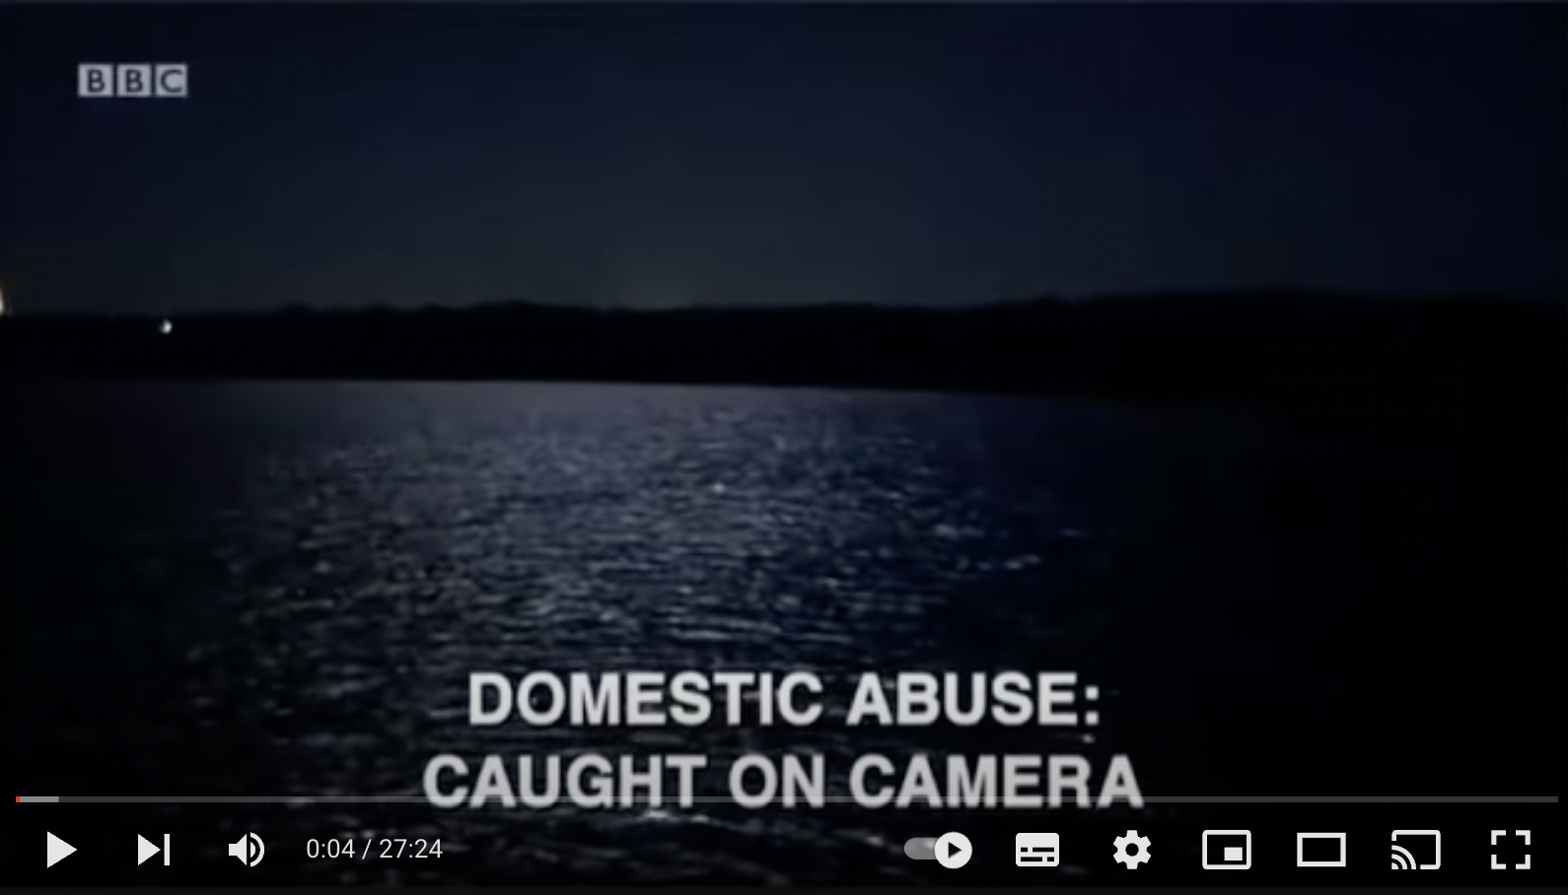
Panorama:
Domestic Abuse Caught on Camera
*** The perpetrator was released from prison in 2020 with a 5 year licence including conditions not to contact Dawn or enter the Isle of Wight***

Slide 47


Additional Safeguarding Measures
Police & Cocoon Watch
MARAC
TecSOS
Wisdom
Drive Project
Clare’s Law
Live Fear Free (SWP)
Assertive Outreach Crisis (GWP)
DVPN/DVPO - DAPN/DAPO

Slide 48

DOMESTIC VIOLENCE
DISCLOSURE SCHEME
Clare’s Law

Slide 49

Criteria:
The Person at Risk MUST reside in the Police area in which they are applying
The Person at risk MUST be in a current relationship with the subject (potential abuser) – states ‘Intimate Relationship’ – Relationship between two people which may be reasonably characterised as being physically and emotionally intimate.
Right to Ask:
Applications are made via a number of methods including ringing 101, attending at a police station, speaking to an officer/member of police staff in the street or via email asking about specific information on ‘their partner’s’ previous violent offending.
Applications can be made from a partner or by a third party i.e a neighbour/relative or friend

Slide 50

Multi Agency Risk Assessment Conference (MARAC)
MARAC is a gathering of agencies who aim to:
Safeguard adult victims
Link with other PP Agencies in relation to children, perpetrators & other VA’s
To safeguard agency staff
To address the behaviour of perpetrators

Slide 51

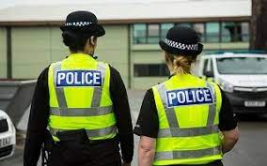





The statutory Agencies involved are:
Police
Probation
Social Services
Housing
Health
Education
IDVA
Voluntary Agencies include:
Women’s Services Kaleidoscope
Victim Support BAWSO
Llamau Services Social Landlords

Slide 52
Domestic Violence Protection Notices & Domestic Violence Protection Orders
DVPNs & DVPOs
Introduced by the Crime & Security Act 2010
Enable Police to put protection in place for the victim in the immediate aftermath of a DV incident
DVPOs can prevent the perpetrator from returning to the residence & from having contact with the victim for up to 28 days
This allows the victim a level of “breathing space” to consider options, with the help of support agencies

Slide 53
DVPNs & DVPOs
DVPN
Issued by the Police to provide emergency protection to the victim. Includes prohibitions & must be heard by a Magistrates Court within 48 hours
DVPO
Police then apply at the Court for a DVPO. Prohibitions are extended for a period between 14 – 28 days

Slide 54
Domestic Abuse Protection Notices & Orders
A senior police officer may give a DAPN to a person (‘P’) if conditions A and B are met
A DAPN is a notice prohibiting P from being abusive to a person aged 16 or over to whom P is personally connected
Condition A is that the senior police officer has RGTB that P has been abusive towards a person aged 16 or over to whom P is personally connected
Condition B is that the senior police officer has RGTB that it is necessary to give the notice to protect that person from DA, or the risk of DA, carried out by P

Slide 55
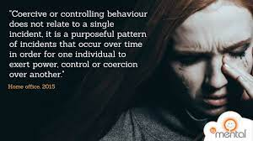
What do you think of when I say
‘coercive control?

Slide 56
Defining Coercive Control
Coercive control is a term developed by Evan STARK to help us understand domestic abuse as more than a “fight.” It is a pattern of behaviour which seeks to take away the victim’s liberty or freedom, to strip away their sense of self
“Not only is coercive control the most common context in which women are abused, it is also the most dangerous – Stark 20

Slide 57

Section 76 Serious Crime Act 2015
A range of acts designed to make a person subordinate &/or dependent by isolating them from sources of support, exploiting their resources & capacities for personal gain, depriving them of the means needed for independence, resistance & escape & regulating their everyday behaviour.

Slide 58
Coercive Control
A person (A) commits an offence if:
(A) repeatedly or continuously engages in behaviour towards another person (B) that is coercive or controlling and
At the time of the behaviour, (A) and (B) are personally connected,
The behaviour has a serious effect on (B), and
(A) knows or ought to know that the behaviour will have a serious effect on (B)
Notes:
.

Slide 59
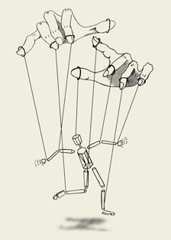
Coercive Control Behaviour
Behaviour of Offender to make the Victim:
Dependent/ Subordinate
Isolating
Fear of/ or actual violence
Fear consequences of Victim’s behaviour
Humiliate, harm, punish, frighten

Slide 60
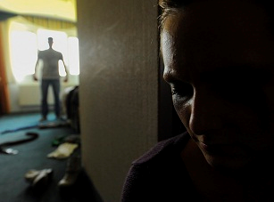
Coercive Control ‘Personally Connected’
They are, or have been married to or have been civil partners of each other
They have agreed to marry each other or enter into a civil partnership agreement
They are, or have been in an intimate personal relationship with each other
They have, or there has been a time when they each have had, a parental relationship in relation to the same child
They are relatives

Slide 61
Coercive Control ‘Serious Effect’
To prove ‘serious effect’
Causes the victim to fear on at least 2 occasions that violence will be used against them S76(4)(a)
Causes the victim serious alarm or distress which has a substantial adverse effect on their day to day activities S76(4)(b)

Slide 62
The Major Tactics of Coercive Control
Intimidation
Degradation & Humiliation
Surveillance
Control
Violence

Slide 63
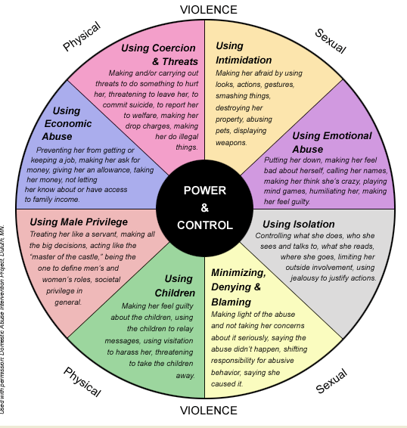
Duluth Power & Control Wheel

Slide 64
The Entrapment Process
Stage 1
Grooming/ Conditioning
Stage 2
Normalisation
Stage 3
Entrapment
Notes:
Please see entrapment process handouts

Slide 65
Safe Relationship Agreements & Unsafe Relationship Rules
Safe relationship agreements | Unsafe relationship rules
Agreed mutually & adhered to by both & provide a mutually agreed understanding | When they are demanded by one & adhered by the other
Constant & only change with mutual agreement | When they are never constant or consistent & only one person makes changes to them
When they are flexible & move with the relationship | When they are constantly changing & only one person has the remote control buttons for them
When there is no punishment attached | When punishment is attached for non-compliance
Notes:
.

Slide 66


Challenging the Stereotypes
“What is the point of screaming when you live in a beautiful detached house in the countryside? Nobody can hear you, there are no neighbours to come running or call the Police”

Slide 67
Institutional Power and Control
Framing the reactions/difficulties within the woman’s experience of coercive control
Manipulated by the perpetrator?
Affirm or validate the behavior of the perpetrator?

Slide 68
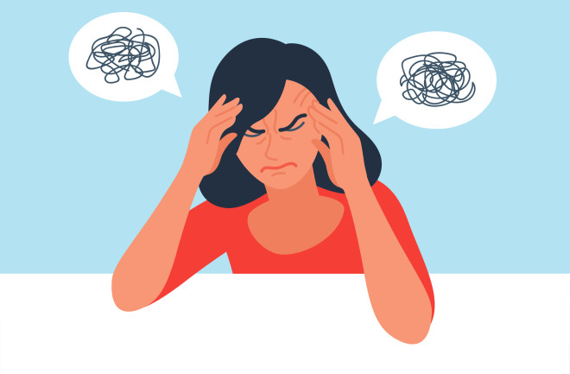
6 Stages of leaving – Liz Kelly
Ending the abuse
Ending the Relationship
Re-evaluating the Relationship
Defining the abuse
Distortion of Perspective/Reality
Managing the Situation

Slide 69
Incident Recording
The victim won’t leave
The victim feels it is not safe to leave
The victim refuses to make a statement
The victim is too frightened to make a statement in fear of repercussion
The victim answers the perpetrators calls and texts
The victim answers the perpetrator’s calls and texts because they fear the consequences of not responding
The victim let the perpetrator into her home
The victim allowed the perpetrator into her home because they were fearful not to. The perpetrator had threatened……

Slide 70
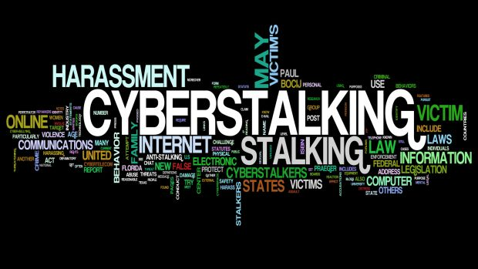
Harassment
&
Stalking
(Covered in full detail in level 5/6)
Subtitle
Speaker

Slide 71
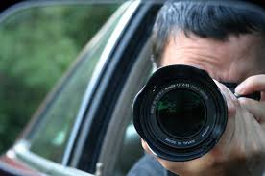

What is Stalking?
Following a person
Contacting or attempting to contact a person by any means
Monitoring the use by a person of the internet/ email/ any other electronic communication
Loitering in any place (public or private)
Interfering with any property in a person’s possession
Watching or spying on a person
Publishing any statement or material relating or purporting to relate to a person or purporting to originate from a person
Notes:
Not an exhaustive list

Slide 72
Stalking & Harassment
Section 1 & 2 Harassment
Section 2A Stalking
Section 4 & 4A Putting People in Fear of Violence
Crime & Disorder Act 1998
Section 32 Racially or Religiously Aggravated Harassment

