Slide 1


PSYCHOLOGY IN HEALTH AND SOCIAL CARE
(LCHS4006_LON)
ASSESSMENT 1
GROUP
MANPREET KAUR: 2130919
FATEMA BEGUM: 213010
SYEDA SHOHANA ISLAM BRISTY: 2132323
IVAN DIMITROV: 2132856

Slide 2
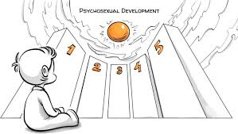
Table of content
Introduction of psychology.
Human lifespan development.
Selected life stage.
Lifespan psychology theory.
Relate lifespan theory to life stage and its importance.
Critically evaluate the identified lifespan psychology theory.
Reference

Slide 3
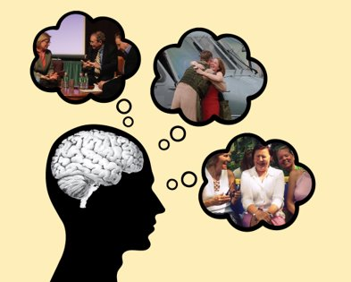
Definition of developmental psychology (syeda shohana islam bristy)
Developmental psychologists investigate newborns' perception and interaction with the environment, children's language and reasoning, teenagers' identity development and social connections, and adults' physical, cognitive, and social changes (Baltes, Staudinger and Lindenberger, 1999). ​
Developmental psychologists do observational, experimental, survey, and longitudinal research. Universities, research institutes, government organizations, and private corporations employ them (Hoffnung et al., 2015). ​
Notes:
Researchers in the field of developmental psychology study topics such as how newborns perceive their surroundings and how they interact with them, how children think and communicate, how teenagers form their identities and how they form social connections, and how adults change physically, cognitively, and socially. Observational, experimental, survey, and longitudinal research are the four types of studies that developmental psychologists do. They find employment in universities, research institutes, government agencies, and commercial enterprises. Research in developmental psychology provides a foundation for educational, social, and therapeutic interventions that aim to foster healthy development and overall well-being at all stages of life.​

Slide 4
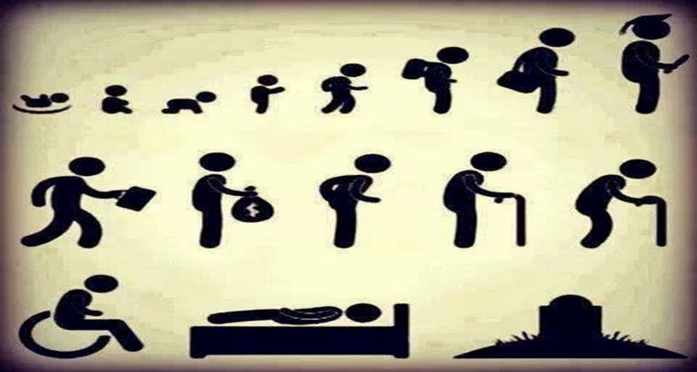
Human lifespan development stages (syeda shohana islam bristy)
Psychologists in the subject of lifespan psychology examine people from the time of their conception until the time of their death, focusing on how they evolve physically, mentally, and emotionally throughout the years (Hoffnung et al, 2015). The study of human development is crucial because it sheds light on the difficulties and possibilities that individuals face at different ages. Having a firm grasp of the transformations that people go through over the course of their lives allows us to make better choices and have a deeper appreciation for the lives of those around us.​
Notes:
One area where lifespan psychology may have a practical impact is in teaching. Teachers and educators may better accommodate the requirements of their students by keeping in mind the various phases of child development (Baltes et al, 1999). For instance, studies in lifespan psychology have demonstrated that young children learn most effectively via play and discovery, and that they also need nurturing relationships with both adults and peers to develop healthily. Hence, play-based learning and the cultivation of social skills may be emphasized in preschools and primary schools to foster healthy growth. Implications for medical and psychological treatment are also substantial in lifespan psychology. Healthcare providers will be better able to address their patients' individual requirements if they have a firm grasp of the alterations that occur throughout the many phases of human development. Lifespan psychological studies have revealed, for instance, that the elderly may benefit from cognitive training and memory methods due to the possibility of memory and cognitive decline with age. Similarly, mental health practitioners can better treat problems like depression, anxiety, and drug addiction if they have a better grasp of the unique developmental obstacles teenagers confront. Lifespan psychology has wider applications than only the professional realm. We can better sympathize with others and provide them assistance while they're going through tough times if we have a firm grasp of the range of developmental obstacles people confront. According to studies in lifespan psychology, for instance, midlife adults may undergo identity and role shifts when they become parents' primary caregivers or when they no longer have children at home (Baltes et al, 1999). The more we learn about these difficulties, the more we can aid people around us who may be experiencing them. ​
In conclusion, lifespan psychology contributes much to our day-to-day lives by illuminating the complexities of human growth and the possibilities and threats that exist at various points in time. We may promote lifelong health and happiness by using this information to improve educational practices, medical treatment, mental health, and interpersonal connections.​
​

Slide 5
Pre-school stage (3-5 years) (fatema begum)
Early childhood is a time of fast physical growth. During this time, a child's height and weight grow, and their muscles become much more versatile and flexible.
In addition to developing both their fine and gross motor abilities, children of pre-school stage learn to run, leap, toss, catch, and draw (Gartstein & Marmion, 2018).
Notes:
Kids prefer playing with active toys like balloons, tubes, and bicycles. Appropriate nutrition and frequent exercise are vital for promoting healthy physical development of pre-school stage children. Even during preschool years, children experience rapid increases in height and weight. Pre-schoolers develop approximately 1-2 inches and 4-5 pounds every year on averages (Berk, 2013). During this time, boys and girls have similar growth tendencies, although boys may be marginally taller and heavier than girls.​

Slide 6
INTELLECTUAL GROWTH (fatema begum)
Pre-schoolers are inquisitive and eager to learn. They have an intrinsic urge to investigate their surroundings and inquire about the outside world.
They acquire fundamental cognitive abilities including as memory, focus, and problem-solving.
During this time, pre-schoolers enjoy tremendous linguistic growth.
Notes:
It is crucial to provide a fascinating setting that supports their curiosity and play-based learning. During this time, pre-schoolers enjoy tremendous linguistic growth. Kids begin to utilise more sophisticated sentences, comprehend more vocabulary, and participate in conversations (Sigelman & Rider, 2018). Kids may also acquire an understanding of the initial sounds of words and to recognise the symbols and their sounds. Parents may assist children's language development by routinely reading to them, participating in discussion with them, and providing them with experiences to use language (Thompson, 2014).​

Slide 7
SOCIAL GROWTH (fatema begum)
Social abilities are developed by pre-schoolers via engagement with one another, particularly parents, guardians, and companions (Thompson, 2014).
They learn to collaborate with others, share, and take turns.
Moreover, pre-schoolers may encounter and learn to handle conflicts with their companions.
Notes:
Pre-schoolers acquire a feeling of belonging and self-worth within their families and neighbourhood. Pre-schoolers may have difficulties comprehending and adhering to social norms; therefore, it is essential to establish clear behavioural expectations and appropriate responsibilities (Sigelman & Rider, 2018).​

Slide 8
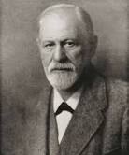
FREUD’S PSYCHOSEXUAL THEORY (MANPREET KAUR)
Sigmund Freud is known as father of psychoanalysis. Freud is created with popularising the discipline. Psychoanalysis is a branch of psychology that focuses on treating mental illness by analysing various stages of development and pattern of human behaviour. In essence, the psychoanalytic hypothesis holds that everyone possesses unconscious wants, emotions, and memories.
Freuds used the following three phrases to describe the theory.
Libido: the various way that sexual energy can appear in behaviour.
Fixation: the hypothesis that overindulged or disturbance has caused some of a person’s libido to become stuck at certain stage of development.
Erogenous zone: bodily portion that responds to stimulus .
( Carnevale and Villard, 2021)
Notes:
NOTES: Freud believed that childhood trauma and experiences lead to unwanted behaviours and repressed feelings, which lead to person’s development as they enter adulthood. This belief was based on years of research and study into human development. Later Freud’s used his research to create the psychosexual theory of development, which has five stages Of development. Freud’s believed that a person libido would develop over time and seek satisfaction through various behaviours using these zones, such as thumb sucking. His theory is based on the idea that a person’s body has multiple erogenous zones. A person may pass from one stop to the next swiftly or the may become fixated on overindulgence depending on what occurs at each stage. He also describes about conscious ans unconscious desires through the ID, EGO AND SUPERGO ( Carnevale, Villard, 2021) .

Slide 9
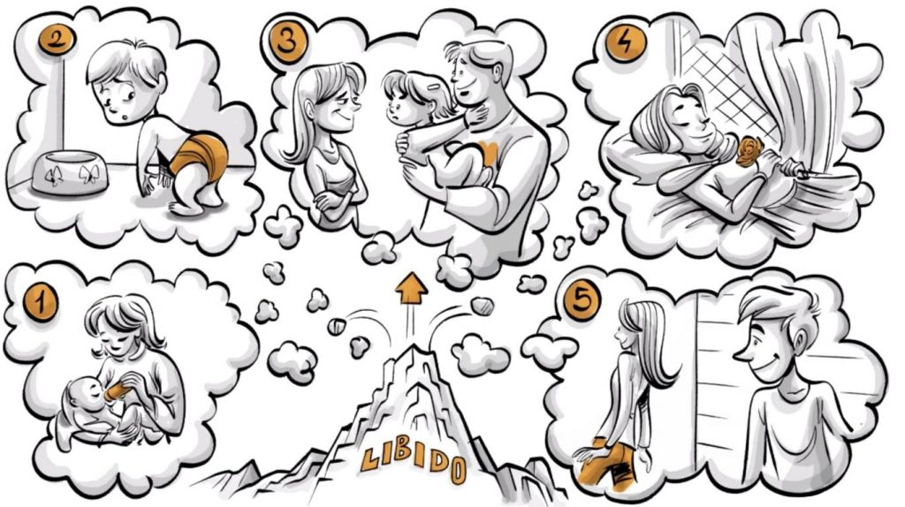
PSYCHOSEXUAL STAGES OF DEVELOPMENT (MANPREET KAUR)
ORAL STAGE (birth to 1 year) (Mcleod, 2023).
ANAL STAGE (1 TO 3 YEAR (Mcleod, 2023).
Phallic stage (3 to 6 year): (Mcleod, 2023).
Latency stage ( 6 to puberty): (Mcleod, 2023).
GENITAL STAGE (PUBERTY TO ADULT): (Mcleod, 2023).
Notes:
ORAL STAGE (birth to 1 year): In first stage the libido of Newborn is focused in its mouth throughout the initial stage of psychosexual development. In order to sate its libido and, by extension, its id demands, the baby enjoys putting all manner of objects in its mouth during the oral stage. Which at this time of life are mouth- focused or oral behaviour, such as breastfeeding and sucking. According to Freud, oral stimulation might cause an oral fixation later in life. People with oral personalities like thumb suckers, nail biters, smokers and these oral habits are especially does under stress (Mcleod, 2023).
ANAL STAGE (1 TO 3 YEAR): The libido turns its attention to the anus during the anal stage of psychosexual development, and the infant finds considerable pleasure in defecating. The youngster is now fully cognizant of fact that they are individuals in their own right and that they are individuals in their own right that they are desires may conflict with those of the outside world (i.e., ego has developed). Freud thoughout that when children are learning to use the potty, adult constraints on when and where they can urinate tend to escalate this kind of conflict. The child’s future interactions with all types of authority may be influenced by the character of this child’s first confrontation with them (Mcleod, 2023).
Phallic stage (3 to 6 year): The third stage of psychosexual development, know as phallic stage, lasts from three to six year and is characterised by the infant’s libido being focused on their genitalia as erogenous zone. The child learns there are anatomical disparities between the sexes, which causes the Oedipus complex (in males) and the Electra complex ( in girls) a battle between competition, jealousy, and fear to come in play ( in girls). The process of identification, in which the child takes on the trait of the same sex parent, helps to settle this (Mcleod, 2023).
Latency stage :( 6 to puberty): the fourth stage of psychosexual development known as latency stage, last for six years until puberty. The libido is latent at this point, and no more psychosexual growth occurs. According to Freud, the majority of sexual urges are supressed during the latent period and can be transformed into energy for friendships, hobbies, ans academic achievement. The focus of the child’s energy is mostly directed towards learning new thing and honing existing skills, which limits play to kids of the same gender (Mcleod, 2023).
Genital stage: Puberty marks the beginning of the genital stage, the last step in Freud's psychosexual theory of personality development. Throughout this period, adolescent sexual experimentation is common, and finding true love and committing to just one partner in our 20s is the only way to effectively end it. Sexual instinct is now driven by the pleasure of heterosexual relations, as opposed to self-pleasure, as it was during the phallic era. (Mcleod, 2023).

Slide 10
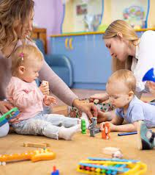
(MANPREET KAUR)
phallic stage
The phallic stage of development, according to Sigmund Freud’s psychosexual phases of development, happens in children between the ages of three and six. A child’s attention is on the genitalia or penis during the phallic stage, according to Freud’s stages, which were based on levels of erogenous zones or pleasure seeking impulses. Children also understand the distinction between males and girls at this stage. According to Freud’s views, if the problem will have an impact on how men and women will behave as adults. The subsequent genital stage is influenced by the phallic stage (Mccaw and stephanie, 2021).
Notes:
According to Freud’s views, during puberty, the phallic stage changes into the genital stage during which the individual’s attention turns from personal pleasure to encompass compassion and appeasing the heterosexual partner. By Freud’s theory, fixation in the form of hypersexual or antagonistic conduct would disturb an individual’s genital stage if the phallic stage was not fully completed (Mccaw, stephanie, 2021).

Slide 11

(MANPRRET KAUR)
PHALLIC STAGE EXAMPLE: Children focus on the genitalia as the erogenous zones when they are in the phallic stage of development. The Oedipus complex and the Electra complex are two prominent examples of behaviour during this period that Freud discussed. Together with these actions. Freud assigned the phallic stage two different types of defensive mechanism and the oedipal complex a fear of the father that he named castration anxiety (Mccaw and Stephanie, 2021)
FATHER CONTRIBUTION IN PHALLIC stage (Mccaw and Stephanie, 2021).
MOTHER CONTRIBUTION IN PHALLIC STAGE (Mccaw and Stephanie, 2021).
Notes:
FATHER CONTRIBUTION IN PHALLIC stage, the third most significant developmental stage, out of a total of five, is the phallic stage. The young infant develops a sense of masculinity in relation to his genitalia. His father serves a role model for him when it comes to masculinity and gender. Dad essentially teaches his son how to be a man and what the entails In the household and in society (Mccaw, Stephanie, 2021).
MOTHER CONTRIBUTION IN PHALLIC STAGE: the boy has a strong incestuous love from birth for his mother. After all, she the one who breastfed him when he was a baby, satisfying his oral hunger. The youngster is prepared to battle for his mother to have her all to himself because he loves her so fervently. Note that this child is between the age of three and six as such, he may be quite possessive of his mother and lack the maturity to see that his affection may not be acceptable in addition, Freud believed that everything was unconscious, therefore the infant was not aware of it (Mccaw, Stephanie, 2021).

Slide 12
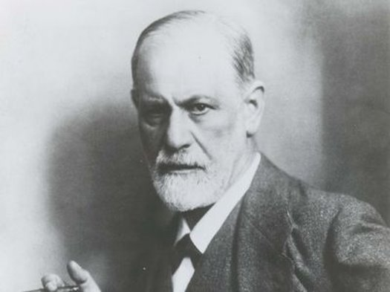
Critically evaluate the lifespan psychological theory (Ivan Dimitrov)
Strenghts​ | Weaknesses​
Opportunities​ | Threats​

Slide 13
Ivan Dimitrov
’’the theory posists that the way in which an individual experiences and resolves conflicts during childhood has significant impact on their adult personality’’ (Mcleod, 2018)
Notes:
’’the theory posists that the way in which an individual experiences and resolves conflicts during childhood has significant impact on their adult personality’’ (Mcleod, 2018)

Slide 14
REFRENCE
Baltes, P.B., Staudinger, U.M. and Lindenberger, U., 1999. Lifespan psychology: Theory and application to intellectual functioning. Annual review of psychology, 50(1), pp.471-507.​
Baltes, P.B., Lindenberger, U. and Staudinger, U.M., 1998. Life-span theory in developmental psychology. John Wiley & Sons Inc.​
Ollendick, T.H. and Vasey, M.W., 1999. Developmental theory and the practice of clinical child psychology. Journal of Clinical Child Psychology, 28(4), pp.457-466.​
Hoffnung, M., Hoffnung, R., Seifert, K.L., Hine, A., Ward, L., Pausé, C., Swabey, K., Yates, K. and Burton Smith, R., 2015. Lifespan Development: a chronological approach [3rd Australasian edition]. Wiley.​
Stever, G.S., 2011. Fan behavior and lifespan development theory: Explaining para-social and social attachment to celebrities. Journal of Adult Development, 18, pp.1-7.. BERK, L. E. (2013). CHILD DEVELOPMENT (9TH ED.). PEARSON EDUCATION.​
GARTSTEIN, M. A., & MARMION, J. (2018). EARLY CHILDHOOD EMOTIONAL DEVELOPMENT: EMERGING PERSPECTIVES ON CULTURALLY SENSITIVE RESEARCH AND PRACTICE. SPRINGER.​
NATIONAL ASSOCIATION FOR THE EDUCATION OF YOUNG CHILDREN. (2009). DEVELOPMENTALLY APPROPRIATE PRACTICES IN EARLY CHILDHOOD PROGRAMS SERVING CHILDREN FROM BIRTH THROUGH AGE 8. RETRIEVED FROM HTTPS://WWW.NAEYC.ORG/SITES/DEFAULT/FILES/GLOBALLY-SHARED/DOWNLOADS/PDFS/RESOURCES/POSITION-STATEMENTS/PSDAP.PDF​
SIGELMAN, C. K., & RIDER, E. A. (2018). LIFE-SPAN HUMAN DEVELOPMENT (9TH ED.). CENGAGE LEARNING.​
THOMPSON, R. A. (2014). SOCIOEMOTIONAL DEVELOPMENT. HANDBOOK OF CHILD PSYCHOLOGY AND DEVELOPMENTAL SCIENCE, 3, 60-100.​
Mcleod, S.(2023) Freud psycosexual theory and 5 stages of human development, Simply psychology. Available at: https://simplypsychology.org/psychosexual.html (Accessed: March 26,2023).
Mccaw, P. and Foley, S. (2021) Take online courses. earn college credit. Research Schools, Degree & Careers, Study.com. Available at: https://study.com/learn/lesson/phallic-genital-stage-development.html (Accessed: March 26, 2023).
Carnevale, J. and Villard, R. (2021) Take online courses. earn college credit. Research Schools, Degree& Career, Study.com. Available at: https://study.com/learn/lesson/freud-psychosexual-stages-development.html (Accessed: March 26, 2023)

Slide 15
McLeod, S. A. (2018). Freud's psychosexual stages. Simply Psychology. https://www.simplypsychology.org/psychosexual.html This article provides a comprehensive overview of Freud's theory of psychosexual development, including its key concepts and criticisms. It also discusses how the theory has influenced later research and theorizing in the field of psychology.
2. Westen, D. (1998). The scientific legacy of Sigmund Freud: Toward a psychodynamically informed psychological science. Psychological Bulletin, 124(3), 333-371. https://doi.org/10.1037/0033-2909.124.3.333 This article provides a detailed examination of Freud's theoretical contributions to psychology, including his lifespan theory. It discusses the strengths and limitations of his approach and argues that a psychodynamically infor

