Slide 1
BMTP6018
Global Sports & Tourism
Event Management
Wrexham Fan Engagement &
Sports Tourism Case Study

Slide 2
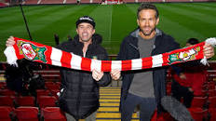
Introduction to the Session!
Fan Engagement & Spectator Experience Case Study
Topical, Welsh but with Global Influence
Assignment Focus
Disneyfication
Sporting Success
Sports Tourism
One of Hollywood????

Slide 3

Wrexham
Historic Club
2011 Winding Up Order
2 Years Administration
Previously Fan Owned
Loyal Fanbase
Predicament – Grassroots Club Survival in Modern Game

Slide 4
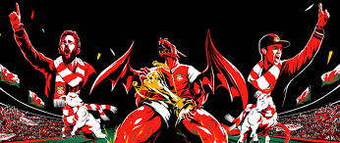
Disneyfication of Sport
Widdop and Chadwick MMU (May 2023) state
“Wrexham’s football fairy tale is fueled by Disney and Hollywood glamour”
3-stage strategy
“Disneyfication”, which they view as the creation of sentimentally compelling entertainment for mass audiences, synonymous with globalization, commercialization, and commodification.
“Theming” which involves an institution being placed into a narrative that is mostly unrelated to its original purpose.
“Hybrid consumption” attracting fans and potential consumers through various commercial means.

Slide 5
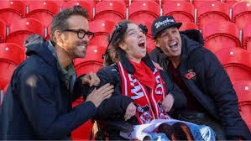
Opportunity for Change - Guardian 20th September 2023
Global Commodification of Football
Circus of Money – Hollywood Cash
Commercialisation
Marketable Product
Authenticity of Football Culture – Red Carpet Glamour Meets Terrace Cultute
Hype – Synthesis of Bingeable Content
Global Impact – Global Commodification of Football
Celebrity Fronted Commercial Documentary
Royal Visits & Celeb Filling – Community Care
Highly Competitive Streaming Market

Slide 6

Welcome to Wrexham
Focus not just on Football
Bromance
1st Visits to Wales
Corporate Style Video
Fly on the Wall
Commercial

Slide 7
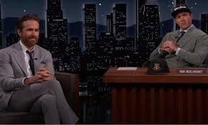
Solutions
Sports Clubs Struggle to Survive
Issues of Competition within the Sport & across Sport
Sports Washing
Petro Dictatorships – Saudi, Russia …..
Clubs fighting for Survival
Stripped of Assetts
Rely on Success
Cost of Relegation – Television Rights – Balloon Payments

Slide 8
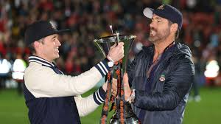
PLAYER POWER V MONEY
Palmer 2021-2 brought from Wimbledon
Pivotal
Deprived Cash Strapped Wimbledon of Striker
Result Relegation

Slide 9
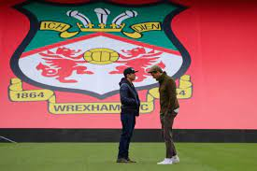
ROB & RYAN STRATEGY
2021 Bought Club for £2m
Take Wrexham to the World Stage
Community Engagement
Wrexham FC Won National League
Promoted to League 2 (4th Tier)
Goal Premier League
Womens, Disabled & Youth Impacts

Slide 10

Strategic Approach
Business World
Marketing Strategies
Media Partnerships
Sponsorship Deals
Sports Franchise Opportunities
Merchandising
Commercial Opportunities

Slide 11

Disney – Story of Cars – Fell in Love with the Town
Impassive Observers (Investors) to Love of the Game & Changed the Community

Slide 12
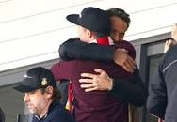
Commercial Impact
Welcome to Wrexham
Disney Partnership
Each Episode generated £430K locally
Impacts for Club & Owners
Tourism Impacts

Slide 13
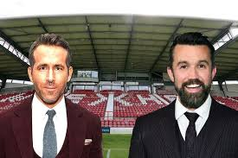
Disneyfication
Paul Widdop (MMU) & Simon Chadwick (SKEMA Business School)
2023 Academic Research
Creates Sentimentality
Compelling Entertainment
Mass Audiences
Synonymous with Globalisation, Commercialisation & Commodification

Slide 14
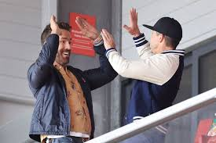
DISNEYFICATION
Theming
Narrative relating to original purpose
Digital Content for US Market
Hybrid Consumption
Attracts Fans & Consumers by Commercial Means
10K Stadium, 319K Watch each Episode, 1M TikTok Followers
Sales & Marketing
Branding (TikTok on Shirts), Merchandising
Visit Wrexham Online Store, Aviation Gin, United Sponsorship

Slide 15
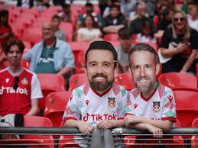
Theme Park
Racecourse Ground - Bought back from Wrexham Glyndwr University
Public Ownership – New 5,500 Stand (£18m LA Funding)
Change Destination
Soaring Visitor Numbers
Local Economic Impacts
Tangible – Hotels, Bars & Facilities
Financial Returns
Fantasty – American Dream
Fan Base

Slide 16
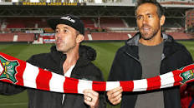
FAN BASE
Marketing Case Study
Integrating into Fan Experience
Leverage
Diverse Story Telling
Touchpoints
Branding
Community Engagement
Success – Sponsorship = Risk if Team Loosses

Slide 17
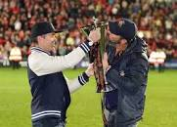
Keys to Success
Scorecard to Select Club to Invest In
Cost
Fan Numbers
Latent Fan Potential
Catchment Area
Club History
Opportunity

Slide 18
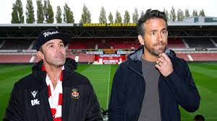
Strategic Response
Prioritise Storytelling
Develop Engagement
Fan Experience
Diverse Storytelling – Influencers, Player Tie Ins
Social Media
Integration
Sponsorship to Partnership
Wrexham, WRob & WRyan Factor
Funding Local Programmes
All levels of Performance, Teams, Players, Coaches & Support Staff

Slide 19
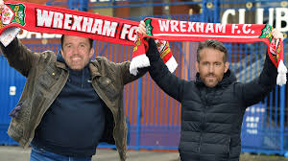
Mission Statement
Grow the Team
Measure with Goals & Heart
Return to EFL
Increase Attendance
Community Impact – Substance & Heart
Global Support – North America to Iceland – USA Invasion
Influencer Marketing Authenticity
Sense of Place
Engage Future Generations Virtually

Slide 20
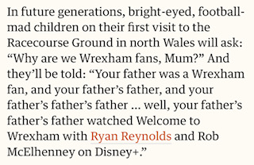
GO WREXHAM

Slide 21
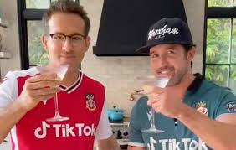
Alternative Fan Engagement Strategies
Manchester United
Profit Only – Commercialisation & Big Business
United Stand Global Membership 1.6m
Wales – 16th Man, We are Wales…..
NFL Legend Tom Brady Buying into Birmingham City
Fan Based – Streaming, Social Media, Influencers
Role Model Influence
Performance Related

Slide 22

Reflection & Review
Assignment Application
Strategic Approach
Business Model
Disneyfication
Fan Engagement
Spectator Experience
Commercialisation
Influencer, Sponsorship, Community Engagement & Passion
Sport Tourism
Future………

