Slide 1
Microwaves 1: Plane Waves
Dr John Rees,
19th February, 2016

Slide 2
James Clerk Maxwell [1855]
“… In order therefore to appreciate the requirements of the science [of electromagnetism], the student must make himself familiar with a considerable body of most intricate mathematics, the mere retention of which in the memory materially interferes with further progress …”

Slide 3
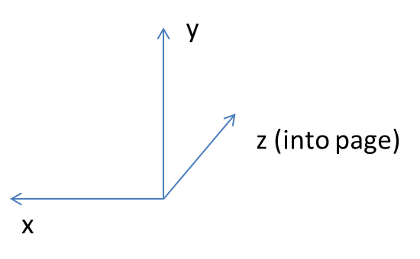
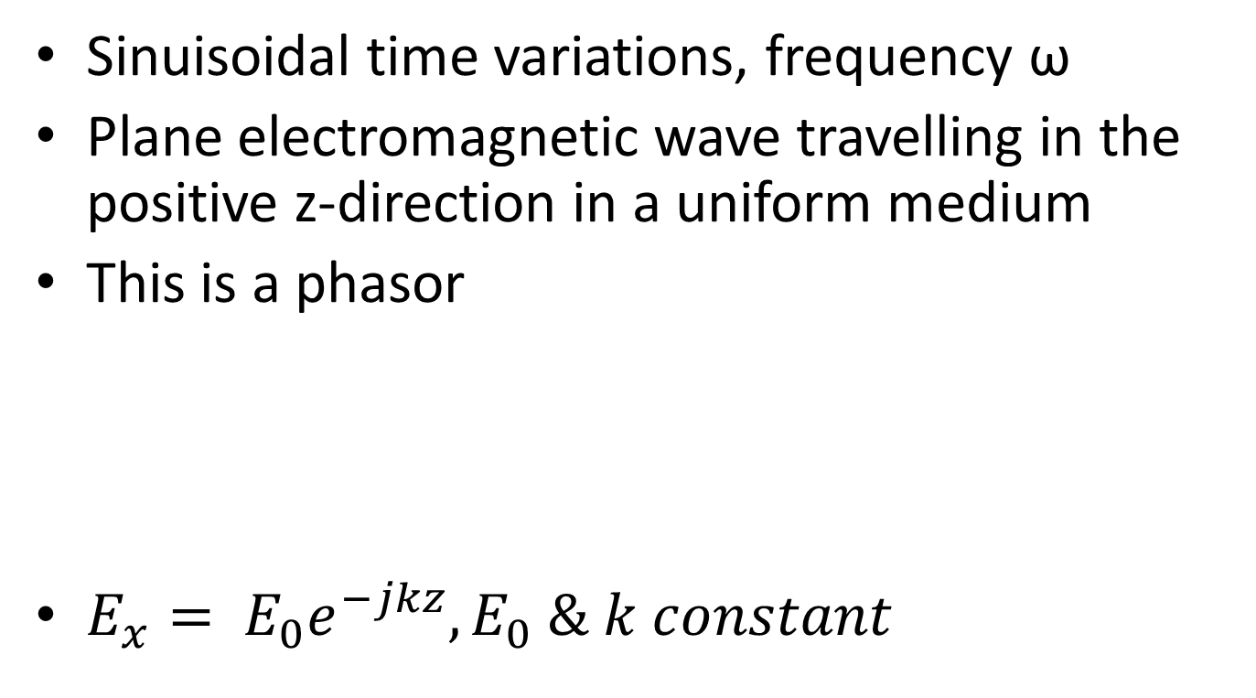
Plane Electromagnetic Wave
Sinuisoidal time variations, frequency ω
Plane electromagnetic wave travelling in the positive z-direction in a uniform medium
This is a phasor
$E_{x}= E_{0}e^{−jkz}, E_{0} \& k constant$

Slide 4
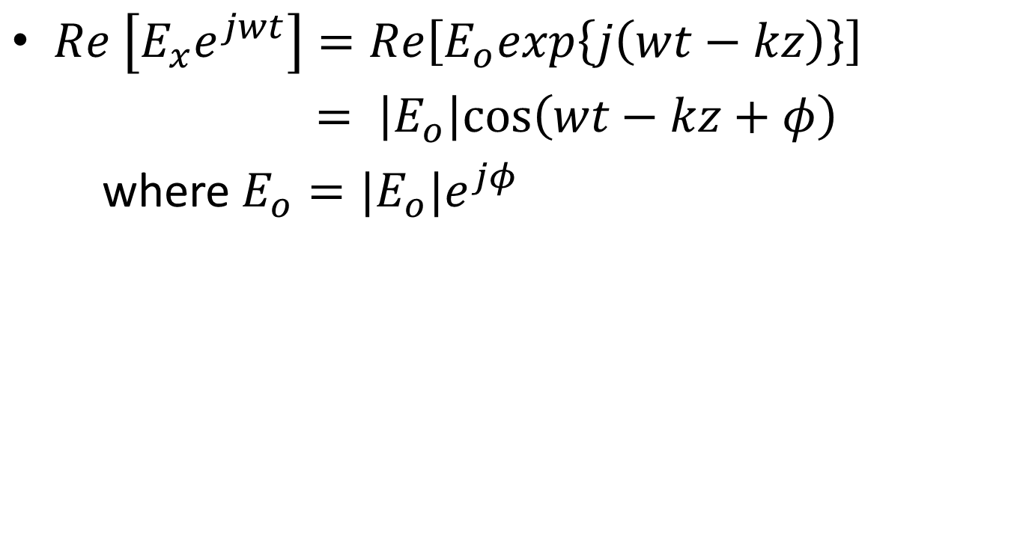
Actual Field Given By
$Re \left[E_{x}e^{jwt}\right]=Re\left[E_{o}exp\left\{j\left(wt−kz\right)\right\}\right]$
$= \left|E_{o}\right|cos⁡\left(wt−kz+φ\right)$
where $E_{o}=|E_{o}|e^{jφ}$
Phase at reference point z = 0
Peak amplitude

Slide 5
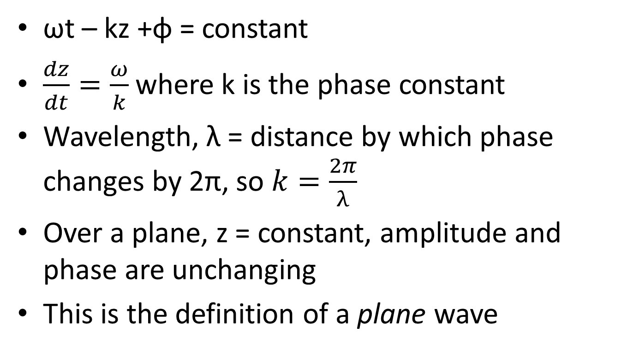
Phase Velocity
ωt – kz +φ = constant
$\frac{dz}{dt}=\frac{ω}{k}$ where k is the phase constant
Wavelength, λ = distance by which phase changes by 2π, so $k=\frac{2π}{λ}$
Over a plane, z = constant, amplitude and phase are unchanging
This is the definition of a plane wave

Slide 6
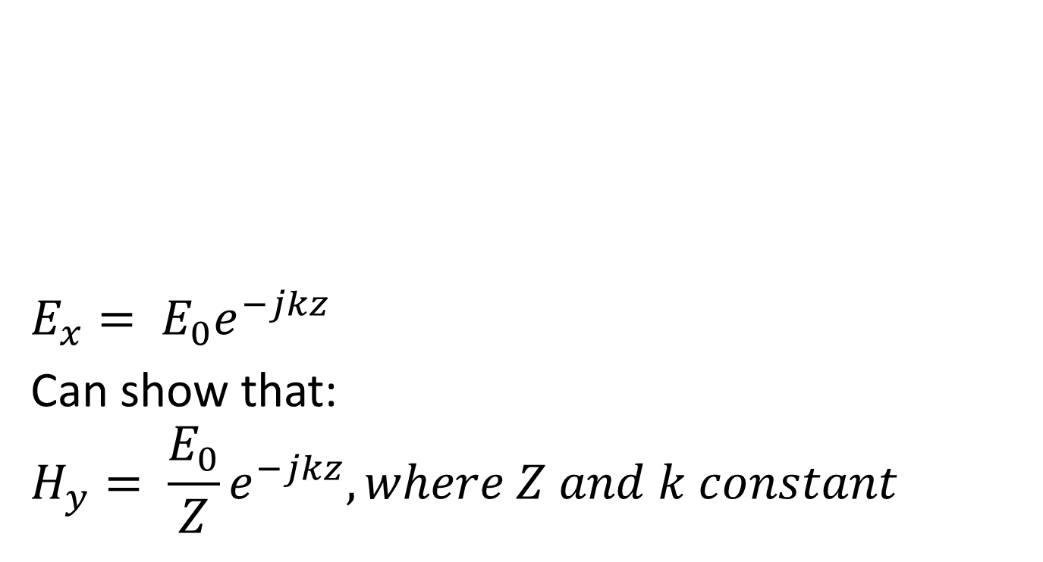
Plane Wave
H_{y} = magnetic field
$$E_{x}= E_{0}e^{−jkz}$$
Can show that:
$$H_{y}= \frac{E_{0}}{Z}e^{−jkz}, where Z and k constant$$
z = direction of travel
E_{x} = electric field

Slide 7
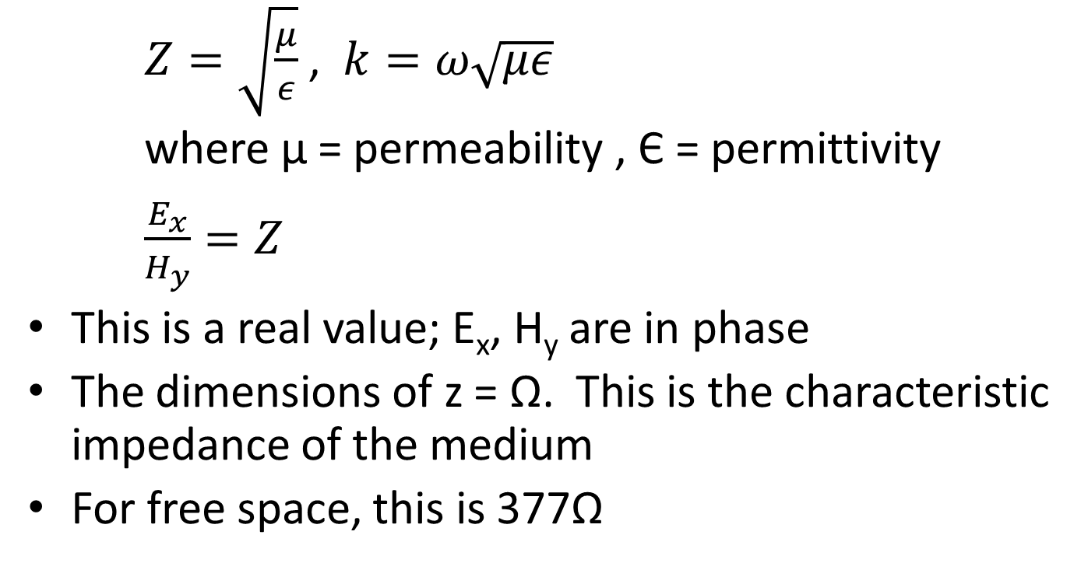
Plane Wave Impedance
$Z=\sqrt{\frac{μ}{ε}}$ , $k=ω\sqrt{με}$
where μ = permeability , Є = permittivity
$\frac{E_{x}}{H_{y}}=Z$
This is a real value; E_{x}, H_{y} are in phase
The dimensions of z = Ω. This is the characteristic impedance of the medium
For free space, this is 377Ω

Slide 8
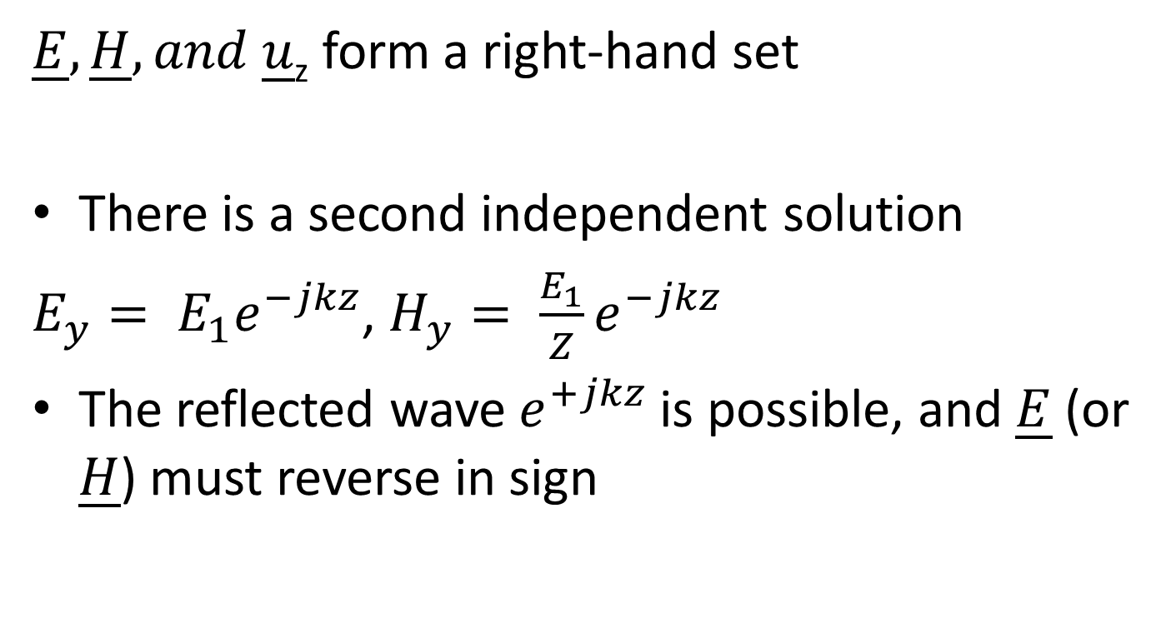
Plane Waves Cont.
$\underline{E}, \underline{H}, and \underline{u}$_{z} form a right-hand set
There is a second independent solution
$E_{y}= E_{1}e^{−jkz}$, $H_{y}= \frac{E_{1}}{Z}e^{−jkz}$
The reflected wave $e^{+jkz}$ is possible, and $\underline{E}$ (or $\underline{H}$) must reverse in sign

Slide 9
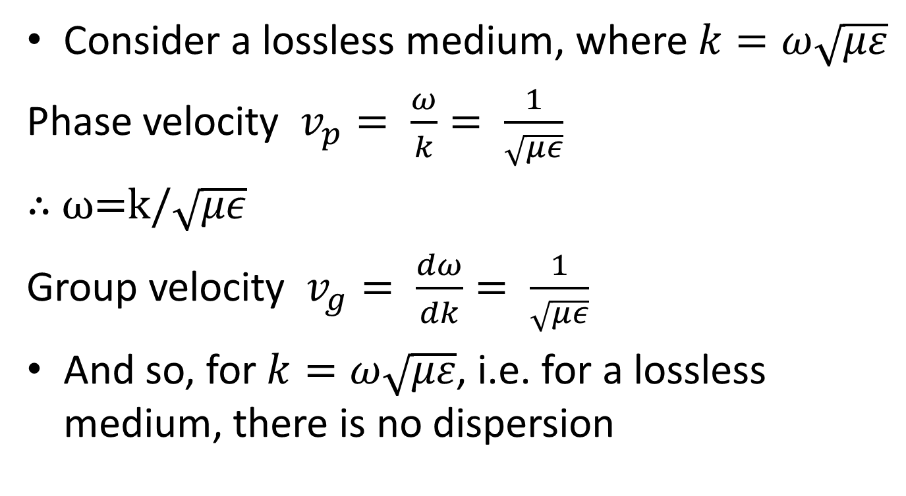
Velocities of Propagation
Consider a lossless medium, where $k=ω\sqrt{με}$
Phase velocity $v_{p}= \frac{ω}{k}= \frac{1}{\sqrt{με}}$
∴ ω=k/$\sqrt{με}$
Group velocity $v_{g}= \frac{dω}{dk}= \frac{1}{\sqrt{με}}$
And so, for $k=ω\sqrt{με}$, i.e. for a lossless medium, there is no dispersion

Slide 10
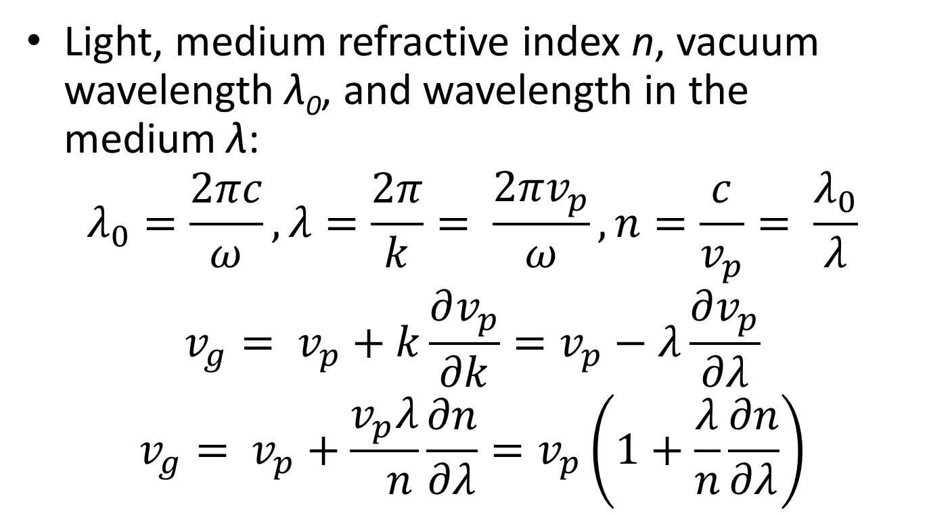
Velocities of Propagation
Light, medium refractive index n, vacuum wavelength λ₀, and wavelength in the medium λ:
$$λ_{0}=\frac{2πc}{ω}, λ=\frac{2π}{k}= \frac{2πv_{p}}{ω}, n=\frac{c}{v_{p}}= \frac{λ_{0}}{λ}$$
$$v_{g}= v_{p}+k\frac{∂v_{p}}{∂k}=v_{p}−λ\frac{∂v_{p}}{∂λ}$$
$$v_{g}= v_{p}+\frac{v_{p}λ}{ n}\frac{∂n}{∂λ}=v_{p}\left(1+\frac{λ}{n}\frac{∂n}{∂λ}\right)$$

Slide 11
An Example: Refraction
Light falls on some glass with a slightly different refractive index for red light and blue light: n = 1.51 at 400 nm, n = 1.49 at 600 nm.
(i) This is a fall of δn = 0.02 in δλ = 200 nm
(ii) The mean λ is 500 nm and the mean n is 1.5
(iii) v_{p} = 2 × 10⁸ m/s
(iv) v_{g} = 2 × 10⁸ (1 − (500/1.5)(.02/200))
= 2 × 10⁸ (1 − .0333)
= 1.93 x 10⁸ m/s

Slide 12
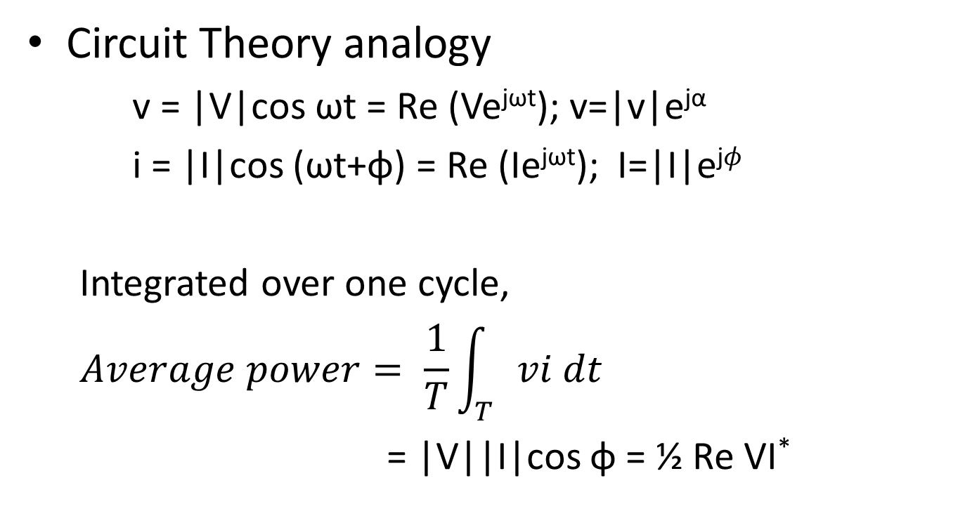
Power Flow in a Plane Wave
Circuit Theory analogy
  v = |V|cos ωt = Re (Ve^{jωt}); v=|v|e^{jα}
  i = |I|cos (ωt+φ) = Re (Ie^{jωt}); I=|I|e^{j𝜙}
  Integrated over one cycle,
  $$Average power= \frac{1}{T}\int_{T}{vi dt}$$
  = |V||I|cos φ = ½ Re VI*

Slide 13
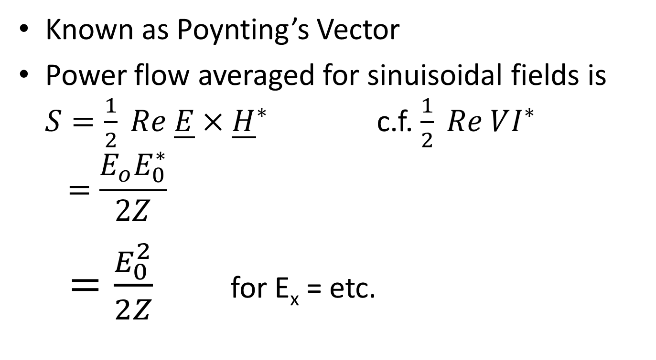
Averaged for Sinuisoidal Fields
Known as Poynting’s Vector
Power flow averaged for sinuisoidal fields is $S=\frac{1}{2} Re \underline{E}×{\underline{H}}^{∗}$ c.f. $\frac{1}{2} Re VI^{∗}$
$$=\frac{E_{o}E_{0}^{∗}}{2Z}$$
$=\frac{E_{0}^{2}}{2Z}$for E_{x} = etc.

Slide 14
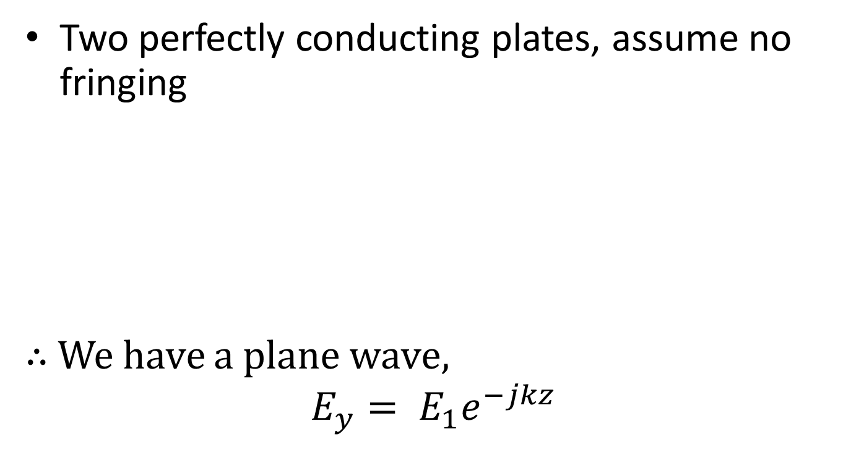
Parallel Plate TEM Waveguide
Two perfectly conducting plates, assume no fringing
∴ We have a plane wave,
$$E_{y}= E_{1}e^{−jkz}$$
Dielectric slab
a
b
y
z
V
I
x

Slide 15
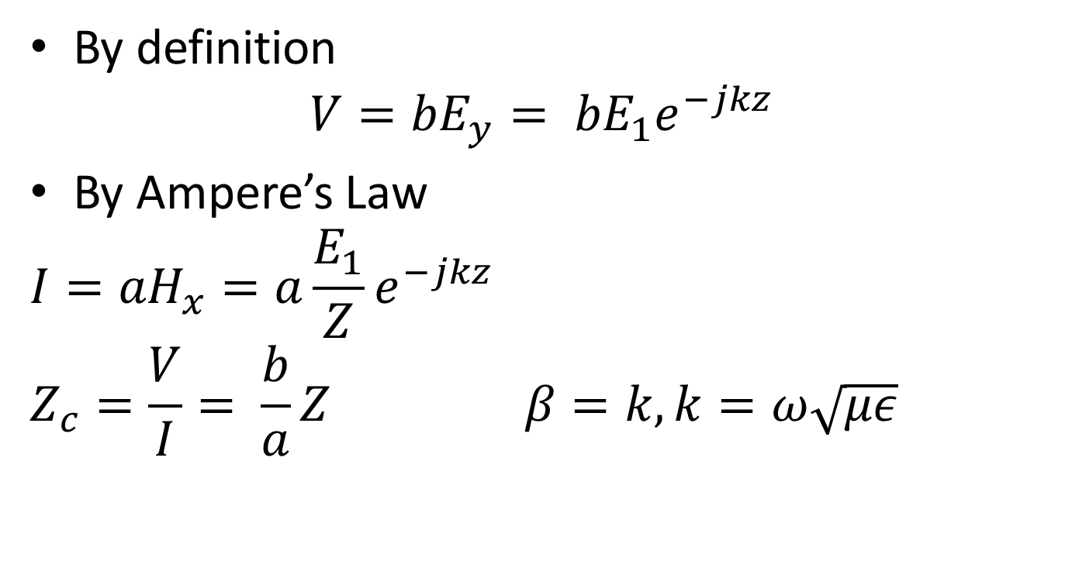
By definition
$${V=bE}_{y}= {bE}_{1}e^{−jkz}$$
By Ampere’s Law
$${I=aH}_{x}=a\frac{E_{1}}{Z}e^{−jkz}$$
$$Z_{c}=\frac{V}{I}= \frac{b}{a}Z β=k, k=ω\sqrt{με}$$

Slide 16
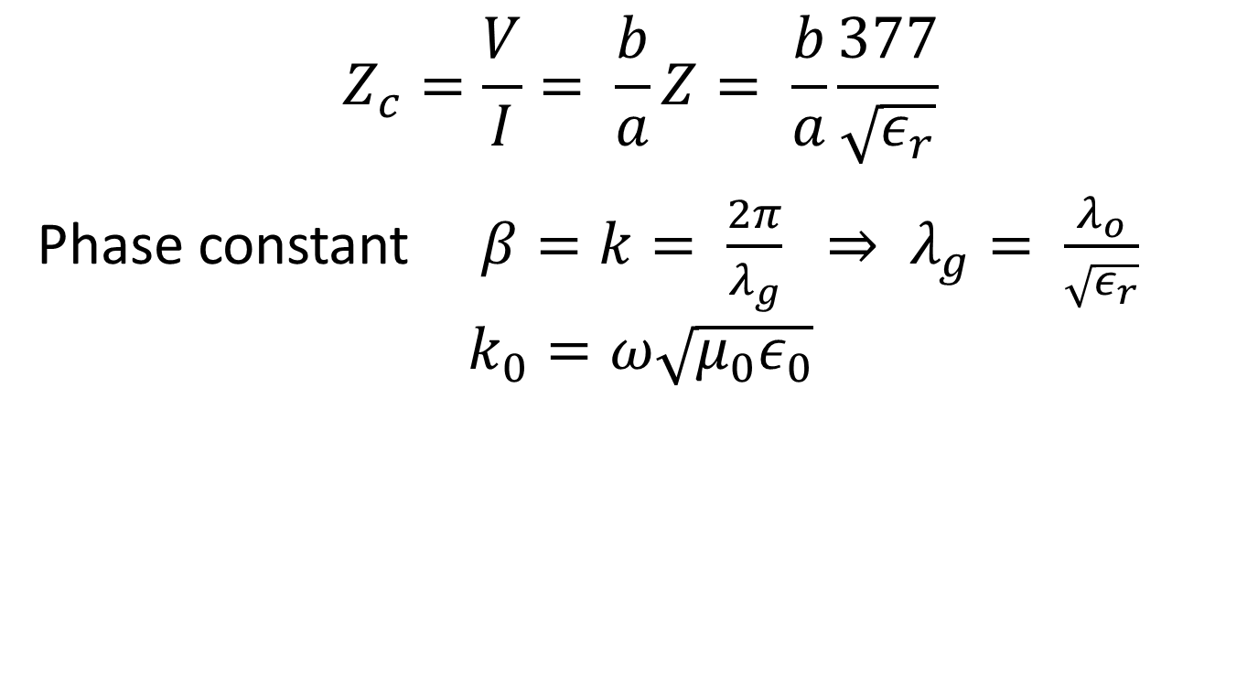
$$Z_{c}=\frac{V}{I}= \frac{b}{a}Z= \frac{b}{a}\frac{377}{\sqrt{ε_{r}}}$$
Phase constant $β=k= \frac{2π}{λ_{g}} ⇒ λ_{g}= \frac{λ_{o}}{\sqrt{ε_{r}}}$
$$k_{0}=ω\sqrt{μ_{0}ε_{0}}$$

Slide 17
Transmission Line Analogy
Plane wave incident normally (perpendicularly) to a plane boundary between two dielectrics:

Slide 18
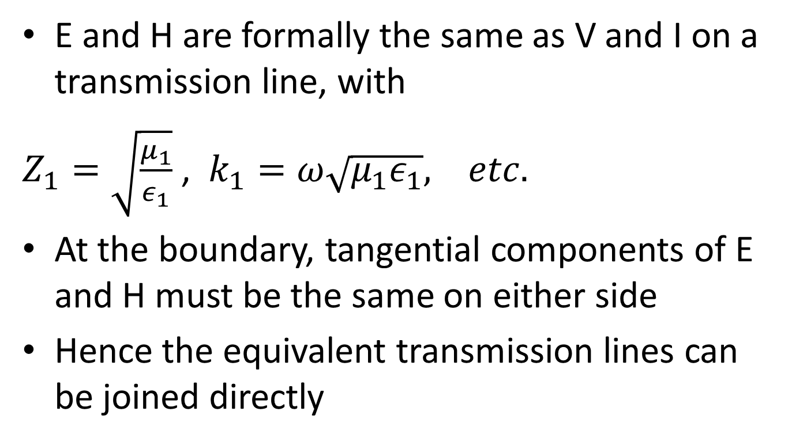
Analogy cont.
E and H are formally the same as V and I on a transmission line, with
$Z_{1}=\sqrt{\frac{μ_{1}}{ε_{1}}}$ , $k_{1}=ω\sqrt{μ_{1}ε_{1}}, etc.$
At the boundary, tangential components of E and H must be the same on either side
Hence the equivalent transmission lines can be joined directly

Slide 19
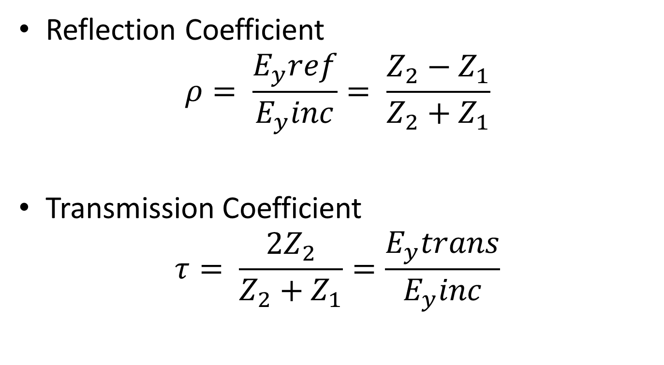
Analogy cont.
Reflection Coefficient
$$ρ= \frac{E_{y}ref}{E_{y}inc}= \frac{Z_{2}−Z_{1}}{Z_{2}+Z_{1}}$$
Transmission Coefficient
$$τ= \frac{{2Z}_{2}}{Z_{2}+Z_{1}}=\frac{E_{y}trans}{E_{y}inc}$$

Slide 20
Interference in Plane Waves

Slide 21
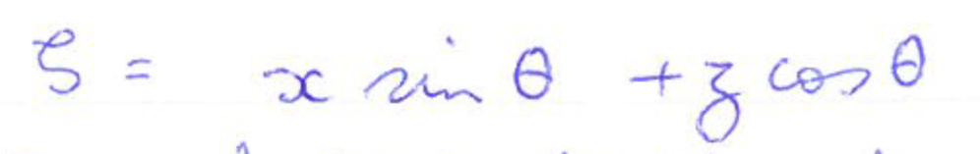
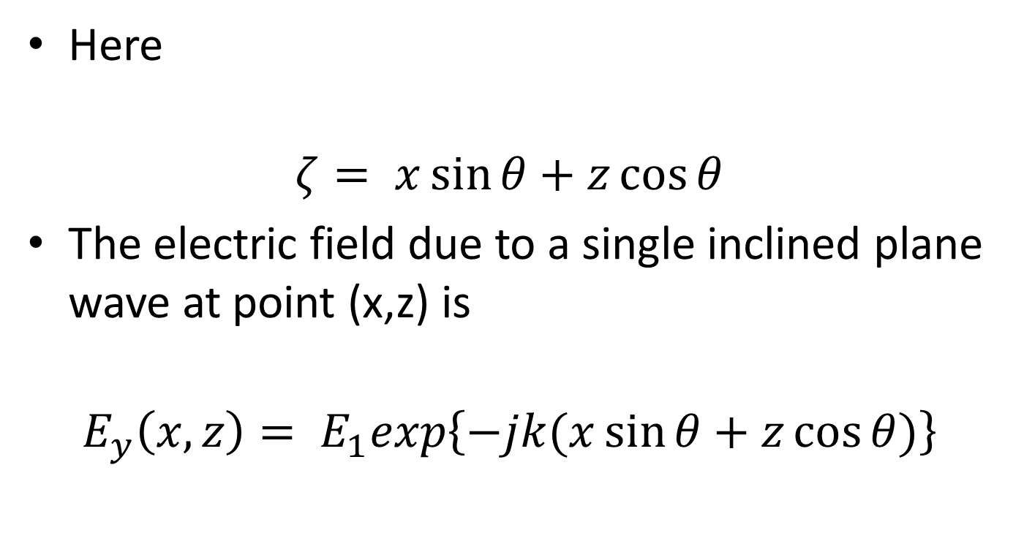
Interference
Here
$$ζ= x\sin{θ}+z\cos{θ}$$
The electric field due to a single inclined plane wave at point (x,z) is
$$E_{y}\left(x,z\right)= E_{1}exp\left\{−jk(x\sin{θ}+z\cos{θ)}\right\}$$

Slide 22
Interference
Take the magnetic field component as

Slide 23
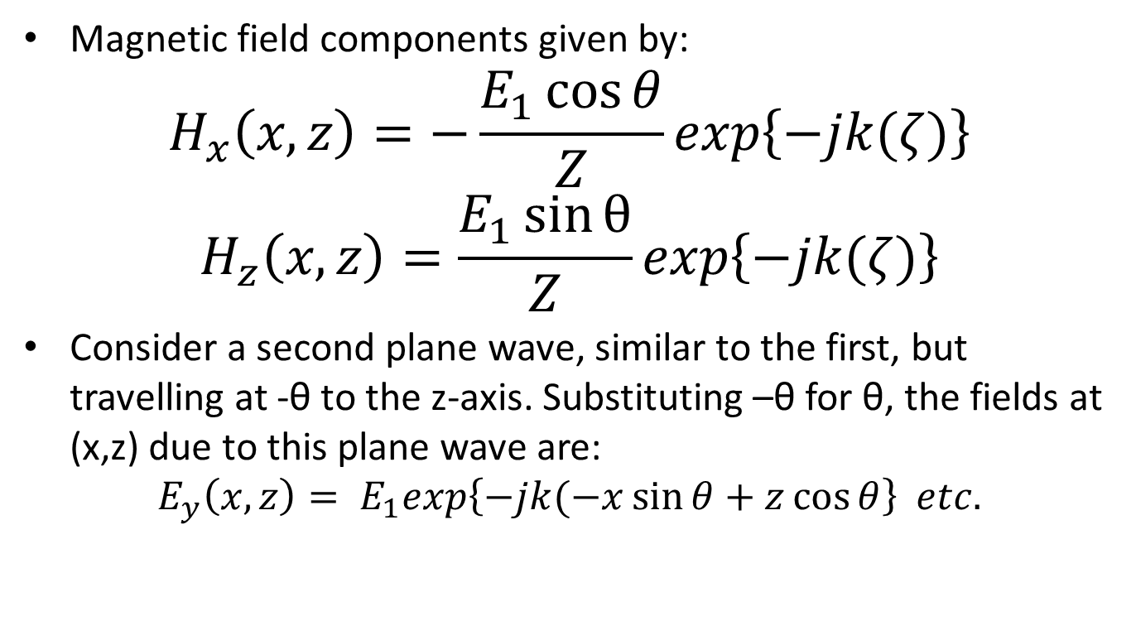
Interference
Magnetic field components given by:
$$H_{x}\left(x,z\right)=−\frac{E_{1}\cos{θ}}{Z}exp\left\{−jk(ζ)\right\}$$
$$H_{z}\left(x,z\right)=\frac{E_{1}\sin{θ}}{Z}exp\left\{−jk(ζ)\right\}$$
Consider a second plane wave, similar to the first, but travelling at -θ to the z-axis. Substituting –θ for θ, the fields at (x,z) due to this plane wave are:
$$E_{y}\left(x,z\right)= E_{1}exp\left\{−jk(−x\sin{θ}+z\cos{θ}\right\} etc.$$

Slide 24
Interference

Slide 25
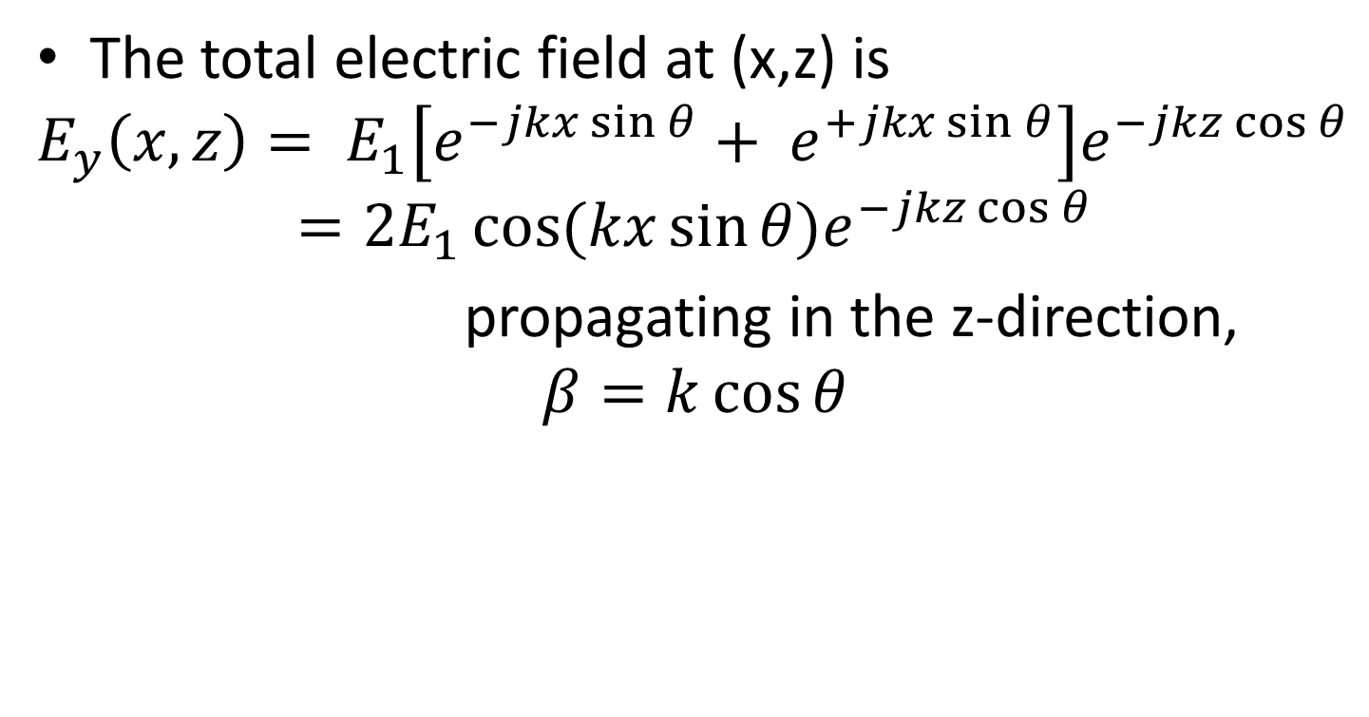
Interference
The total electric field at (x,z) is
$$E_{y}\left(x,z\right)= E_{1}\left[e^{−jkx\sin{θ}}+ e^{+jkx\sin{θ}}\right]e^{−jkz\cos{θ}}$$
$$=2E_{1}\cos{(kx\sin{θ)e^{−jkz\cos{θ}}}}$$
propagating in the z-direction,
$$β=k\cos{θ}$$
sinuisoidal variation
of amplitude across
the wavefront

Slide 26
Interference

Slide 27
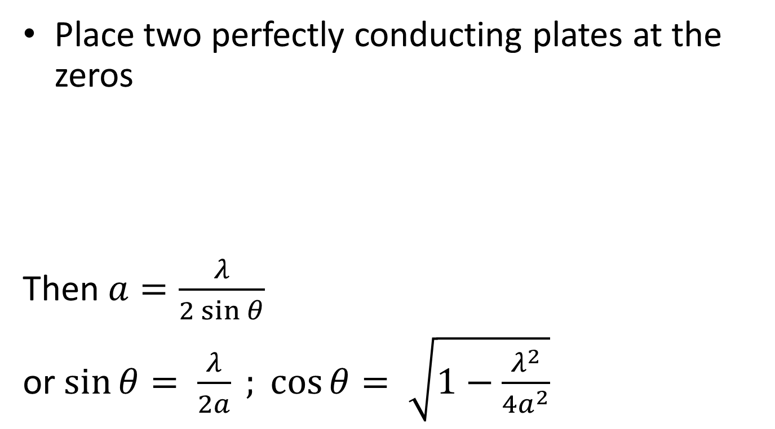
Parallel Plate Waveguides, TE Mode
Place two perfectly conducting plates at the zeros
Then $a=\frac{λ}{2\sin{θ}}$
or $\sin{θ}= \frac{λ}{2a} ; \cos{θ}= \sqrt{1−\frac{λ^{2}}{{4a}^{2}}}$
x
z
a

Slide 28
TE Mode
Note
  Fields need exist only between the plates
  λ is determined by the frequency of the source
  Angle θ is determined by the geometry, i.e. by the separation of the plates, a
  (Remember for later):

Slide 29
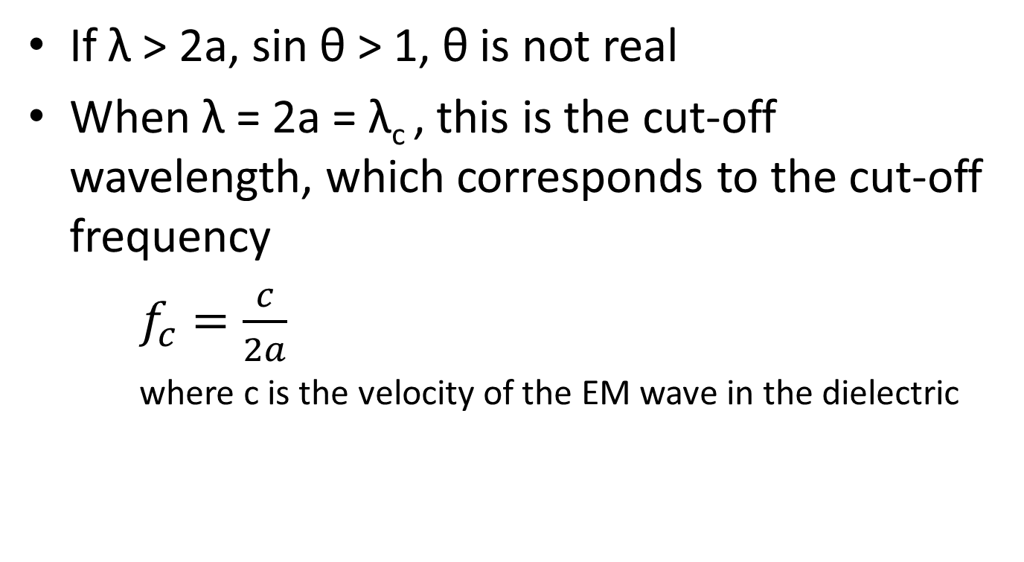
Cut Off
If λ > 2a, sin θ > 1, θ is not real
When λ = 2a = λ_{c} , this is the cut-off wavelength, which corresponds to the cut-off frequency
$f_{c}=\frac{c}{2a}$
where c is the velocity of the EM wave in the dielectric

Slide 30
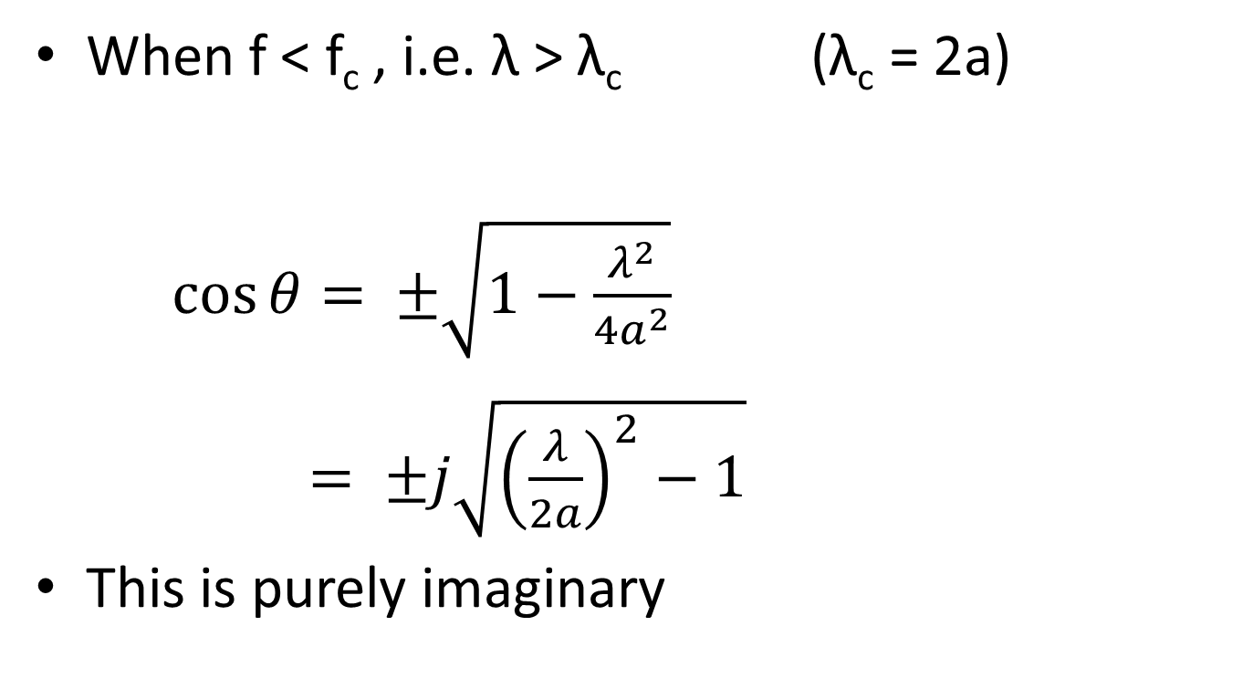
Away from Cut-Off
When f < f_{c} , i.e. λ > λ_{c} (λ_{c} = 2a)
$\cos{θ}= ±\sqrt{1−\frac{λ^{2}}{{4a}^{2}}}$
$= ±j\sqrt{{\left(\frac{λ}{2a}\right)}^{2}−1}$
This is purely imaginary

Slide 31
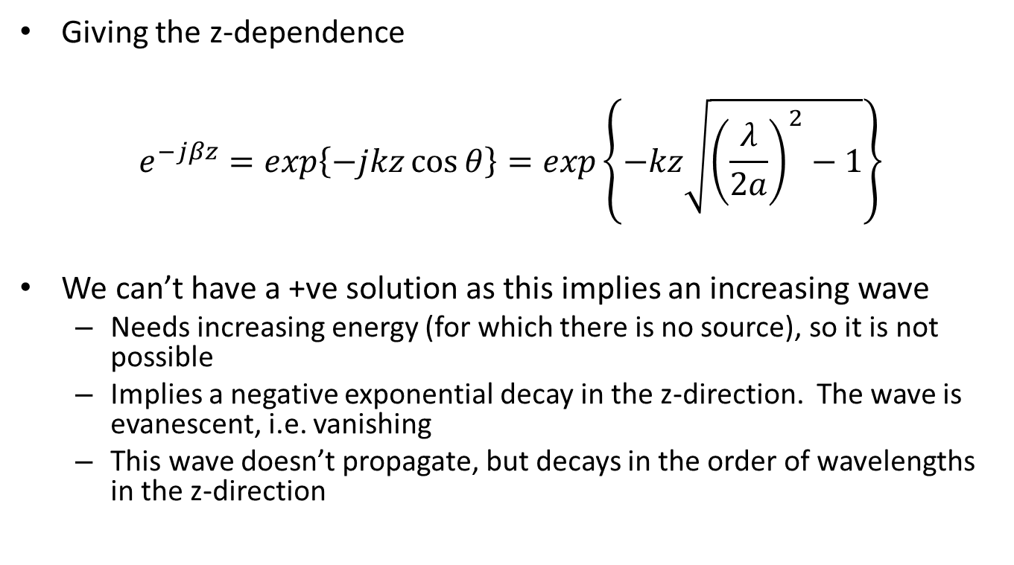
Z-dependence
Giving the z-dependence
$$e^{−jβz}=exp\left\{−jkz\cos{θ}\right\}=exp\left\{−kz\sqrt{{\left(\frac{λ}{2a}\right)}^{2}−1}\right\}$$
We can’t have a +ve solution as this implies an increasing wave
  Needs increasing energy (for which there is no source), so it is not possible
  Implies a negative exponential decay in the z-direction. The wave is evanescent, i.e. vanishing
  This wave doesn’t propagate, but decays in the order of wavelengths in the z-direction

Slide 32
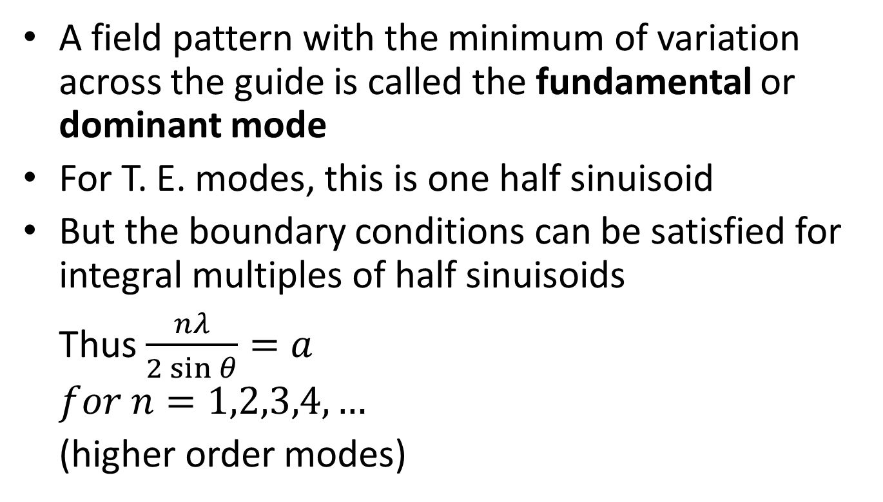
Modes
A field pattern with the minimum of variation across the guide is called the fundamental or dominant mode
For T. E. modes, this is one half sinuisoid
But the boundary conditions can be satisfied for integral multiples of half sinuisoids
Thus $\frac{nλ}{2\sin{θ}}=a$
$$for n=1,2,3,4,…$$
(higher order modes)
a
Mode 1
Mode 2

Slide 33
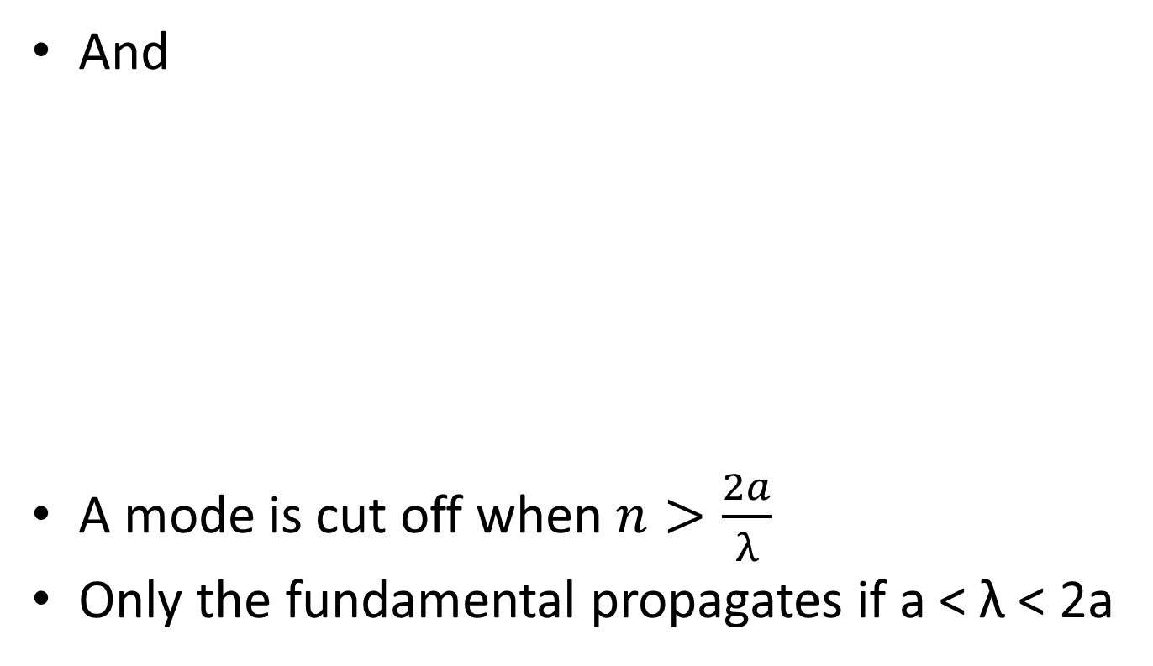
Modes
And
A mode is cut off when $n>\frac{2a}{λ}$
Only the fundamental propagates if a < λ < 2a

Slide 34
Impedance

Slide 35
Rectangular Wave Guides
The boundary conditions are satisfied with the addition of two further parallel plates
Fields only penetrate to skin depth, hence isolation is achieved
b
x
a
E
z
H_{z}
y

Slide 36
Rectangular Wave Guides
Design with b < a so that the structure only supports y-directed electric fields. Then, for a fundamental mode only to propagate,
λ < 2a < 2 λ
The orthogonal mode is cut off

Slide 37
Mode Designation
We use the style TE_{xy} , or TM_{xy ,}
E.g. TE₁₀ ,
  TE – Electric field, wholly transverse
  1 - Has one half sinuisoid variation of the E field in the x-direction
  0 - Has zero half sinuisoid variations in the y-direction
Higher modes, such as TE₂₀

Slide 38
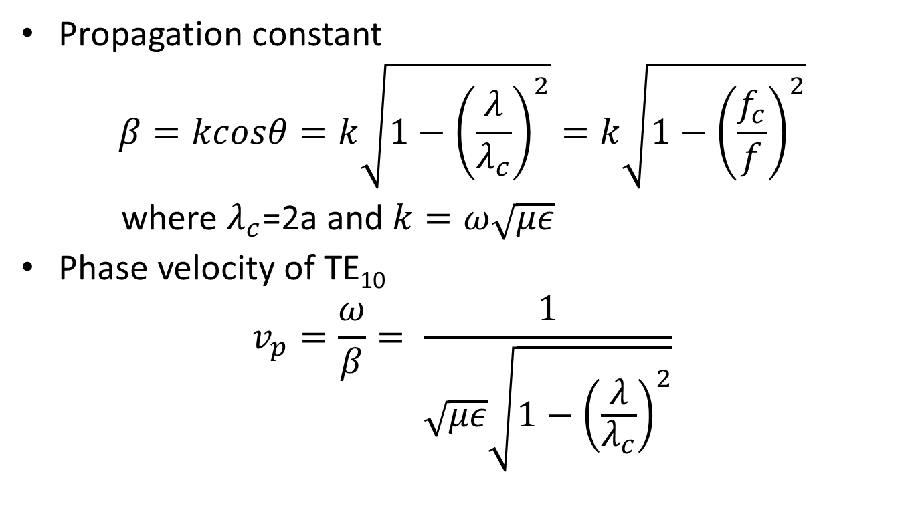
Consider TE₁₀
Propagation constant
$$β=kcosθ=k\sqrt{1−{\left(\frac{λ}{λ_{c}}\right)}^{2}}=k\sqrt{1−{\left(\frac{f_{c}}{f}\right)}^{2}}$$
where $λ_{c}$=2a and $k=ω\sqrt{με}$
Phase velocity of TE₁₀
$$v_{p}=\frac{ω}{β}= \frac{1}{\sqrt{με}\sqrt{1−{\left(\frac{λ}{λ_{c}}\right)}^{2}}}$$

Slide 39
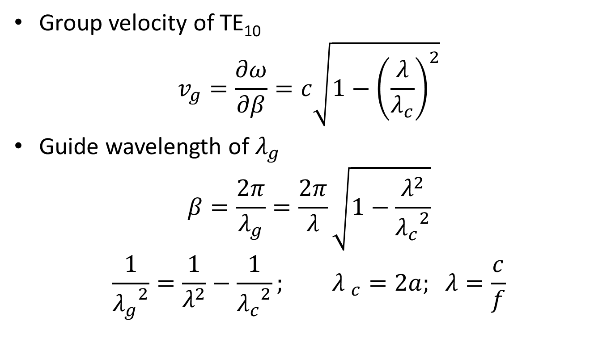
Consider TE₁₀
Group velocity of TE₁₀
$$v_{g}=\frac{∂ω}{∂β}=c\sqrt{1−{\left(\frac{λ}{λ_{c}}\right)}^{2}}$$
Guide wavelength of $λ_{g}$
$$β=\frac{2π}{λ_{g}}=\frac{2π}{λ}\sqrt{1−\frac{λ^{2}}{{λ_{c}^{}}_{}^{2}}}$$
$$\frac{1}{{λ_{g}}^{2}}=\frac{1}{λ^{2}}−\frac{1}{{λ_{c}}^{2}}; {λ }_{c}=2a; λ=\frac{c}{f}$$

Slide 40
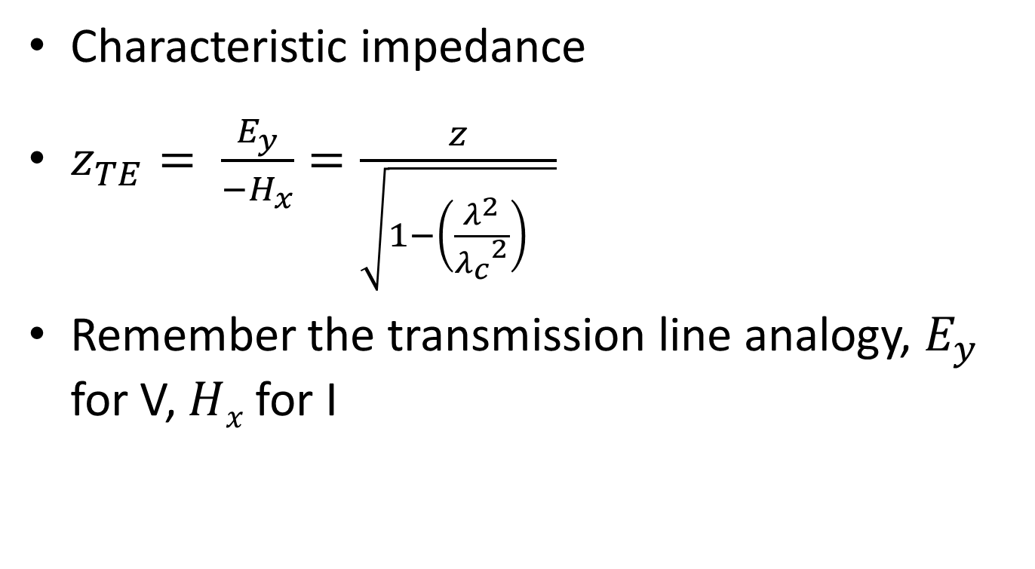
TE₁₀
Characteristic impedance
$z_{TE}= \frac{E_{y}}{−H_{x}}=\frac{z}{\sqrt{1−{\left(\frac{λ^{2}}{{λ_{c}}^{2}}\right)}^{}}}$
Remember the transmission line analogy, $E_{y}$ for V, $H﷮x$ for I

Slide 41
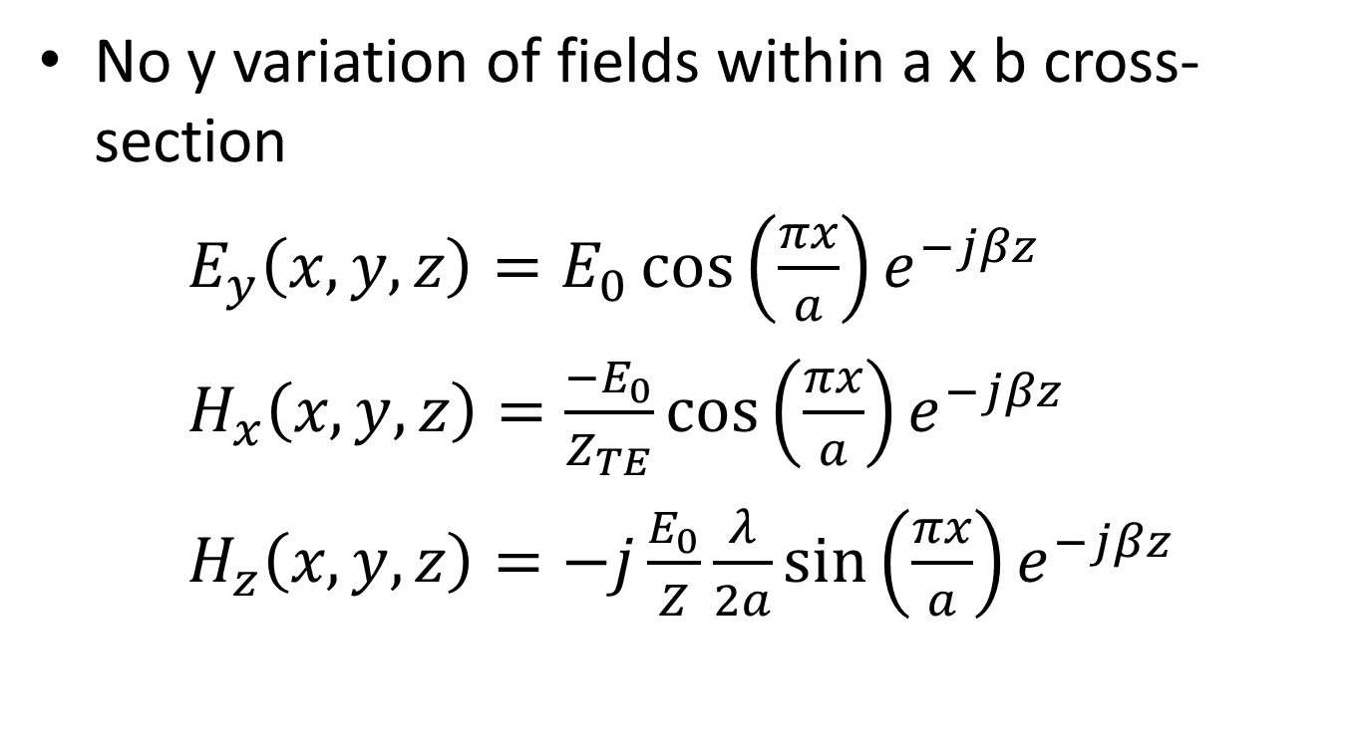
Fields in a TE₁₀ Wave Guide
No y variation of fields within a x b cross-section
$E_{y}\left(x,y,z\right)=E_{0}\cos\left(\frac{πx}{a}\right)e^{−jβz}$
$H_{x}\left(x,y,z\right)=\frac{{−E}_{0}}{Z_{TE}}\cos\left(\frac{πx}{a}\right)e^{−jβz}$
$H_{z}\left(x,y,z\right)=−j\frac{E_{0}}{Z}\frac{λ}{2a}\sin\left(\frac{πx}{a}\right)e^{−jβz}$

Slide 42
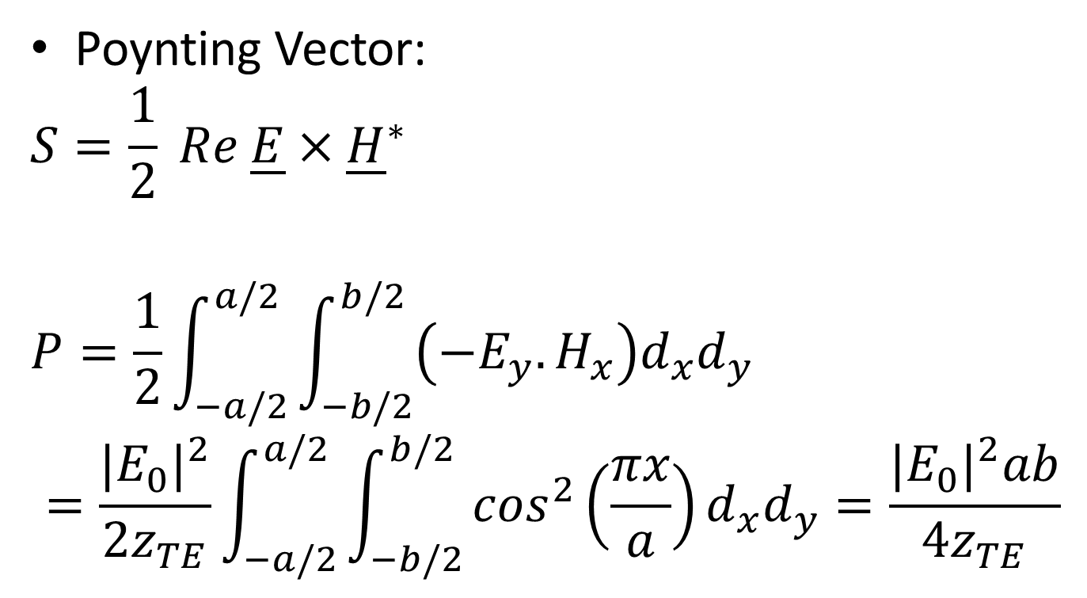
Power Flow
Poynting Vector:
$$S=\frac{1}{2} Re \underline{E}×{\underline{H}}^{∗}$$
$$P=\frac{1}{2}\int_{−a/2}^{a/2}{\int_{−b/2}^{b/2}{\left(−E_{y}.H_{x}\right)d_{x}d_{y}}}$$
$$=\frac{{|E_{0}|}^{2}}{2z_{TE}}\int_{−a/2}^{a/2}{\int_{−b/2}^{b/2}{\cos^{2}\left(\frac{πx}{a}\right)d_{x}d_{y}}}=\frac{{|E_{0}|}^{2}ab}{4z_{TE}}$$

