Slide 1
Academic and Employability Skills
BMSK 4001
Week 2

Slide 2
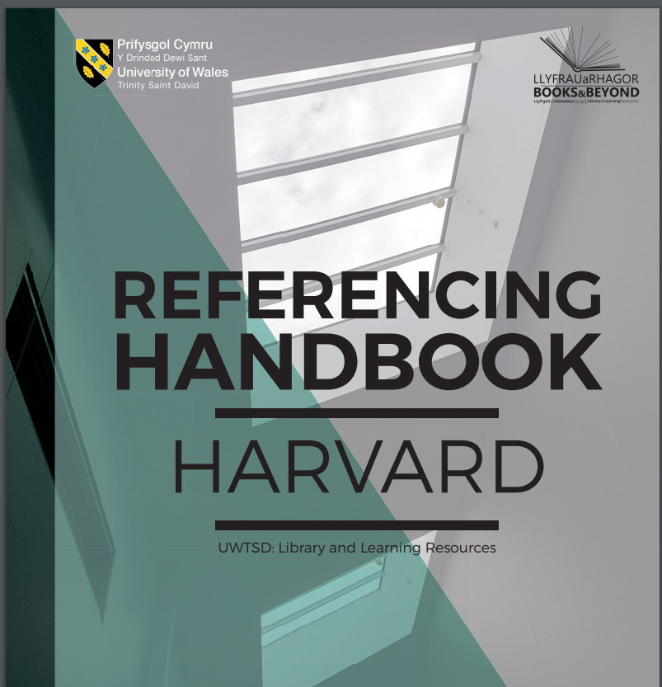

Slide 3

Harvard Referencing

Slide 4


Citing References Quiz: Identify the source
Reference 1
Dickinson, C. 2017. Words fail: theology, poetry, and the challenge of representation. New York:
Fordham University Press.
□ A. Chapter in a book
□ B. Book
□ C. Website
□ D. Insufficient information

Slide 5


Reference 3
Cox, S. 2000. How to herd cats in Piccadilly. Times Higher Education Supplement 14 April, pp. 36-37.
□ A. Chapter in a book
□ B. Newspaper article
□ C. Conference paper
□ D. Insufficient information
Reference 2
Willard, V. C. 2016. Retirement experiences of elite ballet dancers: Impact of self-identity and social
support. Sport, exercise, and performance psychology 5(3), pp. 266-279. doi: 10.1037/spy0000057
□ A. Chapter in a book
□ B. Conference paper
□ C. Journal article
□ D. Insufficient information

Slide 6

Reference 4
Chrulew, M. 2017. Foucault and animals.
□ A. Journal article
□ B. Book chapter
□ C. Website
□ D. insufficient information

Slide 7
Reference 5
Arwill-Nordbladh, E. 2016. Viking Age Hair. Internet Archaeology 42. doi: 10.11141/ia.42.6.8
□ A. Thesis
□ B. Website
□ C. Electronic journal article
□ D. Insufficient information

Slide 8
Reference 6
Barajas, M. and Owen, M. 2000. Implementing virtual learning environments: looking for an holistic
approach. Education Technology and Society.
□ A. Edited book
□ B. Journal article
□ C. Chapter in a book
□ D. Insufficient information

Slide 9
Reference 7
Mosco, V. 2000. The web. In: Browning, G. et al. eds. Understanding contemporary society: theories of the present. London: Sage. pp. 343-355.
□ A. Book
□ B. Journal article
□ C. Chapter in a book
□ D. Insufficient information

Slide 10

Paraphrasing
When you paraphrase you express someone else’s writing in your own words.
An alternative way of referring to an author’s idea
You must still cite and reference the source

Slide 11
How Do I Paraphrase?
First read the source carefully so you actually know what it means. You can’t use it as a source if you don’t understand it.
Next find the part of the source you want to paraphrase. You’re not rewriting the entire source in your paper, so don’t paraphrase much more than a paragraph.
Finally, and pay attention to this step because it’s important, set the source aside.
Write your paraphrase without looking at the original source. This will help you write in your own words and help you resist the temptation to use the wording and sentence structure of the original source.

Slide 12

•Original: Giraffes like Acacia leaves and hay and they can consume 75 pounds of food a day.
•Paraphrase: A giraffe can eat up to 75 pounds of Acacia leaves and hay everyday.
•Original: Any trip to Italy should include a visit to Tuscany to sample their exquisite wines.
•Paraphrase: Be sure to include a Tuscan wine-tasting experience when visiting Italy

Slide 13

Quote, paraphrase and summarise
Quotation should be relevant to your argument and used carefully in your text
Excessive use of quotation can disrupt the flow of your writing and stop you from showing your understanding and analysis of the source
Tutors prefer to read your interpretation and analysis

Slide 14

Direct Quotes
Short direct quotations (up to two or three lines) should be enclosed in quotation marks ( single ‘’or double””- be consistent)
Give the (author, date, Page number (s))
Example
M Delibes says in book El camino that ‘you do not know what you have until it is gone’ (pg 56) in 2010
Published in Madrid, Destino.
In text citation Delibes notes that ‘you do not know what you have until its gone’ (Delibes, 2010, p.56)
Reference list
Delibes, M. (2010) El camino, Madrid: Destino.

Slide 15

Try to identify correct paraphrasing
Activity

Slide 16
Try to paraphrase
In her discussion of what she perceives to be problems of English society at the time, Ellis (1839) argues that English middle-class women "have lately learned to look with envious eyes upon their superiors in rank, to rival their attainments, to imitate their manners, and to pine for the luxuries they enjoy" (p. 15).
Paraphrased
In her discussion of what she perceives to be problems of English society at the time, Ellis (1839) argues that English middle-class women try to imitate upper-class manners and life-style (p. 15).

Slide 17

Remember these three tips to paraphrase like a pro.
1.Include key points and sub-points from the original source.
2.Write a paraphrase in your own words and use your own sentence structure.
3.Always cite a paraphrase.

Slide 18
Don’t do this!
•Don’t just change a couple of words from your information source and think that it is an acceptable paraphrase—adding a reference makes no difference!
•Don’t just switch around sentence parts from your information source and add a reference, then think that it is an acceptable
•Avoid patchworking (cutting and pasting and copying bits of information from a variety of sources and connecting it all together in a paragraph, usually without references).

Slide 19
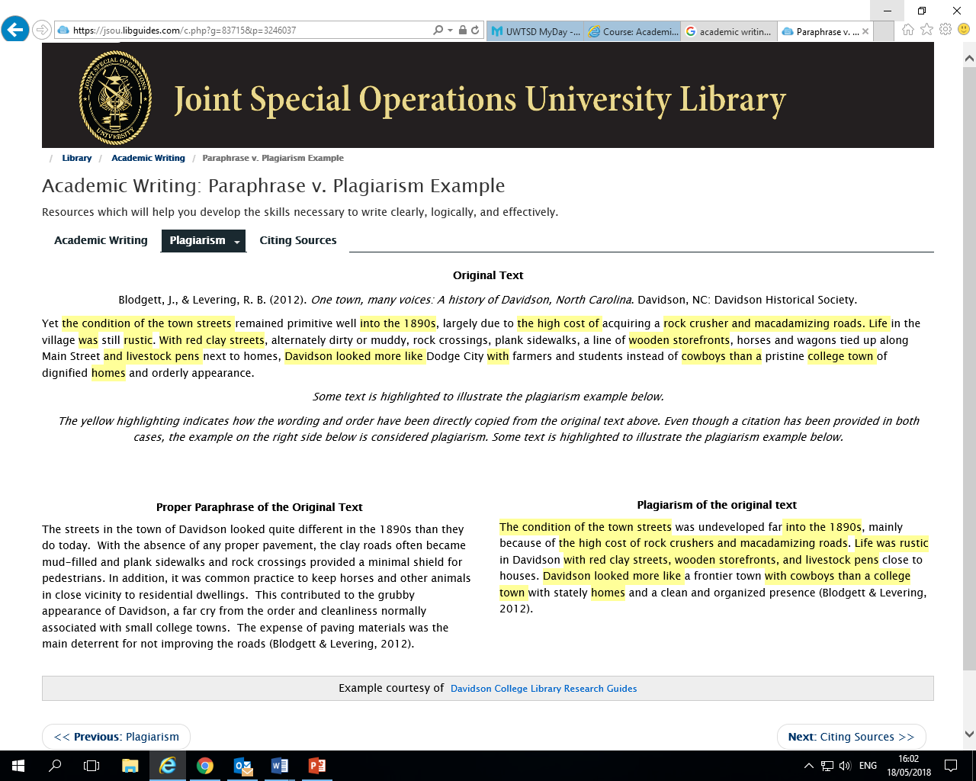

Slide 20

How to read an academic article

Slide 21

To read in an effective way, you must begin by searching for sentence, paragraph
Without an understanding of the overall structure of the article, chapter, or paper that you are reading, it will be difficult to remember and understand what you have read.

Slide 22

Preliminary:
1. Carefully read the title, identify whom the authors are and where they are from (their affiliation), and determine what year the article was written. All of these things may help you remember the article.
2. Determine how long the article is. Determine overall organisation:

Slide 23

3. Read all of the major subheadings of the article first. Write them down on a piece of paper to help you remember later. If there are no subheadings then find the 'topic sentences' in each paragraph and jot them down to get the main ideas of the paper.
4. If there is an 'abstract', also read this to get a general idea of what the article is about Concentrate on content:

Slide 24

5. Identify what the main objectives or research questions of the article are and write them down. There are usually only 1-3 main objectives in any single writing.
In general, you can often find these at the end of an introduction, or sometimes at the very beginning of the introduction.
6. After you have figured out what the main 'questions' or objectives are of the article, then skip to the end and identify what the main conclusions are, and write these down.

Slide 25

7. NOW, you are ready to read the article - you should already have a general idea what the main questions/issues are, you have a general idea of what the main conclusions are, and now you can concentrate on the intricacies of the author's logic and reasoning.
8. Be sure to read and understand ALL figures, tables and graphs. Most often, this is where the most important information is found!

Slide 26

9. You should never finish reading unless you can answer the following questions:
'What was the main point of this article/chapter/paper?';
'What were their main lines of reasoning and the evidence that they used?'; and
'What were their main conclusions?'.
If you cannot answer these questions, then re-do the above steps until you can.

Slide 27

10. While doing the above activities, you should also keep track of what you think the major strengths and major weaknesses of the article are.
Summarize them after you have addressed all of the above issues. Usually, if you can address all of the above issues, then you have effectively read an article.

