Slide 1
Motivation

Slide 2
Motivation at work: significance for employers & employees
Aim:
To explore the concept of motivation & its impact on individual & organisational performance
Objectives are to:
define motivation and its link to performance
highlight key motivation theories
identify strategies used to influence employee motivation

Slide 3
What is motivation?
Some definitions:
“Degree to which an individual wants and chooses
to engage in certain specified behaviour”
        (Mitchell 1982:80, cited in Murton et al 2010:93)
“The willingness to apply one’s efforts towards the achievement of the organisation’s goals, while concurrently an individual need is satisfied”
(Taylor, 2010)

Slide 4
Q. What is performance?
A. Performance is essentially behaviour because when you perform, you are doing something i.e. you are behaving.
Q: All things being equal, why do some people
perform or behave better than others?
A: Because their motivational levels are different

Slide 5
Why do you go to work or study?
Do this individually
Apart from pay…

Slide 6
What motivates people to work?
Does your list include any of the following:
Financial rewards e.g. wages/salary, bonuses
Good working conditions e.g. flexitime, holiday entitlement, training & development opportunities, sickness & maternity leave/pay above statutory minimum
Additional benefits e.g. company pension, car, private health care, subsidised child care & canteen, gym membership etc
Interesting & varied work, contributing to organisational, community & societal wellbeing
Appreciative & open environment, opinions & efforts valued, team ethos & spirit, sense of belonging i.e. psychological rewards
Notes:
Wordwall activity

Slide 7
Extrinsic & Intrinsic Motivation
Extrinsic: tangible rewards such as salary, bonus, terms and conditions
Intrinsic: psychological rewards, sense of satisfaction, challenge

Slide 8
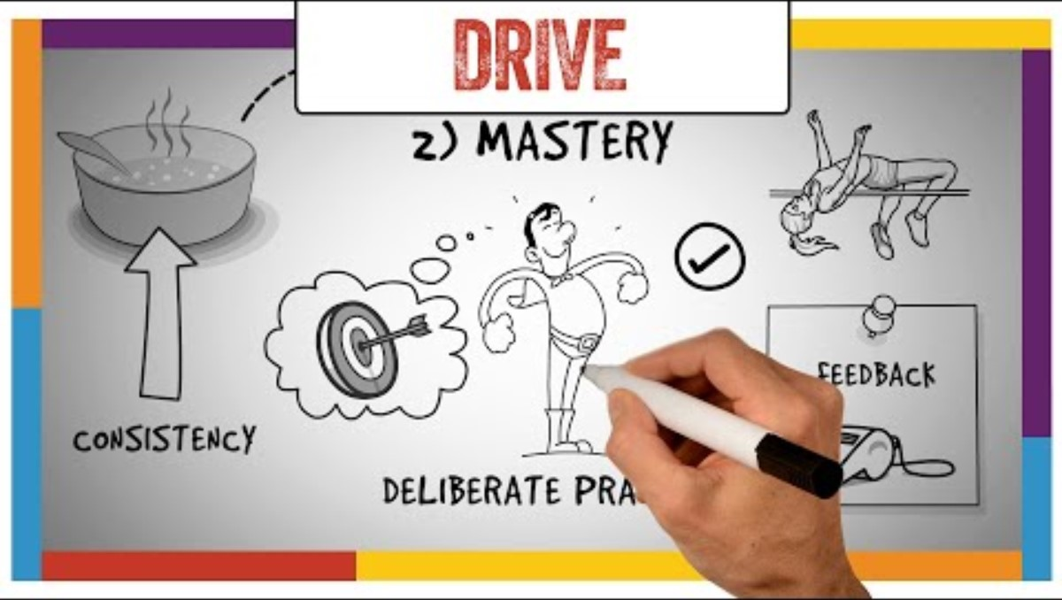

Motivation
TED Talk: Dan Pink – Author of DRIVE: The surprising Truth About What Motivates Us

Slide 9
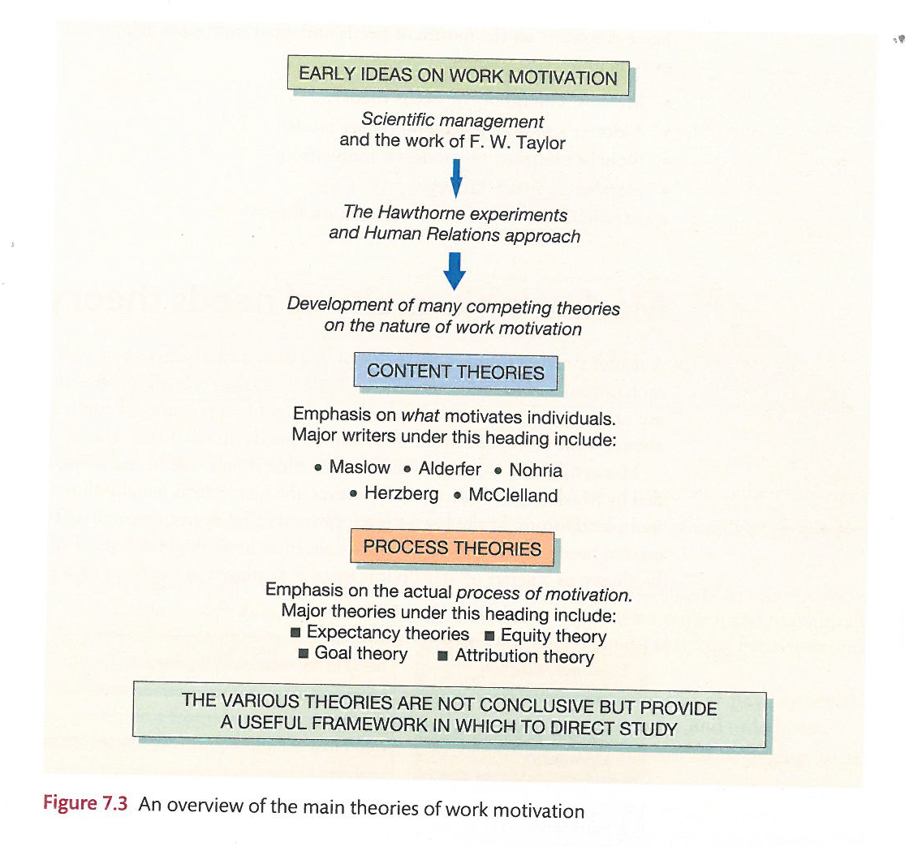
Motivation Theory
Notes:
There are many competing theories that attempt to explain the nature of motivation. They may all be partially true and help to explain the behaviours of certain people at certain times. There is no single answer. They show many motives that influence people’s behaviour and performance. Collectively they provide a framework within which to direct the problem of what motivates people
You can see from the diagram there are two distinct approaches content theory and process theory. We will discuss some of these in more detail.
It is important to note that none are conclusive. They all have their critics and are subject to alternative findings. But we can draw on them and how they might be applied in a particular work setting.

Slide 10

Early Ideas on Work Motivation
F.W.Taylor (1900)Scientific management – ‘economic man’
Employees motivated primarily by money
Important to ensure jobs enabled maximisation of earnings
Jobs had to be examined scientifically to establish the ‘best’ method and ‘best’ workers
Payment by results
Notes:
Is this type of thinking still relevant in todays organisations?
McDonalds, Amazon?

Slide 11

Early Ideas on Work Motivation
‘social man’ (1920’s)The Hawthorne Experiments
Workers studied over a period of time
Changes were made to rest breaks, start & finish times, refreshments, payment schemes, lighting
Production increased by 30%
Rewards should be seen in a broader context
Notes:
Productivity increased whether the lights were on or off. Why??

Slide 12
Key Motivation Theories
Maslow’s Hierarchy of Needs
Self
actualisation
Need to fulfil ones potential
Need to feel valued by self and others
esteem
social
(belongingness)
Need for attachment to person/group
Need for security, physical & psychological
safety
Need for warmth, food, drink, sex etc
physiological
Notes:
Once lower level of needs is satisfied, no longer acts as a motivator
Individuals transcend upwards towards fulfilment of higher level
Each level is distinct
Individuals may operate at more than one level

Slide 13
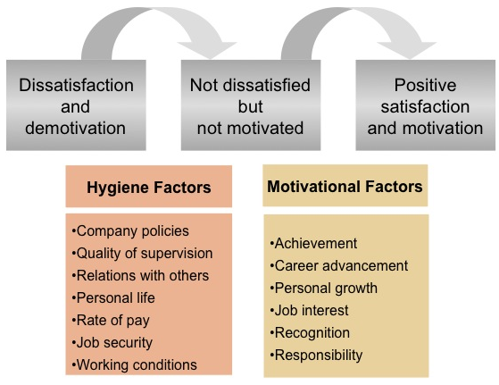
Key Motivation Theories
Herzberg’s Hygiene Factors

Slide 14
Vroom’s Expectancy Theory
Management must demonstrate to employees that effort will be rewarded
People prefer certain outcomes from their behaviour than others.
Onus on management to establish schemes to reward the behaviour it wants
Click here to view a YouTube video about Expectancy Theory
Notes:
Motivation =

Slide 15
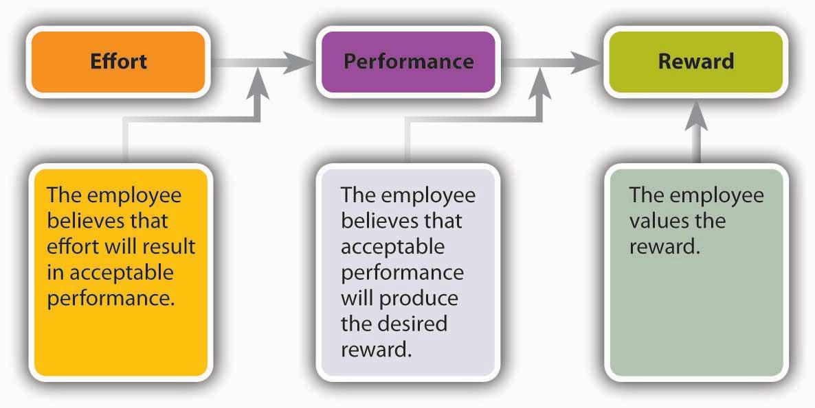
Vroom’s expectancy theory

Slide 16
Equity Theory (Adams,1963)
Based on our perception of fairness
Inequity when get more or less reward than perceived as deserved
Perceived imbalance between reward and contribution is not easily tolerated
Click here to view a YouTube video about Equity Theory

Slide 17
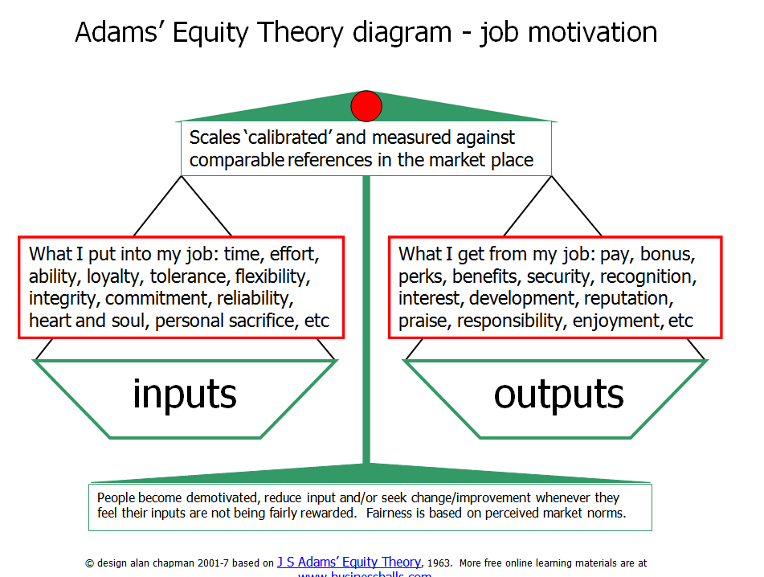

Slide 18
Q. Why is it important to understand what motivates
individuals?
A. Because it aids organisational decision making & encourages the development & use of strategies which will successfully develop high performing individuals
Q. What can organisations do to positively influence motivation?
A. Motivation may be positively influenced via:
Training & development
Safe working environment
Tools for the job
Positive employee relations
Reward – financial & non-financial
Adopting appropriate leadership style/s

Slide 19
The ideal situation
“To get the best from their employees organisations need to create conditions where staff actively want to get in early and stay late because they enjoy what they do and associate the company’s success with their own, just getting paid for attending work is not going to do this. What is required is an employee relationship where the employee regards themselves a stakeholder in the long term success of the company”
(Murton et al, 2010: p93)

Slide 20
Job Satisfaction
An attitude or internal state that is associated with the working environment and working experiences.
A key question:
  Does job satisfaction cause good performance or does good performance cause job satisfaction?

Slide 21
Dimensions of job satisfaction
Levels of job satisfaction can be affected by a wide range of variables including:
  Individual factors
  Social factors
  Cultural factors
  Organisational factors
  Environmental factors

Slide 22
Alienation at Work
Alienation refers to the detachment of the person from their work role. Marx viewed the division of labour as a means by which workers became estranged from their work.
Blauner identifies four dimensions of
alienation:
  Powerlessness
  Meaninglessness
  Isolation
  Self-estrangement

Slide 23
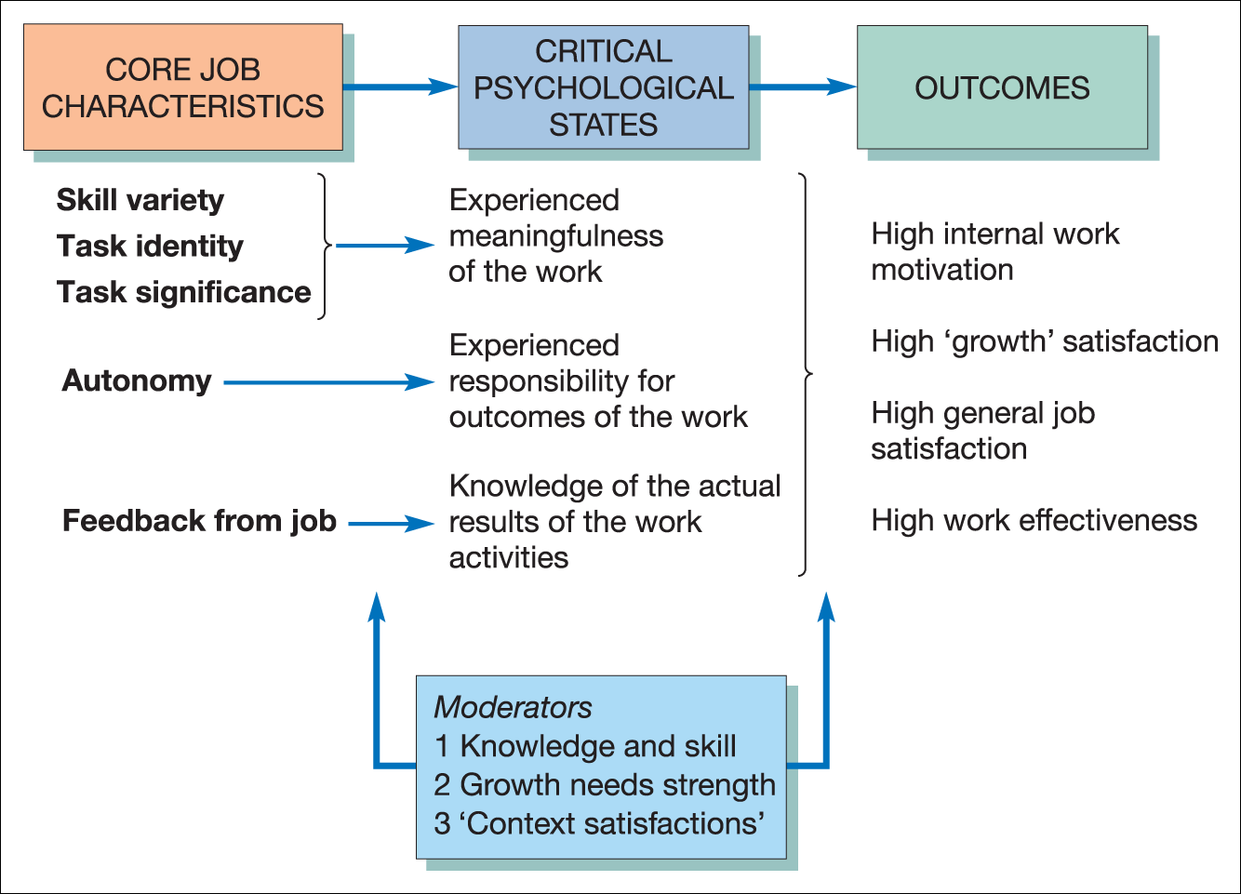
Job Enrichment Model
A job characteristics model of work motivation
Source: Hackman, J. R. and Oldham, G. R. Work Redesign, 1st ed., © 1980, Addison-Wesley Publishing Company, Inc. (1980), Figure 4.6, p. 90. Reproduced with permission from Pearson Education, Inc.

Slide 24
CIPD Good Work
The CIPD believes that good work is fundamental to individual wellbeing, supports a strong, fair society, and creates motivated workers, productive organisations and a strong economy.
They define ‘good work’ as work that:
• is fairly rewarded
• gives people the means to securely make a living
• provides opportunities to develop skills and a career and gives a sense of fulfilment

Slide 25
In groups
What is most important for motivation at work?
  The manager?
  Or what we call Good Work (CIPD)
  Explain why

