Slide 1
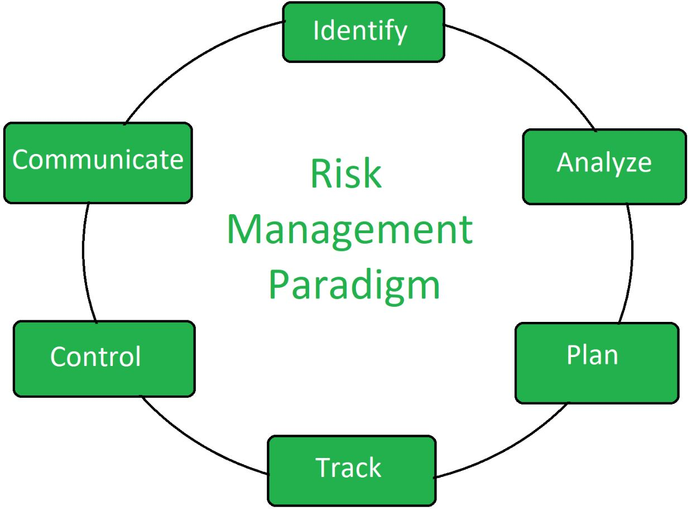
Risk Management

Slide 2

What is risk management?
Simply IT risk management is the application of risk management strategies to manage it threats. These methods include the use of procedures, tools and policies to identify and assess threats or vulnerabilities to a company’s IT infrastructure or network.

Slide 3

Why is the identification of risks and vulnerabilities to assets so important in risk management?
Simply it is important for risks and vulnerabilities to be identified because if a threat to a network can be correctly identified and understood then the process of protecting and safeguarding a network and its data from such threats is made easier, as organizations responsible for protecting networks from these threats will have a better understanding of how these threats work. This then helps organizations create suitable security to combat these threats.

Slide 4
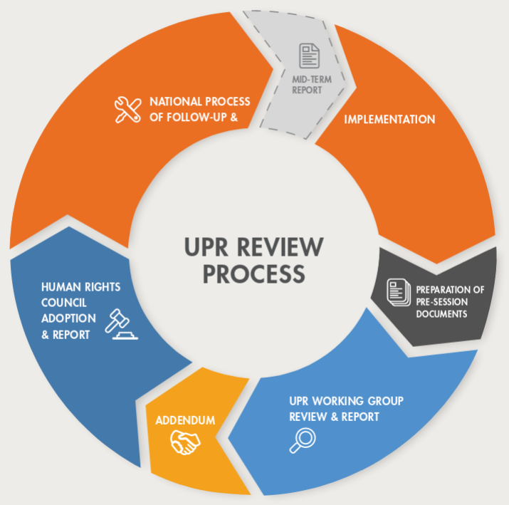
Why is a Periodic Review Important?
What is a periodic review in risk management strategies? A periodic review is a assessment of multiple factors and elements to figure out validation status and to figure out what actions to take to maintain the validated state. a periodic review is important in risk management strategies because threats are continuously and constantly changing so a periodic review allows an organization to maintain a good understanding of the features and common actions of different threats to a company or its network

Slide 5
Any Questions?

