Slide 1
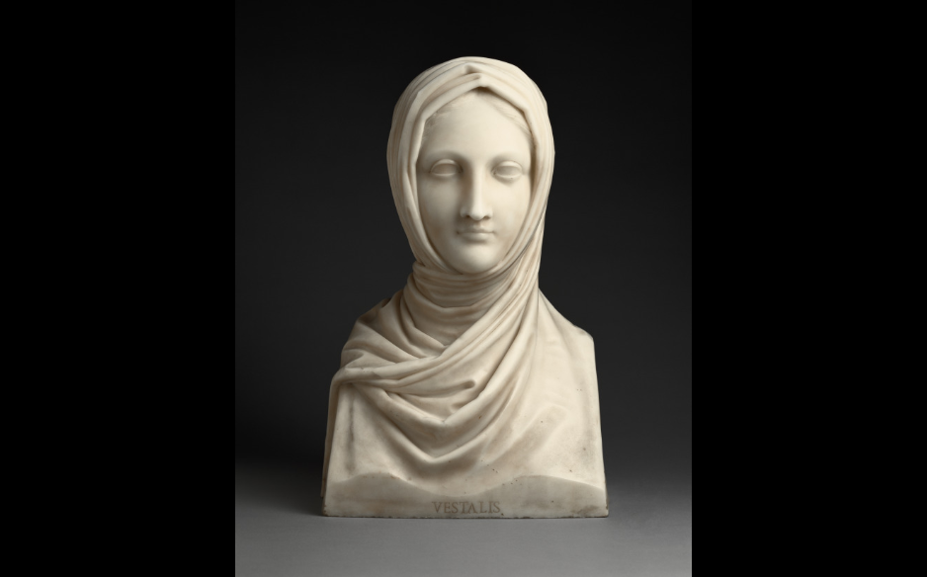
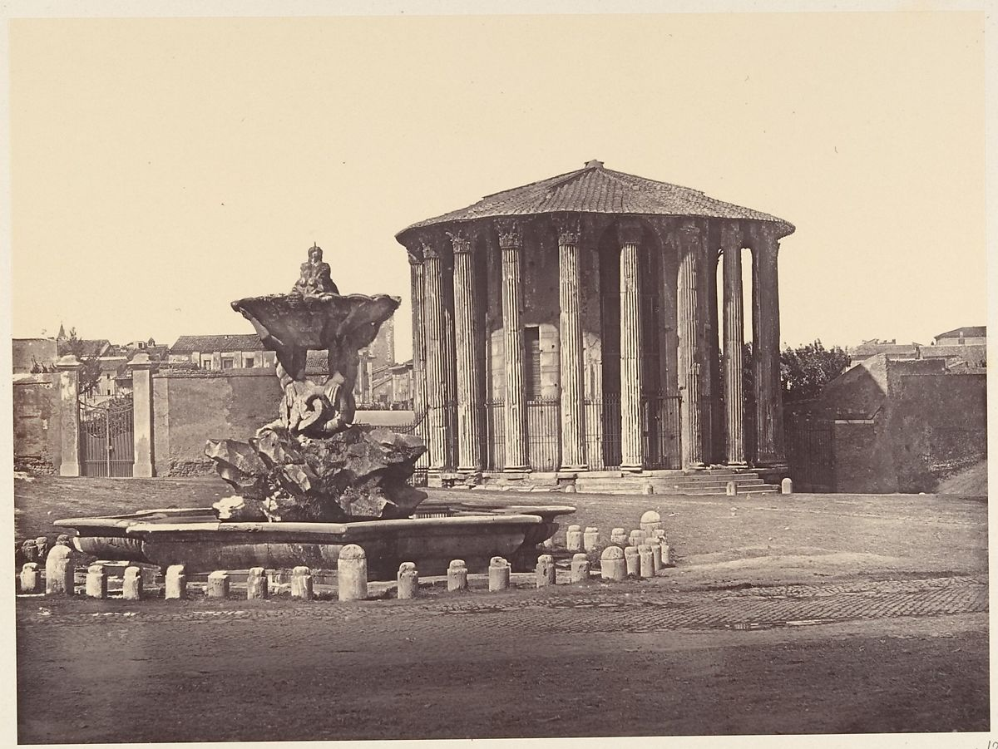
On The Status Of The Vestal Virgins, In Relation To Other Women, Within, And Without, The Order, During The Pax Romana Period Of Imperial Rome, 27BC-180AD
Fig. 2 (The Metropolitan Museum of Art, 2020(a))
Fig. 1 (The J. Paul Getty Museum, 2020)
By Samuel John Lawrence

Slide 2
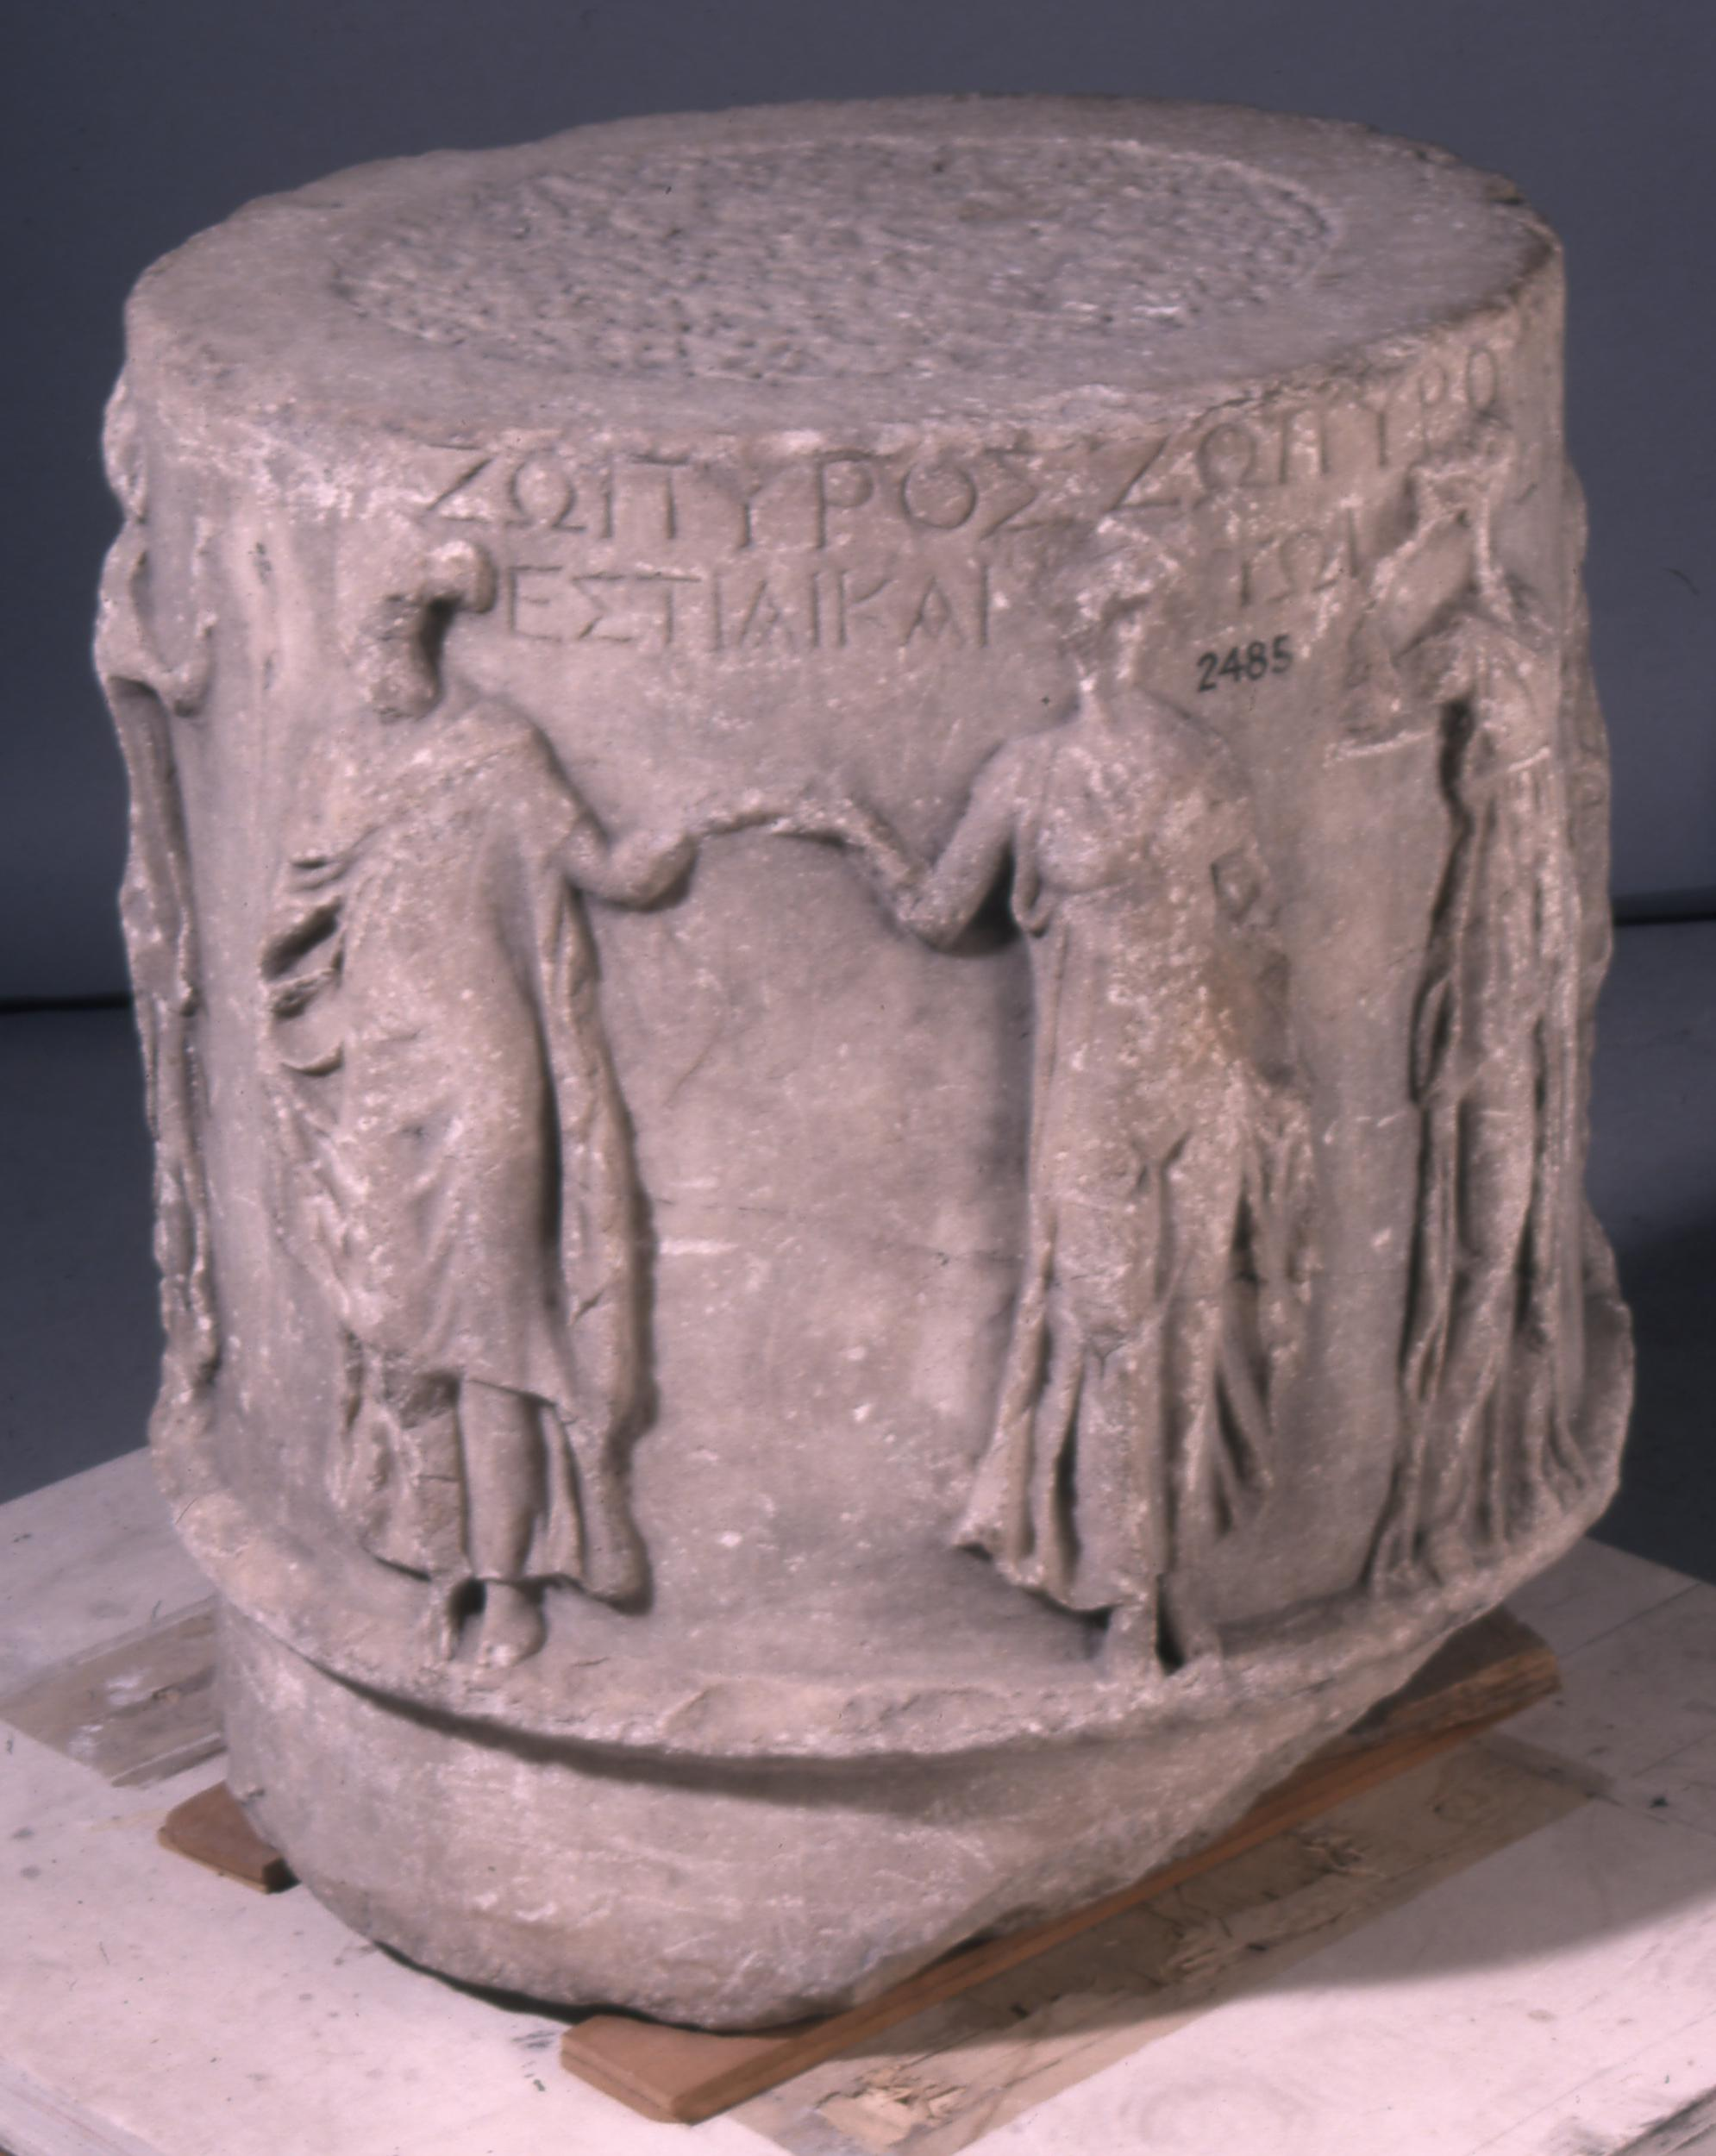
What Was The Vestal Order, And Who Were The Virgins?
A Roman religious order established, according to myth, in 715 BC, and 673 BC, by the semi-mythical Roman king Numa Pompilius (Plutarch, 2013, Pp.3-4 & Mac Dermott, 1853, P.44).
  Though more recent scholars disputer this (Roberts, 2012, Pp.25-29)
It lasted until the late fourth century AD (Lindner, 2015, P.259).
They were, since their inception according to Plutarch, an order which only chaste women could join (Plutarch, 2013, P.19 & Takacs, 2008, P.80 & Livy, 2012).
At any one time there would be six them, ranging in age from six years old, to extreme old age (Staples, 2014, P. 129).
The were priestesses of the goddess Vesta, typically identified with the Greek goddess Hestia, the deity of the hearth, home, and family, and – like her priestesses – a virgin (Clayton, 2017, P.59).
Their primary duty was to care for the flame of Vesta, a fire which was meant to never be extinguished (Plutarch, 2013, P. 19)
Fig. 3 (The British Museum, 2020(a))

Slide 3
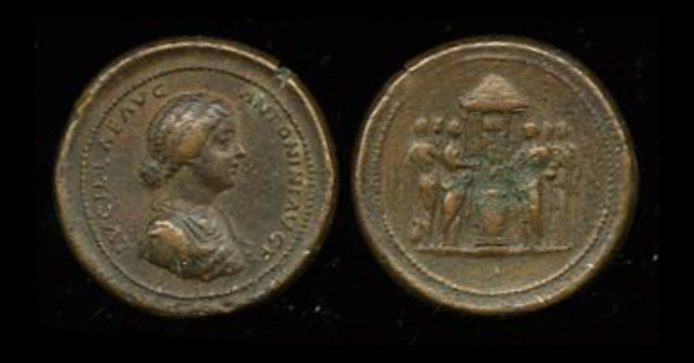
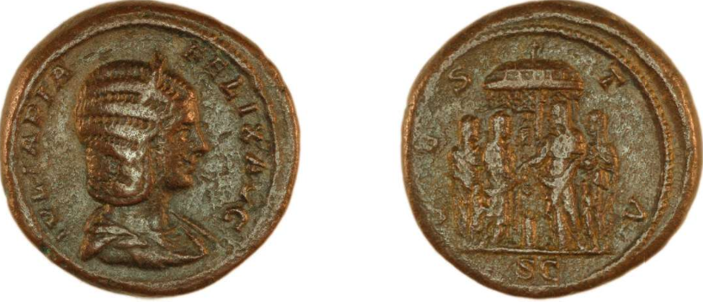
The Significance Of The Vestals In Society
According to popular superstition the Vestals held the power of life, and death over the people of Rome (Livy, 2012).
Legally they had similar level of significance to higher ranking men, and similar rights to men (Takacs, 2008, Pp. 81-83 & Osgood, 2011, P.70).
In addition, they had the right to intervene in matters of criminal law, They could, if they so chose, save the life of a condemned criminal (Fantham, Foley, et al, 1994, Pp.236-237 & Takacs, 2008, P.80).
Socially they were not so significant as to be absolutely respected. Plutarch suggests that virgins were chosen because, like the fire they consumed much, but produced nothing (Plutarch, 2013, P.19 & Dixon, 2007, P.52, P.61).
Fig. 4 (The British Museum, 2020(b))
Fig. 5 (The British Museum, 2020(c))

Slide 4
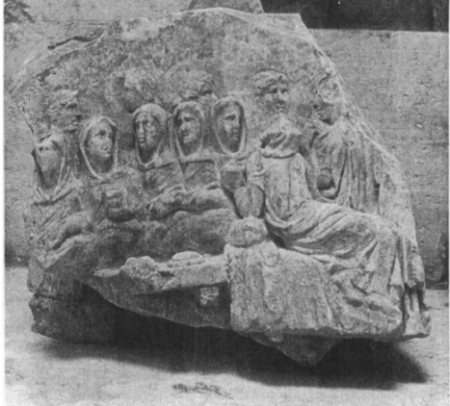
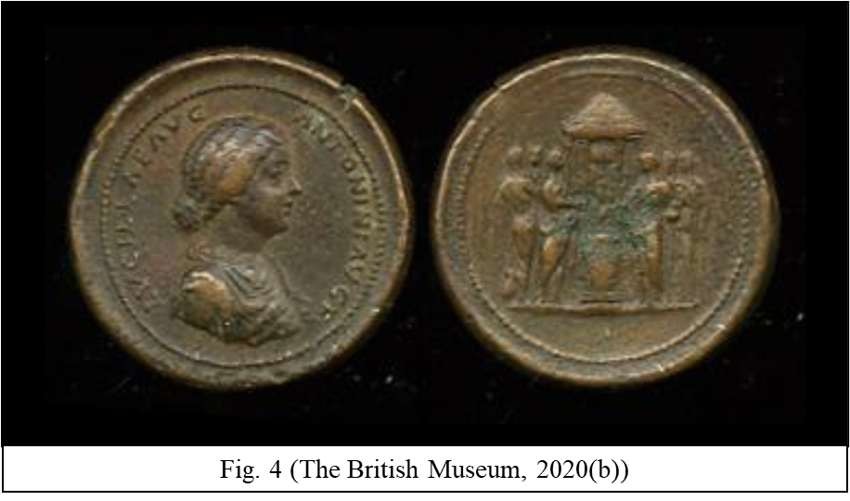
In Relation To Other Women (Within The Order)
Within the order the Vestals had a sort of hierarchy of experience, ranging from novice, to teachers (Biggi, 2018).
There is also the idea of a chief Vestal, suggesting a more official hierarchy (Biggi, 2018).
  However the nature of this is heavily disputed (Lindner, 2015, Pp.108-109 & Livy, 2012, Plutarch, 2013, P.21).
Within the order, the Vestals were outside of the conventional Roman social hierarchy (Takacs, 2008, P.81)
Fig. 6 (Fantham, Foley, et al, 1994, P. 236)

Slide 5
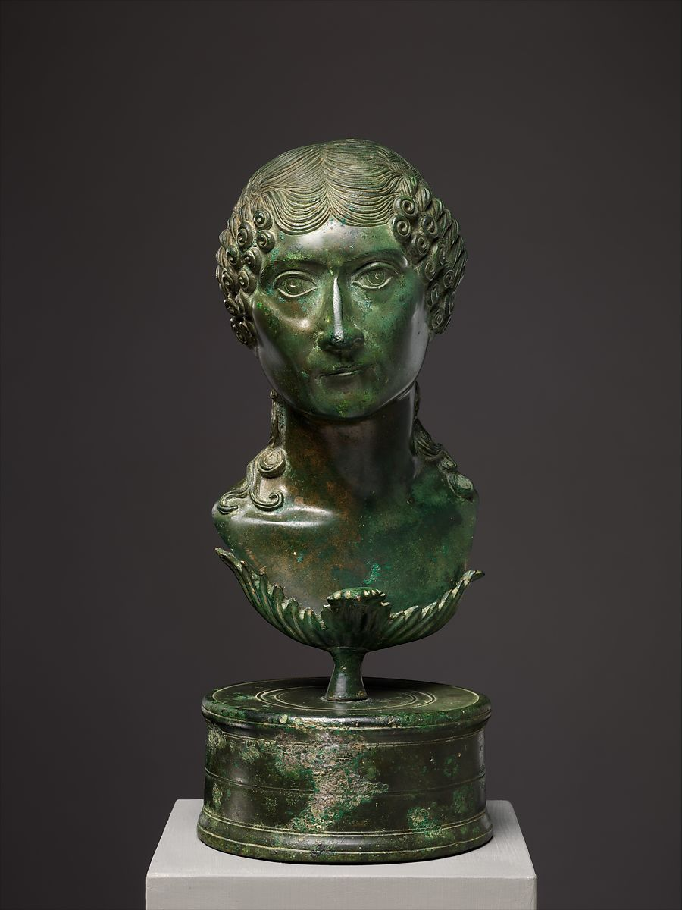
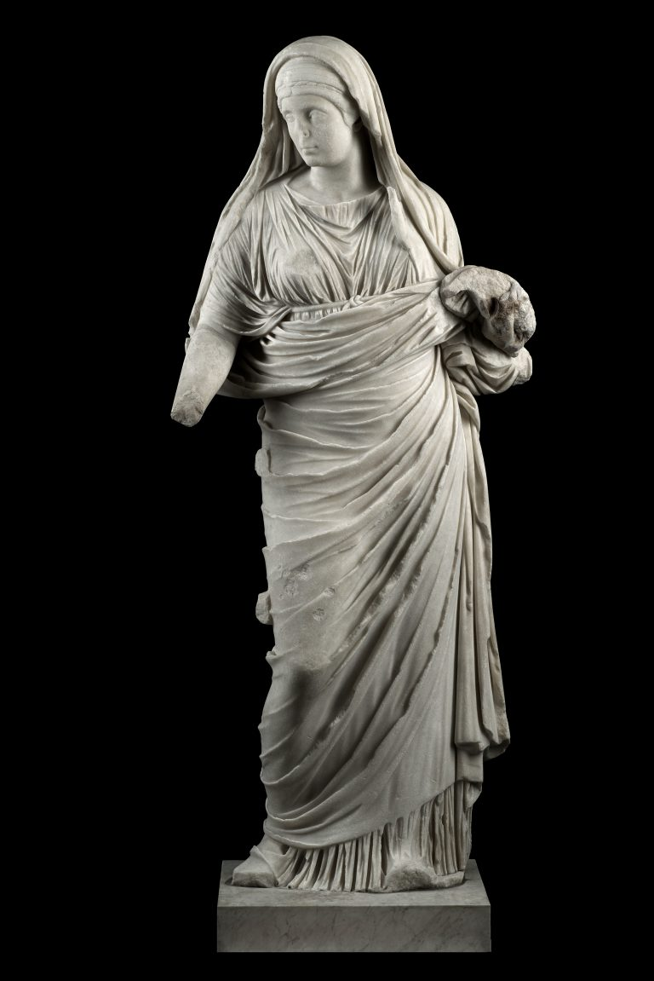
In Relation To Other Women (Outside Of The Order)
Fundamentally Vestals, and non-Vestal women, occupied different spheres (Takacs, 2008, P.81 & Dixon, 2007, P.52, P.61 & Livy, 2012 & Plutarch, 2013, P.21)
Non-Vestal women did not have the rights of Vestals {Plutarch, 2013, P.21 & Takacs, 2008, P.81 & Saller, 1994, P.161 & Skinner, 2005, P.7, P.195).
Even if they left the order, after their thirty years of service, former-Vestals still were treated differently from other women (Takacs,2008, Pp.80-81, P.83 & Shelton, 2013, P.312 & Plutarch, 2013, Pp.20-21).
Fig. 8 (The Metropolitan Museum of Art, 2020(b))
Fig. 7 (Palatine Museum, 2020)

Slide 6
Reference List
Biggi, E. 2018. Rome's Vestal Virgins: protectors of the city's sacred flame. National Geographic. Available from: https://www.nationalgeographic.com/history/magazine/2018/11-12/vestal-virgins-of-ancient-rome/. [Accessed on: 11/11/20]
Clayton, M. 2017. Roman Mythology: A Captivating Guide to Roman Gods, Goddesses, and Mythological Creatures. California, CreateSpace Independent Publishing Platform.
Dixon, S. 2007. Cornelia; Mother of the Gracchi. Abingdon, Routledge.
Fantham, E., Foley H. P, et al. 1994. Women In The Classical World: Image and Text. New York, Oxford University Press.
Lindner, M. M. 2015. Portraits of the Vestal Virgins, Priestesses of Ancient Rome. Michigan, University of Michigan Press.
Livy. 2012. The Complete: Livy The History Of Rome. Kindle Version. Bybliotech (trans.). London, Bybliotech.org.
Mac Dermott, W. C. 1853. History Of Rome From Its Earliest Period To The Death Of Vespasian. Dublin, Alex, Thom And Sons.
Osgood, J. 2011. Making Romans In The Family, in Peschin, M.(ed.) The Oxford Handbook of Social Relations in the Roman World. 69-83. Oxford, Oxford University Press.
Palatine Museum. 2020. Statue Of Vestal Virgin. Parco Archeologico Del Colosseo. Available from: https://parcocolosseo.it/en/opere/statue-of-vestal-virgin/. [Accessed on: 12/11/2020].
Plutarch. 2013. Numa Pompilius. Dryden, J. (trans.). California, CreateSpace Independent Publishing Platform.
Roberts, J. M. 2012. Rome’s vestal virgins: public spectacle and society. Washington. Western Washington University.
Saller, R. P. 1994. Patriarchy, Property and Death in the Roman Family. Cambridge, Cambridge University Press.
Skinner, M. B. 2005. Sexuality In Greek And Roman Culture. Oxford, Blackwell Publishing.
Staples, A. From Good Goddesses to Vestal Virgins: Sex and Category in Roman Religion. Abingdon, Routledge.
Takacs, S. A. 2008. Vestal Virgins, Sybils, And Matrons: Women in Roman Religion. Kindle Version. Texas, University of Texas Press.
The British Museum. 2020(a). Altar; votive offering. The British Museum. Available from: https://www.britishmuseum.org/collection/object/G_1890-0113-1. [Accessed on: 11/11/2020].
The British Museum. 2020(c). Coin. The British Museum. Available from: https://www.britishmuseum.org/collection/object/C_R-15936. [Accessed on: 11/11/2020].
The British Museum. 2020(b). Medallion. The British Museum. Available from: https://www.britishmuseum.org/collection/object/C_1868-0512-8. [Accessed on: 11/11/2020].
The J. Paul Getty Museum. 2020. Herm of a Vestal Virgin. The J. Paul Getty Museum. Available from: http://www.getty.edu/art/collection/objects/1115/antonio-canova-herm-of-a-vestal-virgin-italian-1821-1822/. [Accessed on: 10/11/2020].
The Metropolitan Museum of Art. 2020(a). Tempio di Vesta. The Metropolitan Museum of Art. Available from: https://www.metmuseum.org/art/collection/search/288408. [Accessed on: 10/11/2020].
The Metropolitan Museum of Art, 2020(b). Bronze portrait bust of a Roman matron. The Metropolitan Museum of Art. Available from: https://www.metmuseum.org/art/collection/search/254698?searchField=All&amp;sortBy=Relevance&amp;when=A.D.+1-500&amp;ft=roman+woman&amp;offset=60&amp;rpp=20&amp;pos=65. [Accessed on: 12/11/2020].
.

