Slide 1

Management
Students’ names and IDs:
Flaviu-Ioan-Costin Stefan (2212282)
Valentin Masala (2236548)
Sergiu Constantine Grigorescu (2233162)
Codrin Chirciu (2027548)
Lecturer’s name: Dr. Laila Maazouz
Module’s name and code: Introduction to Leadership and Management LCBB4008

Slide 2
Introduction
This presentation is about managerial principles, functions, roles and behaviours. It will contain definitions, as well as examples and strategies for each of the sections.

Slide 3
Management principles
Customer focus (Baporikar, 2019)
Finding out what the customers want and taking actions in order to satisfy their requests. For example, through experience surveys.
Example: Tesco’s customer surveys.
Engagement of people (Baporikar, 2019)
Employees taking part to shaping their workplace through their own decisions, this helping to maximise their efficiency.
Example: Google that finds ways to always include their employees in their decisions and diversify the workplace.

Slide 4
Management principles
Evidence-based decision making (Baporikar, 2019)
Taking decisions based on statistics and analysing the issue rather than quick reactions to improve the outcome.
Example: The risk assessments that are done by Tesla to stay ahead of the competition.
Continual improvement (Baporikar, 2019)
Assessing the weaknesses and the opportunities of a company and coming up with innovative ways of development.
Example: Samsung’s devices.

Slide 5
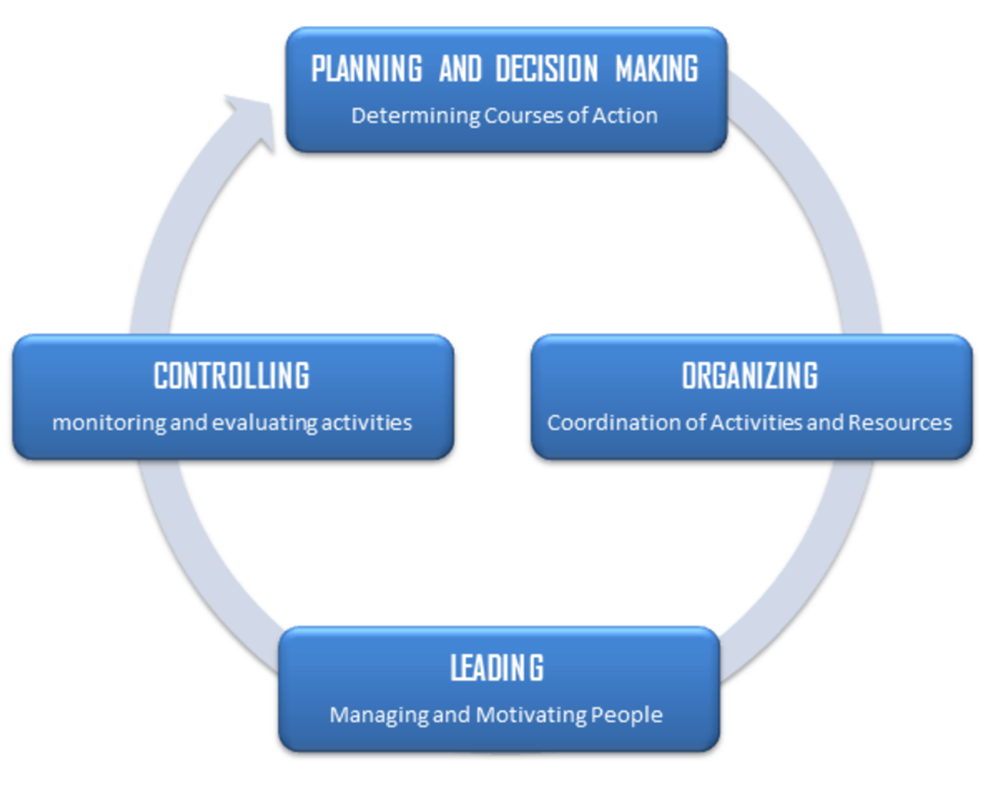
Management function
The Four Functions of Management by Fayol covers how managers should use their time.

Slide 6

Planning
Planning involve:
Goals and activities for the project
Setting up plans
Putting together plans to combine and organize work tasks.
Planning gives managers and people who aren't managers direction (Robbins & Coulter, 2020).
The planning process may include market trends, resource and financial studies, and risk assessments.

Slide 7

Organizing
People + Resources
Organizing is a managerial activity that organizes staff duties and activities to achieve a goal .
Communications are a key part of delegating and coordinating work tasks (Cole & Kelly, 2020).
plays a crucial role in helping businesses improve the utilization of their resources efficiently.
Customer Relationship Management (CRM)

Slide 8
Leading
Leading in an organization means directing and guiding people.
Thibault and Whillans (2018) discovered that appropriate reward power increases employee satisfaction, retention.
Maximize personnel potential.
Communication –important tools in leading.
Motivation- encouraging .
Role model –example for employees.

Slide 9

Controlling
Controlling is about making sure the organization meets its goals and fixing any issues.
Controls should be based on results(Drucker, 1974).
checking and giving feedback
tracking, comparing, and adjusting productivity on the job.
helps to identify the problems.
fixing things that don't follow standards and goals (Koontz et al., 1980).
Decision –Making essential in controlling for corrective action.

Slide 10
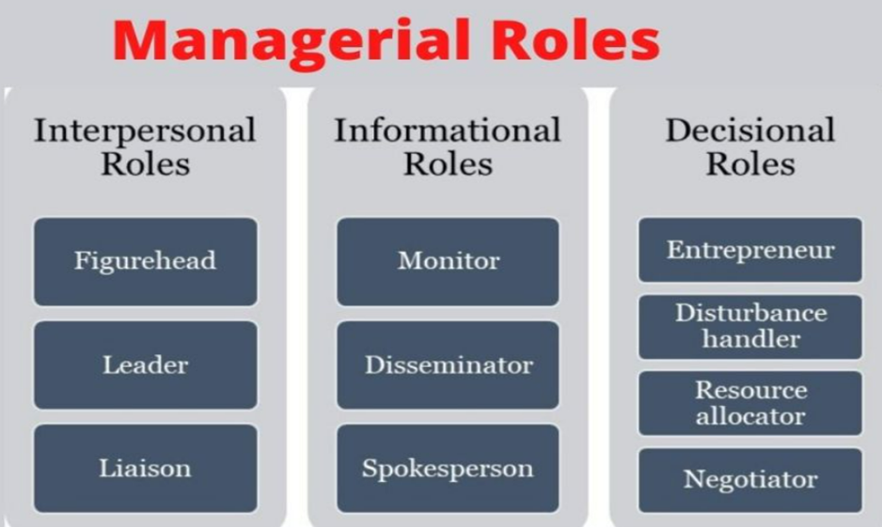
Defined things that employees should do and how managers should act (Robbins, S. P., & Coulter, M. 2020).
These roles show what managers need to do to run groups and companies.
The idea of Henry Mintzberg's "ten manager positions" shows how complicated and changing management work is.

Slide 11

Interpersonal Roles include things that people have to do when they deal with coworkers and other important people. Figurehead, leader, and liaison are some of the managerial jobs that fall into this group.
The Leader A manager's job is to keep an eye on how their workers are doing.
The leader may set the goals and win the support of employees(Cole, G.A and Kelly, P. Phil(2020).
This position requires advise, training, reviews, and inspiration.

Slide 12

Informational roles: Managers develop, get, or exchange information with lower-level coworkers and employees to achieve goals.. In this group of managerial jobs are monitor, disseminator, and spokesperson.
Spokesperson
represent a firm and communicate goals and policies to stakeholders.

Slide 13

Decisional roles
Managers need to use the data they collect to make decisions about business and strategy. Job titles in this group of management positions include entrepreneur, disturbance handler, resource allocator, and negotiator(Robbins, S. P., & Coulter, M. 2020).
Negotiator
Some mediators lead talks, while others take part in them. At these meetings, which might include outside groups, you will speak for the best interests of your company.

Slide 14
Managerial behaviours
Managerial Behaviour:
The actions and attitudes of managers in guiding, supporting, and overseeing employees to achieve organizational goals. This includes decision-making, communication, leadership styles, and methods for motivating and developing staff. According to Smith (2020), “Managerial behaviour significantly influences the productivity and morale of employees, making it a critical aspect of organizational success.”

Slide 15
Key Managerial Behaviours
 | SUPPORTING EMPLOYEE GROWTH | FAIR TREATMENT IN THE WORKPLACE
DEFINTION | Actively helping employees to advance in their careers and develop their skills. | Ensuring that employees are treated with respect and equity
STRATEGIES | Providing regular feedback and performance reviews (Smith, 2020). - Offering training and development programs (Johnson & Lee, 2019). - Mentoring and coaching employees (Brown, 2021). | Implementing clear and consistent policies (Davis, 2018). - Promoting a culture of inclusivity and diversity (Taylor, 2022). - Addressing grievances and conflicts impartially (Garcia, 2020).
EXAMPLE | A manager who regularly checks in with team members to understand their career goals and provides opportunities for growth demonstrates supportive behaviour (Smith, 2020). | A manager who applies company policies consistently and addresses employee grievances fairly fosters a positive workplace environment (Taylor, 2022).

Slide 16
Conclusion
Overall, management is essential for managers to lead their team effectively, achieve organisational objectives, and grow professionally.

Slide 17
References
Baporikar, N. (2019) Quality management principles and policies in higher education. Edited by N. Baporikar and M. Sony. Hershey, Pennsylvania: IGI Global. Available at: https://doi.org/10.4018/978-1-7998-1017-9.
Brown, T. (2021). Mentorship in the modern workplace. Business Leadership Review.
Cole, G. A., & Kelly, P. (2020). Management Theory and Practice (9th ed.). Cengage Learning.
Davis, L. (2018). Effective management policies. Human Resource Management Journal.
Drucker, P. F. (1974). Management : tasks, responsibilities, practices. Harper Business.
Garcia, M. (2020). Conflict resolution in the workplace. Journal of Organizational Behaviour.
Johnson, P., & Lee, K. (2019). Training and development strategies. Training Today.

Slide 18
References
Koontz, H., O’Donnell, C., & Heinz Weihrich. (1980). Management. McGraw-Hill Companies.
P Kelly (Phil) 1965- author & G A Cole (Gerald A) author (eds.) (2020) Management theory and practice. Ninth edition / Gerald A. Cole, Phil Kelly. Andover, Cengage Learning.
Robbins, S. P., & Coulter, M. (2020). Management (15th ed.). Harlow, England Pearson.
Smith, J. (2020). The role of feedback in employee development. Employee Development Review.
Taylor, R. (2022). Promoting inclusivity in the workplace. Diversity and Inclusion Journal.
Thibault L. A., & Whillans, A. (2018). The power of workplace rewards: Using self-determination theory to understand why reward satisfaction matters for workers around the world. Compensation & Benefits Review, 50(3), 123-148.

Slide 19

Thank you!
Questions?

