Slide 1
Markets
Entrepreneurship
M5X01572

Slide 2
Markets
What is your product?
  Your film?
  You?
What do you want to achieve?
  Money?
  Awards?
  Exposure?

Slide 3
Market research
What do you need to know about them?
What is your competition?
How do you distinguish yourself?

Slide 4

Markets

Slide 5
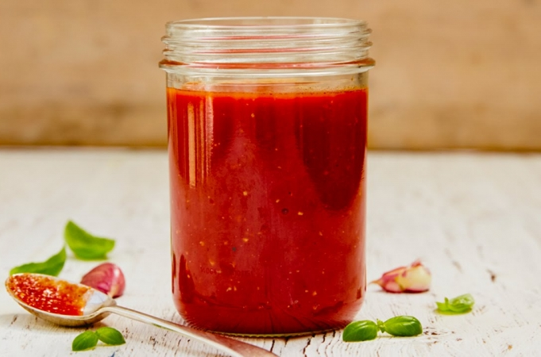
Markets

Slide 6
Markets
Cooked Beans
Simmered Beans
Warmed Beans
Stewed Beans

Slide 7

Markets

Slide 8
Markets
What do you need to know about them?

Slide 9
Markets
Types of film:
  Studio
  Independent
  Micro-budget
  No budget
  Shorts

Slide 10
Markets
Rights are sold for/to:
  Theatrical
  VoD
  TV
  DVD

Slide 11
Markets
Rights are sold by:
  Sales agents
  Distributors

Slide 12
Markets
Sales agents & distribs look for “comps”
Comparable films
  How did they do in the market?
  Where were they shown (in festivals)?
  Making a cost versus value judgement

Slide 13
Markets
What is the shorts market?

Slide 14
Festivals
Awards qualifiers
Industry markets
General festivals
Specialist festivals
Competitive
Non-competitive

Slide 15


Festival Portals

Slide 16
Other shorts markets
Youtube/Vimeo
Curated websites
iTunes
Presales via crowdfunding
Funded short film schemes

Slide 17
Markets
What do you want to do?
How will this film sell you?

Slide 18
Markets
What are the expectations of the market?
What are the minimum quality standards expected of your film?
What is your competition?
How do you distinguish yourself in your market?

Slide 19
Markets - Seminar
Presentation of the market for your film
  Relevant festivals
  Curated websites
  Other outlets
Analysis of relevant “comps”
  Short films in similar genre
  Short films with similar theme
  Short films at similar level

