Slide 1

Macro and Micro Environment

Slide 2
Todays lecture
In todays lecture we will be looking at the following theories or threads, using McDonalds as our case study:
Business Environment – Macro and Micro environments
Business Strategy using Micro and Macro principles
Hofstede’s Cultural Dimensions

Slide 3
Macro and Micro Environment
Every business organization is a part of the business environment, within which it operates. No entity can function in isolation because there are many factors that closely or distantly surrounds the business, which is known as a business environment. It is broadly classified into two categories, i.e. micro environment, and macro environment.
External
Internal
Marketing Management
Micro Env
Macro

Slide 4
Activity
In groups, discuss the possible Macro areas for consideration within the Business Environment of McDonalds.

Slide 5
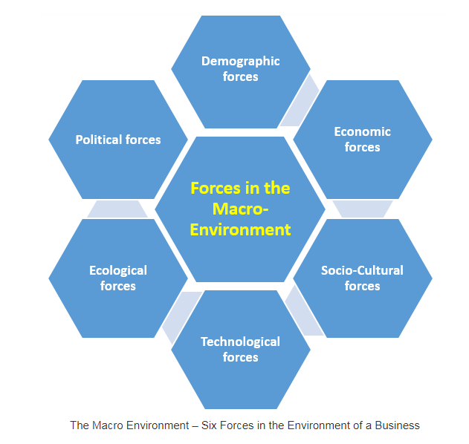
Macro
Macro environment in Marketing consists of 6 key forces:
DESTEP MODEL
Demographic
Economic
Socio Cultural
Technological
Ecological
Political

Slide 6
Demographic Forces in the Macro Environment
Demographic forces relate to people. The name refers to the term Demography. The latter refers to the study of human populations. This includes size, density, age, gender, occupation and other statistics.
Changing demographics mean changing markets. Further, changing markets mean a need for adjusted marketing strategies.
Marketers should keep a close eye on demographics, keys areas are:
World population growth
Changing age structure
Changing family structures
Geographic shift in population
Notes:
World population growth
The world population is growing at an explosive rate. Already in 2011, it reached 7 million, while being expected to reach 8 billion by the year 2030. By the end of the century, it is likely to double. However, the strongest growth occurs where wealth and stability is mostly absent. More than 70% of the expected world population growth in the next 40 years is expected to take place outside of the 20 richest nations on earth. This changes requirements for effective marketing strategies and should be kept in mind.
Changing age structure
The changing age structure of world population is another critical factor influencing marketing. In the future, there will be countries with far more favourable age structures than others. For example, India has one of the youngest populations on earth and is expected to keep that status. By 2020, the median age in India will be 28 years. In contrast, the countries of the European Union and the USA have to face an aging population already today. This may lead to harmful reductions in dynamism and challenges regarding the supply of young workers who, at the same time, have to support a growing population of elderly people.
Changing family structures
Also, families are changing which means that the marketing strategies aimed at them must undergo an adjustment. For example, new household formats start emerging in many countries. While in traditional western countries a typical household consisted of husband, wife and children, nowadays there are more married couples without children, as well as single parent and single households. Another factor comes from the growing number of women working full time, particularly in European nations. Together with further forces, changing family structures require the marketing strategy to be changed.
Geographic shifts in population
One – and the most important – element of geographic shifts is migration. By 2050, global migration is expected to double. This has a major impact on both the location and the nature of demand for products and services. The reason is that the place people can be reached has changed, as have their needs because of the new situations. Other important factors are the ethnic diversity that provides new opportunities, as well as urbanisation.

Slide 7
Economic forces in the Macro Environment
The Economic forces relate to factors that affect consumer purchasing power and spending patterns. For instance, a company should never start exporting to a country before having examined how much people will be able to spend. Important criteria are: GDP, GDP real growth rate, GNI, Import Duty rate and sales tax/ VAT, Unemployment, Inflation, Disposable personal income, and Spending patterns.

Slide 8
Socio-Cultural forces in the Macro Environment
The Socio-Cultural forces link to factors that affect society’s basic values, preferences and behaviour. The basis for these factors is formed by the fact that people are part of a society and cultural group that shape their beliefs and values. Many cultural blunders occur due to the failure of businesses in understanding foreign cultures. For instance, symbols may carry a negative meaning in another culture. To understand these forces, Hofstede’s cultural dimensions can be used: Power Distance, Individualism versus Collectivism, Masculinity versus Femininity, Uncertainty Avoidance etc.

Slide 9
Technological forces in the Macro Environment
Technological forces form a crucial influence in the Macro Environment. They relate to factors that create new technologies and thereby create new product and market opportunities.
A technological force everybody can think of nowadays is the development of wireless communication techniques, smartphones, tablets and so further. This may mean the emerge of opportunities for a business, but watch out: every new technology replaces an older one. Thus, marketers must watch the technological environment closely and adapt in order to keep up. Otherwise, the products will soon be outdated, and the company will miss new product and market opportunities.

Slide 10
Ecological forces in the Macro Environment
Ecological, or natural forces in the Macro Environment are important since they are about the natural resources which are needed as inputs by marketers or which are affected by their marketing activities. Also, environmental concerns have grown strongly in recent years, which makes the ecological force a crucial factor to consider. For instance, world, air and water pollution are headlines every marketer should be aware of. In other words, you should keep track of the trends in the ecological environment.
Important trends in the ecological environment are the growing shortage of raw materials and the care for renewable resources. In addition, increased pollution, but also increased intervention of government in natural resource management is an issue.
Because of all these concerns and the increased involvement of society in ecological issues, companies more than ever before need to consider and implement environmental sustainability. This means that they should contribute to supporting the environment, for instance by using renewable energy sources. Thereby, businesses do not only support the maintenance of a green planet, but also respond to consumer demands for environmentally friendly and responsible products.

Slide 11
Political forces in the Macro Environment
Every business is limited by the political environment. This involves laws, government agencies and pressure groups. These influence and restrict organisations and individuals in a society. Therefore, marketing decisions are strongly influenced and affected by developments in the political environment.
Before entering a new market in a foreign country, the company should know everything about the legal and political environment. How will the legislation affect the business? What rules does it need to obey? What laws may limit the company’s ability to be successful? For example, laws covering issues such as environmental protection, product safety regulations, competition, pricing etc. might require the firm to adapt certain aspects and strategies to the new market.

Slide 12
Activity
Create a DESTEP model for McDonalds, within each section rank the organisation/area/person within order of importance/impact.
For example.
Political
Local Government 2 Key
Local MP 4 1 being most important.
UK Government 1
EU 3

Slide 13
Activity
Consider the micro environment of McDonalds, write these down and be prepared to discuss.

Slide 14
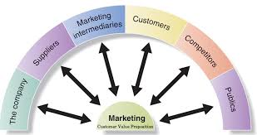
Micro Environment
https://www.youtube.com/watch?v=d1QUX2AFjz0

Slide 15
Customers
They are considered the most important factor in the microenvironment because of the impact they have on it. Their importance has grown higher in the 21st century. Moreover, the better a business knows its customers, the better is its revenue and profits. A company can draft strategies and promotional campaigns to attract and retain its customers in a better manner by understanding its customers better. Being more customer-oriented helps in the new era because serving them in customized manners helps retain hem longer.

Slide 16
Employees
Employees are one of the very important micro-economic factors affecting the performance of any business. The performance of the employees is one of the primary drivers of a business’ productivity. Research has also highlighted the key role that HR plays in the success of a business. A large number of successful companies have excellent HR policies and provide the best training and salaries to their employees, like Google. How motivated and skilled your employees are determines how successful the business is going to be. This is also why companies focus on attracting and retaining the best talent.

Slide 17
Suppliers and distribution channels:
Supply chain management and the management of your distribution channels should also be a primary focus if you want your business to be successful. Having a well managed supply chain reduces your costs and improves efficiency. Some companies that have managed efficient supply chains have been able to pass the savings to the customers, like Costco. Similarly, selecting the right distribution channels also affects your operational efficiency and improves your profits. Apart from sales, customer service is also just as important. You need to be within your customers’ easy reach if you want your business being popular and successful.

Slide 18
Competitors
Competition is everywhere and in every industry. The level of competition in any industry has a major effect on a business’ profits. The higher the number of your competitors, the lower is your market share. When several businesses are battling for winning a market share in limited space, the chances of the market growing saturated quicker are higher. Not just this, competition affects businesses in other ways too. To stand out in a highly competitive market is not easy and businesses must differentiate to attract customers. Moreover, the pressure of competition also compels businesses to regularly update their business and marketing strategies. However, sometimes competition can be a positive factor and can help churn demand.

Slide 19
Shareholders and Investors
Shareholders and investors are among the most important internal stakeholders for any business. Businesses also exist for creating shareholder value. These people have helped you grow your business and expect returns on their investment. You share both your risks and profits with them. So, any business must create healthy profits to keep its investors happy.

Slide 20
Public and Media
A company’s image also decides its fortune in the market. So, every brand in the 21st century wants to have a good brand image. It is why they are investing in social and environmental concerns to have a good social image. Often this also translates into financial success for businesses. Brands with a good brand image are easily noticed and are therefore successful at attracting customers. Public supports the companies that have an ethical image and if you are not a responsible business, chances of a poor image in public and media are higher. Image means a lot in today’s environment and sometimes lost image can be very difficult to regain.

Slide 21
Strategising
Micromarketing: Segmentation - Micromarketing focuses on a small target group in the market. It looks for demographic data to identify a specific type of buyer for a company's product or service. Segmentation can also pertain to buying habits, lifestyle choices and hobbies. Business owners who understand buyers are better able to target ads and marketing efforts to them.
Macromarketing: Scaling Up - Macromarketing takes advantage of economies of scale; it looks at the bigger picture targeting the maximum number of people. Macromarketing strategies are concerned with how the product benefits society as a whole or fulfills a need in society. The goal is to assess the buying trends, customer behavior patterns and regulatory environment. Where micromarketing is directed at one segment of the market, macromarketing looks at the whole market. Coke-Cola doesn't target a small number of specific buyers but instead tries to give everyone a reason to buy Coke when making a soft drink choice.

Slide 22
Activity – Discussion in groups
How relevant do you think the Micro and Macro Environment are to todays marketers?
Would you include it in your marketing plan? If so, how would you write it and what would you include?
Conduct some research on your phones/laptops. Look for examples of Business Environment considerations in marketing plan.
What are the differences between Stakeholder Theory and Business Environment Theory?

Slide 23
Final Activity
https://www.youtube.com/watch?v=RvOv5whZ-a0
Watch the Video about McDonalds, McDonalds face a number of ethical challenges relating to their products and their brand. The have attempted to address these over the past few years with a number of Social Marketing campaigns.
Looking at where McDonalds are today, what could be their next Social Marketing campaign. Please consider their micro and macro environments when designing their campaign.

Slide 24
Pre-lecture Work
Read the Journal on Moodle entitled Hofstede’s dimensions of culture in international marketing studies.
Make notes and be prepared to discuss at the next lecture.

