Slide 1
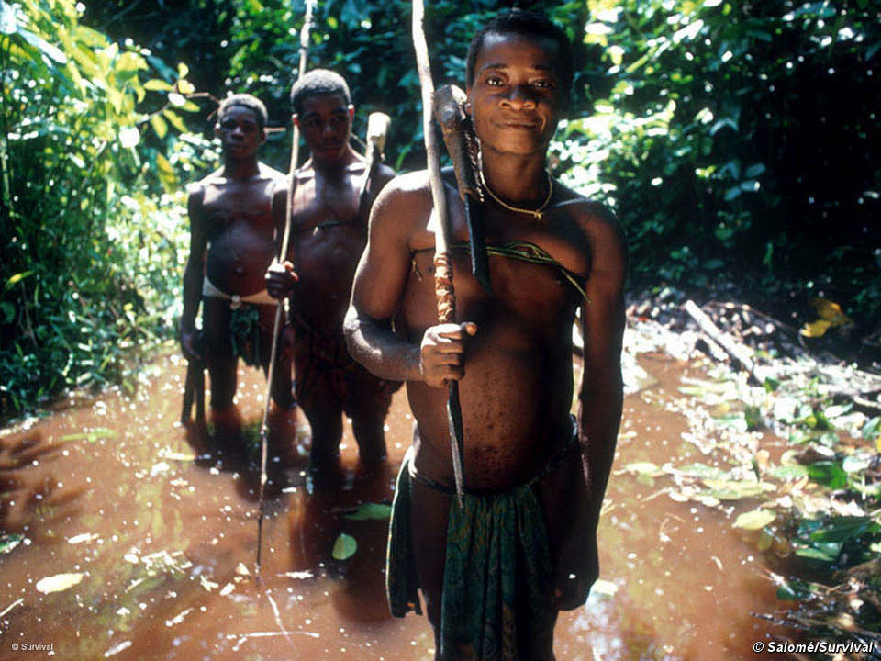
Egalitarianism and the hunting hypothesis

Slide 2
‘Man is man, and not a chimpanzee, because for millions upon millions of evolving years we killed for a living’ (Ardrey, 1977 The Hunting Hypothesis: p15)

Slide 3
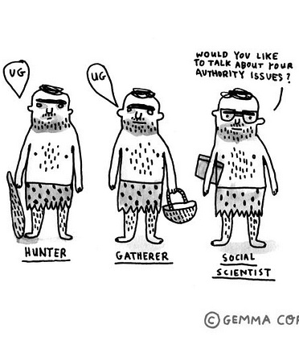
Hunting hypothesis
Foregrounds hunting as explanation of emerging characteristics of modern humans
Hunting = tools = cognitive advances
Implicit is assumption that hunting is aggressive domineering (masculine) too
Materialist explanation for culture
  Nutrition (protein) driver of changes

Slide 4
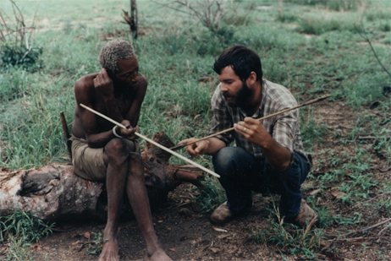
Ethno-archaeology casts doubts
Excessive emphasis on dietary habits denies sociality
  Culture (sociality) = shared meaning
Group dynamics and meaning need consideration – arguably more important than nutrition (remember Sahlins?)
So being social may be more significant and useful framework to structure ideas in

Slide 5
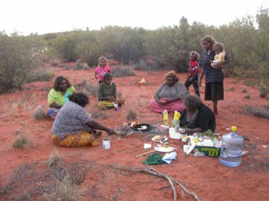
Being social? Relatedness?
How do humans organise their relationships into a social structure?

Slide 6
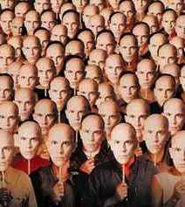
Definition of egalitarianism
Notion that everyone and everything is equal
Societies without power structure
The opposite of hierarchical

Slide 7
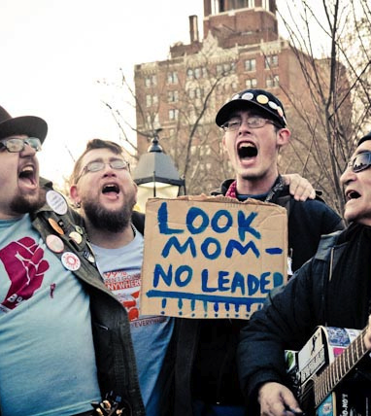
Is egalitarianism
  the baseline from which all organisation grew
  a form of anti-structure
  A structure that makes everyone lead
  an absence of structure
  or the absence of authority?

Slide 8
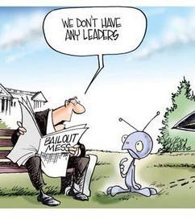
Why are some societies egalitarian?
Evolutionary perspective
  Egal behaviour is an anomaly (Knauft, 1991)
  Great apes = hierarchical
  Most human socs are too
Boas - criticism of unilinear cultural evol in favour of diffusionism accounts for all variants

Slide 9
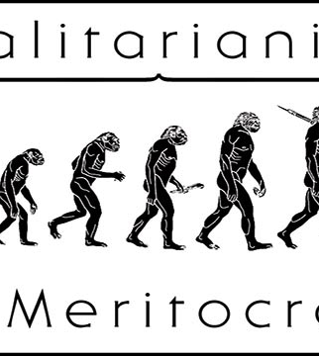
Erdal and Whiten, 1994.
On human egalitarianism
Egal is a puzzle in evolutionary terms
Evol model finds stable tendencies
Note ‘well rehearsed’ probs of using data of living h/gs

Slide 10
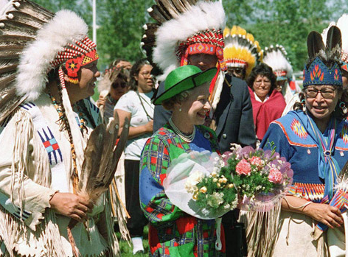
Flanagan, 1989.
Hierarchy in simple egalitarian societies
Do egal. socs represent the foundation of the transition from pre-cultural hominid society?
Is egalitarianism ‘natural’ (because lasted for so long), or competition (hunting etc?).

Slide 11
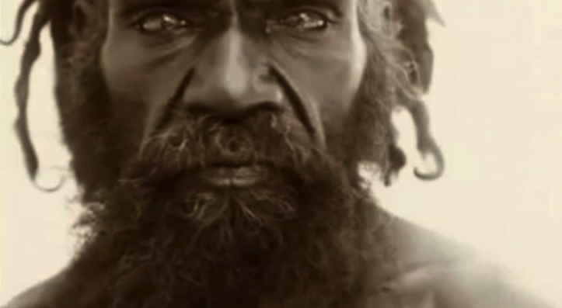
Warfare, hierarchy and horticulture debate

Slide 12
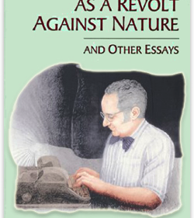
Rothbard (1974, 2000)
Egalitarianism as a revolt against nature
Challenges assumption that egalitarianism is good
Egal is romantically portrayed (along with ideas such as noble savage) and is anti nature
Nothing else is equal so why humans

Slide 13
Egalitarian societies...finally!

Slide 14

Social organisation?
‘authority is the very essence of social organisation’
(Malinowski, 1960:61)
So how do people organise society without leaders? And if there is no leader is the group not a society?

Slide 15
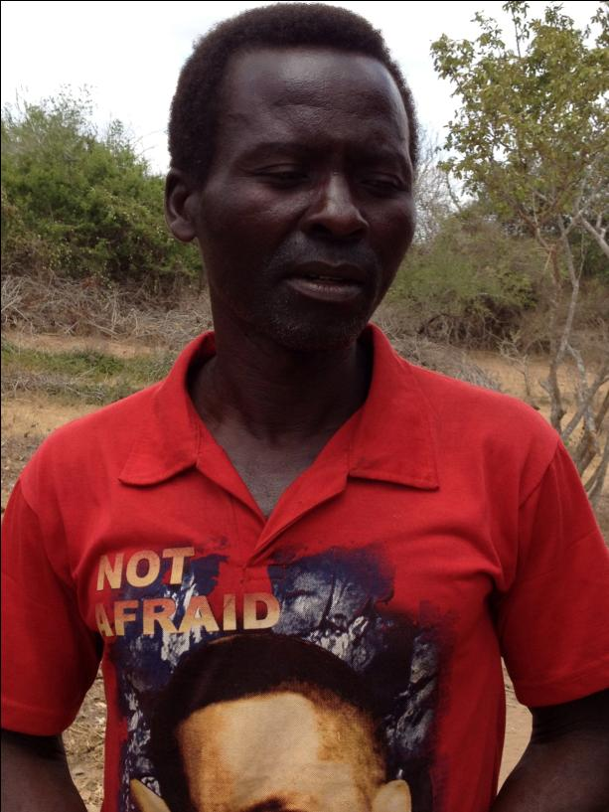
Egalitarianism varies
Without leader
  Group consensus
With nominal leader
  Orator
  Charismatic
  Unassuming
Giriama chief from Bore

Slide 16
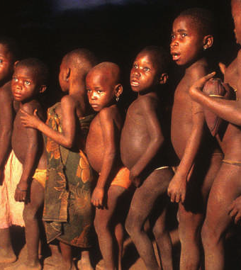
Some reasons that could account for egal behaviour
What Fried (1967) called leveling mechanisms
  Turnbull (1965) – changing group size
  Salzman (1979) – scattered and unpredictable
  Cashdan (1980) – egal arises from ‘stringent constraints’; mobility acts as insurance, sharing pools risk,

Slide 17
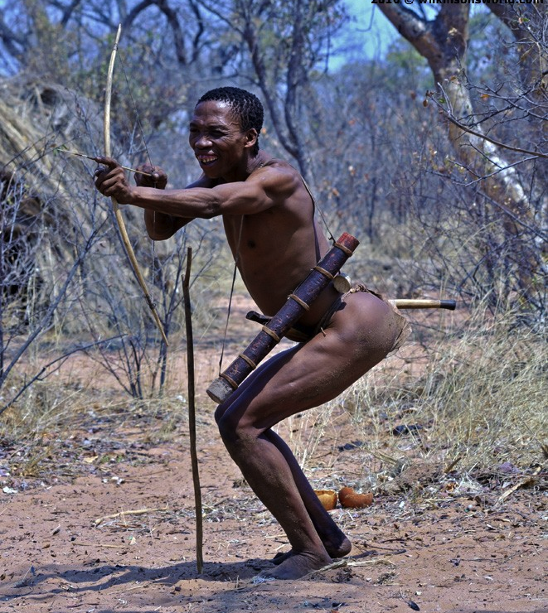
Intentional leveling
Egal is not just an incidental it is intentional
Woodburn, 1981 - Egalitarianism is an active process
Lee – insulting the meat (ju/hoansi)

Slide 18
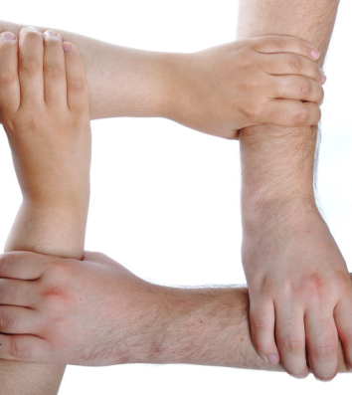
Boehm’s theory of reverse dominance, 1993
Group works to destabilize ascendency by dominating each other
  Why?
    Because we all want to avoid being dominated
Mechanisms
  Public opinion
  Criticism
  Ridicule
    insulting the meat

Slide 19
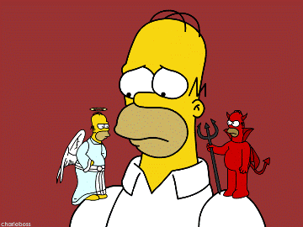
Boehm, 2000. Conflict and evolution of social control Journal of Consciousness Studies. 7. pp79-101
Cites conflict as behaviour that prompts social organisation
Talks of morality as the mechanism around which organisation circulates
Morality as ‘collective suppressant’

Slide 20
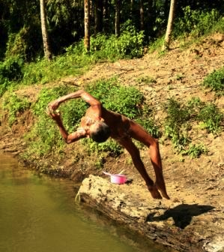
Grey, 2009. Play
Psychologist
Play is foundation of egalitarianism in g/h’s
Defines ‘play’ as motivator and mental attitude in activities
5 points of play – next slide – all seen in egal lives of h/gs

Slide 21
Grey’s 5 points that make ‘play’ (2009)
Self-directed – activities are chosen; what the person wants to do
Intrinsically motivated – activity done for own sake; reward in the doing
Structure – rules come from players’ minds = shared understanding
Imaginative – fantasy worlds
Active, alert non-stressed mind

Slide 22
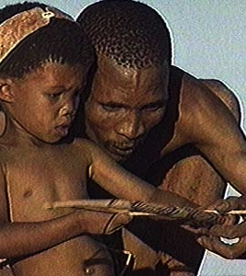
Play as governance
Games keep everyone happy; unhappy players quit
Keeping all activities voluntary makes them ‘play’
Giving autonomy and equality to each player
  Sharing in decision making
  Lack of specialisation

