Slide 1
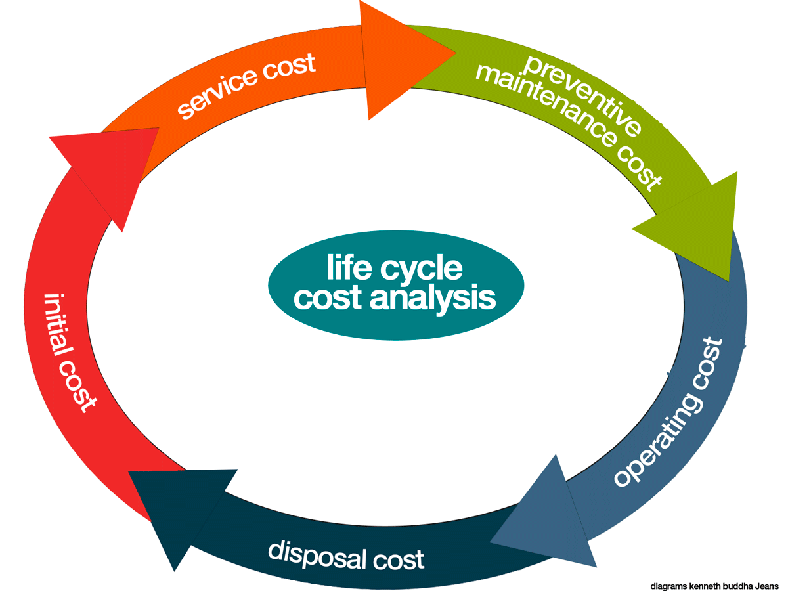
Life Cycle Cost Analysis (LCCA)
Life-cycle cost analysis (LCCA) is a process for calculating the entire cost of a lighting system through each stage in its life cycle. Taking into consideration all cost that will be incurred over the life cycle. LED LIGHTING
Material Cost
Use & Maintenance
End of Life
Material Costs are the cost to produce and run a LED lightbulb. The initial costs is the cost of the raw materials needed to produce the bulb.
Energy Costs is the cost to run that LED bulb using electricity.
Material cost for 40 Watt LED Light will cost roughly £33
The cost to run that bulb is calculated as followed.
40w bulb x 365 (days) x 15 (hours) x 9.1 (life of bulb) this is then divided by 100. Total 498 kWH.
Average cost per kWh is between £0.15 - £0.20
£0.18 x 498 = £89.64 for 1 LED Light
The average expectancy for a 40w Light is 50,000 hour
The average time LED light is left on per day is 15 hours
This means that the light will last for roughly 4 year
Life Cycle : 50,000
Hours Per Day :15
365 x 15 = 5,475 hours per year
50,000 / 5,475 = 9.1
LED Light should last 9 years
At the end of the life cycle the LED lights can be recycled.

