Slide 1

Social Influence
________________________________________________________________________________
Part Two
Conformity
Andy Coard UWTSD
Notes:
http://publish.uwo.ca/~dmann/conformity.jpg

Slide 2
Conformity
Purpose & Overview of Topic
________________________________________________________________________________
To consider definitions of conformity
To draw distinctions between different forms of conformity
Exploration of conformity research methods
Assessment & evaluation of the research

Slide 3



Quick Reminder of Part One
We concentrated on 3 classic studies of conformity
Jenness (1932) Beans in a bottle
Sherif (1935) Light in a Room
Asch (1951) Lines on a Card
Deutsch & Gerard (1955) distinguished between;
Informational Social Influence (ISI)
& Normative Social Influence (NSI)

Slide 4
Conformity: The Asch Paradigm
Asch and other researchers were able to use the Asch Paradigm to highlight factors influential to conformity:
Mode of Response
(E.g. Whether face to face)
Self Esteem
Perceived Status of Group
Reducing Group Size
Unanimity of the Group
Losing a Partner
Task Difficulty

Slide 5


Conformity: The Asch Paradigm
Mode of Response
NSI greater in face-face situations
*When Asch allowed written answers
conformity dropped to 12.5%
Self Esteem
Those with high self esteem conform less than others
Perceived Status of Group
Influential factor in degree of conformity
*Abrams et al. (1990) Replicated Sherif’s Expt.
Reducing Group Size
*When only 2 confederates with participant
conformity drops to 12.8% (*Asch, 1951)
1)
http://a2.espncdn.com/photo/2013/0711/espn_funnies_05.jpg
2)
3)
4)
https://upload.wikimedia.org/wikipedia/en/f/f4/Toffs_and_Toughs.jpg
Notes:
*Asch, nd, cited in Gross 2010: 404
*Asch (1951) cited in Cardwell et al. 1996: 46
*Abrams et al. (1990) used psychology students as participants. Told them confederates were either psch. or history students. Conformity rate greater than the 32% level for the ingroup condition and much lower for outgroup condition (Gross, 2010: 408)

Slide 6



Conformity: The Asch Paradigm
5)
Unanimity of the Group
Asch (1955): participants only
need one supporter to remain
independent (Conformity drops to 5.5%)
Losing a Partner
Conformity increases again if partner defects
or is called away
Task Difficulty
If task difficult, more likely participant
remains independent
http://a57.foxnews.com/global.fncstatic.com/static/managed/img/fn-latino/news/660/371/12%20Angry%20Men%20Main.jpg?ve=1&tl=1
6)
7)
Notes:
Asch (1951) “…. a unanimous majority of three is, under the given conditions, far more effective than a majority of eight containing one dissenter …” (cited in Gross, 2010, p. 404)

Slide 7

The Crutchfield Technique:
Ergonomic changes to the Asch Paradigm, Crutchfield (1954)
Participants seated in cubicles containing box device with lights and switches -
questions projected on wall above
Participants believe flashing lights on device indicate responses of others
Also believe they are last to respond to questions
Each receive same bogus feedback from “other participants”. In fact, all feedback is delivered by experimenter

Slide 8
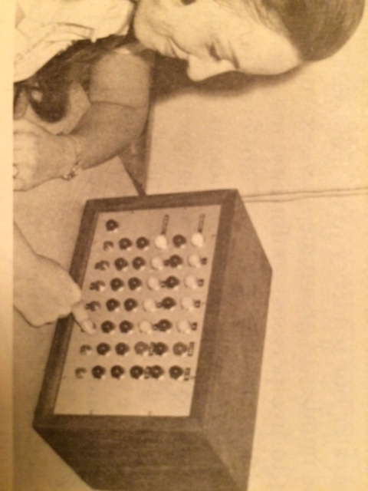
The Crutchfield Device
(Picture taken from Baron & Byrne 1974: 253)
Notes:
Baron & Byrne: 253

Slide 9
Crutchfield (1955)
"The slides call for various kinds of judgements - lengths of lines, areas of figures, logical completion of number series, vocabulary items, estimates of the opinions of others, expression of his own attitudes on issues, expression of his own preferences for line drawings...."
http://www.integratedsociopsychology.net/Conformity-Majority_Influence/RichardCrutchfield(1955).replacepeoplewi.html
Notes:
http://www.integratedsociopsychology.net/Conformity-Majority_Influence/RichardCrutchfield(1955).replacepeoplewi.html [12.12.18]

Slide 10
Conformity: Crutchfield’s findings
Even though participants gave answers in private cubicles, levels of conformity on the Asch Line Judgement Task (30%) were still very close to Asch’s original finding of 32%
For most of the tasks, participants’ conformity rates dropped when re-tested in isolation without group feedback

Slide 11

Crutchfield’s Findings
(NB. conformity levels fell for individual re-tests)
30% conformity on the Asch line task
(Asch found 32% conformity)
46% conformity that a circle was smaller than a star (in fact star was 1/3 smaller than circle)
Some conformed with statements such as;
“The life expectancy of American males is only about 25 years” or “Americans sleep 4-5 hours per night, on average, and eat 6 meals a
http://image.slidesharecdn.com/extensiontoaschandcrutchfield-121202082001-phpapp01/95/extension-to-asch-and-crutchfield-4-638.jpg?cb=1354436471
day”

Slide 12

Crutchfield (1955) tested over *600 participants, claimed those who conformed were more likely to;
Be authoritarian
Be less self-sufficient
Have lower ego strength
Feelings of inferiority
More submissive
More inhibited
https://encrypted-tbn3.gstatic.com/images?q=tbn:ANd9GcRsRia9SIizBT6geyT1Ziws4yC-zYjdTeLai38Ae8mPodd-Rj4g
Submissive participants also more easily swayed when told majority of answers were true (also if told majority false) compared with those who were self-confident
Notes:
*Army personnel, women & students
*Gross 1992: 569

Slide 13
Conformity: Points to Consider
Can we make a clear distinction between Informational Social Influence (ISI) and Normative Social Influence (NSI)?
Do these studies have ecological validity?
Are these findings merely a product of their time? Would we find similar levels today?
Are the findings applicable cross-culturally?

Slide 14
Are the findings a product of their time?
Larson’s (1974) test of US students found lower rates of conformity than Asch, yet in 1979 found similar rates once again (cited in Gross 2010: 405)
Perrin & Spencer’s (1981) test of UK math, engineering and chemistry students found only one example of conformity (cited in Gross 1992: 568)
Perrin & Spencer (1998) suggest “The Asch findings are clearly an indicator of the prevailing culture” (cited in Gross 2010: 405)

Slide 15

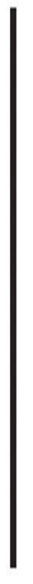
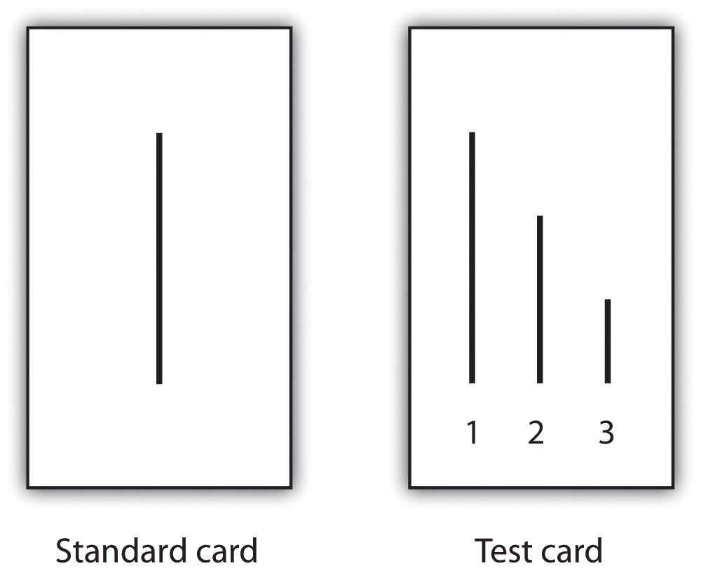
Cross-cultural Studies of Conformity
http://www.newdirectionsconsulting.com/wp-content/uploads/2011/11/flags_world.jpg

Slide 16
Smith & Bond’s (1998) Meta-analysis
Smith & Bond (1998) make a distinction between Individualistic and Collectivist Cultures
Individualist cultures centre more on the individual, collectivist cultures place more emphasis on the group collective
Individualist countries such as the US & UK score less highly for conformity rates using the Asch paradigm
Collectivist countries (e.g. Japan, Fiji, Zimbabwe) score more highly (more likely to conform)

Slide 17
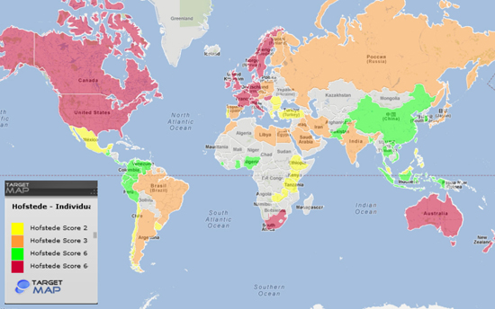
Individualist & Collectivist Countries
http://blog.usabilla.com/wp-content/uploads/IMG_4.jpeg
Notes:
Hofstede (Dutch Social Psychologist -Hofstede's cultural dimensions theory)

Slide 18
Averaged Effect Size (in red) & Number of Studies by Country: Smith & Bond (1998)
United States
Great Britain
Japan
Belgium
Brazil
France
Fiji
Canada
Holland
Germany
Hong Kong
Portugal
Zimbabwe
Zaire
Ghana
Kuwait
Lebanon
1.16 18 Asch’s studies (US)
0.90
0.81
1.42
0.91
1.60
0.56
2.48
1.37
0.74
0.92
1.93
0.58
1.84
1.84
1.84
1.31
1.31
79
10
5
4
3
2
2
1
1
1
1
1
1
1
1
1
1
Averaged Effect Size/
Conformity Rates
(Effect size = difference
Between Experimental
& Control Group Means)
Group of 3
Group of 2
Notes:
Pdf of Smith & Bond’s (1998) study can be found here: http://www3.nd.edu/~wcarbona/Bond-Smith-Asch-meta-analysis.pdf
Effect size = Difference between Experimental & Control Group means, divided by the Standard Deviation of the Experimental Group (Smith & Bond 1998: 117)

Slide 19
Moscovici’s Theoretical Perspective
Moscovici argued Asch paradigm placed too much emphasis on influence of majority: he researched ability of minorities to influence majority
Moscovici demonstrated how a consistent minority could affect judgement of the majority – consistency of the minority being the crucial agent of change
The following website provides an overview of conformity, as well as a good account of Moscovici et al.(1969) and the power of consistent minorities:
https://opentextbc.ca/socialpsychology/chapter/the-many-varieties-of-conformity/

Slide 20
Moscovici’s Theoretical Perspective
For Asch: Unanimity of the group is important
(conformity disappears with just 1 supporter)
For Moscovici: consistency of the minority group is important for change & innovation
Moscovici saw the Asch majority as a receptacle of minority belief reflecting the process of innovation and the acceptance of new ideas

Slide 21
Social Influence: Conformity
(Summary)
Different forms of conformity have been described:
Informational Social Influence (ISI)
(Sherif’s (1935) study is an example of Informational Conformity)
Normative Social Influence (NSI)
(Asch’s (1951) study is an example of Normative Conformity)
Moscovici took a different perspective (the power of consistent minorities), researching social influence & conformity from the minority standpoint & its influence on the majority to stimulate change
Smith & Bond’s (1998) analysis reported cross-cultural differences in conformity rates, reflective of Individualist & Collectivist Cultures

Slide 22

Finally:
Kelman (1958) recognised 3 different forms of social influence in relation to conformity :
Compliance (e.g. Asch, 1951), Internalisation (e.g. Sherif, 1935) & Identification (e.g. Zimbardo, 1973)
Identification may occur when people conform to a social role, as happened in Zimbardo’s Stanford Prison Experiment
http://static1.squarespace.com/static/557a07d5e4b05fe7bf112c19/t/557c5e9ae4b0eee4814e8a1b/1434214043174/maxresdefault.jpg?format=1500w

Slide 23
References:
Asch, S. E. (1955). Opinions and social pressure. Scientific American, 11(32).
Bond, R. & Smith, B. (1996) Culture and Conformity: A Meta-Analysis of Studies Using Asch’s (1952b, 1956) Line Judgement Task. Available at: https://www.researchgate.net/publication/232423600_Culture_and_Conformity_A_Meta-Analysis_of_Studies_Using_Asch's_1952b_1956_Line_Judgment_Task
[Accessed 12th December 2018]
Gross, R. (1992) Psychology: The Science of Mind and Behaviour. London: Hodder Education
Gross, R. (2010) Psychology: The Science of Mind and Behaviour. London: Hodder Education
Stangor, C. & Jhangiani, R. (2014) Influencing and Conforming. Available at: https://opentextbc.ca/socialpsychology/chapter/the-many-varieties-of-conformity/ [Accessed: 12th December 2018]

