Slide 1



Engineering project report
Jordan Williams

Slide 2

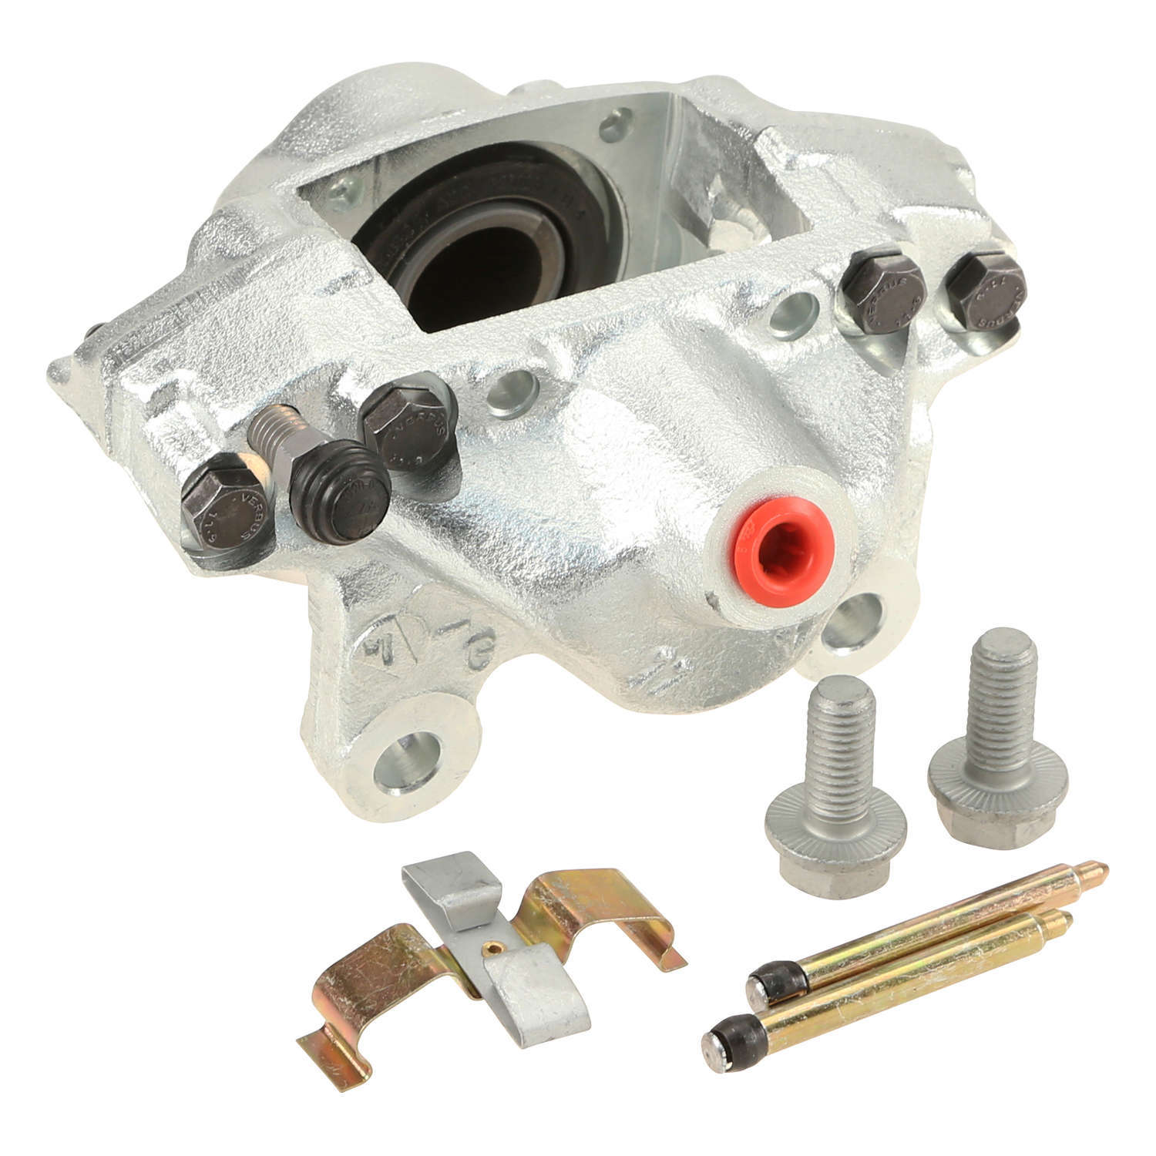
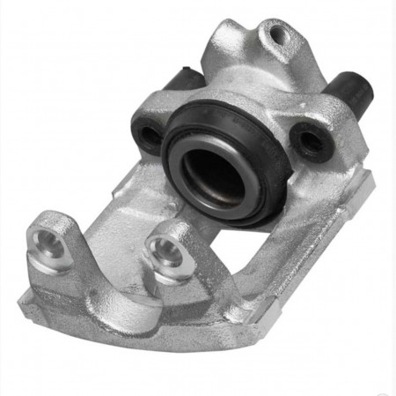
Introduction
Continental is a company that manufactures various automotive parts worldwide. The continental factory I work in specialise in machining, galvanising and assembling break callipers.

Slide 3
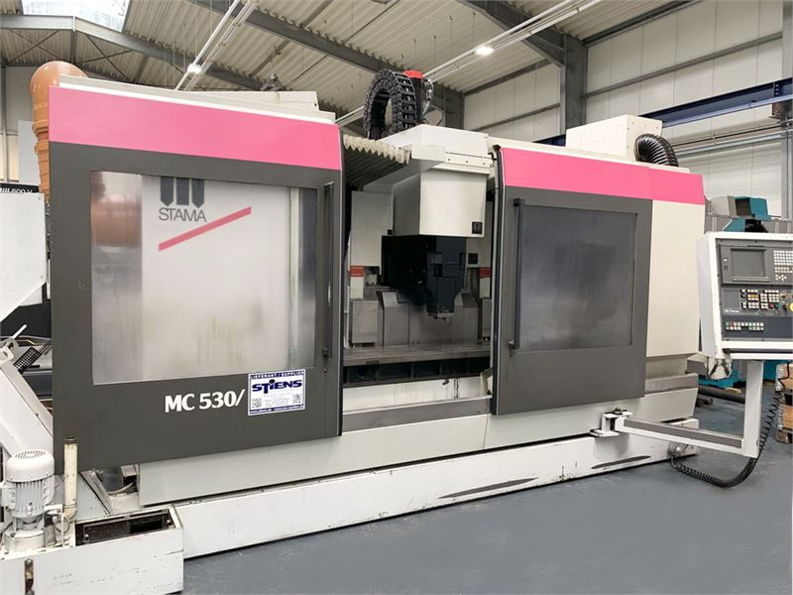
My role at continental
At continental, my role is an apprentice CNC setter/team leader.
This includes:
Changing products running on machines
Maintaining and changing tooling
Dealing with quality concerns from machine operators
Dealing with minor machine breakdowns

Slide 4
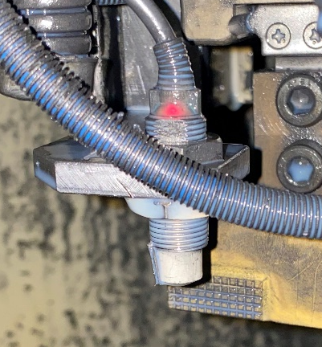
Reduce maintenance on Topper
This machine had a recurring issue with swarf landing on sensors, the sensors would then flag an alarm and stop the machine.

Slide 5
Possible solutions
I considered four possible ways to reduce the number of stoppages, these were;
Change the sensors
Remove the sensors
Use compressed air to blow sensors
Use coolant to wash the sensors

Slide 6
Final solution
 | Cost | Longevity | Time to implement | Potential success | Potential failure | Total
Solution 1 | 4 | 3 | 4 | 2 | 2 | 13
Solution 2 | 5 | 3 | 3 | 5 | 1 | 17
Solution 3 | 5 | 5 | 5 | 4 | 4 | 23
Solution 4 | 2 | 5 | 3 | 4 | 4 | 18

Slide 7
Data collection
Title: Downtime data collection | Version Number: 1 | Effective Date: 02/02/2021 | Author: Jordan Williams
Purpose | This SOP is to record downtime more consistently and reliably, this is necessary to give a better understanding of the current issues being highlighted.
Scope | The scope of this SOP is for all operators to be able to record downtime more accurately to give a truer representation of the current downtime and reasons for machine stoppages.
Responsibilities | Operators will have the responsibility of recording the exact time that the machine stops. Team leaders have the responsibility of recording the nature of the stoppage and the time the machine has been handed back to production. Team leaders also have the responsibility of collecting the downtime record at the end of the shift.
Procedures | Operators needed to record the exact time of the machine stoppage on the document provided, only after the time had been recorded can the operator inform a team leader about the stoppage. When the team leader hands the machine back to the operator the team leader recorded the time and the reason for the stoppage. The document containing the results would be collected at the end of the shift.
I made a new SOP for operators to report downtime.
I decided to collect data on downtime and number of stoppages over a two-week period

Slide 8
Data collection
Initial data collected over a two-week period from following new SOP

Slide 9
Results
Results after project implementation

Slide 10
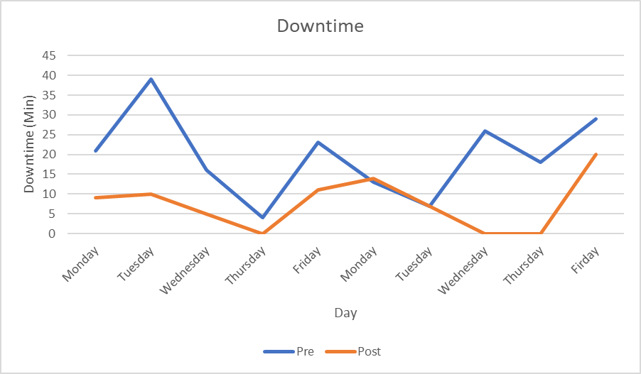
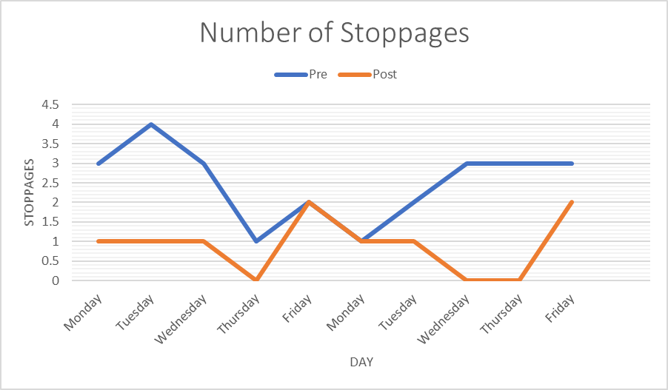
Results
The results show a 48% reduction in downtime and a 36% reduction in the number of stoppages per shift.

Slide 11

Thanks for listening any questions?

