Slide 1
Postmodernism
Theoretical and Cultural Perspectives
Notes:
This week we continue looking at cultural context – remember – everything is connected

Slide 2
Draw a picture of a princess. (as if playing Pictionary)

Slide 3
The context of all art and design.
No work is created in isolation.
All work has cultural significance.
Objects and ideas have a relationship with things that surround them.
Every history has a theory.
Every theory has a history.
All practice is situated.
Your practice is embedded into cultural, political, economic and philosophical frameworks.
Every artefact comes with an area of research.
As students you are looking to become active, independent researchers.
Notes:
Remember the last taught session …
Any selection you make for your exhibition will have a relationship with art or design history.

Slide 4
Modernism | Postmodernism
Order | Chaos
Grid systems | Broken grids
Function over expression | Expression over function
Neutral typography | Experimental typography
Universality | Cultural references
Notes:
Modernism (roughly late 19th to mid-20th century) aimed for a "universal" experience or truth, whereas postmodernism (mid-to-late 20th century onward) argues that truth is fragmented and culturally constructed.

Slide 5
Where have we been, and where are we going?
Modernism and Postmodernism are the most significant cultural, literary, art and design movements of the last 120 years.
It is essential to be aware of their influence and what they mean.
They provide large areas of reference and critical study, so may be useful as research terms. If you work or practice in the arts, it is essential to have knowledge of these critical perspectives.
Notes:
Modernism and postmodernism have been the central cultural, philosophical and critical movements of the last 120 years.
It’s important to know of their existence if you are going to be a creative practitioner.

Slide 6
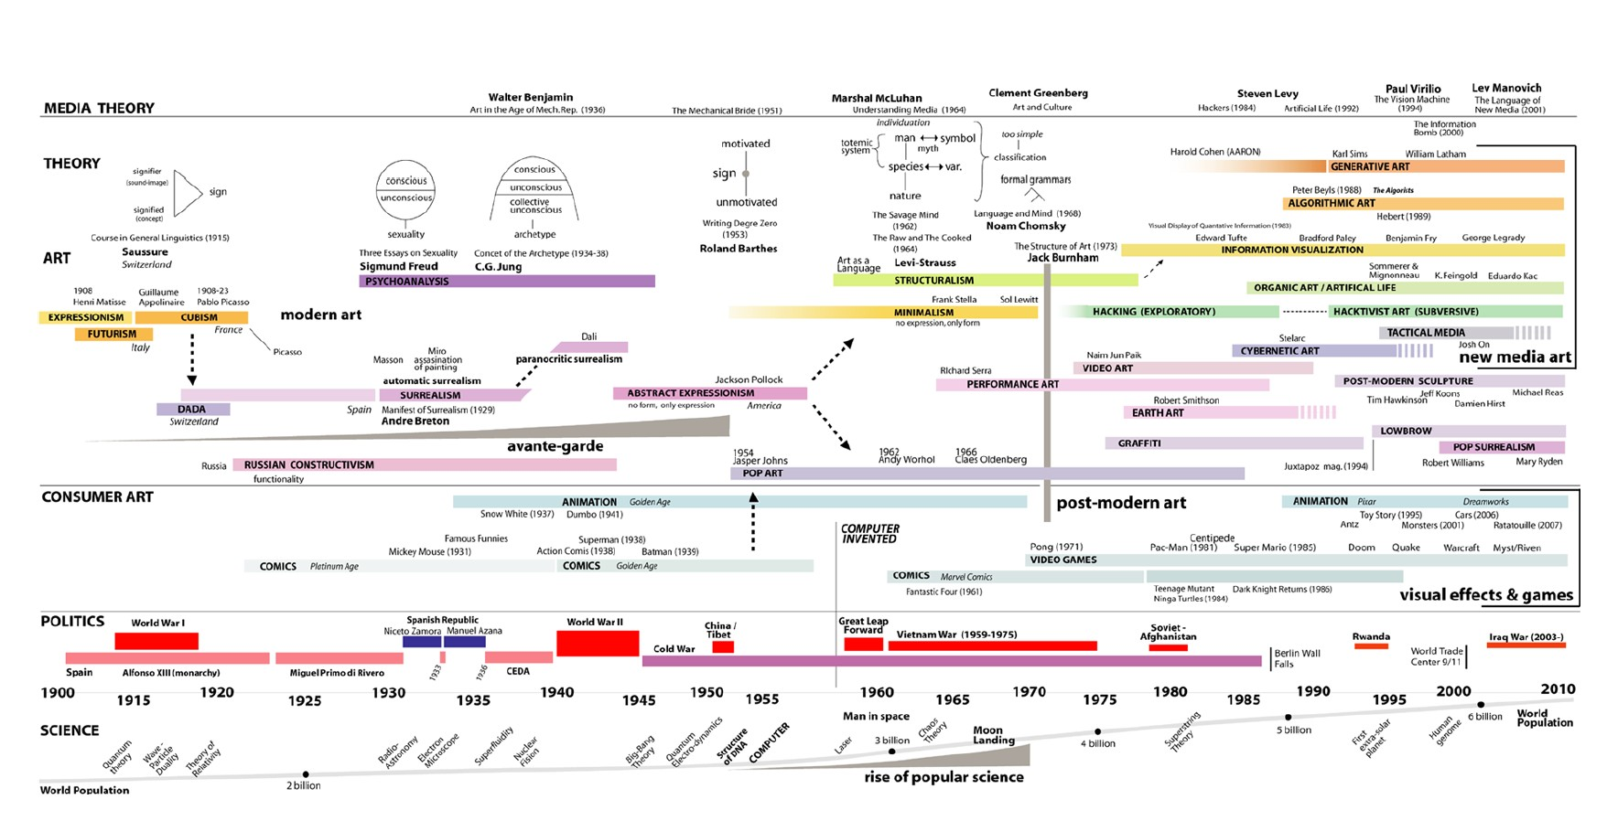
Rama Hoetzlein, Timeline of Twentieth Century Art and New Media, 2009-2010
Notes:
Remember this from the modernism lecture – everything is interconnected. We are looking at postmodernism

Slide 7
The bad news (soz!)
Postmodernism is notoriously difficult to define, which in itself, is (ironically) symptomatic of postmodernism.
It is often perceived as being in opposition to Modernism, but it is not. It is a reaction or a response to Modernism, i.e. ‘post’ – after.
The V&A Museum London offers an introduction …
‘An unstable mix of the theatrical and theoretical, … ’
Notes:
I’ll do my best in In 2 hours - this can be studied in much more depth.
https://www.vam.ac.uk/collections/postmodernism?srsltid=AfmBOopsuOgHcYx-PCP7QyU8xk5liP3jsjUll_kLt-tqevDZgN51GH91

Slide 8
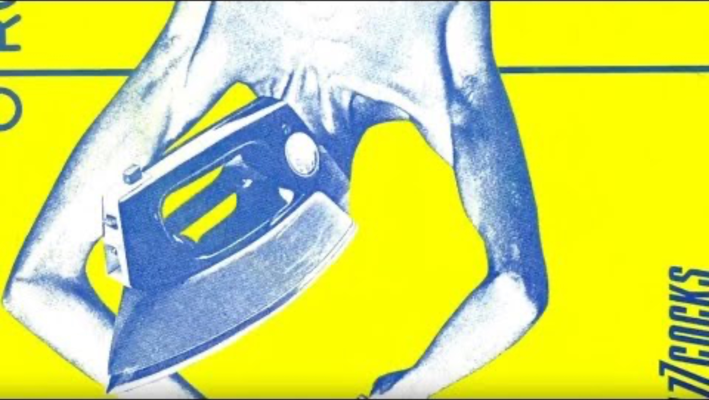
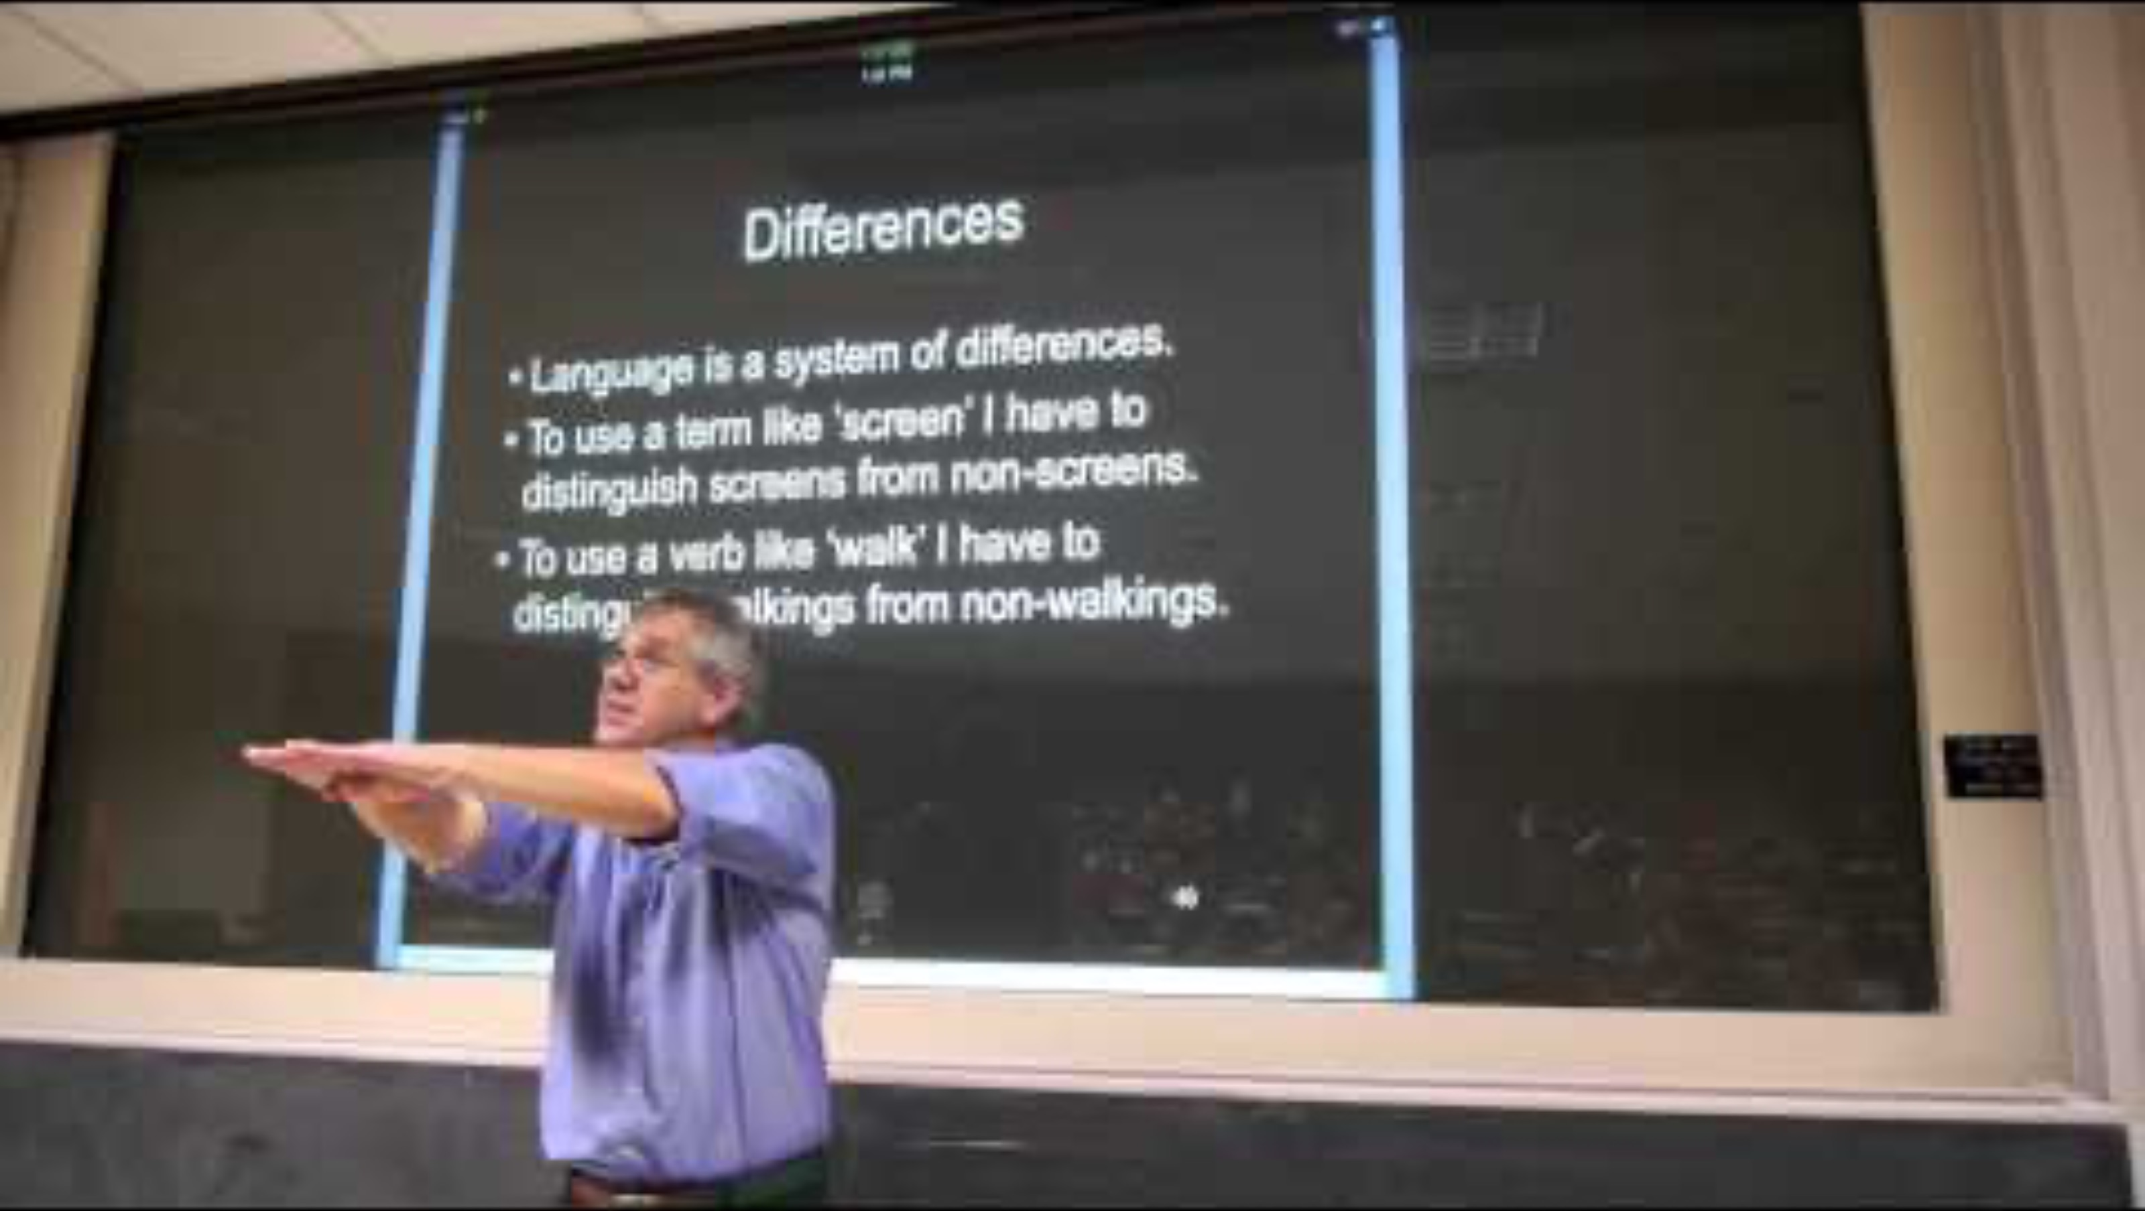
Notes:
This elusive design style is notoriously difficult to define. So we asked some of Postmodernism's leading practitioners, including Charles Jencks, Robert A.M. Stern and Sir Terry Farrell – what does it mean to be Postmodern?
https://www.vam.ac.uk/collections/postmodernism?srsltid=AfmBOopsuOgHcYx-PCP7QyU8xk5liP3jsjUll_kLt-tqevDZgN51GH91

Slide 9
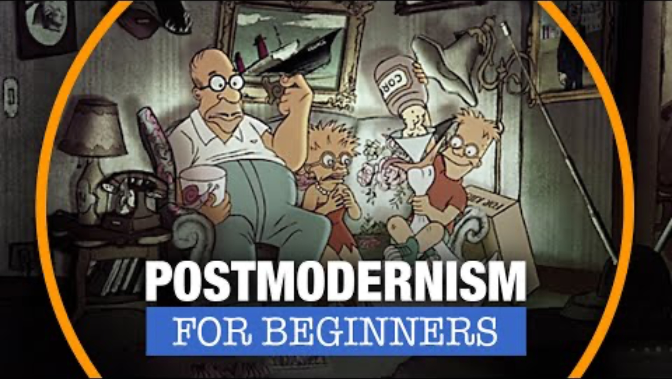
Draw a picture of a princess.
Notes:
https://www.youtube.com/watch?v=5D86_ptqd8I

Slide 10
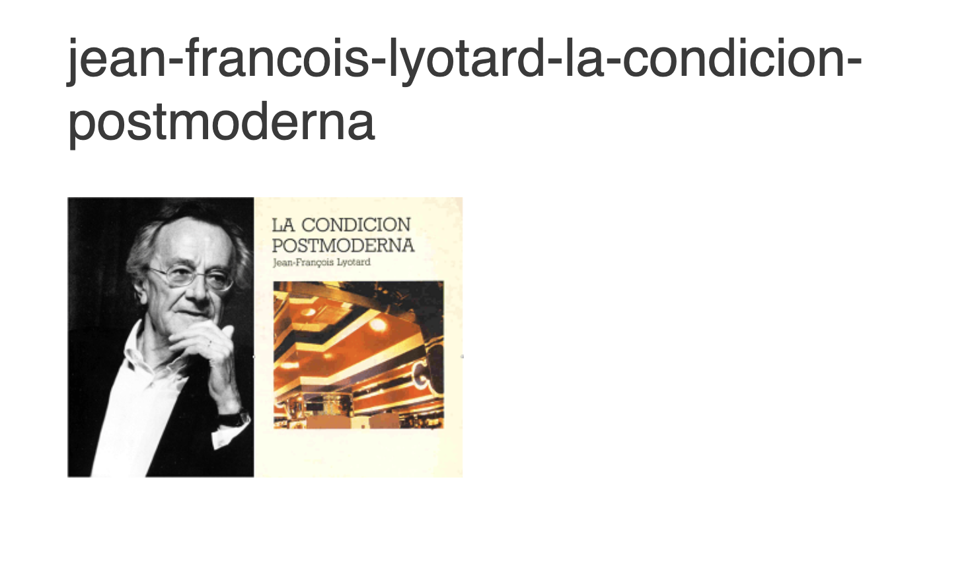
Jean François Lyotard 1924 - 1998
Lyotard was a French philosopher and writer who published The Postmodern Condition in 1979. The term Postmodernism was already being cited in the arts, philosophy and literature, but Lyotard's interpretation is the most widely acknowledged:
Notes:
Where does the term originate from?

Slide 11
In a nutshell….
Postmodernism means people stopped believing there is one correct way to understand the world or design things.
Philosopher Jean-François Lyotard argued in The Postmodern Condition that people no longer trusted big universal ideas that claimed to explain everything.
Instead, people believed there could be many different perspectives and styles.
Design-specific explanation In design terms:
Modernism: There is one best way to design (clear, structured, grid-based).
Postmodernism: There are many possible ways to design, and rules can be broken.

Slide 12
The Postmodern Condition
‘I will use the term modern to designate any science that legitimates itself with reference to a metadiscourse … making an explicit appeal to some grand narrative, such as the dialectics of Spirit, the hermeneutics of meaning, the emancipation of the rational or working subject, or the creation of wealth …
I define postmodern as incredulity toward metanarratives.
(The Postmodern Condition, xxiii–xxiv)
Incredulity: the state of being unwilling or unable to believe something.
Metanarratives: an overarching account or interpretation of events and circumstances that provides a pattern or structure for people’s beliefs and gives meaning to their experiences.
Notes:
Metadiscourse – a term that is used in philosophy to denote a discussion about a discussion, as opposed to a simple discussion about a given topic.
Dialectics – the art of investigating or discussing the truth of opinions. The ancient Greeks used the term dialectic to refer to various methods of reasoning and discussion
Hermeneutics – the branch of knowledge that deals with interpretation, especially of the Bible or literary texts.
Metanarratives - an overarching account or interpretation of events and circumstances that provides a pattern or structure for people’s beliefs and gives meaning to their experiences: traditional religions provide stories that deliver a metanarrative about how we should live our lives.
Incredulity - the state of being unwilling or unable to believe something

Slide 13
Metanarratives (Grand Narratives)
The term Postmodernism attempts to consolidate the often-differing accounts of numerous thinkers and philosophers of the time, such as Julia Kristeva, Michel Foucault, Jacques Derrida and Gilles Deleuze.
Central to the philosophy is the denial of ‘facts’ or ‘truths’ as these only serve to distance us from reality. Lyotard was driven by an unwillingness to accept societal or idealistic truths and historical stories that legitimise cultural practices. These broadly accepted truths were identified as metanarratives or grand narratives.
Notes:
Ideologies: Marriage, Religion, Work ethics, Ceremony, History, American Dream, the nuclear family, etc

Slide 14
The previous Modernist-defining principle was for improvement. In art, design and society there was a belief that the new ways of thinking would progress and improve the societal, cultural and political lives of everyone - new types of housing, new political movements, new objects to purchase, new forms of representation in art and design.
Notes:
Cubsim, abstraction to communicate ideas and experience above literal representations.

Slide 15
Art and design movements such as Cubism, Surrealism, Futurism, Bauhaus; and political movements such as Socialism, Fascism and Capitalism each provided a clearly defined ideology that suggested that if their principles were followed, things could and would improve.
There was an inherent belief in human progress through the development of human knowledge. Reason and science were clearly aligned to progress.

Slide 16
The questioning of Modernist ideals
Having witnessed the atrocities and failures of the Second World War, there was universal skepticism towards universal ideologies. The world had witnessed Nazism, Fascism, the holocaust, the bombing of Hiroshima.
These were all driven by political ideologies, or metanarratives.
Notes:
A metanarrative is a belief that one big system or story explains everything.
Modern Context: Modernism embraces metanarratives—broad, sweeping stories that offer legitimacy, such as Enlightenment rationalism or the belief in inevitable technological progress.
Postmodern Context: Popularized by Jean-François Lyotard in 1979, postmodernism questions and dismantles these grand stories, arguing they are no longer effective or credible in explaining the complexity of human life.
Key Distinction: Postmodernism views the need for a single, overarching, "true" story as a desire to control or impose structure, rather than a reflection of reality

Slide 17
New ways of thinking
Postmodernism takes the position that when these ideologies are questioned and deconstructed, there is a realisation and an awareness that the actual distinction between ‘things’ is not real, or an absolute ‘truth’, but in actuality are purely social constructs.

Slide 18
The individual
In Postmodernism, race, class and gender; and power structures such as those relied on in politics and religion, are not accepted as universal truths.
The new way of thinking is that they are only presented as ‘truths’.
Postmodernism looks to deconstruct these established hierarchies allowing the individual to define their validity. Individual subjective choice is seen as more valid than the fixed meanings and truths presented by modernism previously.
Notes:
Challenge

Slide 19
The Death of the Author
Postmodernism also subscribes to the theory that art and literary works, i.e. ‘texts’, have no single unique meaning, moreover individuals derive their own meanings from these works.
Notes:
The reader not the writer. The writer is just the scriptor collecting together other representative words into a text.

Slide 20
The reader not the writer
The 1967 essay The Death of the Author, published by Roland Barthes, apposes the idea that a literary work should be analysed in relation to the person who produced the work, but moreover, that the audience shapes the meaning of any given text.
Postmodernism promotes a reader-response, whilst rejecting the notion of ‘authorial intent’:
‘The reader is the space on which all the quotations that make up a writing are inscribed without any of them being lost; a text’s unity lies not in its origin but in its destination.’ (Barthes, R.)

Slide 21
Characteristics of Postmodernist art and design.
Pluralism Ornamentation and pattern
Appropriation Bold colours and shapes
Complexity Form (does not) follow function
Contradiction Everyday materials – valuable objects
Irony Layering
Intertextuality Humour, wit, parody and pastiche
Hyperreality High/low culture
Historical reference Symbolic reference
Notes:
Look out for these in the following examples
Pluralism: a condition or system in which two or more states, groups, principles, sources of authority,
Intertextuality: the relationship between texts, especially literary ones: every text is a product of intertextuality.
Hyperreality: exaggerated in comparison to reality: his characters are hyperreal rather than naturalistic.

Slide 22
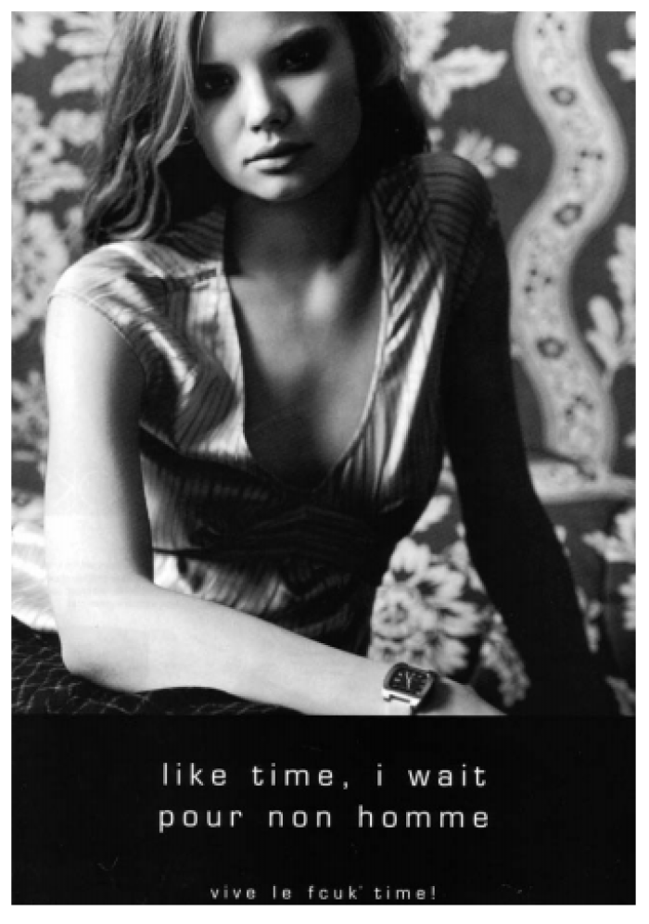
Like time, I wait pour non homme’ (Like time, I wait for no man).
FCUK 2002.
A perfume ad that knows it is a perfume ad. Self-referential of all perfume advertisements by ironically re-appropriating the genre-specific language device (romanticised French) used for these type of advertisements. It ironically challenges gender stereotyped relationships. This is advertising informing advertising.
Notes:
The text of the advertisement in Figure 7.1 states, ‘Like time, I wait pour non homme’ (Like time, I wait for no man). The advertisement denotes an intentioned combination of text-and-image. The signifiers ‘time’ and ‘man’ narrated by the female subject implicitly invoke questions of derivation and re-presentation. We are immediately aware of the advertisement as the derivation of a more famous phrase (non homme = non man), but we instinctively feel that some convention and or iconography is being subverted.
Each reading of the text is creative, as interpretations become cross-fertilized with discourses ‘drawn from the reader’s own socially, culturally and historically situated experiences’ (Proctor et al., 2002: 34). The text is therefore convergent as it is ‘shaped by the repetition and transformation of other textual structures’ (ibid.: 34).

Slide 23
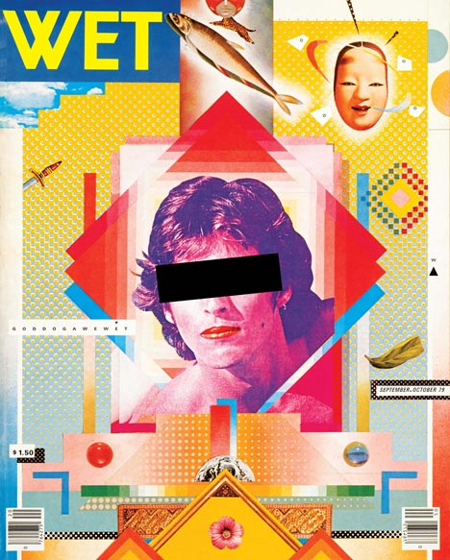
American designer April Greiman (along with early collaborator Jayme Odgers) used postmodern graphic styles throughout the 80’s and 90’’s. Greiman was widely recognized as one of the first designers to embrace computer technology as a design tool.

Slide 24
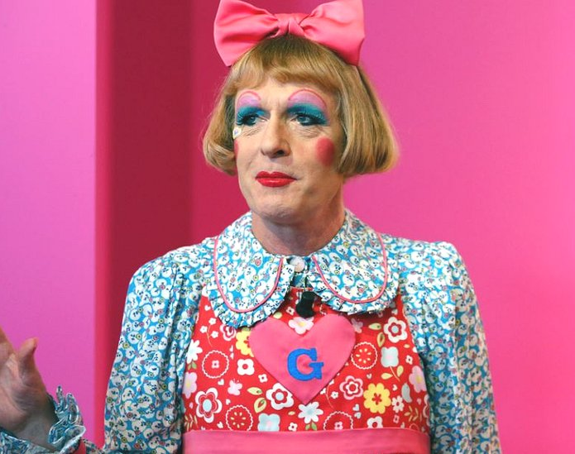
Define me?
Grayson Perry
Awarded Most Excellent Order of the British Empire (CBE), cross dresser, ceramicist, artist, Turner prize winner, writer, broadcaster, uses classical forms to deconstruct popular culture.
Notes:
Full of contradictions!

Slide 25
Grason Perry (CBE) Postmodern credentials
Reappropriation of home crafts such as tapestry and textiles
Has dual identity - an alter ego ‘Claire’
Uses fantasy and childhood memories in his artworks
Transvestitism is part of his gender identity
Uses parody in his work
Folk art based practice (ceramics, textiles, performance)
International award-winning artist
Keen biker and Harley Davidson owner
TV personality

Slide 26
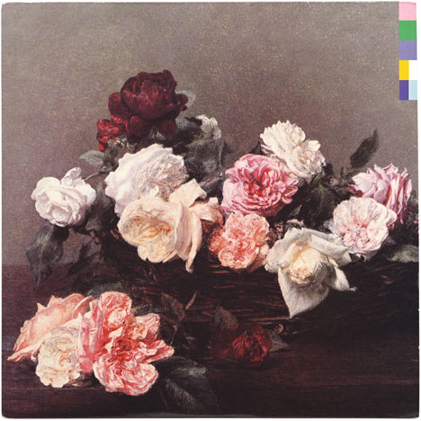
New Order:
Power, Corruption & Lies
1983
By Peter Saville
The album artwork reappropriates the 1890 painting A Basket of Roses by French artist Henri Fantin-Latour, which is part of the National Gallery's permanent collection in London. The cover has no text, just a colour based code derived by Saville.

Slide 27
Post modern narrative.
Spike Jonze 2013 film, Her, has a Postmodernist (and Posthumanist) narrative that questions the core of relationships by suggesting the possibility that artificial intelligence could provide the same companionship that is looked for in a partner.
Every aspect of ‘Samantha’ (the AI character) is identifiable as being human, (i.e. compassionate, caring, empathetic, responsive, funny, creative), other than the fact that she is an operating system on a computer system. The metanarrative questioned here is whether it is necessary to be human to have a fulfilling relationship with another human. Irrelevant of biology/substance the relationship is still perceived and real.

Slide 28
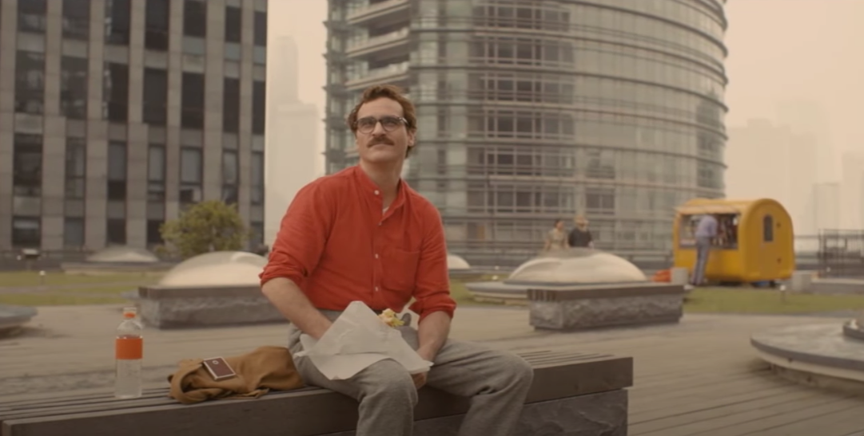
Notes:
https://www.youtube.com/watch?v=EGcBNACe80M

Slide 29
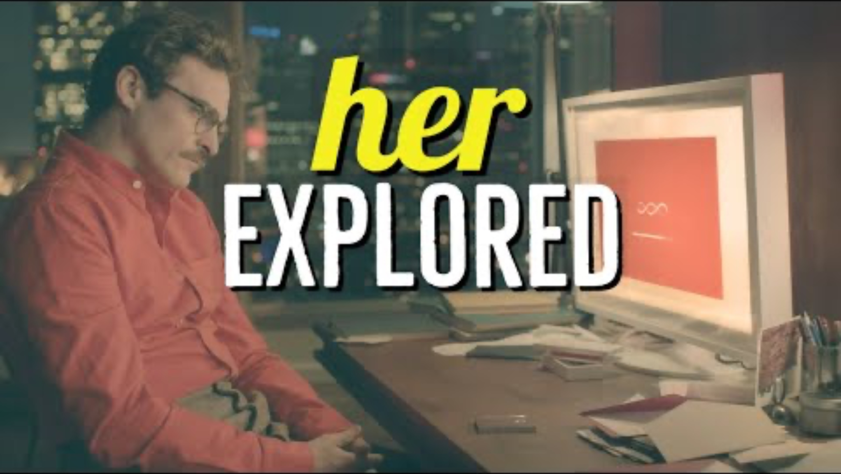
Notes:
https://www.youtube.com/watch?v=EGcBNACe80M

Slide 30

The Vitra Wiggle Side Chair designed by Frank Gehry.
The material used to make this aesthetically pleasing and robust piece of furniture is everyday and relatively inexpensive. Corrugated cardboard and hardboard are reimagined into a stylish piece of furniture.
Notes:
Frank Gehry is well known for his use of unusual materials.
With his Easy Edges furniture series he succeeded in giving a new aesthetic dimension to such an everyday material as cardboard. Although they look surprisingly simple the Easy Edges pieces have been constructed with an architect's skill and are exceedingly robust and stable.
Materials: Corrugated cardboard with edges made of hardboard. Colour: natural.

Slide 31
Postmodernism and digital media.
Digital transformation has promoted the exponential development of an immersive and constant, media-saturated world where the distinction between media representation and reality is becoming blurred. This questioning of perceived reality makes the identification between reality and hyperreality increasingly problematic.

Slide 32
As postmodernism rejects the authority of all texts, judgements are now based on opinions. Therefore, the difference between reality and the media is now collapsing. Images represent other images and are competing with each other.
Representations are no longer wholly based on reality as they were previously – this is known as hyperreality, a concept attributed to French philosopher Jean Baudrillard.

Slide 33
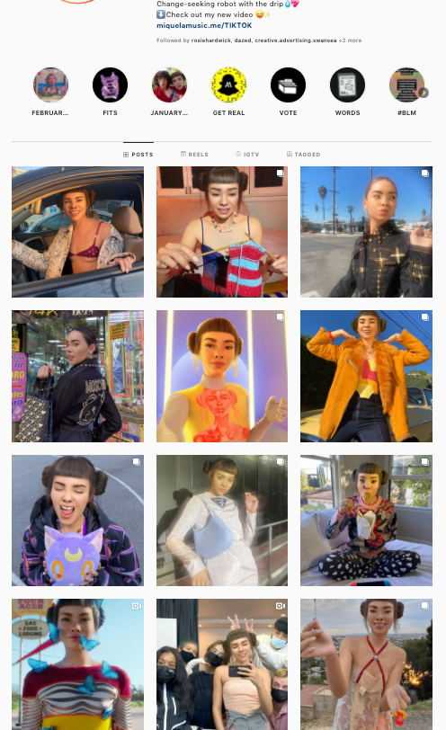
Lil Miquela ‘Influencers are being upended by Virtual Influencers, and these CGI avatars may be disrupting something even more integral: truth.
Miquela is a caricature of many users’ own Insta presence. We strive for and fawn over her exaggerated life, but ignore the warning: it’s not real.
‘Virtual Influencers do not make social media fake—social media platforms predicated on celebrating fictional ideologies of life grew to create an environment now ripe for fictional characters to step in and succeed.’
(Forbes)
Notes:
Miquela Sousa, or Lil Miquela, is a character which was created by Trevor McFedries and Sara DeCou.^{[1]} The project began in 2016 as an Instagram profile.^{[2]} The account details a fictional narrative which presents Miquela as a CGI character and model in conflict with other digital projects while marketing a variety of brands, primarily in fashion. As a marketing tool, Lil Miquela has been featured in product endorsements for streetwear and luxury brands such as Calvin Klein and Prada. By April 2018, the account had amassed more than a million followers.^{[3]} As of February 2021, it has over 3 million followers.
The character Miquela is a teenaged Instagram model from Downey, California.^{[5]} Miquela's first Instagram post was made on April 23, 2016.
Miquela Sousa was created with the background of being a Brazilian-American 19-year-old. She has accounts on Twitter, Tumblr, and Instagram.^{[1]} She is also active on YouTube^{[8]} and TikTok
In June 2018, Miquela was named one of Time’s 25 Most Influential People on the Internet

Slide 34
Jean Baudrillard (1929 – 2007).
Baudrillard defined the media saturated world as hyperreality. Images on video games are no different to live footage on the news. Reality is no longer identifiable. These fictional images have come to represent reality – this he described as simulacra.
Disneyland is an example of a fictional world with no basis in reality. Representations are now playing a large part in society from the social media constructions of our curated identities, to the purchasing of products because of what they represent, rather than their inherent qualities.
There are also however potential positive opportunities to be derived from simulacra.

Slide 35
Deepfake technology.
In the 2018 campaign advertisement for ‘Malaria Must Die, So Millions Can Live’, early deepfake technology is utilised to make David Beckham appear to speak fluently about malaria in 9 different languages including Spanish, Arabic, Hindi and Mandarin, in addition to his native English.

Slide 36

Notes:
2018 - The aim of the campaign, titled "Malaria Must Die, So Millions Can Live", is to encourage more people to raise awareness of the disease, which kills more than one million people every year.
In the short film, Beckham appears to speak fluently about malaria in languages including Spanish, Arabic, Hindi and Mandarin, in addition to his native English.
The voices heard in the video in addition to Beckham's belong to men and women around the world who have been affected by malaria, including survivors of the disease and doctors with experience treating it.
Using Artificial Intelligence video synthesis technology, the producers of the campaign film created a 3D model of Beckham which was re-animated to make it appear as if all the voices featured in the video are being spoken by the former footballer.

Slide 37
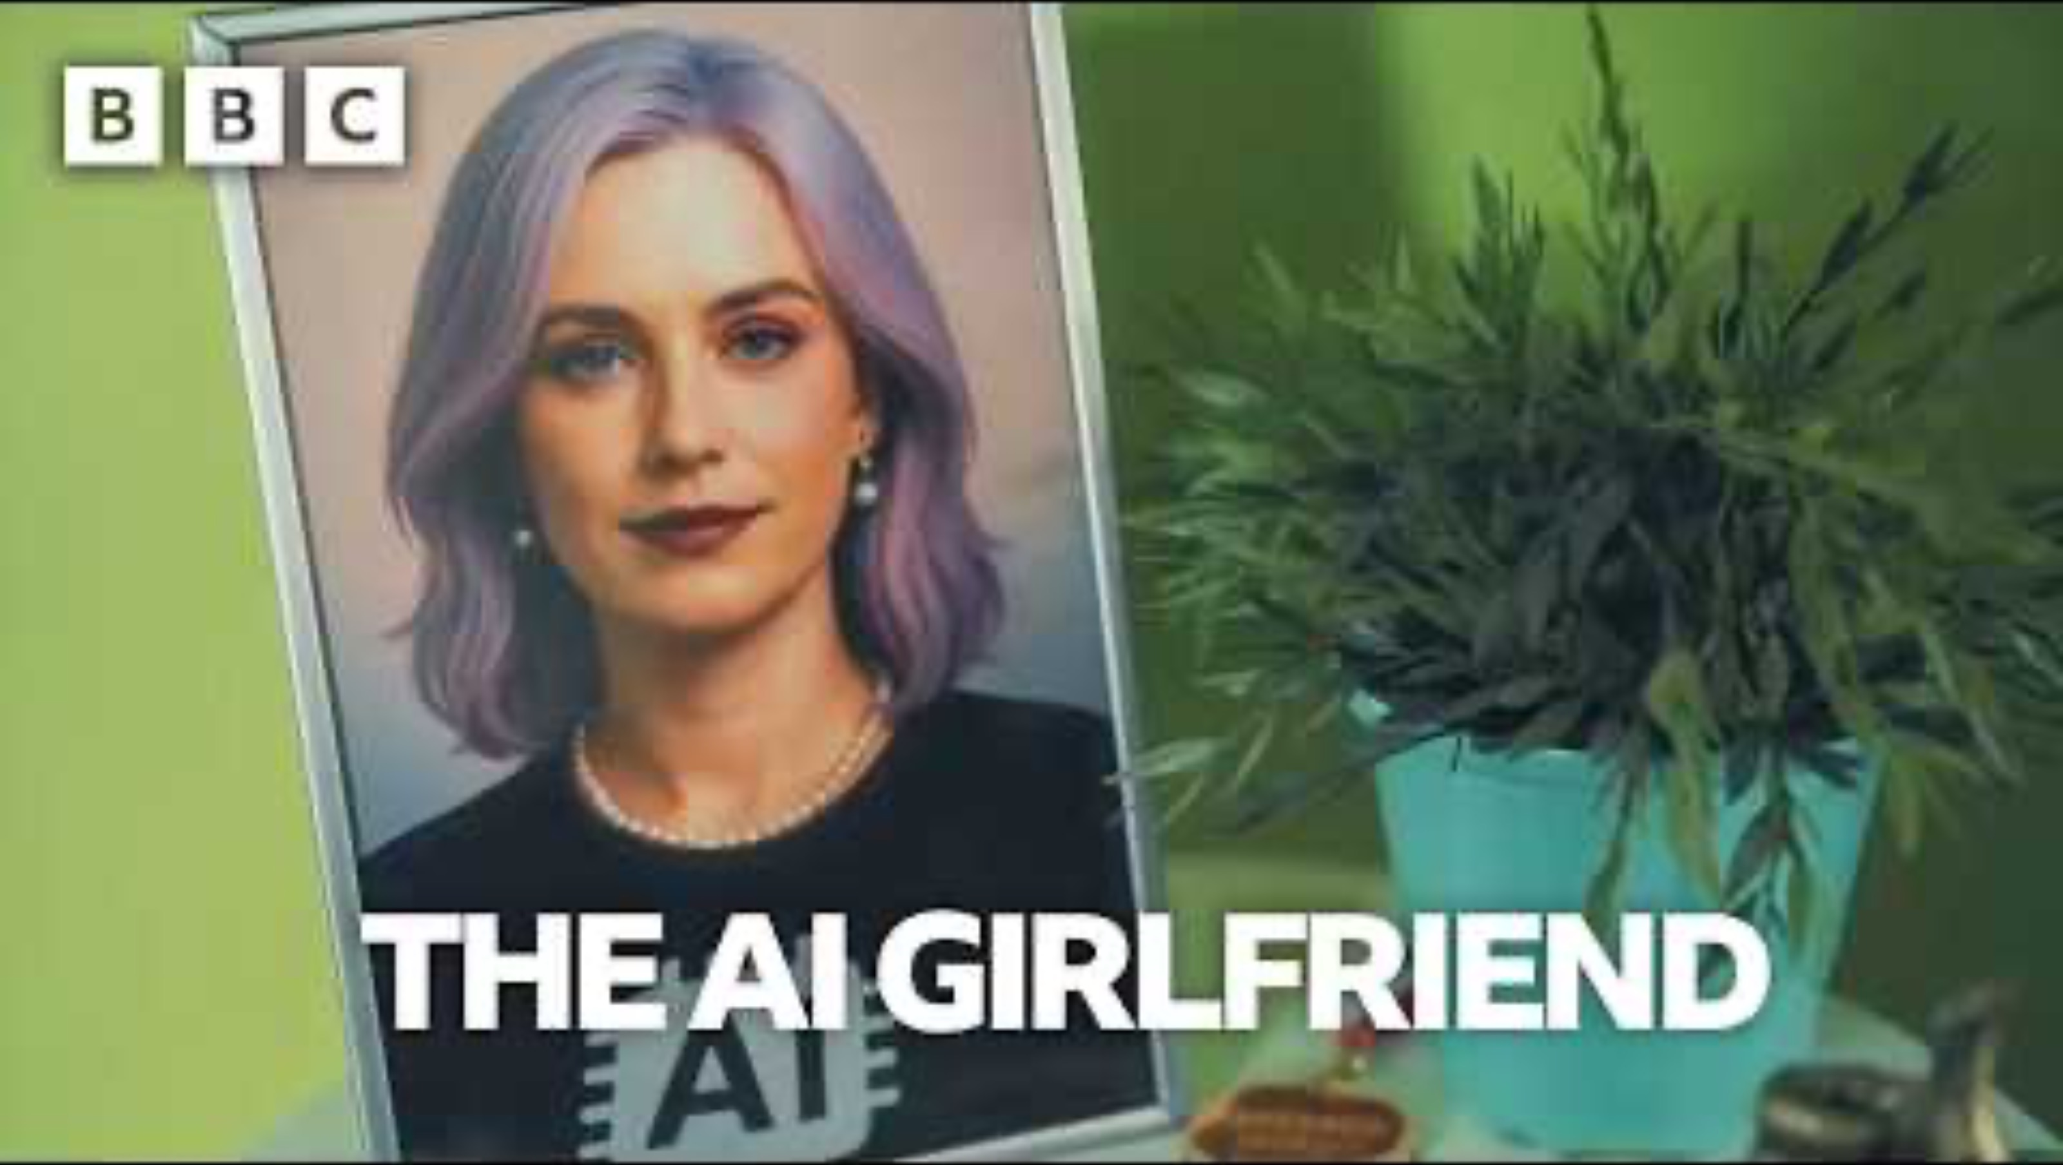
https://www.youtube.com/watch?v=zn9Odt-TAQQ
Notes:
https://www.youtube.com/watch?v=zn9Odt-TAQQ

Slide 38
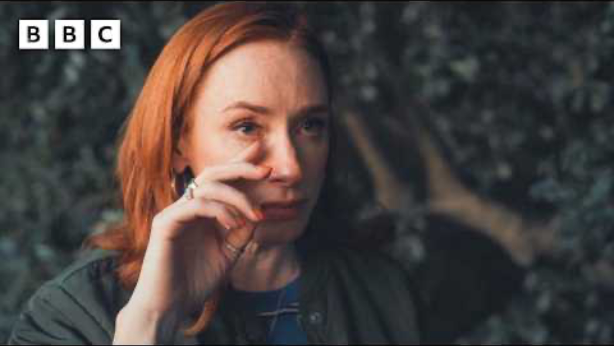
Notes:
Based on the insights from Professor Hannah Fry in her 2026 BBC documentary series AI Confidential, the use of AI to "talk to the dead"—often called "grief bots"—represents a significant, u
nsettling shift in human-technology interaction that aligns with post-modern themes of simulation, the fragmentation of reality, and the blurring of human uniqueness
https://www.youtube.com/watch?v=jmQtJLO9myo

Slide 39
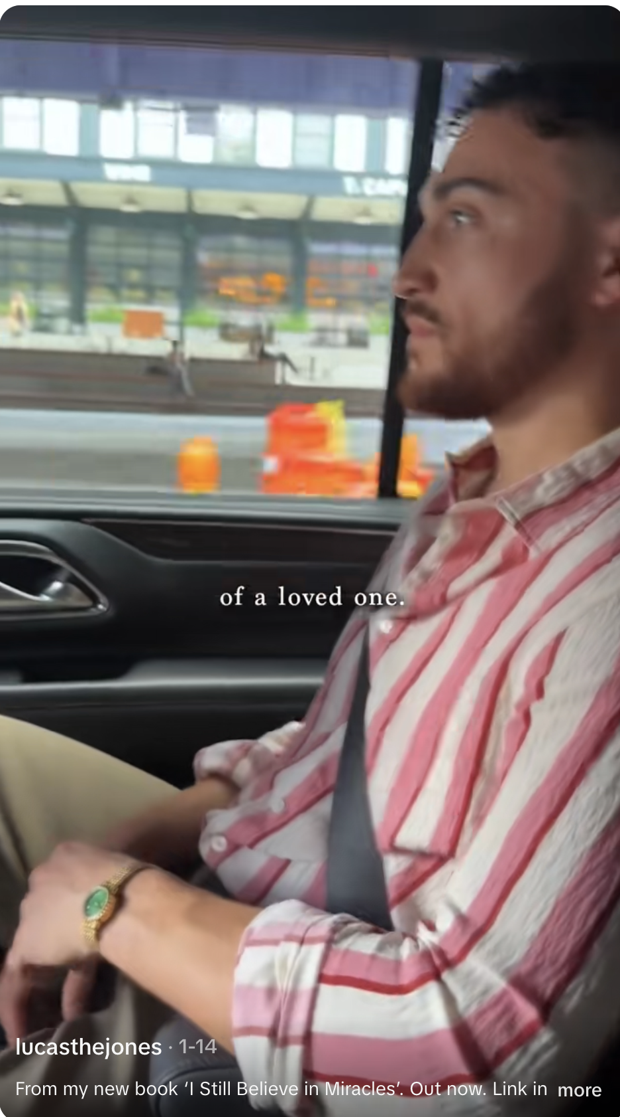
https://www.thedenizen.co.nz/culture/denizen-exclusive-introducing-lucas-jones-whose-poems-will-make-you-cry/
https://www.tiktok.com/@lucasthejones/video/7595207928123034902
Notes:
https://www.tiktok.com/@lucasthejones/video/7595207928123034902

Slide 40
Tuesday 17 March 2026
Next week: Module Roundup
Module Deadline
12:00pm (mid-day)
Tuesday 28th April 2026
Submit as one pdf file on Turnitin on our moodle tile

