Slide 1
Module Name : Electronics II
Module Code : ACDA6001
Topic : Minimization Using K- map
Lecture : 2
Lecture By,
Mrs. Jenifer Prince Devaraj,
Lecturer - Embedded Electronics,
Faculty of Applied Computing,
UWTSD
Email:j.prince-devaraj@uwtsd.ac.uk

Slide 2
Introduction to Digital Electronics
Topics covering the Basics
Logic Gates and Logic symbols
Truth Tables
Logic Diagram
Useful Identities : Boolean Algebra, De morgans theorem
Need for Min – terms and simplifications.
SOP & POS
Simplifying Variables by Boolean laws
Simplifying Variables by K- Map
UWTSD Lectures / ACDA6001 – Electronics 2

Slide 3
Karnaugh Maps (K-Maps)
Introduction to Digital Electronics
K - Map
A visual way to simplify logic expressions
It gives the most simplified form of the expression
UWTSD Lectures / ACDA6001 – Electronics 2

Slide 4
Introduction to Digital Electronics
K - Map
What is K- Map?
A graphical method used to simplify Boolean expressions in standard forms such as Sum-of-Products (SOP) or Product-of-Sums (POS).
The most simplified expression has:
  A minimum number of terms.
  The least number of literals (variables) in each term.
UWTSD Lectures / ACDA6001 – Electronics 2

Slide 5
Introduction to Digital Electronics
K - Map
Combinations in K-Maps Based on Variables
4 Combinations
2 - Variable K- Map (2²)
3 - Variable K- Map(2³)
4 - Variable K - Map(2⁴)
5 – Variable K- Map (2⁵)
8 Combinations
16 Combinations
32 Combinations
UWTSD Lectures / ACDA6001 – Electronics 2

Slide 6
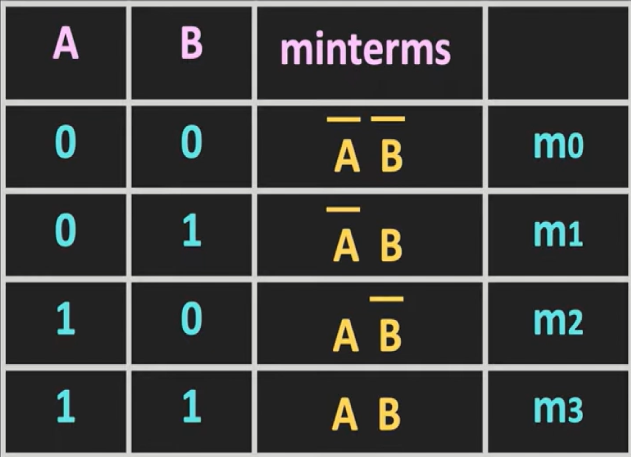
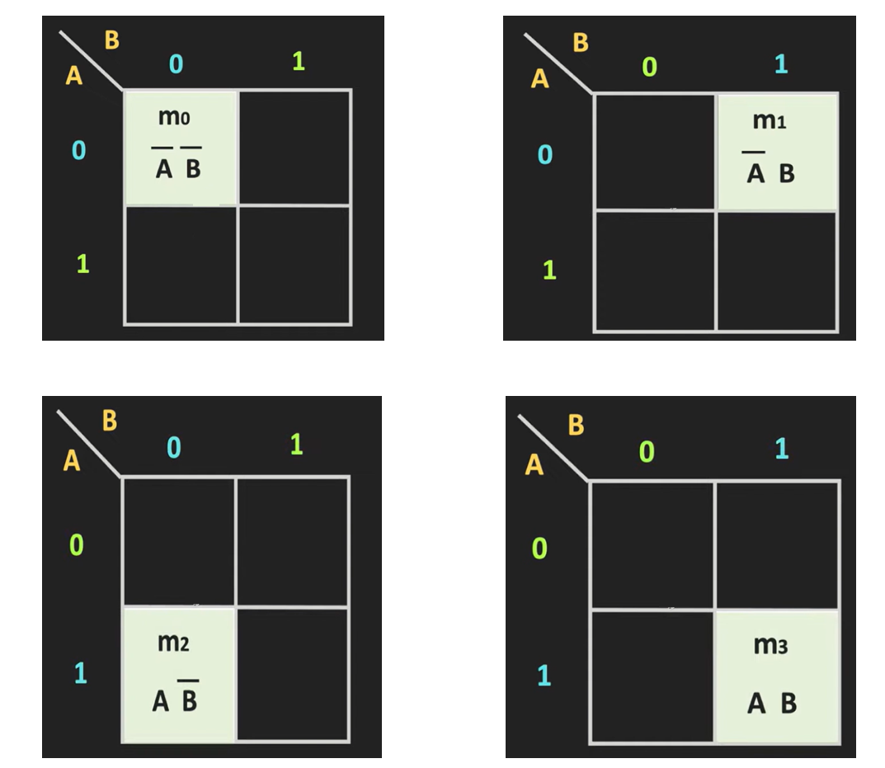
Introduction to Digital Electronics
K - Map
2 – Variable K – Map (2²)
UWTSD Lectures / ACDA6001 – Electronics 2

Slide 7
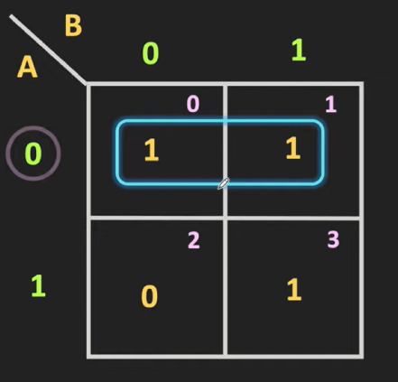
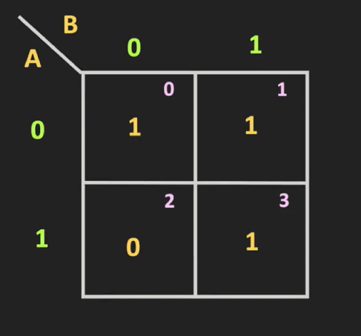

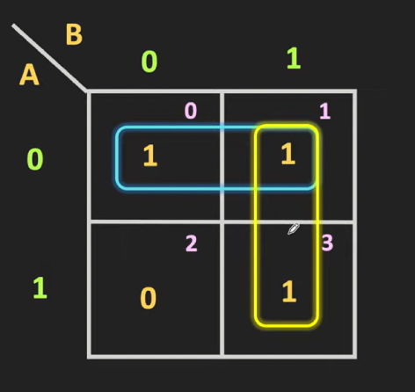



Introduction to Digital Electronics
K - Map
Find the Minimal Expression for the below minterm
$$F_{1}=\overline{A}$$
$$F_{1}=B$$
$$F_{1}=\overline{A}+B$$
UWTSD Lectures / ACDA6001 – Electronics 2

Slide 8
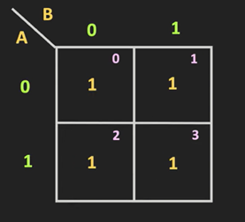




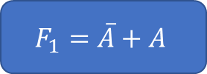

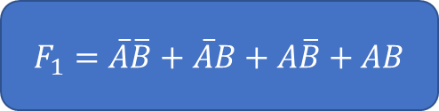

Introduction to Digital Electronics
K - Map
2 – Variable K – Map – Rounding Possibilities
Case 1 Case 2 Case 3 Case 4
$F_{1}=\overline{A}\overline{B}+\overline{A}B+A\overline{B}+AB$
$$F_{1}=\overline{A}+A$$
$$F_{1}=\overline{B}+B$$
$$F_{1}=1$$
$$F_{1}=1$$
$$F_{1}=1$$
$$F_{1}=1$$
UWTSD Lectures / ACDA6001 – Electronics 2

Slide 9

Introduction to Digital Electronics
K - Map
What cannot be done? – Diagonal Grouping
UWTSD Lectures / ACDA6001 – Electronics 2

Slide 10
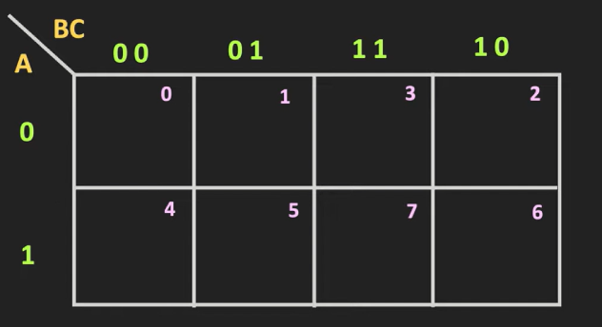
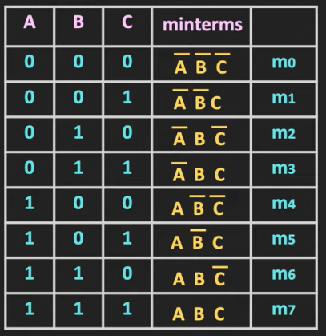
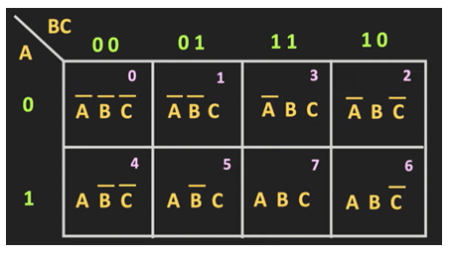
Introduction to Digital Electronics
K - Map
3 – Variable K – Map (2³)
UWTSD Lectures / ACDA6001 – Electronics 2

Slide 11
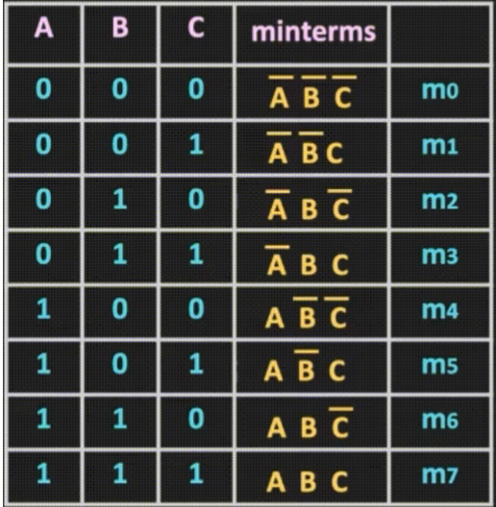
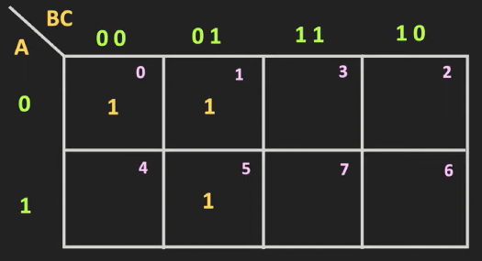
Introduction to Digital Electronics
K - Map
3 – Variable K – Map (2³)
UWTSD Lectures / ACDA6001 – Electronics 2

Slide 12


Introduction to Digital Electronics
K - Map
3 – Variable K – Map – Example
Find the Minimal Expression for the below minterm
UWTSD Lectures / ACDA6001 – Electronics 2

Slide 14
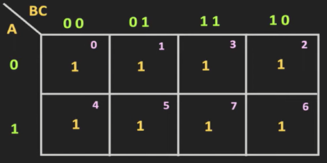



Introduction to Digital Electronics
K - Map
3 – Variable K – Map – Rounding Possibilities
$$F_{1}=\overline{A}\overline{B}\overline{C}+\overline{A}\overline{B}C+\overline{A}B\overline{C}+\overline{A}BC+A\overline{B}\overline{C}+A\overline{B}C+AB\overline{C}+ABC$$
$$F_{1}=\overline{A}\overline{B}+B\overline{C}+A\overline{B}+BC$$
$$F_{1}=1$$
$$F_{1}=\overline{B}+B$$
UWTSD Lectures / ACDA6001 – Electronics 2

Slide 15
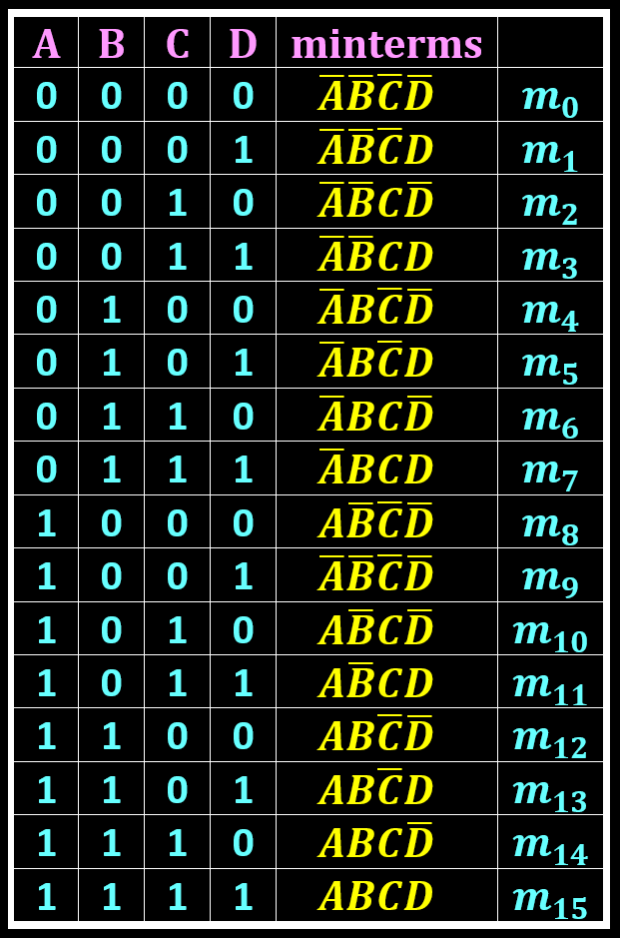
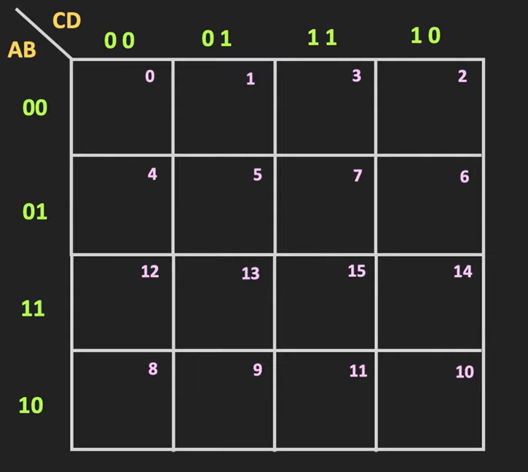
Introduction to Digital Electronics
K - Map
4 – Variable K – Map (2⁴)
UWTSD Lectures / ACDA6001 – Electronics 2

Slide 16
Introduction to Digital Electronics
K - Map
4 – Variable K – Map (2⁴)
Form groups of adjacent 1s (in sets of 2, 4, 8, etc.).
Aim to cover all the 1s using the minimum number of groups.
Overlapping of groups is permitted during minimisation.
Consider individual minterms that cannot be grouped with others.
UWTSD Lectures / ACDA6001 – Electronics 2

Slide 18
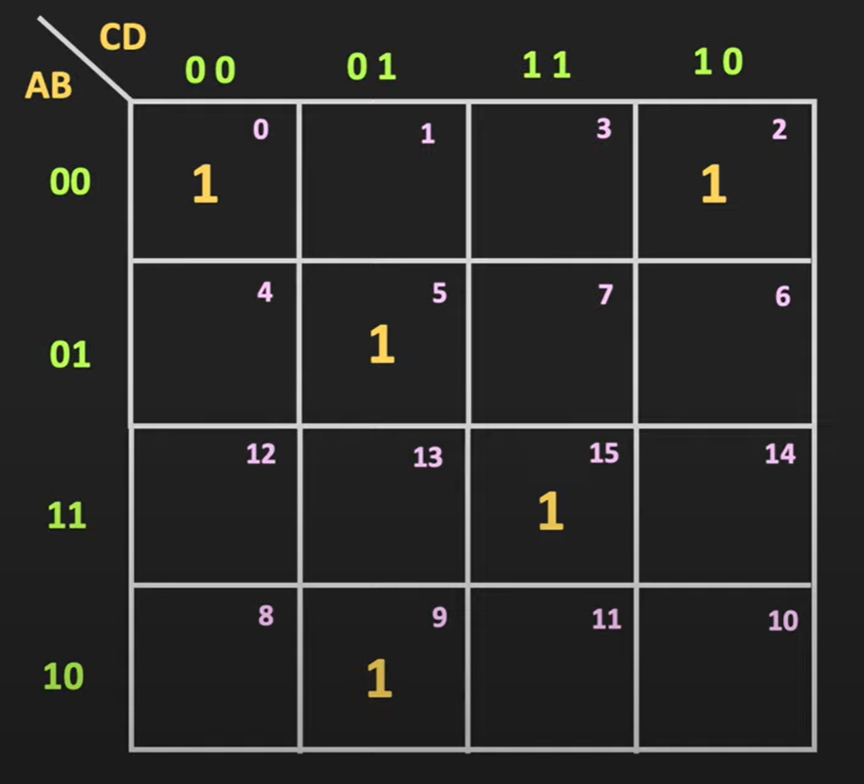
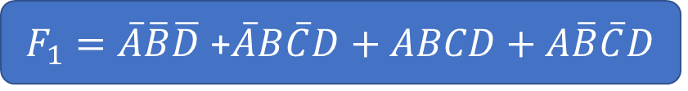


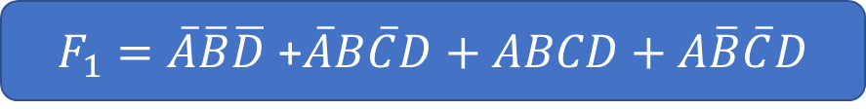

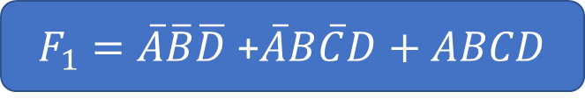

Introduction to Digital Electronics
K - Map
4 – Variable K – Map (2⁴)
Find the Minimal Expression for the minterms $f\left(A,B,C,D\right)=Σ_{m}(0,2, 5,9,15)$
1
$F_{1}=\overline{A}\overline{B}\overline{D}$
2
$F_{1}=\overline{A}\overline{B}\overline{D}$ +$\overline{A}B\overline{C}D$
3
$F_{1}=\overline{A}\overline{B}\overline{D}$ +$\overline{A}B\overline{C}D+ABCD$
4
$F_{1}=\overline{A}\overline{B}\overline{D}$ +$\overline{A}B\overline{C}D+ABCD+A\overline{B}\overline{C}D$
Final Expression
Finally
$F_{1}=\overline{A}\overline{B}\overline{D}$ +$\overline{A}B\overline{C}D+ABCD+A\overline{B}\overline{C}D$
UWTSD Lectures / ACDA6001 – Electronics 2

Slide 19
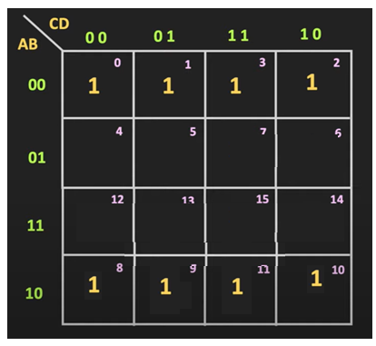
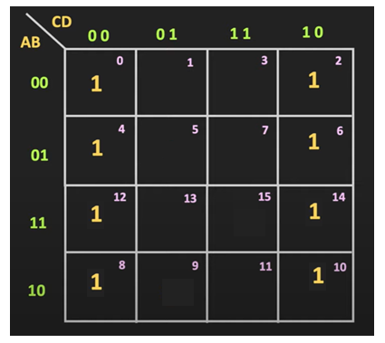






Introduction to Digital Electronics
K - Map
4 – Variable K – Map (2⁴) Possibilities -Round Wrapping
$$F_{1}=\overline{D}$$
$$F_{1}=\overline{B}$$
UWTSD Lectures / ACDA6001 – Electronics 2

Slide 20
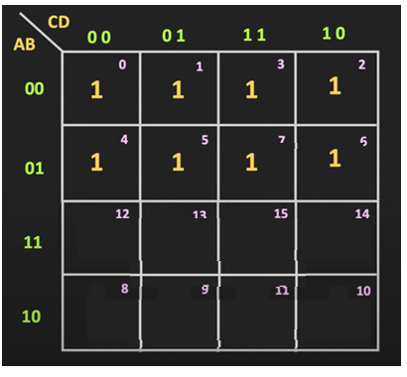
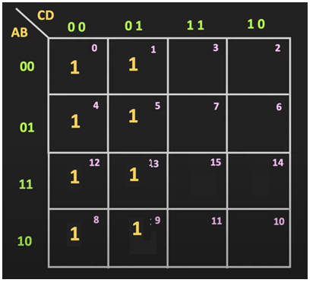


Introduction to Digital Electronics
K - Map
4 – Variable K – Map (2⁴) Possibilities
$$F_{1}=\overline{C}$$
$$F_{1}=\overline{A}$$
UWTSD Lectures / ACDA6001 – Electronics 2

Slide 21
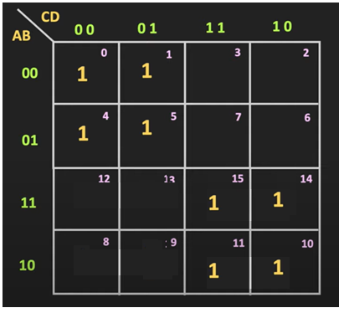
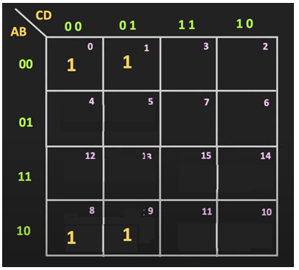


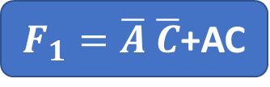

Introduction to Digital Electronics
K - Map
4 – Variable K – Map (2⁴) Possibilities
$F_{1}=\overline{A}$ $\overline{C}$+AC
$$F_{1}=\overline{B}\overline{C}$$
UWTSD Lectures / ACDA6001 – Electronics 2

Slide 22
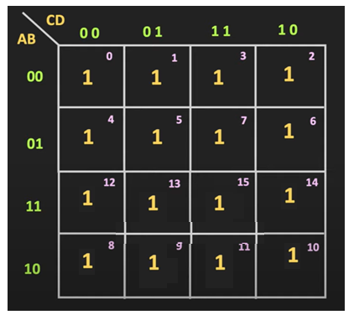

Introduction to Digital Electronics
K - Map
4 – Variable K – Map (2⁴) Possibilities
$$F_{1}=1$$
UWTSD Lectures / ACDA6001 – Electronics 2

Slide 23
Introduction to Digital Electronics
K - Map
4 – Variable K – Map (2⁴) Possibilities
UWTSD Lectures / ACDA6001 – Electronics 2

Slide 24
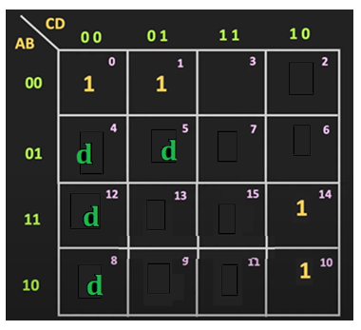
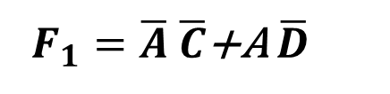
Don’t Care function
Introduction to Digital Electronics
K - Map
Find the Minimal Expression for the function $F_{1}= Σ_{m}(0,1,10,14)+Σ_{d}$(4,5, 8,12)
$F_{1}=\overline{A}$ $\overline{C}$+A $\overline{D}$
UWTSD Lectures / ACDA6001 – Electronics 2

Slide 26
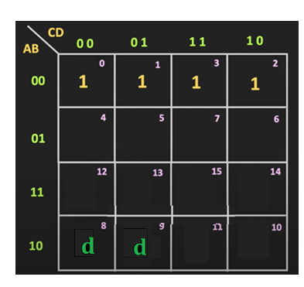





Don’t Care function
Introduction to Digital Electronics
K - Map
Choose the correct option.
Find the Minimal Expression for the function $F_{1}= Σ_{m}(0,1,3,2)+Σ_{d}$(8,9)
(a)
$F_{1}=\overline{A}$ $\overline{C}$+A $\overline{D}$
(b)
$$F_{1}=\overline{A}\overline{B}$$
(c)
$F_{1}=\overline{A}$ $C$+ $\overline{C}$
(d)
$F_{1}=\overline{A}$ $B$C+ $\overline{B}$ $\overline{C}$
UWTSD Lectures / ACDA6001 – Electronics 2

Slide 27

Don’t Care function
Introduction to Digital Electronics
K - Map
Find the Minimal Expression for the function $F_{1}= Σ_{m}(0,1,3,2)+Σ_{d}$(8,9)
$$F_{1}=\overline{A}\overline{B}$$
UWTSD Lectures / ACDA6001 – Electronics 2

Slide 28
Quick Reference
[1] ALL ABOUT ELECTRONICS, “Karnaugh Map (K-map): 2-Variable and 3-Variable K-map Explained,” Available: https://youtu.be/Iw1STgKUpW0.
Reference Book
[2] M. M. Mano and M. D. Ciletti, Digital Design, 5th ed. Boston, MA, USA: Pearson, 2013
Introduction to Digital Electronics
K - Map
UWTSD Lectures / ACDA6001 – Electronics 2

Slide 29
Thank you

