Slide 1
Part 1
The organisational setting
Chapter 1
Understanding organisational behaviour

Slide 2
The significance of organisational behaviour
‘The study and understanding of individual and group behaviour and patterns of structure in order to help improve organisational performance and effectiveness’.

Slide 3
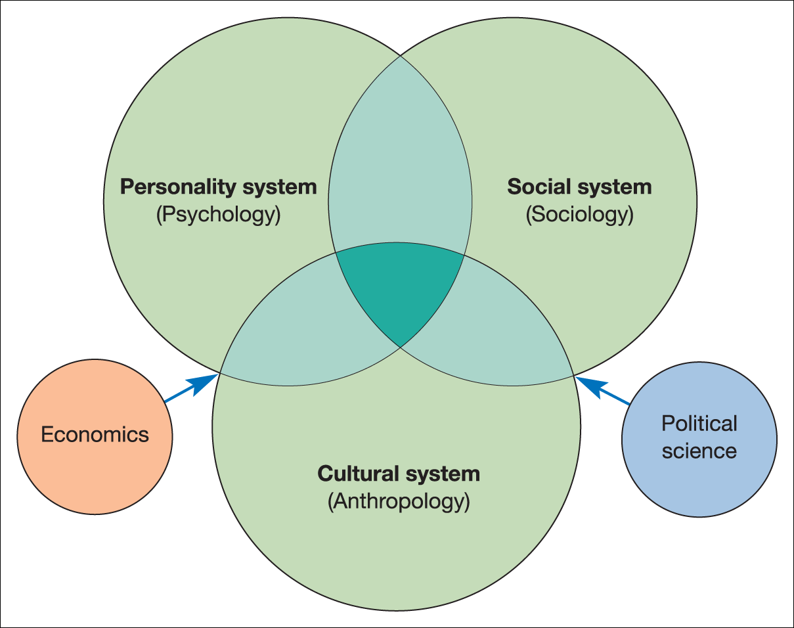
Organisational behaviour – a multidisciplinary perspective
INSERT FIGURE 1.1 HERE
Figure 1.1 Organisational behaviour: a multidisciplinary approach

Slide 4
Three main disciplines
Psychology
  The study of human personality and behaviour, including perception, attitudes and motives.
Sociology
  The study of social behaviour, relationships and order, including social structures, social position and leader – follower relationships.
Anthropology
  The study of mankind, including cultural systems, beliefs, ideas and values and comparisons among such systems.

Slide 5
Influences on organisational behaviour
The individual
The group
The organisation
The environment

Slide 6
The individual
Individuals are central to the study of OB.
Organisations are made up of individual members.
Conflict arises if needs and demands of the organisation and the individual are incompatible.
The role of management is to integrate individuals and the organisation as a means to attaining organisational goals.

Slide 7
The group
Groups are essential to organisation work and performance
Can be formal or informal
Often develop their own hierarchies and leaders
Can influence individual behaviour
An understanding of group structure and behaviour complements knowledge of individual behaviour.

Slide 8
The organisation
Individuals and groups interact within the formal organisation.
Behaviour is influenced by:
  Patterns of structure
  Technology
  Styles of leadership
  Systems of management.
Systems of management plan, direct and monitor organisational processes.

Slide 9
The environment
External environment affects organisations as the result of:
  Technological development
  Economic activity
  Social and cultural influences
  The impact of government actions
  Corporate responsibility and ethical behaviour.
Study of the organisational environment helps organisations adapt to change.

Slide 10
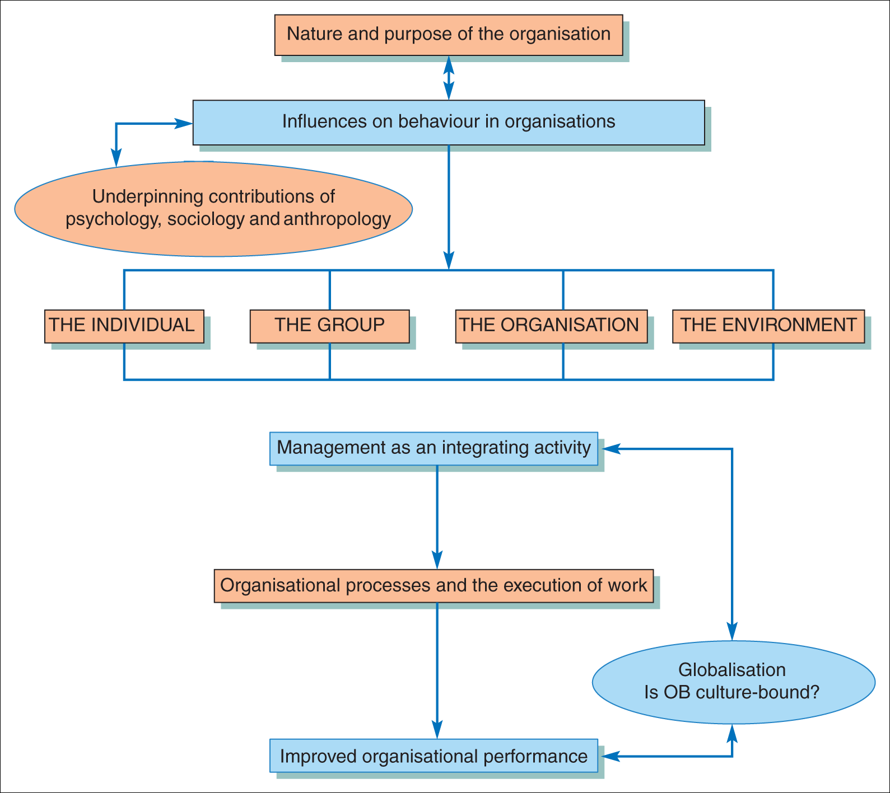
A basic framework of study
Figure 1.2 Organisational behaviour (OB): a basic framework of study

Slide 11
Morgan’s organisational metaphors
Morgan believes we can interpret and understand the nature of organisations by the use of metaphors. We can describe them as:
  Machines
  Organisms
  Brains
  Cultures
  Political systems
  Psychic prisons
  States of flux
  Instruments of domination

Slide 12
Wilson: an extra dimension?
What happens outside work organisations can help us understand what happens inside them.
  Rest and play
  Emotion and feeling
  ‘Men's’ and ‘women's’ work
  Unorganised work
  Unemployment

Slide 13
Importance of people and organisational behaviour
‘One way to recognise why people behave as they do at work is to view an organisation as an iceberg. What sinks ships isn’t always what sailors can see, but what they can’t see’.
Hellriegel, Slocum and Woodman

Slide 14
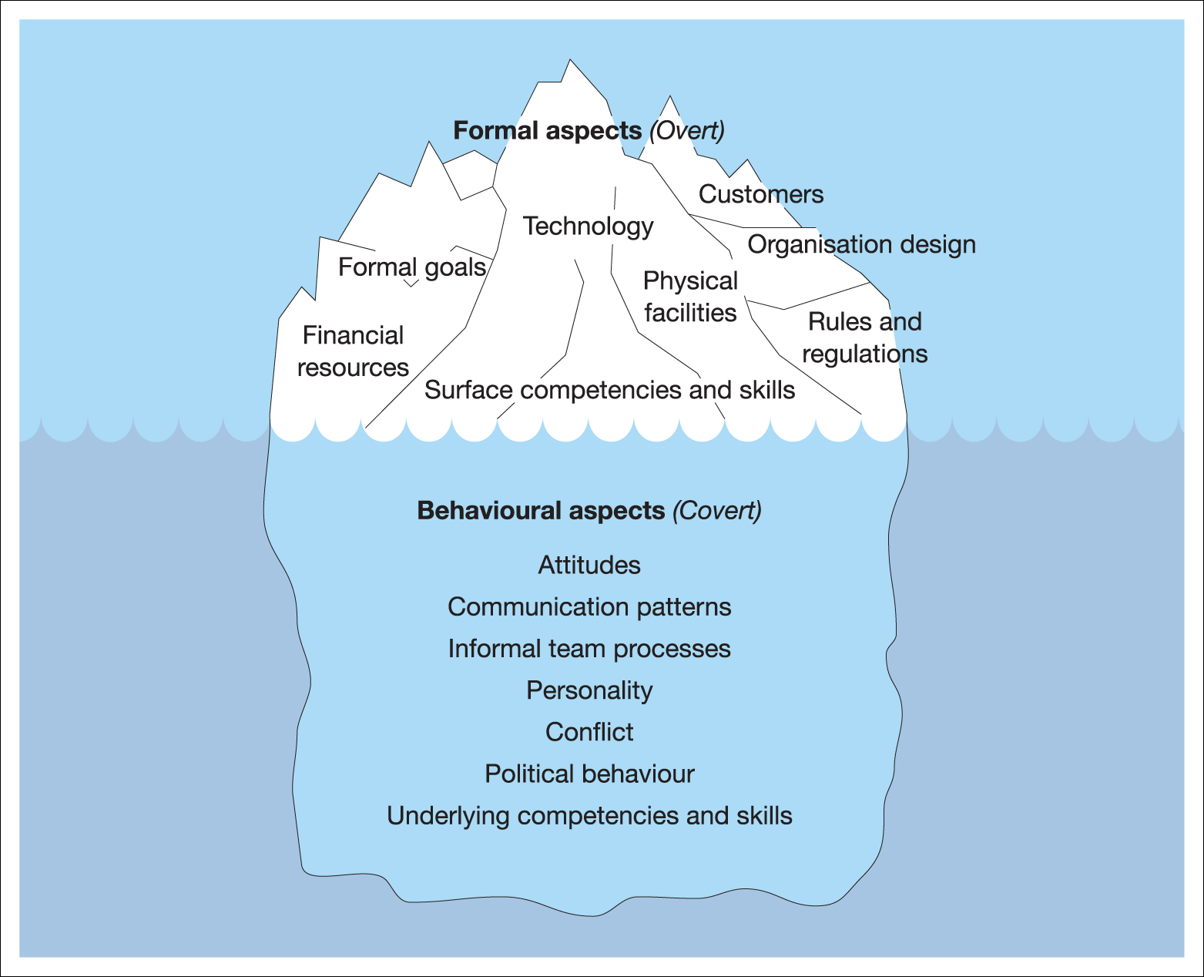
The organisational iceberg
Figure 1.3 The organisational iceberg
Source: From Hellriegel, D., Slocum, J. W., Jr. and Woodman, R. W. Management, eighth edition, South-Western Publishing (1998), p. 6. Reproduced by permission.

Slide 15
Orientations to work and the work ethic
Instrumental orientation
  Work is not central to life, just a means to an end.
Bureaucratic orientation
  Work is central to life and there is a sense of obligation both to the work and the organisation.
Solidaristic orientation
  Work is about being part of a group and these relationships are more important than the organisation.
Goldthorpe et al.

Slide 16
International and cultural influences
‘The Protestant version of the work ethic prevails, implying heads-down work, focused agendas, punctuality, efficiency. In French and Spanish offices, it takes the first hour to kiss everyone, the second to discuss local gossip and the third to pop out for a coffee and croissant. In Britain, these activities would count as sexual harassment, time-wasting and absenteeism’.
Reeves

Slide 17
Social exchange theory
People generally enter into a relationship with others with the expectation of some kind of mutually acceptable exchange.
Exchanges are subject to a ‘cost-benefit’ analysis.
The importance of actual (or perceived) reciprocity in determining attitudes and behaviours at work.

Slide 18
The psychological contract
A series of mutual expectations and satisfaction of needs arising from the people – organisation relationship.
Rights, privileges, duties and obligations which are not part of a formal agreement, but have an important influence of behaviour.

Slide 19
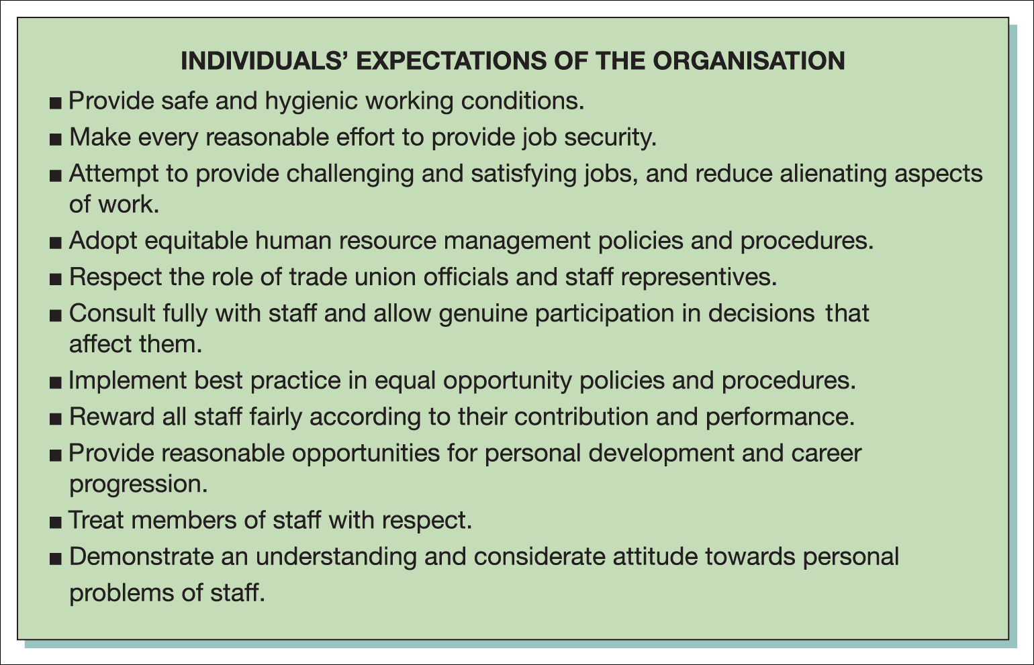
Individuals’ expectations
Figure 1.4 The psychological contract: possible examples of individual and organisational expectations

Slide 20
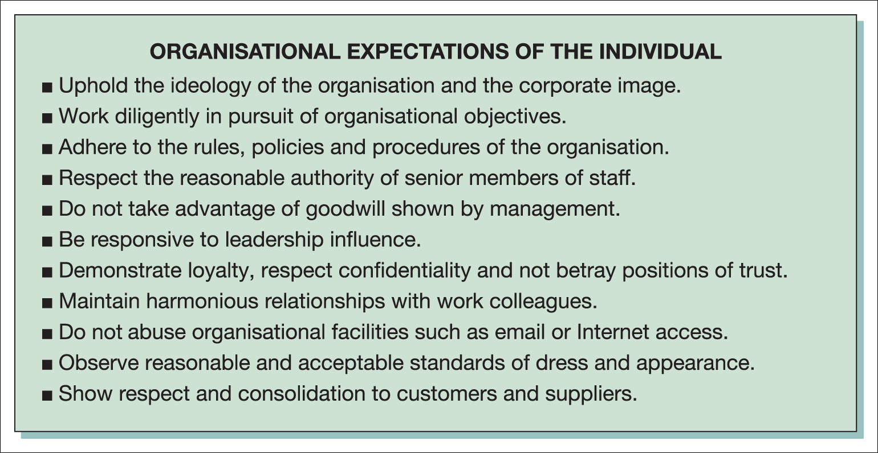
Organisational expectations
Figure 1.4 The psychological contract: possible examples of individual and organisational expectations (Continued)

Slide 21
Process of balancing
Caring
  Demonstrating genuine concern for individuals.
Communicating
  Talking about what the company hopes to achieve.
Listening
  Hearing the words and the meaning behind them.
Knowing
  The individuals who work for you.
Rewarding
  Not necessarily with money, but recognition.
Stalker

Slide 22
The Peter Principle
‘In a hierarchy every employee tends to rise to their level of incompetence’.

Slide 23
Parkinson’s Law
‘Work expands to fill the time available for its completion’.

Slide 24
Positive organisational behaviour (POB)
‘The study and application of positively oriented human resource strengths and psychological capacities that can be measured, developed and effectively managed for performance improvement in today’s workplace’.
Luthans

Slide 25
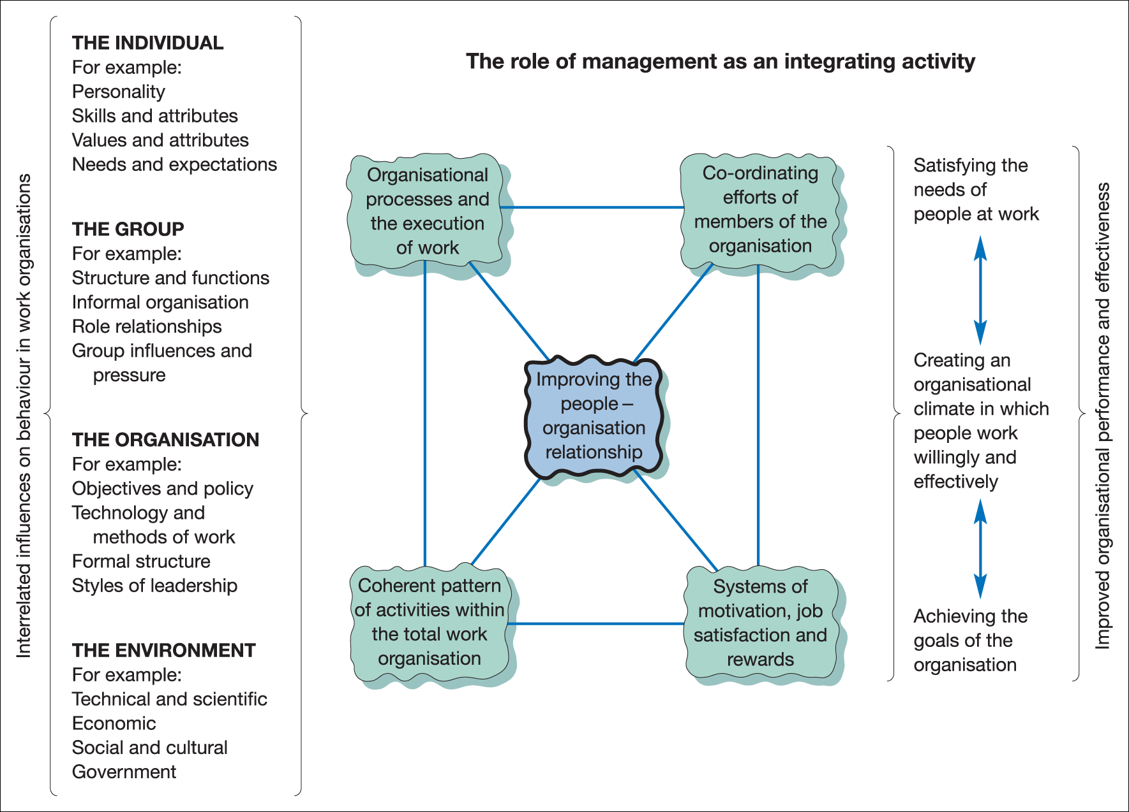
Management as an integrating activity
Figure 1.6 Management as the cornerstone of organisational effectiveness

Slide 26
Globalisation and the international context
Origins
  Improvements in international communication
  International competitive pressure
  Increased mobility of labour
  International business activity
  Greater cross-cultural awareness and acceptance of diversity

Slide 27
Managing people from different cultures
‘Managers must develop organisational systems that are flexible enough to take into account the meaning of work and the relative value of rewards within the range of cultures where they operate’.
Francesco and Gold

Slide 28
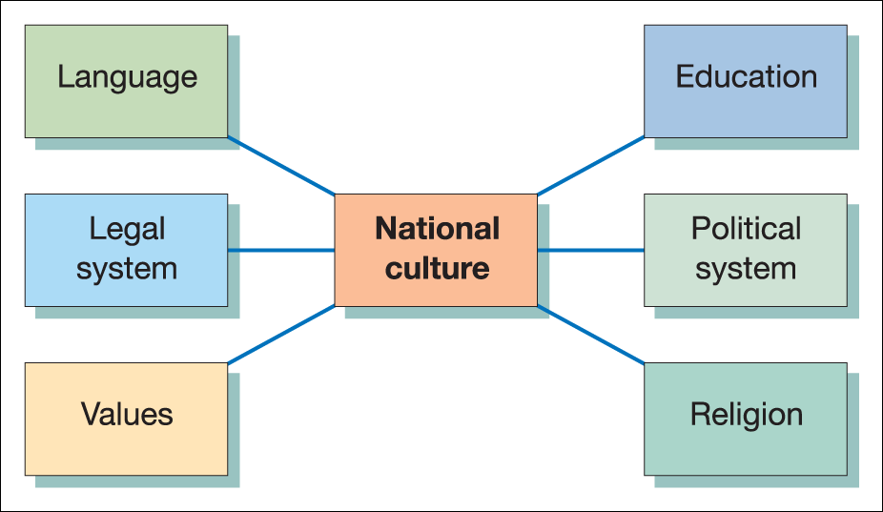
Factors affecting national culture
Figure 1.7 Factors affecting national culture
Source: From Brooks, I. Organisational Behaviour: Individuals, Groups and Organisation, fourth edition, Financial Times Prentice Hall (2009), p. 286. Reproduced with permission from Pearson Education Ltd.

Slide 29
Hofstede’s dimensions of culture
Power distance
Uncertainty avoidance
Individualism
Masculinity
Long-term/short-term orientation
(formerly Confucian work dynamism)

Slide 30
Trompenaars’ framework for analysing cultural differences
Universalism vs. particularism
Individualism vs. collectivism
Neutrality vs. emotion
Diffuse vs. specific relationships
Achievement vs. ascription
Future vs. past orientation
Attitude to the natural environment

Slide 31
Hall’s cultural ‘languages’
Culture as a series of ‘languages’
  The language of time
  The language of space
  The language of things
  The language of friendships
  The language of agreements.
High- and low-context societies differ in the way they communicate shared attitudes.

Slide 32
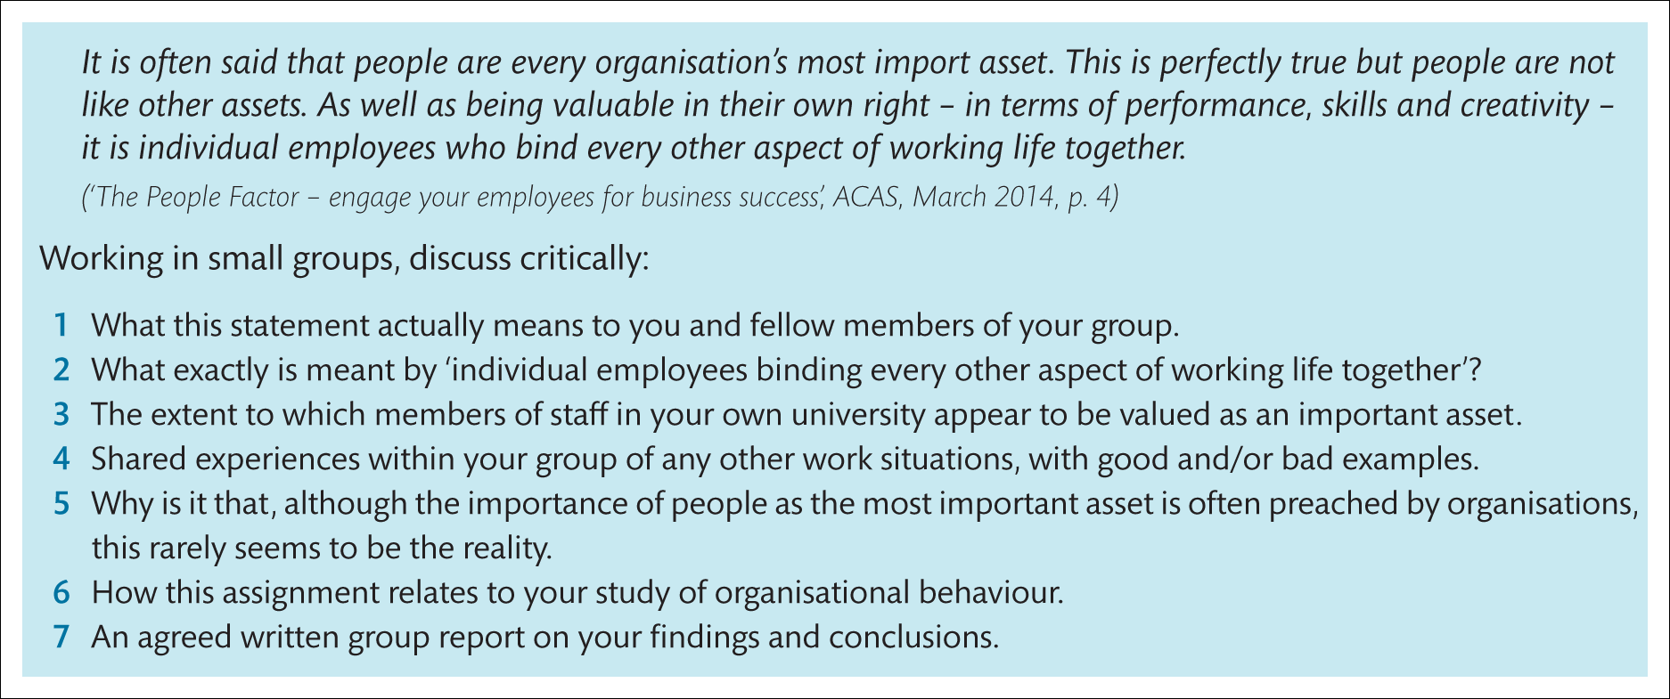
Group Work

