Slide 1

MODULE CODE: Digital Skills for Personal Development and Business Growth BMSW4008
ASSESSMENT COMPONENT: PORTFOLIO
STUDENT NAME: Muhammad Abdul Mutalib
STUDENT NUMBER: 2213289
LECTURER: Aqsa Shabir
DATE: 01st December 2025

Slide 2


Slide 3
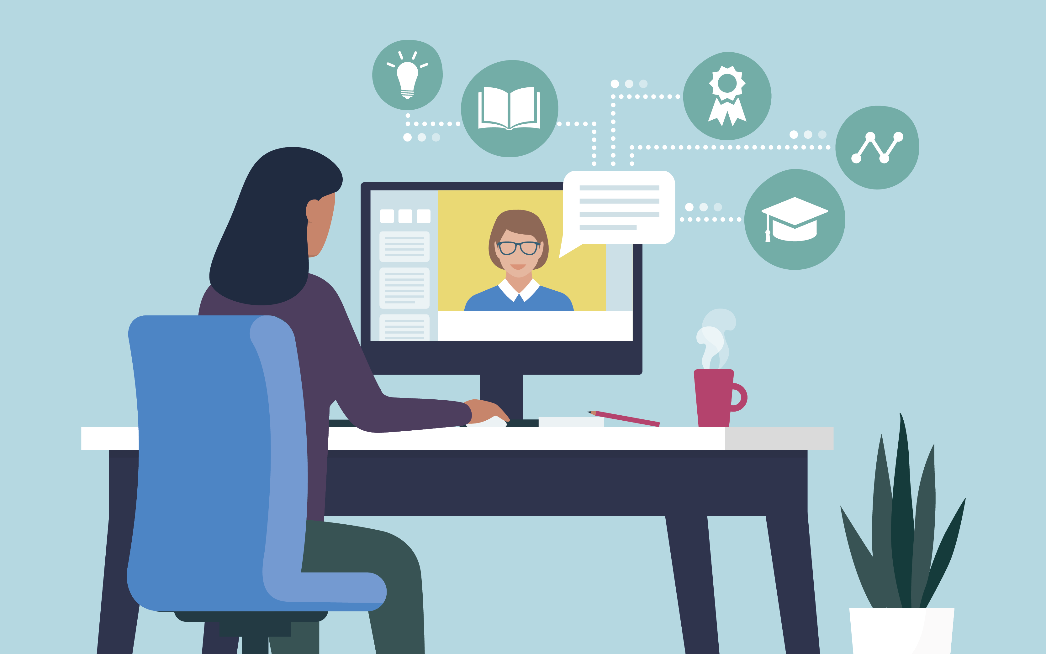
What are digital skills?
Use a smartphone or computer. sending emails. Using tools like Teams WhatsApp, or Zoom. using Google to look up information. Making documents in WordExcel, or PowerPoint. keeping passwords secure and being safe online.

Slide 4

AI (Artificial Intelligence) simply means machines or computer programs that can think or learn in a way similar to humans.
Here’s a simple breakdown:
Artificial = made by humans
Intelligence = ability to understand, learn, and solve problems
So AI is when computers are designed to learn from data, make decisions, recognize patterns, or perform tasks that normally need human thinking.
Examples of AI in daily life:
Voice assistants like Siri or Google Assistant
Google Maps suggesting the best route
ChatGPT (like me) answering questions
YouTube recommending videos
Cars detecting obstacles
Current AI leading apps

Slide 5
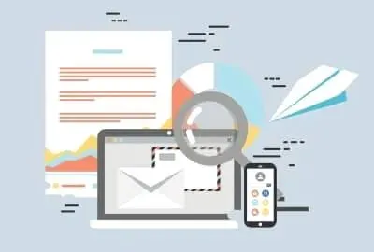
Pros of Digital Skills
Make work faster and easier.
facilitate speedy email or messaging communication.
Give access to information anytime.
Useful for practically every job.
Help you handle documents, numbers, and data.
Allow you to use online services (banking, council forms, NHS).
Improve confidence when using technology.
Reduce errors and save time.

Slide 6
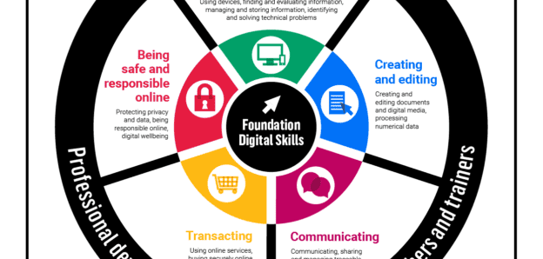

Slide 7
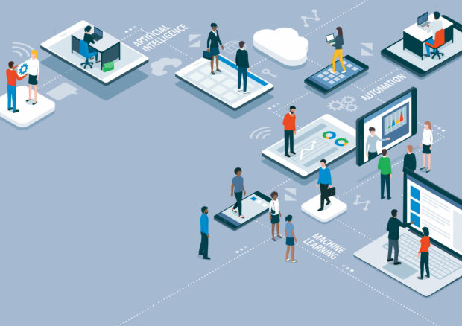
Cons of Digital Skills
Can be hard to learn for beginners.
Need a computer, phone, or internet — which can cost money.
Technology changes fast, so you must keep learning.
Mistakes online can cause problems (wrong email, wrong file).
Risk of scams or hackers if not careful.
Too much screen time can cause stress or eye strain.

Slide 8

Cons of Digital Skills
Can be hard to learn for beginners.
Need a computer, phone, or internet — which can cost money.
Technology changes fast, so you must keep learning.
Mistakes online can cause problems (wrong email, wrong file).
Risk of scams or hackers if not careful.
Too much screen time can cause stress or eye strain.
Online errors can lead to issues (incorrect file, incorrect email).
Risk of scammers or hackers if not attentive.
Too much screen time might create stress or eye strain.
How to Get Better at Digital Skills
Practise regularly on a computer or phone.
Learn one small skill at a time, such as Word, typing, or email.
Watch simple instructional videos on the internet.

