Slide 1
Why is Psychology Important When Working as a Pediatric Nurse?
Janhara Bibi (2025745)

Slide 2
Introduction
Brief introduction to Piaget’s theory of Cognitive Development
What is the concrete operational stage?
How Piaget’s theory has been practically applied by pediatric nurses

Slide 3
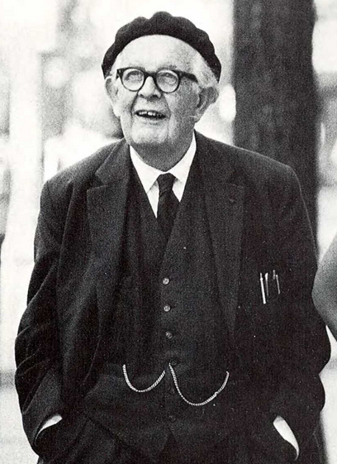
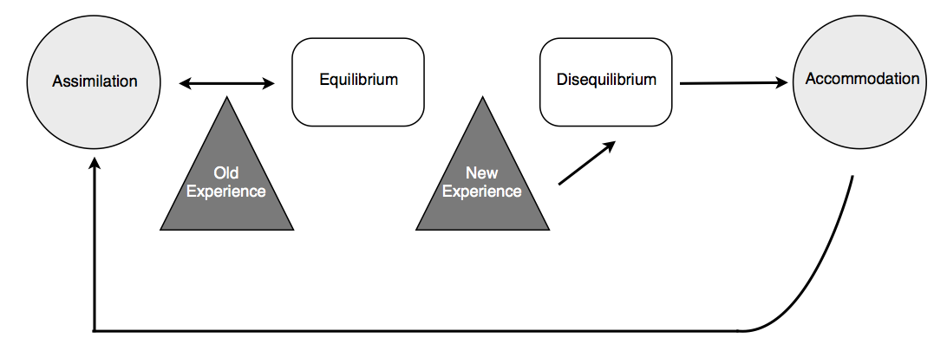
Piaget’s Theory of Cognitive Development
Suggests that children’s way of thinking and understanding changes (“develops”) through a sequence of stages in their life (Boyd, 2019)
Involves learning from experiences (assimilation, accommodation and equilibration)

Slide 4
Four Stages of Piaget’s Theory:
Rachel (2016)
Sensorimotor Stage (0 to 24m) – unaware of outside world
Preoperational Stage (2 to 7y) – start to think but limited
Concrete Operational Stage (7 to 12y) – thinking becomes factual
Formal Operational Stage (12+) - begin thinking like adults

Slide 5
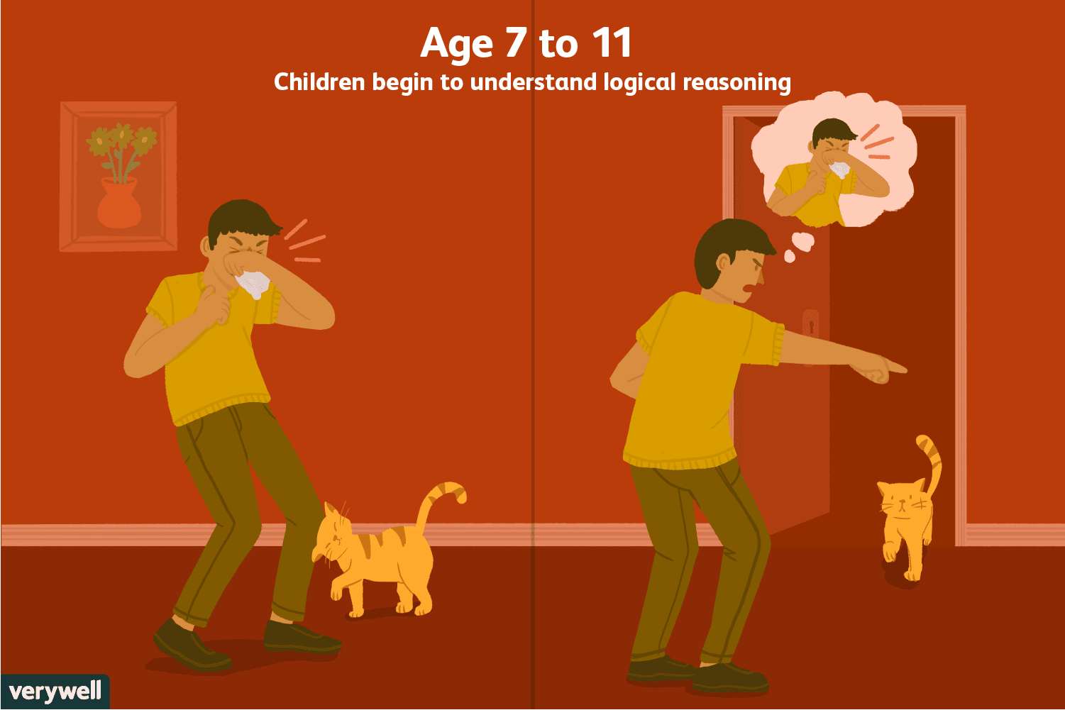
Concrete Operational Stage
Stage where children begin to think logically (using facts) (Huitt & Hummel, 2003)
Involves the development of:
  Decentration – understanding that other people have different thoughts, views etc. from oneself
  Conservation – idea that an object can stay the same even if it’s changed (American Psychological Association, n.d.)
However at this stage, children are still unable to think hypothetically (about made-up scenarios)

Slide 6

Practical Application of Piaget’s Theory
Pediatric nurses use therapeutic play to explain and prepare children for surgery (Li & Lopez, 2008)
  For example: showing the child what will happen in the surgery using a doll and then letting them play it out themselves
Links with Piaget’s theory as role-playing the surgery helps the child think through the procedure logically
  Especially as children cannot think hypothetically before age 12
Can help reduce children’s anxiety surrounding their surgery (Brewer et al, 2006)

Slide 7
Conclusion
Piaget’s theory of cognitive development helps nurses know how much children can think and understand at specific stages in their life
Influences how nurses explain children’s conditions to them
  For example, concrete operational children are told more about their condition than preoperational children

