Slide 1


Strategies for
Effective Communication in a
Business Setting
Effective Team Working and Communication
Module Code: BMSW4002
Module Lead: Dami Pokubo
Made by:
Keila Costa (2127935)
Samuel Kirvej (2120449)
Sorin Pandele (2130592)
Patrick Tolog (2026788)
Notes:
Line spacing + Page numbers
1

Slide 2

This work was done with the objective of presenting strategies that can improve the communication between the members of Tom's team, one of the managers of the big company Amazon, that is facing difficulties in creating a good working environment among the members of his team.
2

Slide 3
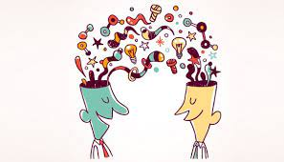
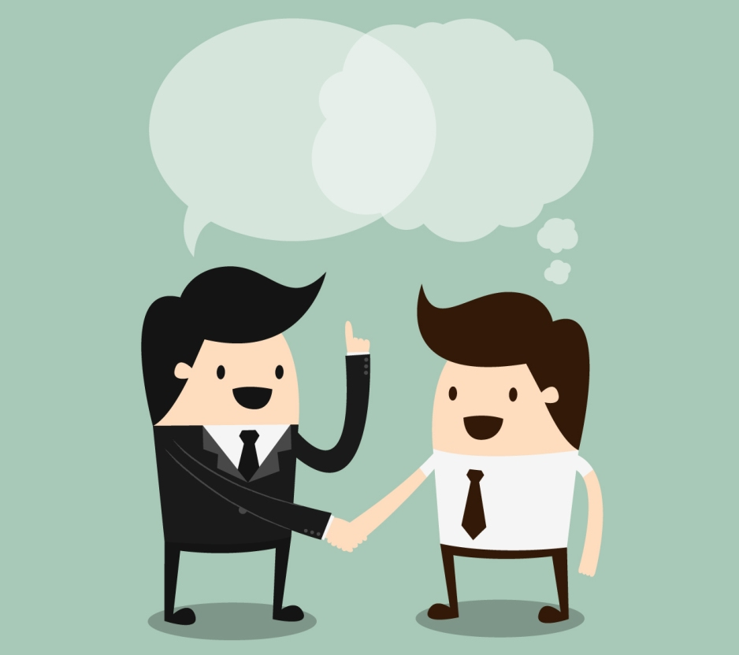
Benefits of effective communication
01
Communication is the way we express our ideas, thoughts and feelings so that they can be understood by other people. It’s can be :
Verbal / Nonverbal
Formal / Informal
Tom must have excellent and effective communication skills which will lead to benefits for the his team and for Amazon such as:
Stimulation of behaviour changes in his team
Inspire employee loyalty by reducing the turnover rate.
Avoids conflicts between team members and leaves no room for gossip.
Increased productivity.
Increases the satisfaction and happiness of the team because there is transparency about what happens in the company (Ali 2017).
Respect and professionalism which will generate trust for feedbacks that lead to positive changes.
Building team
3

Slide 4
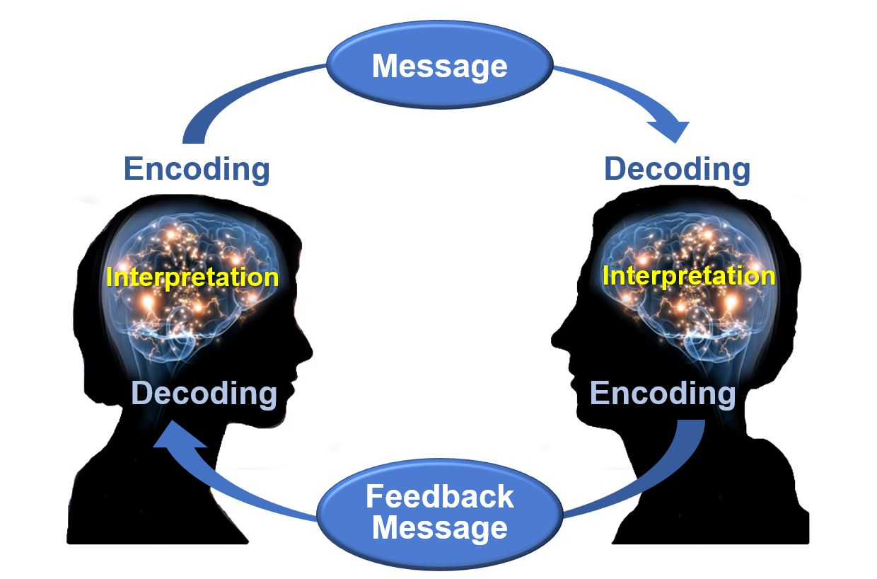
Model of communication
02
Schramm's
This model is based on the Shannon-Weaver communication model. It defines communication as a two-way process between the sender and receiver in which each of them goes through the same steps of encoding and decoding the message.
This model should be used in the case of amazon because in a simple way explains the communication process and identifies the important points for the message to be effective which will help Tom.
Coding starts the communication process because that's when you convert thought into content.
Decoding allows message receiver to understand it.
Communication is only complete when the sender receives feedback from the recipient. (Schramm 1954)

Slide 5
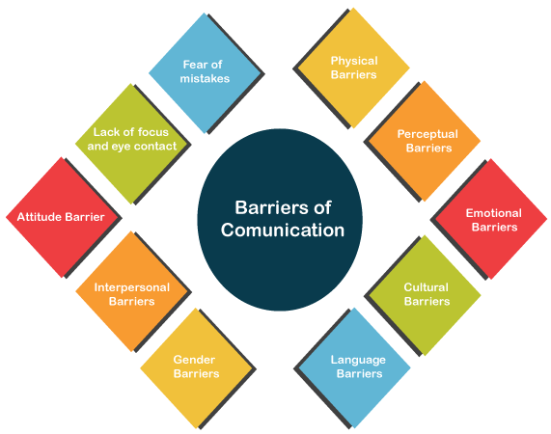
Communication barriers
03
Communication barriers in the case of Tom's team can have different negative impacts such as:
Dissatisfaction and demotivation on the part of some team members.
Some team members will have their ideas barred without any justification.
Lack of feedback.
Defensive attitude on the part of some team members
Kuznar,Lawrence A and Yager,Mariah - 2020
5

Slide 6
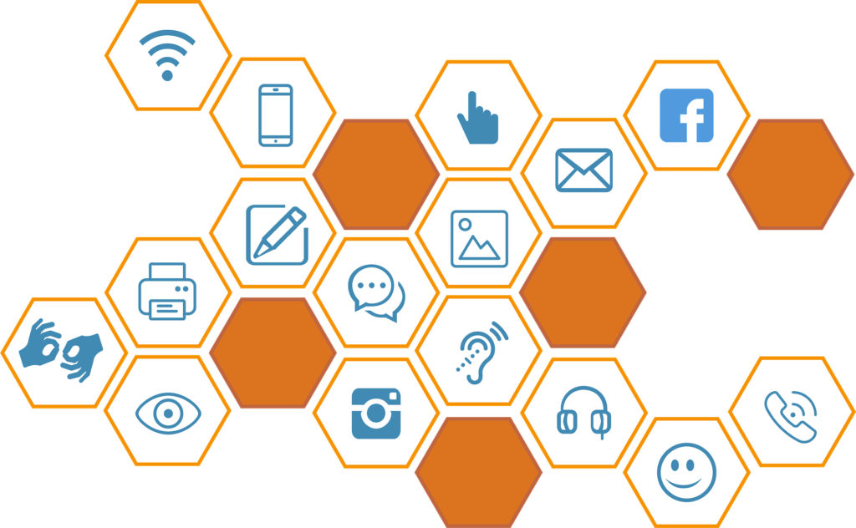
Channel of communication
04
In order to improve Tom's team's problems we advise him to use the face to face method so that according to the Channel Richness Hierarchy model it is the best and most efficient channel.
This method will help Tom to avoid various types of misunderstanding and it will be easier for him to know if each one understands his task and his role in the team through the facial expressions of each one (AR Freitag, G Picherit 2008). However, we also advise that Tom has a private conversation with the most conflicted members of the team so they will feel more comfortable expressing their reasons.
Finally, we advise Tom to implement daily tasks for each one and to stipulate a more formal type of language among his team so that there is more respect between them all.
6

Slide 7
References
  Radovic Markovic, M. and Salamzadeh, A., 2018. The importance of communication in business management. In Radovic Markovic, M., & Salamzadeh, A.(2018). The Importance of Communication in Business Management, The 7th International Scientific Conference on Employment, Education and Entrepreneurship, Belgrade, Serbia.
  Keller, K. L. (2009) ‘Building strong brands in a modern marketing communications environment’, Journal of Marketing Communications, 15(2/3), pp. 139–155. doi: 10.1080/13527260902757530.
  Tourish, D. and Hargie, O., (2009). Communication and organizational success. In Auditing Organizational Communication: A Handbook of Research, Theory and Practice (pp. 3-26).
  Kuznar, L.A. and Yager, M., 2020. The Development of Communication Models, Quick Look. Joint Staff J39, Strategic Multi-layer Assessment Washington, DC United States.
  Tankard Jr, J.W., 1988. Wilbur Schramm: definer of a field. The Journalism Educator, 43(3), pp.11-16.
  Gillespie, D.J. and Schiffman, R., 2018. A critique of the Shannon-Weaver theory of communication and its implications for nursing. Research and Theory for Nursing Practice, 32(2), pp.216-225.
7

Slide 8
Johnson, J.D., Donohue, W.A., Atkin, C.K. and Johnson, S., 1994. Differences between formal and informal communication channels. The Journal of Business Communication (1973), 31(2), pp.111-122
Griffith, B., and Dunham, E., (2015), Working in Teams: moving from high potential to high performance, Los Angeles, SAGE Publications.
Sharpe, N.F., 2019. Prioritizing process: empowering the corporate ethics and compliance function. U. Ill. L. Rev., p.1321.
Johnson, A.M. and Lederer, A.L., 2005. The effect of communication frequency and channel richness on the convergence between chief executive and chief information officers. Journal of Management Information Systems, 22(2), pp.227-252.

Slide 9
Teamwork Evaluation
Teamwork Evaluation | Team responses.
Who was in your team? | Keila Costa (2127935), Samuel Kirvej (2120449), Sorin Pandele (2130592) and Patrick Tolog (2026788)
What were the key strengths of your team? | Communication was my team's biggest strengths. There were communication failures and difficulty in deciding how the work would be organized. The difference in opinions was also a key strengths during the elaboration of the work.
What were the challenges that you overcame as a team? | I was able to establish a connection with my team members.
What would you do differently if you worked as a team again? | From the beginning I will talk to everyone in order to establish tasks for each member.
How would you rate your team working? Out of 10? | 4
9

