Slide 1


Presented by :
Procurement and Supply Chain Management
Module Code: ACHA7024
Module: Procurement and Supply Chain Management
Course: MSc Engineering Project Management
University: University of Wales Trinity Saint David
Student Name: Md Saiful Islam (2418665)

Slide 2

Introduction of the Organisation
  SQDN Engineering is a company which is mostly known as “Squadron Engineering”.
  This company offers military products such as US Air Force Civil Engineering Squadrons (CES) or Software Engineering Squadrons (SWES) (United States Space Force, 2024).
  SQDN Engineering also focuses on the commercial context by involving its role in data platform and data science services.
  This company highlights its service in migrating data workflows from Databricks, Informatica and DataStage platforms.

Slide 3
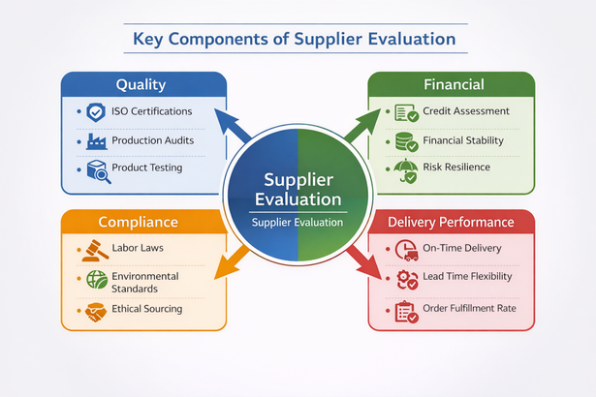
Key Supplier Problems Identified
  This company may involve some limitations such as poor complaint handling, weak buyer-supplier relationship, product quality failures and also environmental non-compliance (Rocha et al., 2023).
  On the other hand, these problems of this company are considered operational, relational, and reputational.

Slide 4

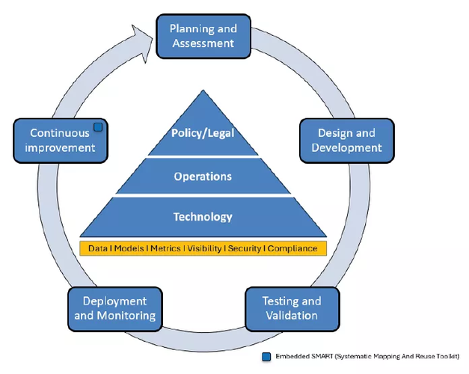
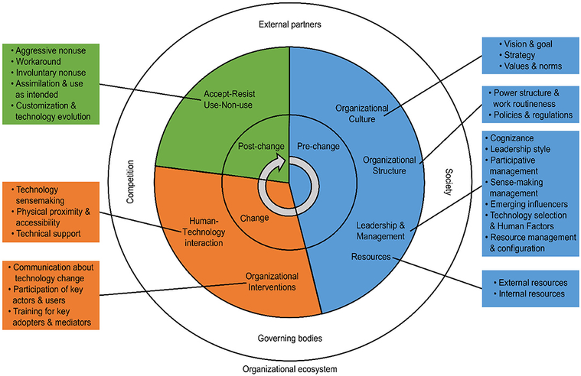
Strategic Approach
  The strategic approach of the engineering squadron may involve system thinking by implementing collaboration among the stakeholders and users (Mazumdar et al., 2024).
  This approach may involve integrated planning, user involvement, Innovation and technology adoption, systems analysis, readiness and flexibility, collaboration and partnerships.

Slide 5
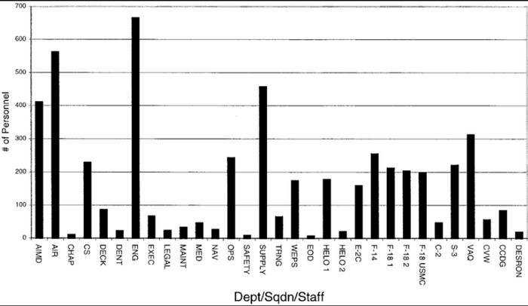



  This company needs to identify its broken feedback loop diagram.
  The highlighted issues may involve delayed replies, zero corrective actions, repeated failures with zero accountability (Parrish, Olsen and Thomas, 2005).
  This can affect the production by creating disruptions with increased internal rework and increased customer dissatisfaction.
Problem: Weak Complaint Response

Slide 6
Solution: Formal Complaint Management Process
  Squadron Energy is aligned with the formal complaint management process with the ISO 10002:2014 guidelines (Tarranco, 2026).
  This company can design to ensure the complaints from stakeholders.
  This company also needs to focus on its visibility by focusing on the customers.

Slide 7
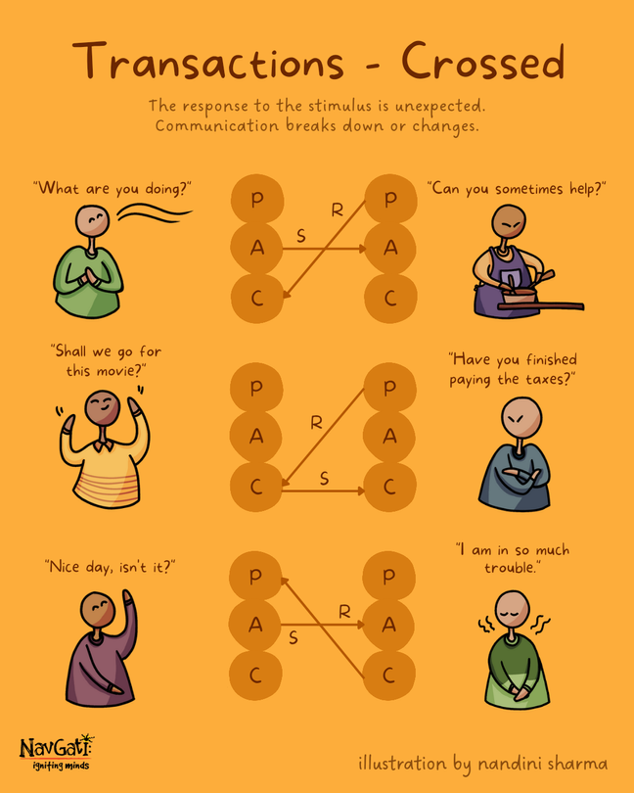
Problem: Transactional Relationship
  SQDN Engineering manages its manpower by managing levels for engineering tasks.
  This company also focuses on the coordination of the monthly checkups.
  This company highlights its transactional relationships including procurement and acquisition, maintenance contracts, internal service level agreements and lastly logistic and supply chain (de Waard, de Bock and Beeres, 2019).

Slide 8
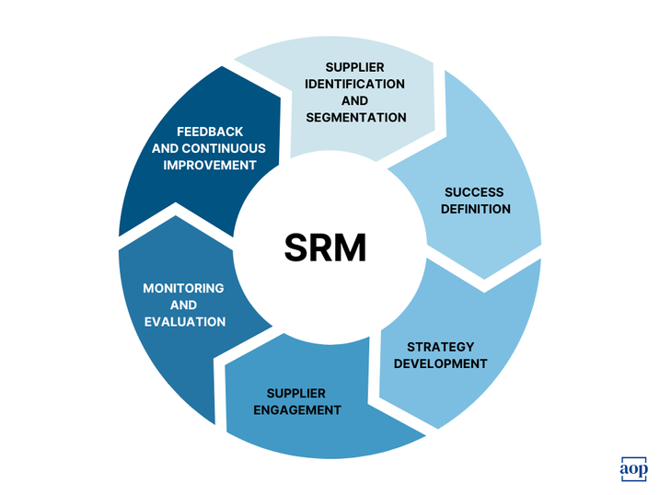
Solution: Supplier Partnership Model
  SRM pyramid can be implemented to the supplier partnership model by incorporating multiple actions.
  These actions may involve quarterly performance review meetings, joint improvement targets, executive level engagement with shared KPIs (Ali and Khan, 2016).
  These actions may help the company to build the level of trust. These actions also help to maintain the commitment of the company to a long term relationship.

Slide 9
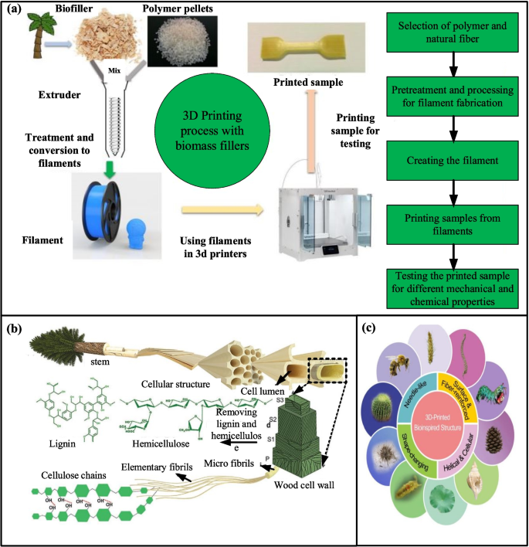
Problem: Inconsistent Timber Quality
  This company inherent Timber quality naturally by incorporating multiple factors such as natural growth variations, anisotropy, defects, moisture content and lastly, processing issues.
  This company also highlights defect categories chart by involving multiple failures in wrong sizing, incomplete treatment and poor material grading (Šuhajdová et al., 2018).

Slide 10
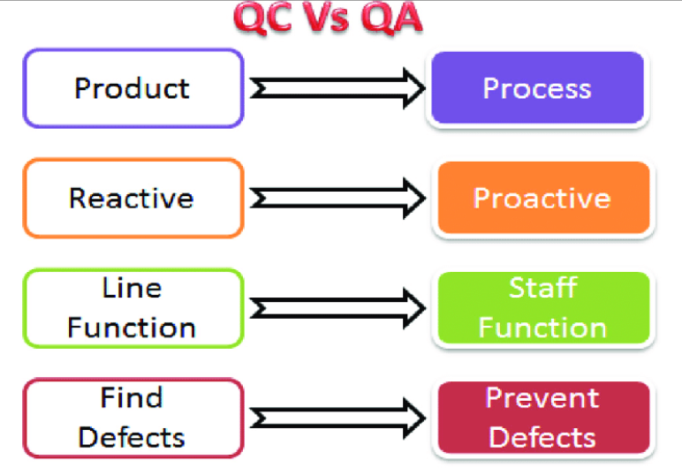
Solution: Quality Assurance Controls
  This company needs to adopt a dual inspection system.
  This system can involve multiple activities by including supplier pre-dispatch inspection, SQDN incoming good inspection, quality specifications document and lastly penalty clauses for defects (Ammar et al., 2021).
  This can help the company to reduce the level of rework and production delays.

Slide 11
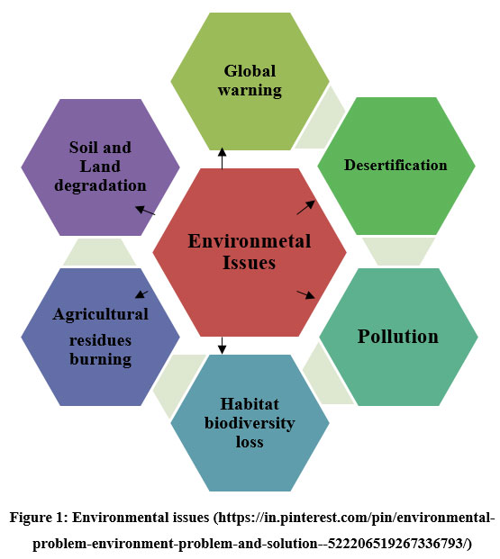
Problem: Sustainability Risks
  This company also highlights its ESG risks triangle for audit failures.
  These audit failures may involve un-sustainable timber sourcing, zero treatment transparency and also non recycled packaging (Prieto, 2023).
  The risk of which company also may invoice regulated penalties with damage of brand image and contractual non compliance.

Slide 12
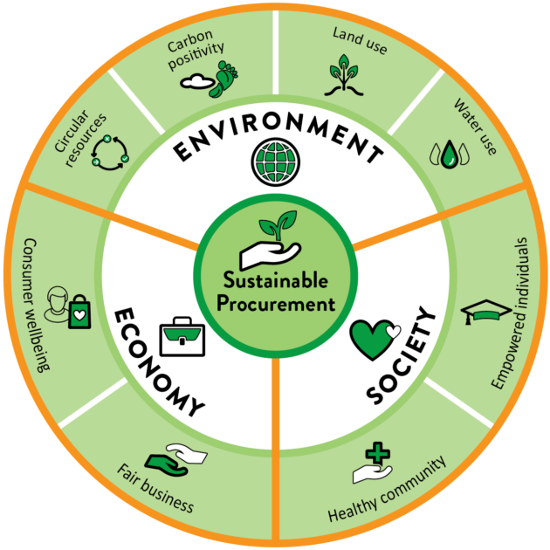
Solution: Green Procurement Enforcement
  SQDN Engineering should focus on green procurement enforcement by implementing compliance checklists.
  This company needs to take actions such as requiring FSC and PEFC certification, mandatory frequent disclosure, reusable or recyclable packaging and glassly annual environmental audits.
  This company can align the action with easy standards for better efficient operations of the company (Prieto, 2023).

Slide 13

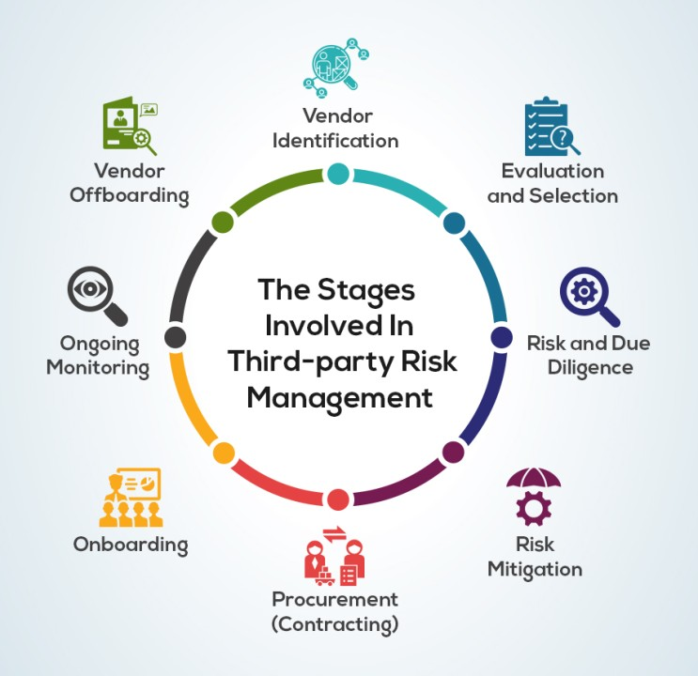
Supplier Dependency Risk Plan
  This company needs to implement some supplier dependency risk plan by incorporating a risk mitigation matrix.
  On the other hand, stabilizing the current supplier is referred to as short term planning.
  Identification of backup suppliers and trial orders with alternates may be included in the planning as a medium term planning (Santos, de and Aprigliano, 2025).
  On the other hand, long term planning involves dual sourcing strategy.

Slide 14
Implementation Roadmap
  For this company, a roadmap can be implemented for smooth operations.
  The roadmap for this company highlights its timeline from 0-12 months.
  Within 0-3 months, this company needs to focus on its SLA, inspections, and complaint process.
  After that within 3-6 months, this company should focus on its relationship reviews, sustainability audit.
  In the last phase, this company needs to prioritise on its backup supplier qualification within 6-12 months.

Slide 15
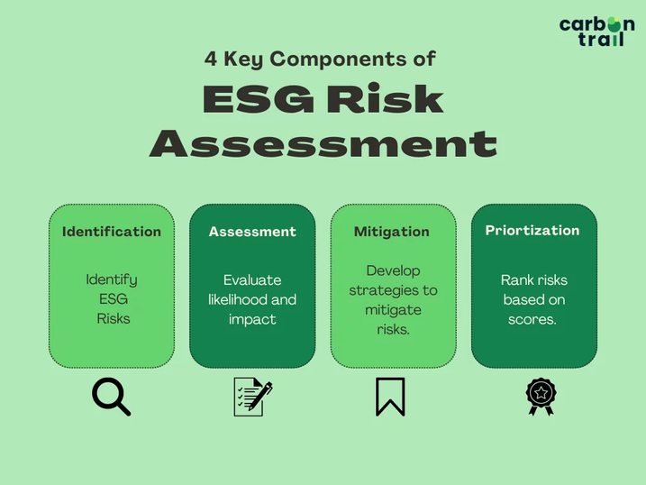
Expected Business Benefits
  This roadmap can help the company to improve its KPI dashboard.
  On the other hand, this company also can improve its delivery accuracy by lowering its defect rates.
  This also can strengthen supplier accountability, ESG compliance which reduces operational risks.

Slide 16
References
Ali, S. and Khan, S.U. (2016). Software outsourcing partnership model: An evaluation framework for vendor organizations. Journal of Systems and Software, 117, pp.402–425. doi:https://doi.org/10.1016/j.jss.2016.03.069. [Accessed 16 Jan. 2026]
Ammar, M., Haleem, A., Javaid, M., Bahl, S. and Verma, A.S. (2021). Implementing Industry 4.0 Technologies in Self-Healing Materials and Digitally Managing the Quality of Manufacturing. Materials Today: Proceedings, 52. doi:https://doi.org/10.1016/j.matpr.2021.09.248. [Accessed 16 Jan. 2026]
de Waard, E., de Bock, P. and Beeres, R. (2019). The transaction costs of intra-organizational captive buying and selling relationships. Journal of Accounting & Organizational Change, 15(2), pp.257–277. doi:https://doi.org/10.1108/jaoc-07-2018-0058. [Accessed 16 Jan. 2026]
Mazumdar, D., Biswas, P.K., Sain, C., Ahmad, F., Ustun, T.S. and Kalam, A. (2024). Performance analysis of drone sqadron optimisation based MPPT controller for grid implemented PV battery system under partially shaded conditions. Renewable Energy Focus, 49, p.100577. doi:https://doi.org/10.1016/j.ref.2024.100577. [Accessed 16 Jan. 2026]
Parrish, D.K., Olsen, C.H. and Thomas, R.J. (2005). Aircraft Carrier Personnel Mishap and Injury Rates during Deployment. Military Medicine, 170(5), pp.387–394. doi:https://doi.org/10.7205/milmed.170.5.387. [Accessed 16 Jan. 2026]
Prieto, R. (2023). Environmental, Social, and Governance (ESG) Risks in Engineering and Construction Key Points. Available at: https://www.researchgate.net/publication/368425991_Environmental_Social_and_Governance_ESG_Risks_in_Engineering_and_Construction_Key_Points [Accessed 16 Jan. 2026].
Rocha, A., Martins, B., Cardoso, J., Rodrigues, J. and Oliveira, A. (2023). Quality control of supplier defects in a precision industry: a case study approach. International Journal of Productivity and Quality Management, 1(1). doi:https://doi.org/10.1504/IJPQM.2023.10058701. [Accessed 16 Jan. 2026]
Santos, C.R., de, R. and Aprigliano, V. (2025). Supplier Risk in Supply Chain Risk Management: An Updated Conceptual Framework. Applied Sciences, 15(13), pp.7128–7128. doi:https://doi.org/10.3390/app15137128. [Accessed 16 Jan. 2026]
Šuhajdová, E., Novotný, M., Pěnčík, J., Šuhajda, K., Straka, B. and Schmid, P. (2018). Evaluation of suitability of selected hardwood in civil engineering. Gradjevinski materijali i konstrukcije, 61(2), pp.73–82. doi:https://doi.org/10.5937/GRMK1802073S. [Accessed 16 Jan. 2026]
Tarranco, D. (2026). Complaint Management: Definition, Requirements, Process, and Software. SimplerQMS. Available at: https://simplerqms.com/complaint-management/ [Accessed 16 Jan. 2026].
United States Space Force (2024). United States Space Force > About Us > Fact Sheets - Tag Software Engineering Squadron. Spaceforce.mil. Available at: https://www.spaceforce.mil/About-Us/Fact-Sheets/Tag/273046/software-engineering-squadron/ [Accessed 16 Jan. 2026].

Slide 17
Presented by :
Thank You
for your time and attention

