Slide 1
Student's Name:Maya Boteva
ID Number:2112590
Course Name: International Business Communications
LCBB6001

Slide 2
Table of contents
Introduction | 3
Overview of Chosen company( Tesco) | 4
History of Tesco | 5
Cultural differences between the UK and Germany | 6,7
Cultural Similarities | 8
Variations | 9
Cultural Dimensions Theory | 10
Hofstede's Cultural Dimensions | 11, 12, 13
cultural challenges , differences and difficulties identified | 14
Recommendations | 15
Conclusions | 16
Q&A | 17
References | 18

Slide 3

Introduction
Welcome to the presentation on Tesco's expansion into Germany.
The presentation Will explore the critical cultural considerations/ differences between Germany and UK, utilizing intercultural communication theories, to ensure a successful establishment of Tesco's management office in Germany.

Slide 4

Overview of Chosen company( Tesco)
Tesco, a leading British multinational retailer, operates in diverse markets, including groceries, clothing, and financial services
It was founded in Founded in 1919,
Headquartered in Welwyn Garden City, England
(Guffey and Loewy, 2019).

Slide 5

History of Tesco
Tesco was founded by Jack Cohen in 1919. Starting as a market stall in London, Cohen initially sold surplus groceries.
Jack Cohen this after he left the royal flying corp at the end of great war.
He used his demob money to buy the first stock
The name Tesco emerged in 1924 when he combined the initials of a tea supplier (T.E. Stockwell) with the first two letters of his surname
Stockwell was a partner in the tea supplier firm
(Guffey and Loewy, 2019).

Slide 6
Cultural differences between the UK and Germany
 | UK | GERMANY
Language | English is the official language. | German is the official language.
Ethnic Makeup | Diverse population with various ethnic backgrounds | Predominantly German, but increasing diversity due to immigration.
Social Structures | Emphasis on individualism and a diverse social structure. | Greater emphasis on collectivism and a more homogeneous social structure.
(Syrbe and Rose, 2018).

Slide 7
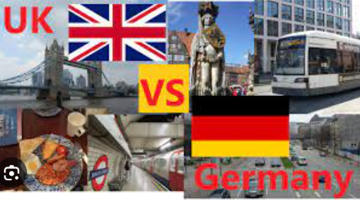
Cont.’….
 | UK | Germany
Religious Values | Religious diversity, with a significant secular population. | Predominantly Christian, with a growing secular demographic.
Business and Work-Related Attitudes | Embraces a dynamic and flexible work culture. | Emphasis on precision, punctuality, and a more structured work environment.
(Varey, 2017).

Slide 8

Cultural Similarities
Both have a high regard for punctuality and professionalism.
Strong work ethics and a commitment to excellence are valued in both cultures.
Both cultures have Direct Communication Style(clear and direct communication,)
Respect for Hierarchy
Written Communication Emphasis while recognizing need for Non-Verbal Communication:
(Smith et al., 2018).

Slide 9
Variations
Communication styles differ; the UK tends to be more direct, while Germany leans towards a more indirect, contextual approach.
Decision-making processes may vary, with the UK favoring a decentralized approach, while Germany have a more hierarchical structure.
The UK often employs a more confrontational and direct approach to address conflicts, while Germany may prefer a more diplomatic and indirect resolution strategy.
variations in the perception of personal space, with the UK generally having a larger personal space bubble compared to Germany
(Smith et al., 2018).

Slide 10
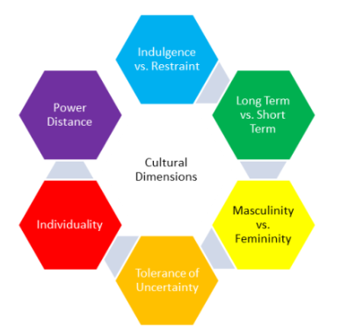
Cultural Dimensions Theory
Hofstede's Cultural Dimensions theory is a framework for understanding cultural differences t
It has 6 dimension as in the figure
(Varey, 2017).

Slide 11
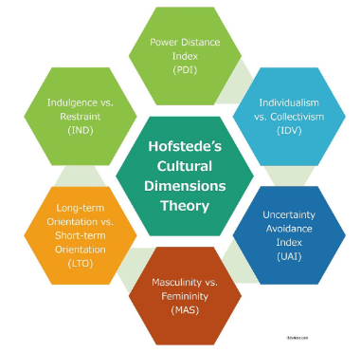
Hofstede's Cultural Dimensions
Power Distance:
  UK: Tends to have lower power distance, emphasizing equality and informality.
  Germany: Typically demonstrates a moderate power distance, respecting hierarchical structures.
Individualism vs. Collectivism:
  UK: Emphasizes individualism, valuing personal achievements and autonomy.
  Germany: Leans towards a more collective mindset, emphasizing group harmony and cooperation.
Masculinity vs. Femininity:
  UK: Exhibits a balanced approach to gender roles.
  Germany: Traditionally demonstrates a slightly more masculine orientation, valuing assertiveness and success.
(Verbeke et al., 2018).

Slide 12
Cont.’….
Uncertainty Avoidance
  UK: Tends to be more open to uncertainty and change, fostering innovation.
  Germany: Demonstrates a higher uncertainty avoidance, preferring structure and careful planning.
Long-term vs. Short-term Orientation:
  UK: Typically exhibits a shorter-term orientation, emphasizing immediate results.
  Germany: Demonstrates a longer-term orientation, valuing sustainability and perseverance.
(Hamilton and Webster, 2018).

Slide 13
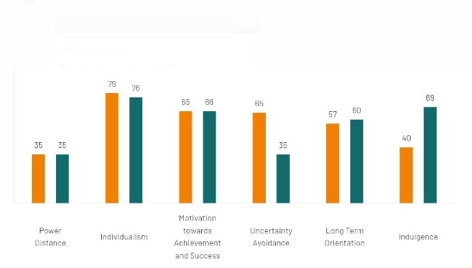
Levels of cultural difference
Notes:
GERMANY have Highly decentralized and supported by a strong middle class, Germany is not surprisingly among the lower power distant countries (score 35). Co-determination rights are comparatively extensive and have to be taken into account by the management. A direct and participative communication and meeting style is common, control is disliked and leadership is challenged to show expertise and best accepted when it's based on it . At 35 Britain sits in the lower rankings of PDI -i.e. a society that believes that inequalities amongst people should.be minimized. Interestingly is that research shows PD index lower amongst the higher class in Britain than amongst the working classes. The PDI score at first seems incongruent with the well established and historical British class system and its exposes one of the inherent tensions in the British culture - between the importance of birth rank on the one hand and a deep seated belief that where you are born should not limit how far you can travel in life. A sense of fair play drives a belief that people should be treated in some way as equals.

Slide 14


cultural challenges , differences and difficulties identified
Communication Style Differences
Masculinity vs. Femininity Considerations
Power Distance Challenges
Decision-Making Variations
Individualism vs. Collectivism Impact
Approach to Conflict Resolution
Uncertainty Avoidance Implications
Long-term vs. Short-term Orientation Challenges
Feedback Culture Differences
Personal space
(Guffey and Loewy, 2019).

Slide 15

Recommendations
Tesco should ensure the following in its expansion to Germany
Implement Cross-Cultural Training Programs
Establish Clear Communication Protocols
Foster an Inclusive Work Environment
Adapt Marketing Strategies to Cultural Nuances
Utilize Technology for Seamless Collaboration
Develop Flexible Work Policies
Conduct Regular Cultural Sensitivity Workshops
Foster open communication channels to bridge language and communication style gaps.
Develop policies that embrace diversity and accommodate different work styles.
(Chapleo, 2016).

Slide 16
Conclusion
In conclusion, navigating the cultural landscape between the UK and Germany is pivotal for Tesco's successful expansion.
By embracing cultural awareness, implementing tailored strategies, and fostering open communication, Tesco can have a path to prosperity in the dynamic German market through establishing new management office in Germany

Slide 17


Slide 18
References
Chapleo, C., 2016. Is communications a strategic activity in UK education?. International Journal of educational advancement, 6, pp.306-314.
Guffey, M.E. and Loewy, D., 2019. Essentials of business communication. Cengage Learning.
Hamilton, L. and Webster, P., 2018. The international business environment. Oxford University Press.
Syrbe, M. and Rose, H., 2018. An evaluation of the global orientation of English textbooks in Germany. Innovation in language learning and teaching, 12(2), pp.152-163.
Smith, S.A., Patmos, A. and Pitts, M.J., 2018. Communication and teleworking: A study of communication channel satisfaction, personality, and job satisfaction for teleworking employees. International Journal of Business Communication, 55(1), pp.44-68.
Verbeke, A., Coeurderoy, R. and Matt, T., 2018. The future of international business research on corporate globalization that never was…. Journal of International Business Studies, 49, pp.1101-1112.
Varey, R.J., 2017. A picture of corporate communications management in the UK. Corporate Communications: An International Journal, 2(2), pp.59-69.

