Slide 1
INTRODUCTION TO PHYSIOLOGY
WEEK 8
PHYSIOLOGICAL PROFILE
Mumtaz Goolam

Slide 2
WEEK 8 SESSION ONE
Objectives of the session
By the end of the session students should be able to:
To explain the importance of measuring physiological profile
Explain the importance of routine body profiles as tools for care planing

Slide 3
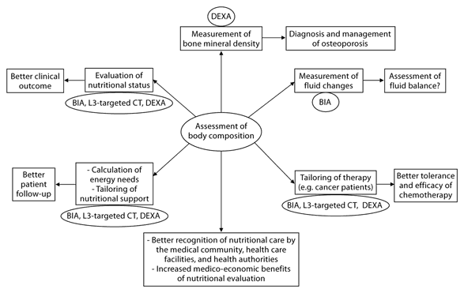

Slide 4
Routine Tests for Men and Women
Liver function test (alanine transferase and gamma glutamyl transferase
Bone profiles to check calcium and magnesium levels
Abdominal aortic aneurysm screening (in men who smoke or have smoked, this test is recommended once between the ages of 65 and 75)
Alcohol counselling (recommended for all primary care and prenatal care visits)
Aspirin therapy to help prevent coronary heart disease (recommended in women 55 to 79 years of age and men 45 to 79 years of age—when benefits outweigh risks)

Slide 5
Routine Tests
Breastfeeding counseling (recommended for women during pregnancy and after giving birth)
Cholesterol screening recommended for men over the age of 35 and women over the age of 45)
Colorectal cancer screening (e.g., fecal occult blood test, sigmoidoscopy, colonoscopy; recommended beginning at 50 years of age until the age of 75)
Depression screening (recommended for primary care when mental health care providers are available)
Diabetes screening (recommended for adults without diabetes symptoms who have sustained blood pressure higher than 135/80 mm Hg)
Folic acid supplements (.4 to .8 mg daily recommended in women of childbearing age)
screening and other tests)

Slide 6
ROUTINE TESTS
Hepatitis B screening (recommended for women who are pregnant)
HIV screening (recommended for all adults at increased risk of infection)
Mammography (recommended every 1-2 years in women beginning at the age of 40)
Obesity screening (recommended for all primary care visits)
Osteoporosis screening (recommended for women 65 years of age and older)
Pap test (also called Pap smear; recommended every 2 years in women 21 to 30 years of age and every 3 years after the age of 30)
Prenatal care (recommended for women who are pregnant; includes anemia screening, bacteriuria

Slide 7
Group Discussion
Discussion
Explain routine measures and information gathering related to body functioning in health and social care.
Explain how this information is gathered
Include how information about body functioning may inform care planning for individuals.
This will be followed by a teacher’s overview of routine profiles and care planning

