Slide 1
Introduction to Networks
Graham Rees-Evans

Slide 2
What is a Network
Collection of interconnected Devices
Nodes
Cables/Medium
Protocols

Slide 3
Why do We Have Networks?
Share
  Info
  Devices
  Resources
We can use them for
  Voice
  Data
  Media

Slide 4
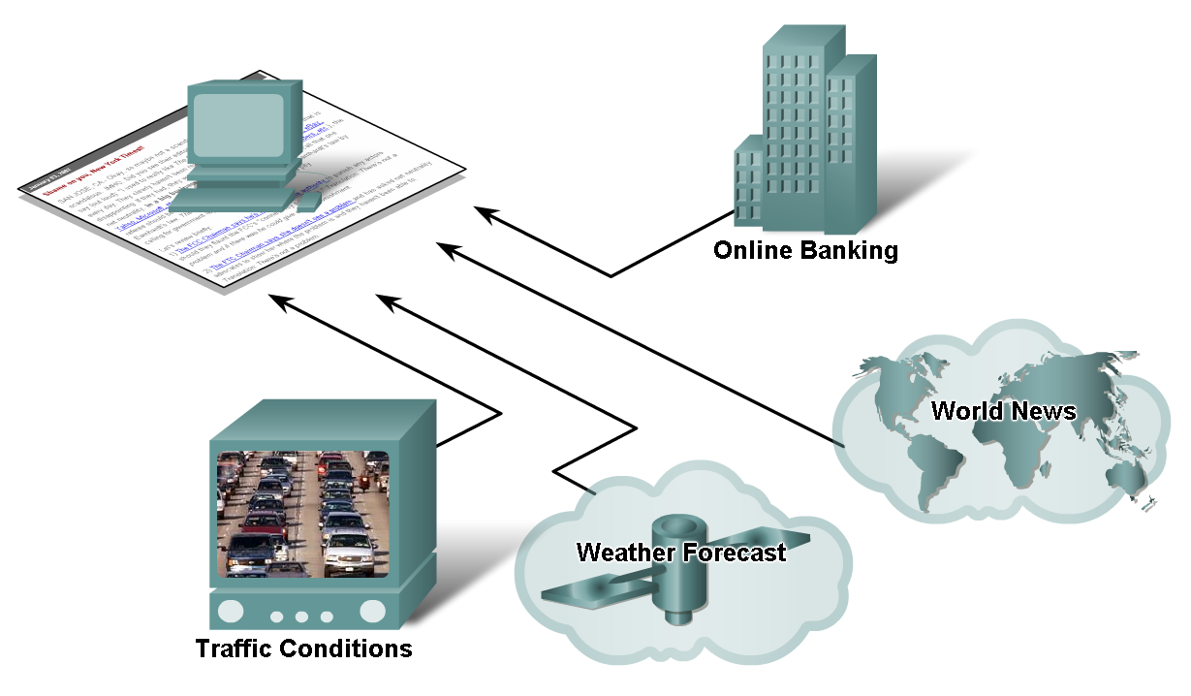
How Networks Impact Daily Life
Notes:
We have benefits of instantaneous communication and how it supports and improves our lives.

Slide 5
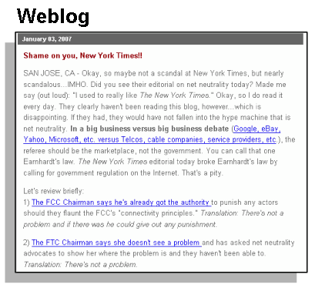
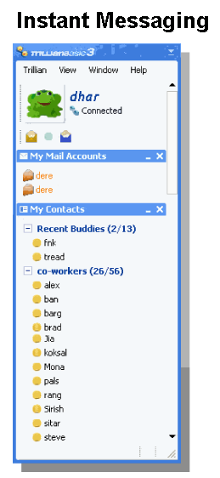
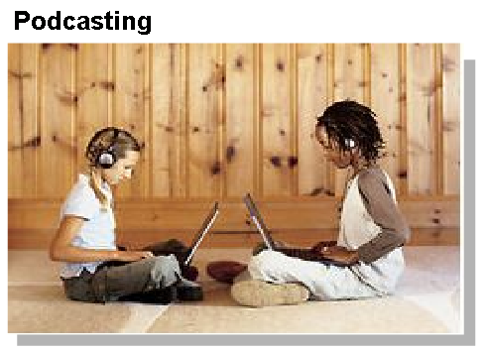
How Networks Impact Daily Life
Communication Media
  IM
  Wikis
  Blogs
  Podcasting
  Collaboration Tools
Notes:
Instant messaging
Real time communication
between 2 or more
people based on typed text
Weblogs (Blogs)
Web pages created
by an individual
Podcasting
Website that contains
audio files available
for downloading

Slide 6
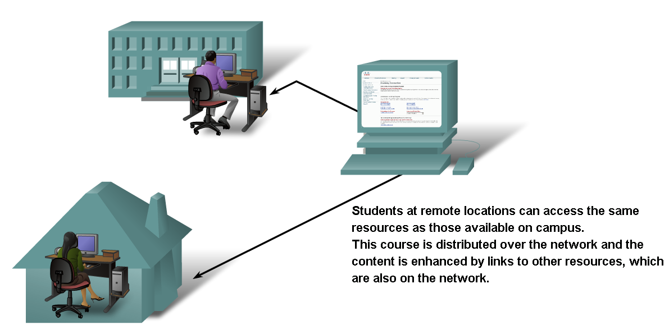
How Networks Impact Daily Life
Sharing Information
Notes:
We use information networks to share and collaborate improves teaching and learning

Slide 7
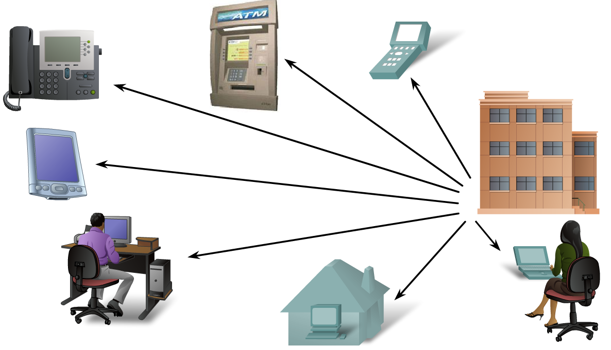
How Networks Impact Daily Life
Communication over a network changes the way we work

Slide 8
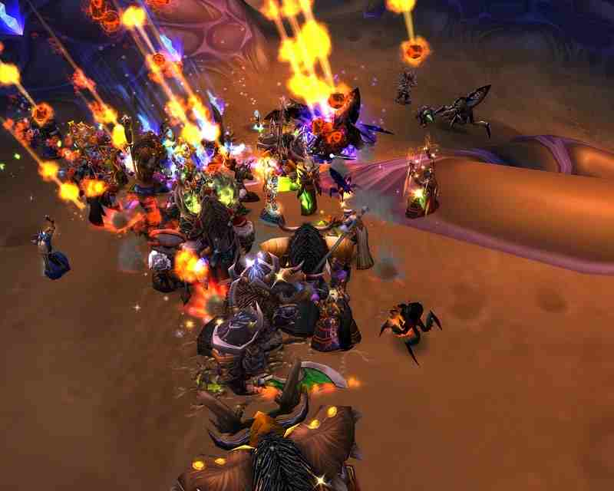
How Networks Impact Daily Life
The Way We Play

Slide 9

Brief History
1969: Arpanet
1971: Email
1973: The first trans-Atlantic
connection
1975: The email client
1977: The PC modem
1978: The Bulletin Board System (BBS)

Slide 10
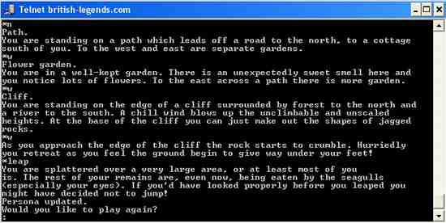
Brief History
1978: Spam is born
1979: MUD

Slide 11


Brief History
1982: The first emoticon
1984: Domain Name System
(DNS)
1987: The Internet grows
1988: IRC – Internet Relay Chat

Slide 12
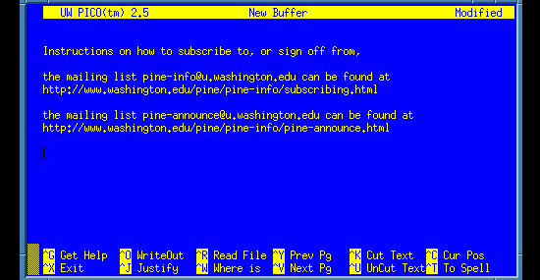
Brief History
1988: First major malicious internet-based attack
1989: AOL is launched

Slide 13
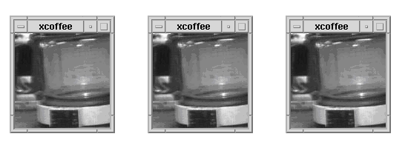
Brief History
1989: The proposal for the World Wide Web
1990: First commercial dial-up ISP
1991: First web page created
1991: First content-based search protocol
1991: The first webcam

Slide 14
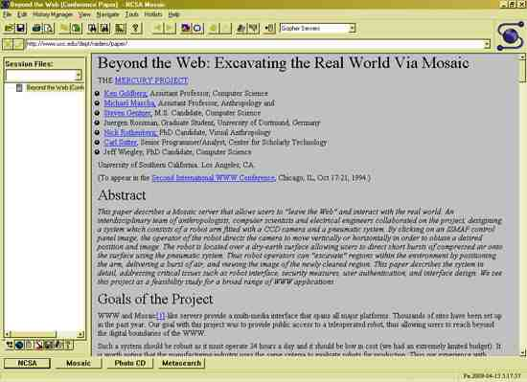
Brief History
1993: Mosaic – first graphical web browser for the general public

Slide 15
Brief History
1993: Governments join in on the fun
1995: Commercialization of the internet
1996: First web-based (webmail) service
1997: The term "weblog" is coined

Slide 16
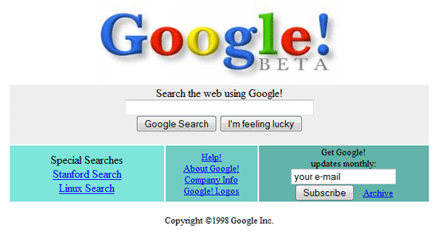
Brief History
1998: Google!

Slide 17
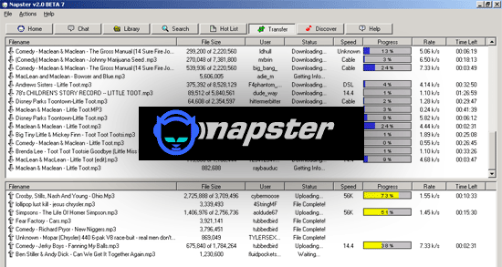
Brief History
1998: Internet-based file-sharing

Slide 18
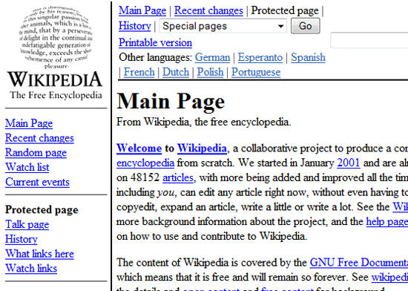
Brief History
2001: Wikipedia is launched

Slide 19

Brief History
2003: VoIP goes
mainstream
2003: MySpace becomes
the most popular social network
2003: CAN-SPAM Act puts a lid on unsolicited emails
(Controlling the Assault of Non-Solicited Pornography and Marketing Act)
2004: Web 2.0

Slide 20



Brief History
2004: "The" Facebook open to college students
2005: YouTube – streaming video for the masses
2006: Twitter gets tweeting

Slide 21
TCP/IP
In January 1983 the TCP/IP protocol became the only official protocol on the ARPANET.
Allows diverse computer networks to interconnect and communicate with each other.

Slide 22
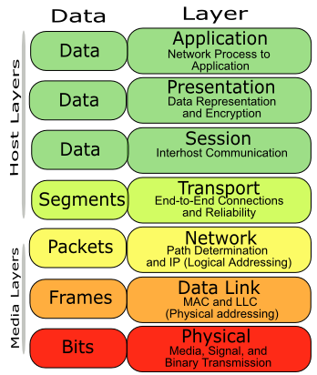

Slide 23
TCP
Delivers packets
Asks for retransmission
Keeps an eye on conversations

Slide 24
Connecting to the Internet
ISP
Modem
Network Card
Web Browser

Slide 25
WWW or Internet
People refer to WWW and the Internet as the same
Email
FTP

Slide 26
Networks

Slide 27
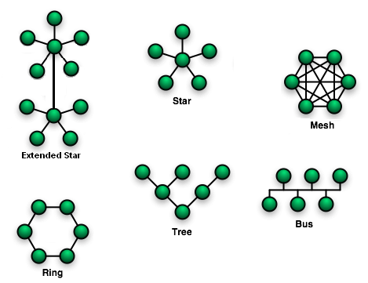
Network Types
Notes:
Bus
Bus networks (not to be confused with the system bus of a computer) use a common backbone to connect all devices. A single cable, the backbone functions as a shared communication medium, that devices attach or tap into with an interface connector. A device wanting to communicate with another device on the network sends a broadcast message onto the wire that all other devices see, but only the intended recipient actually accepts and processes the message.
Ethernet bus topologies are relatively easy to install and don't require much cabling compared to the alternatives. 10Base-2 ("ThinNet") and 10Base-5 ("ThickNet") both were popular Ethernet cabling options years ago. However, bus networks work best with a limited number of devices. If more than a few dozen computers are added to a bus, performance problems will likely result. In addition, if the backbone cable fails, the entire network effectively becomes unusable.
communication purposes. All messages travel through a ring in the same direction (effectively either "clockwise" or "counterclockwise"). A failure in any cable or device breaks the loop and can take down the entire network.
To implement a ring network, one typically uses FDDI, SONET, or Token Ring technology. Rings are found in some office buildings or school campuses.
Star
Many home networks use the star topology. A star network features a central connection point called a "hub" that may be an actual hub or a switch. Devices typically connect to the hub with Unshielded Twisted Pair (UTP) Etherne
Compared to the bus topology, a star network generally requires more cable, but a failure in any star network cable will only take down one computer's network access and not the entire LAN. (If the hub fails, however, the entire network also fails.)
Tree
Tree topologies integrate multiple star topologies together onto a bus. In its simplest form, only hub devices connect directly to the tree bus, and each hub functions as the "root" of a tree of devices. This bus/star hybrid approach supports future expandability of the network much better than a bus (limited in the number of devices due to the broadcast traffic it generates) or a star (limited by the number of hub ports) alone.
Mesh
Mesh topologies involve the concept of routes. Unlike each of the previous topologies, messages sent on a mesh network can take any of several possible paths from source to destination. (Recall that in a ring, although two cable paths exist, messages can only travel in one direction.) Some WANs, like the Internet, employ mesh routing.

Slide 28
Wire Speeds
10Mbs
100Mbs
1000Mbs or 1Gbs
10000Mbs or 10Gbs

Slide 29
Wireless Speeds
802.11a – 54Mbps
802.11b – 11Mbs
802.11g - 54Mbs
802.11n - 100Mbps – 200 Mbps

Slide 30
Devices
Hub
Router
Switch
Repeater
Network Card

Slide 31
Build a Network
Basically put it all together
And you have a network
Simple as that

Slide 32
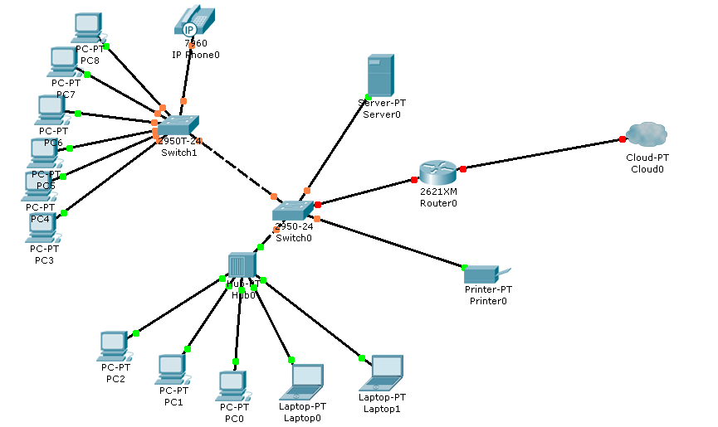
Generic Network

Slide 33
Questions

