Slide 1

Strategies for Effective Communication in a Business Setting.
2109919 - Maria Angelova
2020342 - Denise Chambers
2109147 - Farhana Tahura
2109241 - Tiffany-Ane Lane
2107786 - Plamedy Maketa

Slide 2
Social Contract
Be kind
Have respect for each other
Work as a team
Wait your turn to speak, don’t interrupt
Do your part
Help each other out
Create a plan so everyone knows what needs to be done and when it needs to be done
Hear out the other team members ideas
Be patient
Communicate openly, via agreed channels
Share your ideas

Slide 3

benefits of effective communication on the organisation’s business process?
2109919 - Maria Angelova
Chon.com
Builds effective team
Communication powers organization and production processes

Slide 4
How should the organisation use the theories relating to models of communication?
2020342 - Denise Chambers
Denise

Slide 5
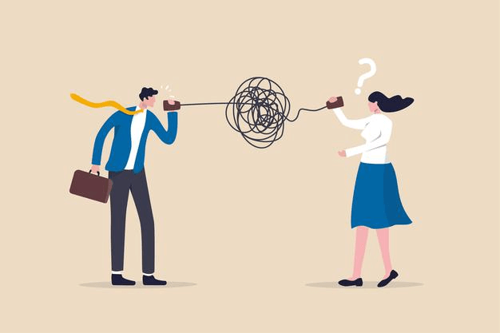
Barriers that can prevent effective communication between the organisation and their external stakeholders.
2109147 – Farhana Tahura
What is ineffective communication?
Here are some barriers that can prevent effective communication:
Inability to listen to others
Lack of Trust
Trainingexpress (2022)

Slide 6
channels of communication used by the organisation
2109241 - Tiffany-Ane Lane
Tiffany

Slide 7


Channels that can be used to improve communication?
2107786 - Plamedy Maketa
One type of channel that can be used to improve communication is face to face or video conference: Face-to-face communication is among the most taxing channels of communication available (it takes more effort to make yourself presentable on video and stay visibly engaged throughout an entire call), but it's still significant because certain situations require nonverbal communication (body language, facial expressions, etc.)
Another type of channel that can be used to improve communication is instant messaging: Instant messaging, like text messaging, is an excellent way to communicate short, direct messages to your staff or clientele in real time. Most of the time, data travels easily over this route.
Although this channel of communication favours internal communication over external communication. Several salespeople who maintain messaging channels with prospects or clients. Because people don't anticipate fast responses, it's a low-pressure manner to engage, but it still allows for prompt responses.
A final channel that can be used to improve communication, is Email: Email is still one of the most common and effective ways to communicate in writing.
Even though email congestion might be a nightmare, it will not go away anytime soon. It's a terrific communication method when utilised correctly, and many people love that you can keep track of everything you've worked on and organise things under folders, and it's vital for both internal and external communications. Email is one of the most difficult ways to put your communication skills to the test because it requires you to write concisely and clearly in order to get your point through, which is difficult for many individuals. (Top Communication Channels to Consider for Your Business, 2022)

Slide 8
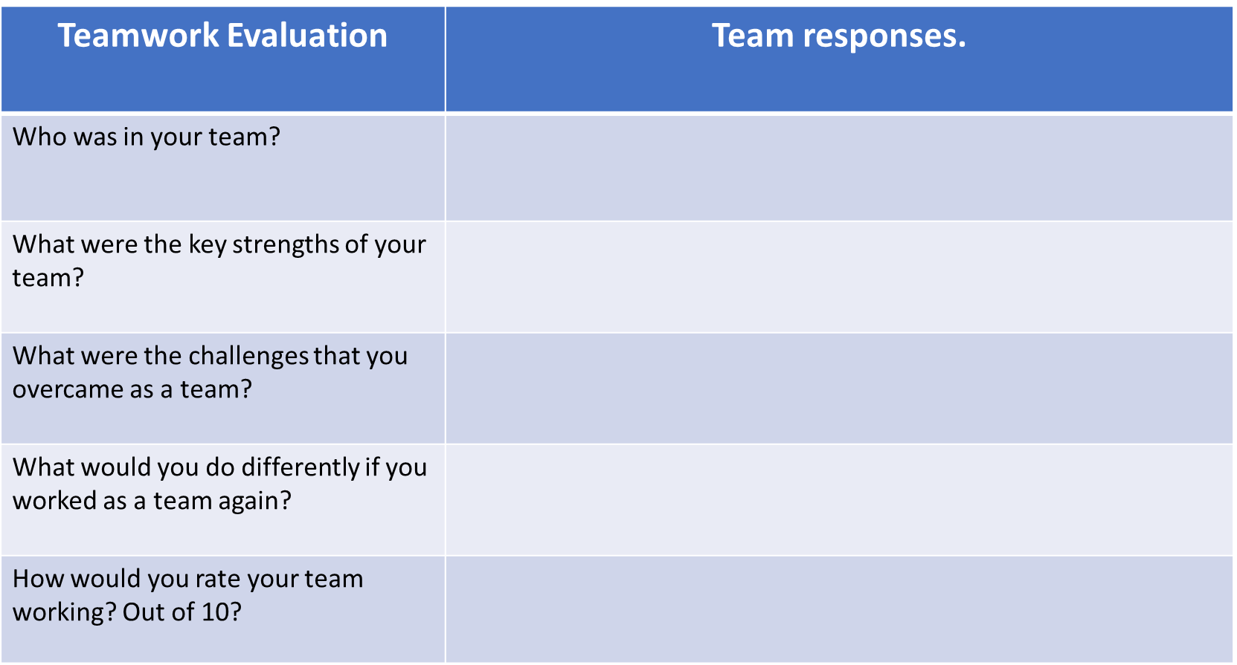
Maria
Denise, Farhana, Tiffany and Plamedy
Sharing information about task
Finish the task on time
Frequent monitoring of the project process

Slide 9
Denise
Maria, Farhana, Tiffany and Plamedy

Slide 10
Farhana
Maria, Denise, Tiffany and Plamedy
.
.
.
.

Slide 11
Tiffany
Maria, Denise, Farhana and Plamedy

Slide 12
Plamedy
Maria, Denise, Farhana and Tiffany
Good communication amongst the team
Finding the right time to communicate
Find the right time to communicate
7/10

Slide 13
References
Blog.smarp.com. 2022. Top Communication Channels to Consider for Your Business. [online] Available at: <https://blog.smarp.com/top-communication-channels-to-consider-for-your-business> [Accessed 23 March 2022].
Trainingexpress (2022) Just 9 Ways to Overcome the Barriers to Effective Communication. Available at: https://www.trainingexpress.org.uk/overcome-the-barriers-to-effective-communication/ (Accessed: 24 March 2022)
Creswell, J., Draper, K. and Abrams, R. (2018) ‘At Nike, Revolt Led by Women Leads to Exodus of Male Executives’, The New York Times, 28 April. Available at: https://www.nytimes.com/2018/04/28/business/nike-women.html (Accessed: 25 March 2022)
Drexel University (2018) 6 BARRIERS TO EFFECTIVE COMMUNICATION. Available at: https://drexel.edu/graduatecollege/professional-development/blog/2018/July/6-barriers-to-effective-communication/ (Accessed: 25 March 2022)
https://smallbusiness.chron.com/benefits-effective-communication-workplace-20198.html
https://www.ringcentral.com/us/en/blog/top-7-benefits-of-workplace-communication/
Thomas, C., 2022. https://gettalkative.com/info/communication-channels. [image].
2019. https://adcortex.com/the-7-most-used-communication-channels/. [image].

