Slide 1
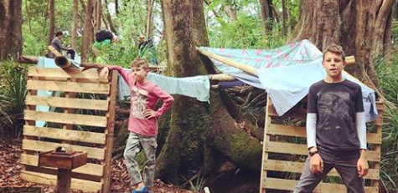
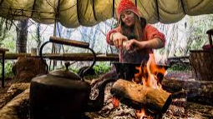
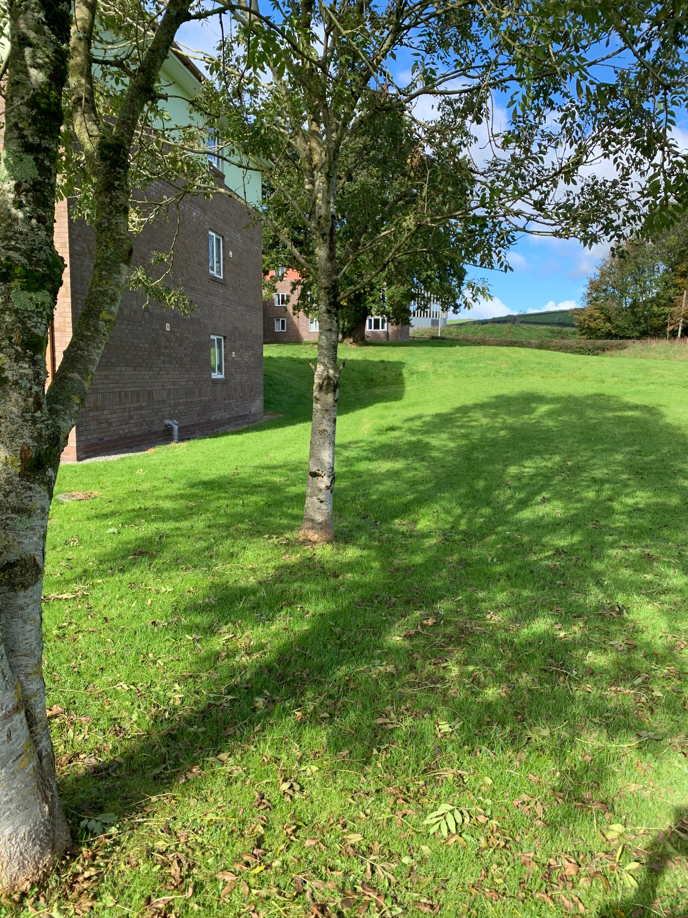
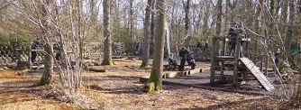
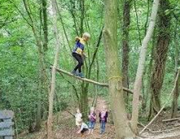
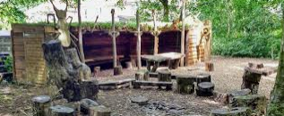
Adventurous activities – shelter building
Camp craft, fire making, bush craft
Wooded areas tree climbing
Range of affordances
Outdoor classroom – social communication
Adventurous activities
Physical development
Environmental awareness

