Slide 1
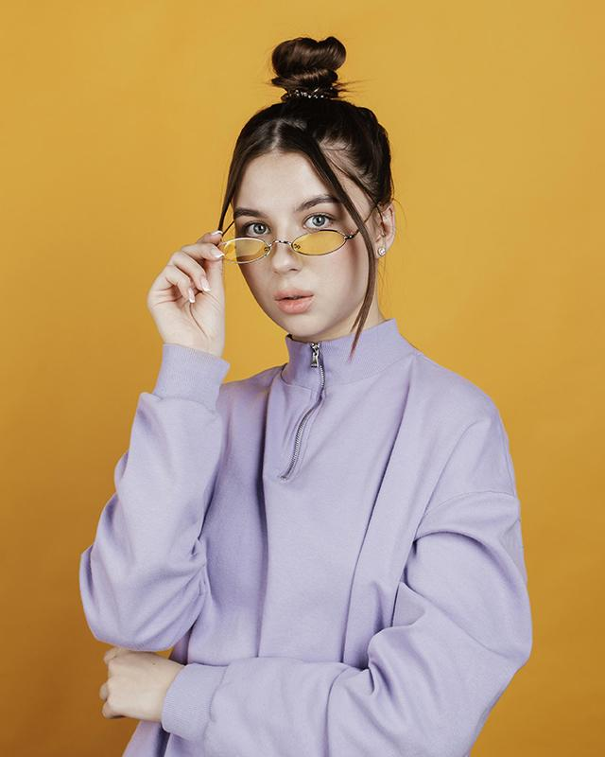
CLOTHING BUSINESS PLAN
B & A Fashion
Title: Managing Enterprise in the 21st Century
Name of the Student and ID number :Ashfaq Ahmed , 2028429
Mohammed Samad, 2106950
Beatris Gelkova, 2117954
Melitsa Ahmed, 2111603
Georgian Pavel, 2030935
Group : 2
Lecturer Name: Rajesh Kumar

Slide 2
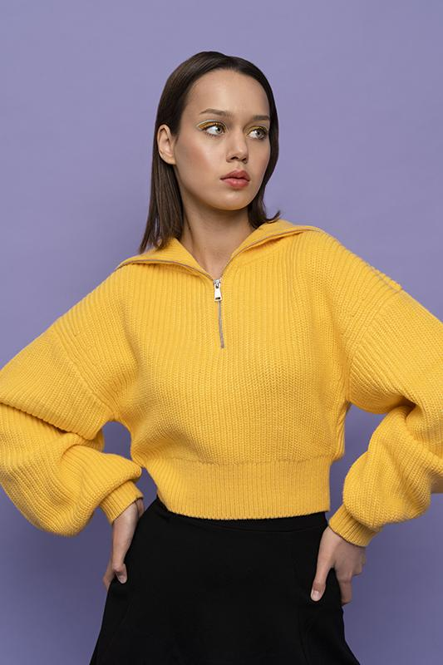
Executive Summary
B & A Clothing business for women of all ages
Online and in store in Birmingham
Owned by university graduates with a love of fashion and all things contemporary and fashionable, launched the store.
Supplier-warehouse located in city-affordable price while sourcing high-quality materials.
In order to appeal to young professionals, college students, and middle- and high-school women.
For every young and professional women who are fashion-conscious.
Our target market is going to be attracted by offering all different kind of forms of advertisement and marketing so that we can our target audience and this will allow us to generate customers
Many sources of finance will be required because we need to make sure that we can customer attention and from the audience we require but also making sure it is affordable. There are examples such as billboards and tv advertisements which will cost money but a free source of marketing could be social media to gain awareness of our brand.

Slide 3
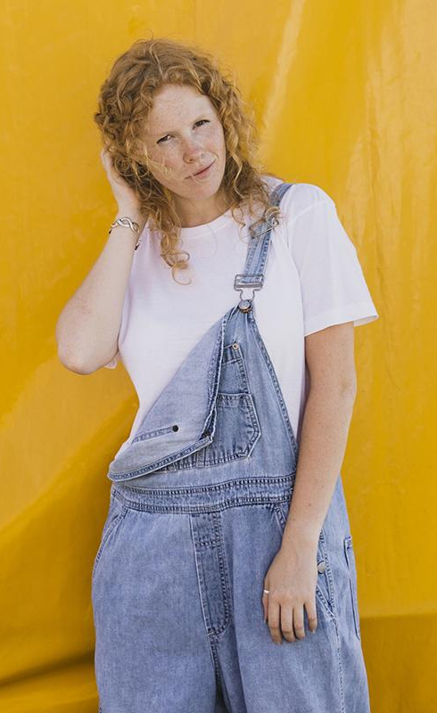
OUR COMPANY
Women of all ages can shop for clothing at B & A fashion Clothing, a boutique with reasonable prices. The stylish women looking for the newest fashion trends will be catered to by B & A fashion Clothing for those customers searching for the newest trendy looks on Instagram. Young professionals, college students, and high school students will all have easy access to the company's tiny location. Our product differs from our competitors because it is for women of all ages and it is affordable aim to our target market so that they can feel comfortable about our products. It is a limited company so decision can be made better and on a wider scale.

Slide 4
Product and services
Tops, Dresses, Trousers, Leggings, Dungarees, Capes, Hoodies, Joggers & Pants, Jumpers, T-Shirts, Coats & Jackets, Jumpsuits & Playsuits, Tracksuits & Loungewear, Pajama Set

Slide 5
Market audit-competitor’s analysis
DUA Boutique
Located in Birmingham , specializes in party and everyday wear clothing of women.
Bonmarché
Provides a wide selection of women's clothing in sizes 10-28
UK's largest value retailer for ladies clothes.
H&M
Competitive prices.
Update their inventory bimonthly
Advanced technical component of an app and website for marketing due to their capabilities in technology, manpower, and international sourcing.

Slide 6
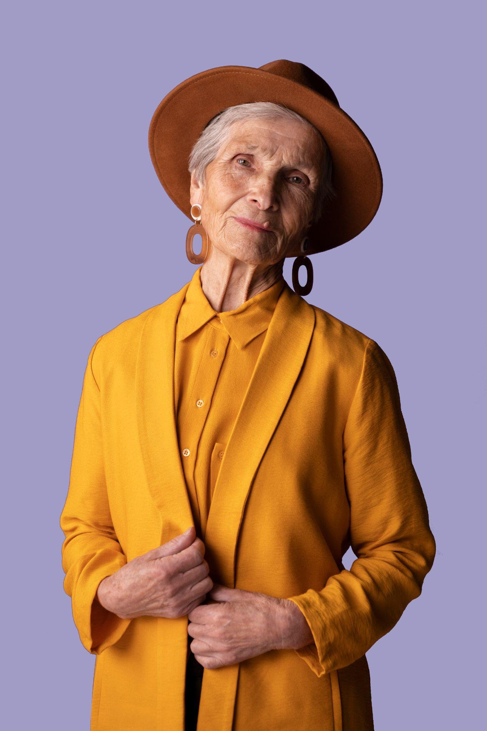
Competitive Advantage
Use of premium materials at competitive rates
Use of technology to our advantage by maintaining a database of client profiles and notifying devoted customers as soon as one of their favorite goods becomes available in their size
Customer care- maintain and grow our clientele

Slide 7
Market swot-competitor’s analysis

Slide 8
Market pestle-competitor’s analysis
Political factors:
Recent shutdown and the current economic situation.
Industry has requested increased funding from the government..
Brexit.
The political commentary and fashion-influenced. Consumers' behaviors are influenced.
Economic factors
Clothing production-expensive. Several retail behemoths source their clothing from Bangladesh, India, Sri Lanka, Turkey, and China.
Producing goods abroad enables them to lower production costs and offer them for sale at competitive pricing.
Notes:
UK- reputable global retail fashion market. However, the most recent shutdown and the current economic situation have severely damaged it. As a result, the industry has requested increased funding from the government. Without significant government assistance, half of the industry may run the risk of entering an unsustainable future.
The UK's fashion industry has benefited greatly from political stability in that country. The uncertainty surrounding Brexit, though, has worried many. Each year, the UK imports footwear and apparel worth almost £10 billion from Europe. Therefore, for the industry to continue to succeed, it requires very solid trading relations with the EU.
The political commentary and fashion world in the UK are heavily influenced. Many consumers' behaviors are influenced by what they wear and how they dress. It is important to keep in mind, though, that clothes can occasionally go beyond the concept of "fashion" and be utilized to make political remarks
Economic factors
In the UK, clothing production is expensive. As a result, several retail behemoths source their clothing from Bangladesh, India, Sri Lanka, Turkey, and China. Producing goods abroad enables them to lower production costs and offer them for sale at competitive pricing. It does not, however, imply that all businesses offer discounted prices on their goods.

Slide 9
Social factors
Influence from music and movies on fashion. Lady GaGa's "Fashion" and Nicki Minaj's "Anaconda," have brand mentions in the lyrics.
Musicians and iconic styles. M.C. Hammer is well known for his enormous pants and Tupac is renowned for wearing gold chains and drooping jeans
Technology
Online shopping. Variety of filters to select the product that best fits your needs.
Notes:
Social factors
There has always been a significant fashion influence from music and movies on any nation. People enjoy purchasing clothing that is featured in movies or music videos. Numerous songs, like Lady GaGa's "Fashion" and Nicki Minaj's "Anaconda," have brand mentions in the lyrics.
The fashion business has also been affected by musicians and iconic styles. For instance, M.C. Hammer is well known for his enormous pants, Tupac is renowned for wearing gold chains and drooping jeans, and Michael Jackson is famous for having one gloved hand.
Technology
Online shopping is more popular than going to crowded stores. You can use a variety of filters to select the product that best fits your needs.
In the modern era, online shopping has taken off, allowing people to not only buy garments but other items as well.

Slide 10
Legal factors
Nation's rules and regulations for the industry. Businesses have outsourced some of their operations overseas due to costly regulations. \
Butler (2022) states that the Competition and Markets Authority targets fashion companies that make false claims about their environmental credentials (CMA). If companies made misleading environmental claims in violation of consumer protection laws, they might be held liable.
Environmental factors
The UN (Dottle and Gu, 2022) estimates-fashion industry contributes about 10% of the world's greenhouse gas emissions.
Disposing of or burning about 300,000 tons of clothing annually.
Notes:
Legal factors
Nation's rules and regulations for the industry must be followed by the fashion retail sector. Many businesses have outsourced some of their operations overseas due to costly regulations. While businesses can cut costs by doing this, many clients find it to be quite unappealing.
Butler (2022) states that the Competition and Markets Authority targets fashion companies that make false claims about their environmental credentials (CMA). If companies made misleading environmental claims in violation of consumer protection laws, they might be held liable
Environmental factors
The UN (Dottle and Gu, 2022) estimates that the fashion industry contributes about 10% of the world's greenhouse gas emissions. This sector uses more energy than the international shipping and aviation sectors put together. For the UK, this is extremely worrying because 80% of shoppers purchase clothing they never wear. More clothing is bought in the UK than in any other nation in Europe. Additionally, they are in charge of disposing of or burning about 300,000 tons of clothing annually. As a result, advocacy groups are pleading with the government to put pressure on clothing manufacturers to shoulder more responsibility and support environmental sustainability.

Slide 11
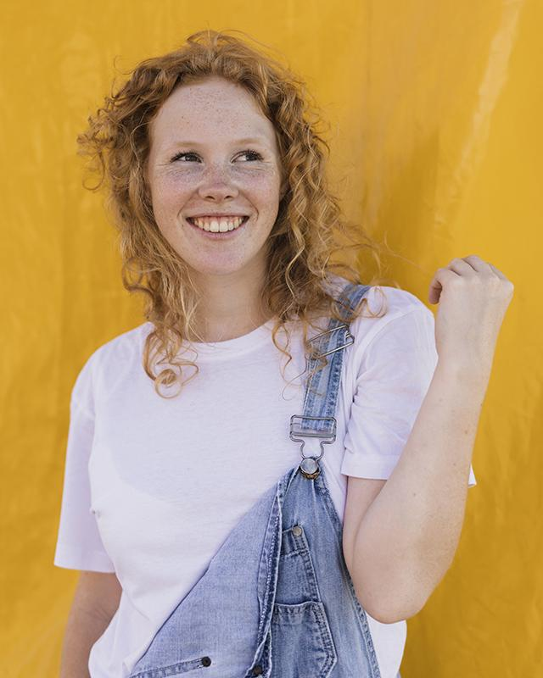
Target market
  New born to Teens
  Students
  Working women and homemakers

Slide 12
Marketing plan
Social Media Platforms
Management of social media company accounts-Writing enticing blogs, and frequently posting the product updates online. Publishing teasers and "Coming Soon" posts.
Brand representatives
Collaboration with young individuals-more than1,000 followers on social media.
Notes:
Social Media Platforms
Management of social media company accounts-Writing enticing blogs, and frequently posting the product updates online. Publishing teasers and "Coming Soon" posts.
Brand representatives
Collaboration with young individuals locally who have more than 1,000 followers on social media. They'll then share photos of themselves wearing these things with the B & A Fashion clothing account tagged so that their followers can see them. The brand ambassadors will receive compensation, but they won't be employed by the business.

Slide 13
Location
Square shopping center
They will be situated amongst the hottest restaurants and other well-known retail stores in a modest but noticeable storefront.
Pricing
Fashion clothing because the prices are reasonable and comparable to those of the competition.

Slide 14
Management team
Ashfaq Ahmed, CEO OF COMPANY
Mohammed Samad, Marketing director
Beatris Gelkova, Operations manager
Melitsa Ahmed, Sales manager
Georgian Pavel, Warehouse manager

Slide 15
Financial plan
Cash Flow forecast
Company B & A Fashion
For the year April 2021- March 2022
 | £
Incoming Cash
Sales Earnings | 100000
Accounts Receivables | 35000
Investment | 19000
New Capital | 26000
Total Incoming Cash | 180000
Outgoing Cash
Marketing Expense | 30000
Payment to Suppliers | 42000
Payroll | 46000
Equipment | 26000
Total Outgoing Cash | 144000
Cash Flow | 36000
Opening Balance | 0
Ending Balance | 36000

Slide 16
Financial plan
Profit and loss Statement
Company B & A Fashion
April 2021- March 2022
 | £
Total Revenue | 180000
Less: Cost of goods sold | 46000
Gross profit | 134000
Operating expenses
Salaries | 23000
Administrative expenses | 18000
Advertising | 13000
Insurance and depreciation expense | 16000
Total operating expenses | 70000
Operating profit | 64000
Less: Interest | 15000
EBT | 49000
Less: Tax | 19000
Net Profit | 30000

Slide 17
References
Butler, S. (2022). Dirty greenwashing: watchdog targets fashion brands over misleading claims. [online] the Guardian. Available at: https://www.theguardian.com/business/2022/jan/14/dirty-greenwashing-watchdog-targets-fashion-brands-over-misleading-claims
Dottle, R., & Gu, J. (2022, February 23). The Global Glut of Clothing Is an Environmental Crisis. Bloomberg. https://www.bloomberg.com/graphics/2022-fashion-industry-environmental-impact/

