Slide 1
Python Installation
The slides in this document are guides for installing Python on your computers.
The installation should be in the following order:
1. Install the latest version of Python (the engine)
2. Install the PyCharmIDE (a software tools that sits on top of your Python to help you work efficiently and conveniently).
Accessing Python Without Installation
You can use an online Python compilers as a temporary measure before installing, e.g.,
  https://www.programiz.com/python-programming/online-compiler/
  https://www.online-python.com/

Slide 2
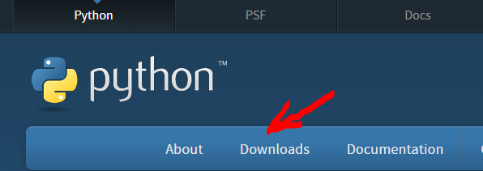
Installing Python and PyCharm IDE (Windows)
1. Go to http://www.python.org and click on "Downloads“
2. Ideally install the latest version (at the time of writing Python is on version 3.12.1). However, an earlier Python 3 will work for our practical exercises.

Slide 3
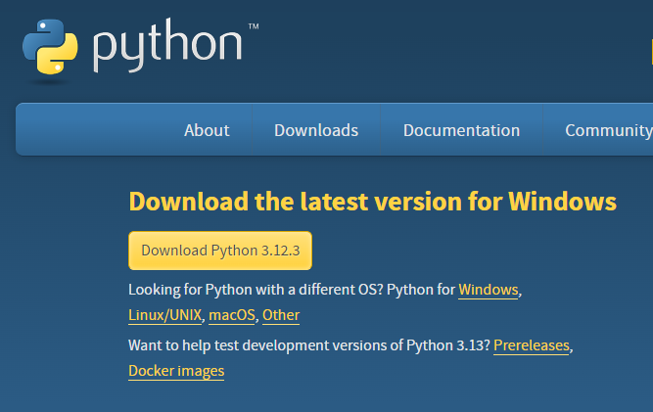
3. Install Python using the downloaded file.

Slide 4
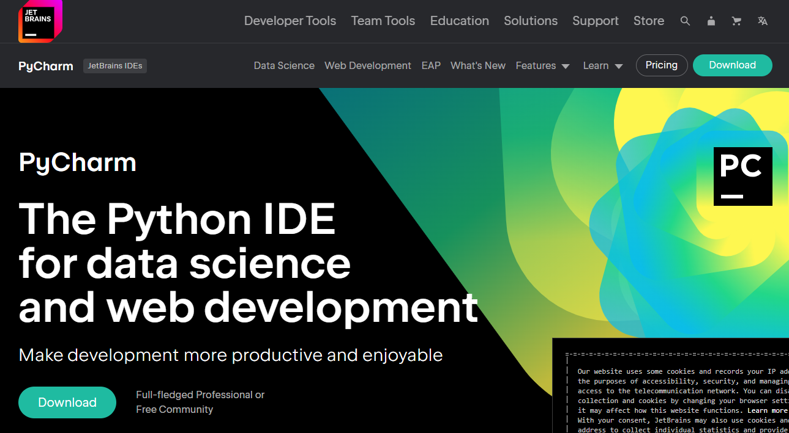
Next: Install PyCharm
4. When Python is installed, go to https://www.jetbrains.com/pycharm/ and download and install the PyCharm IDE (Integrated Development Environment)

Slide 5
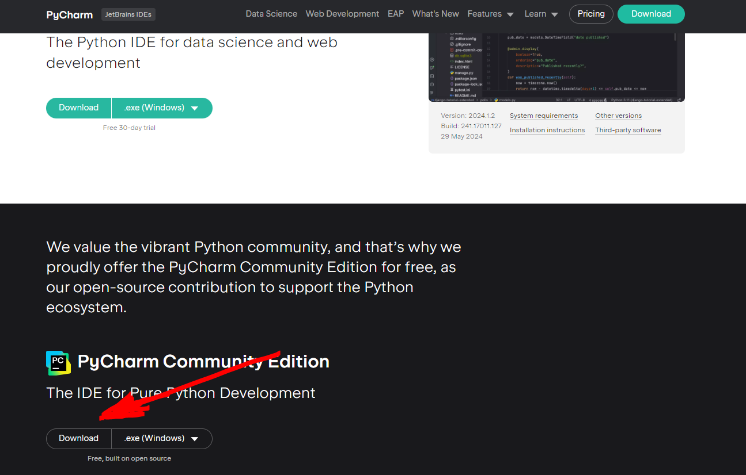
5. Download and Install the free (community) version.

Slide 6
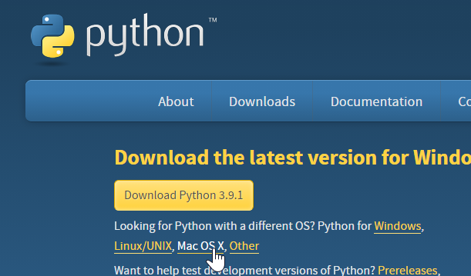
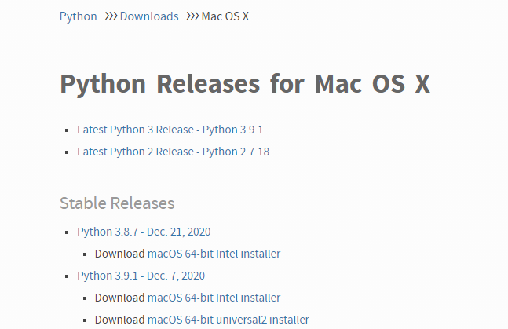
Python for Mac OS
On http://www.python.org/downloads , click on "Mac OS X"
Download and install the latest Python 3 release:

Slide 7
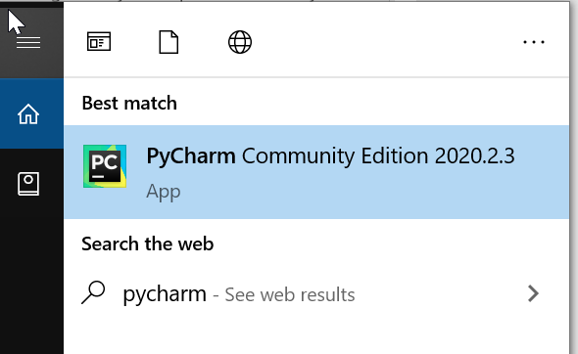
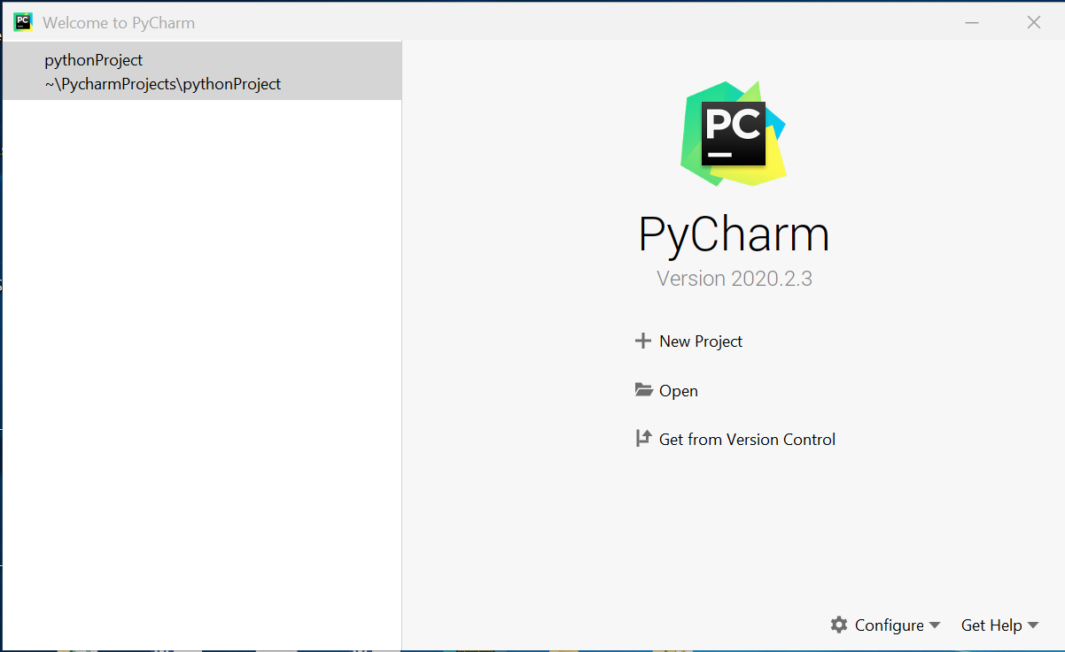
Setting PyCharm IDE
1. Start PyCharm by clicking on the shortcut on your Desktop (if you can't find it – search for "PyCharm" on your computer)
2. On first run, you should see something like this. Click on "New Project"

Slide 8
For the instructions on how to set up Python Project in PyCharm, follow the instructions on the file “Setting up Python Project in PyCharm” from Moodle.
Bus Algorithm

