Slide 1


Digital Transformation in the Health and Care Professions (BMHP6026)
Critical Evaluation of Virtual Consultations in UK Health and Social Care
Student Name: Parwana Rezaeie
Student ID: 1916557
Lecturer Name:Laila Surani

Slide 2

Introduction
Virtual consultations have become a key innovation in healthcare delivery.
Enable remote interactions via telephone and video technologies (Nuffield Trust, 2021),
Expanded rapidly during COVID-19 to maintain service continuity (Nuffield Trust, 2021),
Telehealth usage in the UK rose by up to 400% , (NHS England, 2023).
Now account for a substantial proportion of GP appointments, (NHS England, 2023).

Slide 3
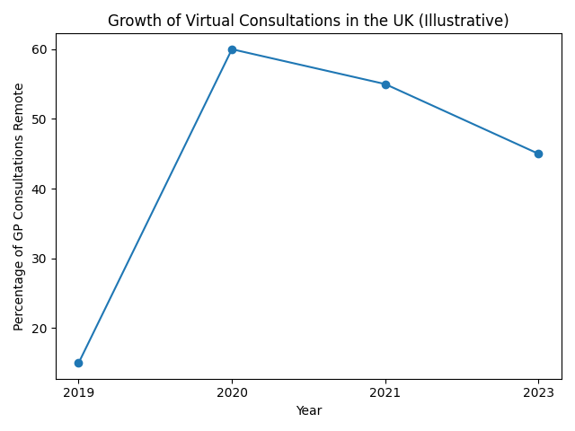
Contiute of introduction
Raises concerns around care quality, equity, and professional standards,
( NHS England (2023) and Nuffield Trust (2021)
May not benefit all patients equally, particularly those at risk of digital exclusion
This report critically evaluates virtual consultations
in UK health and social care, focusing on:
Workforce transformation
Service delivery
Patient experience
Community implications(Greenhalgh et al., 2020; Shaw et al., 2018)
Digital innovation is not inherently beneficial outcomes depend on context, implementation, and inclusivity
(Topol, 2019; NHS England, 2019)
Growth of virtual consultations in the UK (illustrative). Source: Adapted from NHS England (2023) and Nuffield Trust (2021)
(Greenhalgh et al., 2020; Shaw et al., 2018)

Slide 4
Impact of Virtual Consultation on Work Force:
Virtual consultations have significantly transformed workforce roles in health and social care:
Workforce Benefits:
Requires professionals to develop digital literacy, remote assessment, and verbal communication skills
Enables flexible working, better scheduling, and more efficient use of clinical resources
Highly effective for routine and follow-up consultations (NHS England, 2019; Topol, 2019; Shaw et al., 2018).
Workforce Challenges:
Combines clinical and technical responsibilities, increasing workload and risk of burnout
Digital transformation may redistribute rather than reduce workload, raising sustainability concerns
Disparities in digital competence require ongoing training and professional development
Absence of physical examination increases diagnostic uncertainty in complex or high-risk cases
Reduced in-person interaction may affect professional identity, communication quality, and clinical judgement
(Greenhalgh et al., 2020).
Key Takeaway:
Successful implementation depends on adequate training, organizational support, clear clinical guidelines, and balanced integration with in-person care
(Kruse et al., 2017).

Slide 5

Impact On Service Delivery
Virtual consultations have reshaped how health and social care services are accessed, coordinated, and experienced, moving away from traditional face-to-face models .
Reduces travel burden and improves access
Support flexible scheduling and more efficient resource , (Greenhalgh et al., 2020).
Aid patients with mobility, geographical, or accessibility (NHS England,2023),
Help prevent infection by reducing unnecessary physical contact (NHS England,2023),
Unsuitable for clinical scenarios requiring physical examination or complex assessment
Technological dependencies (connectivity failures, platform issues) risk service reliability
(WHO, 2010)
Digital exclusion may create unequal access, raising fairness concerns
Excessive reliance on remote models risks fragmenting care if not integrated within broader service frameworks
(Greenhalgh et al., 2020; NHS England, 2023).

Slide 6

Key Takeaway
Virtual consultations can enhance efficiency, accessibility, and flexibility, but effectiveness depends on proper clinical application, technological infrastructure, and strategies to address inequities (NHS England, 2023).
Digital innovation must be supported by inclusivity and clinical appropriateness to ensure equitable, holistic care
(NHS, 2019) .

Slide 7
Impact On Patients
From a patient perspective, virtual consultations offer notable benefits but also raise significant concerns.
Increased convenience, flexibility, and accessibility — patients can access care from home, reducing travel time and stress
Particularly beneficial for individuals with mobility issues or those in remote areas (NHS England, 2023).
May lack the personal connection of traditional settings, limiting trust and therapeutic relationships
Privacy, confidentiality, and technical reliability issues can reduce patient confidence and disrupt consultations (NHS England, 2023).
Digital exclusion limits access for those with low digital literacy or restricted technology access
Over 40% of adults aged 75+ do not use the internet, making them less likely to access digital services, (NHS England, 2021).
Patient experiences remain variable, shaped by personal preferences, clinical context, and technical capacity
Virtual consultations can widen existing health inequalities if digital exclusion is not actively addressed, (Greenhalgh et al., 2020).

Slide 8
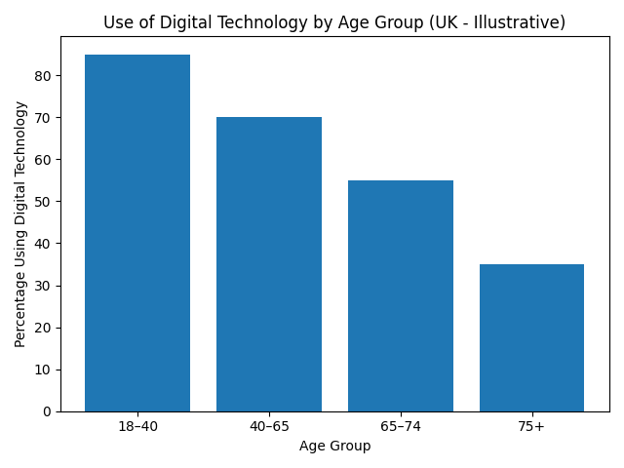
Digital Exclusion and Inequality
Younger individuals show significantly higher digital engagement than older adults (Greenhalgh et al., 2020
Adults aged 75+ have the lowest levels of technology use, increasing their risk of exclusion from digital healthcare
Virtual consultations may enhance accessibility for some while deepening health disparities for others
Digital healthcare risks reproducing existing social inequalities, particularly for older and digitally excluded populations (Nuffield Trust, 2021)
Inclusive, patient-centred approaches are essential to address this ,(NHS England, 2023).
Use of digital technology by age group in the UK (illustrative). Source: Adapted from NHS England (2023) and Nuffield Trust (2021).

Slide 9

Impact in community
Improves healthcare reach for rural and remote populations, reducing travel burdens
Reduces logistical challenges for informal carers and family members
Multi-participant platforms can involve families in care discussions, strengthening collaborative decision-making ,(NHS England, 2023).
Digital exclusion disproportionately affects older adults, disadvantaged, and marginalized groups
May reduce social interaction and community-based relationship-building if not balanced with face-to-face services, (WHO, 2021; NHS England, 2023).
Unequal access to devices, internet, and digital literacy risks reinforcing existing health disparities
Community-level benefits depend on fair digital infrastructure, inclusive service design, and strategies to address digital inequalities ,(Greenhalgh et al., 2020) .

Slide 10
Challenges of Virtual Consultations
Digital exclusion and inequality
Virtual consultations may disadvantage individuals with limited access to digital devices, internet connectivity, or digital literacy skills.
Older adults and low-income populations are particularly at risk, which can widen existing health inequalities(Greenhalgh et al., 2020; Nuffield Trust, 2021).
Reduced quality of patient–professional interaction
The absence of face-to-face communication may limit the development of trust and therapeutic relationships.
Non-verbal cues, which are important for clinical assessment and emotional support, may be missed in virtual settings
(Shaw et al., 2018),
Clinical limitations and diagnostic risks
Virtual consultations restrict the ability to conduct physical examinations
which may lead to diagnostic uncertainty or missed conditions,
particularly in complex or high-risk cases
(Greenhalgh et al., 2020; Murphy et al., 2021).

Slide 11
Increased workload and staff pressure
Healthcare professionals may experience increased cognitive and administrative workload due to managing both clinical and technical aspects of care. This can contribute to stress and potential burnout (NHS England, 2023).
Technical and system reliability issues
Problems such as poor internet connection, software failures, and lack of digital infrastructure can disrupt consultations and negatively affect care quality (Murphy et al., 2021).
Privacy, confidentiality, and data security concerns
Virtual consultations raise concerns about patient confidentiality, particularly when consultations are conducted in non-secure environments or through digital platforms that may be vulnerable to data breaches (World Health Organization, 2021).
Not suitable for all patient groups or conditions
Certain groups, including individuals with cognitive impairments, sensory difficulties, or complex health needs, may find virtual consultations difficult or inappropriate (Monaghesh and Hajizadeh, 2020).
Risk of fragmented care
Over-reliance on virtual consultations may reduce continuity of care and limit holistic assessment, particularly if services are not well integrated with face-to-face care (Topol, 2019; Shaw et al., 2018).

Slide 12
Recommendations
Improve digital inclusion
Provide access to devices, internet, and digital skills training to reduce inequalities in access to virtual consultations (Nuffield Trust, 2021; WHO, 2021)
Train healthcare professionals
Offer continuous training to improve digital skills and confidence in delivering virtual care
Use a hybrid care model
Combine virtual and face-to-face consultations to ensure safe and appropriate care for all patients
(Greenhalgh et al., 2020; Murphy et al., 2021).
Ensure data security
Use secure systems and clear guidelines to protect patient confidentiality and build trust in digital services
(WHO, 2021; NHS England, 2019).

Slide 13
Conclusion
Virtual consultations are a significant digital innovation in UK health and social care, improving accessibility, flexibility, and efficiency.
However, their impact is complex and not universally beneficial, as they also introduce challenges such as digital exclusion, workforce strain, and clinical limitations
Digital transformation is not inherently progressive and may reproduce existing inequalities if not carefully implemented
Effective digital healthcare requires inclusive policies, workforce support, and a strong focus on patient-centred care
A hybrid model combining virtual and face-to-face care is essential to ensure safe, equitable, and high-quality service delivery.
Future healthcare systems must prioritise not only efficiency, but also fairness, accessibility, and sustainability to fully realise the benefits of digital transformation
(Topol, 2019). (Greenhalgh et al., 2020). (NHS England, 2019).

Slide 14
Reference
Bokolo, A.J. (2021) ‘Use of telemedicine and virtual care for remote treatment in response to COVID-19 pandemic’, Journal of Medical Systems, 45(7), pp. 1–9. Available at: https://link.springer.com/article/10.1007/s10916-021-01742-9 (Accessed: 3 March 2026).
Greenhalgh, T., Vijayaraghavan, S., Wherton, J., Shaw, S., Byrne, E., Campbell-Richards, D., Morris, J., Bhattacharya, S., Hanson, P., Ramoutar, S., Collard, A. and Hodkinson, I. (2016)
‘Virtual online consultations: advantages and limitations (VOCAL study)’, BMJ Open, 6(1), e009388. Available at: https://bmjopen.bmj.com/content/6/1/e009388 (Accessed: 2 March 2026).
Greenhalgh, T., Wherton, J., Shaw, S. and Morrison, C. (2020) ‘Video consultations for COVID-19’, BMJ, 368, m998. Available at: https://www.bmj.com/content/368/bmj.m998 (Accessed: 2 March 2026).
Kruse, C.S., Krowski, N., Rodriguez, B., Tran, L., Vela, J. and Brooks, M. (2017)
‘Telehealth and patient satisfaction: a systematic review and narrative analysis’, BMJ Open, 7(8), e016242. Available at: https://bmjopen.bmj.com/content/7/8/e016242 (Accessed: 18 March 2026).
Monaghesh, E. and Hajizadeh, A. (2020) ‘The role of telehealth during COVID-19 outbreak: a systematic review’, BMC Public Health, 20, p. 1193. Available at: https://bmcpublichealth.biomedcentral.com/articles/10.1186/s12889-020-09301-4 (Accessed: 22 February 2026).
Murphy, M., Scott, L.J., Salisbury, C., Turner, A., Scott, A., Denholm, R., Lewis, R., Iyer, G., Macleod, J. and Horwood, J. (2021)
‘Implementation of remote consulting in UK primary care following the COVID-19 pandemic’, British Journal of General Practice, 71(704), pp. e166–e177. Available at: https://bjgp.org/content/71/704/e166 (Accessed: 24 March 2026).

Slide 15
NHS England (2019) The NHS Long Term Plan. London: NHS England. Available at: https://www.longtermplan.nhs.uk (Accessed: 17 February 2026).
NHS England (2023) Transforming outpatient services and digital care delivery. Available at: https://www.england.nhs.uk/outpatient-transformation (Accessed: 19 March 2026).
Nuffield Trust (2021) The digital shift in health and social care. London: Nuffield Trust. Available at: https://www.nuffieldtrust.org.uk/research/the-digital-shift-in-health-and-social-care (Accessed: 25 February 2026).
Shaw, S., Wherton, J., Vijayaraghavan, S., Morris, J., Bhattacharya, S., Hanson, P., Campbell-Richards, D., Ramoutar, S., Collard, A., Hodkinson, I. and Greenhalgh, T. (2018)
‘Advantages and limitations of virtual online consultations in a NHS acute trust: the VOCAL study’, BMJ Open, 8(4), e009388. Available at: https://bmjopen.bmj.com/content/8/4/e009388 (Accessed: 7 March 2026).
Topol, E. (2019) The Topol Review: Preparing the healthcare workforce to deliver the digital future. London: Health Education England. Available at: https://topol.hee.nhs.uk (Accessed: 9 March 2026).
World Health Organization (2010)Telemedicine: Opportunities and developments in Member States: Report on the second global survey on eHealth. Geneva: WHO. Available at: https://apps.who.int/iris/handle/10665/44497 (Accessed: 28 February 2026).
World Health Organization (2021) Global strategy on digital health 2020–2025. Geneva: WHO. Available at: https://www.who.int/publications/i/item/9789240020924 (Accessed: 18 March 2026).

