Slide 1
﻿﻿University of Wales Trinity Saint David
﻿﻿Program: CertHE Business Skills for
Work (BSIW)
﻿﻿Module: LCLM4006 Enterprise &
Entrepreneurship
﻿﻿Business Name: Česká Lipa - Authentic
Czech Restaurant
﻿﻿Student: Dominic Adam | ID: 2509010
﻿﻿Lecturer: Eike Udeagu

Slide 2
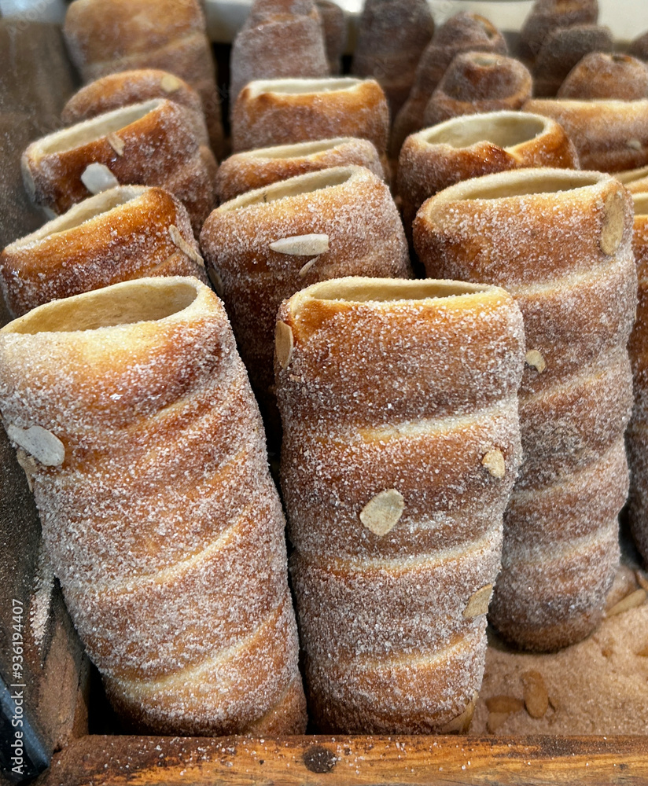
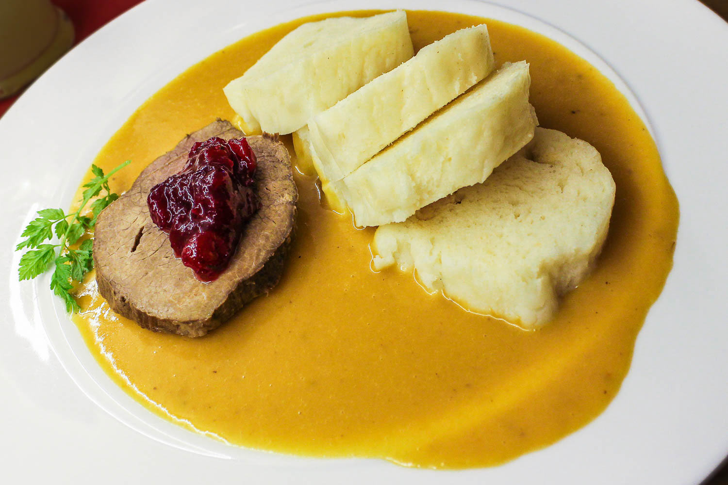
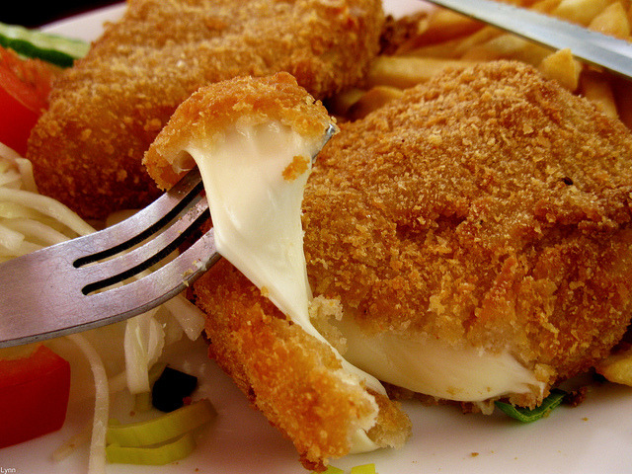
﻿﻿Legal format: Private Limited Company (Ltd) under Companies Act 2006 - protects personal assets, builds credibility with suppliers
﻿﻿Lean structure: Founder/Director, Head Chef, Front of House Supervisor, 3 part-time staff - keeps overheads low and decision-making fast
Business Idea Overview
﻿﻿Traditional Czech home-style dishes (svíčková na smetaně, beef goulash,
knedlíky, palačinky, trdelník) + imported
Czech drinks
﻿﻿Fully adapted vegetarian, vegan, gluten-free menus; dine-in, takeaway, delivery
﻿﻿﻿100% authentic recipes prepared by
Czech-trained kitchen staff
﻿﻿﻿Strong focus on sustainability and ethical sourcing
﻿﻿﻿Inclusive pricing and deep local community ties
﻿﻿﻿Flexible service options for all customers

Slide 3
Key PESTEL External Factors
﻿﻿﻿Political: UK government support via
Start Up Loans scheme, reduced VAT for hospitality, and clear post-Brexit EU import rules that cut trade uncertainty for our Czech ingredients.
﻿﻿﻿Social: The UK ethnic food sector grows
4.3% annually; Birmingham is one of Europe's most multicultural cities, with rising demand for authentic international cuisine and sustainable, ethical businesses.
﻿﻿﻿Environmental: UK single-use plastic bans and national food waste targets align perfectly with our eco-policy - we use no single-use plastics, compost/ donate all surplus food, and run energy-efficient equipment.

Slide 4
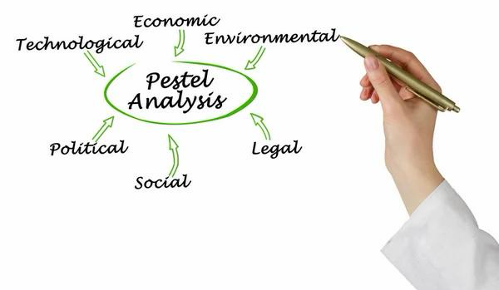
Two Core Marketing Strategies
Digital Marketing
﻿﻿Instagram/Facebook: Food photography, menu updates, and exclusive offers
﻿﻿TikTok: Short behind-the-scenes clips of
Czech cooking and culture
﻿﻿Mobile-friendly website + delivery app listings (Just Eat, Uber Eats, Deliveroo) + email loyalty scheme
﻿﻿Why: Low cost, high reach to our target audience of students, families, and European communities
. Local Community Marketing
﻿﻿Flyers at universities, libraries, and local shops; partnerships with Central European cultural groups
﻿﻿"Student & Senior Tuesday" 15% discount; monthly free "Czech Culture Nights"
﻿﻿Why: Builds long-term loyalty in
Moseley's 16,000+ daily visitors, and directly addresses the lack of dedicated local Czech food options.

Slide 5
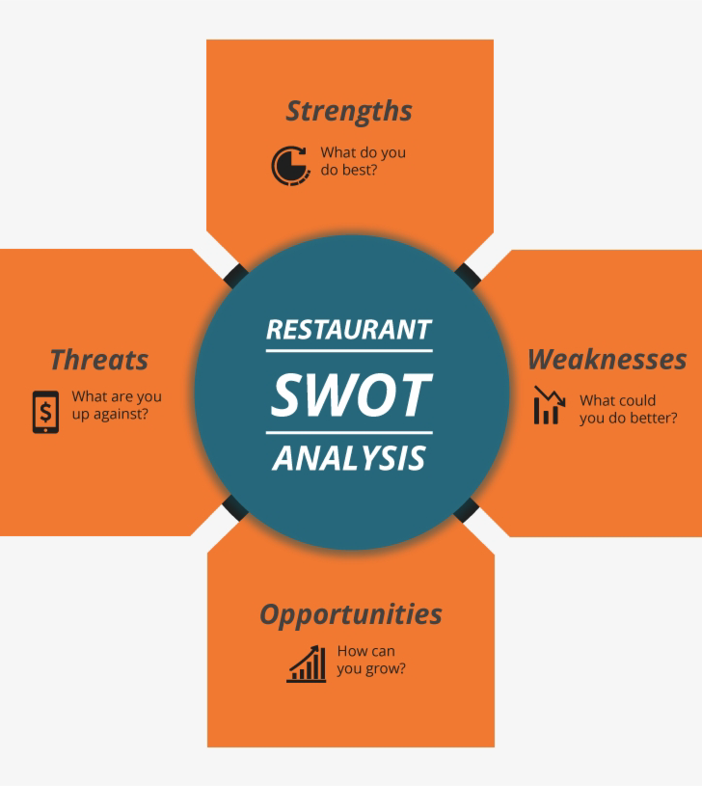
Funding & Cost Allocation
Total Required: £41,500
V Sources:
﻿﻿Personal investment: £16,500 (shows full commitment to the business)
﻿﻿Government-backed UK Start Up Loan:
£20,000
﻿﻿West Midlands Combined Authority
Small Business Grant: £5,000
V How funds are allocated:
﻿﻿Premises: Rent deposit + first month rent (£5,500)
﻿﻿Setup: Kitchen/dining equipment, furniture, branding, legal/licensing fees (E12,800)
﻿﻿Operations: Initial stock, insurance, staff wages, launch marketing (E13,200)
﻿﻿Working capital: £10,000 - covers unexpected costs and keeps cash flow stable for the first 3 months

Slide 6
Summary & Next Steps
﻿﻿
﻿﻿Strong, sustainable business model
﻿﻿Secure funding and realistic growth targets

