Slide 1
SBPD7010
QUANTITATIVE RESEARCH METHODS
Unit 6 Data Analysis I

Slide 2
Topics
Descriptive and inferential statistics
Univariate, bivariate and multivariate analyses
Measurement scales
Descriptive statistics
Inferential statistics
  Confidence intervals
  Statistical significance
  Hypothesis Testing

Slide 3
Descriptive and Inferential Statistics
Statistics enable managers to know how to:
  Properly present and describe information (descriptive statistics)
  Draw conclusions about populations based on information obtained from samples (inferential statistics)
Descriptive statistics
  Use of numerical information to summarize, simplify, and present masses of data.
  Organized and summarized for clearer presentation
  For ease of communications
  Data may come from studies of populations (often called a census study) or samples

Slide 4
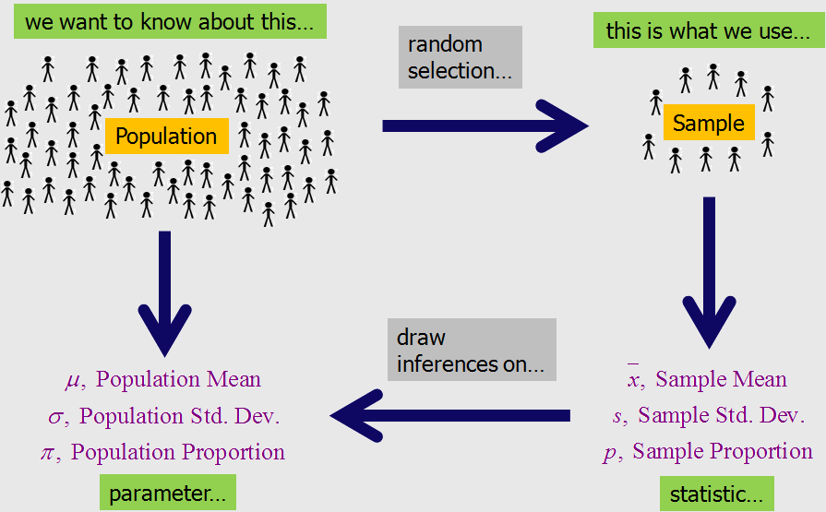
Descriptive and Inferential Statistics
Inferential statistics
  The process of making guesses about the truth from a sample.
  Techniques which tell us how much confidence we have when we GENERALIZE from a sample to a population.

Slide 5
Example
Question: How much are you willing to spend on a date (or want your date to spend on you)?
A total of 988 students responded (n=988) to this question. If we assume that this sample represents the undergraduate population (N=30,000), then we can make inferences regarding this population based on the survey results.
Solutions: = = $49.35 ≤ μ ≤ $54.54
SPSS output
Variable N Mean StDev SE Mean 95% CI
DateSpnd 988 51.9423 41.5440 1.3217 (49.3487, 54.5360)
Descriptive statistics
Inferential statistics

Slide 6
Example
Descriptive statistics: The sampled students (n=988) indicated that they would spend US$51.94 on a date
Inferential statistics: We are 95% confident that the true mean amount of money that undergraduate students (N=30,000) at X university would spend on a date is between US$49.35 and US$54.54

Slide 7
Examples of Descriptive and Inferential Statistics
Descriptive Statistics
Inferential Statistics
Graphical
  Arranging data in tables
  Histograms, bar graphs and pie charts
Numerically
  Percentages
  Averages
  Range
  Variance
  Standard deviation
Confidence interval
Compare means of two samples
  Pre/post scores
  t Test
Compare means from three samples
  ANOVA = analysis of variance
Relationships
  Correlation coefficient
  Regression analysis

Slide 8
Statistics vs. Parameters
Sample Statistics – any summary measures calculated from data; e.g., could be a mean, a difference in means or proportions, or a correlation coefficient
  E.g., the mean satisfaction level in a sample of 100 customers is 4.2, with 1 being least satisfied and 5 being most satisfied.
  E.g., the correlation coefficient between perceived quality and customer satisfaction in a sample of 100 customers is 0.75
Population parameters – the true value/true effect in the entire population of interest
  E.g., the true mean satisfaction level of all customers is 4.0, with 1 being least satisfied and 5 being most satisfied.
  E.g., the true correlation between perceived quality and customer satisfaction of all customers is 0.80.

Slide 9
Univariate, Bivariate and Multivariate analyses
Descriptive
  Univariate: When we use one variable to describe a person, place, or thing.
Inferential
  Bivariate: When we compare summary values from two groups for the same variable (mean difference between males and females) or two variables within one group (correlation).
  Multivariate: When we use three or more variables to measure a person, place or thing. Variables may or may not be dependent on each other.

Slide 10
Measurement Scales
Nominal or categorical scales
  Classification of people, places, or things into categories (e.g. age ranges, colors, etc.).
  Classifications must be mutually exclusive (every element should belong to one category with no ambiguity).
  Weakest of the four scales. No category is greater than or less (better or worse) than the others. They are just different.
Ordinal or ranking scales
  Classification of people, places, or things into a ranking such that the data is arranged into a meaningful order (e.g. poor, fair, good, excellent).
  Qualitative classification only

Slide 11
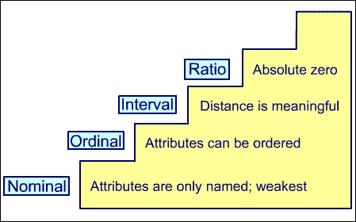
Measurement Scales
Interval scales
  Data classified by ranking.
  Quantitative classification (attitudes, opinions, etc.).
  Zero point of scale is arbitrary (differences are meaningful).
Ratio scales
  Data classified as the ratio of two numbers.
  Quantitative classification (height, weight, distance, etc.).
  Zero point of scale is real (data can be added, subtracted, multiplied, and divided).

Slide 12
Descriptive Statistics
Descriptive Statistics
  Histogram
  The Range (min./max.)
  Average
  Median
  Mode
  Variance
  Standard Deviation

Slide 13
Histograms
Descriptive statistics are easier to interpret when graphically illustrated.
A histogram is a graphical display of data using bars of different heights.
  However, charting each data element can lead to very busy and confusing charts that do not help interpret the data.
  Grouping the data elements into categories and charting the frequency within these categories yields a graphical illustration of how the data is distributed throughout its range.

Slide 14
Histograms
The marks of 20 students in a test are shown below:
87 67 69 85 71 45 100 78 73 50 65 66 81 49 60 74 62 74 53 63.
With just a few columns this chart is difficult to interpret. It tells you very little about the data set. Even finding the Min and Max can be difficult.
The data can be presented such that more statistical parameters can be estimated from the chart (average, standard deviation).

Slide 15
Histograms
Category Labels | Frequency
0-50 | 3
51-60 | 2
61-70 | 6
71-80 | 5
81-90 | 3
>90 | 1
Frequency Tables
  The first step is to decide on the categories and group the data appropriately.
  (45, 49, 50, 53, 60, 62, 63, 65, 66, 67, 69, 71, 73, 74, 74, 78, 81, 85, 87, 100)
Histograms
  A histogram is simply a column chart of the frequency table.

Slide 16
Histograms
Average (68.6) and Median (68)
Mode (74)
-1SD
+1SD

Slide 17
The range
Difference between minimum and maximum values in a data set
Larger range usually (but not always) indicates a large spread or deviation in the values of the data set.
(73, 66, 69, 67, 49, 60, 81, 71, 78, 62, 53, 87, 74, 65, 74, 50, 85, 45, 63, 100)

Slide 18
average (mean)
Sum of all values divided by the number of values in the data set.
There are three main measures of central tendency: the mean, the median and the mode.
Average =
Average=(73+66+69+67+49+60+81+71+78+62+53+87+74+65+74+50+85+45+63+100)/20 = 68.6
Excel function: AVERAGE()

Slide 19
median
The middle value in a sorted data set. Half the values are greater and half are less than the median.
Another measure of central location in the data set.
(45, 49, 50, 53, 60, 62, 63, 65, 66, 67, 69, 71, 73, 74, 74, 78, 81, 85, 87, 100)
Median: 68
Excel function: MEDIAN()

Slide 20
mode
Most frequently occurring value.
Another measure of central location in the data set.
(45, 49, 50, 53, 60, 62, 63, 65, 66, 67, 69, 71, 73, 74, 74, 78, 81, 85, 87, 100)
Mode: 74
Generally not all that meaningful unless a larger percentage of the values are the same number.

Slide 21
Which Measure is Best?
The most important factor to consider is: the level of measurement
Nominal scales: the mode is the only appropriate measure of central tendency.
Ordinal scales: both the mode and median are used.
Interval and ratio scales: mode, median, and mean can all be used. Mean is usually the measure of choice because it is a unique value, it uses all values in the data set, and it can be used in subsequent analyses. But the mean is subject to extreme (high or low) values (outliers). If the data set contains extreme values, calculate both median & mean.

Slide 22
variance
Note: The latest version of Excel uses
Population: VAR.P ()
Sample: VAR.S ()
One measure of dispersion (deviation from the mean) of a data set. The larger the variance, the greater is the average deviation of each datum from the average value.
Variance =
Variance = [(45 – 68.6)² + (49 – 68.6)² + (50 – 68.6)² + (53 – 68.6)² + …]/20 = 181
Excel Functions: Population: VARP(); sample: VAR()
Average value of the data set

Slide 23
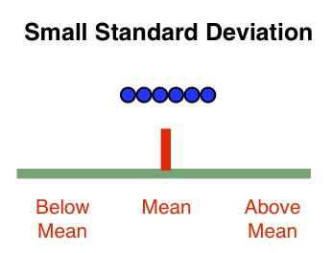
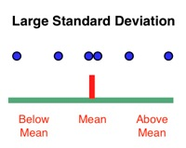
Standard deviation
Square root of the variance. Can be thought of as the average deviation from the mean of a data set.
The magnitude of the number is more in line with the values in the data set.
Standard Deviation = ([(45 – 68.6)² + (49 – 68.6)² + (50 – 68.6)² + (53 – 68.6)² + …]/20)^{1/2} = 13.5
Excel Functions: Population: STDEVP()
Sample: STDEV()
Note: The latest version of Excel uses
Population: STDEV.P ()
Sample: STDEV.S ()

Slide 24
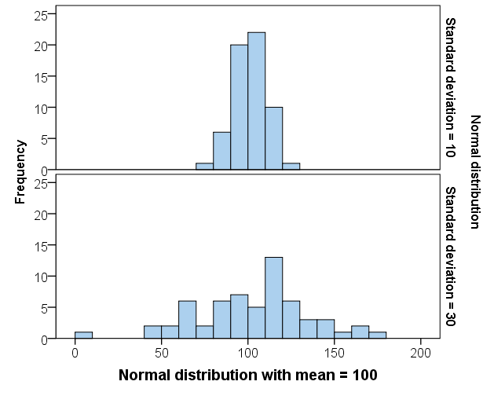
Interpretation of standard deviation
The larger the standard deviation, the more spread out the data is.
Notes:
For most students, the standard deviation is calculated using the computer so it is the interpretation that is most important. Showing them how standard deviation is a measure of spread using histograms is helpful.

Slide 25
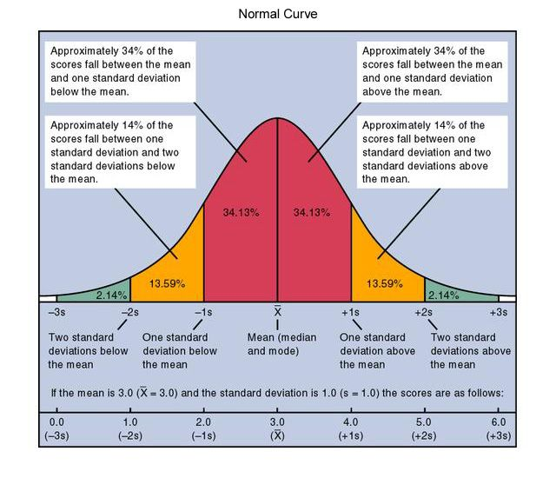
Normal Distribution
A normal distribution with a mean of 0 and a standard deviation of 1 is called a standard normal distribution.
For ratio and interval data (continuous or discrete), we often assume it follows a normal distribution
68% of data will fall within 1σ of the μ
95% of data fits within 2σ of the μ
99.7% of data fits within 3σ of the μ

Slide 26
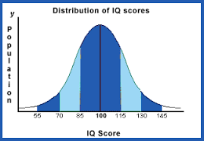
Example: IQ is normally distributed
68% of data will fall within 1σ of the μ
95% of data fits within 2σ of the μ
99.7% of data fits within 3σ of the μ
Above average
Average
Nobel Prize winners
Mean = 100, SD = 15.3
Notes:
This is the probability distribution as a curve for IQ. The mean is 100 and the standard deviation shows the spread. For a perfect normal distribution, 50% of the population are above the mean and 50% are below. Most people are between 70 and 130 with a few above 145. The probability of randomly selecting a person from the population with an IQ above 145 is very small.

Slide 27
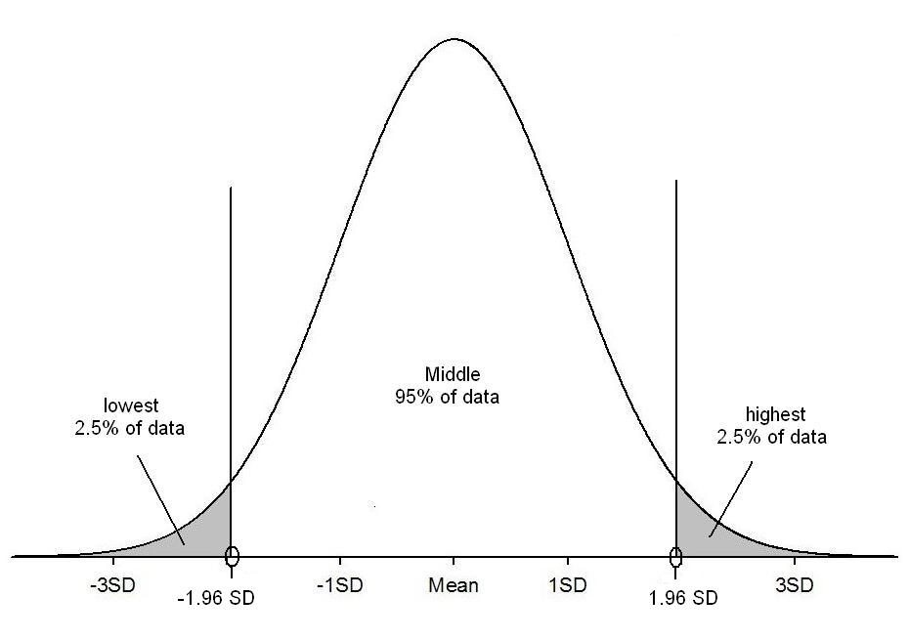
95%: 1.96 x SD’s from the mean
95% of values
P(score > 130) = 0.025
70
100
130
95% of people have an IQ between 70 and 130
Notes:
Another important fact about normally distributed data is that 95% of the population lie between plus and minus 1.96*SD’s of the mean. For the IQ data this means that 95% of people have an IQ between 70 and 130 with only 2.5% above 130. This is important when understanding confidence intervals.

Slide 28


Confidence Interval
Sampling variation
Every sample taken from a population, will contain different numbers so the mean varies.
Which estimate is most reliable?
How certain or uncertain are we?
Sample A
n=200
Mean = 277
$$\overline{x}$$
Population
Mean = ?
SD =?
Sample B
n=200
Mean = 274
$$\overline{x}$$
Sample C
n=200
Mean = 275
$$\overline{x}$$
Notes:
Point is that your data will vary from study to study and so the sample mean etc. has a sampling distribution. Even of the data is not normal this will look more normal when the sample size is medium or large (i.e. >30).

Slide 29
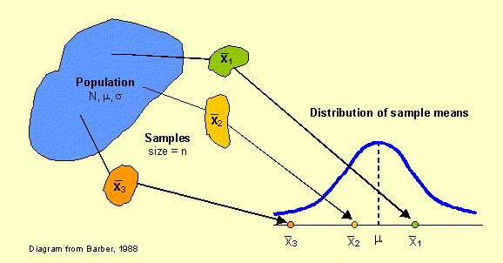
Confidence Interval
The sampling distribution is the distribution of a statistic across an infinite number of samples.
Sampling error is the difference between a sample statistic used to estimate a population parameter and the actual but unknown value of the parameter.
Sampling distribution

Slide 30
Confidence Interval
A range of values within which we are confident (in terms of probability) that the true value of a population parameter lies
  A 95% CI is interpreted as 95% of the time the CI would contain the true value of the pop parameter
  i.e. 5% of the time the CI would fail to contain the true value of the pop parameter
The point estimate is our best guess of the true value of the parameter, while the interval estimate gives a measure of the accuracy of that point estimate by providing an interval that contains plausible values.
Solutions: = = $49.35 ≤ μ ≤ $54.54
Question: How much are you willing to spend on a date (or want your date to spend on you)?
SPSS output
Variable N Mean StDev SE Mean 95% CI
DateSpnd 988 51.9423 41.5440 1.3217 (49.3487, 54.5360)
Notes:
Discuss the interpretation of the CI in the above and also comment on how this relates to the conclusion drawn from the earlier (equivalent) hypothesis test.

Slide 31
statistical significance
Extracts from research papers:
  “A series of t-tests and one-way ANOVAs were performed to compare data from respondents of different sex and category of hotels visited. Since there were no statistically significant differences, the data were merged for subsequent analyses.”
  “All variables were statistically significant predictors of repurchase intention (p < 0.05), except for the room encounter (p = 0.75).”
Significance is a statistical term that tells how sure you are that a difference or relationship exists. For example:
  Findings: There were significant differences (p < 0.05) between males and females in terms of job satisfaction.

Slide 32
statistical significance
Less than 5 percent probability that the difference occurred by chance.
We are 95% confident that males and females are different (μ1 – μ2 ≠ 0).
That is, if we repeat the survey 100 times and compare the results to the population, on an average, 95 of the 100 results will be correct and 5 times will be incorrect.
If the 95% confidence interval (interval estimate) does not contain zero, then the difference/relationship will be statistically significant at the 0.05 level. That is, every value in the confidence interval is a plausible value of the parameter. When zero is not in the interval, the null hypothesis (H0: μ1 – μ2 =0) should be rejected.

Slide 33
statistical significance
SPSS can calculate exact probabilities for most test statistics.
We simply compare the probability from SPSS to the critical alpha level α (usually 5%).
If the probability is less than the critical alpha level, your finding is significant
If the probability is greater than the critical alpha level, your finding is not significant
The chance that : μ1 – μ2 =0 is less than 5%
The chance that : μ1 – μ2 =0 is greater than 5%

Slide 34
Symbols used in Hypotheses
m= sample mean
µ (mu: mew)= population mean
α= significance level; probability of committing a Type I Error (α= .05)
p= probability value (p= .05)
Null Hypothesis= (H₀: µ1 - µ2 = 0 or H₀: µ1 = µ2)
Alternative Hypothesis= (H₁: µ1-µ2 ≠ 0 or H₁: µ1 ≠ µ2 )
  Sometimes you may see it noted as H_{a}

Slide 35
Testing Hypotheses
Statistical Hypotheses are mathematical, or logical statements that help researchers interpret the results of research
Statistical hypotheses consist of
  Null hypothesis (H₀) and alternative hypothesis (H₁ or H_{a})
  Null: (H₀: µ1 - µ2 = 0 )
  Alternative: (H₁: µ1 - µ2 ≠ 0)
Remember, and this is important:
  The null hypothesis always implies that there is no relation or statistical difference between variables or groups
  The alternative hypothesis implies that there is a meaningful relationship among variables or groups

Slide 36
Testing Hypotheses
Is it possible that our observations occurred by chance?
We use a variety of statistical procedures to test null hypotheses. The choice of which procedure we use depends on a variety of factors including:
  the research hypothesis,
  the data,
  the sampling strategy,
  and what we want to be able to say as a result of our testing.

Slide 37
Types of Tests
Statistical procedures that are commonly used for hypothesis testing include: correlation, analysis of variance (ANOVA), regression, multivariate analysis of variance (MANOVA), t-tests, and Chi-Square.
  Each of these procedures has an associated test statistic, which is used to determine significance. For example ANOVA and regression use F statistics and their associated p-values.
Multivariate procedures, like MANOVA, use a variety of test statistics with interesting names, like Wilk’s lambda. These are then related to a more common test statistic, like F.
The secret here, for the layperson, is that all test statistics are eventually related to a probability distribution and a p-value. These p-values mean the same thing across test statistics.

Slide 38
P-value
A p-value represents the probability with which the result would occur by chance when the null hypothesis is true.
It is a number between 0 and 1 and interpreted in the following way:
  A small p-value (typically < 0.05) indicates strong evidence against the null hypothesis, so you reject the null hypothesis.
  A large p-value (typically > 0.05) indicates weak evidence against the null hypothesis, so you fail to reject the null hypothesis.

Slide 39
Testing hypotheses
State a null hypothesis
  There is no relationship [H₀: r=0]
  There is no difference [H₀: µ1- µ2 = 0]
State an alternative hypothesis
  there is a relationship [Ha: r≠0]
  there is a difference [Ha: µ1- µ2 ≠ 0]
Establish a level of risk of making a mistake in your inference (p-value < 5%)
Assess the null hypothesis based on the p-value

Slide 40
Example
A graduate survey report shows that new graduates on average earned $13,300 in 2017.
You think business graduates earned more than $13,300
H₀ : Average salary for business graduates was $13,300 or less
[H₀: µ ≤ $13,300]
Ha: Average salary for business graduates was more than 13,300
[Ha: µ > $13,300]
Business graduates earned more than $13,300 in 2017

Slide 41
150 students were surveyed. If the sample mean was much greater than $13,300, say x̅ = $18,000, you would reject the null hypothesis [H₀: µ ≤ $13,300].
Rationale: there is only a small probability of getting that result by chance if business graduates’ average salary was $13,300 or less.
I am 95% confident that business graduates earned more than $13,300 in 2017
Mean, μ, is unknown
Much greater than $13,300
Population
Sample
x̅ = $18,000
Random Sample

Slide 42
If the sample mean close to $13,300, say x̅ = $12,500, you would not reject the null hypothesis [H₀: µ ≤ $13,300].
Rationale: there is a large probability of getting that result by chance if business graduates’ average salary was $13,300 or less.
There is not enough statistical evidence to infer that business graduates earned more than $13,300 in 2017.
Mean, μ, is unknown
Close to $13,300
Population
Sample
x̅ = $12,500
Random Sample

Slide 43
Type I and Type II Errors
When conducting hypothesis testing, there are two possible states of nature (the null hypothesis is either true or false) and two possible decisions we can be made based on the sample statistic (reject the null hypothesis or fail to reject it).
When the null hypothesis is true but our decision is to reject it, we say that a Type I error (α) has occurred.
On the other hand, when the null hypothesis is false but we fail to reject it, then a Type II error (β) has occurred.
All statistical hypothesis tests have a probability of making type I and type II errors. Neither can be avoided entirely.

Slide 44
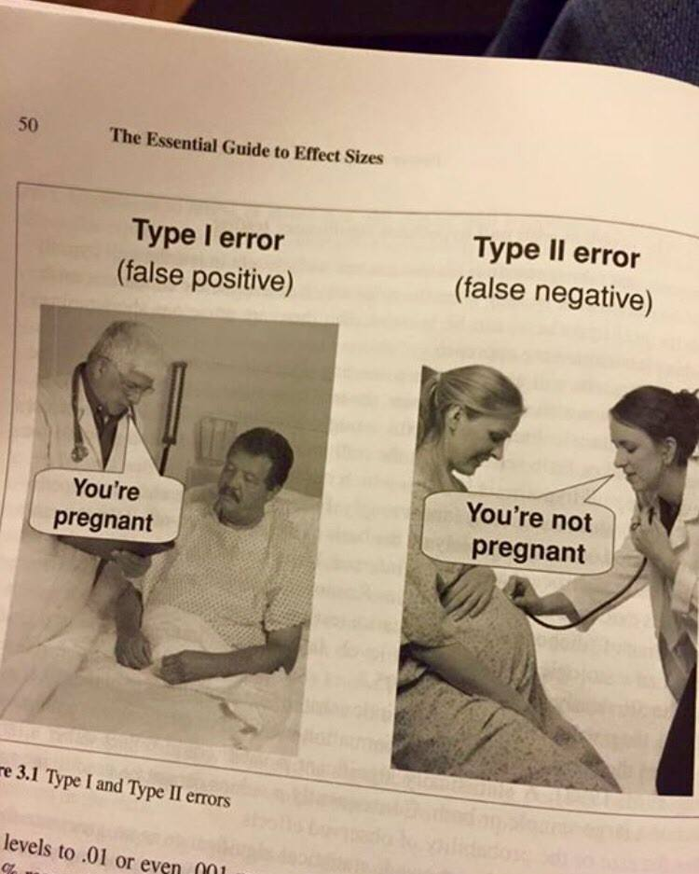
Type I and Type II Errors
Failing to reject the null hypothesis that is actually not true in the population
Rejecting the null hypothesis that is actually true in the population
Reality
H₀: A patient is not pregnant
Ha: A patient is pregnant
The null hypothesis is true
The alternative hypothesis is true
The null hypothesis is true
Accurate
1 - α
Type II Error
β
The patient is not pregnant
Researcher’s decision
The alternative hypothesis is true
Type I Error
α
Accurate
1 - β
The patient is pregnant

Slide 45
Type I Error
Type I error: (false-positive) rejecting the null hypothesis that is actually true in the population.
  Risk of a Type I error is the same as the significance level, e.g., p < .05.
  Solutions: use a more stringent significance level, use replication
Type I and II error rates are traded off against each other: for any given sample set, the effort to reduce one type of error generally results in increasing the other type of error.

Slide 46
Type II Error
Type II error: (false-negative)failing to reject the null hypothesis that is actually not true in the population (i.e., the alternative hypothesis is true).
Type II error (beta, β) is directly related to the power of a test.
Power refers to the probability that a test will find a statistically significant difference when such a difference actually exists.
Beta plus the power of a test is always equal to 1*.
Usually, researchers will refer to the power of a test (e.g. a power of .8), leaving the beta level (.2 in this case) as implied. That is, you should have an 80% or greater chance of finding a statistically significant difference when there is one.
Solutions: increase sample size, use more sensitive precise measures, use replication.
Prob.(not reject|Ha is true)
Prob.(reject|Ha is true)
Prob.(reject|Ha is true) + Prob.(not reject|Ha is true) =1
β = 1- power

Slide 47
Simulating Confidence Intervals
Click the link below:
http://www.rossmanchance.com/applets/ConfSim.html
This simulation illustrates confidence intervals.
Once you are in, do the following:
change “proportions” to “means”
change “µ” to 50.5
change “σ” to 28.87
change “Intervals” to 100

Slide 48
Simulating Confidence Intervals
For each run of the simulation, 100 sample experiments are conducted and a confidence interval on the mean is computed for each experiment.
In each run, scores are sampled from a population with a mean of 50.5 and a standard deviation of 28.87. Therefore the parameter being estimated is always 50.5.
A 95% confidence interval is computed for each experiment. If the interval contains the population mean of 50.5, then the confidence interval is shown as a green line. If the interval does not contain 50.5, it is shown as a red line.

Slide 49
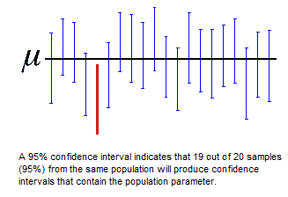
Simulating Confidence Intervals
For a 95% CI, we say
  “we are 95% confident that the true population parameter is between the lower and upper calculated values”
  if we repeat this process many times, 95% of all intervals should in fact contain the true value of the parameter.
i.e., 95 out of 100

Slide 50
Central Limit Theorem
Rule 1 of the Central Limit Theorem: The mean of the population and the mean of the sampling distribution of means will always have the same value. This rule is important to hypothesis testing because when we go to test a hypothesis even though our sample will not be exactly like the population, on average it will be exactly the same. We can be sure that repeated experiments will yield sample values close to the mean, and exactly the same over time.
Rule 2 of the Central Limit Theorem states: the sampling distribution of the mean will be normal regardless of the shape of the population distribution. Whether the population distribution is normal, positively or negatively skewed, unimodal or bimodal in shape, the sampling distribution of the mean will have a normal shape.

Slide 51
The mean of the population and the mean of the sampling distribution of means will always have the same value
In this example a small population of four values is represented. Every possible combination of values from the population is sampled to form a true sampling distribution of the mean. Note, however, that a sampling distribution of any true population would be much larger, thereby making their very nature theoretical rather than practically demonstrable.
Start with a population of values (here scores from 1-4)
1
2
3
4
Population distribution
μ=2.5 σ=1.18
Take every possible sample from the population (n=3)
1,2,3
1,2,4
3,4,1
2,3,4
Calculate the mean for each of the samples
2
2.33
2.67
3
Calculate the average of all the sample means (μ_{x̅})
2
2.33
2.67
3
10/4
μ_{x̅} = 2.5

Slide 52
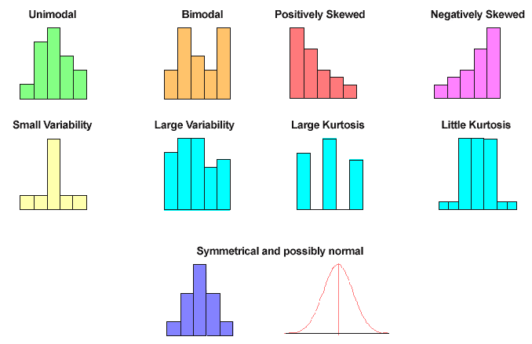
Curves of Distribution

Slide 53
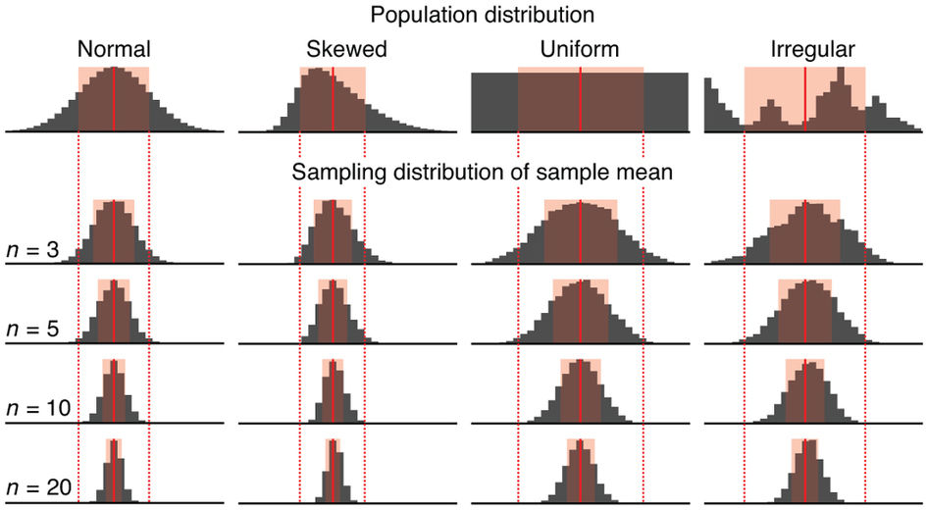
Population and sampling distributions
A sampling distribution is the frequency distribution of a statistic over many random samples from a single population.

