Slide 1
Emerging Trends · University of Wales Trinity Saint David
AI-Powered Domain Security
Module - ACCB6019, Lecturer – Sadeque Imam Shaikh
Klarvex Platform
Transforms technical domain scan data into a clear, prioritised security
action plan for non-technical users, using local AI.
Member 1 - Constantin Strinu (2321711)
Member 2 - Ionela Alina Marcu (2321713)
Member 3 - Eric Marinho Nazare 2223750
Vision, scope, full backend — Klarvex
Research & Tool Analysis
Ollama, prompt engineering, streaming UX
Member 4 - Andrian Morteanu (2242425)
Member 5 - Alexandra Craciun (2323954)
Member 6 - Valerio Cinquemani (2130904)
System Architecture & Integration
Wireframes, prototype, design system
Legal, ethics, AI limits, business model

Slide 2
Presentation Agenda
Project Overview
• What we are building and why it matters
• Target users and use cases
Team Contributions
• Member 1 - Project Lead & Backend (Klarvex) - Constantin Strinu
• Member 2 - Research & Tool Analysis - Ionela Alina Marcu
• Member 3 - AI Integration & Prompt Engineering - Eric Marinho Nazare
• Member 4 - System Architecture - Adrian Morteanu
• Member 5 - UX/UI Design & Prototype - Alexandra Craciun
• Member 6 - Risk, Legal & Business Model - Valerio Cinquemani
Live Demo & Conclusion
• Full application flow demonstrated end-to-end

Slide 3
Section 1 of 6
Constantin Strinu
Project Lead & Backend
Vision · Problem · App flow · Klarvex implementation

Slide 4
The Problem We Are Solving
Member 1 – Constantin Strinu
The Gap
• Security solutions require expert knowledge to use
• Tools like Nmap, Nessus, PentestTools generate data not understandable by average users
• Small businesses face risks but have no ways to understand them
Potential Target Users
• Small business owners running their own website
• Freelancers and those managing websites
• Junior IT personnel
• Those who are looking for: “What is this about and what to do next?”
• NOT pentesters, red teams, cybersecurity specialists
Project Description in One Sentence
• Translates technical findings of the domain scan into actionable security recommendations with help of AI

Slide 5
Full Application Flow
Member 1 — Project Lead
Step 1 - User Input
• User enters a domain name (e.g. mywebsite.com)
• Confirms consent checkbox before scanning begins
Step 2 - Safe Scan (passive only)
• Checks open ports and services - Nmap safe profile
• Checks for missing security headers [2]
• Web fingerprinting: Apache, Nginx, Cloudflare…
• No exploits, no brute force, no aggressive scanning
Step 3 - Risk Engine (rule-based)
• Remote access port open → High risk
• Missing security headers → Medium risk [2]
• AI does NOT decide severity - rules do
Step 4 - AI Explanation (Ollama, local)
• AI receives structured findings from the risk engine
• Explains each finding in plain English
• Suggests: what to fix and who fixes it
• Runs locally - no data sent to external servers
Step 5 - Dashboard
• Risk score clearly displayed
• Top 5 issues with severity breakdown
• Owner / Developer / Hosting Provider labels
Step 6 - PDF Report
• Downloadable, professional, client-ready
• Plain language throughout - no jargon

Slide 6
What we Built - Klarvex (Next.js Backend)
Member 1 – Constantin Strinu
Technology Stack
• Next.js 16 with App Router + React 19 + TypeScript [4]
• Pure CSS with custom properties - no UI framework
• Ollama API for AI narrative generation
• Custom passive scan engine (no third-party scanning tools)
Scan Capabilities
• HTTPS / TLS 1.2/1.3 certificate validation [3]
• Security headers: CSP, HSTS, X-Frame-Options, Referrer-Policy [2]
• DNS health + SPF, DKIM, DMARC email authentication
• Open port detection and service fingerprinting (passive)
Pricing Tiers
• Free - £0 - one scan, AI summary, no account needed
• Professional - £29/mo - history, PDF export, recurring scans
• Agency - £99/mo - multi-domain, white-label, portfolio monitoring
Design Choices
• No need for an account with the free plan - barrierless sign-up process
• Horizontal statistics panel (better mobile experience) [4]
• Separation between AI summary and unprocessed results (for non-tech savvy users)
• Modular scan engine that makes adding new check types trivially simple
What We Are NOT Building
• No replacement for tools such as Nessus or PentestTools
• No exploitation or aggressive scanning
• We are a decision support/explanation layer [1]
Deployment
• Ready for Vercel - one command deployment [4]
• Environmental API key management
• Working live demo at the end of presentation

Slide 7
Klarvex — Platform at a Glance
Member 1 – Constantin Strinu
12+
3s-180s
3
0
Passive Checks
Scan + AI Time
Pricing Tiers
Data Sent Out
DNS, TLS, security headers, open ports,
email auth (SPF/DKIM/DMARC)
Full passive scan and
AI summary generated
Free · Professional £29
· Agency £99/mo
AI runs locally via Ollama
- fully private

Slide 8
References
Member 1 – Constantin Strinu
[1] National Cyber Security Centre, “Cyber security for small businesses,” NCSC, 2023. [Online]. Available: https://www.ncsc.gov.uk/collection/smallbusiness
[2] OWASP Foundation, “OWASP Secure Headers Project,” 2023. [Online]. Available: https://owasp.org/www-project-secure-headers/
[3] E. Rescorla, “The Transport Layer Security (TLS) Protocol Version 1.3,” Internet Engineering Task Force, RFC 8446, Aug. 2018.
[4] Vercel Inc., “Next.js Documentation,” 2024. [Online]. Available: https://nextjs.org/docs

Slide 9
Section 2 of 6
Ionela Alina Marcu
Research & Tool Analysis
Existing tools, limitations and how we improve

Slide 10
Problem Context & Research Objective
Member 2 — Ionela Alina Marcu
Core Issue
• Great at finding problems, cybersecurity applications designed to work by professionals [1]
• Technical report is hard to understand for those who do not have the necessary knowledge [1]
• In the case of small organizations, the problem is about comprehending the issue
Case Study - Equifax Breach (2017)
• A known security flaw was ignored, leading to data leakage for 147 million customers [4]
• Not enough if we cannot comprehend the results
• With MITRE ATT&CK, technical information can be used effectively [5]
Research Aim
• To assess popular cybersecurity applications like Nmap [2] and Nessus [3], as well as PentestTools, Maltego, Nikto, and WhatWeb
• The aim of evaluation: technical features and user-friendly interfaces
• Role of AI in resolving the problem (according to MITRE ATT&CK guidelines [5])

Slide 11
Comparative Analysis of Existing Security Tools
Member 2 — Ionela Alina Marcu
Tool Comparison
• Nmap - Network and port scanning - Free - Not user-friendly for non-technical users [2]
◦ Our improvement: explanation of vulnerabilities in simple terms
• Nessus - Vulnerability scanning and reporting - Paid - Not user-friendly for non-technical users [3]
◦ Our improvement: simplified reporting and risk prioritisation
• PentestTools - Browser-based security testing - Freemium - Not user-friendly for non-technical users
◦ Our improvement: interpretation rather than mere identification
• Maltego - OSINT investigations - Paid - Not user-friendly for non-technical users
◦ Our improvement: simplified results for non-specialists
• Nikto/WhatWeb - Web reconnaissance tools - Free - Not user-friendly for non-technical users
◦ Our improvement: transformation of outputs into actionable insights
Limitations Identified
• Technical Results [1]
◦ Vulnerability information included in reports is complicated for users - difficulty determining severity
• Command Line Interface [2]
◦ Tools like Nmap are hard to use - not user-friendly
• Complicated Reports [4]
◦ Connection between vulnerabilities and CVEs but no context - dangers overlooked
• Missing Context - MITRE [5]
◦ No connection to actual techniques used in an attack - difficulty determining actual danger
Our Tool Closes The Gap
• Connects vulnerabilities with attack techniques from the MITRE framework [5]
• Everything clearly explained [1]
• Prioritises the essential information

Slide 12
Proposed AI Solution & Conclusion
Member 2 — Ionela Alina Marcu
How Our App Improves on Existing Tools
• AI-based Analysis - uses AI to interpret vulnerability data [5]
◦ Reduces the need for security expertise to understand results
• Plain Language Output - simplifies all technical findings [1]
◦ Improves accessibility for non-technical users
• MITRE Mapping - links vulnerabilities to real attack techniques [5]
◦ Better threat understanding and context for every finding
• Risk Prioritisation - highlights critical issues first
◦ Enables faster, more confident decision-making
Conclusions
• Effective for detection; however, does not provide sufficient explanation [2][3]
• Particularly ineffective in cases where non-technical users require an explanation [1]
• MITRE ATT&CK [5] emphasizes the need to relate findings to actual attack techniques
How This Research Added Value
• Enhanced our knowledge about cybersecurity analysis and vulnerability detection
• Helped make critical decisions for our application design
• Demonstrated the existence of a gap between technical tools and end-users [1]

Slide 13
References
Member 2 — Ionela Alina Marcu
[1] National Cyber Security Centre, Cyber Security for Small Businesses Guide, 2023.
[2] G. F. Lyon, Nmap Network Scanning: The Official Nmap Project Guide. Sunnyvale, CA, USA: Insecure.com LLC, 2009.
[3] Tenable Inc., Nessus Vulnerability Scanner Documentation, 2023.
[4] OWASP Foundation, OWASP Top 10 Web Application Security Risks, 2021.
[5] MITRE, MITRE ATT&CK Framework, 2023. [Online]. Available: https://attack.mitre.org

Slide 14
Section 3 of 6
Eric Marinho Nazare
AI Integration & Prompt Engineering
From Technical Data to Business Clarity

Slide 15
AI Strategy & Purpose
Member 3 – Eric Marinho Nazare
The Purpose
• Converting complicated security “noise” into clear recommendations for small business operators [4]
AI Model Options for Users
• Mistral [1], Neural Chat, Llama 3 [2], Dolphin - or AI-off option
• Privacy by default using local Ollama [2]
• Cloud provider integration optional, controlled through AI_PROVIDER
Design for Reliability
• Timeouts included - avoids AI-induced crashes
• Secure backups (local analysis) when AI is down
• Service still valuable without AI operation
What AI Does Not Do
• It does not attack or crack anything [3]
• It does not make any security decisions independently
• It just interprets results and recommends steps

Slide 16
Prompt Engineering & Optimisation
Member 3 – Eric Marinho Nazare
Prompt Engineering
• Designed dedicated “AI Personas” - professional, reliable responses [1]
• Guardrails: “Keep language simple”, “Don’t make up facts”
• Actual scan information included in prompt templates - not just queries [1]
• Ensures that response is accurate, professional, and clear
A/B Testing
• Comparison between “Formal” and “Casual” responses to determine user’s preference
• “Formal” was chosen by default because of the professional target audience
Streaming User Experience
• Progressively shows response information as AI generates its response
• Allows user to see result as it appears
Performance
• Prompt Reuse Strategy
◦ Avoids reproducing replies for recurring findings
• Monitoring
◦ Speed and accuracy tracked to maintain quality
◦ Metadata records model used and whether safety mode was active
Example AI Output
• Input: Port 22 open [3]
◦ "This indicates that remote access is enabled. If not restricted, attackers may attempt login access. Restrict to trusted IPs or disable if not needed."
Future Vision
• Voice-to-Text: users talk to their security reports
• Multi-model ensemble for higher-confidence summaries [1][2]

Slide 17
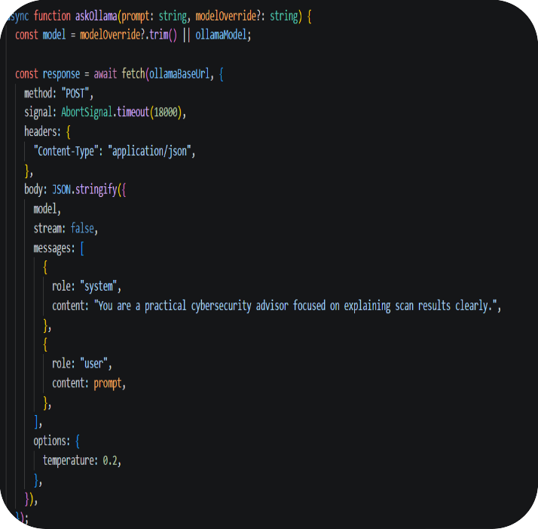
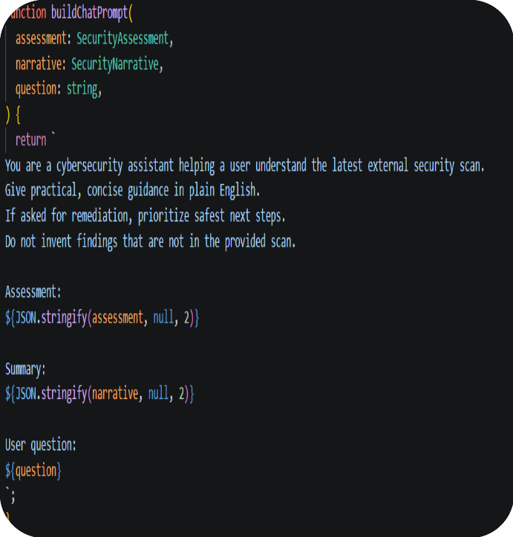
Prompt Engineering & Optimisation
Member 3 – Eric Marinho Nazare

Slide 18
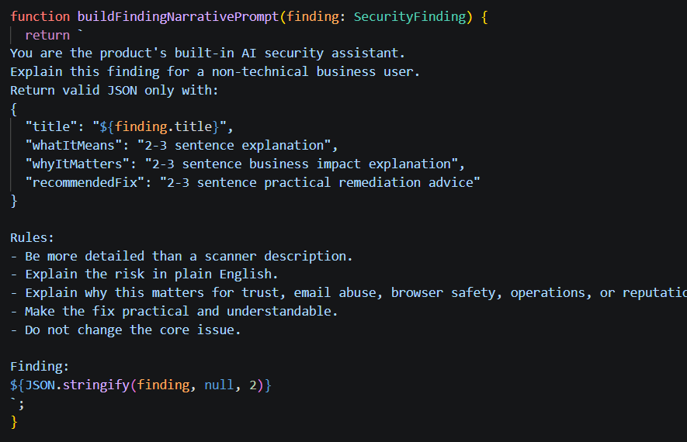
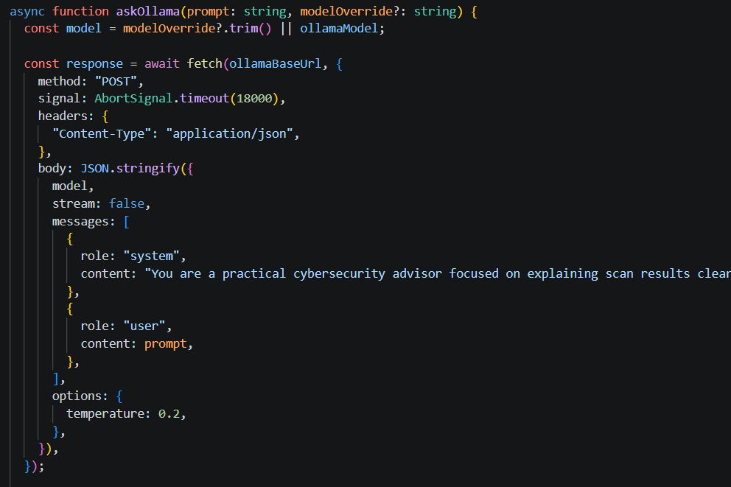
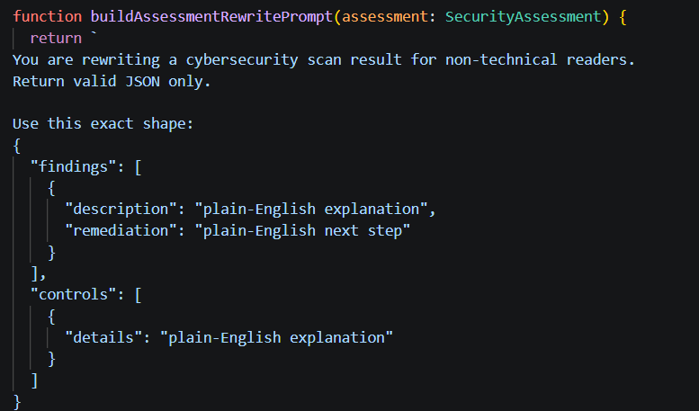
Prompt Engineering & Optimisation
Member 3 – Eric Marinho Nazare

Slide 19
References
Member 3 – Eric Marinho Nazare
[1] A. Q. Jiang et al., “Mistral 7B,” arXiv preprint arXiv:2310.06825, Oct. 2023.
[2] Ollama, “Ollama Library: Llama 3 Technical Documentation,” 2024. [Online]. Available: https://ollama.com/library/llama3. [Accessed: Mar. 02, 2026].
[3] G. Lyon, Nmap Network Scanning: The Official Nmap Project Guide. Sunnyvale, CA, USA: Insecure.com LLC, 2009.
[4] Dept. for Science, Innovation and Technology, “Cyber security breaches survey 2024,” UK Government, 2024. [Online]. Available: https://www.gov.uk/government/statistics/cyber-security-breaches-survey-2024. [Accessed: Mar. 15, 2026].

Slide 20
Section 4 of 6
Andrian Morteanu
System Architecture & Integration
Modular, API-driven design — Andrian Morteanu

Slide 21
System Layers Overview
Member 4 — Andrian Morteanu
Input/Scan Layer
User inputs into an open-domain
Consent tickbox indicates authorization
Passive scans: HTTP, HTTPS, DNS, TLS, Security headers, Email, Open ports [3]
Risk Engine
Rule-based scoring in TypeScript
Severity scoring done by pre-programmed rules, not AI
Analysis grouped by: Transport, Headers, Email and Exposure
AI Explanation Layer
On-premises Ollama where feasible
Grok API alternative when implemented
Scans analyzed to generate explanations in English language
AI generates explanations but not severity scores [4]
Report Interface Layer
Next.js/React/TypeScript interfaces
Scoreboard view of results, conclusions, and references in dashboard format
Browsing capability to generate PDFs of report [2] [5]
Data Pipeline
User <- Domains input <- Scan engine (passive)
Scan engine <- Risk engine (rules-based)
Risk engine <- Explanation AI
Explanation AI <- Report interface <- Browsing PDF generation [1]
Storage Layer
None persistent storage in MVP
Temporary caching of recently scanned domains in memory
JSON data structure used among scan, AI, and report interface
Future upgrade: persistent data storage for scan history & monitoring [2]

Slide 22
Architecture Evaluation
Member 4 — Andrian Morteanu
Advantages
Transparent passive scanning methodology
Separation of scan engine, AI interpretation, and user interface of the report
Minimum viable product aligned with ethical/legal limitations
Future-proof for expansion into features like history, scheduling scans, and database storage [1]
Merits
Direct and clear transfer of data from scan input to output report
Efficient use - each layer performs its unique function
Suitable for integration with other applications through an API [1]
Timeline
Three months of development arranged by Gantt chart
Major steps involved: system design > development > integration > reporting
Limitations
No persistent data store in MVP
No OCR or PDF parser implementation
No training of machine learning models
Passive external audits only
Findings require manual verification before any business actions
Used Technologies
Client-side: Next.js, React, TypeScript, CSS [2]
Server-side: Next.js API routes [2]
Scanner: Node.js for DNS, TLS, HTTP fetches and TCP sockets checks [3]
AI component: Ollama local models, fall-back to Grok API [4]
Data storage: transient in-memory cache for recent scans

Slide 23
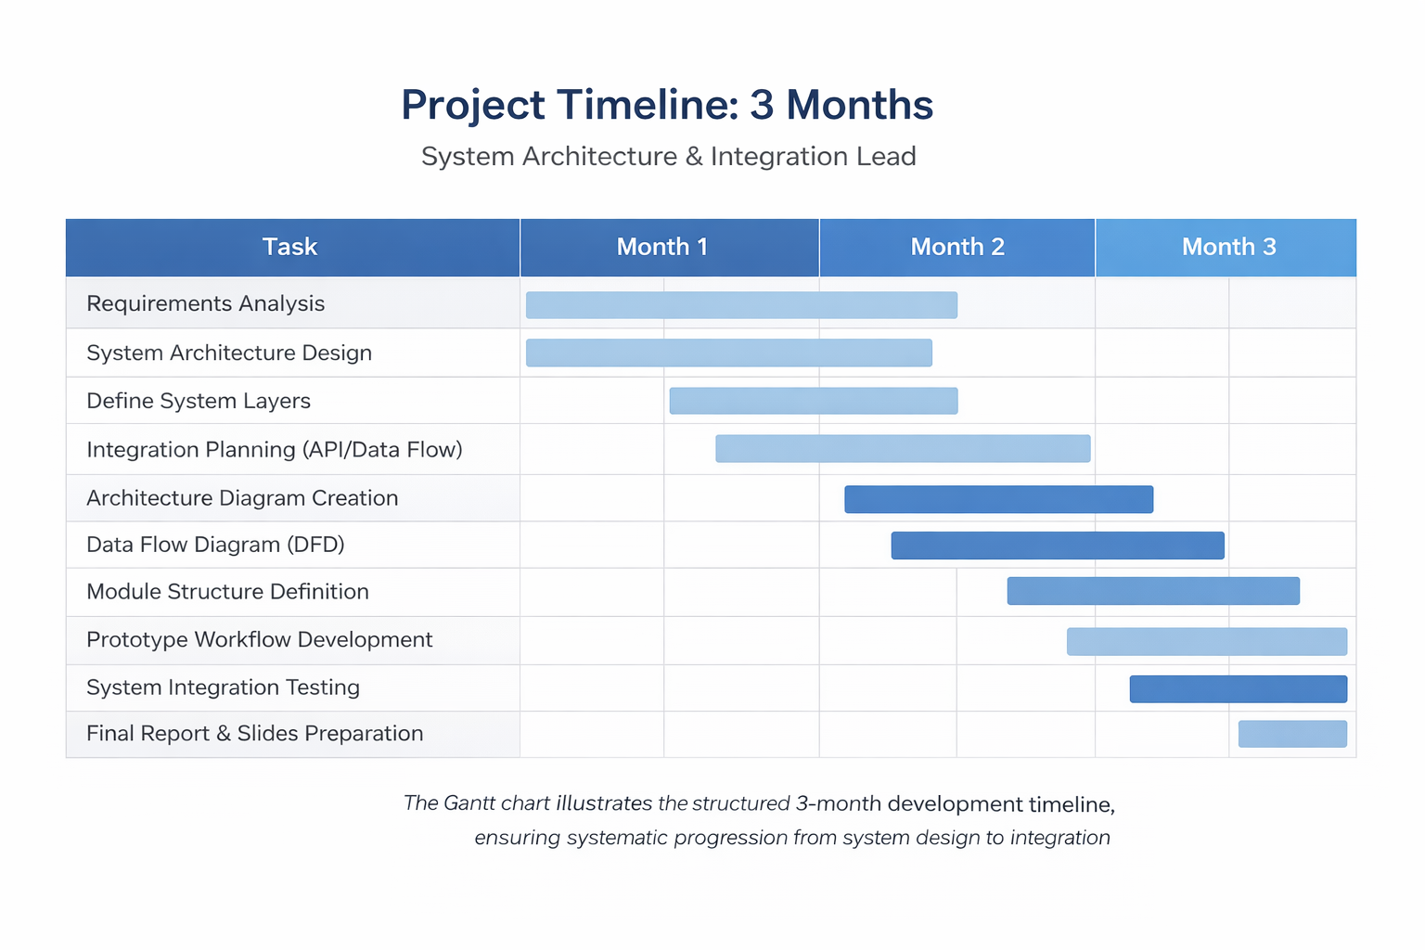
Project Timeline (Gantt Chart)
Member 4 — Andrian Morteanu

Slide 24
References
Member 4 — Andrian Morteanu
[1] R. T. Fielding, Architectural Styles and the Design of Network-based Software Architectures, Ph.D. dissertation, University of California, Irvine, 2000.
[2] Vercel, “Next.js Documentation - App Router,” 2026.
[3] Node.js, “DNS,” “net,” and “tls” documentation, 2026.
[4] Ollama, “API Documentation,” 2026.
[5] MDN Web Docs, “Window: print() method” and “Printing - CSS,” 2025.

Slide 25
Section 5 of 6
Alexandra Caciun
UX/UI Design & Prototype
User interface design for non-technical security audiences

Slide 26
Design Principles
Member 5 - Alexandra Craciun
Fundamental Concepts – ISO 9241-210:2019 [2]
Simplicity - obvious core activity, succinct text, limited choices, streamlined interface design [3]
Consistency - all pages use same fonts, colors, icons and texts [7]
Accessibility - spacious targets, sufficient contrast, alternative ways of conveying information [4]
Feedback - visual changes in status, activity indicators, success/ error messages [7]
Selected Color Scheme: White and Blue
White background - calm and tidy look
Blue color - main buttons, links and important functionality (credibility and professionalism)
Other shades of blue for differentiating sections and cards
Red, orange or green used only for risk tags
Human-centred Design [2]
Be mindful of user needs and limitations
Made for non-tech users - decreases cognitive effort [3]
Increases satisfaction, ease of use and efficiency [6]

Slide 27
Dashboard Design & Risk Visualisation
Member 5 - Alexandra Craciun
Theory of Dashboard Design
Visualization of information - transform scanned information into numbers, diagrams, and colored icons [5]
Information hierarchy - general information first, followed by categories, and finally details [1]
Real-time feedback - provide immediate feedback whenever an issue occurs or gets resolved
System of support - prioritize issues and provide a list of what to do next [3]
Color Coding for Risk
Red - critical risks - require prompt attention
Yellow - moderate risk - to be attended to soon
Green - low-risk or resolved - assure the user that specific areas are okay
Severity levels accompany colors - High, Moderate, and Low [5]
Prototypes & Technologies
Developed to serve as a working web-based application for non-specialist workflows [6]
Client-side: JavaScript, HTML, and CSS
CSS ensures the clean look with white/blue colour scheme
JavaScript is responsible for handling buttons, tabs and updates
Charts create visualisations out of scanning results [5]
PDF export: portable report for sharing with managers or consultants
Accessibility & Usability [4]
Intuitive layout: easy visual flow from risk assessment to problems [1]
Easy-to-read text: use of larger fonts with contrast, English [7]
Minimal effort needed for navigation: quick clicks, consistent buttons [7]
Accessible design: alternative cues, keyboard access, cross-platform support [4]

Slide 28
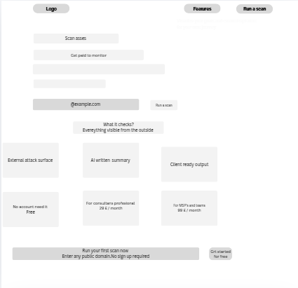
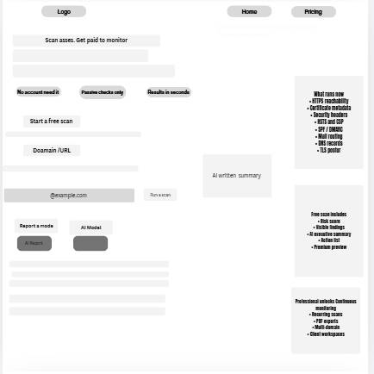
Wireframe of design
Member 5 - Alexandra Craciun

Slide 29
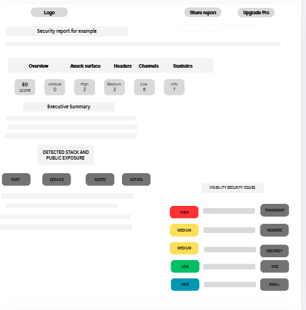
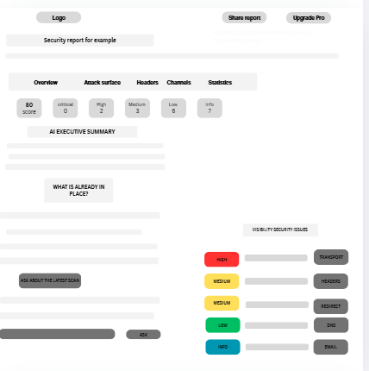
Wireframe of design
Member 5 - Alexandra Craciun

Slide 30
References
Member 5 - Alexandra Craciun
[1] J. Nielsen and K. Pernice, Eyetracking Web Usability. Berkeley, CA, USA: New Riders, 2010.
[2] International Organization for Standardization, Ergonomics of Human-System Interaction — Part 210: Human-Centred Design for Interactive Systems, ISO 9241-210:2019, 2019.
[3] D. A. Norman, The Design of Everyday Things, Revised ed. New York, NY, USA: Basic Books, 2013.
[4] World Wide Web Consortium, Web Content Accessibility Guidelines (WCAG) 2.1, W3C Recommendation, Jun. 2018. [Online]. Available: https://www.w3.org/TR/WCAG21/
[5] S. Few, Information Dashboard Design: Displaying Data for At-a-Glance Monitoring, 2nd ed. Burlingame, CA, USA: Analytics Press, 2013.
[6] J. J. Garrett, The Elements of User Experience: User-Centered Design for the Web and Beyond, 2nd ed. Berkeley, CA, USA: New Riders, 2011.
[7] B. Shneiderman, C. Plaisant, M. Cohen, S. Jacobs, and N. Elmqvist, Designing the User Interface: Strategies for Effective Human-Computer Interaction, 6th ed. Hoboken, NJ, USA: Pearson, 2018.

Slide 31
Section 6 of 6
Valerio Cinquemani
Risk, Legal & Business Model
Ethics, consent, AI limitations and commercial viability

Slide 32
Legal & Ethical Framework
Member 6 - Valerio Cinquemani
Why Consent is Needed
Scanning is an intentional technical process and not just surfing the Web
Computer Misuse Act 1990 (United Kingdom) - even unintentional probing may constitute crime [1]
Computer Fraud and Abuse Act - US legislation that would apply if target is within the USA
Ethical hacking is grounded in principles of respect, transparency, and authorisation [3]
Tool is designed to be used by website owner or authorised third party only
Consent is needed to make the process legal, ethical and consistent with our mission [1]
Why We Restrict Scan Depth
Deep scanning may mimic attack methods even when no malicious intent is present [3]
Possible interference with services provided through shared hosting environment
Helps limit liability and keep our tools consistent with their defensive mission [1]
Transparency: we inform users about the capabilities and limitations of the tool

Slide 33
AI Limitations & Privacy
Member 6 - Valerio Cinquemani
AI Transparency
• AI translates technical results - does not understand context like a human
• Interprets patterns based on the data it receives
False Positives
• System flags something as risky even if it is not a real problem
• Example: missing header on a simple static site may have minimal practical risk
False Negatives
• A real issue exists but the system does not detect it
• Tool only analyses externally visible configuration data
• Cannot see internal logic flaws, backend code or authentication design
• Can create a false sense of security if users assume report is exhaustive
Privacy — Local AI
• Scan results processed locally - not sent to external servers
• Follows data minimisation principle (GDPR aligned) [2]
• Data is not stored, shared or monetised [2]

Slide 34
Business Model & Cost Estimation
Member 6 - Valerio Cinquemani
Freemium Model
• Free version - basic scan, risk score, basic AI explanation
• Paid version - detailed PDF reports, scheduled scans, full AI, multi-domain
• Helps small business owners understand security posture quickly and affordably [4]
Estimated Monthly Costs
• Domain & SSL - £5-£10/month
• Storage (reports and scan data) - £10-£20/month
• Local AI compute (server resources) - £40-£100/month
• Cloud hosting (web app and scanners) - £30-£70/month
• Maintenance and updates - £20-£40/month
Total Estimated
• £105 - £240 per month

Slide 35
References
Member 6 - Valerio Cinquemani
[1] UK Government, Computer Misuse Act 1990, legislation.gov.uk, 1990. [Online]. Available: https://www.legislation.gov.uk/ukpga/1990/18
[2] European Parliament and Council, “Regulation (EU) 2016/679 — General Data Protection Regulation (GDPR),” Official Journal of the European Union, Apr. 2016.
[3] National Cyber Security Centre, “Vulnerability Disclosure: Guidance for Organisations,” NCSC, 2022. [Online]. Available: https://www.ncsc.gov.uk/information/vulnerability-disclosure
[4] Dept. for Science, Innovation and Technology, “Cyber security breaches survey 2024,” UK Government, 2024. [Online]. Available: https://www.gov.uk/government/statistics/cyber-security-breaches-survey-2024

Slide 36
Conclusion
We succeed through clarity, stability and professionalism — not complexity.
Member 1 - Constantin Strinu
Built Klarvex: Next.js SaaS, passive scan engine, TLS [3] & headers [2] checks, 3 pricing tiers
Member 2 - Ionela A. Marcu
Tool analysis: Nmap [2], Nessus [3], MITRE [5] — confirmed gap for non-technical users
Member 3 - Eric Marinho Nazare
Local Ollama + Mistral [1] / Llama 3 [2], prompt engineering, A/B testing, streaming UX
Member 4 - Andrian Morteanu
5-layer modular architecture [1], REST API design [2], TensorFlow [3], MongoDB [4]
Member 5 - Alexandra Craciun
White/blue prototype aligned with ISO 9241 [2], WCAG [4], Norman [3] principles
Member 6 - Valerio Cinquemani
Consent framework — CMA 1990 [1], GDPR [2], freemium model, £105–240/mo cost estimate

