Slide 1
MSc
Policing (Operational & Strategic Leadership)
Lesson: Vulnerability & its complexities
MSc Plismona (Arweinydd Weithredol a Strategol)
Gwers: Bregusrwydd a’i gymhlethdodau

Slide 2
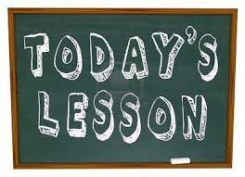
Lesson Outcomes
Define ‘Vulnerability' in the Context of Operational Policing
National Drivers for the Police to deliver a Professional Service to the Vulnerable, who have Suffered or are at Risk of Harm
Law around Vulnerability
Personal Aspect of Vulnerability
Extrinsic factors result in Harm, or Risk of Harm to the Vulnerable
Concepts and Theories of how a Person becomes a Victim
Explain the Influences of Risk Factors on Vulnerability
Notes:
Split the lesson into 2 parts
Part 1 – I will look at defining vulnerability and defining vulnerability in the context of policing
Touch upon the drivers for the police to deliver a service to the vulnerable
And also highlight key legislation around vulnerability for both children and adults
Then the second part will look at the persona aspects of vulnerability, the factors that influence the risk of harm and will introduce you to some of the theories of how a person becomes a victim
And if I have time at the end I have a short quiz to end us on a high.

Slide 3
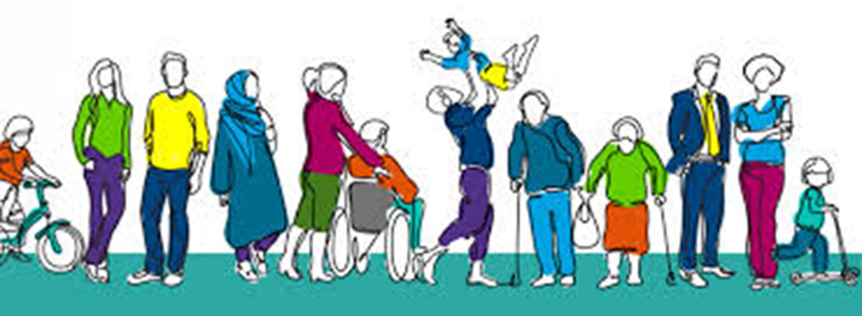
Questions
Why do you think police officers need to study ‘Vulnerability, Risk & Public Protection’?
When do police officers come into contact with Vulnerable individuals?
When do police leaders?
What are the challenges for leadership in respect of this area of policing?
Notes:
Vulnerability in its many forms and contexts has become a significant part of policing and appears in almost all areas.. All new police officers have to study ‘vulnerability and risk during their degrees. and Why do you think so much emphasis is placed on this particular subject area?
Integral to policing
Effective policing
HMIC inspections focusing on
Challenges for police leadership:
1. Demand on the police service has changed significantly and the police are expected to understand and deliver a range of different services for a complex society
2. Early identification of vulnerability and reducing harm has a significant impact
3. The way that the police deal with individuals will affect attitudes and cultures long into the future
4. Financial constraints and the demand on police services is a significant challenge for the service

Slide 4
What is vulnerability?
Vulnerability is NOT….
1. ….. new topic within policing
HOWEVER
What is new is how the concept of vulnerability has slowly begun to seep into policing policies and become part of operational policing
2. …… a criminological concept
It is simply based around a universally accepted acknowledgement that humans are fragile
3…..clearly defined
‘at risk’, ‘complex needs’, vulnerable adult etc.
Notes:
When we look at defining ‘vulnerability’ in its every day context its easier to start by explaining what it is NOT
1. Its not a new topic within policing HOWEVER What is new is how the concept of vulnerability has slowly seeped into policing policies and become part of operational policing over the last few years to now being an integral part of policing
2. Its NOT a criminological concept – It is simply based around an universally accepted acknowledgement that humans are fragile. Every single one of us will have seen family or friends showing fragility at some stage whether through family conflict , experiences of illness, personal circumstance etc.
3. And finally it is NOT clearly defined. This aspect in particular is highlighted so often within academia and is visible . Research undertaken by two academics called Asquith and Bartowiak showed that over a 10 year period a host of terminology was used to describe vulnerability such as - . at risk, disadvantaged, risky, problem people, vulnerable populations, vulnerable adults, adults at risk, has complex needs, to name but a few,

Slide 5
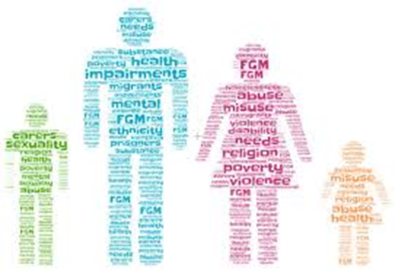
Task
How do you define ‘vulnerability’ in an everyday context?
Notes:
Task – How do you define ‘vulnerability’?
( answers in chat)
How easy is it to define?
What about the terminology – what words would you use?
Adult/child/person/individual/community/group
Lets look at how you would define it within a policing context?
Would you add/alter/change anything?
Would it be specific to adult/child/group or Can/should it be ?

Slide 6
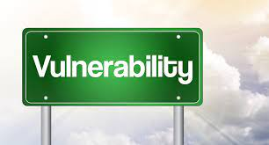
Defining vulnerability
Oxford Dictionary
‘susceptible to physical or emotional attack or harm’.
Cambridge Dictionary
‘able to be easily physically, emotionally or mentally hurt, influenced or attacked.’
Notes:
A starting point when looking at defining ‘vulnerability’ is to see how the dictionary defines it.
Vulnerable comes from the Latin meaning ‘to wound’.
Oxford dictionary defines it as - ‘being susceptible to physical or emotional attack or harm’
Whereas
The Cambridge dictionary defines it as - ‘able to be easily physically, emotionally or mentally hurt, influences or attacked’
Do you think that these are fair definitions and are they current within the context of today’s complex society.

Slide 7
Academic Definitions
A Universal concept, inherent in all people, and core to the very nature of what it means to be human’ (Luna,2009; Cunha & Garrafa,2016)
‘definition is not appropriate’ (Wrigley & Dawson, 2016)
‘Variations amongst humans means we have particular experiences of vulnerability’ (Fineman,2010,p.269)- a simple definition would therefore deny its complexity
Harmon (2015,p.1) ‘Involves those individuals….. Easily harmed physically, mentally or emotionally.’
Green (2007,p.92) vulnerability ‘is often used to express the level of risk posed to certain groups or individuals’.
Notes:
Academia has its own definitions of the term ‘vulnerability’
Such as
On one level ( according to Luna, Cunha and Garrafa) there is a suggestion that vulnerability is A Universal concept, inherent in all people, and core to the very nature of what it means to be human’ (Luna,2009; Cunha & Garrafa,2016)
However, the subject eludes a precise or agreed definition, which means there is no consistency in its meaning or use
Harmon’s definition of it ‘Involving those individuals …that are easily harmed physically, mentally or emotionally’
Some like ,Wrigley and Dawson are controversial where they assert that a ‘definition is not even appropriate’ and Wrigley adding that defining vulnerability offers little to academics as it does not explain the world.
and finally Fineman’s suggests that variations amongst humans means that each have particular experiences of vulnerability and that due to its complexities a simple definition would not suffice or be true to its meaning.

Slide 8
Vulnerability
‘The most prominent problem that arises in the analysis of the emergence of vulnerable people as a key focus of policy and operational procedure is a lack of definition and a subsequent lack of uniform terminology across policies and jurisdictions’ (Bartkowiak & Asquith,2012).
Notes:
Bartkowiak & Askwith in their article ‘Extraordinary Intrecacies of policing vulnerability ‘ in 2012 highlighted that
The most prominent problem that arises in the analysis of the emergence of vulnerable people as a key focus of policy and operational procedure is a lack of definition and a subsequent lack of uniform terminology across policies and jurisdictions
A could summing up of the key issue around policing vulnerability
How can you adequately address the needs of a vulnaerable group/individual if you haven’t got a solid definition to work from?
Within the UK the definition of vulnerability Is not legislated for – we have vulnerable adult procedures which provide a working definition – but when you start to look and compare different agencies definitions ( e.g. within local authority SSD, Government agencies , NGO’s etc) there are variations upon which each agency will categorise a vulnerable person.
Interestingly in New South Wales , there is a legislated definition within section 24 of the Law Enforcement (Powers and responsibilities) Regualtions 2005.
…a person who falls within one or more of the following categories: (a) children, (b) persons who have impaired intellectual functioning, (c persons who have impaired physical functioning, (d) persons who are Aboriginal persons or Torres Strait Islanders, (e) persons who are of non-English speaking background,
Importantly when we move to discuss the definition in a policing context , the New South Wales definition adds to the above by saying that the s24 definition does not include a person whom the custody manager reasonably believes is not a person falling within any of those categories.

Slide 9
Vulnerability in a Policing context
Vulnerability should be
  Understood
  Identified and
  Responded to effectively
In order to protect vulnerable individuals from harm.
(Wiltshire Police, 2018)
Notes:
Let’s move on to look at vulnerability within the context of policing
Wiltshire Police make a strong statement regarding their policing of vulnerability…
‘Vulnerability should be UNDERSTOOD, IDENTIFIED and RESPONDED TO EFFECTIVELY in order to protect vulnerable individuals from harm’ (2018).
Let me post some questions:
Do you think that officers understand the term vulnerability sufficiently? Does their knowledge and experience allow them to identify it correctly and sufficiently to respond to it effectively?
ANSWERS in chat box
Do you feel confident that you as leaders understand ‘Vulnerability’ and its many facets to respond effectively?
Where and when would you come into contact with ‘vulnerability’?
Answers in chat
If officers don’t understand the term ‘vulnerability’ how can we identify it correctly within a policing role?
Does being able to identify ‘vulnerability’ correctly allow the police to tailor their services effectively and efficiently?
IMPORTANT for leaders/managers to be aware o the vulnerabilities of their staff

Slide 10

Vulnerability and Policing
Research shows that 75% of police work concerns vulnerability (Bartkowiak-Theron & Askwith, 2019)
Significant increases in demand associated with protecting vulnerable persons in homes and on-line
Dominates discussions around policing business and quality assurance
Notes:
Research shows that 75% of police work concerns vulnerability (Bartkowiak-Theron & Askwith, 2019)
Significant increases in demand associated with protecting vulnerable persons in homes and now more than ever on-line
Dominates discussions around policing business and quality assurance

Slide 11
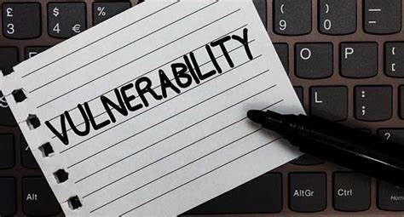
Defining ‘vulnerability’ in a policing context
How would you define ‘vulnerability’ in the context of policing
Notes:
Question: How do you define ‘vulnerability’ in the context of policing
Answers in chat box

Slide 12
Vulnerability
  ‘Vulnerability is a difficult term to define and operationalise. It is a label that can be applied to diverse and large populations including people who are physically ill, young, old, homeless, disabled or have a mental illness. Vulnerability can be a descriptor of a substantial portion of the population with a host of attributes that can be permanent or temporary’.
(Policing vulnerable people – a framework for analysis, Bangor University.).
Notes:
This is taken from a research paper produced by Bangor University

Slide 13
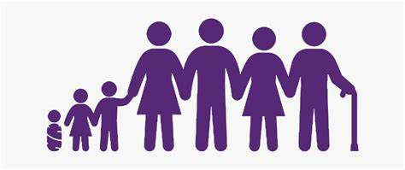
College of Policing - Definition
'A person is vulnerable if, as a result of their situation or circumstances, they are unable to take care or protect themselves, or others, from harm or exploitation.’
  They are vulnerable individuals who have or are at-risk of becoming victims of crime.
  It includes the care and welfare of those detained in police custody, dealing with individuals who suffer from mental ill-health and the management of sexual and violent offenders.
Notes:
It is important the police work to one specific definition of vulnerability but the complex nature of vulnerability (e.g. presence of some situational/environmental factors) can combine with personal vulnerability, resulting in a person possibly being both a victim and/or perpetrator and susceptible to a range of harms which therefore makes defining vulnerability difficult in all circumstances.
Definitions can vary across for different organisations for many reasons including their role. For example the police include perpetrators who are in custody.
It is also important to note that there are different thresholds that exist for assessing vulnerability within different organisations/agencies
For police purposes, it does not matter how they come across the vulnerable, their core role since the initial days of Sir Robert Peel is to protect the vulnerable.

Slide 14
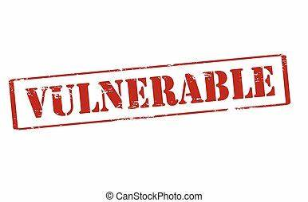
Defining vulnerability
Why is it important to have one definition of ‘vulnerability’ within policing?
Performance measurement (PEEL Inspections)
Consistency of approach
Overlapping into other services appropriately delivered by others (e.g. NHS, probation etc.)
Problems for police practioners (Keay & Scott, 2018)
Notes:
Question:
Why is it important to have one definition of vulnerability within policing?
Answers in chat box
Consistency of approach – service delivery standards maintained
Lack of ambiguity
PEEL Inspections ( HMICFRS)
Possibility of overlapping into other services delivered by other agencies e.g. Social services, health, probation etc.
As ‘vulnerability’ is such a strong emerging theme, although inherent difficulties exist in composing a definition for it, the absence of a definition generates three specific problems for police practitioners.
Firstly, UK police forces are now measured on their approach to tackle vulnerability. As such, there should be common agreement on what an appropriate standard should be.
Secondly, police forces require some consistency of approach if they are to establish expertise and good practice.
Finally, if the concept remains fluid there is a danger that the police will suffer mission creep, overlapping into services that may be more appropriately delivered by another institution. These issues demand the need for further definitional and operational clarity. (Keay & Scott, 2018)

Slide 15
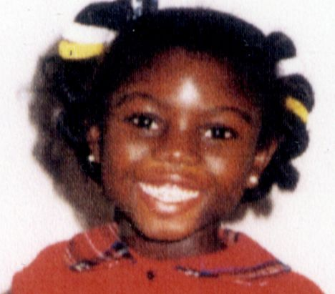
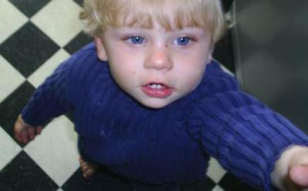


Infamous cases of vulnerability
Many Cases of Vulnerable Victims
Focussed National Attention
Individual Clues on Abuse were Present
Need Multi Agency Information Sharing
Positive Action and Interventions
Investigative Mindset from all Agencies
Notes:
Can you name any of these infamous cases?
8 years old, Victoria Climbié, died in 2000. There were many signs both physical with 128 injuries and scars, and with multi agency opportunities that were missed during which Victoria was not spoken to alone. Her death resulted in the LAMING ENQUIRY and Children Act 2004
Baby P, Peter Connelly a 17-month old boy who died on 3rd August 2007 after suffering more than 50 injuries, over an eight-month period, during which he was repeatedly seen by Local Authority Children’s Services and NHS health professionals.
Dr Harold Shipman, in 2000 was found guilty of murdering 15 patients mostly elderly and female and suspected murdering over 200 similarly vulnerable people in the Manchester area. There were multi agency clues.
Sir James Wilson Vincent Savile OBE KCSG After his death, hundreds of allegations of sexual abuse were made against him, leading the police to conclude that Savile had been a predatory sex offender - possibly one of Britain's most prolific. There had been allegations during his lifetime, but they were dismissed and accusers ignored or disbelieved; Savile took legal action against some accusers.
More recently we have had similar cases such as the little boy in Bridgend

Slide 16

National Drivers
The public expects their local police force to support Vulnerable people, whether or not they have been a victim of crime.
Annual Police Effectiveness, Efficiency and Legitimacy (PEEL) Inspections look at the Vulnerable and ask the question;-
‘How effective are forces at protecting from harm those who are vulnerable, and supporting victims?’
It looks at how well does the force:
  Identify the vulnerable and assess their level of risk and need?
  Respond to vulnerable victims?
  How Police work with partners to keep victims safe?
  How police respond to and safeguard specific vulnerable groups e.g. missing and absent children & victims of domestic abuse and child sexual exploitation?
‘The extent to which a police force is successful at identifying, protecting and supporting those who are vulnerable is a core indicator of its overall effectiveness’ (HMIC, 2015)
Notes:
What get Measured Gets Done !!
National Drivers for the Police in Providing a Professional Service to Individuals who are, or may be, Vulnerable, have Suffered Harm or be at Risk of Harm
The public expects their local police force to support victims of crime by responding to calls for help, putting in place the right support and keeping them informed. It is particularly important that vulnerable people, whether or not they have been a victim of crime, are identified early and receive the support they need. As part of its annual inspections into police effectiveness, efficiency and legitimacy (PEEL), HMIC’s effectiveness programme assessed how well forces keep people safe and reduce crime.
Within this programme, HMIC’s vulnerability inspection examined the overall question, ‘How effective are forces at protecting from harm those who are vulnerable, and supporting victims?’ We have considered in depth how forces respond to and support missing and absent children and victims of domestic abuse, and assessed how well prepared forces are to respond to and safeguard children at risk of sexual exploitation.
HMIC look at four areas:
How well does the force identify those who are vulnerable and assess their level of risk and need?
How well does the force respond to vulnerable victims?
How well does the subsequent police action and work with partners keep victims safe?
How well does the force respond to and safeguard specific vulnerable groups (missing and absent children & victims of domestic abuse); and how well prepared is it to tackle child sexual exploitation?
At the heart of this inspection is the protection of people who are vulnerable. A force may therefore be judged as requiring improvement by HMIC where it exhibits shortcomings in one of these areas, even if its performance in other areas is strong, and even if there are many elements of its service that HMIC considers to be good. This inspection follows up our 2014 domestic abuse inspection and reviews forces’ progress on implementation of their action plans following that inspection.
HMIC inspections collect data and plans from forces, conduct a review of case files and observe multi-agency meetings, speak to victims of domestic abuse through a number of focus groups across England and Wales and conduct an online survey with practitioners, including Independent Domestic Violence Advocates, outreach and refuge workers, to gauge views on what has changed since the previous inspection and inform local practitioner focus groups. Chief officers in each force are interviewed they and hold focus groups with officers, staff and partners, and made unannounced visits to police stations, force control rooms and specialist teams. HMIC worked with the force missing person coordinator (or equivalent) to review cases of missing and absent children, including children considered to be ‘repeat absent’ and ‘repeat missing’ and children shown to be at risk of child sexual exploitation.

Slide 17
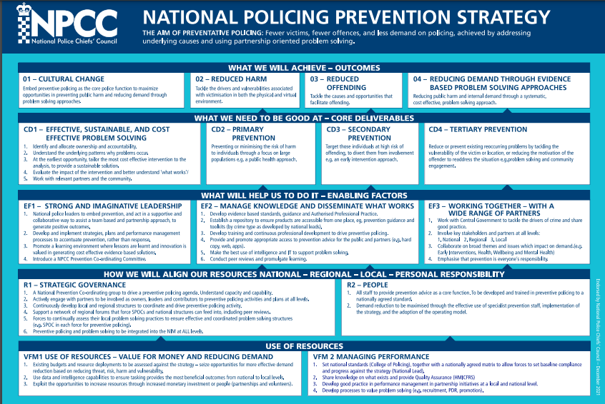
Notes:
National Police Crime Prevention Strategy 2021 is primarily a long-term programme aimed at creating conditions in which opportunities and motivation for crime will be reduced BUT includes a cross-governmental approach for managing vulnerability and recognising the changing demand arising from complexity of some vulnerability cases.
Do you have your own in Force?
The majority of police forces compile their own Force Crime Prevention Strategies using this national one as the basis of their own.
All forces are subject to significant cost reductions and these issues have been reflected in HMICFRS efficiency reports
The police are under significant financial challenges but safeguarding the vulnerable must be a forces priority.

Slide 18

Key Legislation - Vulnerability
Children & Young Persons Act 1933
Children’s Act 1989
Children’s Act 2004
Serious Crime Act 2015
National Assistance Act 1948 /1951
Mental Health Act 1983 / 2007
Police & Criminal Evidence Act 1984
National Health Service & Community Care Act 1990
Family Law Act 1996 & Human Rights Act 1998
Care Standards Act and No Secrets 2000
Sexual Offences Act 2003
Domestic Violence Crime & Victims Act 2004
Safeguarding Adults and Mental Capacity Act 2005
Safeguarding Vulnerable Groups Act 2006
Deprivation of Liberty 2009
Notes:
Let’s look at Legislation that is available in this arena
Firstly for children – those under 18years
Legislation was introduce to criminalise offending against children such as:
Children & Young Persons Act 1933
Children’s Act 1989
Children’s Act 2004
Serious Crime Act 2015
Alongside specific processed and procedures such as Safeguarding was also introduced
For Adults however there is not a single offence of abusing a vulnerable adult , although there are procedures to be followed. SO in these circumstances to prosecute any offences relies heavily on offences under other legislation.

Slide 19
Vulnerability & its concepts
List the Personal Aspect of Vulnerability
Extrinsic factors result in Harm, or Risk of Harm to the Vulnerable
Concepts and Theories of how a Person becomes a Victim
Explain the Influences of Risk Factors on Vulnerability
Notes:
So I’m now going to move on to part two where we will look at the personal aspects of vulnerability, factors that result in harm or the risk of harm to vulnerable persons and explore the concepts and theories around how a person becomes a victim

Slide 20

Personal aspect of vulnerability
All victims especially vulnerable ones have individual needs depending on the circumstances of the individual victim, abuser and wider circumstances.
list individuals/groups in the community that may have specific needs due to vulnerability
Notes:
Victims from different cultural backgrounds
A person’s cultural background or immigration status may make them more vulnerable to abuse.
Not speak much English or know where to turn to for help
they may be reliant on their partner or partner’s family for financial support and be isolated from people outside their immediate family or community
they may have an insecure immigration status and fear contact with the authorities
their right to remain may depend on their relationship with the abuser continuing
they may have been forced into marriage or be subjected to honour-based violence (HBV)
certain forms of domestic abuse, e.g., between husband and wife or father/uncle and daughter/niece, may be accepted in some families or households and cultural background may be a factor – if it is considered normal by the victim, perpetrator and their community, the victim may not seek help or be aware of what help is available
the police in the victim’s country of origin may not enforce laws against domestic abuse effectively or at all, resulting in a lack of trust by victims
the police may be mistrusted by the community as a whole due to involvement in persecution in the country of origin
police attendance may be viewed as shameful, discouraging those involved as well as neighbours from calling the police.
Some distinct cultural groups originating wholly or partly in the UK can also adopt a particular way of life which may create additional barriers for victims of domestic abuse. For example, women living in the Gypsy and Traveller community can face similar cultural issues to those listed above but may also face additional barriers to escaping an abusive partner due to the wider community’s nomadic way of life. Some of the reasons for this may be that:
those who choose to live nomadically may find it difficult to access mainstream services
inter-family feuds can mean that members of one family should not be housed where members of a feuding family are already living
as the community is scattered, it may be difficult for victims who are rehoused to keep their emergency location secret from the rest of their family.
Male victims A man who is a victim of domestic abuse may be reluctant to approach the police for many reasons, some of which are the same as for women victims, e.g., fear of not being believed, belief the police will assume he has done something to provoke the situation, fear of losing access to children. Some of these fears may be intensified because of gender stereotypes and societal assumptions, e.g., shame at not being perceived as a ‘real man’, belief the police will automatically assume the woman is the victim.
Victims from lesbian, gay, bisexual and transgender (LGBT) communities LGBT people may be abused by their partners in specific ways that are connected to their sexual orientation or gender identity. Examples include:
threatening to ‘out’ a victim, ie, telling family or work colleagues about their sexual orientation or gender identity
threatening to ‘out’ a lesbian or gay parent/couple to social services, claiming that their children will then be taken away from them
threatening to disclose or make allegations about the victim’s HIV status or other sexually transmitted infection – while also possible in the heterosexual community, this is potentially more damaging to a person in the LGBT community
telling a victim that abuse is part of a ‘normal’ LGBT relationship
claiming that no one will help the victim because they are lesbian, gay, bisexual or transgender
criticising someone for not being, eg, a ‘real lesbian’ if they are currently in their first lesbian relationship after a series of heterosexual ones
forced marriage/HBV.
Victims with a disability
Victims with a long-term illness or disability, which includes physical, mental or learning disability, are particularly vulnerable to abuse from carers partners, ex-partners and family members. Office of National Statistics analyses consistently show that both men and women with a long-term illness or disability are more likely to experience domestic abuse than those without. Victims with a disability may face particular difficulties in reporting abuse and accessing support services. These could include:
communication difficulties
concern that they will not be believed, particularly if they have known mental health issues
not recognising the behaviour as abusive
reluctance to report their abuser if that person is also their carer.
Safety planning must address their specific needs, eg, supplying appropriate equipment to alert the police of an incident if the person is hearing and speech-impaired.
Victims from armed services families and emergency service/public service personnel
While there is no evidence that domestic abuse is more prevalent in military families than general society, such families do face unique factors in terms of impact on career, implications of loss of family accommodation, particular psychological stressors, and long periods of not being together as a family. Victims can find it difficult to confide in anyone because frequent relocation can prevent them from establishing relationships of trust. Consequently, families can feel that they face additional barriers to reporting domestic abuse and accessing support.
Emergency service personnel, ie, police, fire and ambulance staff, may be exposed to trauma that has an impact on their personal relationships in a similar way to military staff. Victims in a relationship with someone in these services may be concerned that they will not be believed, as may those whose partner is in a public service such as probation, UKBA, social services or the prison service. Victims who are themselves employed in an emergency or public service may find it equally difficult to report abuse. They may have a sense that their role, training and increased awareness of domestic abuse means that it should not happen to them. They may be worried about their partner being able to access personal information if they are both in the police service.
Teenagers and young persons Teenagers and young persons may be vulnerable to abuse from their peers but also from older or significantly older partners who may have groomed or conditioned them. They may have little experience of positive relationships, making it more difficult for them to identify abusive behaviour. Teenagers and young persons may be vulnerable to peer pressure and gang associations. This may result in pressure to engage in sexual activity and sometimes sharing of partners between gang members.
Some of those teenagers and young persons who identify as lesbian, gay, bisexual or transgender may also be susceptible to domestic abuse, not only in intimate partner relationships, but also from parents and other family members who may not accept their emerging sexual identity or choice of dress or appearance. Victims of domestic abuse who are 16 or 17 years old are still children and therefore victims of child abuse as well as domestic abuse. Witnessing domestic abuse in the home may also amount to child neglect.
Abuse of older people, older victims are often dependent on their abuser, whether this be an intimate partner or a family member. Unlike other such relationships, dependence generally increases with age for health reasons. This makes the prospect of the victim gaining independence from their abuser less likely than for other domestic abuse victims.
Abuse can occur where the abuser has taken on a carer role towards the older person. If the adult child or grandchild has formally taken on the role, abuse may result from tensions caused by the carer relationship or as a means of maintaining control. In some cases, a person with a certain illness or condition, eg, dementia, may also become uncharacteristically abusive to their familial carer. The carer may not recognise this as domestic abuse or may not report it because they feel it is not the person’s fault, but the difficult nature of the situation can sometimes result in mutual abuse.

Slide 21
Personal aspects of vulnerability…
Different Cultural Background
Vulnerable Immigration Status Possibly Linked to Abuser
Reliant on Partner/Parent/Carer - isolation
Forced into marriage or be subjected to honour-based violence
Community / Family Pressure
Male Victims
Lesbian, gay, bisexual and transgender (LGBT) communities
Illness or physical, mental or learning disability
Armed and emergency service personnel
Teenagers and Young Persons
Elderly including those linked to illness (Victim often dependent on their abuser)
Notes:
Can include many as can be seen from this list which is not exhaustive
Victims from different cultural backgrounds
A person’s cultural background or immigration status may make them more vulnerable to abuse.
Not speak much English or know where to turn to for help
they may be reliant on their partner or partner’s family for financial support and be isolated from people outside their immediate family or community
they may have an insecure immigration status and fear contact with the authorities
their right to remain may depend on their relationship with the abuser continuing
they may have been forced into marriage or be subjected to honour-based violence (HBV)
certain forms of domestic abuse, e.g., between husband and wife or father/uncle and daughter/niece, may be accepted in some families or households and cultural background may be a factor – if it is considered normal by the victim, perpetrator and their community, the victim may not seek help or be aware of what help is available
the police in the victim’s country of origin may not enforce laws against domestic abuse effectively or at all, resulting in a lack of trust by victims
the police may be mistrusted by the community as a whole due to involvement in persecution in the country of origin
police attendance may be viewed as shameful, discouraging those involved as well as neighbours from calling the police.
Some distinct cultural groups originating wholly or partly in the UK can also adopt a particular way of life which may create additional barriers for victims of domestic abuse. For example, women living in the Gypsy and Traveller community can face similar cultural issues to those listed above but may also face additional barriers to escaping an abusive partner due to the wider community’s nomadic way of life. Some of the reasons for this may be that:
those who choose to live nomadically may find it difficult to access mainstream services
inter-family feuds can mean that members of one family should not be housed where members of a feuding family are already living
as the community is scattered, it may be difficult for victims who are rehoused to keep their emergency location secret from the rest of their family.
Victims from armed services families and emergency service/public service personnel
While there is no evidence that domestic abuse is more prevalent in military families than general society, such families do face unique factors in terms of impact on career, implications of loss of family accommodation, particular psychological stressors, and long periods of not being together as a family. Victims can find it difficult to confide in anyone because frequent relocation can prevent them from establishing relationships of trust. Consequently, families can feel that they face additional barriers to reporting domestic abuse and accessing support.
Emergency service personnel, ie, police, fire and ambulance staff, may be exposed to trauma that has an impact on their personal relationships in a similar way to military staff. Victims in a relationship with someone in these services may be concerned that they will not be believed, as may those whose partner is in a public service such as probation, UKBA, social services or the prison service. Victims who are themselves employed in an emergency or public service may find it equally difficult to report abuse. They may have a sense that their role, training and increased awareness of domestic abuse means that it should not happen to them. They may be worried about their partner being able to access personal information if they are both in the police service.
Teenagers and young persons Teenagers and young persons may be vulnerable to abuse from their peers but also from older or significantly older partners who may have groomed or conditioned them. They may have little experience of positive relationships, making it more difficult for them to identify abusive behaviour. Teenagers and young persons may be vulnerable to peer pressure and gang associations. This may result in pressure to engage in sexual activity and sometimes sharing of partners between gang members.
Some of those teenagers and young persons who identify as lesbian, gay, bisexual or transgender may also be susceptible to domestic abuse, not only in intimate partner relationships, but also from parents and other family members who may not accept their emerging sexual identity or choice of dress or appearance. Victims of domestic abuse who are 16 or 17 years old are still children and therefore victims of child abuse as well as domestic abuse. Witnessing domestic abuse in the home may also amount to child neglect.
Abuse of older people, older victims are often dependent on their abuser, whether this be an intimate partner or a family member. Unlike other such relationships, dependence generally increases with age for health reasons. This makes the prospect of the victim gaining independence from their abuser less likely than for other domestic abuse victims.
Abuse can occur where the abuser has taken on a carer role towards the older person. If the adult child or grandchild has formally taken on the role, abuse may result from tensions caused by the carer relationship or as a means of maintaining control. In some cases, a person with a certain illness or condition, eg, dementia, may also become uncharacteristically abusive to their familial carer. The carer may not recognise this as domestic abuse or may not report it because they feel it is not the person’s fault, but the difficult nature of the situation can sometimes result in mutual abuse.

Slide 22

Concepts & Theories of how a person becomes a victim
Four Theories of Victimisation
Victim Precipitation Theory (Either Active or Passive)
Lifestyle Theory
Deviant Place Theory
Routine Activity Theory
(Seigel, L., J. (2006). Criminology, 10th Edition. University of Massachusetts, Lowell. Thomson Wadsworth.)
Notes:
Four Theories of Victimisation
The noun "victimisation" in this report has two meanings, "an act that exploits or victimises someone" and "adversity resulting from being made a victim" (Victimisation, N.d).
For the purpose of understanding and researching victimology, four theories have been developed: victim precipitation theory, the lifestyle theory, deviant place theory, and the routine activity theory.
Question: Have you heard of any of them?
The Victim Precipitation Theory
The first of these, the victim precipitation theory, views victimology from the standpoint that the victims themselves may actually initiate, either passively or actively, the criminal act that ultimately leads to injury or death. During passive precipitation, the victim unconsciously exhibits behaviours or characteristics that instigate or encourage the attack. Siegel (2006) lists job promotions, job status, successes, love interests, and the like as examples of these unconscious behaviours and characteristics. Essentially, the victim precipitation theory focuses on the idea that passive precipitation of violence is a result of a power struggle. In this instance a new employee may push up the corporate ranks quickly, threatening long-time employees; or a transsexual may be the victim of crime due to their existence "threatening" the beliefs and/or ideas of another individual or group of individuals. The latter is a good example of a hate crime, in which victims are often unaware of the individuals that perpetrate the crime, yet their actions and/or characteristics trigger the crime.
Active precipitation, on the other hand, is the opposite of the afore-described. Victimisation under this theory occurs through the threatening or provocative actions of the victim. One of the most controversial points of this theory is the idea that women who are raped actively contributed in some way, either through provocative dress, a relationship, or suggested consent of intimacy (Siegel, 2006). Because of this viewpoint, it is hard to convict an accused rapist who has had some form of relationship with the accused, or one that was behaving provocatively or suggestively. When dealing with this theory we must ask ourselves whether or not it is really okay to blame the occurrence of a crime on the victim. This is especially true in cases of rape when flirtation may be present, yet there is no consent to sexual intercourse.
The Lifestyle Theory
This theory purports that individuals are targeted based on their lifestyle choices, and that these lifestyle choices expose them to criminal offenders, and situations in which crimes may be committed. Examples of some lifestyle choices indicated by this theory include going out at night alone, living in "bad" parts of town, associating with known felons, being promiscuous, excessive alcohol use, and doing drugs. In addition to theorizing that victimisation is not random, but rather a part of the lifestyle the victims pursues, the lifestyle theory cites research that victims "share personality traits also commonly found in law violators, namely impulsivity and low self control" (Siegel, 2006). This previous statement was discussed in a psychology journal by Jared Dempsey, Gary Fireman, and Eugene Wang, in which they note the correlation between victims and the perpetrators of crimes, both exhibiting impulsive and antisocial-like behaviours (2006). These behaviours may contribute to their victimisation since they cause the individual to put themselves at higher risk for victimization than their more conservative lifestyle counterparts.
Deviant Place Theory
The deviant place theory states that greater exposure to dangerous places makes an individual more likely to become the victim of a crime (Seigel, 2006). Unlike the victim precipitation theory, the victims do not influence the crime by actively or passively encouraging it, but rather are victimized as a result of being in "bad" areas. In order to lower the chance that one will become the victim of a crime, the individual should avoid the "bad" areas of town where crime rates are high. The deviant place theory suggests that taking safety precautions in these areas may be of little use since it is the neighbourhood, and not the lifestyle choices, that affect victimization (Seigel, 2006). In a nutshell, if a neighborhood is "deviant," the only way to lower your risk of victimisation is to leave the neighbourhood for a less deviant, low crime rate area.
Routine Activity Theory
Lastly, the routine activity theory explains the rate of victimisation through a set of situations that reflect the routines of typical individuals.
The availability of suitable targets,
The absence of capable guardians and
The presence of motivated offenders.
According to this theory, the presence of one or more of these factors creates a higher risk of victimisation.
Empirical evidence for this theory is seen in the work of Cohen and Felson, who noted that the crimes rates from 1960 to 1980 increased due to a decreased presence in the home (i.e. less guardianship) (Seigel, 2006).
While each of these theories has different positives and negatives, controversies and points of contention, as well as points of accord, each also explains in various situations why a certain individual may be the victim of theft, violence, or abuse. Furthermore, with an understanding of the patterns of victimization through the lens of one or more of these theories, the criminal justice system, as well as the general public, may better be equipped to prevent crime and treat the many victims.
References
Dempsey, J., Fireman, G., Wang, E. (2006). "Transitioning Out of Peer Victimization in School Children: Gender and Behavioural Characteristics." Journal of Psychopathology and Behavioural Assessment 28: 271 - 280.
Seigel, L., J. (2006). Criminology, 10th Edition. University of Massachusetts, Lowell. Thomson Wadsworth.

Slide 23
Extrinsic Facts of Harm and Risk
A person is vulnerable if, as a result of their situation or circumstances, they are unable to take care of or protect themselves or others from harm or exploitation
Notes:
A person can become vulnerable as a result of two intrinsic or key factors being presesnt
Personal factors
And
2. Situational factors
Let’s take a look at what these may mean in practice

Slide 24
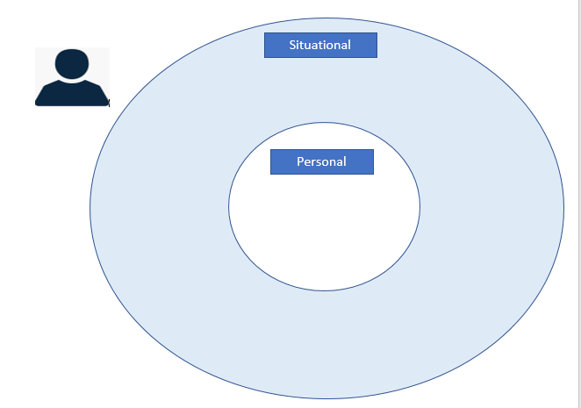
Aid to understanding ‘Vulnerability’
Notes:
I sent a document on email earlier if you haven’t got it at hand roughly draw this on your notebook/piece of paper.
Shortly I will give you a list of factors which I want you to identify as either ‘personal’ factors or ‘situational’ factors – when
You have decided which it is write it into the correct circle.

Slide 25
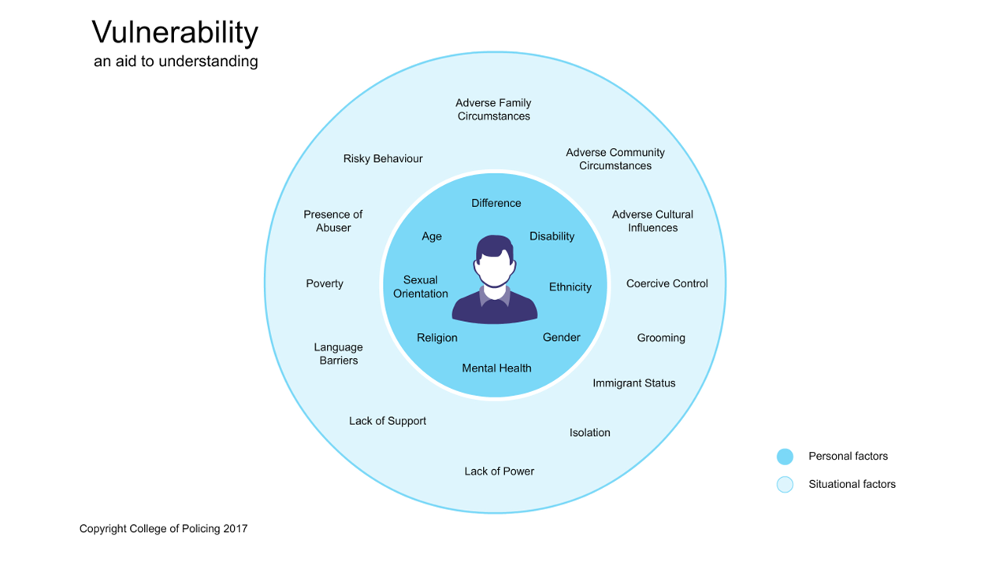
Notes:
By referring to the diagram that you have just completed – it demonstrates and re-inforces what we discussed earlier in that it is difficult to work to one specific definition of vulnerability due to its complex nature and that complexity being highlighted by the presence of various situational/environmental factors combining with personal vulnerability.
This can then result in a person possibly being both a victim and/or perpetrator and susceptible to a range of different categories of harm. Again strengthening the argument that defining vulnerability is difficult in all circumstances.
Thresholds of vulnerability are very hard to define but in policing now there is a move to aspire to early prevention and hence lower thresholds.

Slide 26
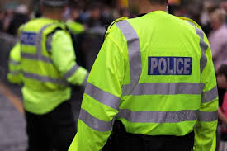
Complexities of policing vulnerability?
What do you think are the complexities of vulnerability?
Notes:
Having given you that brief overview of vulnerability
What do you think are the complexities of vulnerabilities? Why is policing vulnerability so complex ?
Answers in chatbox
Suggestions:
One definition to fit all agencies
Being able to identify ‘vulnerability’ correctly
Consent from adults to undertake any action
What role should the police have in relation to ‘vulnerable adults’?
Do you think they are the best service to deal with the challenges of mental health, vulnerabilities of old age?

Slide 27
NPCC – Policing Vision 2025
Aim – to deliver
‘an improved understanding of vulnerability, both in physical and virtual locations, as a means of improving and differentiating service and protection’.
Notes:
NPCC – National Police Chief’s Council
Have developed a Policing Vision which takes policing into 2025 – part of that vision or plan’s aim is as the slide states.
To have ‘an improved understanding of vulnerability, both in physical and virtual locations, as a means of improving and differentiating service and protection’.

Slide 28
Policing Vision 2025
Also by 2025
‘the police service will have transformed the way it delivers its mission with a keen focus on prevention and vulnerability and the effective management of risk’

Slide 29
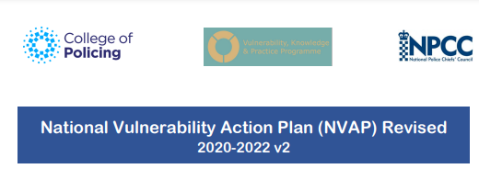
NPCC Vulnerability Plan 2021-2022
https://www.npcc.police.uk/SysSiteAssets/media/downloads/publications/publications-log/2019/national-vulnerability-action-plan-2020-2022.pdf

Slide 30
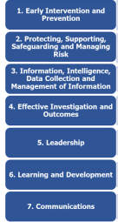
NPCC Vulnerability Plan – Key Themes
Notes:
The National Action Plan is aimed at providing support to policing to deliver 7 identified key themes that have specific actions:

Slide 31
Protocols and procedures
Child protection procedures
Vulnerable adult procedures
Honour Based Violence Procedures
Hate Crime Procedures
Domestic Abuse Procedures
Etc
‘the operationalisation of vulnerability has created a labyrinth of standard operational procedures ‘
(Asquith & Bartkowiak, 2012).
Notes:
When you think about policies, protocols and procedures that you have in your respective forces – how many do you think you have?
Can you name any?
Do these assist or become a hindrance when dealing with vulnerability?
Asquith & Bartkowiak argue that ‘the operationalisation of vulnerability has created a labyrinth of standard operational procedures and
that there is nothing ‘standard’ about these protocols, memoranda, practice documents and legislation; they are often hard to follow and reconcile, let alone put into operational practice.
Would you agree or disagree?

Slide 32

Challenges for Police Leaders
What challenges does policing vulnerability raise for you as leaders?
Notes:
What are the key challenges for you as leaders in relation to the policing of vulnerability?
Suggested answers:
Demand on resources
Lack of specialist resources
Training for specialists
The changing nature of ‘vulnerability’
Public scrutiny
When things go wrong – public inquiries!
Accountability
Lack of other agency resources
Lack of suitable premises for safety ( Homeless shelters, hospitals, care in the community etc)
VULNERABILITY amongst staff

Slide 33
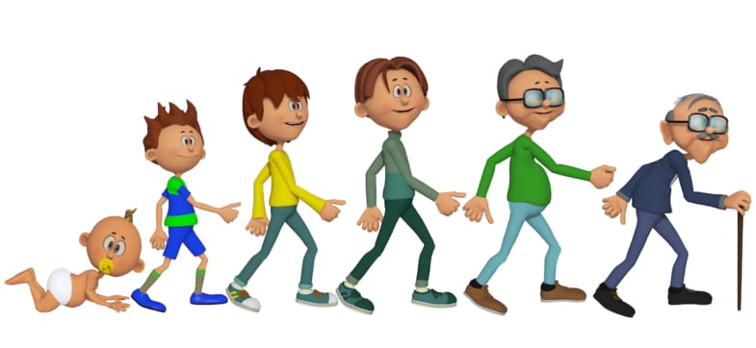
How old? - quiz

Slide 34
Lesson Outcomes
Define ‘Vulnerability' in the Context of Operational Policing
National Drivers for the Police to deliver a Professional Service to the Vulnerable, who have Suffered or are at Risk of Harm
Law around Vulnerability
Personal Aspect of Vulnerability
Extrinsic factors result in Harm, or Risk of Harm to the Vulnerable
Concepts and Theories of how a Person becomes a Victim
Explain the Influences of Risk Factors on Vulnerability
Notes:
Split the lesson into 2 parts
Part 1 – I will look at defining vulnerability and defining vulnerability in the context of policing
Touch upon the drivers for the police to deliver a service to the vulnerable
And also highlight key legislation around vulnerability for both children and adults
Then the second part will look at the persona aspects of vulnerability, the factors that influence the risk of harm and will introduce you to some of the theories of how a person becomes a victim
And if I have time at the end I have a short quiz to end us on a high.

Slide 35

Cwestyniau?

