Slide 1
Electrical Engineering
(ACDA5001)
Lecture 17

Slide 2
Content
Introduction
Electrical Machines
DC generator
Construction
Types

Slide 3
Learning Outcome
The student upon completion of the lecture will be able to:
Describe the components of DC generators
Describe the types of DC generators

Slide 4
Types of DC machines
DC machines are classified as follows.
DC generator (Converts mechanical energy into electrical energy)
DC Motor (Converts electrical energy into mechanical energy)
(These machines operates in DC current)

Slide 5
Types of DC machines
DC machine operates in DC current.
They work on the principle of Faraday’s law of electromagnetic induction (Whenever a flux linking with a conductor or a coil changes, an emf is induced which will cause a current to flow through the circuit).
The basic requirement for the DC machines are magnetic field, conductor and relative motion between them.

Slide 6
DC generator - working principle
Working principle
DC generator works on the principle of Faraday’s law of electromagnetic induction (i.e) Whenever a flux linking with a conductor or a coil changes, an emf is induced which will cause a current to flow through the circuit.
The direction of induced emf is given by Fleming’s right hand rule.

Slide 7
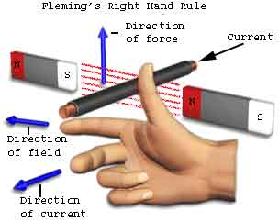
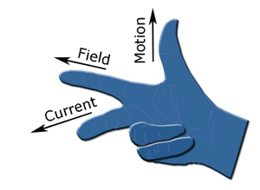
DC generator - working principle
Working principle - Fleming’s right hand rule.
If thumb, forefinger and middle finger are outstretched, so that the three fingers are at right angle to each other. If the fore finger points the direction of the line of flux, thumb points the direction of relative motion of the conductor with respect to the flux, then the middle finger gives the direction of the induced emf in the conductor

Slide 8
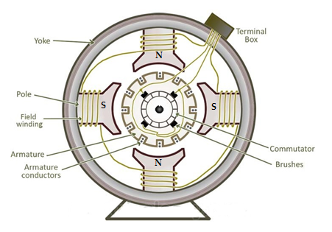
DC generator - Construction
Construction –Cross section of DC machine

Slide 9
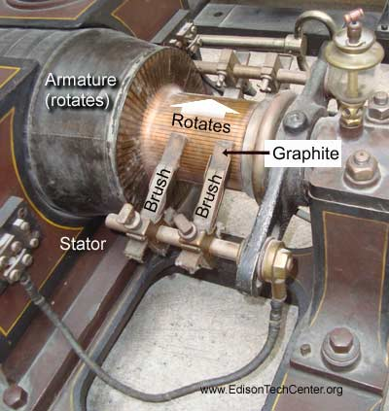
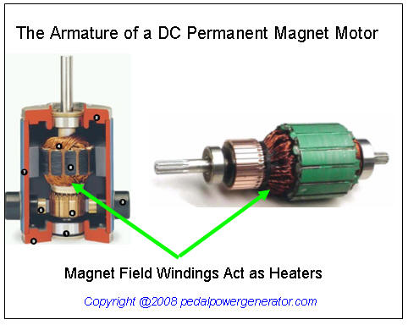
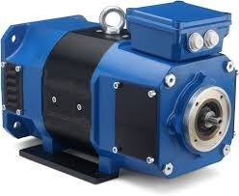
DC generator - Construction

Slide 10
DC generator - Construction
DC generator and DC motor has the same general construction, any DC generator can be used as a DC motor and Vice versa.
The Major parts of DC machine are
  Yoke
  Field system
  Armature core
  Amature windings
  Commutators
  Brushes

Slide 11
DC generator - Construction
Yoke
It is also called as magnetic frame, it serves for two purposes
  Protecting cover for DC machine and provide mechanical support
  It carries the magnetic poles.
Field system
  Function - To provide uniform magnetic field.
  Consists of number of poles bolted inside the circular frame.
  Field windings are mounted on the poles and carry the DC exciting current.
  Field coils are connected in such a way the adjacent poles have opposite polarity.
  The mmf (magnetomotive force) produced by the field windings provides a magnetic flux that passes through the pole pieces, the air gap, the armature and the frame.

Slide 12
DC generator - Construction
Armature core
  The armature core is keyed to the machine shaft and rotate between the field poles.
  The armature core consists of slotted soft –iron laminated that are stacked to form a cylindrical core.
  The laminations are individually coated with a thin insulating fills so that they do not come in electrical contact with each other.
  The purpose of laminating the core is to reduce he eddy current loss.
  The laminations are slotted to accommodate and provide security to the armature winding and give shorter air gap for the flux.

Slide 13
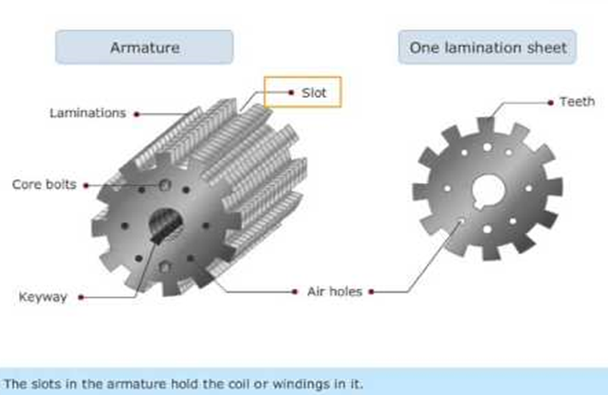
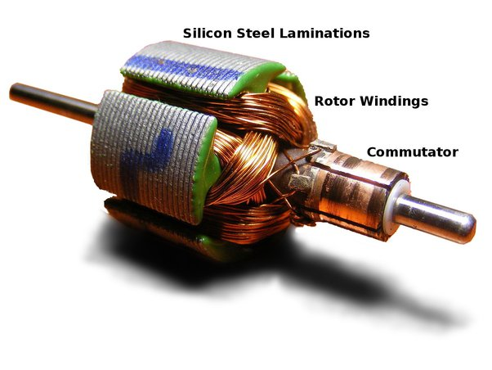
DC generator - Construction

Slide 14
DC generator - Construction
Armature winding
  The slots of the armature core holds the insulated conductors that are called as armature windings.
  The emf is induced in armature windings
  The armature conductors are connected in series-parallel connection.
    The conductor being connected in series so as to increase the voltage.
    Conductors connected in parallel to increase the current.
  The armature winding of a DC machine is a closed- circuit winding.
  Armature winding (two types)
    Lap winding
    Wave winding

Slide 15
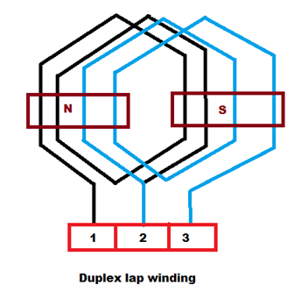
DC generator - Construction
  Lap winding:
    Connection starts from conductor in first slot, the connections overlap each other as windings proceeds sill starting point is reached again.
    Number of Parallel paths = Number of poles

Slide 16
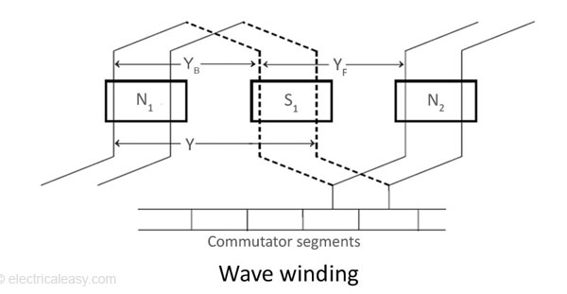
DC generator - Construction
  Wave winding
    This type of windings travels as wave and avoid overlapping.
    Number of parallel paths =2

Slide 17
DC generator - Construction
Commutator
  Commutator acts as a mechanical rectifier which converts the AC induced emf in the armature winding into DC across the brushes.
  It is made of copper segment insulated from each other by mica sheet.
  It is mounted on the shaft of the machine.
  The characteristics of the DC commutator is that it should not produce spark during the working condition. If not the sparks may burn the brushes and overheat and carbonise the commutator.

Slide 18
DC generator - Construction
Brushes
  The purpose of the brushes is to collect the current from commutator to external load circuit.

Slide 19
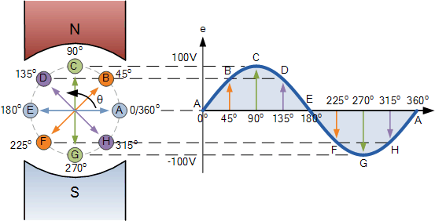
DC generator - working

Slide 20
DC generator - Working
The field winding is supplied with power supply. So, the poles get magnetised and the magnetic flux across the pole increases.
The armature is provide with a mechanical force (rotational force), which cuts the magnetic flux lines.
The Emf will be induced in the conductor, as per the Faraday’s law of electromagnetic induction.
The direction of the induced Emf is given by the Flemming’s right hand rule.

Slide 21
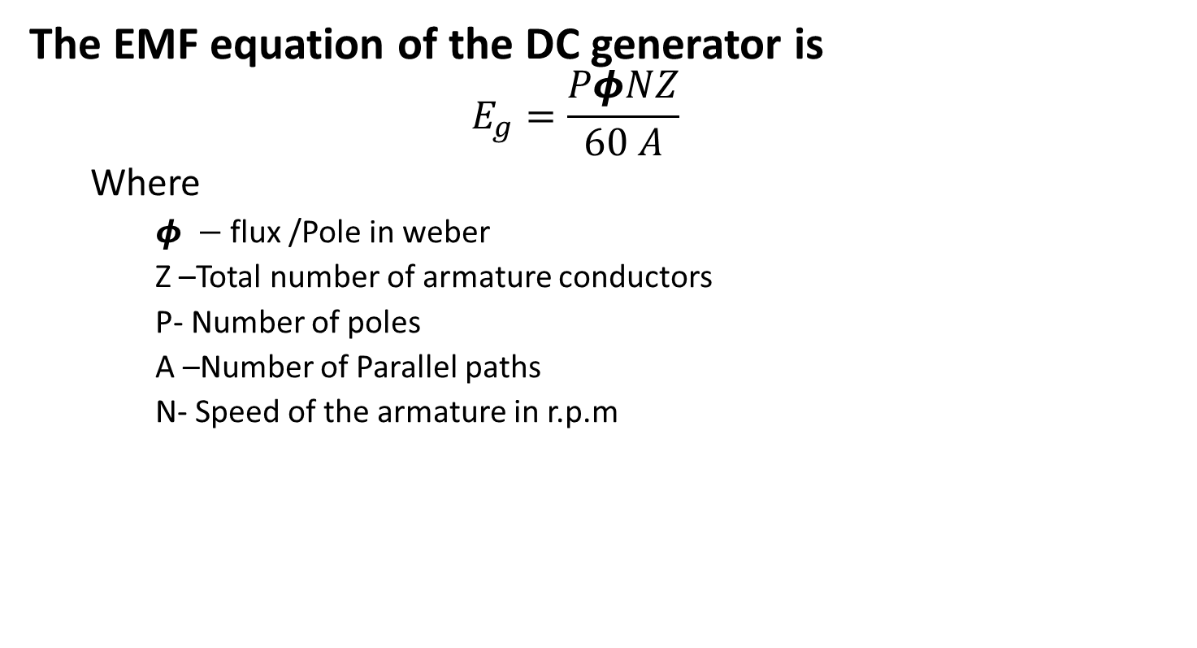
DC generator - Emf equation
The EMF equation of the DC generator is
  $$E_{g}=\frac{PφNZ}{60 A}$$
  Where
    $φ −$ flux /Pole in weber
    Z –Total number of armature conductors
    P- Number of poles
    A –Number of Parallel paths
    N- Speed of the armature in r.p.m

Slide 22
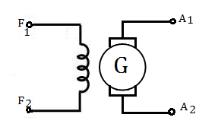
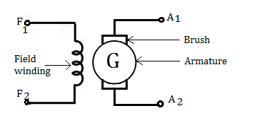
DC generator – Symbol

Slide 23
Types of DC generator
DC Generator
Separately Excited DC generator
Self Excited DC generator
Series Generator
Shunt Generator
Compound Generator
Short shunt Compound Generator
Long Shunt Compound Generator
Differential Compound Generator
Cumulative Compound Generator

Slide 24
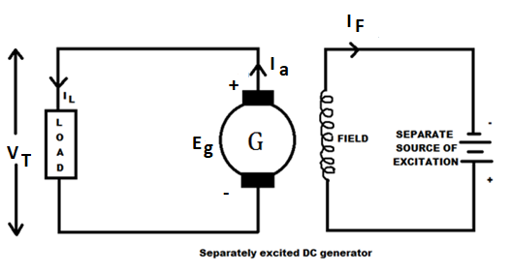
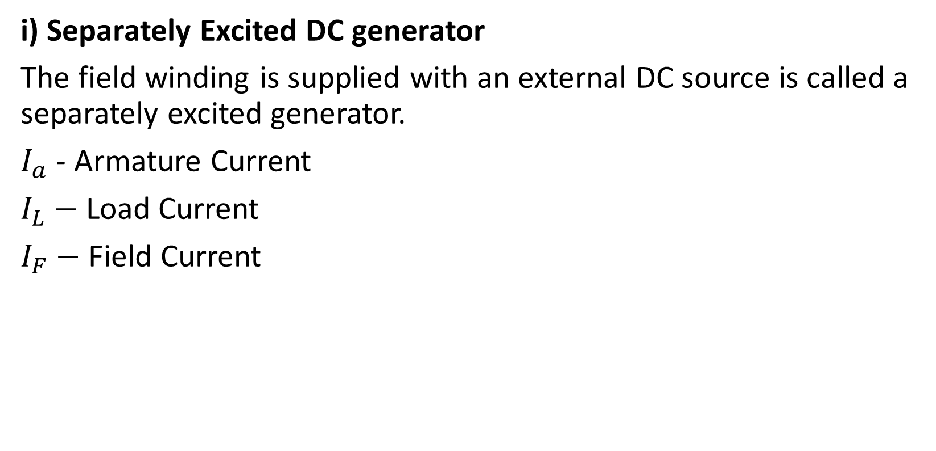
DC generator - Types
i) Separately Excited DC generator
The field winding is supplied with an external DC source is called a separately excited generator.
$I_{a}$ - Armature Current
$I_{L}−$ Load Current
$I_{F}−$ Field Current

Slide 25
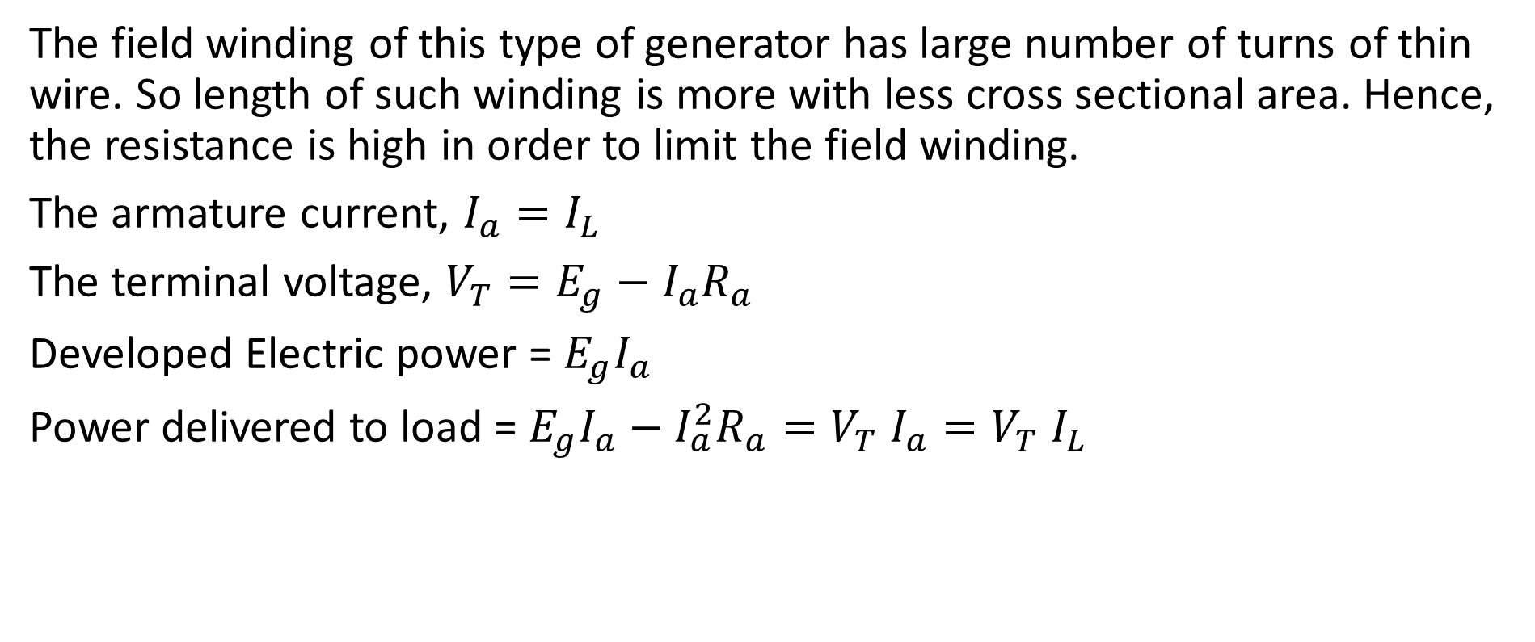
DC generator - Types
The field winding of this type of generator has large number of turns of thin wire. So length of such winding is more with less cross sectional area. Hence, the resistance is high in order to limit the field winding.
The armature current, $I_{a}=I_{L}$
The terminal voltage, $V_{T}=E_{g}−I_{a}R_{a}$
Developed Electric power = $E_{g}I_{a}$
Power delivered to load = $E_{g}I_{a}−I_{a}^{2}R_{a}=V_{T}$ $I_{a}=V_{T} I_{L}$

Slide 26
DC generator - Types
ii) Self excited DC generator
It does not require any external supply to excite the winding. Based on the manner the field winding is connected to the armature, the self excited generators are classified into three types.
They are as follow.
  a) Shunt generator
  b) Series generator
  c) Compound generator

Slide 27
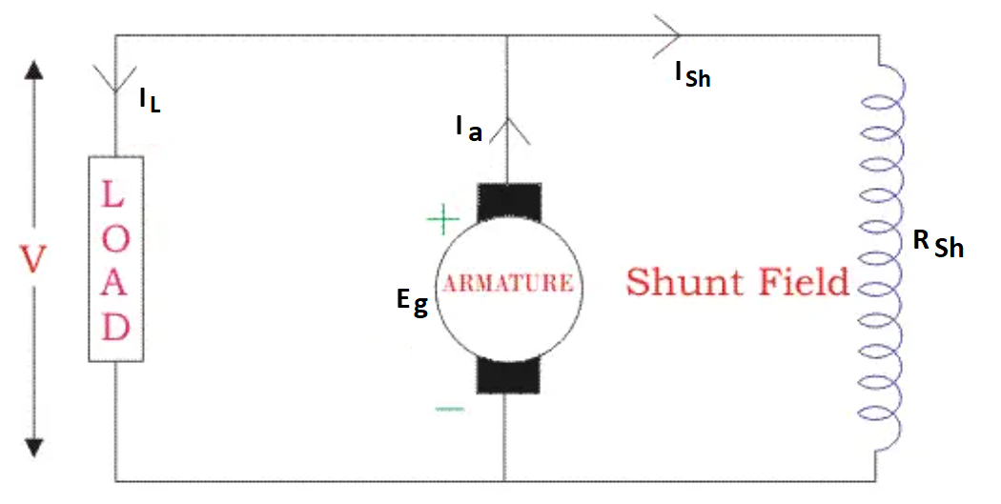
DC generator - Types
a) Shunt generator
In shunt generator, the field winding is connected in parallel with the armature winding.
Shunt winding has many turns of fine wire, provide high resistance.
Only a portion of current will flow through winding and remaining flows through load

Slide 28
DC generator - Types
R_{sh} = Shunt winding resistance
I_{sh} = Current flowing through the shunt field
R_{a} = Armature resistance
I_{a} = Armature current
I_{L} = Load current
V = Terminal voltage
E_{g} = Generated EMF

Slide 29
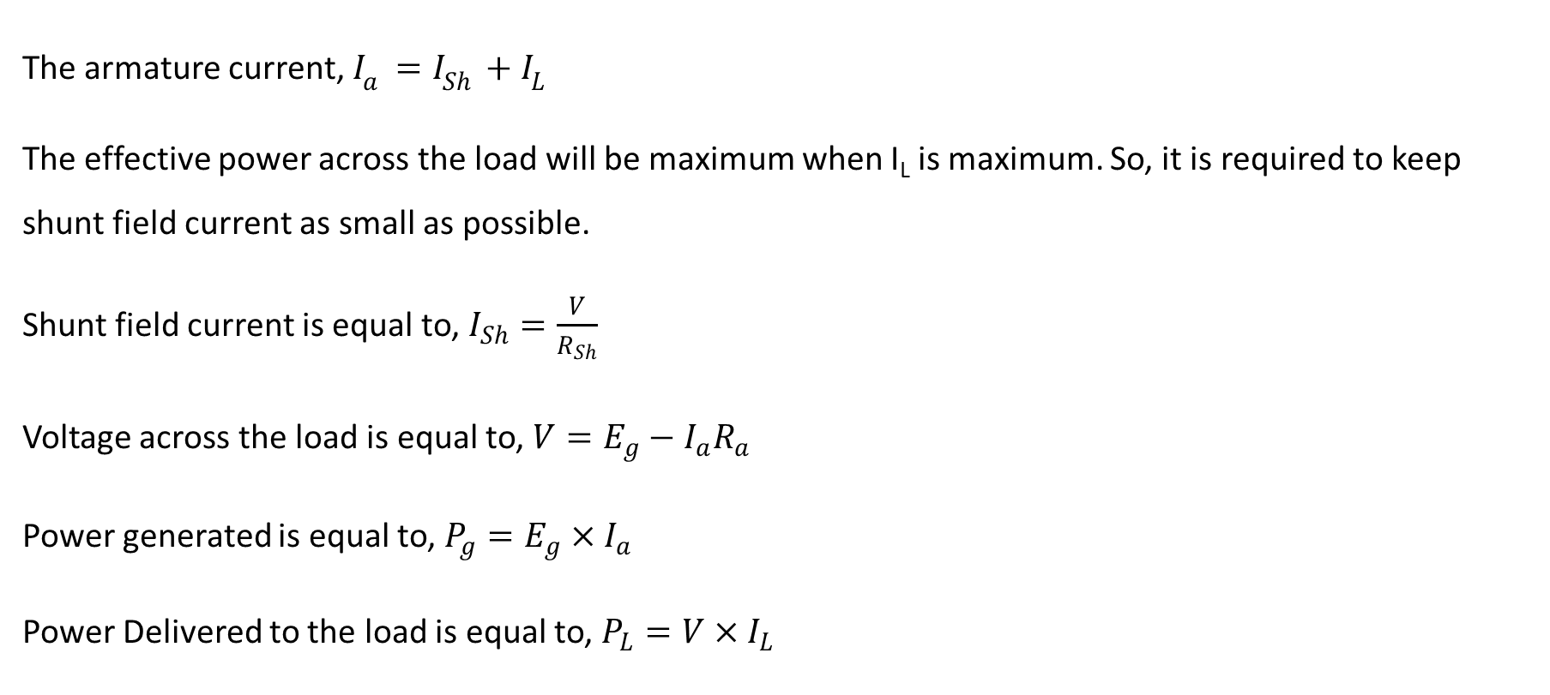
DC generator - Types
The armature current, $I_{a}=I_{Sh}+I_{L}$
The effective power across the load will be maximum when I_{L} is maximum. So, it is required to keep shunt field current as small as possible.
Shunt field current is equal to, $I_{Sh}=\frac{V}{R_{Sh}}$
Voltage across the load is equal to, $V=E_{g}−I_{a}R_{a}$
Power generated is equal to, $P_{g}=E_{g}×I_{a}$
Power Delivered to the load is equal to, $P_{L}=V×I_{L}$

Slide 30
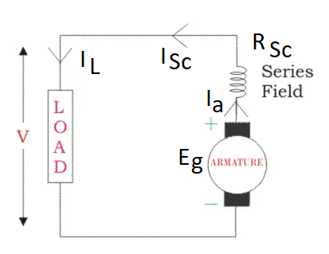
DC generator - Types
b) Series generator
In a series wound generator, the field winding is connected in series with the armature winding.
As fields and armature windings are in series, the whole current flows through fields as well as load.

Slide 31
DC generator - Types
R_{sc} = Series winding resistance
I_{sc} = Current flowing through the series field
R_{a} = Armature resistance
I_{a} = Armature current
I_{L} = Load current
V = Terminal voltage
E_{g} = Generated EMF

Slide 32
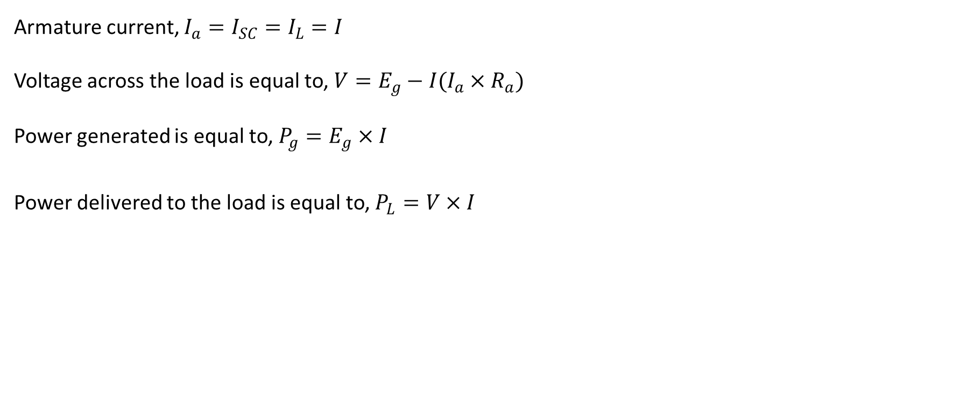
DC generator - Types
Armature current, $I_{a}=I_{SC}=I_{L}=I$
Voltage across the load is equal to, $V=E_{g}−I(I_{a}{×R}_{a})$
Power generated is equal to, $P_{g}=E_{g}×I$
Power delivered to the load is equal to, $P_{L}=V×I$

Slide 33
DC generator - Types
C) Compound generator
The compound generator has both the series and shunt winding. This type of generators are classified as
  Long shunt
  Short shunt
  Differential
  Cumulative

Slide 34
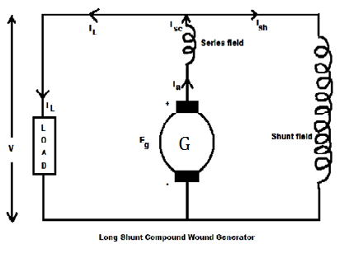
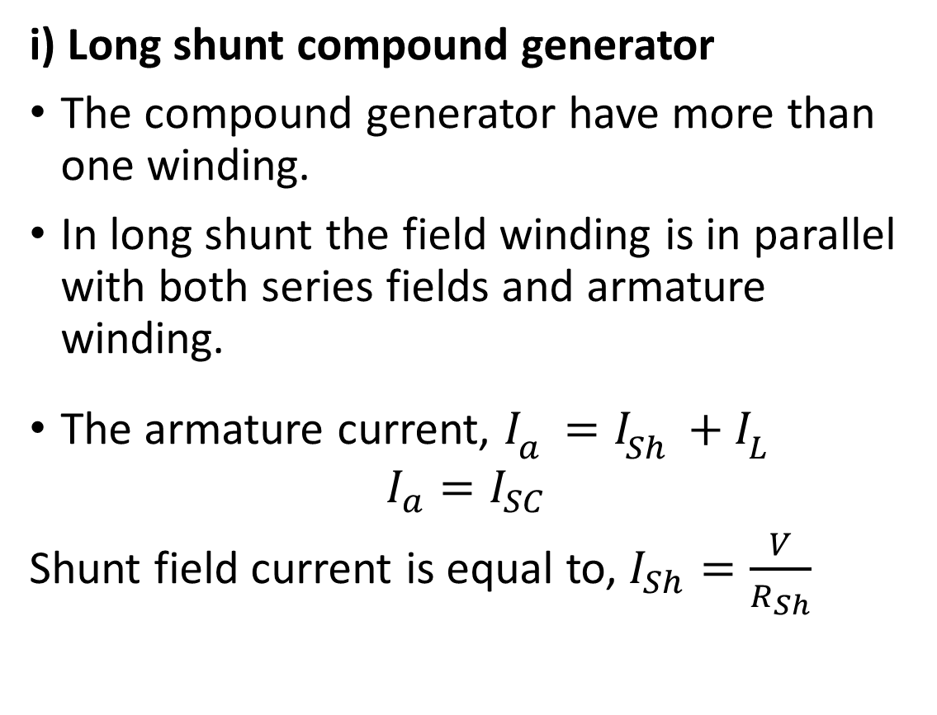
DC generator - Types
i) Long shunt compound generator
The compound generator have more than one winding.
In long shunt the field winding is in parallel with both series fields and armature winding.
The armature current, $I_{a}=I_{Sh}+I_{L}$
$$I_{a}=I_{SC}$$
Shunt field current is equal to, $I_{Sh}=\frac{V}{R_{Sh}}$

Slide 35
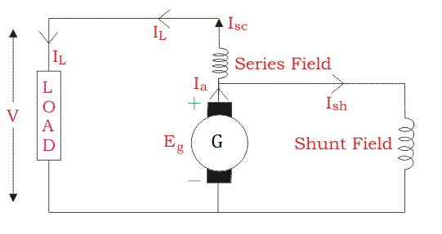
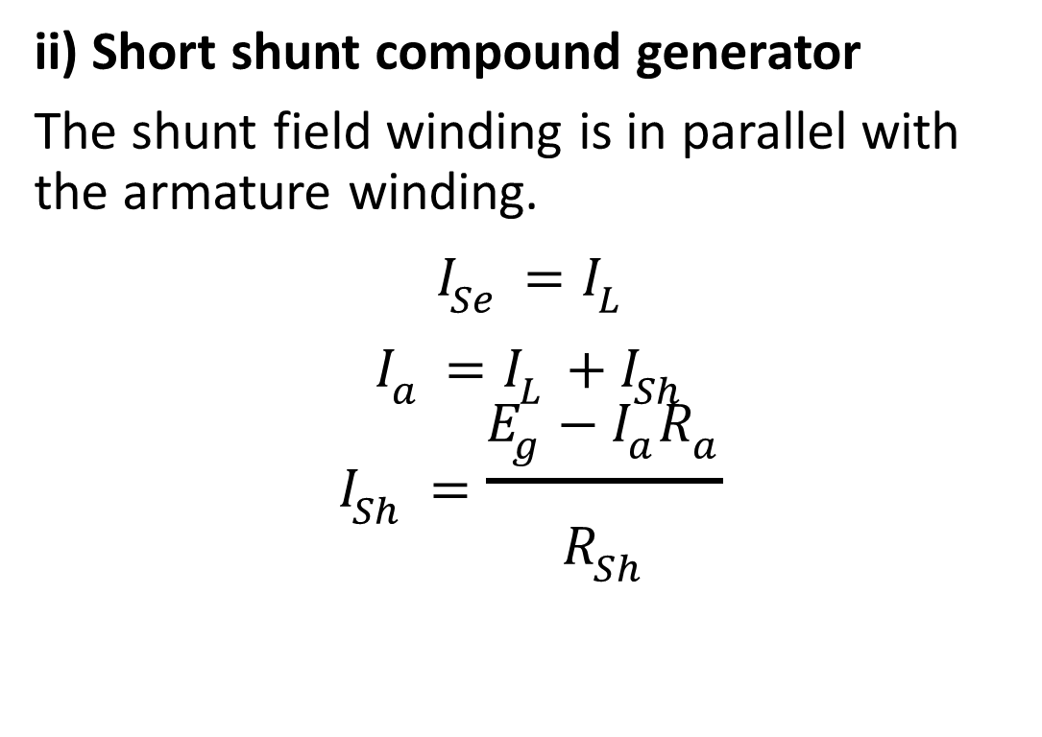
DC generator - Types
ii) Short shunt compound generator
The shunt field winding is in parallel with the armature winding.
$$I_{Se}=I_{L}$$
$$I_{a}=I_{L}+I_{Sh}$$
$$I_{Sh}=\frac{E_{g}−I_{a}R_{a}}{R_{Sh}}$$

Slide 36
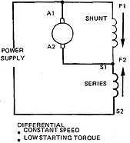
DC generator - Types
iii) Differential compound generator
Shunt and series windings are wounded on the same pole.
Depending on the direction of winding, flux produced by shunt and series field may oppose each other.
If the two fluxes oppose each other, then it is called differential compound generator

Slide 37
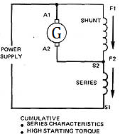
DC generator - Types
iv) Cumulative compound generator
Shunt and series windings are wounded on the same pole.
Depending on the direction of winding, flux produced by shunt and series field will not oppose each other.
If the two fluxes aid each other, then it is called cumulative compound generator

Slide 38
DC Generator - Applications
Applications of DC generator
Shunt generator
  Battery charging
  Exciter for synchronous motor
Series generator
  Boosters in transmission line
  Traction applications
Compound generator
  Voltage regulator
  Compensator for control system applications
  Used in arc welding

Slide 39

Thank You
Notes:
Health and Safety module – coming soon on Moodle

