Slide 1

Counselling Skills and Approaches ECPS5019
Week 9
Portfolio Building
Reflective Practice – Self Awareness
Recording Feedback

Slide 2
REVIEW: Portfolio Layout
Title Page/Cover Page
Table of Contents
Reflective Commentary/narrative essay 1, 500 Words with REFERENCE LIST
Portfolio of Evidence
Evidence 1: Background Information – Provide brief narratives as the information that is included
  Mission Statement or general introduction of your organisation or project
  Correspondence
  Other examples
Evidence 2: Reflective Logs
  Examples that tell what you have been reflecting on with various task – Skills that you have been developing
Evidence 3: Trainings/Meeting – Provide brief descriptions of the information that is included.
  Training examples
  Certificates]
  Pictures or pamphlets
References
Appendices

Slide 3
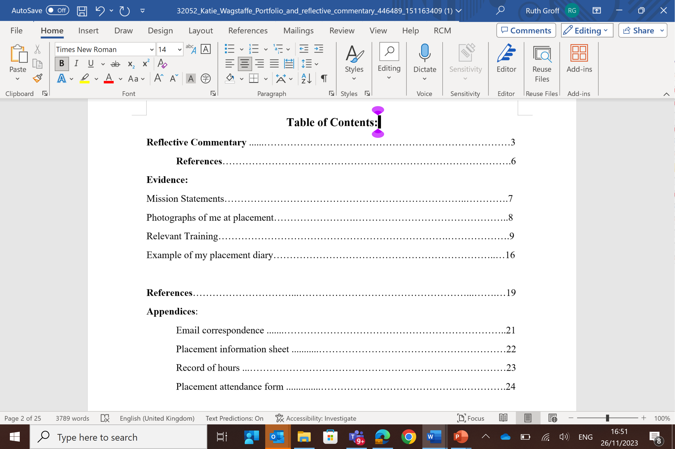

Slide 4
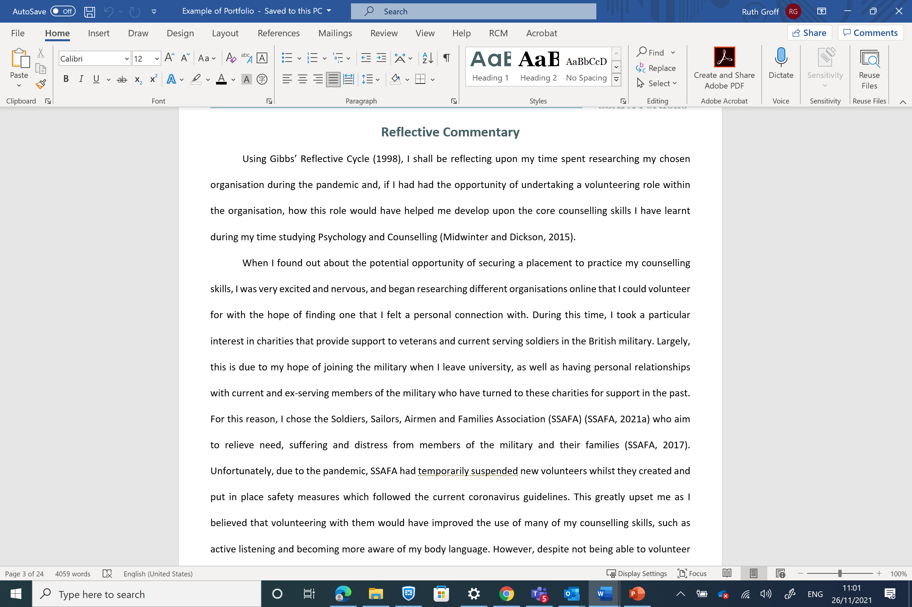
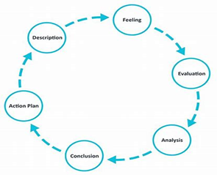
Reflective Commentary (1,500 words)
What is considered:
Follow Gibb Reflective Cycle - write in a narrative format - Essay
Supportive Literature – journal, website of organization
Refer to the Portfolio for examples

Slide 5
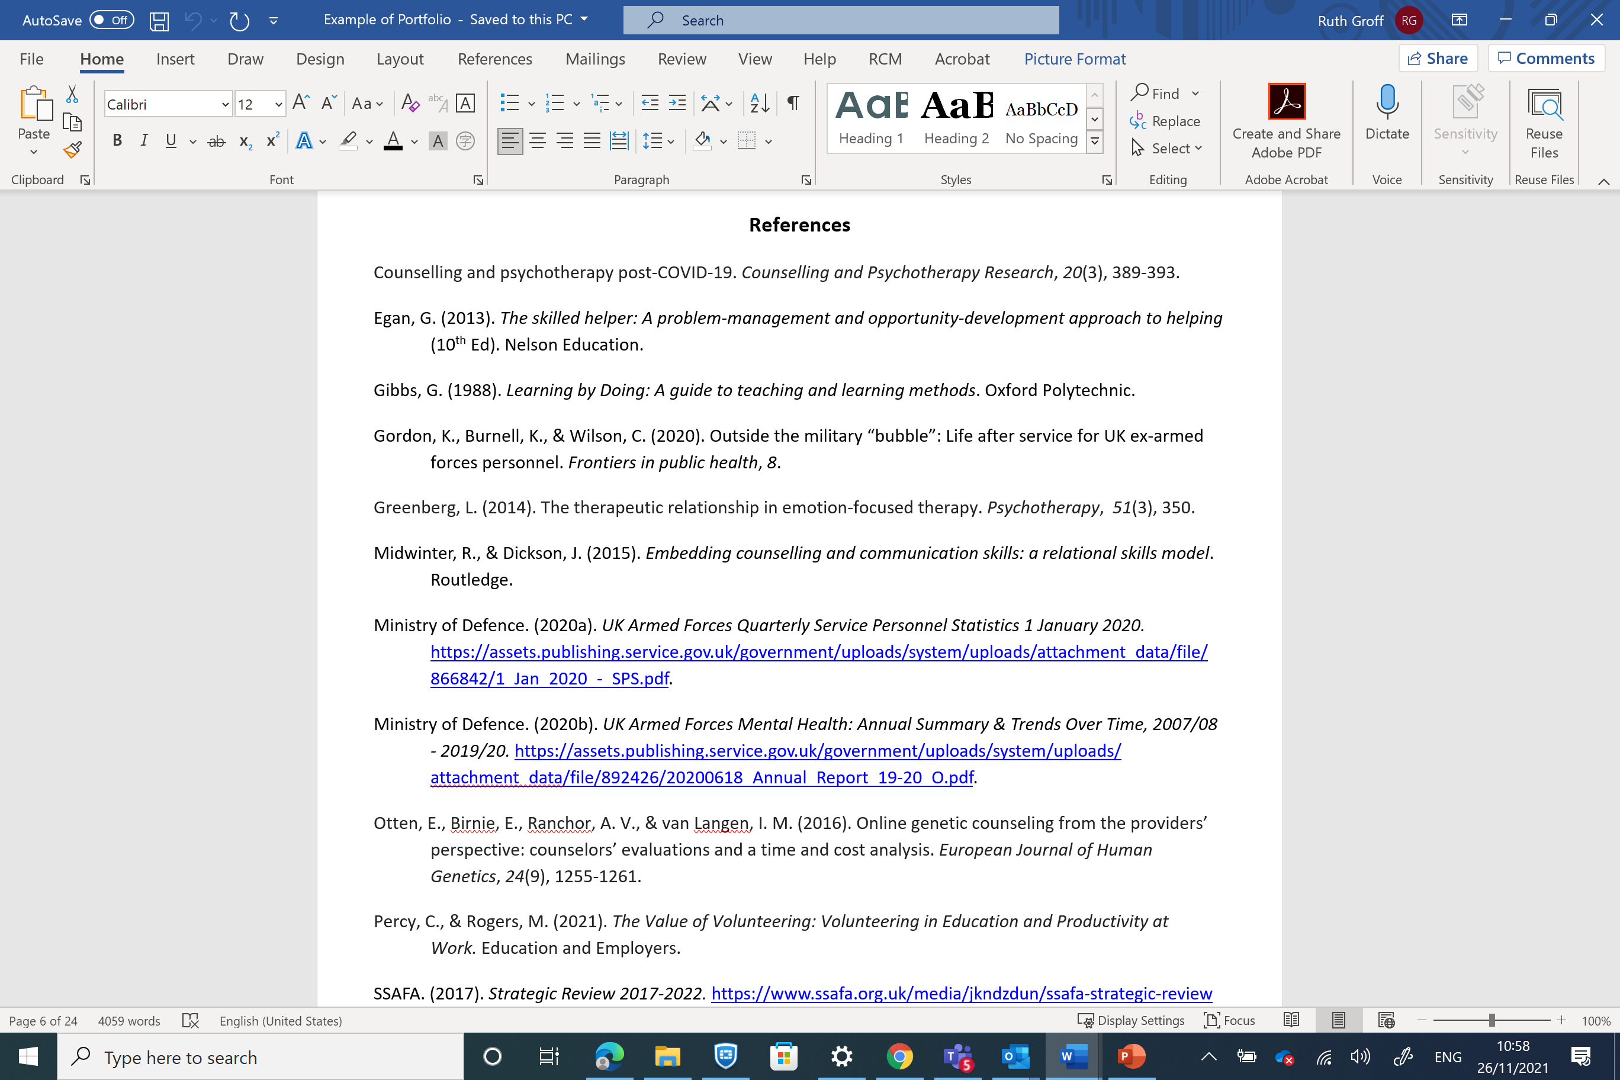

Slide 6
Portfolio Building What to include
Appendices:
Completed information Sheet
Correspondence with the Organisation – confirming your spot
Email from Module Lead confirming your placement
Attendance Confirmation and own record of time spent
Evidences:
Log Book – Reflection on various tasks, learning/trainings opportunities/ helping and listening skills
Training induction/information
Safeguarding policies – confidentiality
Mission Statement/Purpose of organisation.
Skills used within the placement - Listening and other skills you developed while in placement
Supporting/Helping Activities/Counselling Activities
Any correspondence or inquiries/emails
Application Form/ Skills Requirements or other requirements
Annual Reports – What do these say about the organisation
Website information/Media information]
Others

Slide 7
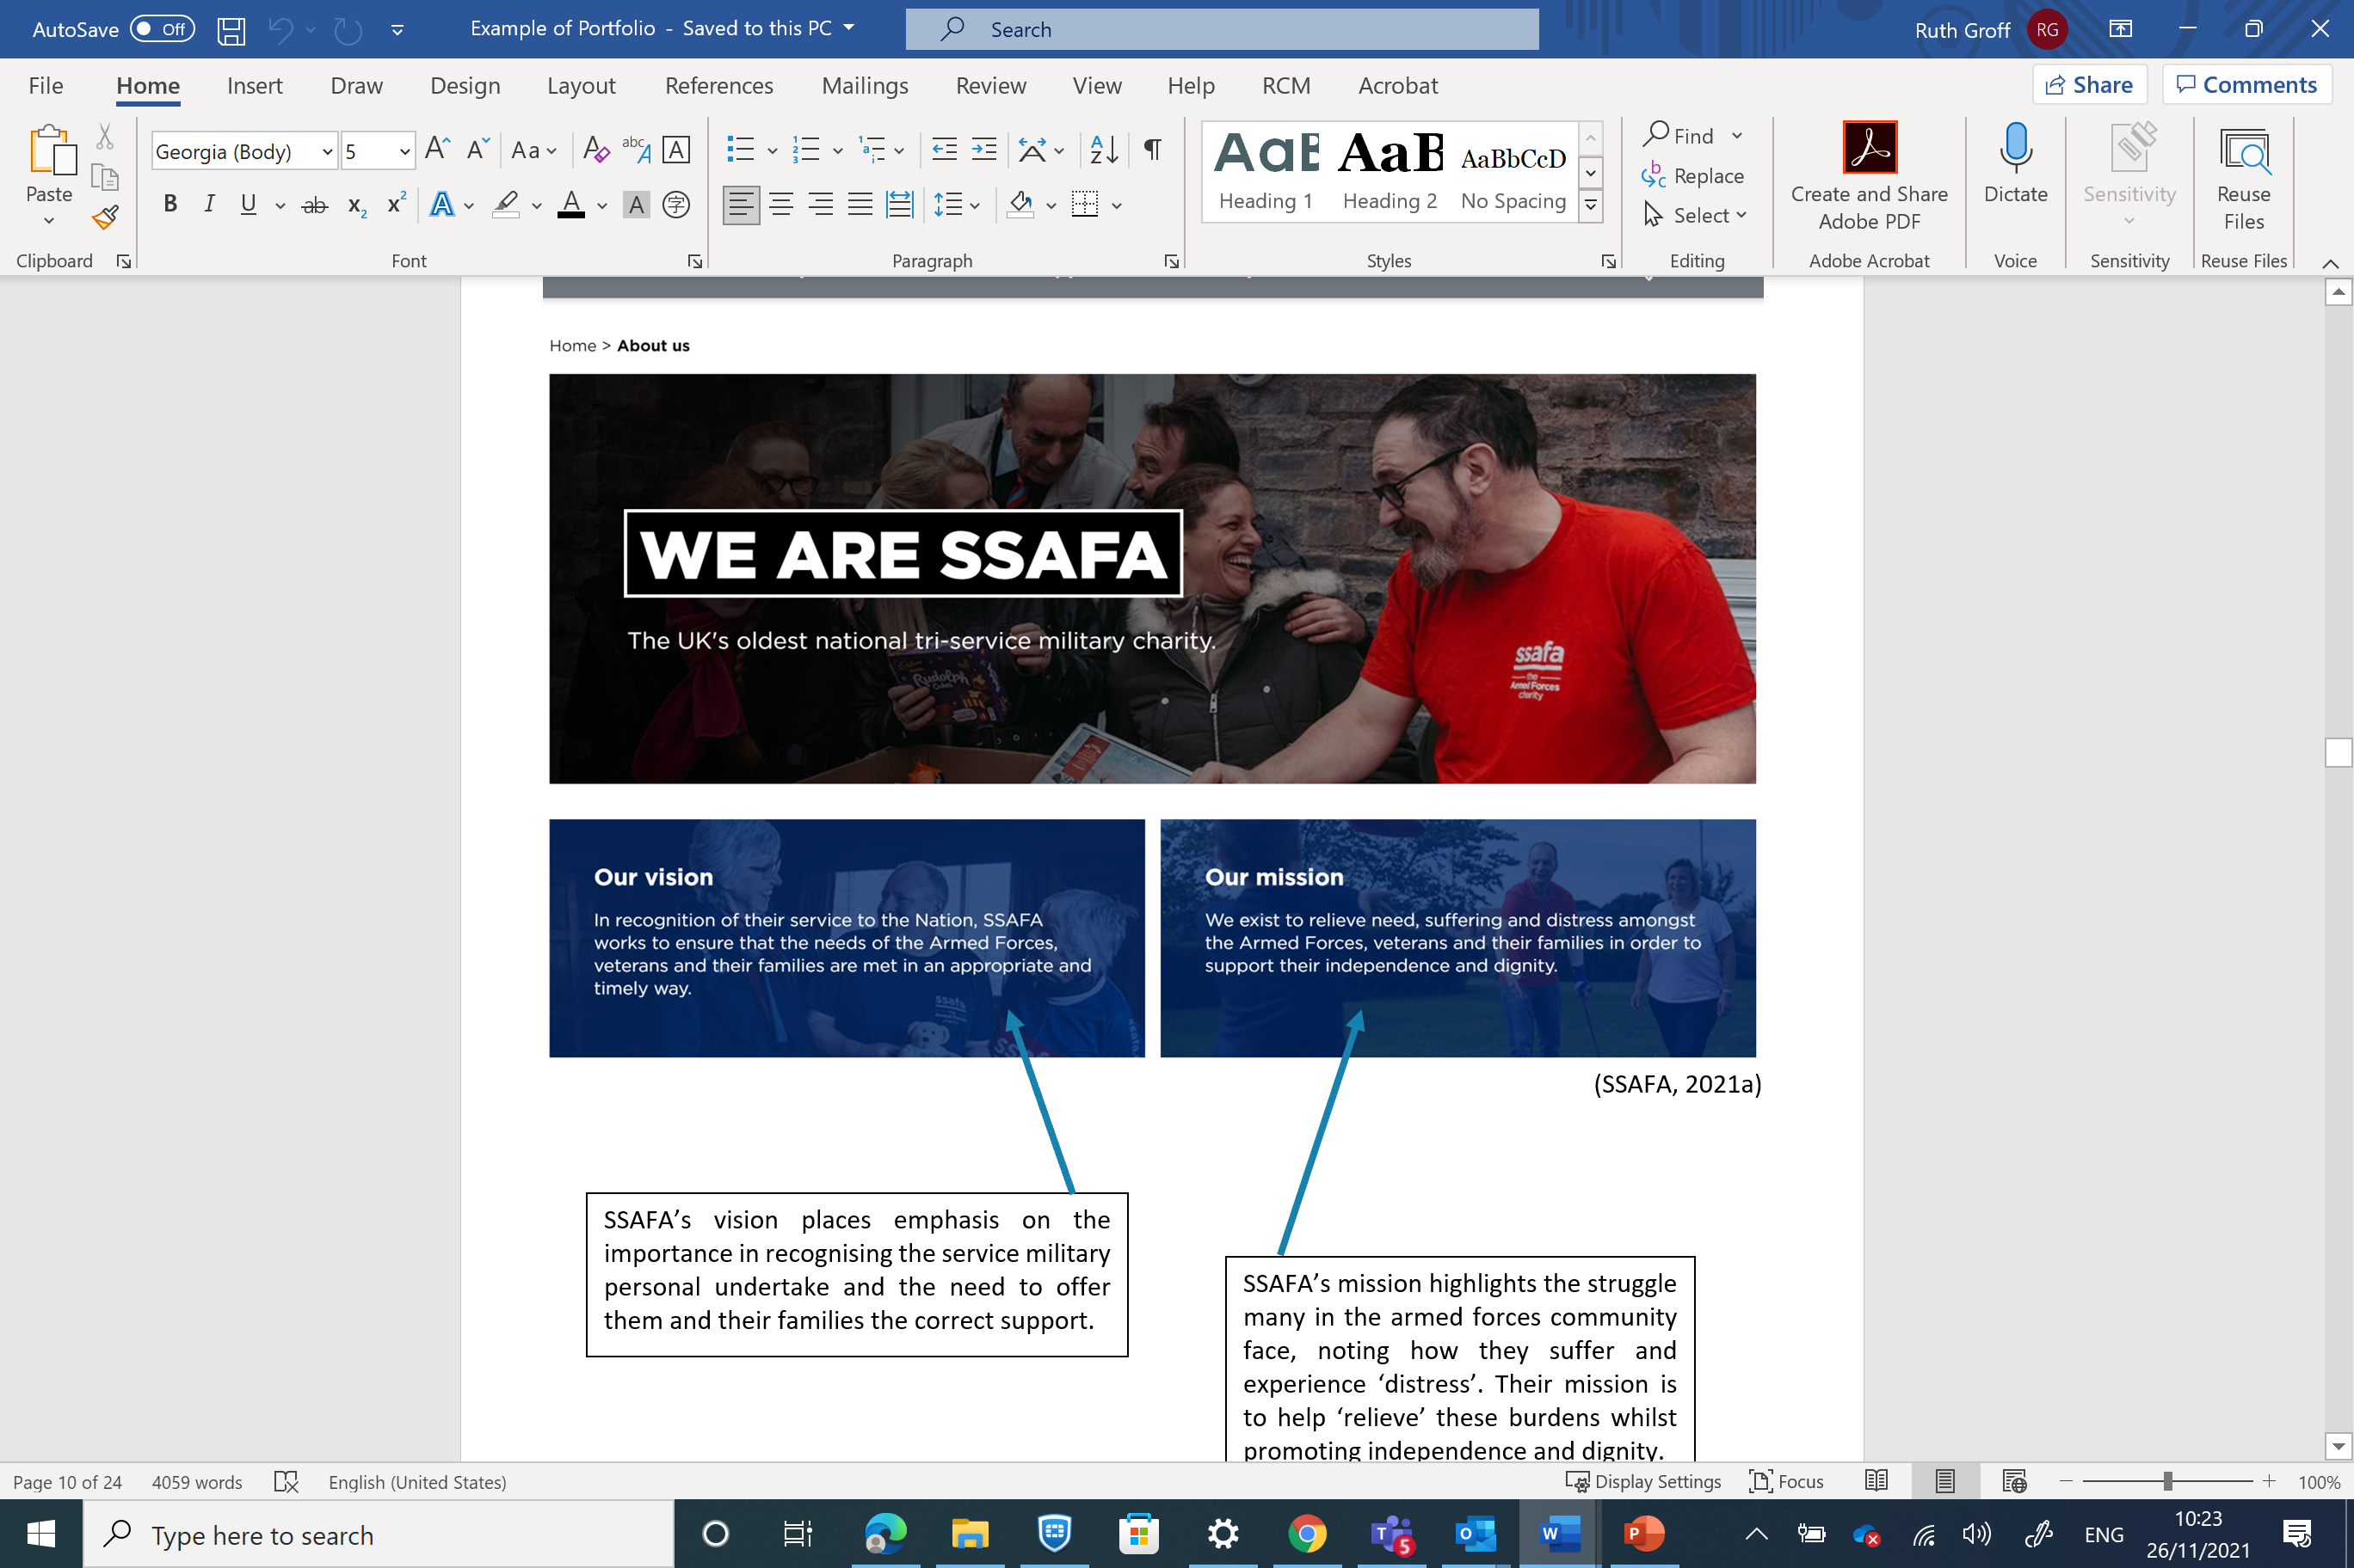

Slide 8
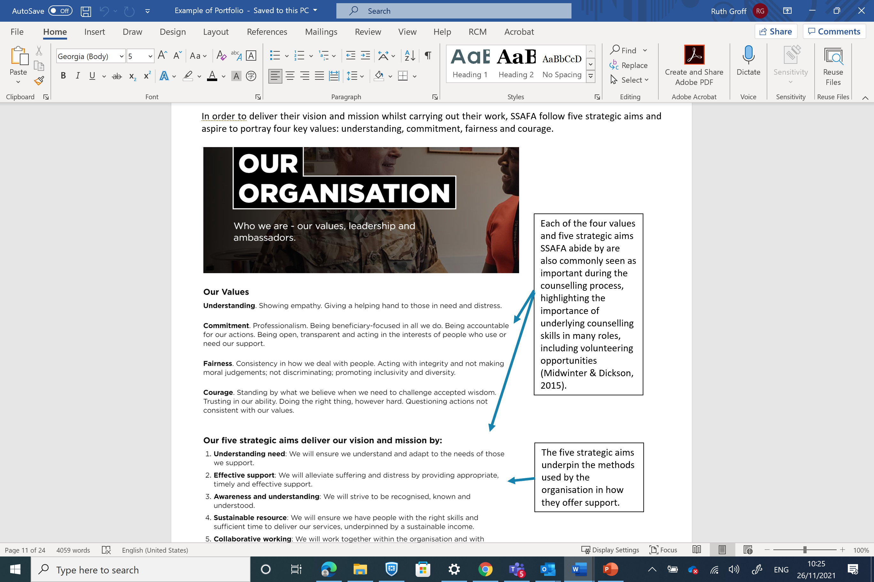

Slide 9
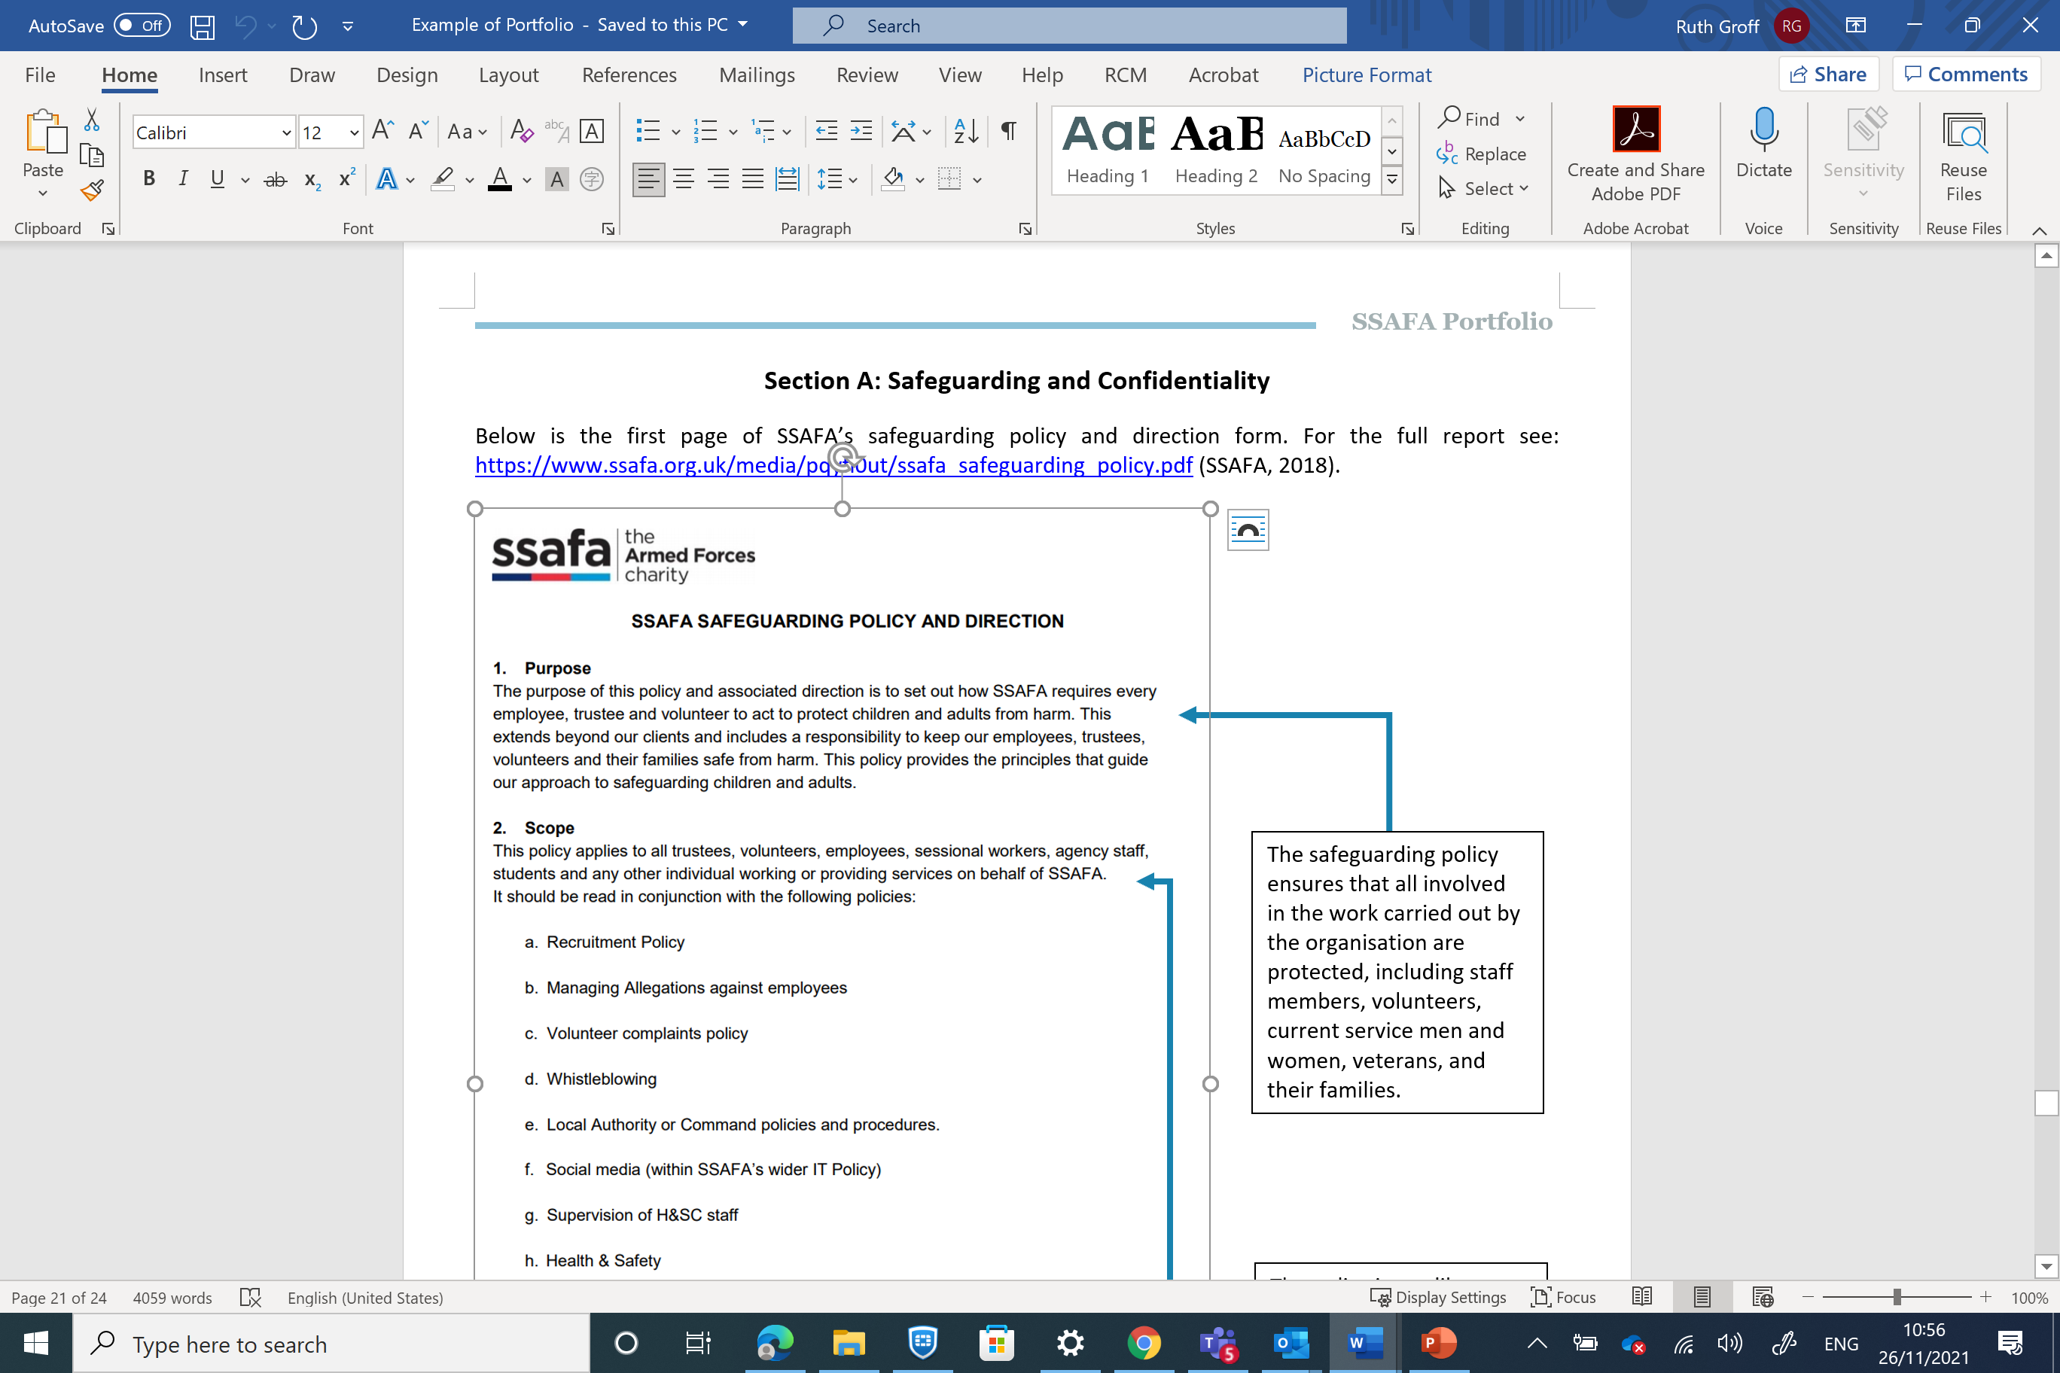

Slide 10
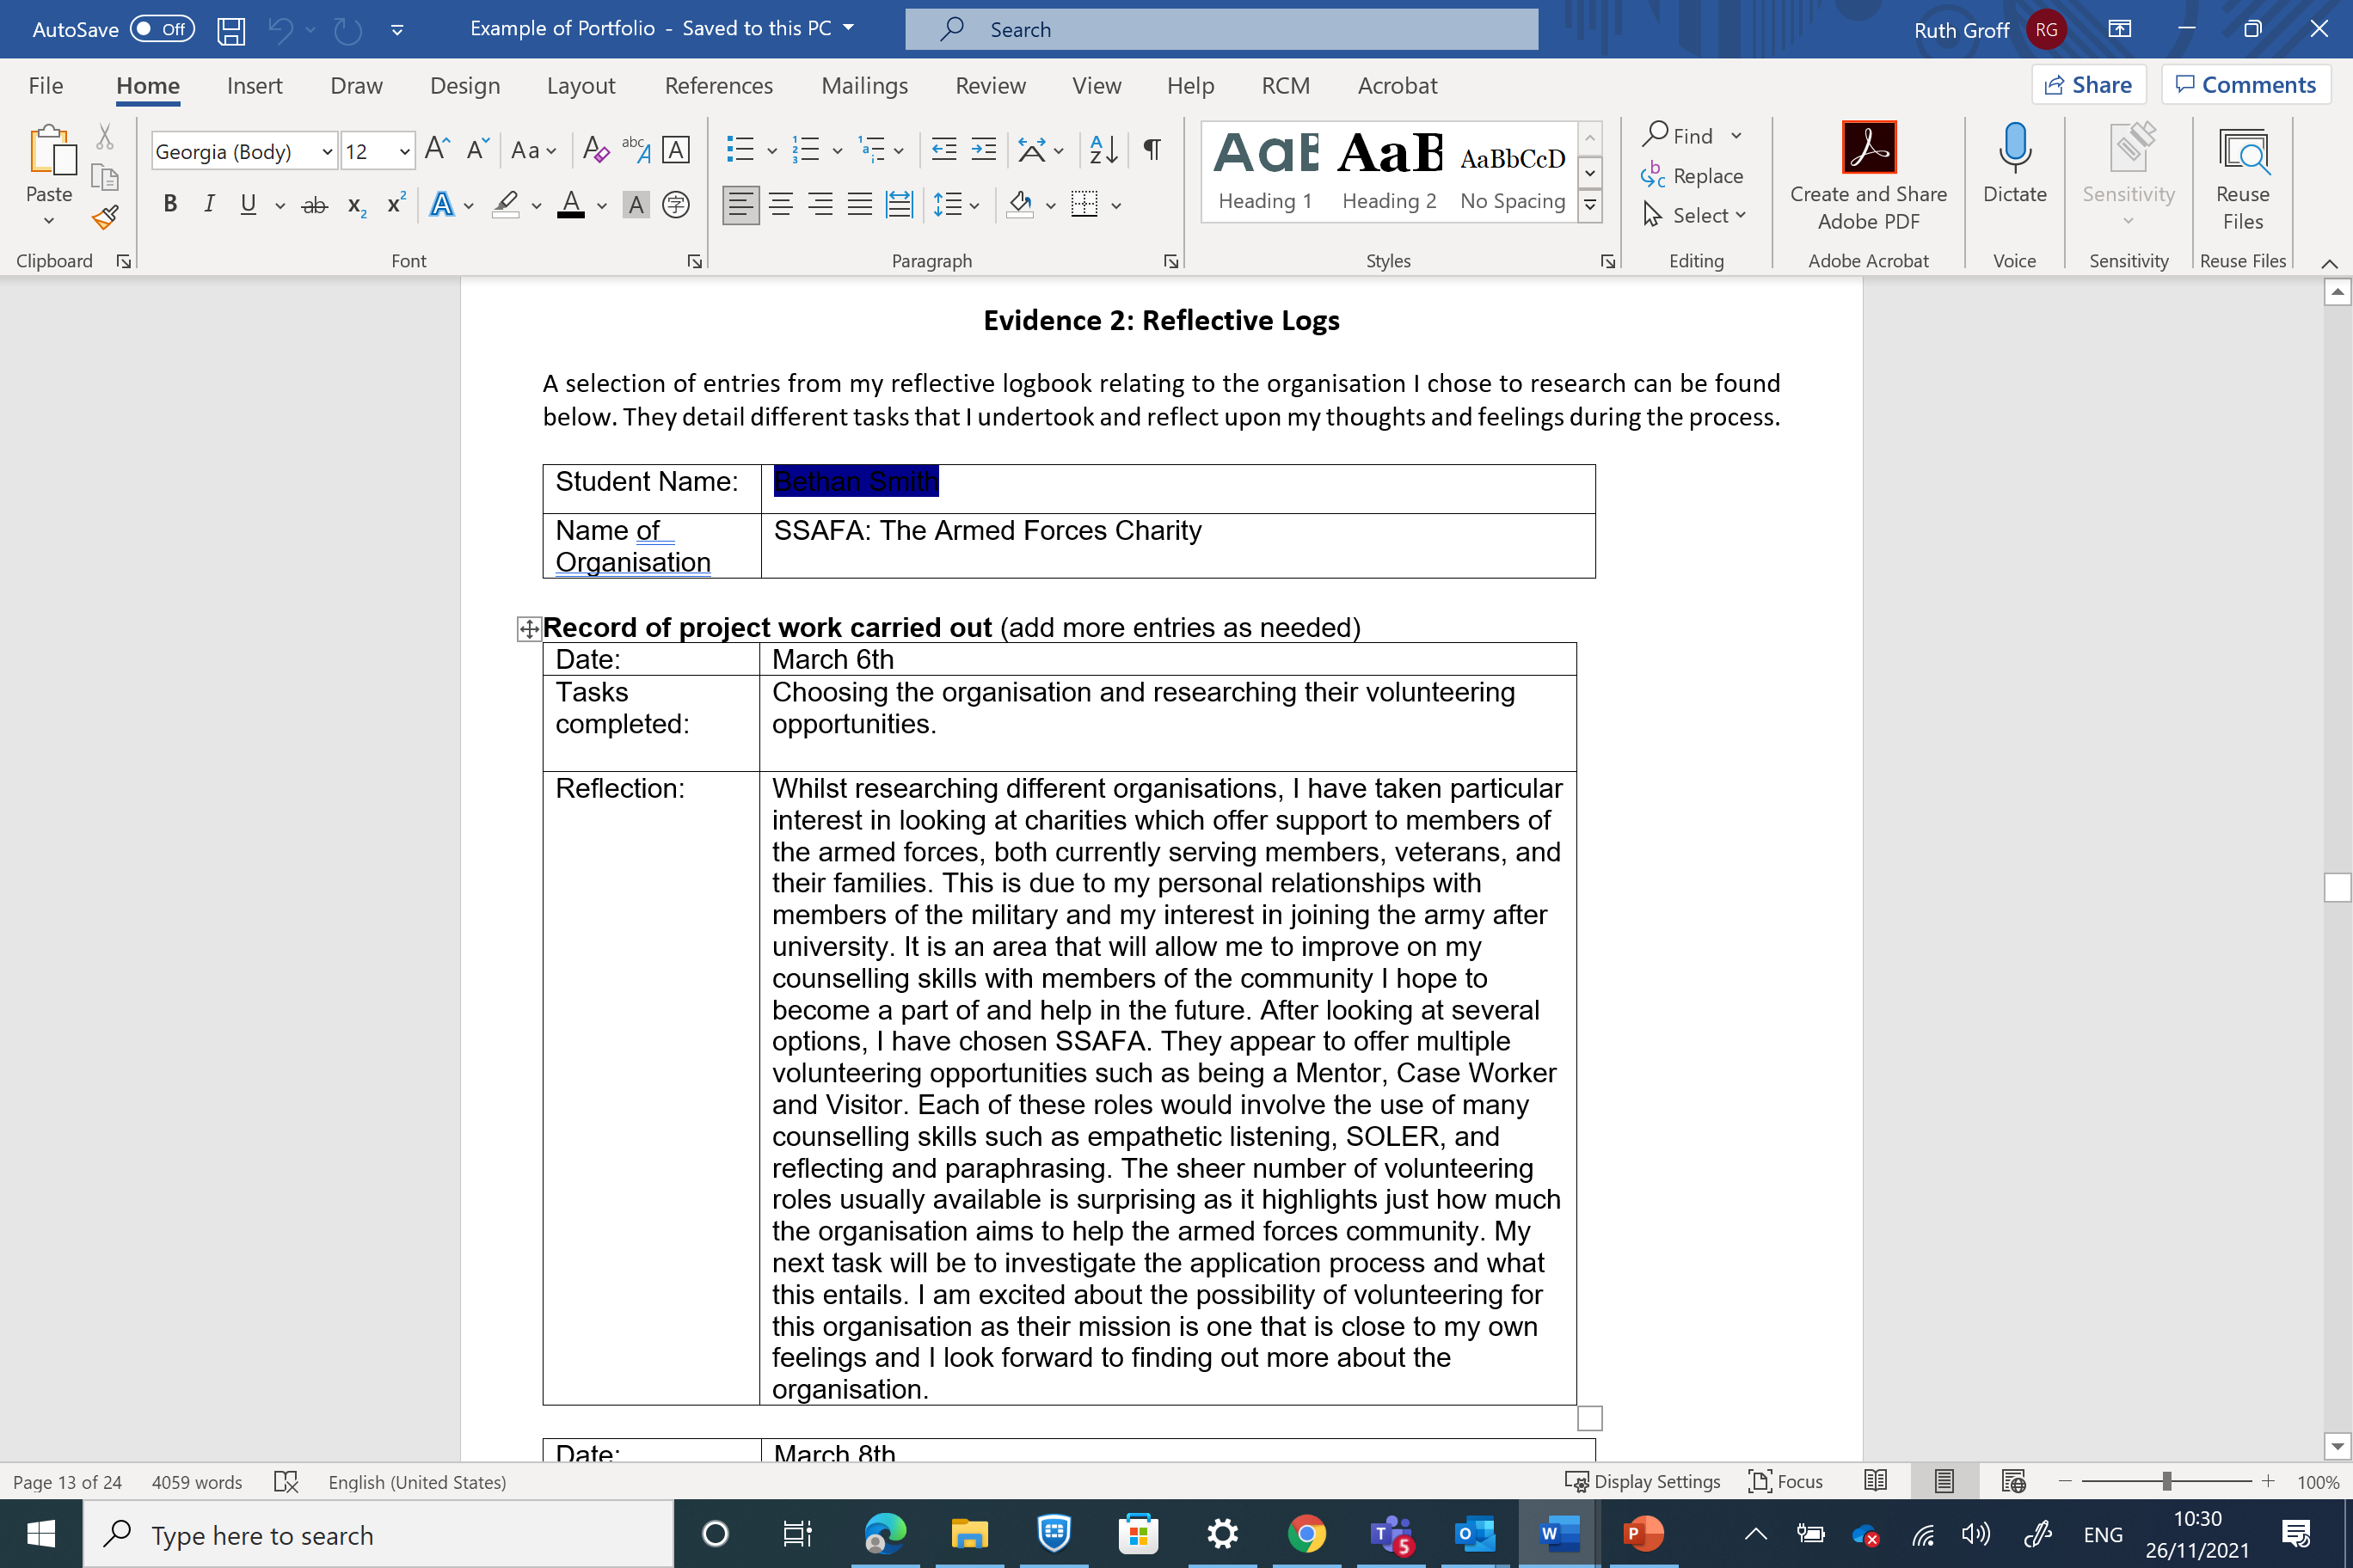

Slide 11
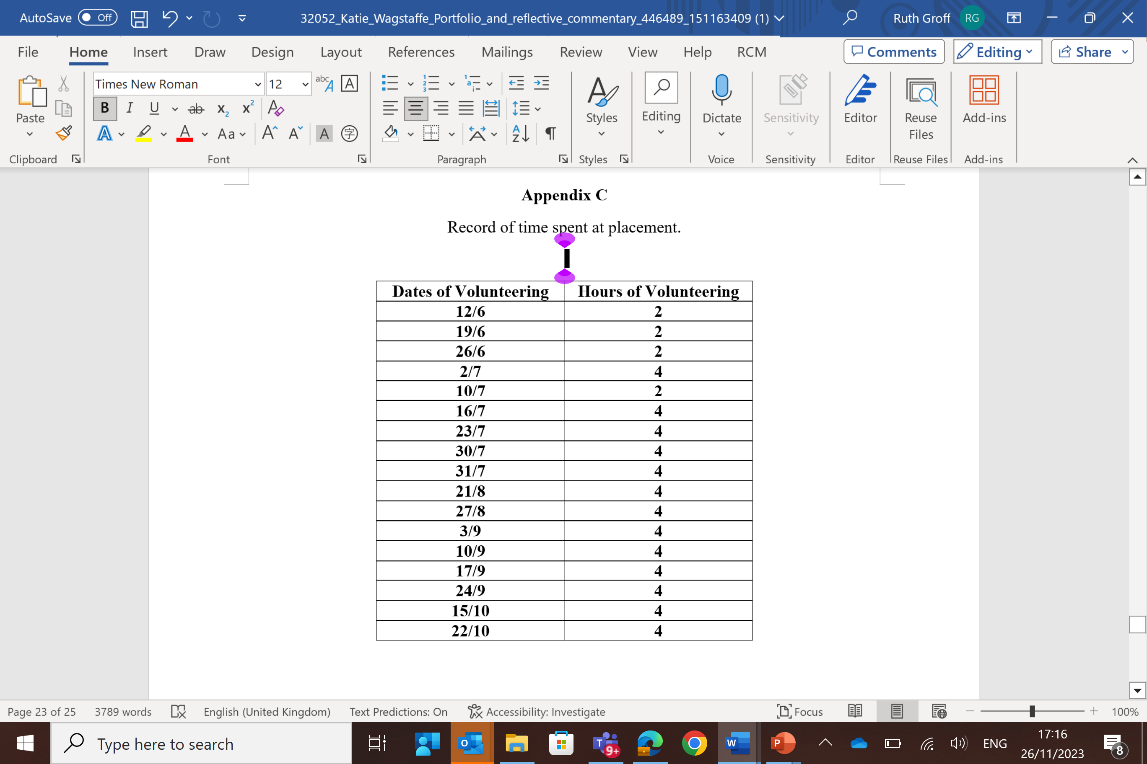
Appendices - Example
A

