Slide 1
ECCE4005C
Dysgu i Bawb: Cyflwyniad i ADY
Sesiwn 6
Anghenion cyfathrebu, synhwyraidd a chorfforol
ECCE4005
Learning for All: Introduction to ALN
Session 6
Communication, sensory and physical needs

Slide 2
Amcanion y sesiwn
Session objectives
Disgrifio prif anghenion Lleferydd, Iaith a Chyfathrebu;
Esbonio rôl AAC;
Adnabod rhwystrau;
Gwerthuso strategaethau;
Myfyrio ar effaith anawsterau cyfathrebu a rhyngweithio.
Describe key Speech, Language and Communication needs;
Explain the role of AAC;
Identify barriers;
Evaluate strategies;
Reflect on the impact of communication and interaction difficulties.

Slide 3
Sgiliau trosglwyddadwy lefel uwch
High-level transferable skills
Empathi;
Gwrando gweithredol;
Deallusrwydd emosiynol;
Datrys problemau;
Myfyrio beirniadol;
Adeiladu perthnasoedd;
Cyfathrebu effeithiol;
Arfer cynhwysol.
Empathy;
Active listening;
Emotional intelligence;
Problem solving;
Critical reflection;
Relationship building;
Effective communication;
Inclusive practice.

Slide 4

ACEIM SEMH
Anghenion Cymdeithasol, Emosiynol ac Iechyd Meddwl.
Social, Emotional and Mental Health Needs.
(Source: EdTech Innovation Hub, 2026)

Slide 5
ACEIM SEMH
Mae emosiynau ac iechyd meddwl yn dylanwadu ar ddysgu a chyfranogiad;
Gall dysgwyr brofi gorbryder, hwyliau isel, trawma neu anawsterau wrth reoli emosiynau;
Gall anghenion SEMH effeithio ar bresenoldeb, perthnasoedd, ymddygiad a chyrhaeddiad;
Dylai cymorth ganolbwyntio ar berthnasoedd, llesiant a chynhwysiant.
Emotions and mental health influence learning and participation;
Learners may experience anxiety, low mood, trauma, or difficulties regulating emotions;
SEMH needs can affect attendance, relationships, behaviour and attainment;
Support should focus on relationships, wellbeing and inclusion.

Slide 6
Cwestiwn
Question
Pa ffactorau sy'n helpu plant i deimlo eu bod yn cael eu deall a'u cynnwys?
What factors help children feel understood and included?

Slide 7
Pam mae cyfathrebu’n bwysig
Why communication matters
Mae cyfathrebu'n cefnogi:
Dysgu;
Perthnasoedd;
Cyfranogiad;
Lles;
Hunaniaeth.
Communication supports:
Learning;
Relationships;
Participation;
Wellbeing;
Identity.

Slide 8
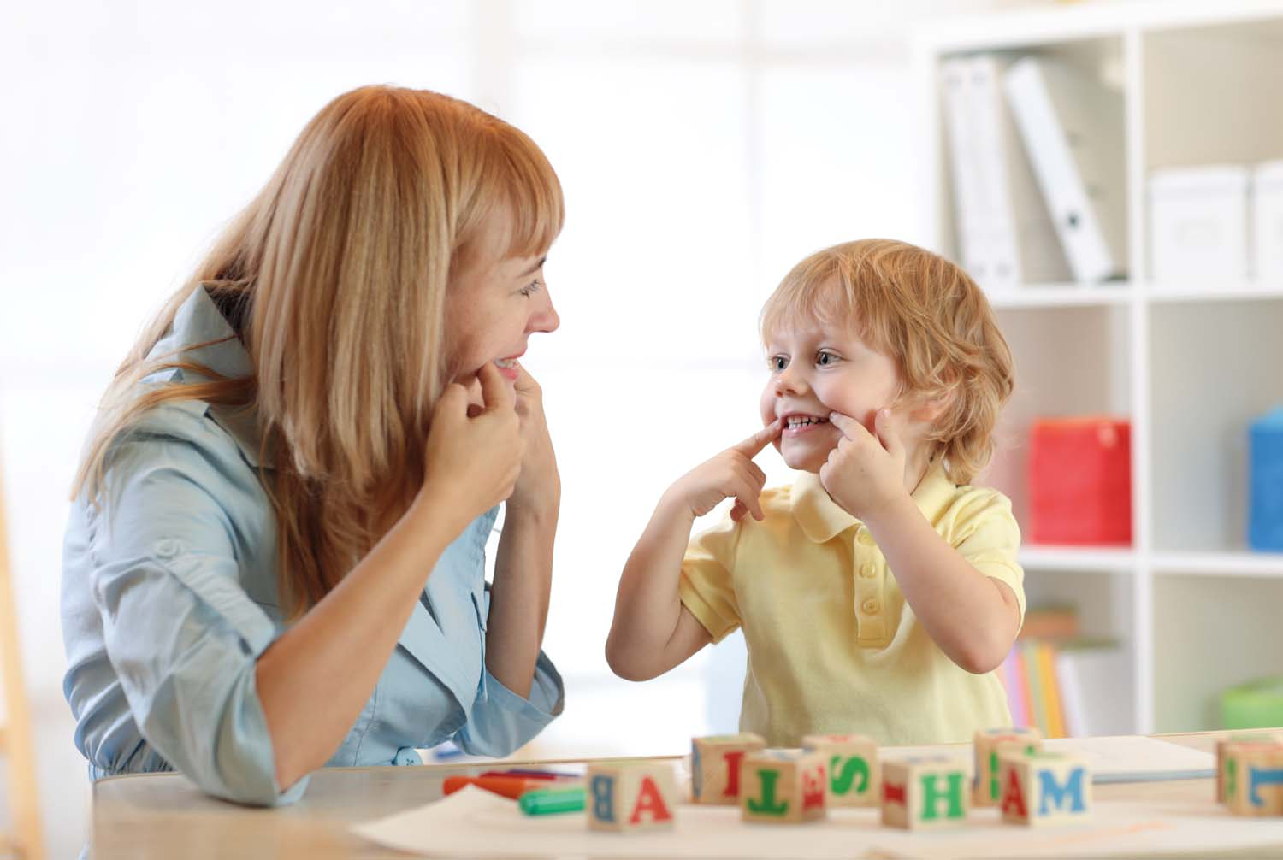
ALlICh SLCN
Anghenion Lleferydd, Iaith a Chyfathrebu
Speech, Language and Communication Needs
(Source: CYP Now, 2023)

Slide 9
Beth yw ALlICh?
What are SLCN?
Lleferydd
Cynhyrchu synau.
Iaith
Deall a defnyddio geiriau.
Cyfathebu
- Rhannu ystyr gydag eraill.
Speech
Producing sounds.
Language
Understanding and using words.
Communication
- Sharing meaning with others.

Slide 10
Anhwylder Datblygiadol Iaith
Developmental Language Disorder (DLD)
Gall dysgwyr brofi anawsterau gyda:
Geirfa;
Deall cyfarwyddiadau;
Sgiliau sgwrsio;
Adrodd straeon.
Learners may experience difficulties with:
Vocabulary;
Understanding instructions;
Conversation skills;
Narrative skills.

Slide 11
Cyfathrebu a llesiant
Communication and wellbeing
Gall anawsterau cyfathrebu gyfrannu at:
Rhwystredigaeth;
Pryder;
Unigrwydd cymdeithasol;
Hyder is.
Communication difficulties may contribute to:
Frustration;
Anxiety;
Social isolation;
Reduced confidence.

Slide 12
Trafodwch…
Discuss…
Nid oes angen diagnosis ar ddysgwr i brofi rhwystrau i ddysgu sy'n gysylltiedig â SEMH.
Ystyriwch arfer ar sail perthnasoedd (Bombér, 2020).
A learner does not need a diagnosis to experience SEMH-related barriers to learning.
Consider relationship-based practice (Bombér, 2020).

Slide 13

Louise Bombér (2020)
Therapydd integredig cofrestredig;
Ymarferydd DPP.
Registered integrative therapist;
DPP practitioner.
DPP – Dyadic Developmental Psychotherapy
(Source: Louise Michelle Bomber, no date)

Slide 14
Neges graidd
Core message
Gall plant a phobl ifanc sydd wedi profi adfyd:
Ei chael yn anodd ymddiried mewn oedolion;
Aros mewn cyflwr uwch o straen;
Cael anhawster wrth hunanreoleiddio;
Camddehongli sefyllfaoedd cymdeithasol;
Angen cydreoleiddio cyn datblygu hunanreoleiddio.
Children and young people who have experienced adversity may:
Struggle to trust adults;
Remain in a heightened state of stress;
Find self-regulation difficult;
Misinterpret social situations;
Require co-regulation before self-regulation.

Slide 15

Astudiaeth achos
Dyma Megan.
Mae hi yn 14 mlwydd oed.
Mae presenoldeb ysgol wedi cwympo.
Nid yw Megan yn cwblhau gwaith cartref.
Dydy hi ddim yn cyfrannu yn y dosbarth ac yn ymddangos yn ddadgysylltiedig.
(Source: Child Mind Institute, 2026)

Slide 16
Un dysgwr, Tair safbwynt
Model Meddygol
Pa anawsterau sydd gan Megan?
Model Gymdeithasol
Pa rwystrau a allai fod yn effeithio ar Megan?
Model Perthnasoedd (Bombér)
Beth allai Megan fod yn ceisio ei gyfleu drwy ei hymddygiad neu ei diffyg ymgysylltiad?
Pa oedolion dibynadwy y gallai ei chefnogi?
Sut gallai'r ysgol gryfhau perthnasoedd o'i chwmpas?

Slide 17
Case study
This is Megan.
She is 14 years old.
Attendance at school has dropped.
Homework is often incomplete.
She rarely contributes in class and appears disengaged.
(Source: Child Mind Institute, 2026)

Slide 18
One learner, Three perspectives
Medical Model
What difficulties does Megan have?
Social Model
What barriers may be affecting Megan?
Relationships Model (Bombér)
- What might Megan be communicating?
- Which trusted adults could support her?
- How might school strengthen relationships?

Slide 19
Arfer sy’n ystyriol o drawma
Trauma-informed practice
Arfer sy’n cydnabod y gall ymddygiad gael ei ddylanwadu gan brofiadau blaenorol:
Adfyd;
Trawma;
Colled;
Straen parhaus.
Recognises that behaviour may be influenced by previous experiences:
Adversity;
Trauma;
Loss;
Chronic stress.

Slide 20
Arfer sy’n ystyriol o drawma
Trauma-informed practice
Pan fydd dysgwr yn teimlo’n anniogel, mae’r ymennydd yn blaenoriaethu goroesi yn hytrach na dysgu.
Gall hyn effeithio:
Sylw
Cof;
Prosesu iaith;
Rheoleiddio emosiynol;
Rhyngweithio cymdeithasol.
When a learner feels unsafe, the brain prioritises survival rather than learning.
This can affect:
Attention;
Memory;
Language processing;
Emotional regulation;
Social interaction.

Slide 21
Cyfathrebu sy’n ystyriol o drawma
Trauma-informed communication
Mae cyfathrebiad sy’n ystyriol o drawma yn canolbwyntio ar greu diogelwch drwy:
Perthnasoedd cadarnhaol;
Ymatebion cyson;
Tiwnio emosiynol.
Trauma-informed communication focuses on creating safety through:
Positive relationships;
Consistent responses;
Emotional attunement.

Slide 22
Cyfathrebu sy’n ystyriol o drawma
Trauma-informed communication
Dylai oedolion:
Wrando'n weithredol;
Adeiladu ymddiriedaeth;
Defnyddio trefnau rhagweladwy;
Darparu diogelwch emosiynol;
Ymateb gyda chwilfrydedd yn hytrach na barnu;
Cydnabod bod ymddygiad yn fath o gyfathrebu.
Adults should:
Listen actively;
Build trust;
Use predictable routines;
Provide emotional safety;
Respond with curiosity rather than judgement;
Recognise behaviour as communication.

Slide 23
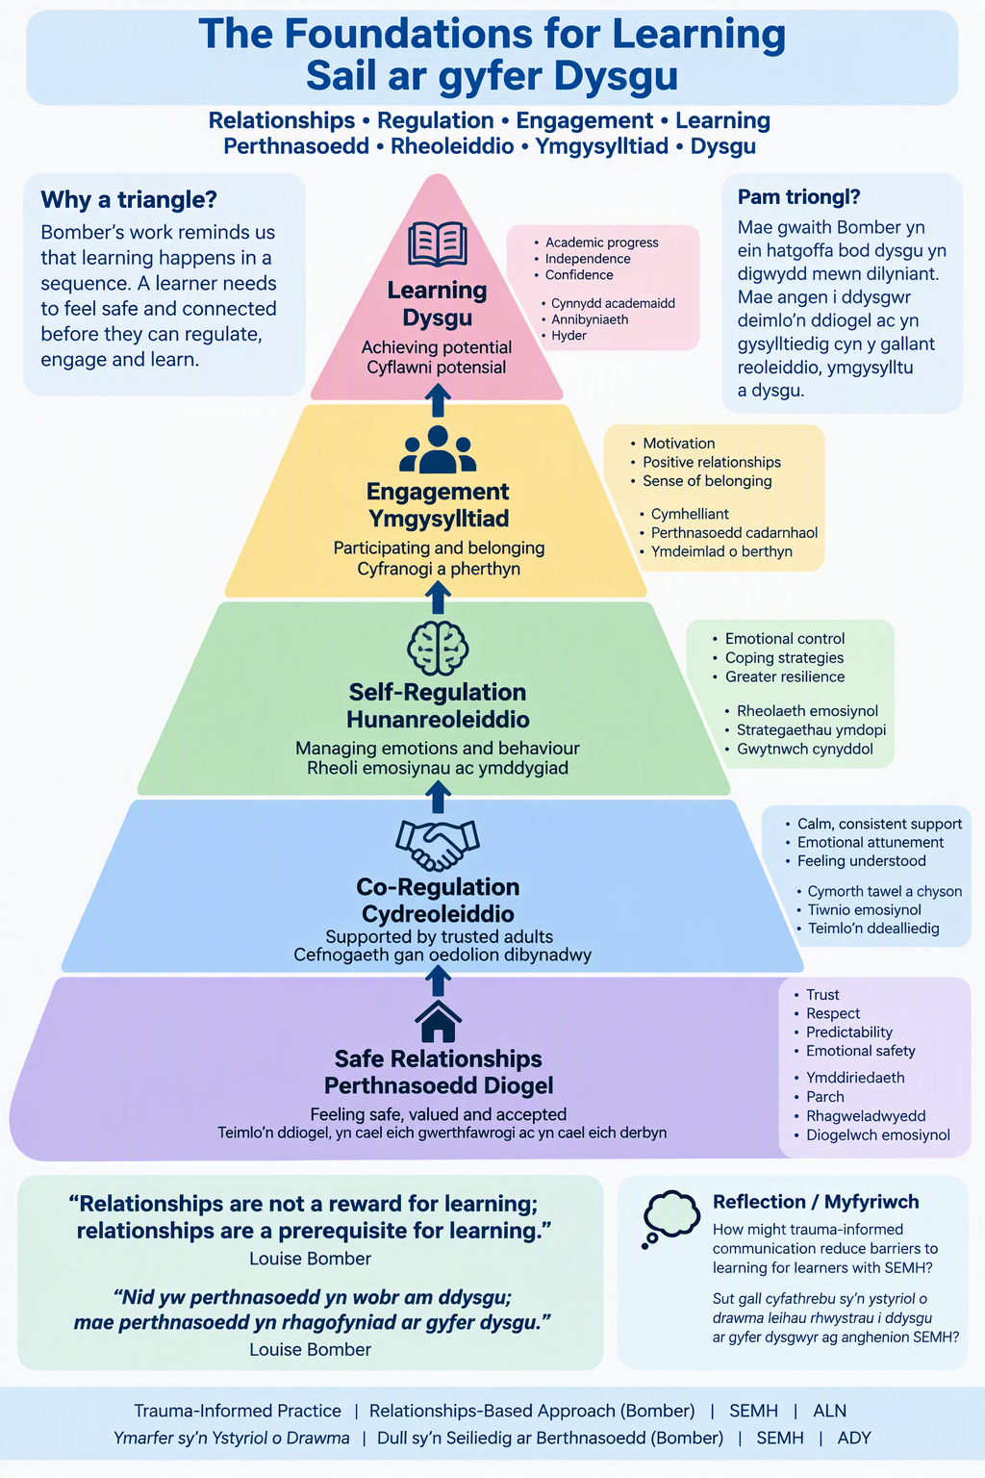
Model Triongl Triangle Model

Slide 24
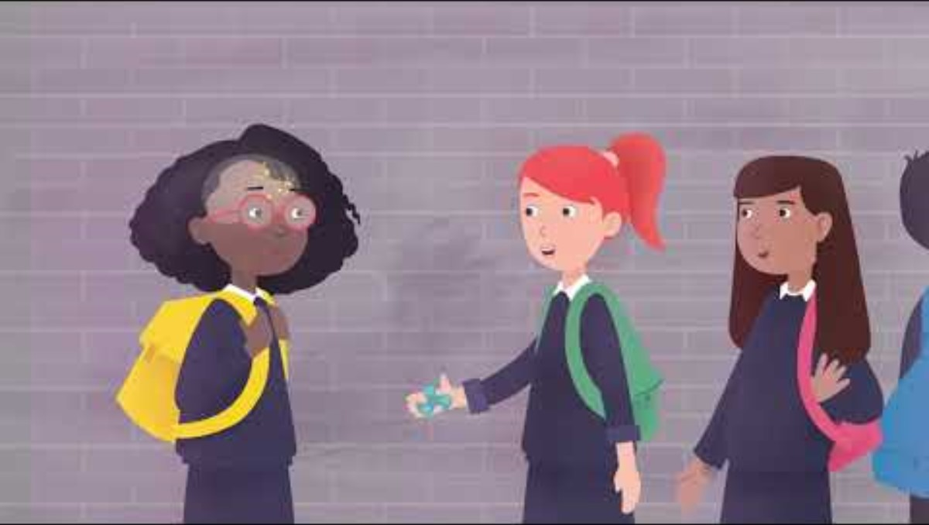
Fideo
Video

Slide 25
Cyfathrebu Estynedig ac Amgen
Augmentative and Alternative Communication (AAC)
Mae AAC yn cynnwys dulliau cyfathrebu sy'n cefnogi lleferydd neu'n cymryd lle lleferydd.
Enghreifftiau:
- Makaton;
PECS;
Byrddau cyfathrebu ;
Llyfrau cyfathrebu;
Dyfeisiau cynhyrchu lleferydd.
AAC includes communication methods that support or replace speech.
Examples:
Makaton;
PECS;
Communication boards;
Communication books;
Speech-generating devices.

Slide 26
Buddion
Benefits
Mae AAC yn gallu:
Cefnogi cyfranogiad mewn dysgu;
Hyrwyddo annibyniaeth;
Gwella rhyngweithio cymdeithasol;
Sicrhau bod llais y dysgwr yn cael ei glywed.
AAC can:
Support participation;
Promote independence;
Improve social interaction;
Ensure learner voice is heard.

Slide 27
Trafodwch
Discuss
Nid yw gallu siarad yr un peth a gallu cyfathrebu.
Gall AAC helpu dysgwyr i gymryd rhan lawn mewn addysg a bywyd bob dydd.
Sut gall AAC gefnogi hawl dysgwr i leisio barn a gwneud dewisiadau?
Speaking and communicating are not the same thing.
AAC helps learners participate fully in education and everyday life.
How can AAC support a learner’s right to express their views and make choices?

Slide 28
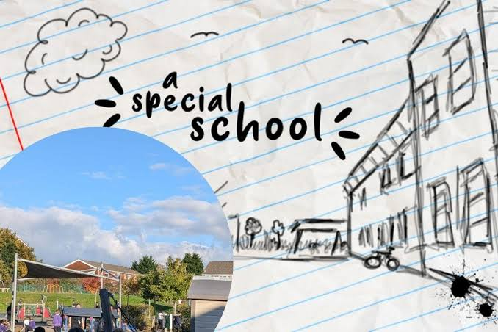
Fideo
Video
View Record: Clip from A Special School · BoB
Source: Barry and District News, 2024)

Slide 29
Gweithdy Ymarferol
Practical Workshop
Archwiliwch:
Systemau symbolau;
Byrddau cyfathrebu;
Apiau AAC;
Cymhorthion gweledol.
Ystyriwch:
Pa mor hygyrch yw pob adnodd?
Pa ddysgwyr allai elwa?
Explore:
Symbol systems;
Communication boards;
AAC apps;
Visual supports.
Consider:
How accessible is each tool?
Which learners may benefit?

Slide 30
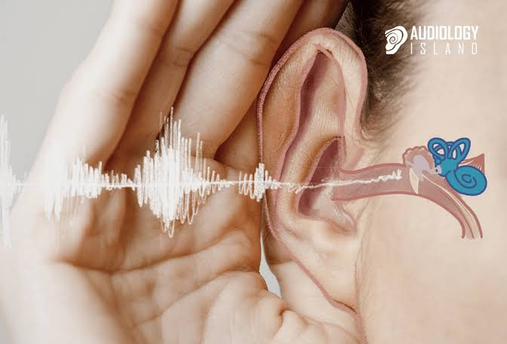
Nam ar y clyw
Hearing impairment
Enghreifftiau:
- Tympan y glust wedi'i ddifrodi;
Geneteg.
Examples:
Damaged ear drum;
Genetics.
(Source: Audiology Island, 2020)

Slide 31
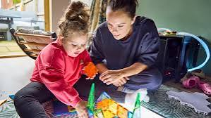
Nam ar y golwg
Visual impairment
Enghreifftiau:
- Colli golwg ganolog;
- Colli golwg ymylol;
Nam gweledol yr ymennydd.
Examples:
Loss of central vision;
Loss of peripheral vision;
Cerebral visual impairment.
(Source: Guide Dogs, 2026)

Slide 32
Archwiliad yr Amgylchedd
Environment Audit
Edrychwch o amgylch y gofod addysgu.
Nodwch rhwystrau sy’n berthnasol i:
Clywed;
Golwg;
Cyfathrebu;
Mynediad corfforol.
Take a look around the teaching space.
Identify barriers related to:
Hearing;
Vision;
Communication;
Physical access.

Slide 33
Deall anableddau corfforol
Understanding physical disabilities
Mae anableddau corfforol yn effeithio ar unigolion mewn ffyrdd gwahanol.
Gall anghenion gynnwys:
Symudedd;
Lleoli;
Mynediad;
Rheoli blinder.
Physical disabilities affect individuals differently.
Needs may involve:
Mobility;
Positioning;
Access;
Fatigue management.

Slide 34
Symudedd
Mobility
Gallu dysgwr i symud yn annibynnol ac yn ddiogel;
Gall rhai dysgwyr brofi:
Anableddau corfforol;
Cyflyrau meddygol;
Anafiadau;
Gwahaniaethau datblygiadol.
A learner’s ability to move independently and safely;
Some learners may experience:
Physical disabilities;
Medical conditions;
Injuries;
Developmental differences.

Slide 35
Lleoli
Positioning
Sut mae dysgwr yn eistedd neu'n cael ei gefnogi'n gorfforol;
Mae safleoli priodol yn dylanwadu ar:
Sylw a chanolbwyntio;
Mynediad at ddeunyddiau dysgu;
Cyfathrebu a rhyngweithio cymdeithasol;
Lles a chysur corfforol.
How a learner is seated of supported physically;
Appropriate positioning influences:
Attention and concentration;
Access to learning materials;
Communication and social interaction;
Physical wellbeing and comfort.

Slide 36
Mynediad
Access
Sicrhau bod pob dysgwr yn gallu ymgysylltu'n ystyrlon â chyfleoedd dysgu.
Mae mynediad yn ymestyn y tu hwnt i hygyrchedd corfforol ac yn cynnwys:
Mynediad at gyfathrebu;
Mynediad synhwyraidd;
Mynediad digidol;
Mynediad at y cwricwlwm.
Ensures all learners can engage meaningfully with learning opportunities.
Access extends beyond physical accessibility and includes:
Communication access;
Sensory access;
Digital access;
Curriculum access.

Slide 37
Blinder
Fatigue
Gall blinder effeithio ar:
Sylw a chanolbwyntio;
Cof a phrosesu gwybodaeth;
Cyfathrebu;
Rheoleiddio emosiynol;
Cyfranogiad corfforol.
Fatigue can affect:
Attention and concentration.
Memory and information processing.
Communication.
Emotional regulation.
Physical participation.

Slide 38

Anghenion meddygol
Medical needs
Enghreifftiau:
Epilepsi;
Diabetes;
Asthma;
Cyflyrau iechyd cymhleth.
Examples:
Epilepsy;
Diabetes;
Asthma;
Complex health conditions.
(Source: OECD, 2024)

Slide 39
Gall effeithio...
May affect…
Bresenoldeb a chyfranogiad;
Lefelau egni a chanolbwyntio;
Gweithgarwch corfforol a symudedd;
Mynediad at brofiadau dysgu;
Lles emosiynol.
Attendance and participation;
Energy levels and concentration;
Physical activity and mobility;
Access to learning experiences;
Emotional wellbeing.

Slide 40
Cwestiwn
Question
Pam mae gwaith amlasiantaethol yn bwysig i ddysgwyr ag anghenion meddygol?
Ystyriwch:
Rhieni a gofalwyr;
Gweithwyr iechyd proffesiynol;
Athrawon a staff cymorth;
CADY;
Gwasanaethau cymdeithasol (lle bo'n briodol).
Why is multi-agency working important for learners with medical needs?
Consider:
Parents and carers;
Health professionals;
Teachers and support staff;
ALNCo;
Social services (where appropriate).

Slide 41
Beth yw hygyrchedd?
What is accessibility?
Mae hygyrchedd yn golygu dileu rhwystrau fel bod pawb yn gallu cyfranogi.
Mae hygyrchedd yn cynnwys:
Amgylcheddau corfforol;
Dylunio'r cwricwlwm;
Cyfathrebu;
Adnoddau a thechnoleg;
Dulliau asesu.
Accessibility means removing barriers so everyone can participate.
Accessibility includes:
Physical environments;
Curriculum design;
Communication;
Resources and technology;
Assessment methods.

Slide 42
Addasiadau rhesymol
Reasonable adjustments
Mae addasiadau rhesymol yn newidiadau a wneir i leihau rhwystrau a chefnogi cyfranogiad cyfartal.
Enghreifftiau:
Fformatau amgen;
Adnoddau wedi'u haddasu;
Amser ychwanegol;
Technoleg gynorthwyol;
Asesiadau hyblyg;
Cymorth gweledol;
Trefniadau eistedd hyblyg;
Seibiannau gorffwys.
Reasonable adjustments are changes made to reduce barriers and support equal participation.
Examples:
Alternative formats;
Adapted resources;
Additional time;
Assistive technology;
Flexible assessment;
Visual supports;
Flexible seating;
Rest breaks.

Slide 43
Addasiadau rhesymol ar waith
Angen | Enghraifft o addasiad
Dyslecsia | Troshaenau lliw, testun digidol, amser ychwanegol
Nam ar y golwg | Print bras, deunyddiau sain
Nam ar y clyw | Capsiynau, cyfarwyddiadau gweledol
ADCG | Seibiannau symud, tasgau mewn camau
Awtistiaeth | Amserlenni gweledol, trefnau rhagweladwy
Anabledd corfforol | Dodrefn wedi'u haddasu, mannau hygyrch

Slide 44
Reasonable adjustments in practice
Need | Example of adjustment
Dyslexia | Coloured overlays, digital text, extra processing time
Visual impairment | Large print, audio materials
Hearing impairment | Captions, visual instructions
ADHD | Movement breaks, chunked tasks
Autism | Visual timetables, predictable routines
Physical disability | Adapted furniture, accessible spaces

Slide 45
Senario
Scenario
Mae gan ddysgwr ADHD ac mae'n profi anawsterau gyda chanolbwyntio, trefnu a thasgau ysgrifenedig hir.
Trafodwch:
Pa rwystrau allai'r dysgwr eu hwynebu?
Pa addasiadau rhesymol allai helpu?
Sut gallai'r addasiadau hyn fod o fudd i ddysgwyr eraill?
A learner has ADHD and experiences difficulties with concentration, organisation and lengthy written tasks.
Discuss:
What barriers might the learner face?
Which reasonable adjustments could help?
How might these adjustments benefit other learners?

Slide 46
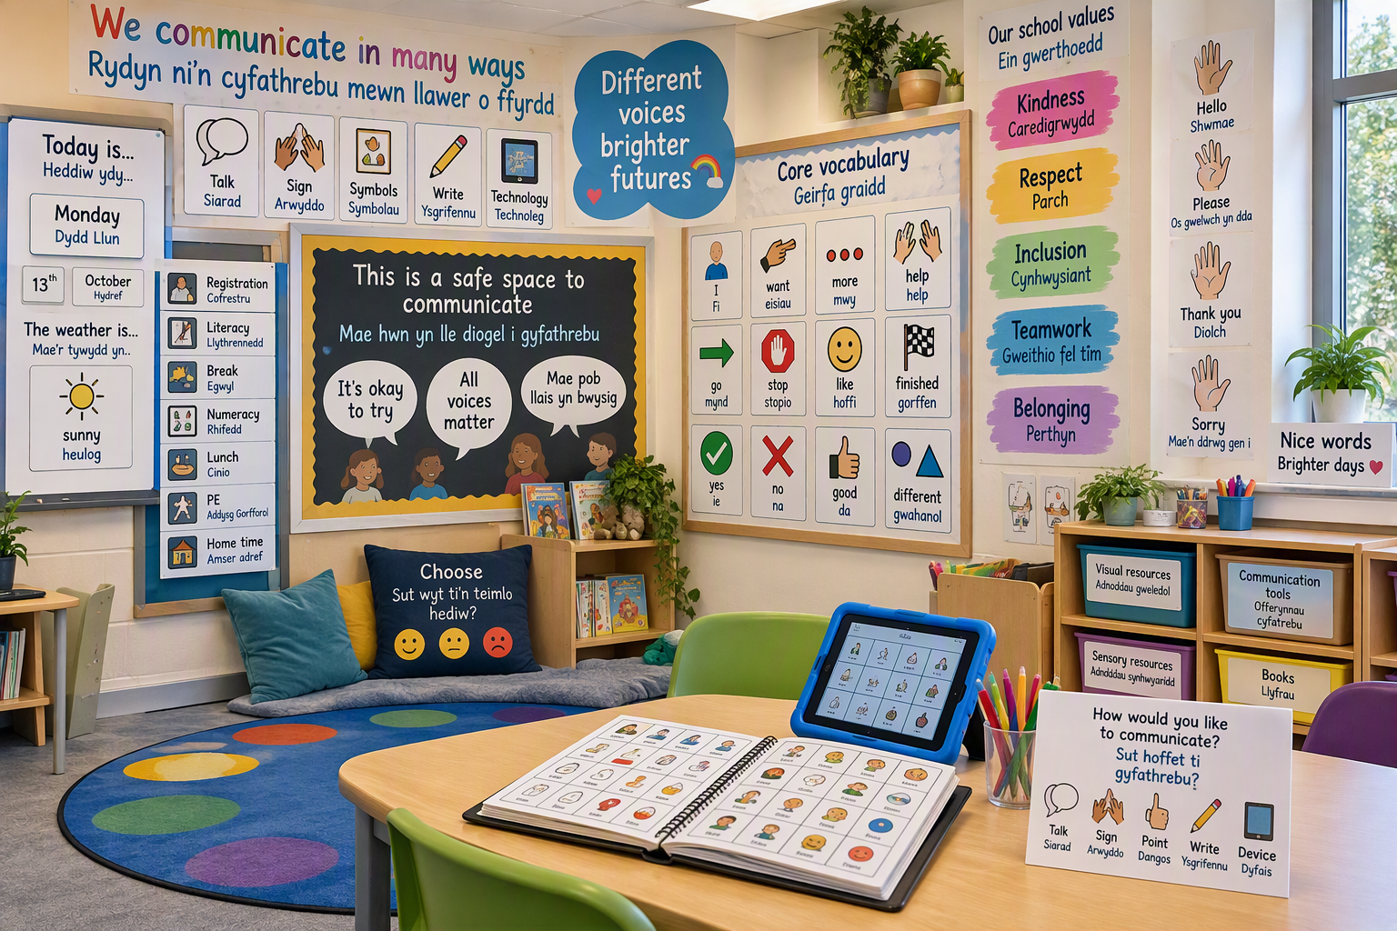

Slide 47
Amgylcheddau cyfoethog mewn cyfathrebu
Communication-rich environments
Nodweddion Allweddol:
Cymhorthion gweledol
Iaith hygyrch
Rhyngweithiadau cadarnhaol
Llais y dysgwr
Cyfathrebu cynhwysol
Key Features:
Visual supports
Accessible language
Positive interactions
Learner voice
Inclusive communication

Slide 48
Adfyfyriad
Reflection
Pryd mae cymorth yn dod yn wirioneddol gynhwysol?
Sut gall rhwystrau cyfathrebu effeithio ar ymdeimlad o berthyn?
Sut gall ymarferwyr leihau rhwystrau?
When does support become genuinely inclusive?
How can communication barriers affect belonging?
What role do practitioners play in reducing barriers?

Slide 49
Crynodeb
Summary
✅ Mae cyfathrebu yn ganolog i ddysgu a llesiant;
✅ Mae AILlI yn effeithio ar ddysgwyr mewn ffyrdd gwahanol;
✅ Gall AAC gynyddu cyfranogiad ac annibyniaeth;
✅ Yn aml gellir lleihau rhwystrau synhwyraidd a chorfforol drwy arfer cynhwysol;
✅ Mae hygyrchedd yn fuddiol i bob dysgwr;
✅ Dylai llais y dysgwr lywio pob cynllun cymorth.
✅ Communication is central to learning and wellbeing;
✅ SLCN affects learners in different ways;
✅ AAC can increase participation and independence;
✅ Sensory and physical barriers can often be reduced through inclusive practice;
✅ Accessibility benefits all learners;
✅ Learner voice should inform all support planning.

Slide 50
Paratoi ar gyfer Sesiwn 7
Preparation for Session 7
ACE Hub Wales (2022) Resources. Available at: https://www.acehubwales.com/resources/ [Accessed: October 26 2026].
Bombér, L.M. (2020) Know Me to Teach Me: Differentiated Discipline for Those Recovering from Adverse Childhood Experiences. 2nd edn. Worth Publishing.
Children’s Commissioner for Wales (2026) Participation. Available at: https://www.childcomwales.org.uk/faqs/participation/ [Accessed: October 26 2026].
Nurture UK (2026) The six principles of nurture. Available at: https://www.nurtureuk.org/the-six-principles-of-nurture/ [Accessed: October 26 2026].
Welsh Government (2021) Additional Learning Needs Code for Wales 2021. Available at: https://www.gov.wales/additional-learning-needs-code [Accessed: October 26 2026].

Slide 51
Cyfeirnodi
Referencing
Bomber, L.M. (2020) Know Me To Teach Me. 2nd edn. Worth Publishing.
Dockrell, J., Law, J. and Lindsay, G. (2020) Supporting Children's Speech, Language and Communication Needs in the Classroom. Routledge.
Florian, L. and Beaton, M. (2018) Inclusive Pedagogy in Action. University of Edinburgh.
Law, J., Charlton, J., Dockrell, J., Gascoigne, M., McKean, C. and Theakston, A. (2017) Early Language Development: Needs, Provision and Intervention for Preschool Children from Socio-Economically Disadvantaged Backgrounds. Education Endowment Foundation.
United Nations (1989) Convention on the Rights of the Child. United Nations.
Welsh Government (2021) Additional Learning Needs Code for Wales 2021. Available at: https://www.gov.wales/additional-learning-needs-code [Accessed: October 26 2026].

