Slide 1

Programme: BA (Hons) Business Management
Module: Entrepreneurship
Module code: LCBB5013
Student name: Iulian Marius Zegheru
Student ID: 2314051

Slide 2
Table of contents
Slide number | Title
3 | Introduction
4-5 | Business Idea, Products/Services, Objectives & USP
6-7 | Business Environment & Competitor Analysis
8-9 | Market Segmentation & Marketing Strategies
10-11 | Legal, Management, and Financial Planning
12 | Conclusion
13 | Reference list

Slide 3
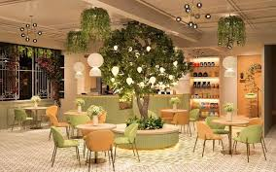
Introduction
This presentation will offer a brief idea of MoodBrew Café, a mood-driven café.

Slide 4

Business Idea, Products, Objectives, and USP
A café that will allow customers to select café ambience and food options according to their moods.
Notes:
The business will leverage smart technologies and integrate them with a mobile application to allow customers to gain a unique experience.

Slide 5

Business Idea, Products, Objectives, and USP (Continued)
Objectives
To acquire 500 app downloads and 120-150 customer footfall per day
To increase brand awareness and social media presence
USP
Mood-driven café, offering personalised experiences and food recommendations
Notes:
The café will focus on the emotional comfort and well-being of customers by allowing them to enjoy the ambience as per their mood.

Slide 6
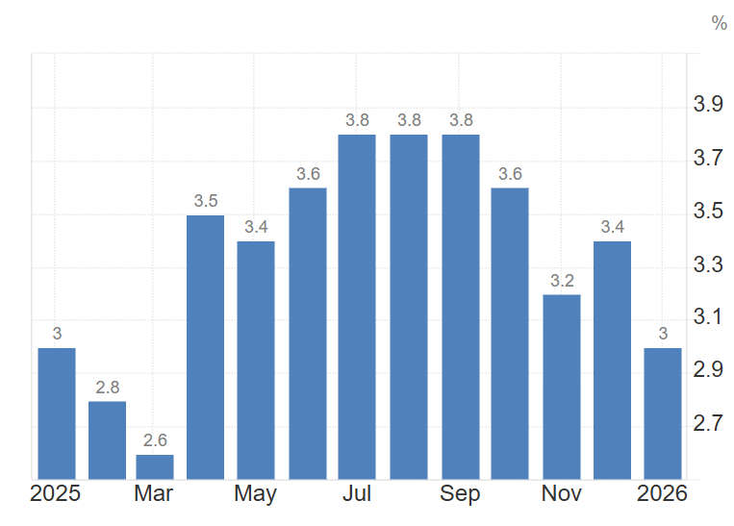
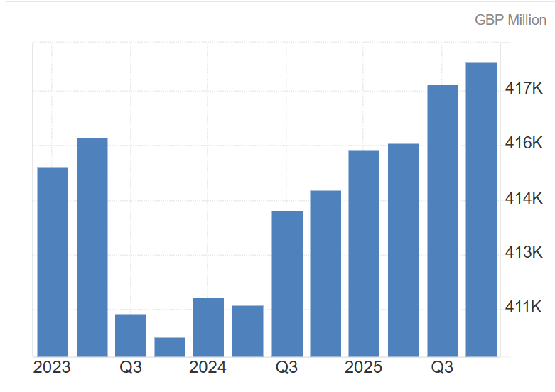
Business Environment and Competitor Analysis
Declining inflation rate of 3% as of January 2026 (Trading Economics, 2026)
Increasing consumer spending of $418232 million (Trading Economics, 2026)
Notes:
However, political stability declined to 0.26, which can affect business operations (The Global Economy, 2026).

Slide 7
Business Environment and Competitor Analysis (Continued)
Forces | Impact
Competitors | High
Supplier power | High
Customer power | High
Threats of new entrants | Moderate
Threats of substitute products | Moderate
Notes:
The main competition MoodBrew Café will face includes Urban Social, The Palm Court, Tattle Coffee House and so on (Trip Advisor, 2026).

Slide 8
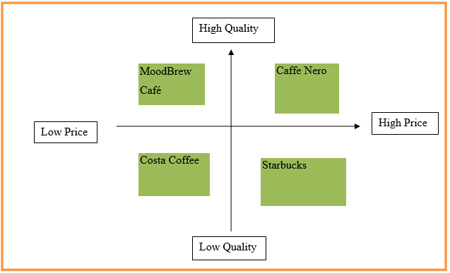
Market Segmentation and Marketing Strategies
Segmentations: Demographic, behavioural, and psychographic
Targeting: young adults aged 18-35 years
Positioning: A new and personalised café
Notes:
MoodBrew Café will mainly target the younger demographics, who are seeking personal experiences and are inclined to the aesthetic appeal of mood-driven café offerings. Targeting the younger audience is important as Generation Z are seeking more hyper-personalised food and beverage services (Mintel, 2025).

Slide 9
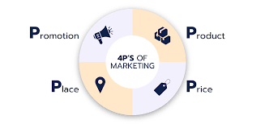
Market Segmentation and Marketing Strategies (Continued)
Product: A curated selection of food and beverage options to go with the service of selecting moods through the mobile app.
Price: Value-based pricing to suit the unique experience offered by the café
Notes:
Located in London, the café will promote itself using digital marketing tools like social media marketing, experiential marketing, and such.

Slide 10
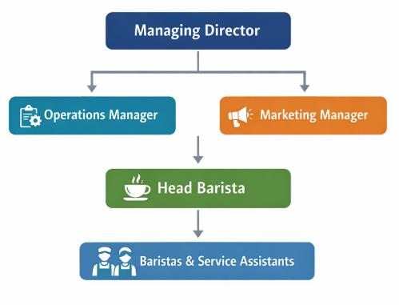
Legal, Management and Financial Planning
A simple but effective organisational structure that will ensure the provision of good customer service
Notes:
MoodBrew Café will operate as a limited company. The managing director will be at the top of the business, with operations manager and marketing managers being responsible for daily operations and marketing activities, respectively.

Slide 11
Legal, Management and Financial Planning (Continued)
Expense Category | Estimated Cost (£)
Property lease and deposit | 15,000
Interior design and décor | 10,000
Lighting and sound technology system | 8,000
Coffee machines and kitchen equipment | 12,000
Furniture and seating | 7,000
Mobile application development | 10,000
Initial marketing and promotion | 5,000
Licences and legal registration | 3,000
Initial inventory (coffee, ingredients) | 2,500
Contingency fund | 2,500
Total Estimated Start-Up Cost | 75,000
Notes:
The total estimated costs for the start-up are £75,000.

Slide 12

Conclusion
The uniqueness of MoodBrew Café to prioritise customer well-being by enabling them to enjoy a unique experience by selecting their moods can make it stand out.

Slide 13
Reference List
Mintel (2025) UK Technology in Leisure and Foodservice Market Report 2025. Available at: https://store.mintel.com/report/uk-technology-in-leisure-and-foodservice-market-report (Accessed: 14 March 2026).
The Global Economy (2026) United Kingdom: Political stability. Available at: https://www.theglobaleconomy.com/United-Kingdom/wb_political_stability/ (Accessed: 14 March 2026).
Trading Economics (2026) United Kingdom Consumer Spending. Available at: https://tradingeconomics.com/united-kingdom/consumer-spending (Accessed: 14 March 2026).
Trading Economics (2026) United Kingdom Inflation Rate. Available at: https://tradingeconomics.com/united-kingdom/inflation-cpi (Accessed: 14 March 2026).
Trip Advisor (2026) Cafés in London. Available at: https://www.tripadvisor.co.uk/Restaurants-g186338-c8-London_England.html (Accessed: 14 March 2026).

Slide 14


