Slide 1
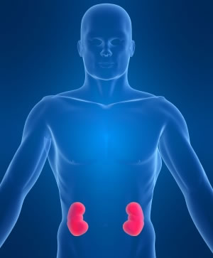
The kidneys
& filtration
Sarah Dalton
This Photo by Unknown Author is licensed under CC BY-ND

Slide 2
There are 2 kidneys within the human body and they are located in the back of the body behind the abdomen(retroperitoneal).
They play a vital role in homeostasis
They control what is in the blood
They clean the blood by acting as filters
They have 3 main functions within the body
Remove urea from the blood(produced in the liver and is poisonous)
To control the amount of ions(salt) in the blood(as a result of diet)
To control the water content within the blood

Slide 3

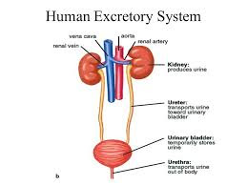
This Photo by Unknown Author is licensed under CC BY-NC-ND

Slide 4
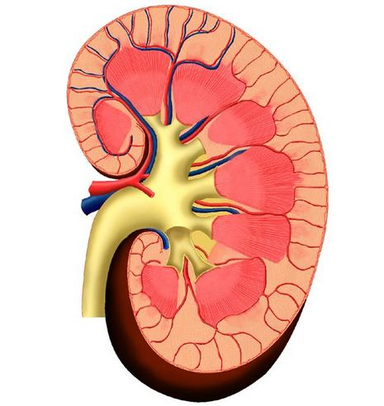
This is what a kidney looks like if it is cut in half.
There are 3 regions
Renal cortex (outer layer)
Renal Medulla (middle layer)
Renal pelvis (inner area)

Slide 5

There are 3 stages in the filtration process
Ultrafiltration
Reabsorption
The release of waste

Slide 6
Nephrons
There are approximately 1 million nephrons in a kidney. The nephron can be thought of as the main unit of the kidney. Each nephron will filter a small amount of blood. Initially blood will enter the kidney via the renal artery. The artery becomes more branched and smaller creating a lot of blood pressure. Very much like tree branches becoming twigs. After entering the glomerulus via the afferent arteriole small molecules will leave the glomerulus i.e. salts, amino acids, urea and water. The increased pressure of the blood squeezes the water, urea, ions and sugar out of the blood. This process is known as ultrafiltration. After this initial process the removed is known as glomerular filtrate.

Slide 7
The important thing to remember is that not everything that is filtered is disposable. There are things that have been removed at the ultrafiltration stage that the body will still need. The waste will continue through the tubule until it reaches the proximal tubule where by a process of diffusion aids any useful substances to re-enter the blood i.e. ions, glucose. As urea is poisonous it will continue the journey through the tubule. Water is however filtered at the next stage.
The glomerular filtrate will continue until it is at the loop of Henle. As the loop of Henle is within the medulla and it is high in salt concentration the water is aided to re enter the blood by a process of osmosis.
Lastly before entering the collecting ducts the filtrate will go through the distal tubule which is a sort of fine tuning.
The remaining filtrate is now made up of urea and unwanted salts and water. We know it as urine.

Slide 8
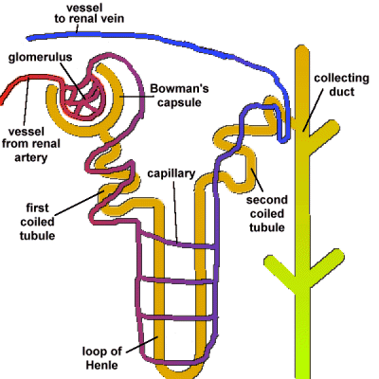
This Photo by Unknown Author is licensed under CC BY-SA-NC

Slide 9
Group activity
Split into 2 groups
You have been asked to show a group of year 7 students how filtration works. Come up with a simple and creative way to show them. You must include the bowman's capsule and the Loop of Henle.
The more creative the better.

Slide 10
When things go wrong
Swelling in feet, hands, face, ankles or even legs
Changes in the appearance or frequency of urine
Nausea &vomiting
Feeling tired or lethargic in the day
Pains in your legs
Bad taste
Experiencing itchy rashes
aneamia
This is due to water retention. If the kidneys are not functioning correctly it can lead to fluid build up in the tissue.
It makes sense that as urine is an end result of kidney filtration any change would indicate an issue
This is an indication that toxins are not being removed
Stressed kidneys wont produce the hormone to stimulate red blood production
Kidney stones can produce back and leg pain
The increase in toxins can create not only a bad taste in your mouth but also bad breath
Build up of uric acid can create itchy patches on the skin that don’t appear to ease
Kidneys not operating properly will not produce red blood producing hormones

Slide 11
Key words
homeostasis – the constant balance of the internal environment.
Osmosis – fluids diffusing through a membrane, sometimes to equalise the concentration either side of the membrane.

Slide 12
Reference list
how stuff works. 2018. how your kidneys work. [ONLINE] Available at: https://health.howstuffworks.com/human-body/systems/kidney-urinary/kidney2.htm. [Accessed 25 October 2018].
AQA. 2018. assessment resources. [ONLINE] Available at: https://learn2.open.ac.uk/mod/oucontent/view.php?id=1041680§ion=1.4. [Accessed 24 October 2018].
good free photos. 2018. man sitting on the toilet. [ONLINE] Available at: https://www.goodfreephotos.com/cache/vector-images/man-sitting-on-the-toilet-vector-clipart_w80_h80_cw80_ch80_thumb.png. [Accessed 28 October 2018].
dictionary .com. 2018. osmosis. [ONLINE] Available at: https://www.dictionary.com/browse/osmosis. [Accessed 30 October 2018].
save institute. 2018. 8 early warning signs your kidneys arent working as the should. [ONLINE] Available at: https://saveourbones.com/8-early-warning-signs-your-kidneys-arent-working-as-well-as-they-should/. [Accessed 28 October 2018]
Ash et al, P., 2006. book 3 Body systems. 2nd ed. Milton Keynes: Open University

