Slide 1


The 60’s
How it impacted upon young people, their lives communities, on policy development and Youth Work practice

Slide 2
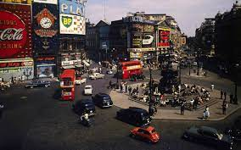
Life in the 60’S
Described by Watson as the decade that shook Britain. The swinging 60’s was a decade of rapid change. London had transformed from a bleak Conservative city that began to forget the troubles of the Second World War.
The city quickly became the centre of all excitement, full of freedom, hope and promise.
The vibrant West End of London in 1961 was the battleground between the new minicabs and black taxis
(London’s original minicab wars (2021)

Slide 3
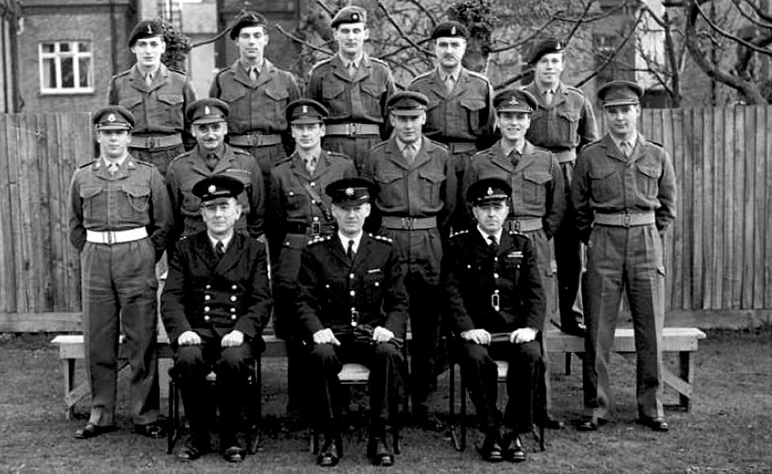
Key events in the 60’s
The Last man to do National service (2015)
1960 – Began the end of National Service.
The 60’S saw the first teenage generation free form conscription, giving them a voice and the freedom to do what they wanted

Slide 4
According to Davenport-Hines (2014) “every fortnight 6000 male youths were conscripted, with a total of 2,301,000 over the period National service was mandatory”.
(Davenport-Hines, 2014, no page no)
Concern began to grow in society about what all these young youths would now be doing without what many viewed as the disciplinarian values and structure that the military had provided.

Slide 5
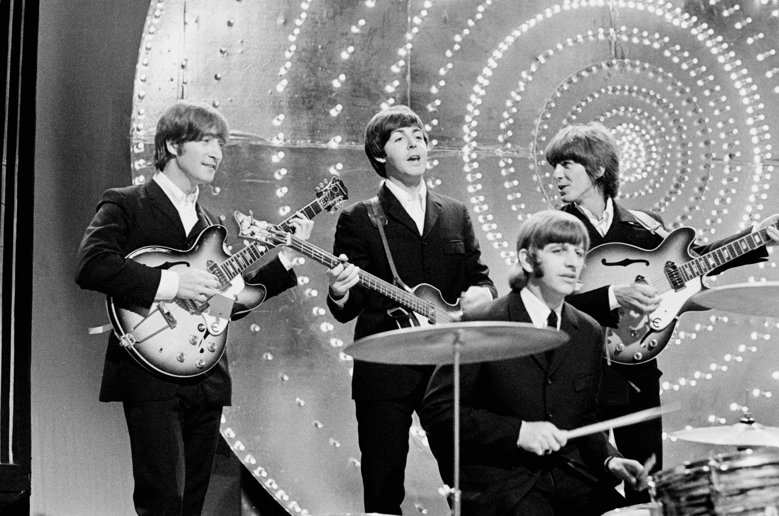
1960
USA enters the Vietnam war.
NASA’S space probe is launched.
An emerging British band called the Beatles perform their first public performance.
The music scene began to explode with rock and roll!
The Beatles perform on Top of the Pops in June 1966 Mark and Colleen Hayward
Artists like the Beatles began to influence the lives of young people many of their later albums included lyrics encouraging rebellion against authorities. Young People began to stand up for their beliefs and express individuality.

Slide 6
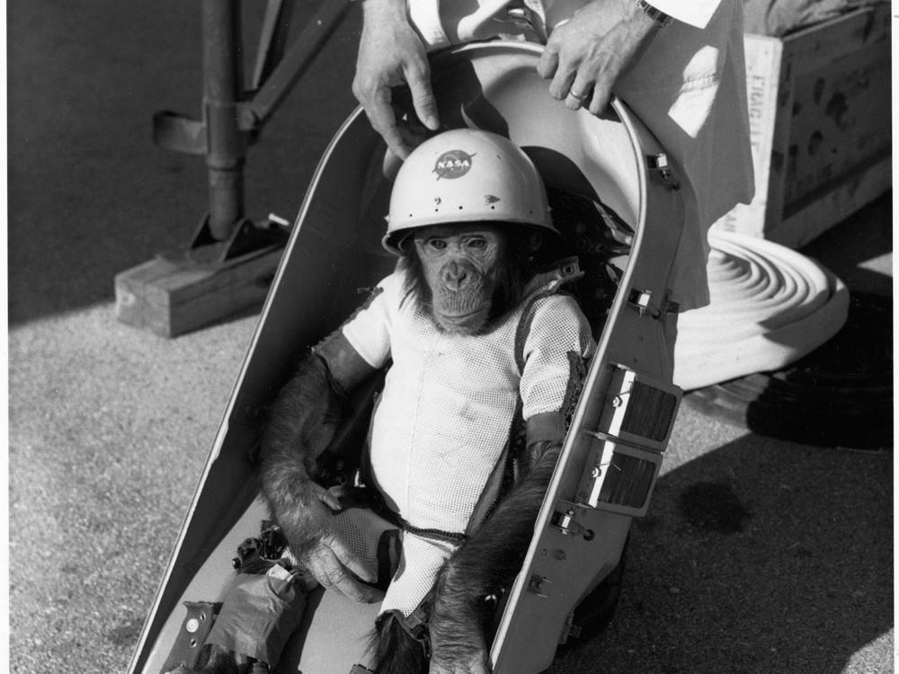
1961
Ham the chimp becomes the first ape in Space.
Construction of the Berlin wall begins forming a solid boundary between East and West Germany.
Contraceptive pill becomes available to married women only on the NHS .
Current PM McMillan had talked about affluence in a recent speech saying that people in Britain had never had it so good.
Unemployment rate was low at just 2% resulting in young people having more than before.
Mercury Primate Capsule and Ham the Astrochimp
Nov 10, 2015

Slide 7
1962
The Beatles release their first single.
The South African government arrests Nelson Mandela and charge him with incitement to rebellion.
The world comes close to Nuclear warfare with the Cuban missile crisis (Cold War) between USA and the Soviet Union.
Technology began to develop rapidly as did the growth of mass media, exposing young people more to what was happening all around the world.

Slide 8
1963
Beatle-mania arrives in the United states.
Nelson Mandela is sentenced to life imprisonment in South Africa and sent to Robben Island prison.
The 1964 Olympics takes place in Tokyo.
The house of Commons votes to abolish the death penalty for Murder in Britain.
BBC launched its second channel and Top of the pops began broadcasting.
Labour government is elected and Harold Wilson becomes PM
1964
Assassination of JFK.
U.S Civil Rights Leader Martin Luther King JR gives a speech “I have a dream”. Sparking a real movement against racial discrimination.
The Profumo Affair proved to be detrimental to Conservative party paving the way for the Labour government in the next general election.
The Bristol bus company saga (Paul Stephenson led a 60 day bus boycott and the news of racism made headlines

Slide 9
1965
The Race Regulations Act 1965 is created in the UK to address racial discrimination.
Winston Churchill dies.
National Speed limit of 70mph is introduced.
1966
England beat West Germany to win the football world cup.
In Aberafon, South Wales , 116 children and 28 adults are killed as a coal waste heap slid onto a school.
Queen Elizabeth 11 officially opens the Seven Bridge.
Both USA and USSR sign a treaty to prohibit nuclear weapons in outer Space.

Slide 10
1968
1967
The Beatles release “Sgt. Pepper’s Lonely Hearts Club Band” nicknamed the soundtrack of summer love.
Peace rallies continued to grow regarding the Vietnam war.
Colour televisions became popular as their price came down.
Abortion Act of 1967 legalised termination of pregnancies under 28 weeks.
Changes were made to the Sexual offences act (1967 which decriminalised homosexuality activity between two men over 21 years old
The My Lai massacre occurs in which 400 unarmed Vietnamese civilians are killed .
Martin Luther King is assonated.
The first Big Mac goes on sale in McDonalds.
Protesters gathered in London Grosvenor square outside the American embassy.

Slide 11
1969
Neil Armstrong and Buzz Aldred walk on the Moon.
The Beatles give their last public appearance.
The boing 747 takes-off on its maiden flight.
John Lennon returns his MBE medal in protest to the British governments support of the Vietnam war.
Prince Charles is in invested with the title ‘Prince of Wales’ at Caernarfon in a televised ceremony.
By the end of the decade Young people had really found their voices and continued to campaign against wars, sexism, racism and authoritarianism this went on to play a major role in social revolution.

Slide 12
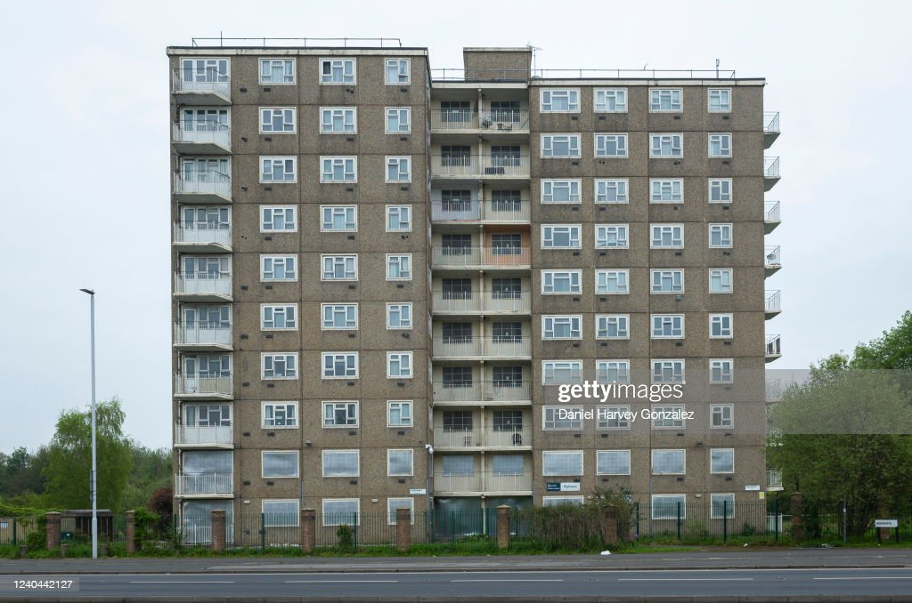
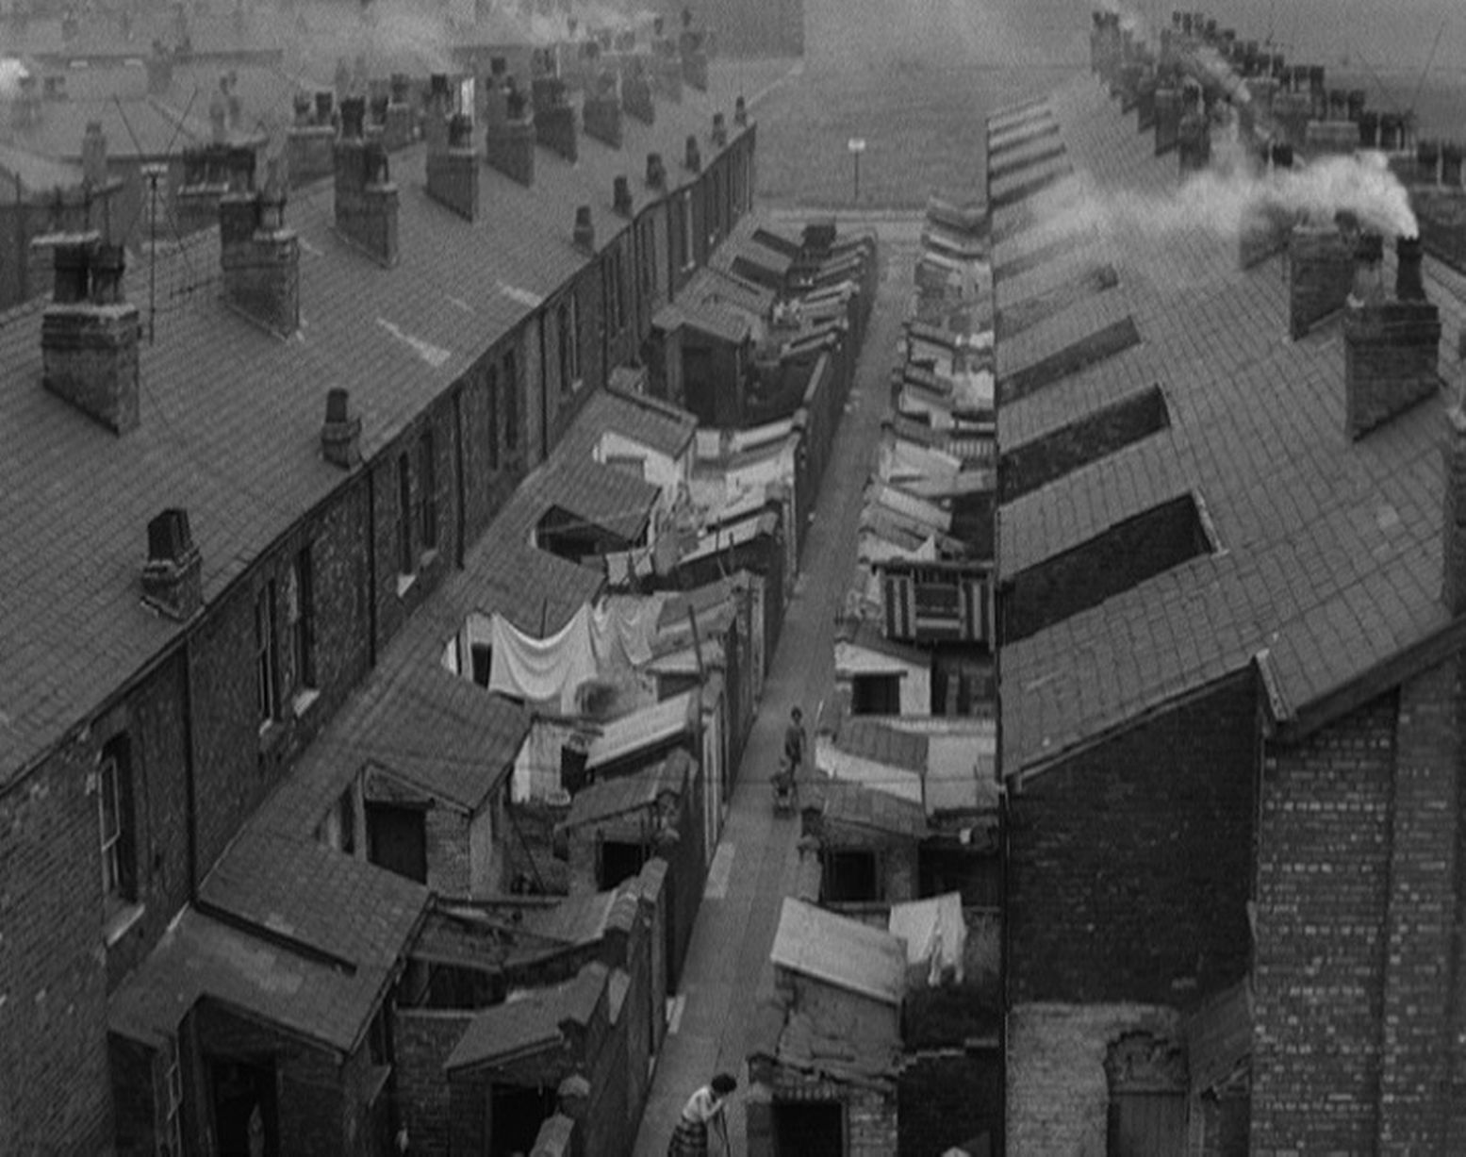
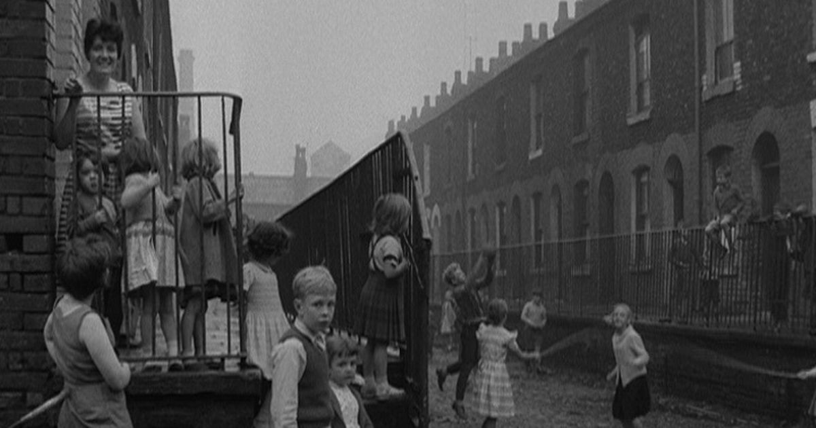
Communities
Lambert (2021) discussed how In the 1960’s a large scale slum clearance took place, resulting in in swathes of old terraced house being demolished. Some of which were then replaced by high-rise flats. However this proved to be unpopular. People living in these flats reported feeling isolated. Unlike the strong sense of community developed within the old terrace house.
Communities were uprooted as streets were lost to slum clearance. 17 nostalgic photos of neighbours chatting and kids at play in 1960s Salford (2022).

Slide 13
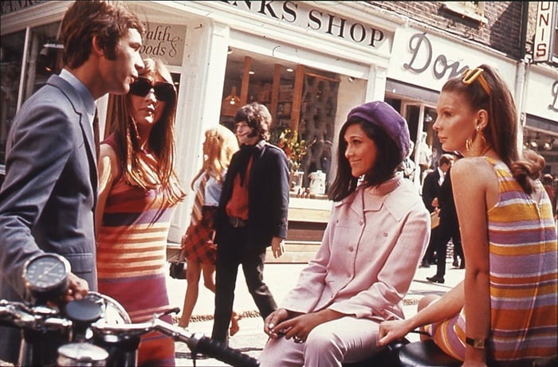
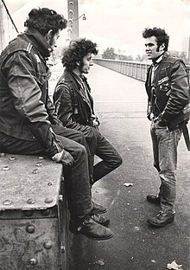
60’s Sub cultures, Fashion and recreational drugs
( According to StudySmarter)
Modernists or Mods – Were described as girls and boys who dressed smartly and rebelled against the frugality of their parents As a generation with more disposable income and more leisure time. They put every effort into fashion and spent their weekends in dance clubs, aided by drugs.
Rockers – Wore heavy leather chains and had motorcycles. They often spent their time in coffee bars and listening to music. Although considered a rival to a Mod, the media exaggerated most clashed between the groups giving rockers in particular a bad name.
Hippies – The hippie movement was based upon people beginning to question authority and not adhering to social norms and behaviour. Artists such a John Lennon brought attention to the Vietnam war by protesting about conflict. Songs like “Give peace a chance” highlighted how pointless wars were and the horrors they caused.
Mods on Carnaby Street, London. 1969.
Chelsea bridge rockers (2010).

Slide 14
What did this mean for Young People and Youth Work?
Post War baby boom and the UK population began to grow rapidly.
According to Davies (2010) “By the early 1960’s there would be an increase of 800,000, 14-20 year olds. Figures also suggest that crime amongst young people was increasing”.
A teenage culture was emerging, expressed through styles of dress, music and leisure.
Young people were seen as deferring less to their elders and those in authority.
Civil servants and minsters fuelled by the media and society’s perception began to doubt weather the established Youth Work organisations were up to meeting these new challenges.
The Government responded.

Slide 15
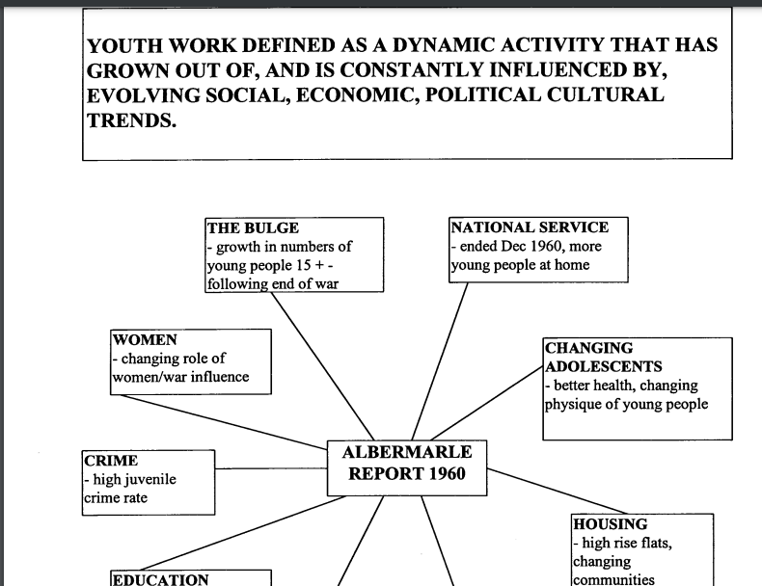
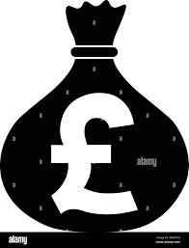
The Albemarle Report 1960

Slide 16
Big injection of funding into the Youth service
Purpose built Youth centres built.
Youth work qualifications and leadership qualifications introduced.
Budgets increased
Full- time and Part-time workers increased.
Pembrokeshire Youth Service constructed ten purpose built Youth Centres.
Sadly this was not backed up by strategic vision and strategy like we see today. Little attention was given to sustainability and further policy development for a period still leaving the Youth Service vulnerable to funding cuts.
Towards the end of the decade the country was heading back towards economic difficulty.

Slide 17
The Importance of Policy and understanding the bigger picture
Merton (2009, p. 116) explains that it is vital for Youth Workers to understand the bigger picture and develop a perspective on policy if they are to influence the nature, range and quality of services provided for young people on the ground.
…“Youth Work is not a policy free zone. Nor should it be because policy matters. It matters because it says a great deal about how society views and values young people and their best interest. Those work directly with young people are in strong position to influence the policy that shapes their work.”

Slide 18
P.E.S.T Analysis of similarities between now and then.
(Aguilar. F 1960)
P Political | E Economic | S Social | T Technological
A government scandal was uncovered causing the public to lose trust in them. Involved in a War. | In the later years the economy began to suffer due to government over spending. Increase in immigration. Ongoing housing crisis. | Growing distrust in establishments . Protests swept the globe as issues of civil and women's rights took centre stage. More open drug use, particularly cannabis and LSD. Issues with racism and discrimination. Overcrowding and housing shortages became an issue in the late 60’s Fashion and individuality. Loss of community ethos. | Space travel Mass growth in national media. Now social media Portable music/internet players. Airline travel. Computers are invented. Internet was developed.

Slide 19
To conclude
Gray (2009) discusses
“how current changes in the world are not necessarily any more significant than changes in the past, although they are different occasionally you can see similarities. However despite changes in government, policy, funding, globalisation and technological developments, Youth Workers still find that young peoples concerns and aspirations remain similar such as forming happy relationships and getting a decent job”.
It is essential that we as Youth Workers remain fluid, open and willing to adapt/move with the changes in times, guided by updated polices and strategic vision developed alongside young people in a manner that allows them to feel empowered and included in the process.
It is vital that we also consider sustainability and ensure we are able to evidence positive outcomes for young people in order to protect the service.
Thank you for your time.

Slide 20
References
Aguilar. F. (1960) ‘All you need to know about PEST analysis. Available at: https://miro.com/blog/what-is-pest-analysis/#:~:text=Harvard%20professor%20Francis%20Aguilar%20created,model%20to%20include%20additional%20factors (accessed on 11.03.23).
Davies, B. (2010). ‘What do we mean by policy, Page 8’. What is youth work. Exeter: 20 Cathedral Yard.
Grey, C. (2009) A very short, fairly interesting and reasonable cheap book about studying organisations. 2 edition. London: Sage.
StudySmater. Available at : https://www.studysmarter.co.uk/explanations/history/modern-britain/british-youth-culture/ (Accessed on 11/03/23).
Merton, B. (2009). ‘Managing in a complex and fast-changing policy environment’. Managing Modern Youth Work. Exeter: 33 Southernhay East , Learning Matters Ltd.
Chelsea bridge rockers. (2010). Available at :https://en.wikipedia.org/wiki/Rocker_%28subculture%29#/media/File:Chelsea-Bridge-Rockers.jpg
Mods on Carnaby Street, London. 1969. (2021) National archives London. Available at :https://allthatsinteresting.com/

Slide 21
Youth work in Wales Review Group. (2022) ‘The five pillars of youth work in Wales’. Youth work in Wales: Principles and purposes.
How the Beatles' Revolver ripped up the rulebook for popstars. (2022) by Fergal Kinney. Available at : https://www.gq-magazine.co.uk/culture/article/the-beatles-revolver-remix-giles-martin (Accessed on 11the March 2023).
Mercury Primate Capsule and Ham the Astrochimp.(2015). Available at : https://airandspace.si.edu/stories/editorial/mercury-primate-capsule-and-ham-astrochimp (Accessed on 11the March 2023).
Davenport-Hines R. (2014). National Service Conscription in Britain 1945-1963 by Richard Vinen-review. Available at : https://www.theguardian.com/books/2014/aug/20/national-service-consctiption-britain-richard-vinen-review (Acessed on 11th March 2023)
The last man to do National Service. (2015). Available at: https://www.bbc.co.uk/news/magazine-32929829 (Accessed on 11th March 2023).
Lewis, A (2023) ‘The Milestones in Youth Work’s history’ (Recorded lecture). University of Wales Trinity Saint David. 09th of February 2023. Available at: https://moodle.uwtsd.ac.uk/course/view.php?id=8543
Kimberly Watson. (No date). The 1960's The Decade that Shook Britain. Historic UK. 1(1), p.1. [Online]. Available at: https://www.historic-uk.com/CultureUK/The-1960s-The-Decade-that-Shook-Britain/ [Accessed 9 March 2023].
London’s orginal minicab wars, 60 years on (2021). Available at: https://www.telegraph.co.uk/cars/classic/londons-original-minicab-wars-60-years/ (Accessed on 9th March 2023).
17 nostalgic photos of neighbours chatting and kids at play in 1960s Salford. (2022) available at: https://www.manchestereveningnews.co.uk/news/nostalgia/gallery/17-fascinating-photos-1960s-salford-25191184 (Accessed on 9th of March 2023).
Tim Lambert. (28 May 2021). Life in the 1960's. Local histories. Volume 1(issue 1), p.Page 1. [Online]. Available at: https://localhistories.org/life-in-britain-in-the-1960s/ [Accessed 9 March 2023].

