Slide 1

Corporate Social Responsibility (CSR) a Critical Analysis
Defined : Corporate Social Responsibility is the continuing commitment by business to behave ethically and contribute to economic development while improving the quality of life of the workforce and their families as well as the local community and society at large. Mallen Baker 2004
Operating a business in a manner that meets or exceeds the ethical, legal, commercial and public expectations that society has of business.(bsr.org)
Does CSR have real Value to an organisation or a moot point for academics ?
Okoye (2009, pg.613) (CSR) are an attractive area of research with noteworthy ‘implications for academia, industry and society.’
This Photo by Unknown Author is licensed under CC BY

Slide 2
History & Evolution & The modern CSR movement
Wallace B. Donham in 1929 stated :
“Business started long centuries before the dawn of history, but business as we now know it is new - new in its broadening scope, new in its social significance. Business has not learned how to handle these changes, nor does it recognize the magnitude of its responsibilities for the future of civilization.”
Interestingly, 1929 was a time of great turmoil with the Wall Street Crash : People want answers and change and corporations taking greater responsibility for their actions.

Slide 3
History & Evolution & The modern CSR movement
CSR has been found difficult to define causing much debate
A Philanthropic action Bowen (1950)
Although Philanthropy Dismissed by Davis(1960)and Frederick(1960)
Foolish & Vague-Friedman(1970)
A competitive Tool -Carroll(1999)
Still no consensus on a universal Definition Font et al(2012)

Slide 4
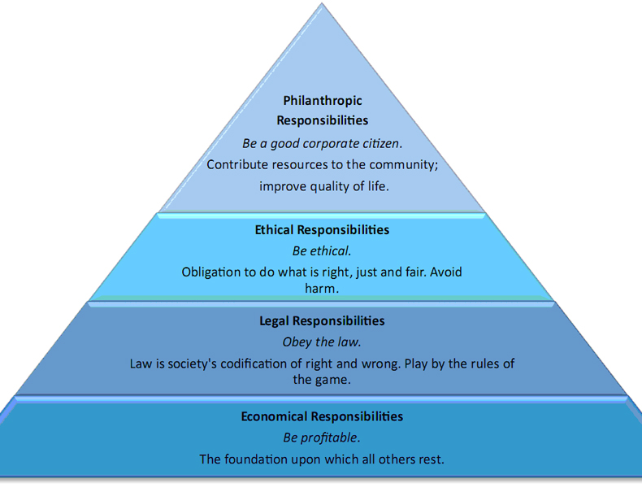
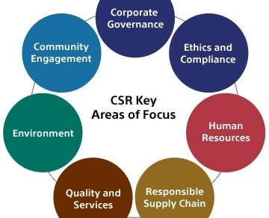
WHAT IS CSR
It ‘means something, but not always the same thing, to everybody’ (Votaw, 1973, pg.11; Moneva, Archel and Correa, 2006)
A business must act ethically and consider the social economic and environmental implications.
Corporate Responsibility includes sustainability and the reduction of its environmental impact- Reduction and recycling

Slide 5
CSR conflict
Most organisations historically have been concerned with their bottom line. P R O F I T
The 1970’s saw a competitive advantage by acting
responsibly to its workers community & environment .
Friedman(1970) believed this was overstated and CSR
can only be considered if within the realms of profit.
Even more critically a business are not
‘vehicles for social benevolence’ (Reich, 2008, pg.9)
The only social responsibility a business should hold is to
maximise profits for stakeholders (Swartz & Saiia 2012)

Slide 6
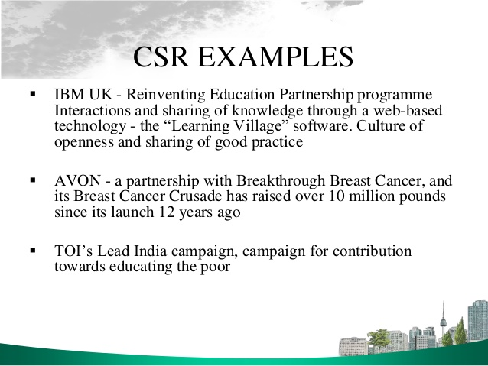
CSR is here to stay and many companies are embracing the concept and seeing it as an opportunity – the news continually reflects that society is putting pressure on organisations to change – plastic bag tax - changes in other packaging - reduced sugar in drinks. All can be seen as marketing opportunities for companies to change and be more responsible and adopt good CSR initiatives.

Slide 7

The clock is ticking for companies to get there act together in order to develop sound CSR policy.
Volkswagen And The Failure Of Corporate Social Responsibility – Emissions Scandal – environmental failure.
Nike – Contravened Labour Organisation Convention 1973 – child labour scandal – not looking after its employees. Poor working conditions and pay.
Not only are companies failing in their duty of care in a socially responsible way for workers, communities and environment – but they are also incurring the wrath of the legal system around the world.

Slide 8
The Corporate Social Responsibility is it a Trend
A study found that many companies devote resources to CSR initiatives as a means of maximizing long‐run value rather than out of a prior commitment to stakeholders.
The study shows that companies appear to invest more heavily to build CSR strengths to negate CSR concerns.
The strategy involves using CSR as a risk management device that promotes their strengths thus limiting any weakness onlinelibrary.wiley.com

Slide 9
Why Adopt a CSR Policy ?
The world is changing – everybody is accountable for their actions- full transparency is required particularly in a successful business – access to information is easier than ever with advancing internet technology.
Technically, CSR is not a traditional management tool, thus it can be viewed as a moral duty rather than a business tactic (Zwetsloot, 2003);
reinforcing the need for clear guidance and a deeper understanding of social responsibility (Boeger, Murray and Villiers, 2008).

Slide 10
How do you measure CSR performance is it quantifiable and what are the costs ?
Market value increased Customer satisfaction levels higher happier workforce more productive Reduction of operational costs
studies have pointed out that companies can earn positive publicity when they fulfil their CSR Spence 1973
More competent staff would effectively improve the quality of products and services Moskowitz 1972.
CSR investment of resources increases cost and effects performance financially - Becchetti, Ciciretti& Hassan 2009
Bragdon and Marlin 1972increased cost of investing in CSR puts companies at a disadvantage in a competitive market, weakening financial performance. - Bragdon and Marlin 1972.

Slide 11
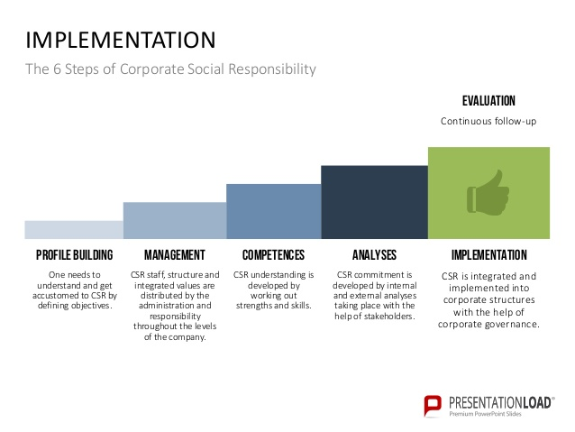
conclusion
In the absence of a concise definition this does not negate the importance of CSR- it is not just a concept but a reality that any business avoids at it’s peril. Implementation is essential see diagram, example. Responsibility to all stakeholders is essential workers, community, society and the environment. There is a resource and financial cost but a much greater cost if ignored.

Slide 12
Conclusion – a comparison below of differing arguments still pulling in opposite directions and the fine balance between profit and corporate responsibility , the debate goes on. Profit should now not be the only way to measure a successful business but great CSR Policies – a company seeking full success should include this in any marketing strategy.
Corporate social responsibility is a dangerous distortion of business principles. If you find an executive who wants to take on social responsibilities, fire him. Fast. ( Drucker, 2004)
Despite little universal knowledge of essential CSR actions expected by businesses, as the power of corporations expands over time, those businesses choosing to not use their authority in a socially responsible manner may well lose that luxury, opportunity and positive reputation (Davis, 1973)

