Slide 1
BA Leadership & Management Skills for the Workplace
Module: BMSK5001
Developing Workplace Critical Thinking
Online Session 3

Slide 2


Research & Report - Feedback
Have a look at the university’s ‘online library’, and see what you can find on ‘critical thinking’. Record 4 or 5 sources by writing down the author, type of publication, title, and a basic overview for the next session
Look at:
  Online textbooks
  Journal articles

Slide 3


Agenda
Research & Report – Feedback/Discussion
Appendices
Critical Thinkers
Strategies for Critical Thinking
Pearson’s RED
Techniques for Critical Thinking
Research & report
References

Slide 4

Appendices – A Useful Device
The appendices include additional information, which is referenced within the actual report
This might include additional information such as organisational charts, questionnaires, financial data etc. It is important that this area is not a dumping ground for irrelevant information, which is simply padding for the assignment
Your appendices should ADD VALUE to the report
Appendices do not impact on Word Count

Slide 5
Critical Thinkers Have…
Good analysis and problem-solving skills
Good judgment and decision making
Good overall job performance
The ability to evaluate the quality of information presented
Creativity
Job knowledge
The potential to move up within the organization

Slide 6

Strategies for Critical Thinking?
Exercise: Discussion
What strategies would you use for critical thinking?
Notes:
Guidelines on Critical Reflection
There are a number of key questions you could ask yourself to help critically analyse the material regardless of its source:
1. What is the main purpose of the material?
Was the material designed to inform and teach?
Was the material designed to persuade or present an argument?
Was the purpose of the material to entertain the reader?
What is the overall value of the material?
Did the content of the material meet your initial expectations?
Does the content fulfil any aims or objectives set out at the beginning?
How is the material organised?
Is the material structured around a few key topics?
Is the material presented in a random fashion with no cohesion?
Does the material jump back and forward between topics?
Does the author or speaker go off at a tangent all the time?
Who is the intended audience?
At whom is the material aimed? Is its intended audience technical, basic or scientific?
Is the material designed to be an introductory book or an advanced technical journal?
Is the lecture aimed at level 3 students or level 1 students?
What are the writer's assumptions about the audience?
Are there assumptions stated at the beginning of the material?
Are any pre-requisites necessary for using this material?
What kind of language and imagery does the author use?
Is the material written using good English or are there many slang expressions and acronyms?
Are there images and/or diagrams to illustrate key points?
Do you think the language is suitable for the intended audience?
What are its strengths and weaknesses?
Does the material present arguments for and against specific points?
Are there many hidden assumptions within the material?
When asked to critically appraise a section of material, which is often the case in exam questions, your review should provide information, interpretation, and evaluation, which serve in the following respective ways:
The information will help your reader understand the nature of the work under analysis.
The interpretation will explain the meaning of the work and will therefore require your correct understanding of it.
The evaluation will present your opinions of the work and offer valid justifications for them

Slide 7
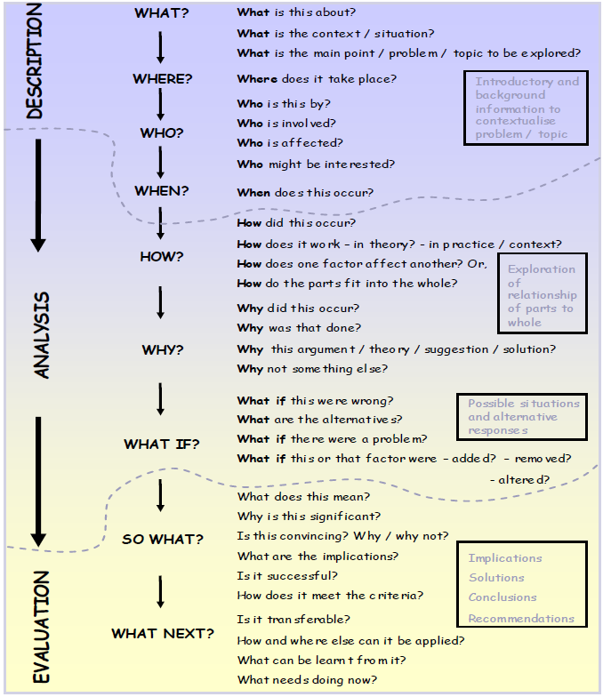
HO

Slide 8
Critical Thinking/Reflection
Critical thinking/reflection provides the ability to:
build new ideas by linking different or opposing concepts;
undertake deductive reasoning to link causes and effects.

Slide 9
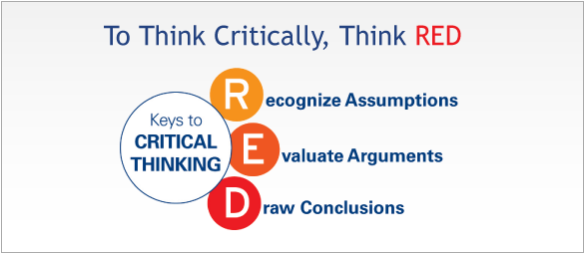
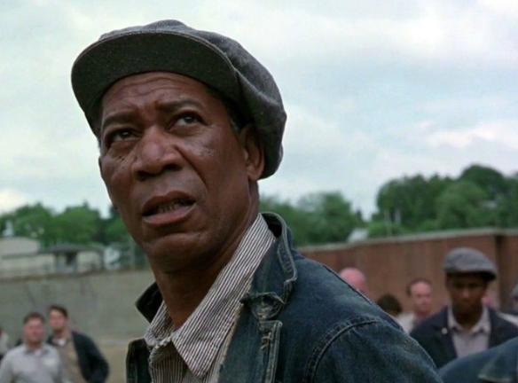
Pearson's RED Critical Thinking Model
Chartrand, Ishikawa & Flander (2013).
Notes:
This is a model to encourage students to make use of as it is easy to commit to memory.

Slide 10
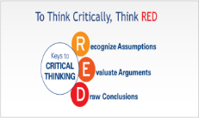
Pearson's RED Critical Thinking Model
Recognise Assumptions
This is the ability to separate fact from opinion
It is deceptively easy to listen to a comment or presentation and assume the information presented is true even though no evidence was given to back it up
Noticing and questioning assumptions helps to reveal information gaps or unfounded logic
Chartrand, Ishikawa & Flander (2013).
Notes:
http://www.thinkwatson.com/think-red/red-critical-thinking-model

Slide 11
Pearson's RED Critical Thinking Model
Recognise Assumptions
Taking it a step further, when we examine assumptions through the eyes of different people (e.g., the viewpoint of different stakeholders), the end result is a richer perspective on a topic.
Chartrand, Ishikawa & Flander (2013).
Notes:
http://www.thinkwatson.com/think-red/red-critical-thinking-model
Example: Walk a mile in my shoes – have you heard this phrase? What does it mean? “See and experience things from MY perspective”.

Slide 12
Pearson's RED Critical Thinking Model
Recognise Assumptions
How to use it:
When you’re gathering information, listening to what people say, or assessing a situation, think about what assumptions you have going in
Perhaps you assume that a trusted co-worker is providing reliable information – but is there really evidence to back that up? Learn to see gaps in logic, and opinion disguised as fact
Chartrand, Ishikawa & Flander (2013).
Notes:
http://www.thinkwatson.com/think-red/red-critical-thinking-model

Slide 13
Pearson's RED Critical Thinking Model
Evaluate Arguments
The art of evaluating arguments entails analysing information objectively and accurately, questioning the quality of supporting evidence, and understanding how emotion influences the situation
Common barriers include confirmation bias, or allowing emotions-yours or others-to get in the way of objective evaluation
People may quickly come to a conclusion simply to avoid conflict
Chartrand, Ishikawa & Flander (2013).
Notes:
http://www.thinkwatson.com/think-red/red-critical-thinking-model
Confirmation bias? What is this? “The tendency to interpret new evidence as confirmation of one’s existing beliefs or theories”. Any examples?

Slide 14
Pearson's RED Critical Thinking Model
Evaluate Arguments
Being able to remain objective and sort through the validity of different positions helps people draw more accurate conclusions.
Chartrand, Ishikawa & Flander (2013).
Notes:
http://www.thinkwatson.com/think-red/red-critical-thinking-model

Slide 15
Pearson's RED Critical Thinking Model
Evaluate Arguments
How to use it:
We often have problems sorting through conflicting information because we unknowingly let our emotions get in the way, or because – like just about everyone – we sometimes only hear what we want to hear
Learn how to push all that aside, and analyse information accurately and objectively
Chartrand, Ishikawa & Flander (2013).
Notes:
http://www.thinkwatson.com/think-red/red-critical-thinking-model
In the last year of your degree, we will look at Emotional Intelligence – Not I.Q. but E.Q.

Slide 16
Pearson's RED Critical Thinking Model
Draw Conclusions
People who possess this skill are able to bring diverse information together to arrive at conclusions that logically follow from the available evidence, and they do not inappropriately generalize beyond the evidence
Furthermore, they will change their position when the evidence warrants doing so. They are often characterized as having "good judgment" because they typically arrive at a quality decision
Chartrand, Ishikawa & Flander (2013).
Notes:
http://www.thinkwatson.com/think-red/red-critical-thinking-model

Slide 17

Pearson's RED Critical Thinking Model
Draw Conclusions
How to use it:
This is the payoff. When you think critically, the true picture becomes clear, and you can make the tough decision, or solve a difficult problem
Chartrand, Ishikawa & Flander (2013).
Notes:
http://www.thinkwatson.com/think-red/red-critical-thinking-model
Note: You still need the emotional resilience and robustness to see it through….critical thinking tells you what you need to do….you still need to do it! This is where great leaders earn their corn,

Slide 18
Techniques to Encourage Critical Thinking
Socratic questioning
Systems thinking
Validating evidence
Notes:
Socratic questioning is “disciplined questioning that can be used to pursue thought in many directions and for many purposes, including: to explore complex ideas, to get to the truth of things, to open up issues and problems, to uncover assumptions, to analyse concepts, to distinguish what we know from what we don’t know, to follow logical implications of thought or to control the discussion. Socratic questioning is usually systematic, disciplined, deep and usually focuses on fundamental concepts, principles, theories, issues or problems. Used in teaching and Psychology…..also coaching?

Slide 19
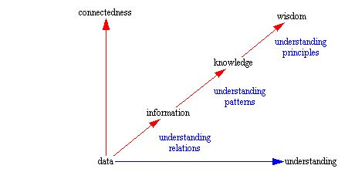
Formulating Questions
Notes:
Formulating Questions
The character of the questions we ask greatly influences the appropriateness of the answers we develop. If we ask short sighted questions should we be surprised if we develop short sighted answers? I would think not.
The following diagram provides a perspective on the relation of data, information, knowledge, and wisdom. As we describe situations and seek understanding further up this path we develop a foundation for subsequently more effective actions. Actions which are more likely to produce the desired results, and less likely to simply create more problems to be solved.
To improve the character of the questions we ask it is important to transcend the levels in the above diagram. If we ask questions that allow data to be an answer that is what we will get. If we ask questions regarding relations, i.e. cause and effect, then we will find, or make up, causes as answers to the questions we pose. When we finally reach the level of asking questions that cause us to seek out and understand the patterns responsible for the situations we consider we finally arrive at answers that represent knowledge. Finally when we ask questions which cause us to seek the underlying fundamental principles that are responsible for the patterns represented in the knowledge we are finally in a position to develop answers that represent wisdom.
How you ask questions is a choice. Make of it what you will.
As such, when posing questions think about the manner in which the situation has developed over time. Think about the relationships between the components that make up the situation, and how have these relationships developed over time. Consider the following as two alternative perspectives on the same situation.
Sales are down.
As monthly sales volumes were somewhat less than desirable a rebate program was implemented. The rebate program seemed to work as shortly after its implementation sales began to increase. When sales reached an acceptable level the rebate program was discontinued. After some time sales began to decline again. Another rebate program was implemented but did not seem to have the same level of effect on sales as the previous program. With higher levels of rebate sales were returned to an acceptable level. Now that the rebate program has been stopped sales are again down and we're uncertain as to whether implementing another rebate program is an appropriate action.
Items 1 and 2 both describe the same current state, "Sales are down." In an attempt to determine an appropriate course of action for the future, which set of information do you think provides you with the best starting point from which to develop an answer? The answer to this question should be rather obvious.

Slide 20
Six Types of Socratic Questions
Probing underling concepts
Probing Assumptions
Probing evidence
Probe implications and consequences
Questioning underling position
Questions about the question
Notes:
Probing underling concepts
Get them to think more about what exactly they are asking or thinking about. Prove the concepts behind their argument. Basic 'tell me more' questions that get them to go deeper.
Here are some useful examples:
Why are you saying that?
What exactly does this mean?
What do we already know about this?
Can you give me an example?
Are you saying ... or ... ?
Probing assumptions
Probing of assumptions makes them think about the presuppositions and unquestioned beliefs on which they are founding their argument. Dig into that reasoning rather than assuming it is a given. People often use un-thought-through or weakly understood supports for their arguments.
Here are some useful examples:
What else could we assume?
You seem to be assuming ... ?
How did you choose those assumptions?
Please explain why/how ... ?
How can you verify or disprove that assumption?
What would happen if ... ?
Do you agree or disagree with ... ?
Probing the evidence
When they desribe the evidence behind the arguments, prove if those are fact are fiction. Facts are stubborn things. People often use weak, refutable evidence to support for their arguments.
Here are some useful examples:
Why is that happening?
How do you know this?
Show me ... ?
Can you give me an example of that?
What do you think causes ... ?
What is the nature of this?
Are these reasons good enough?
How can I be sure of what you are saying?
Why is ... happening?
What evidence is there to support what you are saying?
On what authority are you basing your argument?
Questioning underling position
If arguments are given from a particular position you can try not attack the arguments directly but attack the underling foundation -- the position on which they are explicitly or implicitly based. It is important that there might be other, equally valid, viewpoints.
Here are some useful examples:
Does this approach is reasonable, justifiable?
What alternative ways of looking at this are there?
Why it is ... necessary?
Who benefits from this?
Why is it better than ...?
What are the strengths and weaknesses of...?
What are similarities between ... and ... ?
What are differences between ... and ... ?
How could you look another way at this?
Probe implications and consequences
The argument that they give may have logical implications/consequences that can be predicted. Do these make sense? Are they desirable?. Here are some useful examples:
Then what would happen?
What are the consequences of that assumption?
How could ... be used to ... ?
What are the implications of ... ?
How does ... fit with what we learned before?
Why is ... important?
Why this approach is considered to be the best ... ?
Questions about the question
Sometimes it is useful to become reflexive about the whole thing, turning the question in on itself.
Here are some useful examples:
What was the point of asking that question?
Why do you think I asked this question?
What does that mean?

Slide 21
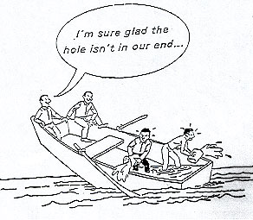
Systems Thinking

Slide 22

Influence Diagram
Recruitment
Costs
Staff Turnover
-
Training
Morale
Notes:
The core tool in systems thinking is the influence diagram, which captures graphically how each factor or variable in a system influences the others. Arrows are used to indicate the direction of the influence together with a '+' or '-' sign to show whether an increase in the one variable leads to an increase or decrease in the other. A double line across an arrow indicates a delay before the influence is felt.

Slide 23
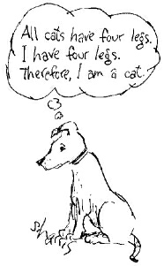
Validating Evidence

Slide 24
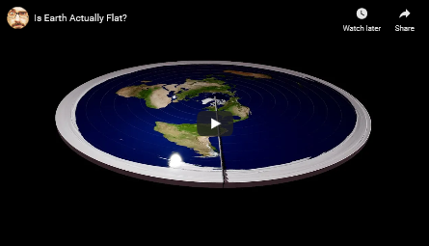
Validating Evidence
Notes:
Truth Validation with Evidence. ... We develop a system to validate the truthfulness of a given statement together with underlying evidence. The proposed system provides supporting evidence when the statement is tagged as false.

Slide 25
Valid & Authentic ?
Does it measure or describe what it is supposed to measure ?
Is it authentic? – what’s the source
Is it reliable?
Notes:
Reliability
Depends on how consistent the findings are with other research.

Slide 26
Valid & Authentic ?
Why use triangulation in research methods?
“Good research practice obligates the researcher to triangulate, that is, to use multiple methods, data resources, and researchers to enhance the validity of research findings.”
(Mathison, S. 1988)
In essence triangulation can be determined as a process that therefore improves the validity of research through the application of rigorous evaluation to research discoveries.
[Credibility/Dependability/Conformability]
Notes:
Reliability
Depends on how consistent the findings are with other research.

Slide 27
Critical Analytical Thinking - Checklist
What is the main line of reasoning (the main argument)?
Is the line of reasoning clear, both in the introduction and in the conclusion?
What is the key evidence used to support the line of argument?
Is the evidence presented in a way that develops the argument and leads clearly to the conclusion?
When was the evidence produced? Is it up to date? Is it still relevant?

Slide 28
Critical Analytical Thinking - Checklist
Is there sufficient evidence to prove the case? Is the evidence relevant? What might be missing?
What (if any) would have been a better order in which to present the evidence, so as to strengthen the line of reasoning?
Are there any examples of flawed reasoning? Attempts to persuade the reader through an appeal to the emotions? Is evidence interpreted and used correctly?
Has the writer given sufficient consideration to alternative points of view?

Slide 29

Summary
Take 5 minutes to reflect upon this session – what have you learnt?
Any key areas you want to research further?
What can help you with your assignment?
What can help you in your career?
Engage with your tutors on the topics

Slide 30
References
Chartrand, Ishikawa & Flander (2013). Critical thinking means business: Learn to apply and develop the new #1 Workplace Skill. [Website] Available at: https://us.talentlens.com/content/dam/school/global/TalentLens/us/whitepapers/critical-thinking-means-business.pdf [Accessed: 12 Feb 2021]
Mathison, S. (1988). ‘Why triangulate?’ Educational researcher. Vol. 17, Issue 2. Pg.13-17. URL: Why Triangulate? - Sandra Mathison, 1988 (sagepub.com) [Accessed: 11th Feb 2021]

